Slide 1
PEFAs in the PACIFIC
Country | 2005/06 | 2007 | 2008 | 2009 | 2010 | 2011 | 2012 | 2013 | 2014 | 2015 | 2016
Cook Islands |  |  |  |  |  | Public (IMF) |  |  |  | Public (IMF)
Fiji | Final (WB) |  |  |  |  |  |  | Draft (IMF)
French Polynesia |  |  | Final (EU) |  |  |  |  |  |  | Public (Gov+EU)
Marshall Islands |  |  |  |  |  |  | Public (IMF)
New Caledonia |  |  | Final (EU) |  |  |  | Public (EU)
Papua New Guinea | Final (WB) |  |  | SubNat Draft (WB) |  | Final (EU) |  |  |  | Public (IMF)
Pitcairn
Samoa | Public (EU) |  |  |  | Public (Gov+EU) |  |  |  | Public (IMF)
Solomon Islands |  |  | Public (EU) |  |  |  | Public (EU)
Timor-Leste |  | Public (EU) |  |  | Public (IMF) |  |  |  | Public (EU)
Tonga |  | Final (USAID) |  |  | Public (USAID) |  |  |  | Self-assessment (*) |  | Planned (IMF)
Vanuatu | Public (EU) |  |  | Final (EU) |  |  |  | Final (Gov)
Wallis and Futuna |  |  |  | Final (EU)
(*) Tonga self-assessment - not recorded in the PEFA website, official status un-known

Slide 2
How does PACIFIC compare to others?
Table below shows scores by range (A, B, C, D)
 | EU BS Countries |  |  |  |  |  |  |  |  | ALL NON-BS
 | All BS | Asia | WCA | ESA | CAR | PAC | LA | ENP-S | ENP-E
PEFA dimensions averages (latest) | 78 | 12 | 19 | 13 | 8 | 6 | 9 | 5 | 5 | 41
Credibility of the budget | B | B | C+ | B | C+ | B | B | B+ | B+ | C+
Compr. & Transparency | B | B | C | B | C+ | C+ | B | B | B+ | C+
Policy-based budgeting | B | B | C+ | B | C+ | B | B | B | B+ | C+
Pred. & control Budget ex; | C+ | C+ | C+ | C+ | C+ | C+ | B | B | B | C+
Accounting, Recording & Rep. | C+ | C+ | C | C+ | C+ | C+ | C+ | C+ | B+ | C+
External scrutiny and audit | C+ | C+ | D+ | C+ | C | C | C | C | C+ | C
Source: Computations based on Dec 2015 PEFA secretariat data. Only the latest public and final PEFA results are considered
Notes:
The following table presents the average PEFA dimension results for the latest PEFAs available, showing that budget support countries (1st column) present on average PEFA results above averages seen in other developing countries (last column).
For Pacific
BS pacific countries (6 PAC column) : Cook Islands, Samoa, Solomon Islands, Timor-Leste, Tonga, Vanuatu
Non-BS Pacific countries (6/41 last column) : Fiji, Kiribati, Marshall Islands, Micronesia, Papua New Guinea ,Tuvalu
Small sample (6 cntries): Comparaison with all-countries' average should be done with parsimony
Not included in calculations : Wallis and Futuna, French Polynesia, Nauru, Niue (NZ) and New Caledonia

Slide 3
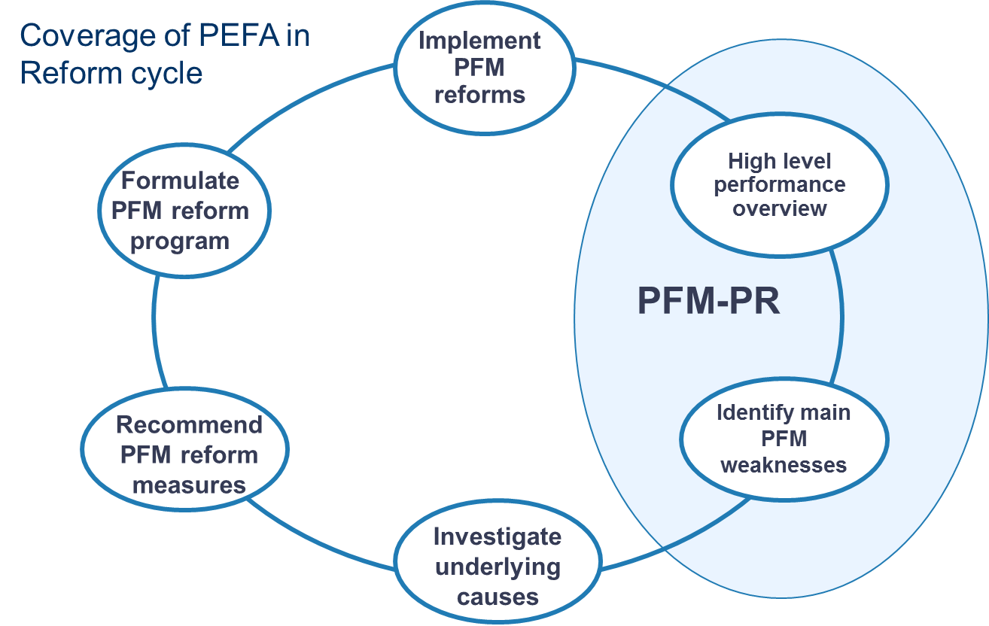
Supporting the Reform cycle
Financial Assistance
+ Monitoring
DIAGNOSIS (PEFA)
Policy dialogue
Technical assistance
Drill-down diagnosis tools (TADAT, PIMA, DEMPA)

