Slide 1
Pacific Regional Training on EU Budget support and blending modalities 24-28 October 2016
Additional Module on
Main macroeconomic challenges in the Pacific Region

Slide 2
Macroeconomic perspectives
“Pacific budget support countries' growth outlook was revised downwards. Samoa and Tonga particularly continue to suffer from low potential growth combined with a high vulnerability to natural disasters. A protracted period of slower growth in regional advanced and emerging economies is a further risk to the region. On the fiscal side, Timor-Leste is heavily affected by the oil price slump, and Vanuatu by post-cyclone reconstruction efforts”. Source :Draft 2016 annual BS report”.
“Growth in the Pacific economies is expected to decelerate during 2016-17 partly reflecting the sluggish global recovery. As external demand remains relatively subdued and global financial conditions have started to tighten, domestic demand is expected to be a major driver of activity across most of the region”
“Natural disasters are a major perennial risks to most Pacific economies”
“The spending mix in the Pacific remain tilted toward current spending, despite infrastructure bottlenecks and this could impede higher real GDP per capita growth” “High population dispersion is associated with lower efficiency education and health
expenditure “..(source: IMF 2015 and 2016; WP and regional outlook)

Slide 3
Key macroeconomic challenges
Diseconomies of scale in providing public goods and services (small size and geographical/population dispersion) resulting in lower efficiency.
Currents spending rigidity (large share of current spending to GDP) due to higher per capita government costs relative to other countries
Public sector being the main employer: rigidities into the budget
Greater revenue volatility (exposure to exogenous shocks and narrow production bases) implying volatile spending patterns and pro-cyclical fiscal policy.
Lack of capacity to weather revenue volatility (cannot finance temporary fiscal shocks/shallow domestic banking systems and limited access to international capital markets)

Slide 4
Key macroeconomic challenges (concluded)
Fiscal frameworks not always designed with a multi-year perspective to allow smoothing of expenditures over the business cycle
Budget pressures and external shocks affecting primarily capital spending and undermining longer-term growth
Existence of several extra budgetary funds that are not integrated in the budget (“trusted funds”, “CDF”…)
Debt pressure and limited fiscal space

Slide 5
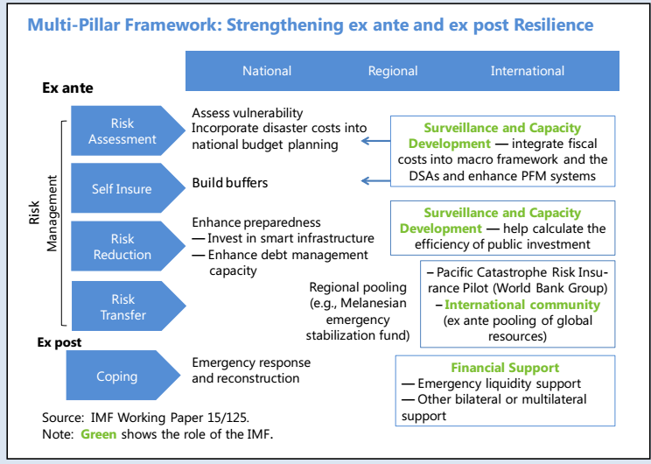
Macroeconomic resilience to natural disasters

Slide 6
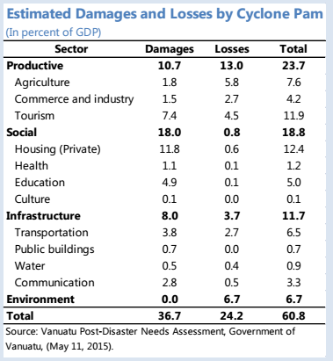
Specific key challenges: vulnerability to climate change and natural disasters
Economic damage and losses from natural disasters

Slide 7
Challenges in building macroeconomic resilience I
Strengthening fiscal frameworks by isolating the budget from revenue volatility and shielding public spending (especially capital) to help increase small states’ resilience to shocks and boost their potential growth
Strengthening domestic revenue mobilization to support the rebuilding of policy buffers
Using fiscal anchors/rules (debt targets, expenditure ceilings, budget balance rules...) to help smooth spending and isolate the budget from revenue volatility
In commodity-resource-rich countries, targeting the non-commodity fiscal balance and using sovereign wealth funds to enhance the management of natural resources will also ensure the long-term sustainable use of exhaustible resources
Rather than focusing on the current fiscal deficit, the budget should provide for spending in line with underlying revenues (e.g. TL and the estimated sustainable income ESI rule)
Notes:
Timor-Leste: The estimated sustainable income (ESI) rule has worked well to minimize the effects of revenue volatility. It has also allowed Timor-Leste’s Petroleum Fund to grow to be equivalent to three times GDP.

Slide 8
Challenges in building macroeconomic resilience II
Problem in making the distinction between temporary and more sustained revenue shocks there
Maybe no alternative to adjusting spending, and the focus should be on the pace of adjustment and on achieving a balanced adjustment between recurrent and capital spending.
Developing a proper mix of income and consumption taxation (VAT and sales tax)would raise additional revenues (ex Kiribati)
Lower oil prices also offer an opportunity to reform energy subsidies and taxes in both oil exporters and importers. In oil-importing small states, the saving from the removal of energy subsidies should be used to strengthen fiscal buffers or to increase public infrastructure

Slide 9
Challenges in building macroeconomic resilience III
Enhancing regional cooperation on nontax revenue to increase revenue mobilization: Need to strengthen regional economic, institutional, and technological networks to compensate for geographical isolation and dispersion and create a more attractive business environment for foreign investors
Key sectors are fisheries, information and communication technology. (e.g. Nauru Agreement on fisheries…)

Slide 10
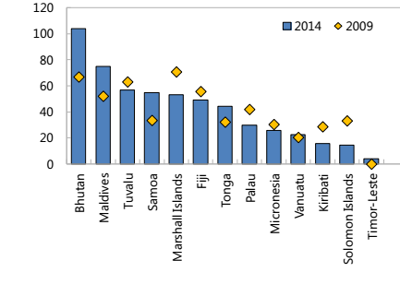
International reserves and public debt
International reserve, May 2015
Public and publicly guaranteed debt
Sources: IMF

Slide 11
Debt Management Framework: the example of the Solomon Islands
Debt management framework on Solomon islands (2012)
Broad definition included in the PFMA (legal effect) to capture all obligations resulting in direct or indirect obligation on government (direct government borrowing, state-owned enterprise borrowing, government guarantees).
Establishment of an appropriate authority to enter into government borrowing: MoF only
Establishment of a Debt Management Advisory Committee
Requiring an Annual Borrowing Limit included in the annual Appropriation Bill (legally enforced limit)
Notes:
Fiscal frameworks should be integrated with a debt management strategy to manage cash flows effectively and reduce sovereign financing risks. In this regard, a successful case is Solomon Islands that introduced in May 2012 a strategy to strengthen debt management and debt sustainability, superseding the Honiara Club Agreement that prevented the country from contracting external borrowing.

