Slide 1


PARTNERSHIP BETWEEN GOVERNMENT AND CIVIL SOCIETY ORGAIZATION IN IMPLEMENTING TERM
ENERGY SECTOR REFORM CONTRACT

Slide 2
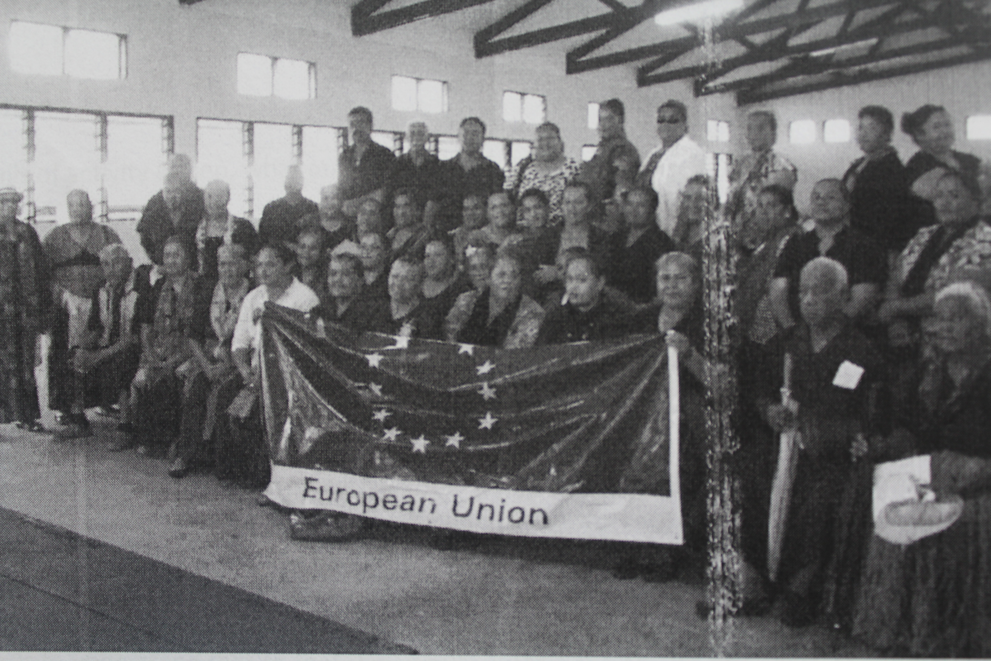
OUTLINE
Tonga Energy Roadmap (TERM) 2010-2020
TERM’s Objectives & Core Roles
Energy Indicators
TAs
CSO’s collaboration . (Tonga Trust)
Conclusion

Slide 3
TONGA ENERGY ROADMAP (TERM) 2010-2020
TERM developed to help tackle vulnerability to global oil prices and reduce GHG.
Targets:
  50% RE share by 2020
  Improvement in EE through improvement of line loss from 18% to 13.8%
  100% access to modern and sustainable energy services
The TERM is coherent with the Tonga Government's development strategy, namely the Tonga Strategic Development Framework II and the 11th EDF National Indicative Programme. It covers the years from 2010 till 2020 and takes into account needed improvements in the area of energy.
The Renewable Energy and Energy Efficiency Plan (REEEP) runs for a period of three years ending in 2016 and it is currently being revised and integrated into the TERM document for the period until 2020.

Slide 4
TERM’s OBJECTIVES & CORE ROLES
50 % of power from renewable sources by 2020
Integration of renewable energy sources
Improvement in the grid throughout Tonga
Tariff review
Legislative review
Integration of skills and experiences

Slide 5
EXPECTED RESULTS
1. Improvements in petroleum supply chain.
2. Improvements in efficiency of conversion of petroleum to electricity.
3. Improvements in efficiency of conversion of electricity into consumer electricity services.
4. Replacing a portion of current or future grid-based generation with renewable energy.
5. Increasing access to good-quality electricity supply to meeting the needs of consumers too remote to be connected to a grid-based supply.

Slide 6
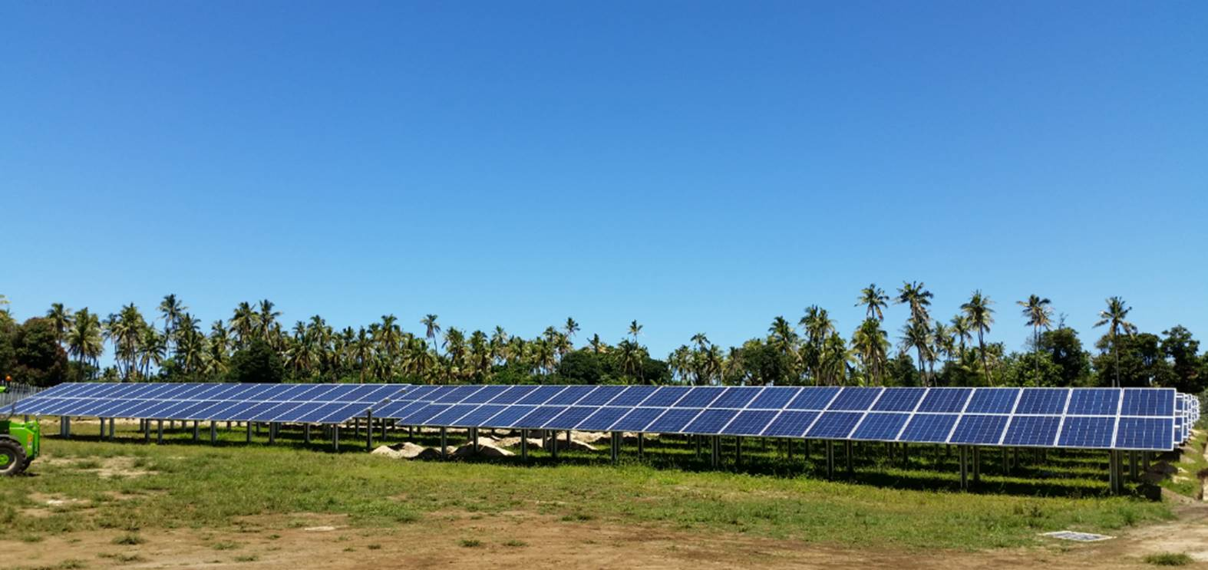
INDICATORS & TARGETS
First indicator: The renewable energy share in relation to overall electricity generation.
Target: From the baseline of 6.4% total RE share in 2014/15, total RE share shall rise to:
9% (2016/17)
12% (2017/18)
16% (2018/19)
20% (2019/20)

Slide 7

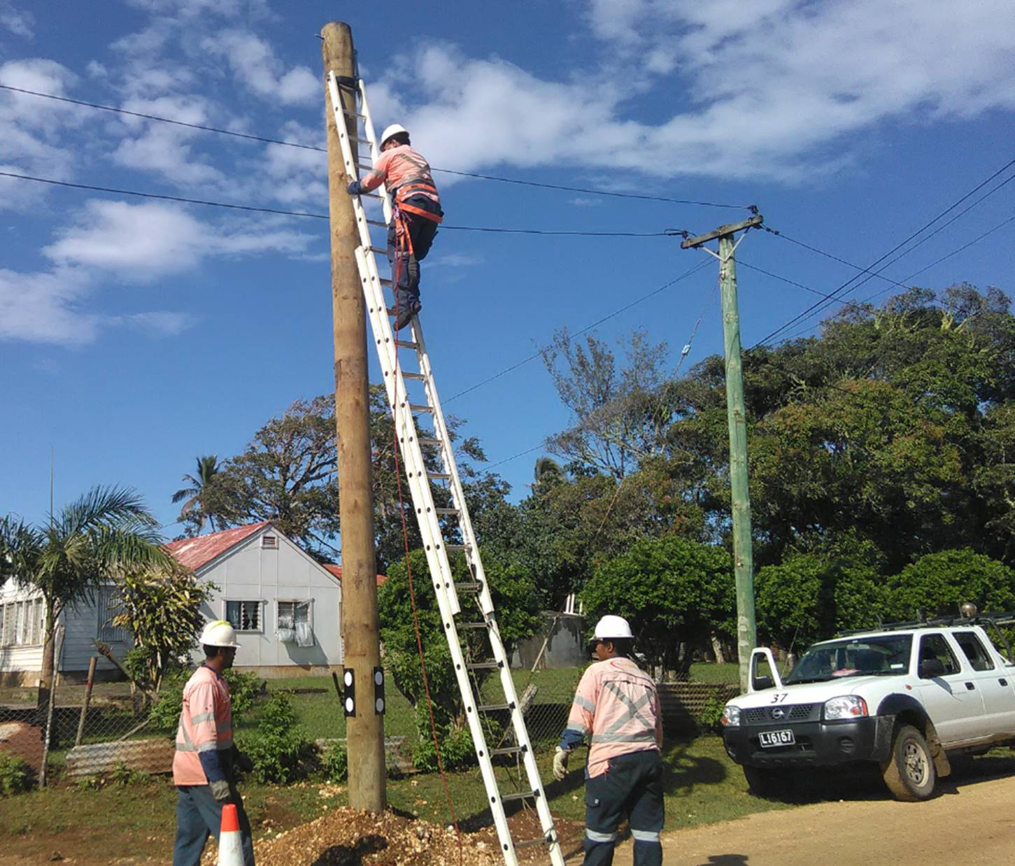
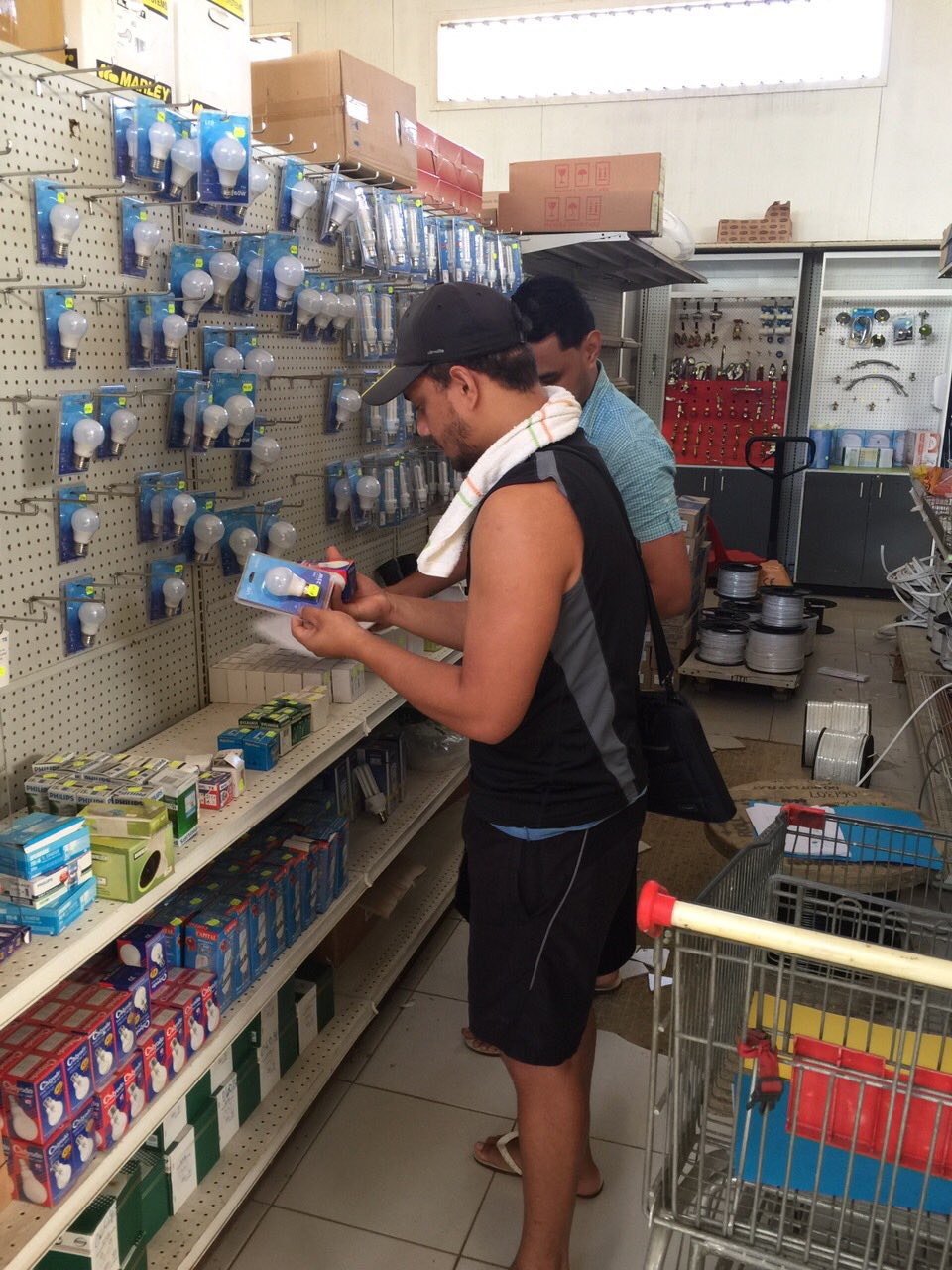
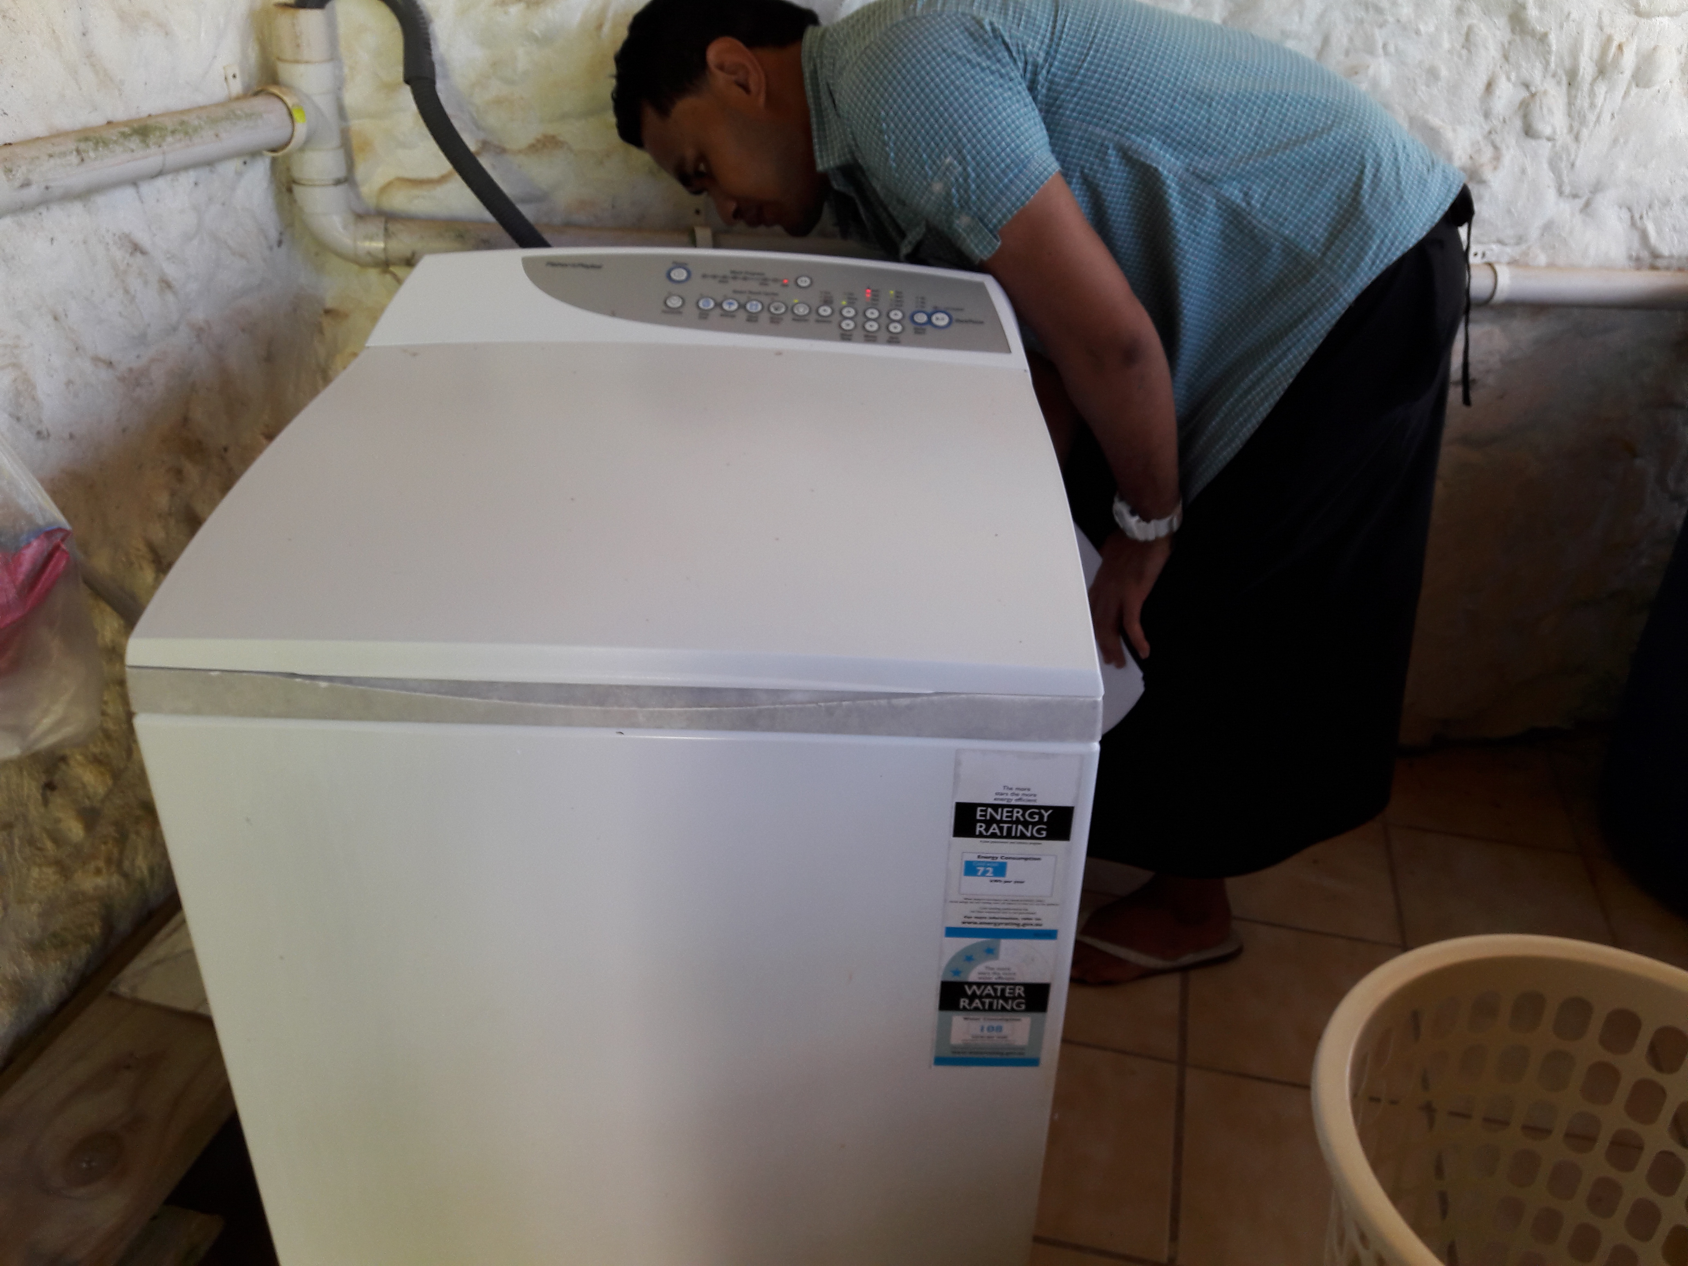
INDICATORS & TARGETS
Second indicator: Improvements in overall station efficiency
Target: From a baseline of 4.04kWh/L in 2015/2016 rise to:
4.06kWh/L (2016/17)
4.08kWh/L (2017/18)
4.10kWh/L (2018/19)
4.12kWh/L (2019/20)

Slide 8
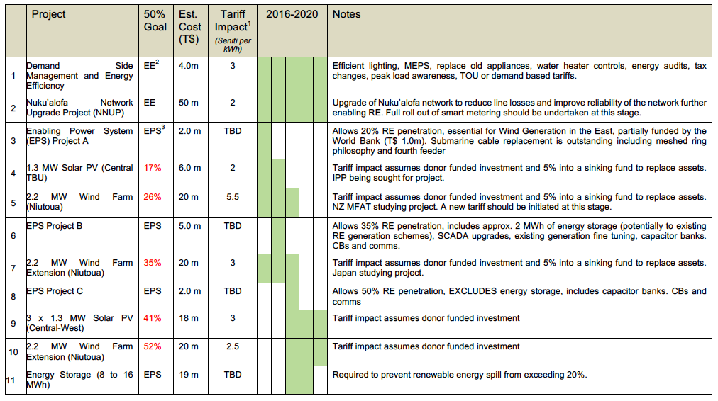
Getting to that 50%

Slide 9
Key Initiatives to date
Green Climate Fund:
  ADB Regional Renewable Energy Facility
  UNEP/SPC Energy Efficiency Regional Programme
  EIB GEEREEF Energy Private Sector development
Energy legislation and institutional reform (WB)
EU Budget Support
  Outer Island Renewable Energy Programme (OIREP)
  Technical Assistance
    Renewable Energy and Energy Efficiency Plan
    Grid Assessment study

Slide 10
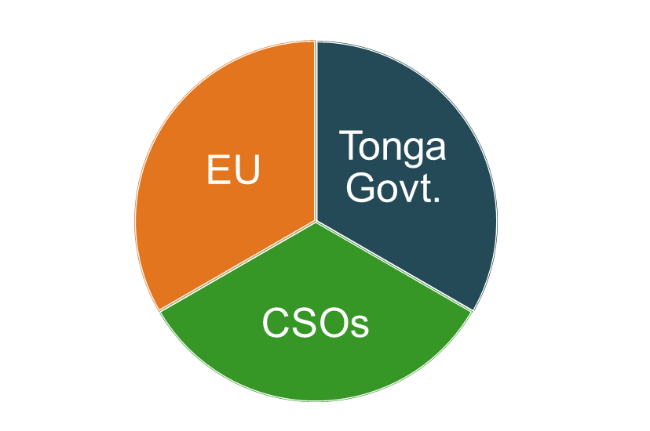
CSOs CONTRIBUTION TO THE ENERGY SECTOR
The Tonga Government is expanding its partnerships with Civil Society Organisations (CSOs) to raise awareness in relation to energy efficiency, renewable energy and climate adaptation.
In addition, the EU supports an increased cooperation between CSOs and the Tonga Government in existing developments in the energy sector through the Non-State Actors (NSA) Programme and Budget Support Programme.
.
The EU recognizes that communities need to be strengthened so that they can manage their energy resources effectively and efficiently particularly during incidents of natural disasters.
Raising awareness at the poorest communities including cyclone affected communities is an important part of this co-operation.

Slide 11
TONGA COMMUNITY DEVELOPMENT TRUST
The Tonga Community Development Trust (TCDT) is among the six CSOs who received EUR 27,000 under the EDF 10 to support the EU’s focal area through the Non-State Actors 12 months programme. TCDT has a long history of support for the Energy Sector especially with regards to community awareness on energy related matters.
Overall Objective
To improve the social, economic and heath standards of rural based women and their families in Tonga through access to more efficient and sustainable sources of renewable energy.
Specific Objectives
To increase awareness of women, youth and farmers about efficient energy
To map out changes in practice by collecting baseline information monthly monitor and evaluate the information towards the end of the project
To engage communities on tree planting to demonstrate adaptation to climate change

Slide 12
TCDT ACTIVITIES
Community Awareness Workshops
i. Discuss current & alternatives sources of energy
ii. Share achievements experiences & lessons learnt
Collect Baseline Data
i. Conduct survey on commonly used & alternative sources of energy
ii. Identify pattern of energy use and consumption
Develop and Distribute Awareness Materials
i. Provide results from baseline survey
ii. Outline key messages & recommenda-tions on accessing sustainable energy sources
Tree Planting
i. Encourage tree planting to reverse the negative impact of deforestation
ii. Build resilience towards the adverse effects of climate change
Develop Action Plans
i. Participants develop action plans to improve access to more efficient energy sources
ii. Develop strategies for saving energy to help reduce hefty power bills

Slide 13
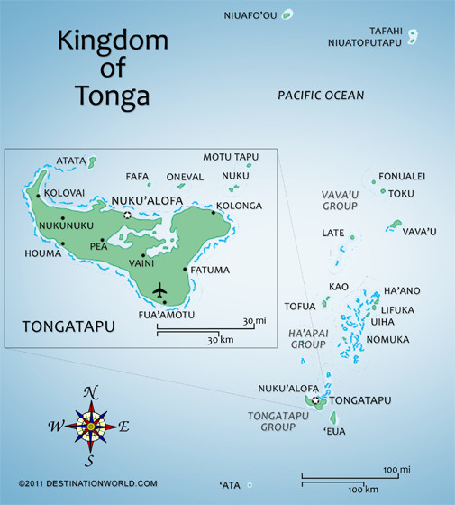
WHY SELECTED VILLAGES WERE TARGETED
Villages selected in Tongatapu are among the low income areas that have limited access to reliable and affordable energy services. In Ha’apai, four villages were identified to be the most vulnerable and at high risk of natural disasters. Some communities were severely affected by Cyclone Ian early 2014. Community infrastructures were destroyed hence access to power are limited with frequent power disconnection.
There is a general lack of understanding on how energy can be utilized in a sustainable manner in the villages targeted in the programme. The project helps promote the full participation of vulnerable communities in energy saving initiatives and alternative energy source schemes.
Tongatapu: Ha‘apai Is.:
  Popua i. Mo‘unga‘one
  Lapaha ii. Lofanga
  Makaunga iii. Lifuka
  ‘Ahau iv. Foa
  ‘Atata Is.

Slide 14
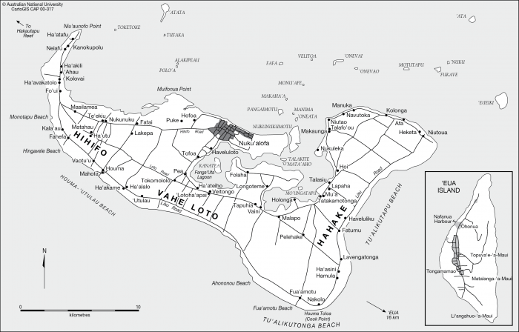
LOCATIONS THAT BENEFIT FROM TCDT’S EU FUNDED PROJECT
(HA‘ATAFU, ‘AHAU, LAPAHA, POPUA, MAKAUNGA AND ‘ATATA IS.)
MAP OF TONGATAPU
Popua

Slide 15
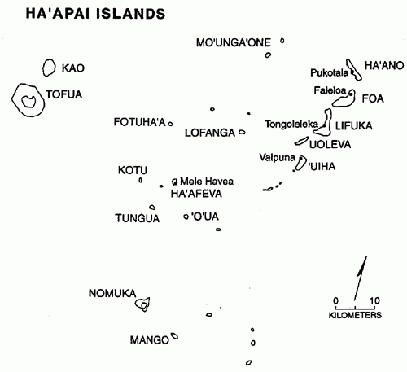
LOCATIONS THAT BENEFIT FROM TCDT’S EU FUNDED PROJECT
(LIFUKA, FOA, LOFANGA AND MO‘UNGA‘ONE)

Slide 16
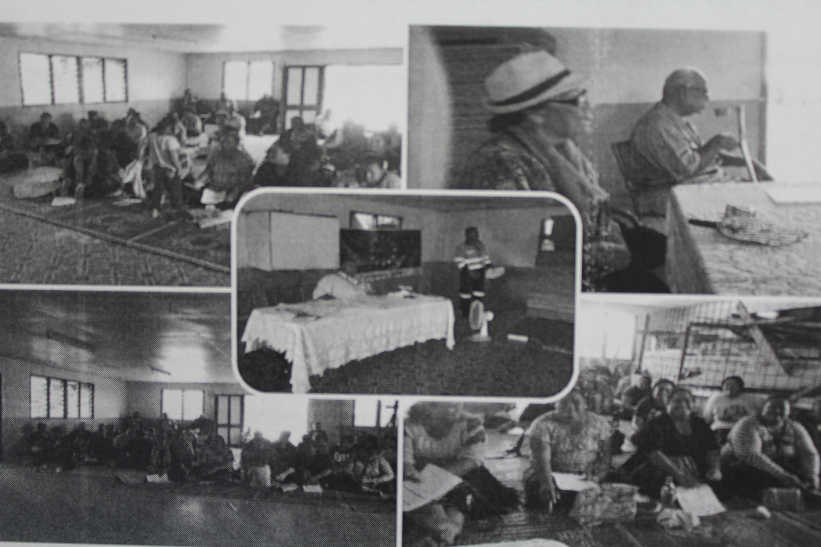
Workshop Discussion Topics
Renewable Energy Policy
Implications for communities
Electricity in Tonga
Realistic ways to cut cost or save money
Energy Road Map
Achievements and expectations
Climate Change
Impacts on the energy sector development in Tonga

Slide 17
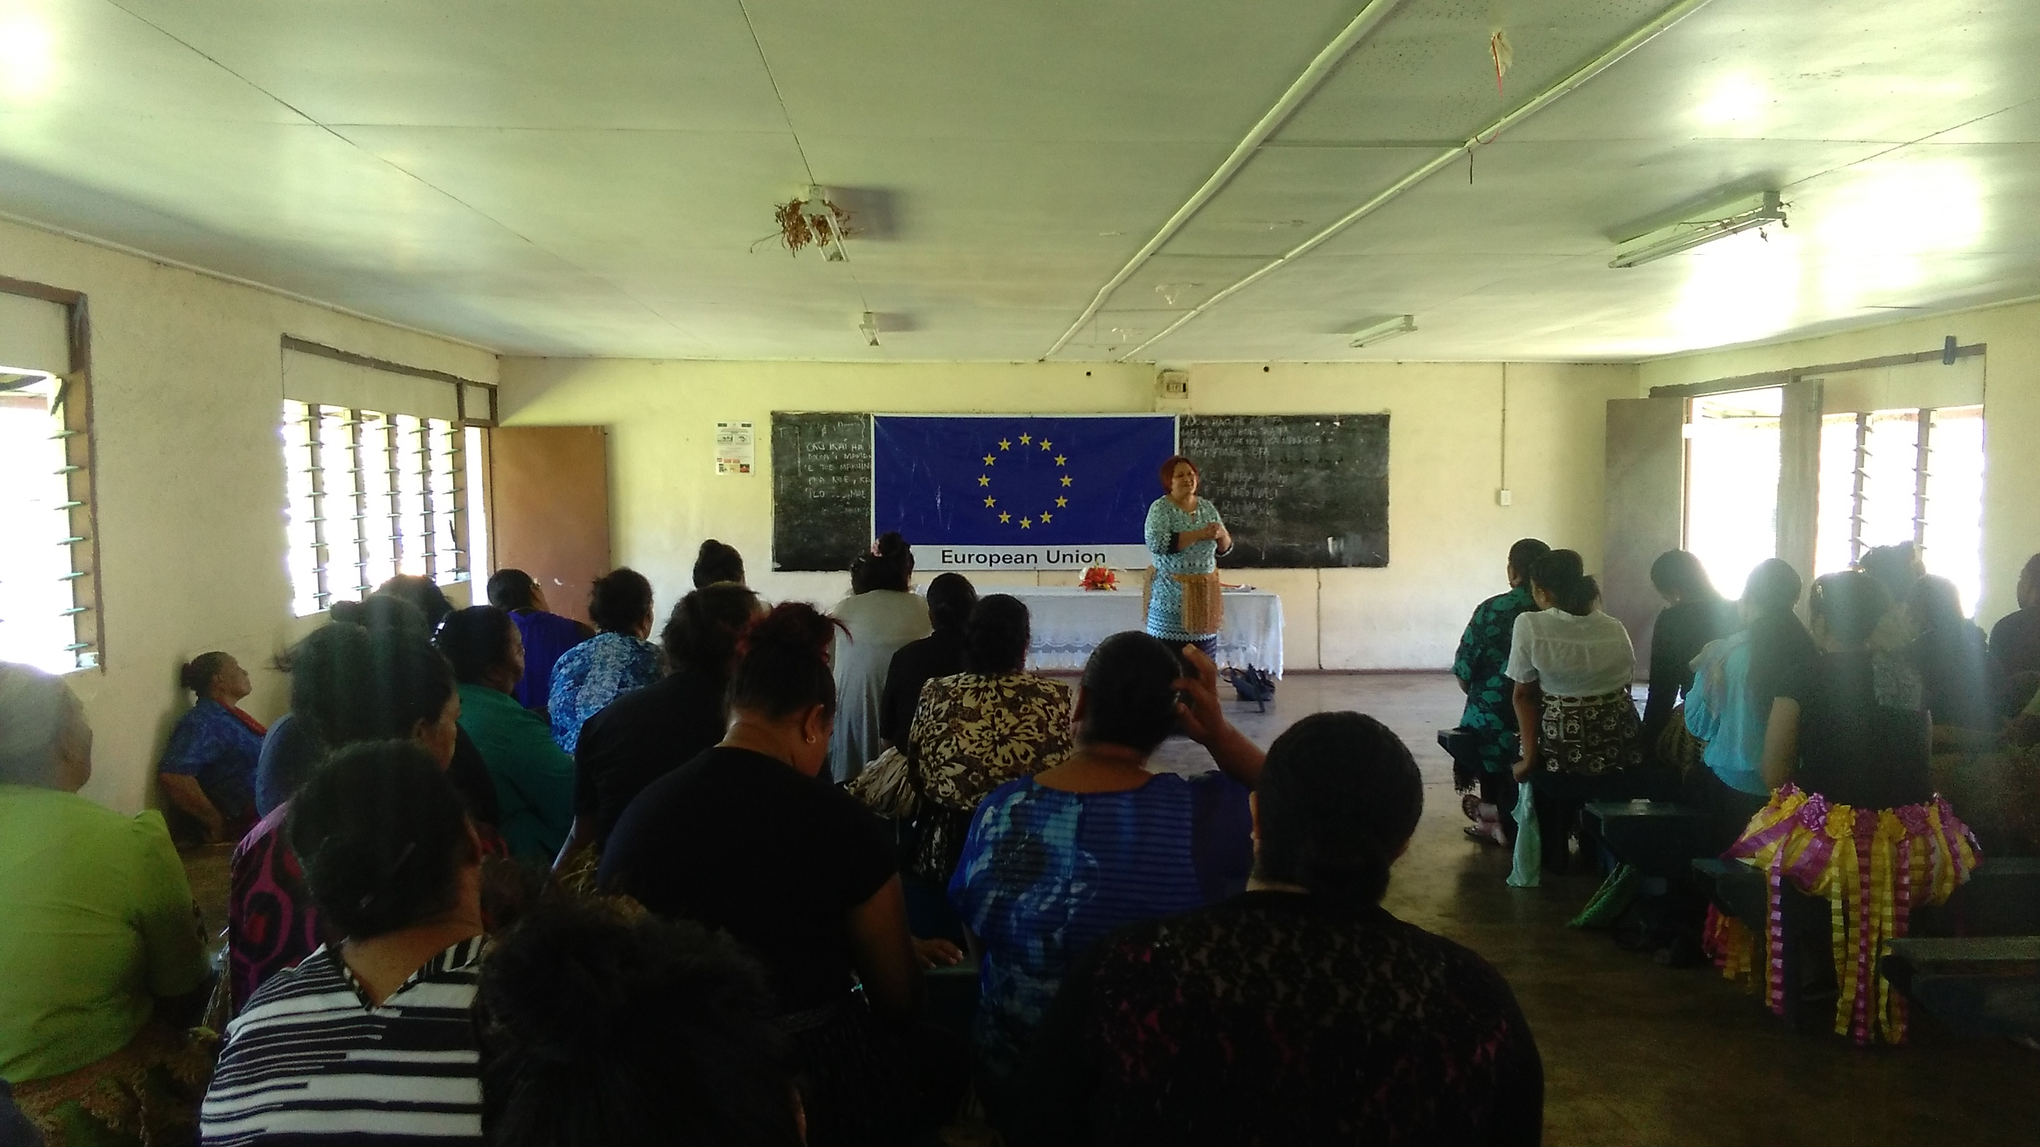
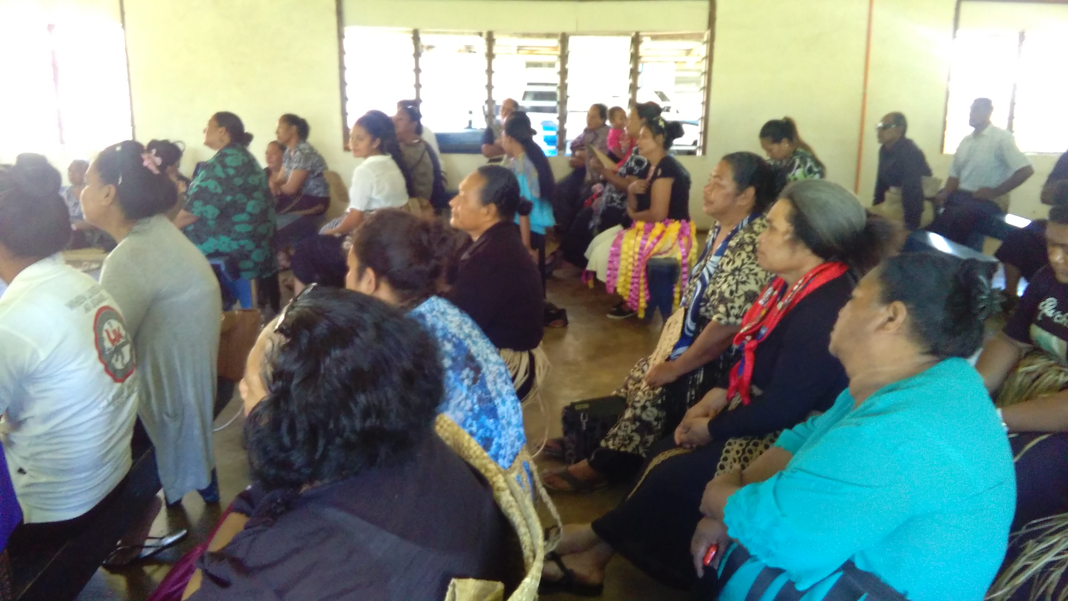
NUMBER OF WORKSHOP PARTICIPANTS
10
Youth
444
Female
574
Total
Participants
120
Male

Slide 18
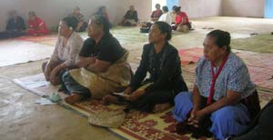
INDICATORS OF ACHIEVEMENT & RESULTS
More than 90% of participants invited to attend the workshop
More than 70% of participants, complete, implement and monitor their action plan
More than 70% of participants have a good record of declining power bill over 6-9 months period after the workshop
More than 70% of participants demonstrate behaviour change, practicing new pattern of energy consumption that are more sustainable, cost effective and efficient.
More than 70% of participants plant 5 or more trees at home or in their farming land.

Slide 19



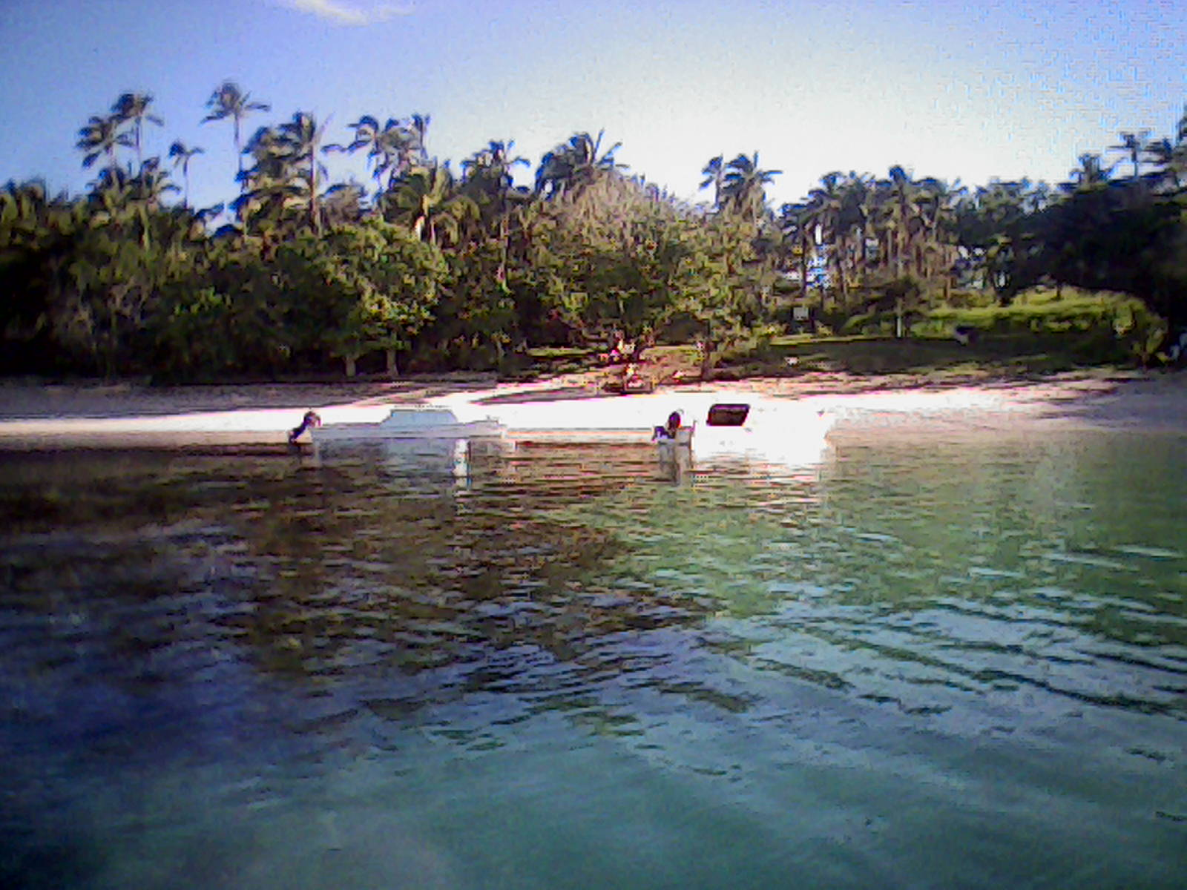
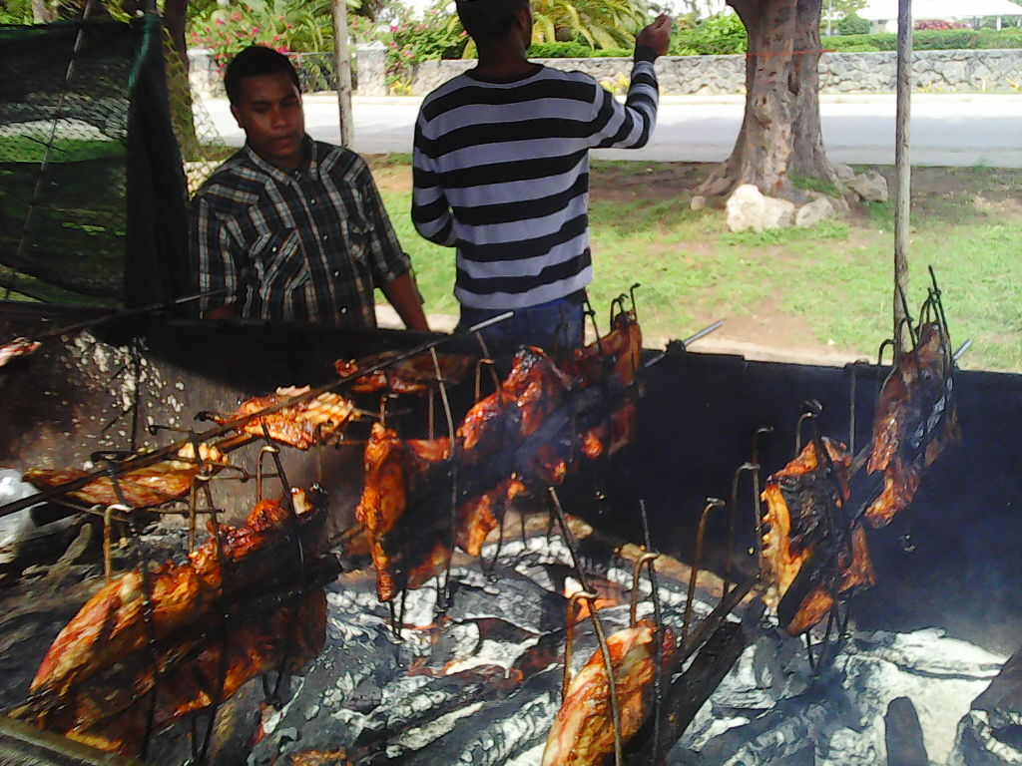
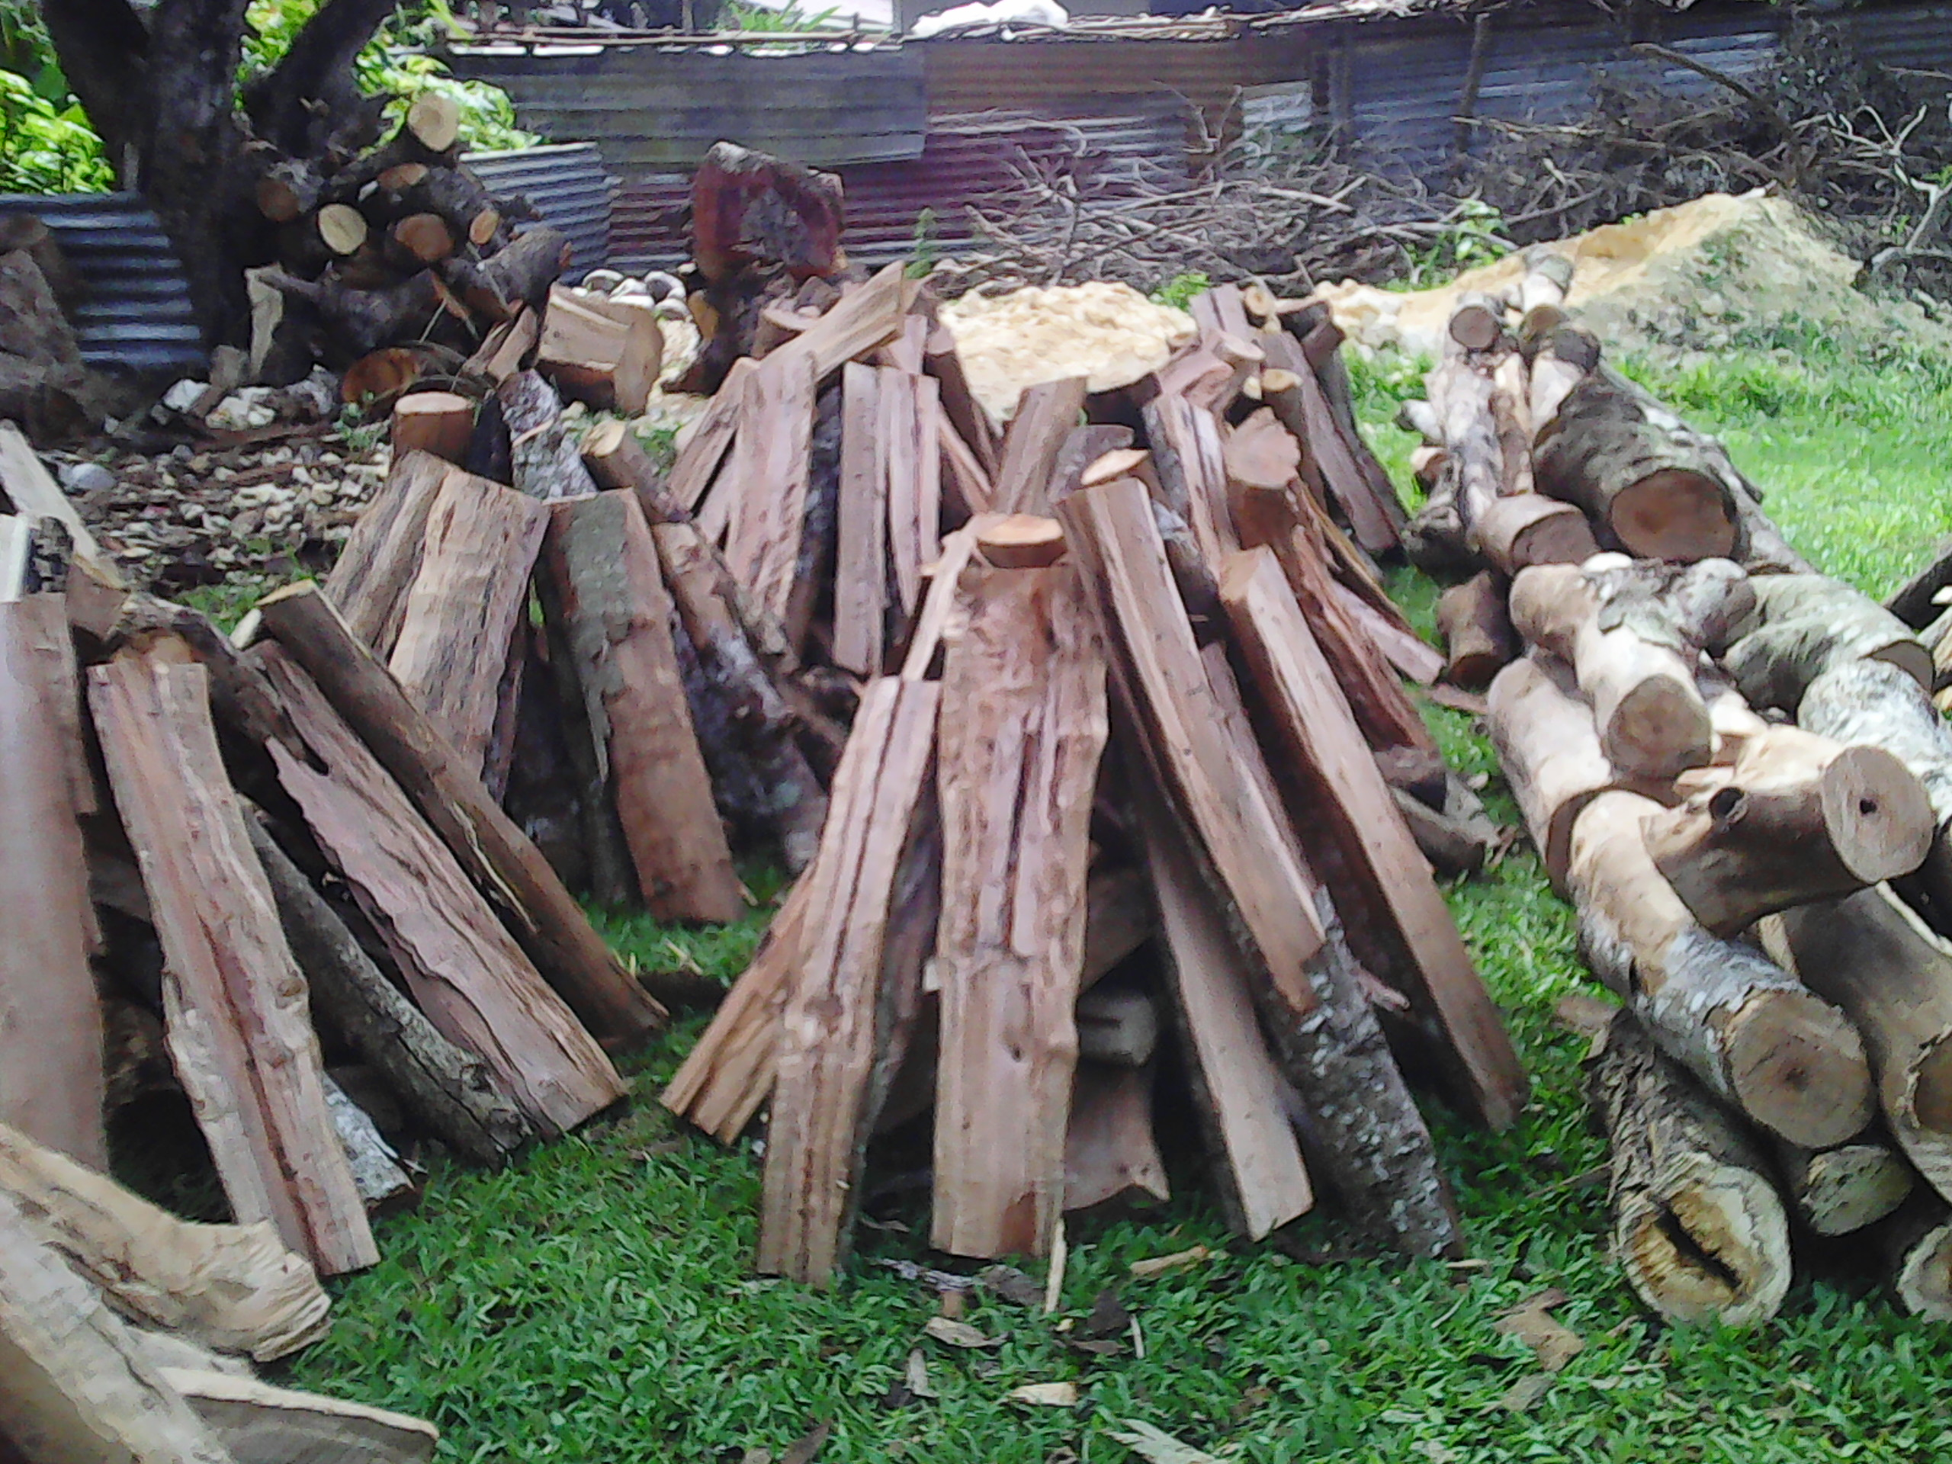


TCDT BROCHURE
Sustainable Renewable Source of Energy
NGAAHI KUPU FENGAUE’AKI
FAKAPOTOPOTO’I HONO NGAUE’AKI ’OE MA’U’ANGA IVI, FAKAHAOFI HO”O PA”ANGA.
Fakapa’anga ‘ehe
European Union(EU)
Fakahoko ngaue ‘ae Tonga Community
Development Trust
Ngaue fakataha moe Potungaue Ma’u’anga ivi
Tonga Power Limited
Ministry of Internal Affairs (kau ofisa kolo ‘oe ngaahi kolo)
Ngaahi kolo na’e
fakahoko ki ai ‘ae
Polokalama
(Ma’u’anga Ivi Tu’uloa)
LA’A,……...HAVILI ……TAHI

Slide 20
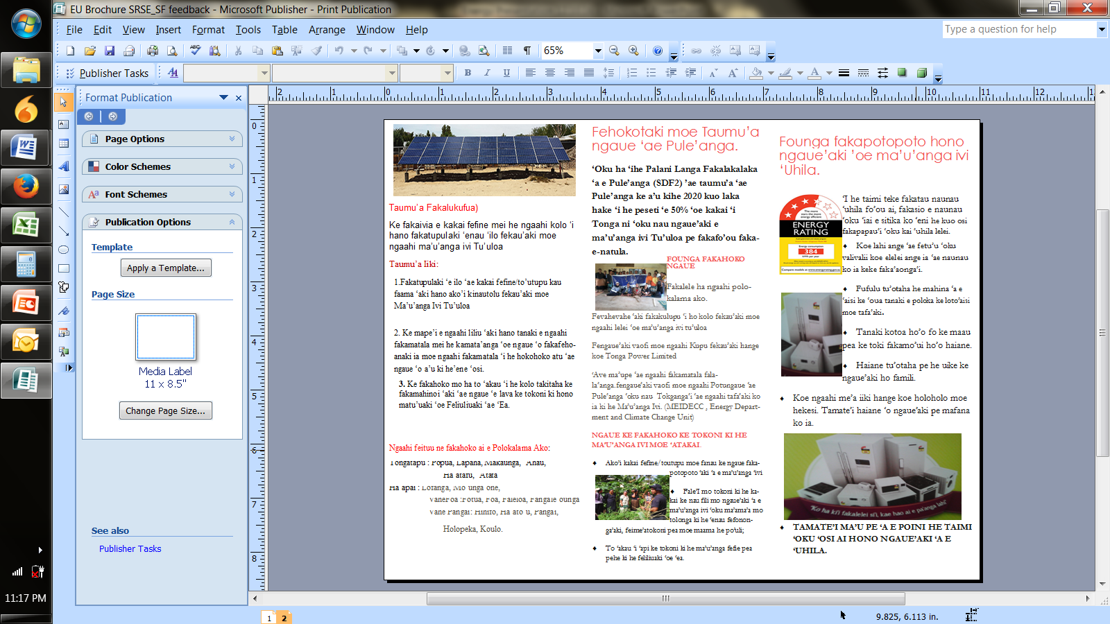
TCDT BROCHURE
Sustainable Renewable Source of Energy
NGAAHI KUPU FENGAUE’AKI
FAKAPOTOPOTO’I HONO NGAUE’AKI ’OE MA’U’ANGA IVI, FAKAHAOFI HO”O PA”ANGA.
Fakapa’anga ‘ehe
European Union(EU)
Fakahoko ngaue ‘ae Tonga Community
Development Trust
Ngaue fakataha moe Potungaue Ma’u’anga ivi
Tonga Power Limited
Ministry of Internal Affairs (kau ofisa kolo ‘oe ngaahi kolo)
Ngaahi kolo na’e
fakahoko ki ai ‘ae
Polokalama
(Ma’u’anga Ivi Tu’uloa)
LA’A,……...HAVILI ……TAHI

Slide 21
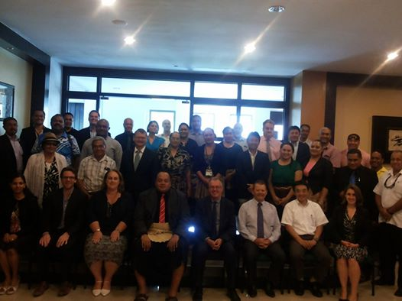
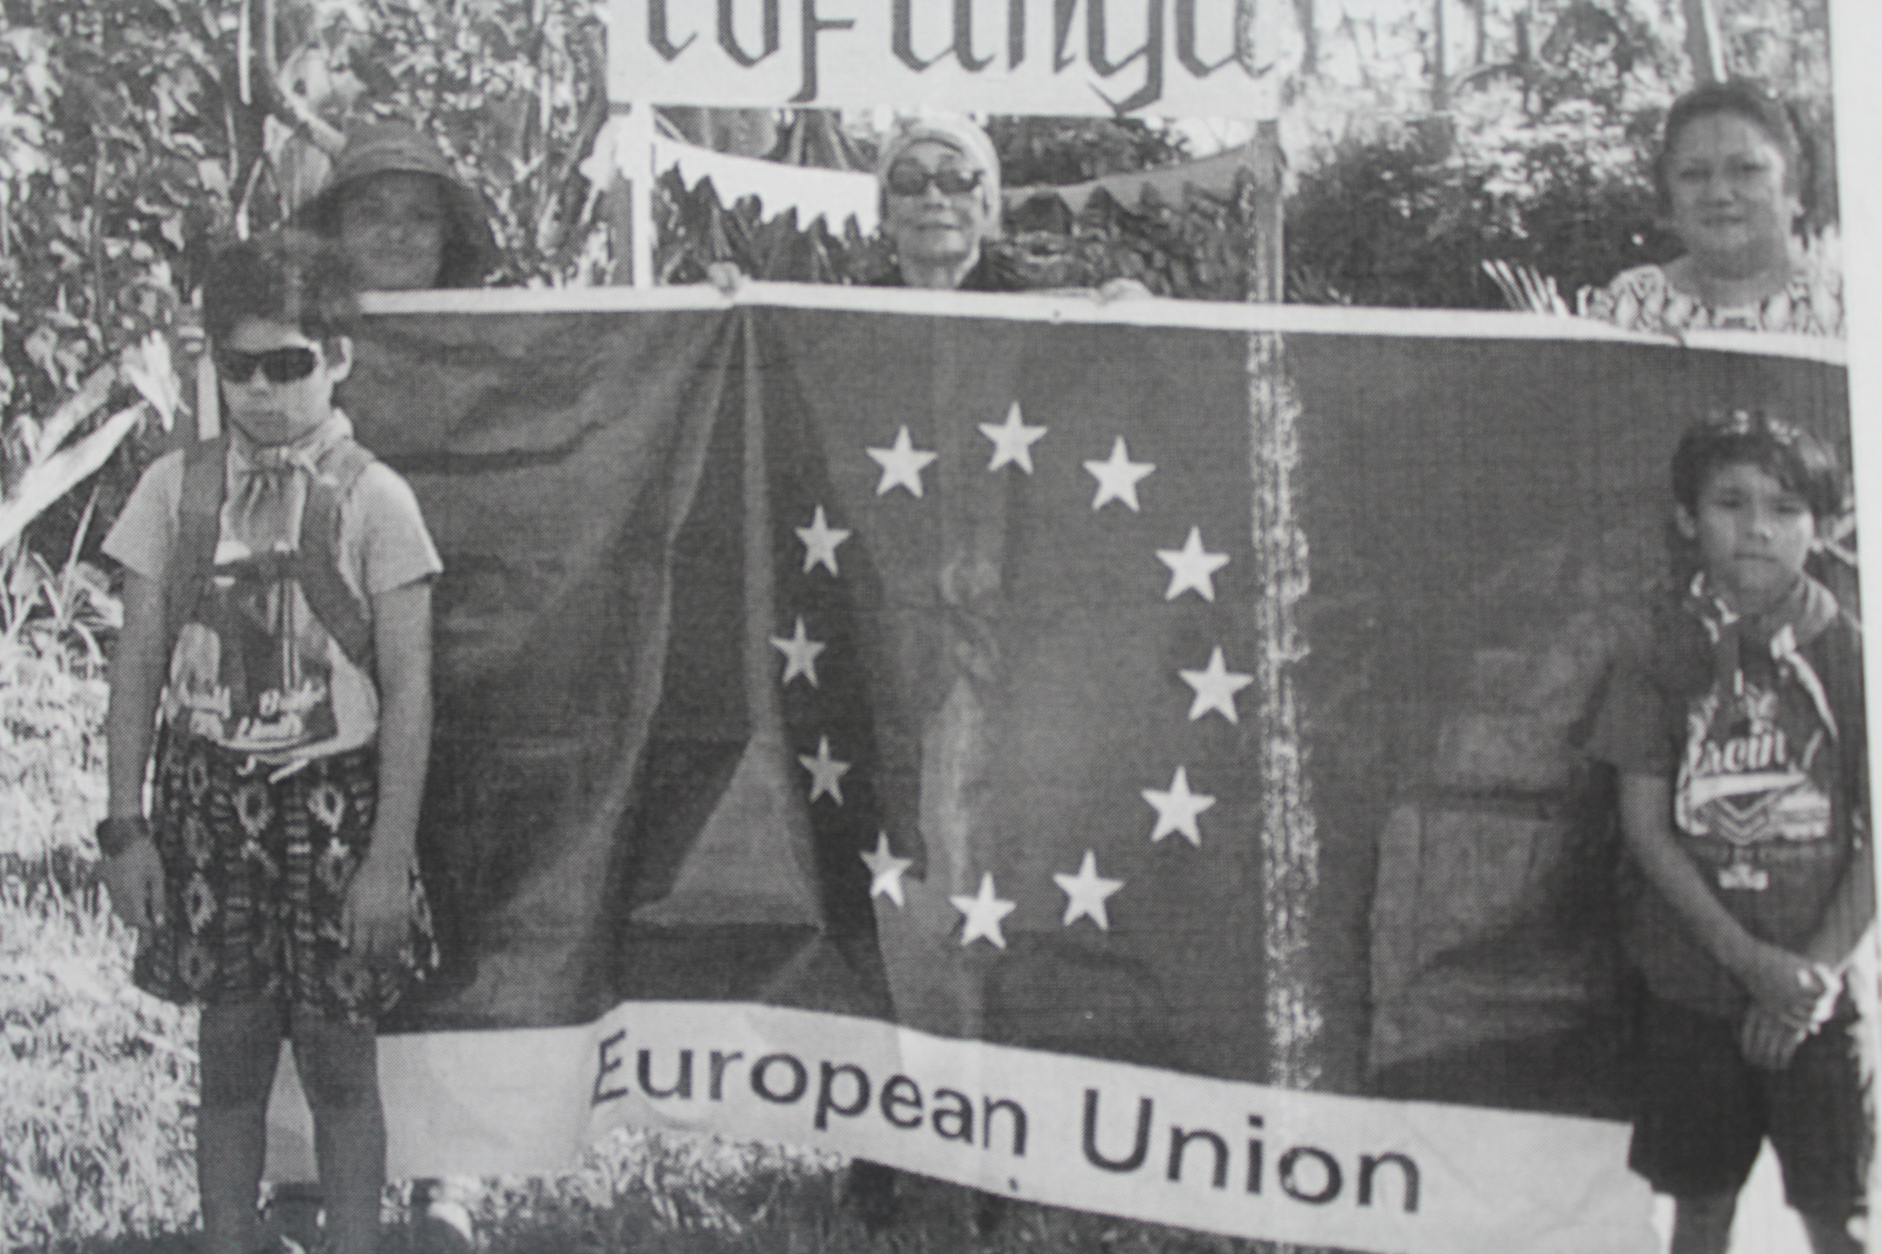
Summary & Recommendations
The Tonga Energy Road Map (TERM) 2010 - 2020 outlined targets for Tonga and proposed ways to achieve those targets. Since the approval of the TERM in 2010, there is already some positive signs of the increased use of renewable energy, especially on solar electrification. In the long term, increase use of alternative renewable energy will eventually reduce the cost for electricity.
The government should raise the awareness of the communities about its policy on energy as well as the TERM. Communities will contribute to achieving some of the TERM targets provided they understand how they can engage.
The government should actively engage communities in developing policies that will encourage sustainable energy use.
The government should facilitate the introduction of cheap and alternative sources of energy that will benefit the communities who are often victimised by the costly available choices and unfavourable natural events that deepen their vulnerability.

Slide 22
Thank you

