Slide 1
Inclusive Green Economy:
Seizing new opportunities to generate growth, create jobs and help reduce poverty
A DEVCO Training Course
Notes:
1

Slide 2
Addressing environmental challenges and seizing economic opportunities
Module 1:

Slide 3
Objectives of Module 1:
Outline key global and regional environmental challenges
Highlight the cost of inaction to address environmental degradation
Introduce the business case for an inclusive green economy and explain economic opportunities from integrating the environment into a new economic model

Slide 4
Global and Regional Environmental Challenges

Slide 5
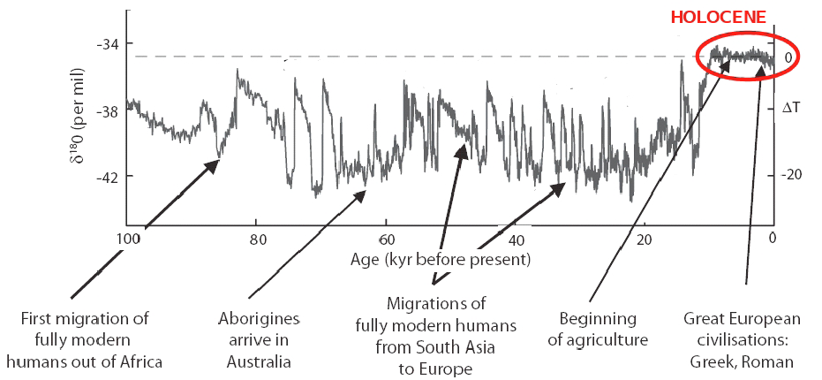
Planetary boundaries
Earth’s environment ➔ stable for 11,700 years
Drivers of change (last 100yrs): Population + Economic activity
Source: Rockström et al (2009a).
Notes:
The concept of ‘Anthropocene’ was coined by the ecologist Eugene Stoermer, but popularised by atmospheric chemist Paul Crutzen (chemistry Nobel-prize winner in 1995).
The concept of “Planetary Boundaries” was proposed by scientists from the Stockholm Resilience Centre and the Australian National University. It was disseminated through a publication in Nature (2009).
The concept of carrying capacity can be useful to understand the perils of population growth and unsustainable resources use. In ecology, when population of a species grows beyond its carrying capacity, its population crashes; ecosystems can sometimes recover but may also be permanently altered.
Human action ➔ significant environmental change
- Population: 4x increase
- Economic activity: 20x GDP

Slide 6
How safely are we using our operating space?
Impact from:
Systemic processes at planetary scale
Aggregated processes from regional/local level (with or without quantified boundaries
Source:
Steffen et al (2015)
Notes:
The green inner shading represents proposed safe operating space.
Red wedges represent an estimate of the current position for each variable.
The scheme has been revised with regard to the 2009 version

Slide 7
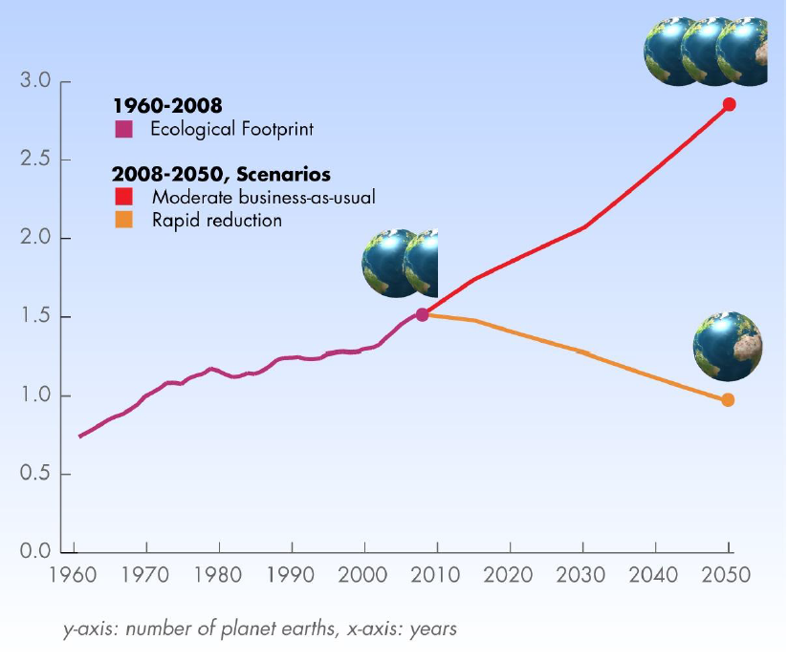
WHY care?
Today we use the equivalent of 1.5 Earth.
By 2030 we will need 2.0 based on moderate BAU scenario.
Global Footprint Network 2012
Notes:
ENVIRONMENTAL RATIONALE : pretty obvious… we should be protecting the earth(‘s capacity) – thus our interventions should not contribute (too much – at all) to environmental degradation… + we have international commitments etc.
The environmental (ecological) footprint calculates human pressure on the planet. It measures how much land and water area a human population (region, activity, humanity) requires to produce the resource it consumes and to absorb its carbon dioxide emissions, using prevailing technology and compares this measurement to how much land and sea area is available.
Since the 1970s, humanity has been in ecological overshoot with annual demand on resources exceeding what Earth can regenerate each year. Today humanity uses the equivalent of 1.5 planets to provide the resources we use and absorb our waste. This means it now takes the Earth one year and six months to regenerate what we use in a year. i.e. we eat/deplete the stock.
This translates into the concept of sustainable consumption and production: using resources and energy more efficiently and reducing GHG emissions and other environmental impact. It is about producting and using products and services in a way that is least harmful to the environment (and why not neutral or even positive impacts – this is what we shall see in future slides).
i.e. idea of this environmental rationale – current way of producing and consuming is not sustainable in the long run
-----
Added info.
Biologically productive land and sea includes area that 1) supports human demand for food, fiber, timber, energy and space for infrastructure and 2) absorbs the carbon dioxide emissions from the human economy. Biologically productive areas include cropland, forest and fishing grounds, and do not include deserts, glaciers and the open ocean.
Current Ecological Footprint Standards (www.footprintstandards.org) use global hectares as a measurement unit – which makes data and results globally comparable.

Slide 8
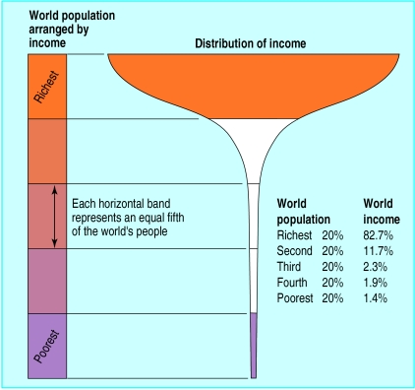
Income Distribution under the Current Growth Scenario
In 2009, global GDP reached US $58.22 trillion and yet, almost 80% of humanity continues to live on less than US$ 10/day
The poorest 40 percent of the world’s population produce only 5 percent of global income
Source: UNEP
The threat to the planet, inequality and barriers to growth go hand in hand!
Notes:
All kinds of services provided by poor people in terms of natural resource management are not being taken into account, and neither is the way in which environmental degradation affects the poor.

Slide 9
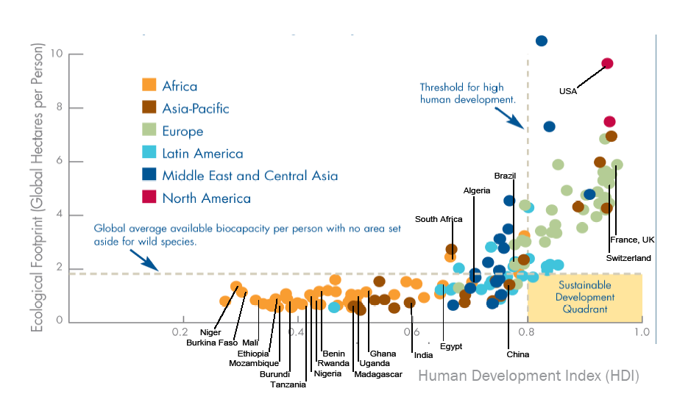
Promoting Human Development While Recognizing Ecological Limits
Global Footprint Network and WWF 2006
Notes:
Ecological footprint in Africa and Asia-Pacific is relatively low, as is the Human Development Index value. On the other hand, most of the countries in North America, Europe, Middle East and Central Asia have a much higher ecological footprint and HDI value. Only few countries fall within or near the Sustainaible Development area; these are mostly from Latin America.

Slide 10
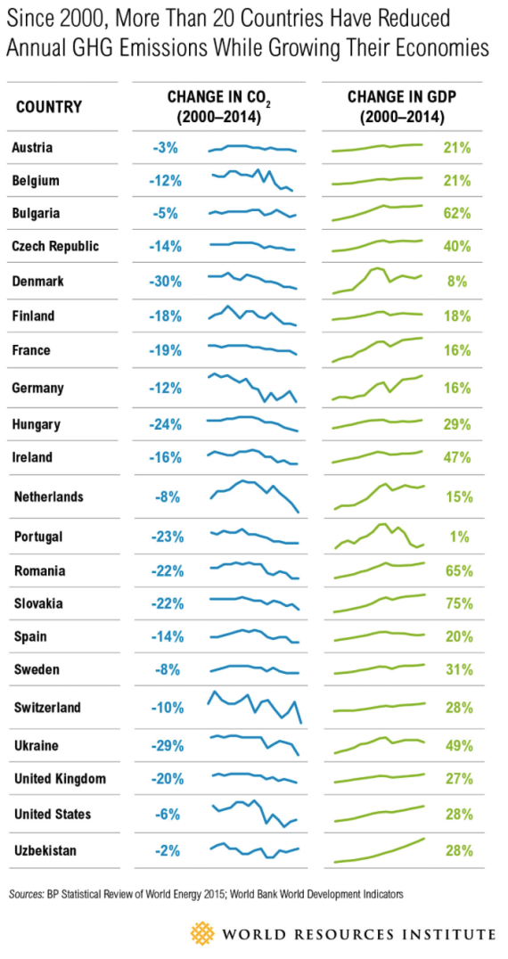
Decoupling GDP from GHG emissions

Slide 11
Addressing environmental degradation: Cost of Inaction

Slide 12

What is....
…an Environmental Externality?
Economic Externality:
  Effect of an activity on an uninvolved party
Environmental Externality:
  Uncompensated/ignored environmental
  effects deriving from production and consumption
Full cost of activity not reflected by market mechanisms/market prices
Creates markets distortions and misallocation of capital
Source:
http://www.greenbiz.com

Slide 13
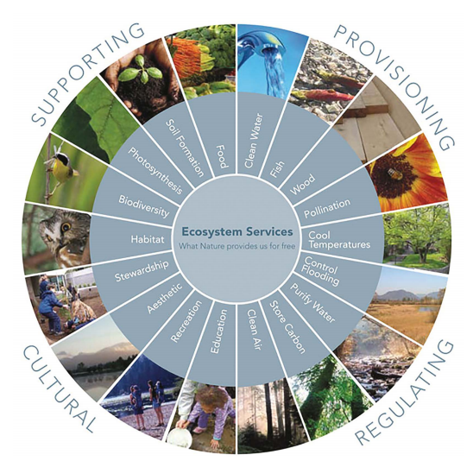
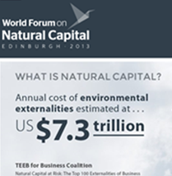
Global Costs of Environmental Externalities
Market prices need to reflect environmental and social externalities/costs!
Source: Millennium Ecosystem Assessment (2005)
Notes:
The report, “Natural Capital at Risk – The Top 100 Externalities of Business”, estimates the global top 100 environmental externalities are costing the economy world-wide around $4.7 trillion a year in terms of the economic costs of greenhouse gas emissions, loss of natural resources, loss of nature-based services such as carbon storage by forests, climate change and air pollution-related health costs.
THE PRIMARY PRODUCTION AND PRIMARY PROCESSING SECTORS ANALYZED IN THIS STUDY ARE ESTIMATED TO HAVE UNPRICED NATURAL CAPITAL COSTS TOTALLING US$7.3 TRILLION, WHICH EQUATES TO 13% OF GLOBAL ECONOMIC OUTPUT IN 2009.
THE MAJORITY OF UNPRICED NATURAL CAPITAL COSTS ARE FROM GREENHOUSE GAS EMISSIONS (38%) FOLLOWED BY WATER USE (25%); LAND USE (24%); AIR POLLUTION (7%), LAND AND WATER POLLUTION (5%) AND WASTE (1%).
NO HIGH IMPACT REGION-SECTORS GENERATE SUFFICIENT PROFIT TO COVER THEIR ENVIRONMENTAL IMPACTS. SUBJECT TO ADAPTIVE CAPABILITIES, THIS WILL CAUSE THEM TO PASS ON THESE COSTS TO CUSTOMERS. REGION-SECTORS MOST AT RISK INCLUDE COAL POWER GENERATION IN EASTERN ASIA AND NORTHERN AMERICA, WHEAT FARMING IN SOUTHERN ASIA, AND CATTLE RANCHING IN SOUTH AMERICA AND SOUTHERN ASIA.
COMPANIES AND INVESTORS CAN USE INFORMATION ON THE REGION-SECTORS THAT HAVE THE LARGEST NATURAL CAPITAL COSTS TO ASSESS THE POSSIBLE SCALE OF DIRECT, SUPPLY-CHAIN AND INVESTMENT RISKS. REGIONAL AND SECTORAL VARIATIONS PRESENT OPPORTUNITIES FOR BUSINESSES TO ENHANCE COMPETITIVE ADVANTAGE, AND FOR INVESTORS TO IMPROVE RELATIVE RETURNS.
The System of Environmental-Economic Accounting (SEEA) contains the internationally agreed standard concepts, definitions, classifications, accounting rules and tables for producing internationally comparable statistics on the environment and its relationship with the economy. The SEEA framework follows a similar accounting structure as the System of National Accounts (SNA) and uses concepts, definitions and classifications consistent with the SNA in order to facilitate the integration of environmental and economic statistics.

Slide 14
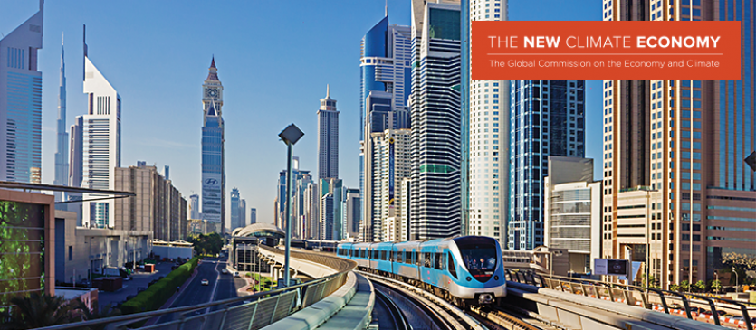
Cost of environmental degradation
Global land use changes result in a loss of ecosystem services of between USD 4.3 and USD 20.2 trillion per year - or between 5% and 25% of global GDP

Slide 15
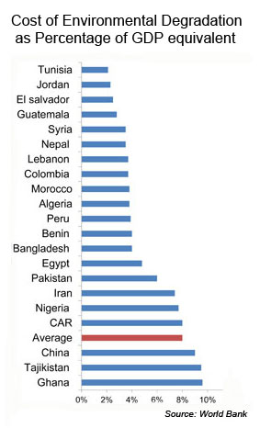
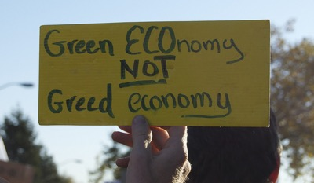
Grow First and Clean Up After:
Not an Option….
Source: http://www.urbanafrica.net/
Notes:
Average cost of environmental degradation too high to be neglected.

Slide 16
Economic opportunities:
The Business Case for
an Inclusive Green Economy

Slide 17
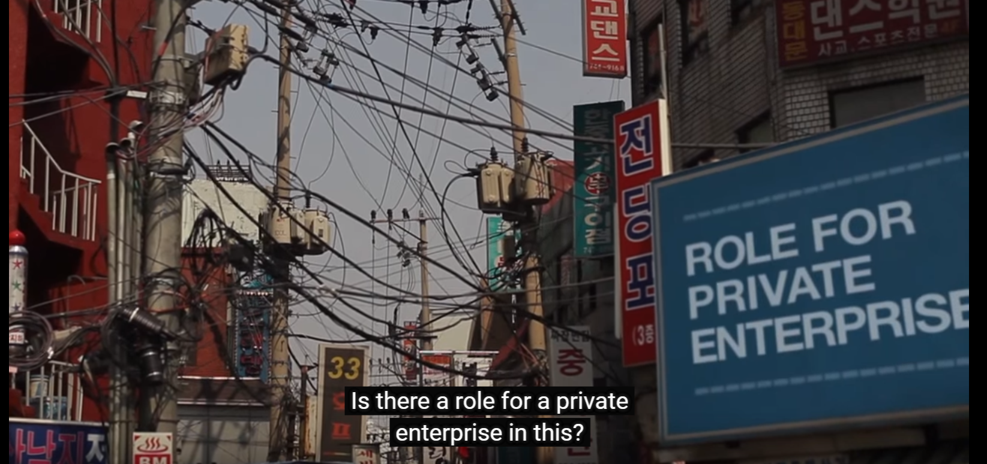
The Business Case for an Inclusive Green Economy
Reaction by the business world:
https://www.youtube.com/watch?v=_6eWgDxJW_Y#

Slide 18
Inclusive Green Economy Opportunities
Integration of environment:
  not necessarily a cost to the economy
  a driver of stability and sustainable development
contribution of the natural capital to economic development and livelihoods security
mitigation of risks associated to resources scarcity and climate change
Notes:
Comment on the region in focus, e.g. Building on a strong endowment of natural resources and skills, as well as a culture that increasingly values such attributes, Africa is well positioned to be the epicentre of a global transition to more inclusive economies that produce growth without eroding the underlying stock of natural wealth.

Slide 19
Inclusive Green Economy Opportunities
New economic opportunities and markets:
  growing production and trade of Environmental Goods and Services
Technological innovation
  Leap frog to cleaner technologies
Goods & services produced to:
  prevent, reduce and eliminate pollution and any other degradation of the environment
  preserve and maintain the stock of natural resources
Notes:
Comment on the region in focus, e.g. Africa’s strong growth is projected to continue in the medium-term due to increasing domestic demand, driven mainly by the rising middle class, improving regional business environment and macroeconomic management, increasing public investment, a buoyant services sector and robust trade and investment ties with emerging economies.
Source: Economic Report on Africa, United Nations Economic Commission for Africa 2015

Slide 20
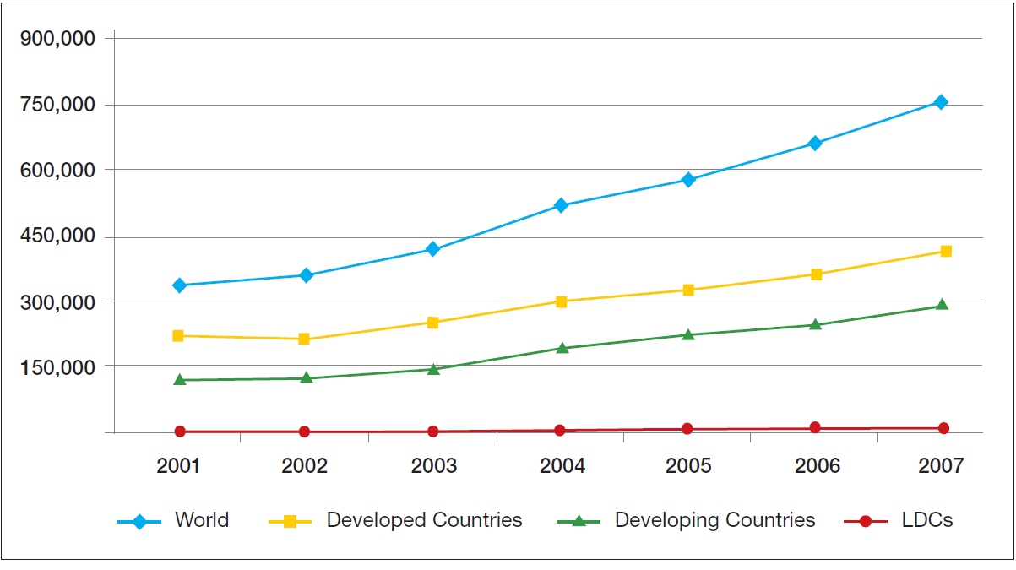
Growth of Environmental Goods Export, 2001-2007
UNEP, 2013
Notes:
The size and maturity of environmental goods and services markets in Africa are still rather limited. However, the opportunities for promoting sustainable consumption in Africa should not be underestimated, given that numbers of middle class consumers in Africa are on the increase.

Slide 21
The Business Case for an Inclusive Green Economy
Enhanced skills of workforce
Efficiency gains and profits (Better use of resources):
  overall savings potential for European industry estimated at €630 billion per year
  potential boost of EU GDP by up to 3.9%
IGE added value
COM(2014)398 Towards a circular economy

Slide 22
Key Messages of Module 1
Economic activities need to be environmentally sustainable to ensure human well-being. This is no longer an option, but a necessity.
The cost of inaction in addressing environmental degradation exceeds that of proactive action
Investments in measures that advance environmental sustainability can trigger economic growth and job creation.
Inclusive green economy provides an opportunity to reform economic and financial systems to achieve environmental and social objectives.

Slide 23
References
Rockström, J; et al. (2009) A Safe Operating Space for Humanity, Nature, September 2009
Steffen, W.; et al. (2015) Planetary boundaries: Guiding human development on a changing planet, Science, February 2015
National Geographic (2016) Images p.6. Available at: http://www.nationalgeographic.com/
Global Footprint Network (2012) Chart p.11. Available at: http://www.footprintnetwork.org/en/index.php/GFN/blog/year/2012/
Global Footprint Network (2016) Ecological Footprint Standards. Available at: http://www.footprintnetwork.org/en/index.php/GFN/page/application_standards/
WWF & Global Footprint Network (2006) Living Planet Report 2006. Available at: http://wwf.panda.org/about_our_earth/all_publications/living_planet_report/living_planet_report_timeline/lp_2006/
Hsu, A., et al. (2016) The 2016 Environmental Performance Index, Yale University, New Haven, CT. Available at: www.epi.yale.edu
GreeenBiz (2016) Image p.15. Available at: https://www.greenbiz.com/
Stern, N. H. (2007) The economics of climate change: the Stern review, Cambridge, UK: Cambridge University Press.
Asian Development Bank (2014) Climate Change May Slash 9% From South Asia's Economy By 2100 – Report, News Release. Available at: http://www.adb.org/news/climate-change-may-slash-9-south-asias-economy-2100-report
WHO (2015) Economic cost of the health impact of air pollution in Europe: Clean air, health and wealth, Copenhagen: WHO Regional Office for Europe.
Lazard (2015) Lazard' s levelized cost of energy analysis — version 9.0, Nov. 2015. Available at: https://www.lazard.com/media/2390/lazards-levelized-cost-of-energy-analysis-90.pdf.
World Bank (2012) Inclusive Green Growth: The Pathway to Sustainable Development, World Bank, Washington, D.C.

Slide 24
UrbanAfrica.Net (2016) Image p.20. Available from: http://www.urbanafrica.net/
UNEP (2016) Green Economy and Trade. Available at: http://www.unep.org/greeneconomy/GEandTrade/tabid/105867/Default.aspx
GIZ (2013) Green Economy in Sub-Saharan Africa: Lessons from Benin, Ethiopia, Ghana, Namibia and Nigeria. Available at: http://www.greengrowthknowledge.org/sites/default/files/downloads/resource/green_economy_in_sub_saharan_africa_GIZ.pdf
UNDP (2010) Human Development Report 2010. Available at: http://hdr.undp.org/en/content/human-development-report-2010
Keynote address by Meles Zenawi on Green Economy and Structural Transformation in Africa, October 2011, www.uneca.org/aec/2011/updates/Speech%20by%20HE%20Meles%20Zenawi.pdf
OECD and Eurostat. (1999), The Environmental Goods and Services Industry: Manual for Data Collection and Analysis, OECD Publishing, Paris.
UNEP (2011) Global Growth Trends 2010–2050 and the “Green Investment Scenario
UNEP (2011) Presentation on “Introduction to Green Economy and Sustainable Consumption and Production and EaP GREEN Programme” available at http://www.unep.org/roe/Portals/139/documents/EaPGreen/1._Introduction_to_SCP_and_GE.pdf
UNEP (2013) Chart p. 28 on Growth of Environmental Goods Export, 2001-2007. Available at: http://www.unep.org/greeneconomy/Portals/88/GETReport/pdf/Chapitre%201%20introduction.pdf
European Commission, Communication COM (2014) 398 final of 2.7.214 “Towards a circular economy: A zero waste programme for Europe”
World Economic Forum (2012) The New Sustainability Champions. Video available at: https://www.youtube.com/watch?v=_6eWgDxJW_Y#
Millennium Ecosystem Assessment, 2005. Ecosystems and Human Well-being: Synthesis, World Resources Institute, Island Press, Washington, DC. Available at: http://www.millenniumassessment.org/documents/document.356.aspx.pdf

