Slide 1
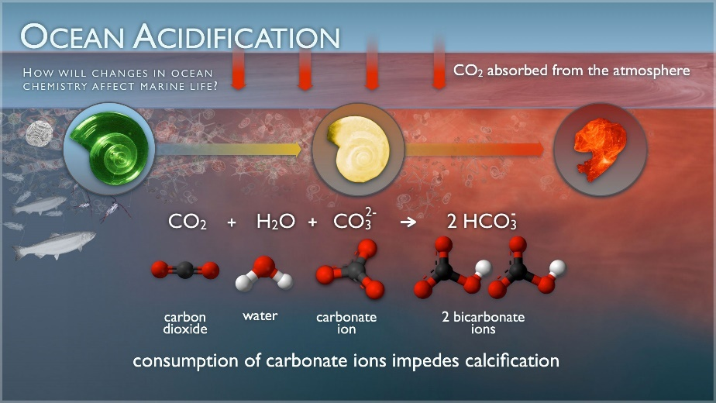
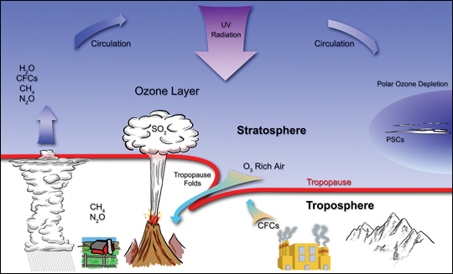
Systemic processes at planetary scale
Ocean acidification: (since pre-industrial times)
  Surface ocean pH -0.1 (100x in last 20M yrs)
Climate change
  CO₂ concentrations ≈40 ppm
Stratospheric O₃ depletion
  near complete recovery of the ozone layer ±2050
Sources: Ocean Acidification taken from NOAA and O₃ depletion from NASA websites
Notes:
Rationale (from Rockström et al, 2009b):
Climate change:
Current climatic models may significantly underestimate severity of long-term CC for a given GHG concentration. Most models suggest a doubling in atmospheric CO2 concentration will lead to global temperature rise of about 3ºC (2-4.5ºC uncertainty range) once the climate has regained equilibrium. These models don’t include long-term reinforcing feedback processes that further warm the climate, such as decreases in distribution of vegetation. If these slow feedbacks are included, doubling CO2 levels gives an increase of 6ºC (4-8ºC uncertainty range), threatening ecological life-support systems and severely challenging viability of contemporary human societies.
CO2 concentrations were major factor in long-term cooling over past 50 million years, and the planet was largely ice-free until CO2 concentrations fell below 450 ppm (per volume), so there is a critical threshold around 350-550 ppm. The 350 ppm threshold aims at ensuring continued existence of large ice sheets.
There is evidence some Earth subsystems are being altered beyond stability, e.g. retreat of summer sea ice in Arctic ocean, retreat of mountain glaciers, loss of mass from Greenland and West Antarctic ice sheets, accelerating rates of sea level rise in past 10-15 years.
Rate of biodiversity loss:
Main cause is land use change (into agriculture and urban areas); changes in frequency, duration or magnitude of wildfires; introduction of new species.
Up to 30% of all mammal, bird and amphibian species will become threatened with extinction this century.
More research needed to pin down the boundary.

Slide 2
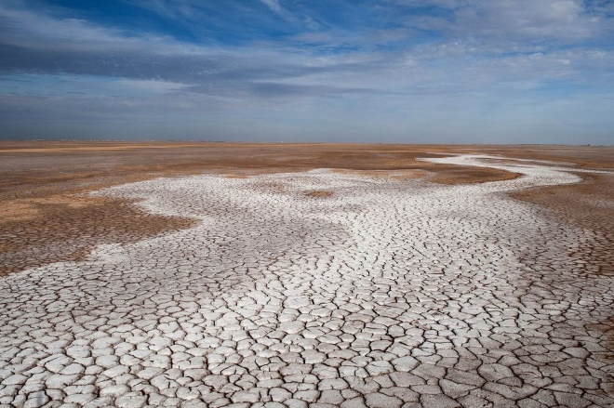
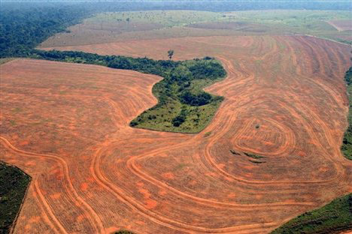
Aggregated processes from local/regional scale (boundaries quantified)
Freshwater use:
  ≈25% river basins run dry before reaching oceans
Land system change:
  Agricultural land-use change rate = 0.8%/yr (past 40-50 yrs)
Biogeochemical flows:
  ≈ 200Mt P mined/yr with P inflow to oceans = 8x the natural background rate of influx
Photos: National Geographic
Notes:
Threats to human livelihoods include:
Loss of soil moisture resources (green water) due to land degradation and deforestation, threatening terrestrial biomass production and carbon sequestration
Use and shifts in runoff (blue water) volumes and patterns threatening human water supply and aquatic water needs
Impacts on climate regulation
Estimates indicate 90% of global green water are required to sustain critical ecosystem services, whereas 20-50% of mean annual blue water flows in river basins are required to sustain aquatic ecosystems

Slide 3
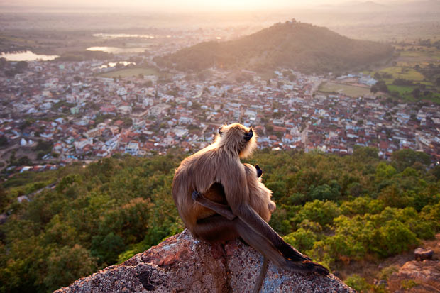
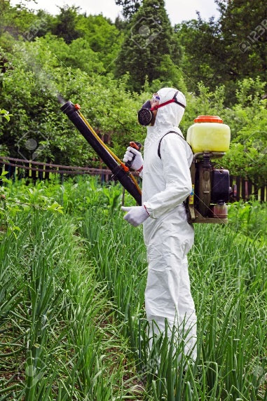
Aggregated processes from local/regional scale (boundaries not yet quantified)
Biosphere integrity (no global quantification on functional diversity):
  Species extinct at 100-1,000 x natural rate
Atmospheric aerosol loading:
  human activity ➔ 2x aerosols concentration
Novel entities: Chemicals & modified life-forms
  >140,000 chemical products commercially available (UNEP, 2013) / toxicity known for only a few thousand + no knowledge of combined effects
Notes:
Rationale (from Rockström et al, 2009b):
Climate change:
Current climatic models may significantly underestimate severity of long-term CC for a given GHG concentration. Most models suggest a doubling in atmospheric CO2 concentration will lead to global temperature rise of about 3ºC (2-4.5ºC uncertainty range) once the climate has regained equilibrium. These models don’t include long-term reinforcing feedback processes that further warm the climate, such as decreases in distribution of vegetation. If these slow feedbacks are included, doubling CO2 levels gives an increase of 6ºC (4-8ºC uncertainty range), threatening ecological life-support systems and severely challenging viability of contemporary human societies.
CO2 concentrations were major factor in long-term cooling over past 50 million years, and the planet was largely ice-free until CO2 concentrations fell below 450 ppm (per volume), so there is a critical threshold around 350-550 ppm. The 350 ppm threshold aims at ensuring continued existence of large ice sheets.
There is evidence some Earth subsystems are being altered beyond stability, e.g. retreat of summer sea ice in Arctic ocean, retreat of mountain glaciers, loss of mass from Greenland and West Antarctic ice sheets, accelerating rates of sea level rise in past 10-15 years.
Rate of biodiversity loss:
Main cause is land use change (into agriculture and urban areas); changes in frequency, duration or magnitude of wildfires; introduction of new species.
Up to 30% of all mammal, bird and amphibian species will become threatened with extinction this century.
More research needed to pin down the boundary.

Slide 4
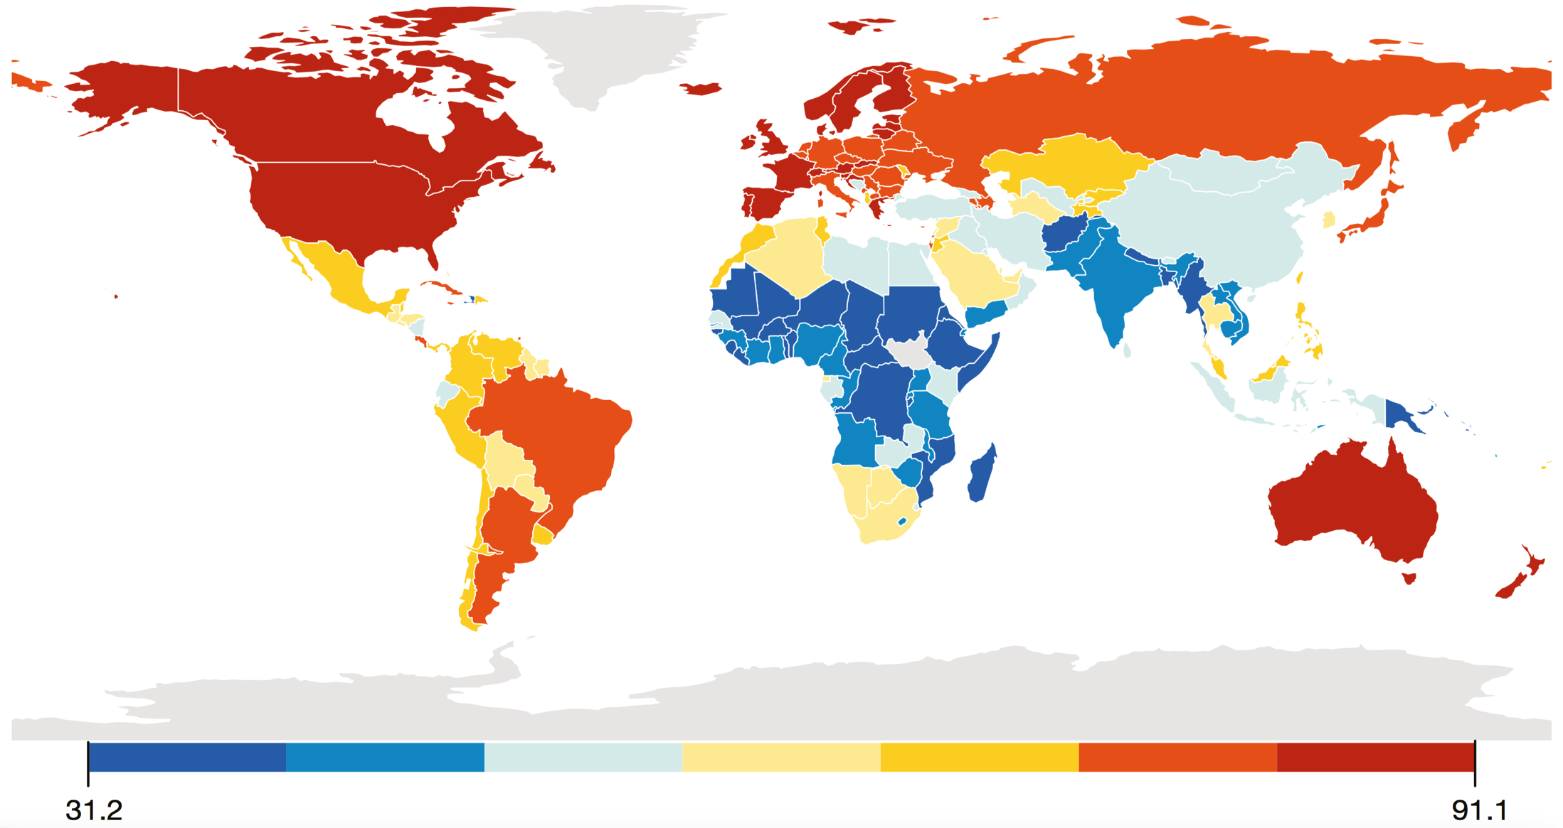
Environmental Performance Index (2016)
Source: Hsu et al (2016)
Notes:
The Environmental Performance Index (EPI) ranks countries’ policy performance on high-priority environmental issues in two areas: protection of human health and protection of ecosystems. Within these two policy objectives the EPI scores national performance in nine issue areas comprised of more than 20 indicators (see EPI Framework). EPI indicators measure country proximity to meeting internationally established targets or, in the absence of agreed targets, how nations compare to one another.
Africa still scores very low on policy performance, meaning that there is a long way to policy reform, with new, improved policy and regulatory frameworks needed to create the incentives to address environmental challenges, with among other things, the development of green businesses and the mainstreaming of green practices.

Slide 5
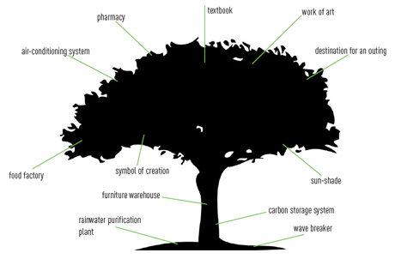
Ecosystem services
Notes:
What’s the largest multinational of Europe?
There is no other that produces so much food, provides us with so many services and products and offers so many jobs.
…it’s NATURE!
(Gerben Jan Gerbrandy, MEP, 2012)

Slide 6
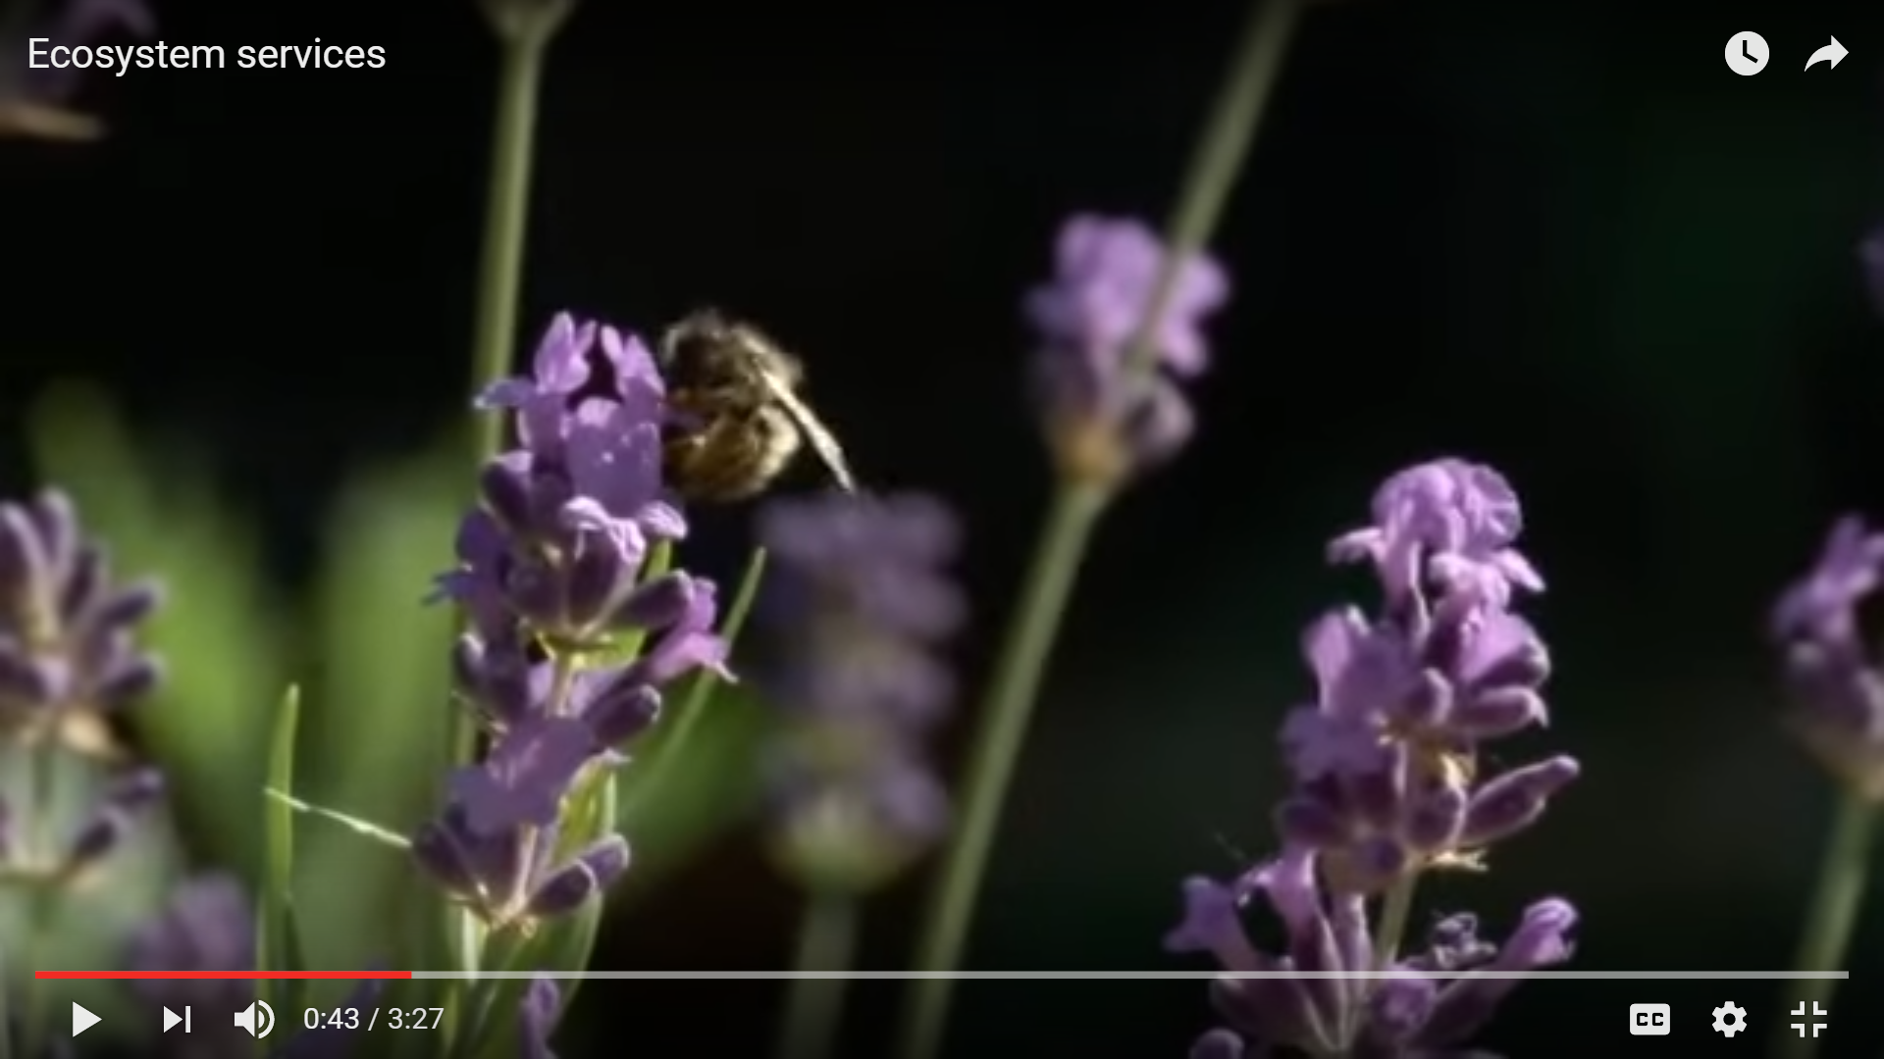
Ecosystem services
https://www.youtube.com/watch?v=wMIUglBligI

Slide 7
Cost of environmental degradation
Climate change is estimated to:
  cost 5%-20% of global GDP (Stern Review)
  slash up to 9% of the South Asian economy annually by the end of this century if the world continues on its current fossil-fuel intensive path (ADB)
Proactive measures are more effective:
  reducing greenhouse gas emissions to avoid worst impacts of climate change could be limited to 1% of global GDP each year (Stern Review)

Slide 8
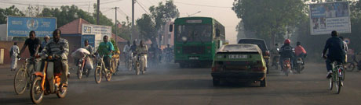
Cost of environmental degradation
Effects of air-pollution (WHO, 2015):
  Approximately 776,000 premature deaths in the WHO African Region in 2012
  Cost of air pollution in African cities can be as high as 2.6% of GDP
Indoor air-pollution
Ouagadougou, Burkina Faso
Notes:
US$ 1.6 trillion is the economic cost of the approximate 600 000 premature deaths and of the diseases caused by air pollution in the WHO European Region in 2010, according to the first-ever study of these costs conducted for the Region. The amount is nearly equivalent to one tenth of the gross domestic product (GDP) of the entire European Union in 2013.
Source: WHO (2015) Economic cost of the health impact of air pollution in Europe: Clean air, health and wealth.
In the African Region urban air pollution data remains very sparse, however available data revealed particulate matter (PM) levels above the median. The database now contains PM measurements for more than twice as many cities than previous versions.
Recent data from the World Health Organization (WHO) show that four of the world’s 20 worst-ranked cities for air quality are in Nigeria (at least among cities of more than 100,000 inhabitants that monitor their air quality).
Main causes of air pollution in Africa:
-urbanization
-motorization
-economic activity
-use of wood and charcoal for energy
-open burning including vegetation fires and waste burning
In some African countries simply preparing a meal is a major risk to health because of indoor air pollution. Source: WHO (2014) Indoor Air Quality Guidelines: Household Fuel Combustion, Geneva http://www.who.int/indoorair/guidelines/hhfc/IAQ_HHFC_guidelines.pdf?ua=1&ua=1
WHO estimates 176,000 deaths per year in Africa due to outdoor air pollution and 600,000 deaths per year from household air pollution. Source: The Acute Respiratory Infections Atlas, First Edition.
About €1.4 Trillion cost the deaths & diseases caused by air pollution in the WHO European region in 2010 – almost 1/10 of EU2013 GDP.
Approximately 600,000 premature deaths in the WHO European Region in 2010

Slide 9
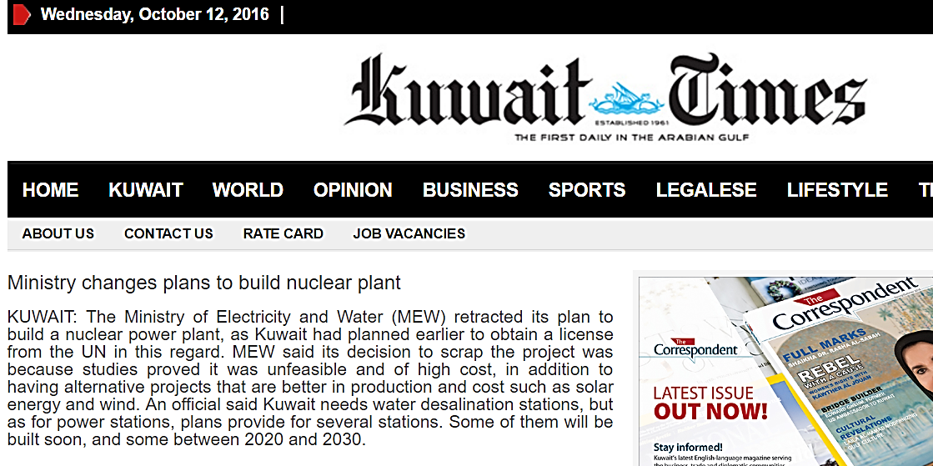
The Business Case for an Inclusive Green Economy
New investment opportunities
Global market in low-carbon and energy efficient technologies projected to nearly triple to US$ 2.2 trillion by 2020 (UNEP)
By 2013 the global market for organic agriculture products reached US$ 72 billion (FiBL and IFOAM, 2015)
Kuwait signs $385 mn solar energy project
September 10, 2015
EXAMPLE:
Renewable Energy Sources generating electricity at prices competitive to those of coal and natural gas units
Notes:
4 out of 5 SMEs in Africa have no access to finance (IFC 2011); the introduction of green financing products can change this ratio.
Kuwait signed a contract worth 116 million dinars ($385 million) with Spain's TSK Group on Thursday 8 Sep 2016, for a 50 megawatt solar energy project as part of its renewable energy drive. Read more at: http://phys.org/news/2015-09-kuwait-mn-solar-energy.html#jCp
“Even though alternative energy is increasingly cost-competitive and storage technology holds great promise (see our study on its first storage costs assessment) alternative energy systems alone will not be capable of meeting the baseload generation needs of a developed economy for the foreseeable future. Therefore, the optimal solution for many regions of the world is to use complementary traditional and alternative energy resources in a diversified generation fleet.” Lazard (2015)

Slide 10
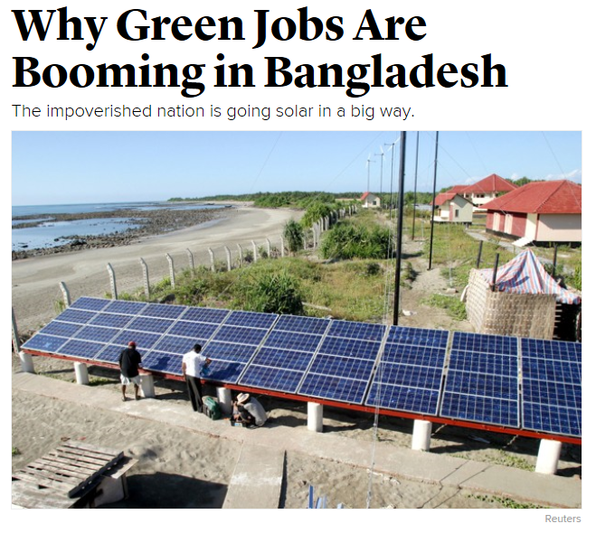
The Business Case for an Inclusive Green Economy
Green investments:
  Potential for net job creation, income generation and poverty reduction
  In rural Bangladesh, selling, installing and maintaining small photovoltaic panels provides direct livelihoods for about 70,000 people, and 150,000 are employed directly and indirectly (REN21, 2013)

Slide 11
The Business Case for an Inclusive Green Economy
Regional economic opportunities
  Large parts of Sub-Saharan Africa still without access to modern energy
  Economic transformation and growth requires significant energy resources and electricity generation
  Africa has untapped potential sources of renewable energy (incl. solar energy, biomass and wind energy), thus significant potential for green growth and jobs creation in the transition to an inclusive green economy
Notes:
An important economic opportunity for GE arises from the fact that (i) a large share of the population in Sub-Saharan Africa is still without access to modern energy and (ii) an economic transformation and the economic growth necessary to lift countries out of poverty will require important energy resources and electricity generation. A large part of the population in African countries do not have access to electricity. The African continent has enormous untapped potential sources of renewable energy, including solar energy, biomass and wind energy that incur few opportunity costs and entail huge potential for job creation, economic development and long-term energy security.
Sources:
- GIZ (2013) Green Economy in Sub-Saharan Africa: Lessons from Benin, Ethiopia, Ghana, Namibia and Nigeria
Human Development Report, 2010, http://hdr.undp.org/es/estadisticaseconomic
Keynote address by Meles Zenawi on Green Economy and Structural Transformation in Africa, October 2011, www.uneca.org/aec/2011/updates/Speech%20by%20HE%20Meles%20Zenawi.pdf

Slide 12
The Business Case for an Inclusive Green Economy
Inclusive green economy added value in Africa – few examples (UNEP, 2014):
  Kenya GDP growth projected to be 12% higher by 2030 under a GE scenario compared to a BAU scenario
  In the energy sector, investments in expanding solar and wind capacity in Senegal are projected to create up to 30,000 additional jobs by 2035
Notes:
Evidence from a range of green economy assessments carried out by UNEP demonstrate that redirecting investments to energy and resource efficiency can drive growth and produce gains that are higher than a business-as-usual (BAU) scenario.
Sources:
UNEP (2015), Building Inclusive Green Economies in Africa, Experience and Lessons Learned 2010-2015, 50 pages.
UNEP (2014), Green Economy Assessment Report – Kenya.
GE Assessment reports for Kenya, Burkina Faso and Senegal available at: http://web.unep.org/greeneconomy/resources/publication

Slide 13
Discussion Points
Are the presented key global and regional environmental challenges clear and evident?
Who bears the cost of inaction in addressing environmental degradation?
What does the shift to an inclusive green economy mean for the current approach to growth and development? What are the challenges and opportunities for society, business and governance centres?

