Slide 1
Inclusive Green Economy:
Seizing new opportunities to generate growth, create jobs and help reduce poverty
A DEVCO Training Course
Notes:
1

Slide 2
Understanding Inclusive Green Economy
Module 2:

Slide 3
Objectives of Module 2:
Define inclusive green economy: Introduce concepts and highlight key principles and processes of an inclusive green transformation
Consider inclusive green economy approaches by developing countries and understand the transition process in the context of development cooperation

Slide 4
What is an Inclusive Green Economy?

Slide 5
Inclusive Green Economy:
A pathway to Sustainable Development
Economic
Development
Inclusive
Growth
Green
Growth
Social
Development
Environmental
Sustainability
An inclusive green economy that can reduce poverty and inequality and sustain growth for all
Adapted graph based on UNDP (2013)
Notes:
The inclusive green economy is a pathway to sustainable development.

Slide 6

EC Perspective
“An economy that can secure growth and development, while at the same time improving human well-being, providing decent jobs, reducing inequalities, tackling poverty and preserving the natural capital upon which we all depend.”
Commission Communication “Rio+20: towards the green economy and better governance’’ COM (2011) 363 adopted on 20 June 2011
Notes:
ILO definition emphasises on the need for comprehensive, long-term perspective of sustainability, with a particular focus on social aspects: An economy that
promotes economic growth, environmental sustainability and social inclusion
includes greening of the entire economy, long-term objectives of sustainable development, and promotion of social justice and decent work
includes broader dimensions of energy and resource efficiency, poverty eradication, social equity, and human wellbeing

Slide 7




More definitions – similar perspective
Social equity and ecological risk reduction
Social inclusion / justice and decent work
Natural assets ➔ resources & services
Prosperity for all within one planet limits
Notes:
UNEP 2011: “A green economy is one that… results in improved human well-being and social equity,
while significantly reducing environmental risks and ecological scarcity.”
ILO definition emphasises on the need for comprehensive, long-term perspective of sustainability, with a particular focus on social aspects: An economy that
promotes economic growth, environmental sustainability and social inclusion
includes greening of the entire economy, long-term objectives of sustainable development, and promotion of social justice and decent work
includes broader dimensions of energy and resource efficiency, poverty eradication, social equity, and human wellbeing
OECD: Green growth means fostering economic growth and development, while ensuring that natural assets continue to provide the resources and environmental services on which our well-being relies.
GEC: An economy that provides a better quality of life for all within the ecological limits of the planet.

Slide 8
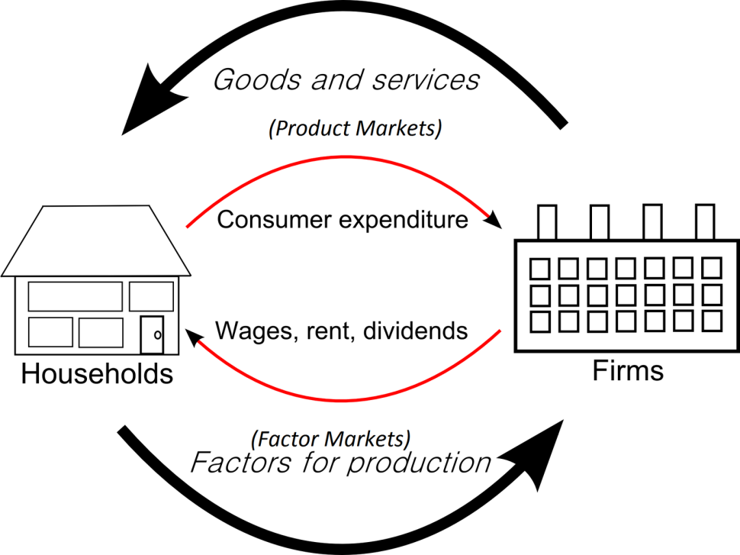
Circular flow on income
Inclusive Green Economy as an economic model
Traditional vs Green economics
Environmental and social externalities ≠ GDP growth
Ecosystems ➔ economy’s building block
Resource efficiency
Human development
Long term economic growth
Biosphere
Waste
Pollution
Resources
Ecosystem services
Biosphere

Slide 9
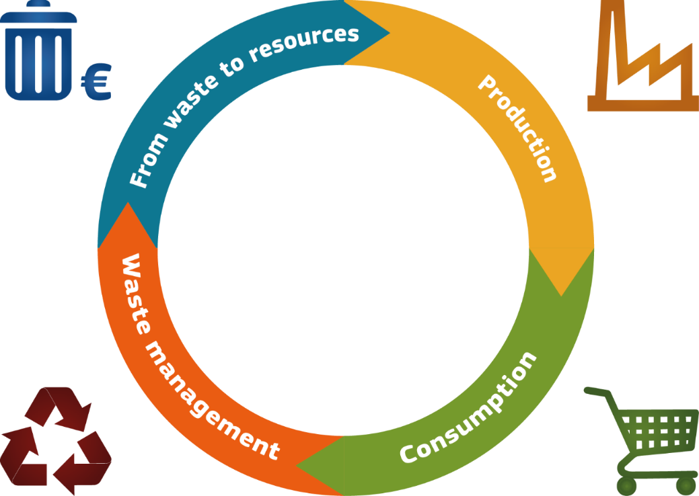
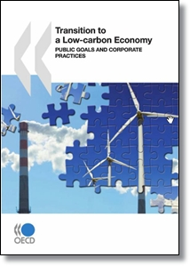
Circular Economy
Related economic models
Source: DG Environment
Low-carbon Economy
Notes:
Reduces the consumption of resources and the generation of wastes
Reuses and recycles wastes throughout the production, distribution and consumption processes.
Resonates with the “3R” concept signalling a waste mitigation hierarchy
LCE: “achieving high energy efficiency, using clean and renewable energy, and pursuing green GDP via technological innovation, while maintaining the same levels of energy security, electricity supply and economic growth”

Slide 10
Inclusive Green Economy processes
Green Economy
Sustainable development
ApproachesTools
1. Greening the brown economy
2. Growing the green economy
Safeguarding
Reduce, Reuse, Recycle
Slow down environmental destruction
“cradle to grave”
Opportunities
Innovative business models
Address environmental concerns
from initial stages of product design
Eliminate environmental destruction
“cradle to cradle”
Adapted from C.Pasca Palmer: Growing the green economy in transitioning economies (CIERP, Tufts University (USA), 2009)
Notes:
A pathway to sustainable development:
- “Greening the grown (brown)” economy: addressing the environmental impacts of polluting sectors at all stages of products life cycle
- “Growing the green” economy: changing the way we produce and consume, by developing industries and services that do not generate waste and pollution

Slide 11
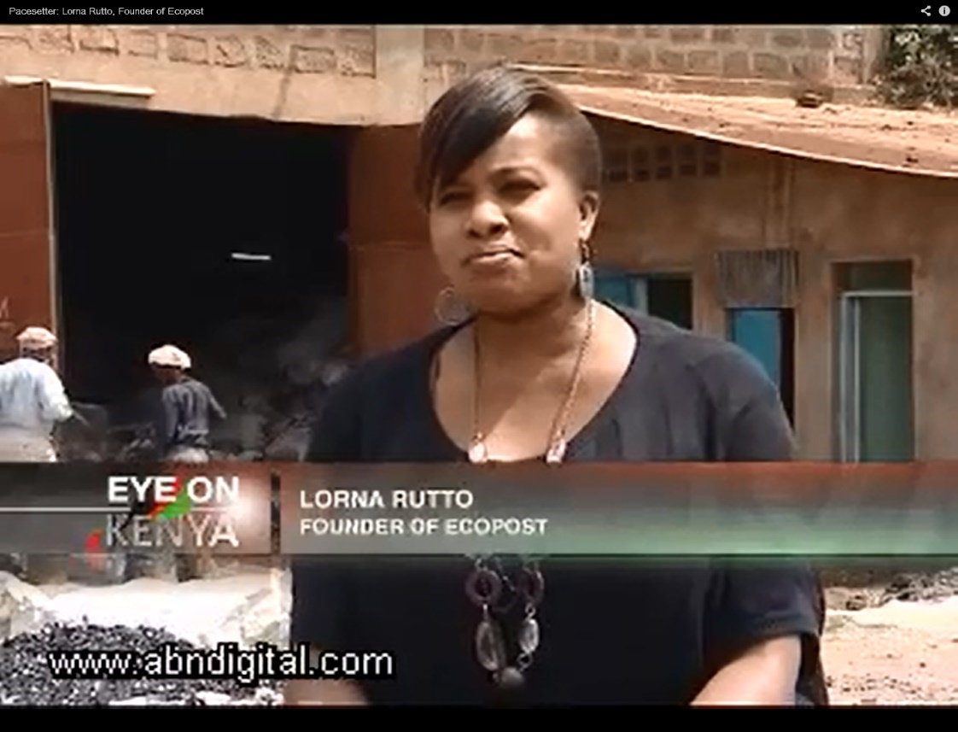
Inclusive Green Economy Entrepreneurship on the Ground
https://www.youtube.com/watch?v=0wFbo8pGNw8
Notes:
Move to later in the presentation

Slide 12
Developing Country Perspectives

Slide 13
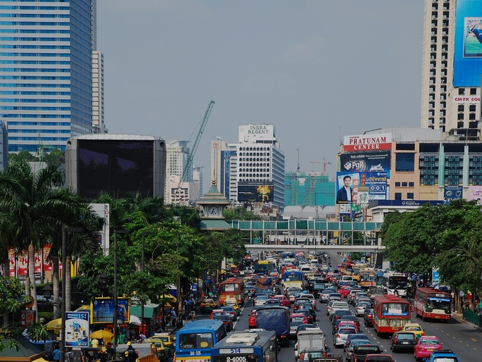
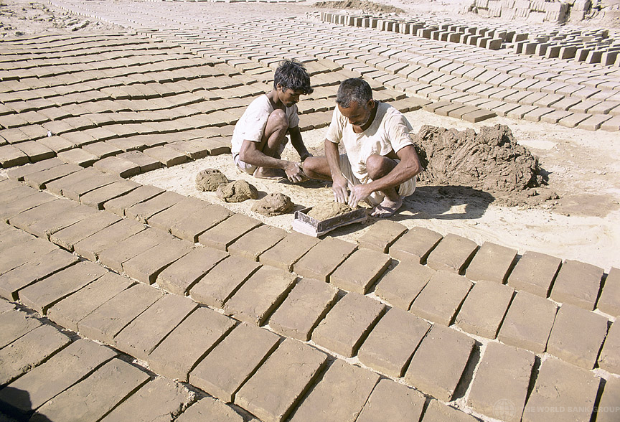
Challenges towards inclusive green economy can be global…
…but also local!
Notes:
The green economy transformation is being increasingly recognised as an urgent need for developed economies, but at the same time, is at least as important for developing countries, with the latter facing the same necessity to improve the environmental sustainability of their economy and mitigate the economic costs of further environmental degradation, which, if unaddressed, could lock them further into poverty. At the same time, more efficient resource use and presence on the rapidly growing global environmental goods and services market are important for developing countries’ competitiveness and growth. Source: DEVCO Reference document
Global material productivity has declined since the beginning of the millennium, following a large shift of economic activity to less material-efficient economies, such as those of China, India and South East Asia, resulting in growing average environmental pressure per unit of economic activity. See UNEP (2016), “Global material flows and resource productivity”, Summary for Policymakers, pp. 19 and 26-27.

Slide 14
Making Inclusive Green Economy Work for the Poor
Entry points:
  Low carbon, organic sustainable agriculture
  Improved off-grid green energy sources
  Fiscal mechanisms to foster pro-poor environmental change
  Poverty reduction through greening the tourism sector
  …
(Based on the Poverty-Environment Partnership 2013)
Notes:
The identification of realistic preliminary measures, or “entry points”, that do not entail costly investments or which are based on affordable –yet efficient- practices or technologies is particularly important for developing countries. This includes, for example, the redirection of subsidies allocated to non-productive or polluting activities into environment friendly alternatives, the promotion of sustainable farming methods, or changes to the legal framework in order to facilitate investments in areas such as decentralised renewable energy production.

Slide 15
Inclusive Green Economy transition options
Related with country objectives
Based on national context, such as:
  country comparative advantages,
  structure of the economy
  Access to natural and/or financial resources
No “one-size-fits-all” solutions
Notes:
There is no standard pathway towards a green economy and the transformation process cannot be the same for all. Countries adopting measures to transform their economy may have different objectives which are often mutually reinforcing, such as securing long term benefits from natural resources exploitation and conservation, improving domestic industry competitiveness, accessing new markets, creating jobs, and reducing reliance on imports of raw materials (box 4). Strategies to achieve these objectives should be tailored to national contexts and depend on many factors, such as existing or potential country comparative advantages, the structure of the economy, access to natural and/or financial resources, and ability to attract investments. For economies largely based on agriculture, as in many developing countries, measures related to water efficiency and resilience to climate change are essential, to secure growth in the sector while addressing environmental problems.

Slide 16
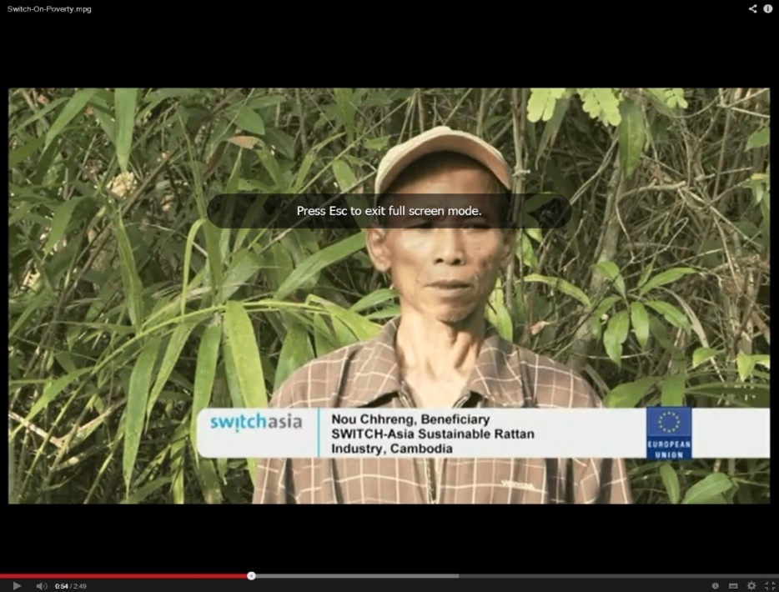
Inclusive Green Economy for the LDCs
Reliance on natural capital assets
Existence of sustainable practices ➔ Opportunity to jump start the transition
Challenge of creating links with global value chains
Large potential for renewable energies
Inclusive Green Economy and Poverty Eradication:
Sustainable Rattan in Cambodia
Notes:
In the report “Why a Green Economy Matters for the Least Developed Countries”, UNEP stresses the importance but also the opportunities for the poorest countries to transform their economy, observing that Least Developed Countries (LDCs) rely significantly on natural capital assets, on which their green economy can be based, and have a large potential for renewable energies. The report also argues that, “while other countries face sizeable economic and social costs of ‘decarbonisation’, alongside costs linked with retiring inefficient fossil fuel-based technologies, LDCs can jump start the green economy transition by maintaining and expanding the sustainable practices that already exist”. See http://www.unep.org/greeneconomy/Portals/88/documents/research_products/Why%20a%20GE%20 Matters%20for%20LDCs-final.pdf

Slide 17

Inclusive Green Economy transition:
Country examples - Ethiopia
Vision for climate resilient green economy:
  fostering growth and economic development;
  managing GHG emissions; and
  improving resilience to climate change (CC)
Initial focus on:
  CC Institutions
  Monitoring and finance systems
  Sector and regional action plans
Water and Energy implementation priorities
Notes:
Ethiopia’s Climate Resilience Green Economy (CRGE) vision: Achieve middle income status by 2025 in a climate resilient green economy.
While building its resilience, Ethiopia will also take steps to ensure that its economy is green and sustainable. To do this, we will seize the opportunities presented by low carbon technologies and invest in green industries. Evidence shows that Ethiopia’s agriculture, forestry, energy, industry and transport sectors are ripe for low carbon development. By making the right investments, Ethiopia will position itself to be competitive in a carbonconstrained global economy. Through initiatives like the Nationally Appropriate Mitigation Actions (NAMAs), we have identified some immediate priorities for international climate finance for low carbon development. The aforementioned climate action plans will be an opportunity to build on emissions abatement initiatives and mainstream green growth into Ethiopia’s regional and sectoral development plans.
Inter-ministerial endorsement, incl. the Minister of Finance and Economic Development.

Slide 18

Inclusive Green Economy transition:
Country examples - Vietnam
Green Growth strategy overall goal:
  Green growth and the low carbon economy will become the mainstream of sustainable economic development and strengthen social economic development
Major tasks:
  Green production processes and restore natural capital
  Reduce GHG intensity (per unit of GDP) and promote clean / renewable energy use
  Green lifestyle and promote sustainable consumption
Notes:
Vietnam Green Growth Strategy Targets By 2020:
the average GDP per capita will double the 2010 level, the energy consumption per capita be reduced by 1–1.5%/year, the greenhouse gas emission intensity be reduced by 10-15% compared to the 2010 level; a modern and efficient economic structure be formed, with which the value of hi-tech products an d products applying high technologies will account for about 42- 45 % in the total GDP, the aggregate aggregate productivity productivity contribute contribute about 35% to the growth;
By 2030: Vietnam will achieve the middle-income country status, develop sufficient and appropriate material, technical, human, and institutional bases for a widespread implementation of green growth methods. The total greenhouse gas emission will be reduced by 1.5-2%/year; the aggregate productivity contribute at least 50% to the growth.
By 2050: Green energy and technologies will be widely used.

Slide 19

Inclusive Green Economy transition:
Country examples - Kenya
Green Economy Strategic objectives:
  Promoting sustainable infrastructure
  Building Resilience
  Sustainable Natural Resource Management
  Promoting Resource Efficiency
  Social Inclusion and Sustainable Livelihoods
  Sector specific policy opportunities for:
  Agriculture: agroforestry, sustainable water management, etc.
  Energy: distributed clean energy solutions, etc.
  Manufacturing: eco-labelling of manufacturing products, etc.
  Transport: mass transit promotion, etc.
Notes:
Kenya Green Economy Strategy
Green economy scoping study:
Sector specific policy opportunities:
Agriculture: agroforestry, sustainable water management, improved livestock management and extension services, education, training with capacity building and research and development.
Energy: distributed clean energy solutions for households and institutions, geothermal energy, distributed renewable energy and small-scale systems connected to the grid.
Manufacturing: use of more efficient kilns for charcoal production, eco-labelling of manufacturing products and investing in cogeneration in the food-processing sub-sector.
Transport: transition of Kenya’s passenger and freight vehicle fleet with moderately recent vehicles, promote mass transit, particularly rail and public transport.

Slide 20
Key Messages of Module 2
Inclusive green economy is a realistic approach to achieve sustainable development.
Towards an inclusive green economy, challenges and opportunities for developing and developed countries are equally important, though not always similar.
There is no standard pathway towards inclusive green economy, as the transformation process needs to be adjusted to the specific context of each target area.

Slide 21
References
Commission Communication “Rio+20: towards the green economy and better governance’’ COM (2011) 363 adopted on 20 June 2011
UNDP (2013) Inclusive Green Economy Contribution to Sustainable Development Chart p.6
UNEP (2011) Towards a Green Economy: Pathways to Sustainable Development and Poverty Eradication, Report. Available at: http://www.unep.org/greeneconomy/GreenEconomyReport/tabid/29846/Default.aspx
CNBC Africa (2012) Pacesetter: Lorna Rutto, Founder of Ecopost, Video available at: https://www.youtube.com/watch?v=0wFbo8pGNw8
Green Economy Coalition (2012) Principles of an Inclusive Green Economy Transition. Available at: http://www.greeneconomycoalition.org/
UN DESA (2012) Inclusive Green Economy Principles.
UN (1987) Report of the World Commission on Environment and Development: Our Common Future. UN, New York.
RSC (2016) Regions for sustainable change. Website available at: http://www.rscproject.org/
OECD (2010) Transition to a Low-carbon Economy: public goals and corporate practices. Available at: http://www.oecd.org/corporate/mne/transitiontoalow-carboneconomy.htm
OECD (2011) Towards Green Growth. OECD, Paris.
UNESCAP (2001) Green growth approach: experiences in mainstreaming disaster risk reduction and climate change adaptation.
Chart on p.23 adapted from C.Pasca Palmer: Growing the green economy in transitioning economies (CIERP, Tufts University (USA), 2009)
SWITCH-Asia Network Facility (2010) Switch-On-Poverty.mpg. Video available at: https://www.youtube.com/watch?v=1icOCnJq394&feature=player_embedded

