Slide 1
Inclusive Green Economy:
Seizing new opportunities to generate growth, create jobs and help reduce poverty
A DEVCO Training Course
Notes:
1

Slide 2
Inclusive green economy in EU development cooperation: Key principles
Module 4:

Slide 3
Objectives of Module 4:
Introduce key principles of EU development cooperation on inclusive green economy
Highlight key EU policies and actions promoting a transition towards an inclusive green economy
Explore coherence of development cooperation actions with EU policies and domestic experience on inclusive green economy

Slide 4
Principles guiding EU actions on inclusive green economy
Promoting a green economy that is inclusive and reduces poverty
Promoting the green economy in partner countries through policy coherence
Building on EU’s domestic experience and promoting partnerships of mutual interest

Slide 5
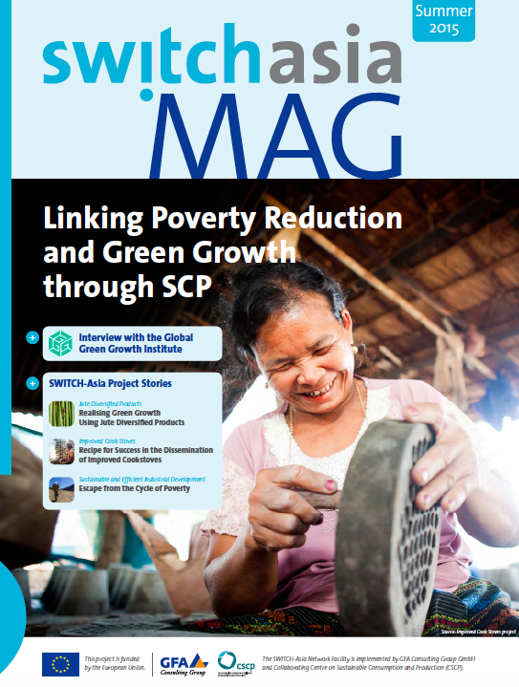
1. Promoting a green economy that is inclusive and reduces poverty
  Delivering benefits to all
  Equally distributing wealth achieved through green practices
  Green and decent job creation
  Pro-poor measures
  Social and political acceptance of required reforms
https://issuu.com/switch-asia/docs/switch-asia_mag_summer_2015_-_epape
Notes:
Promise to deliver both direct and indirect benefits to all people, including the poorest
Addressing an equal distribution of wealth achieved through green practices, e.g. productivity gains
Attention to green and decent job creation
Consideration of pro-poor measures
Encouragement of social and political acceptance of required reforms

Slide 6
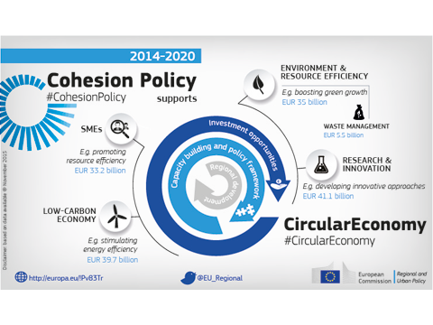
2. EU’s domestic experience and partnerships of mutual interest
      Dedicated IGE initiatives in Europe
      Partnerships among EU and partner countries organisations
      Lessons learnt from EU domestic actions
      Added value and potential for synergies
Notes:
Dedicated initiatives in Europe addressing the main areas of international action on IGE
Encouraging partnerships involving organisations from both EU and partner countries in international cooperation programmes
Identifying and promoting lessons learnt from EU domestic actions
Prioritising areas with added value and potential for synergies

Slide 7
Europe 2020 strategy
EU’s growth strategy aiming at facilitating a more competitive economy with higher employment by delivering growth that is:
  smart, with effective investments in education, research and innovation;
  sustainable, following the path to a low‑carbon economy; and
  inclusive, fostering job creation and poverty reduction
Notes:
The strategy includes 7 Flagship initiatives, with ‘A Resource Efficient Europe’ being the most relevant to Inclusive Green Economy (also relevant are ‘An industrial policy for the globalisation era’ and ‘An agenda for new skills and jobs’).

Slide 8
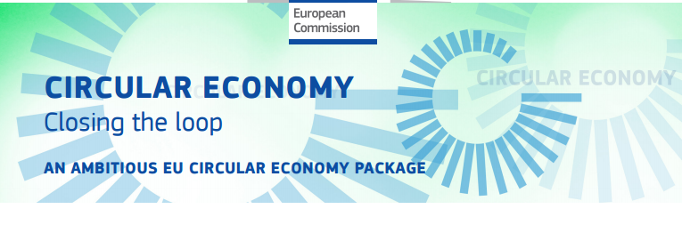
Circular economy strategy
An EU Action Plan
Key action areas:
Production
  Circular product design
  Innovative and efficient processes
  Consumption
  Products with reduced environmental impact across their lifecycle
  Innovation and Investment
  Enabling environment
  Waste management
  Alignment with EU waste hierarchy
  Addressing implementation gaps
  Long-term investments’ support
  Secondary raw materials market
  Material stocks knowledge
  Demand for secondary raw materials
  Recycled nutrients and reuse of treated wastewater
  Chemicals risk safety management
Notes:
Key action areas:
Production
Provide incentives to boost circular product design
Innovative and efficient production processes
Consumption
Allow consumers to identify products that have a reduced environmental impact throughout their lifecycle
Innovation and Investment
Create an enabling environment
Waste management
Improve waste management in line with the EU waste hierarchy
Address implementation gaps
Guide investments through long-term vision and targets
Secondary raw materials market
Knowledge of material stocks
Demand for secondary raw materials
Use of recycled nutrients and reuse of treated wastewater
Safely manage risks associated with chemicals of concern
Aims at boosting global competitiveness, fostering sustainable economic growth and generating new jobs.
EASME showcases 10 relevant projects in the following link: https://ec.europa.eu/easme/en/news/closing-loop-ground-10-eu-projects-working-towards-circular-economy
Noise protection panels made of recycled tyres
Every year, about 3.4 million tonnes of old tyres are disposed of in Europe, most being dumped or sent to landfill, in direct contravention of EU rules banning landfilling of both whole and shredded tyres. Noise is assessed as one of the main environmental problems, and traffic is one of the principle sources of noise. The RUCONBAR project has come up with a solution, using scrap tyres to make noise protection panels for busy urban roads and railway lines. Such use of recycled used tyres combats noise pollution and also helps with waste management.

Slide 9
Circular economy strategy
An EU Action Plan
Missions to non-EU countries:
Cooperation between the EU and third countries in the field of environmental policy
  signing political agreements fostering circular economy, innovative, sustainable and inclusive growth, green public procurement
  Achieve a better understanding of the environmental challenges faced by third countries
  Promote green solutions through business partnerships abroad
  matchmaking events between European and local entrepreneurs
  exchange of views with targeted audiences
  Chile, 25-26 April 2016
  China, 23-25 November 2016

Slide 10
The 7th Environment Action Programme
Living well, within the limits of our planet: enhancing Europe's ecological resilience and transforming the EU into an inclusive green economy
Three thematic priority objectives:
  Natural capital protection;
  EU shift to a resource‑efficient, green and competitive low‑carbon economy;
  EU citizens health and well-being
  Six objectives establishing an enabling framework, e.g. knowledge based policy, legislation implementation
Notes:
Overall policy umbrella. Six objectives establishing an enabling framework supporting effective action: improved implementation of legislation; EU environment policy based on increased knowledge; environment and climate policy investments secured and environmental externalities accounted for; improved environmental integration and policy coherence; EU sustainable cities; effectiveness in addressing international environmental and climate‑related challenges)

Slide 11
EU Roadmap to a Resource efficient Europe
Objectives for 2020
Action to be taken in:
  SCP
  Waste
  research and innovation
  environmentally harmful subsidies
  ecosystem services
  Biodiversity
  minerals and metals
  Water
  Air
  land and soil
  marine resources
  food and drink
  buildings
  mobility
Notes:
EU Roadmap to a Resource efficient Europe: a. http://europa.eu/rapid/press-release_MEMO-11-43_en.htm?locale=en (see part B showing concrete examples from EU MS); b. LIFE Programme (http://ec.europa.eu/environment/life/project/Projects/index.cfm) ENVIRONMENT strand

Slide 12
EU Roadmap to a Low-carbon economy
Incremental targets until 2050 on greenhouse gas (GHG) emissions
Cost‑effective path to a Competitive Low‑Carbon Economy
Crucial factors for a successful transition:
  Power generation
  Industry
  Transport
  Buildings and Construction
  Agriculture
Notes:
ENERGY 21: the Upper Austrian Energy Concept
The Energy 21 strategy focussed on four main areas of intervention: (i) improving EE; (ii) increasing the use of RES; (iii) relying on hydro power up to defined ecological limits; and (iv) decreasing the use of fossil fuels. Intervention was guided by means of an action plan including 25 measures aimed at reaching a defined set of goals. The 25 measures addressed private households and public stakeholders as well as businesses and institutions. Measures ranged from the establishment of new forms of financing for the implementation of EE interventions, to the improvement of heating technologies, the setting of energy requirements for renovated or new buildings, the inclusion of energy indicators in public building-related procurement, the consideration of external costs in the investment decision-making process, the introduction/strengthening of energy accounting, and the provision of advice to local authorities on energy planning. The latter was translated into the ‘Energy concept for municipalities’ (E-GEM) programme where the development and implementation of ‘local energy concepts’ around some main objectives was supported, including in financial terms (i.e. up to 20,000 EUR per application). Other measures of Energy 21 directly tackled the increased use of RES, the generation of electricity from RES, Combined Heat and Power (CHP), and heat production from waste. Further, they pointed to the support of energy-related research; the support of the energy industry in terms of advice, funding and development and use of eco-efficient technologies and eco-designs; the establishment of voluntary agreements and of benchmarking; and the creation of the Oekoenergie-Cluster.

Slide 13
EU Energy Roadmap 2050
A strategy for the energy system to balance between :
  greenhouse reduction targets and
  the need to increase competitiveness and security of supply, building possible scenarios for 2050.
Focus on four key aspects:
  energy efficiency
  renewable energy
  nuclear energy
  carbon capture and storage
Notes:
The Model City Mannheim project in Germany (http://www.advancedfp7.eu/Home/AD-Projects-Map/Model-City-Mannheim)
The first Smart City in Germany has been established in Mannheim (MOMA), one of 6 model regions undertaken in the E-Energy project where a calculated balance of the local supply (including renewables and decentralized energy) against local consumption is being facilitated through ICT technology and smart grid and flexible demand management to increase energy efficiency. Every household in the city has been successfully connected to a smart energy network that is based on a cellular grid infrastructure. Within this concept are 3 levels: the first is the object grid cell, including buildings and real estate that contain a smart meter and Energybutler (connects household appliances and monitors the grid to obtain real-time pricing in 1,000 households); the second is the distribution grid cell, where 1 or more transformer stations are connected to buildings and the network with broadband communications via the already existing transmission lines; and, the third is the system cell, which provides the central control and data collection at the highest level through an alpha core platform. If parts of the infrastructure break down, other parts will not be affected in this cellular architecture. Variable energy tariffs have been introduced to reflect the actual energy price and the capacity of the grid that allows for smooth renewables integration and more efficient energy consumption responses through transparent pricing to consumers. In this project, energy use is being shifted to off peak periods and issues of energy storage and long-distance transmission regarding renewables are being addressed with local solutions to relieve stress on the grid.

Slide 14
3. Ensuring EU policy coherence to promote IGE in partner countries
    EU as a Trade or Investment partner
    EU requirements or incentives
    Effects of EU policies on partner countries
    Policy dialogue
http://ec.europa.eu/trade/policy/countries-and-regions/development/
Notes:
EU as a Trade or Investment partner (Free Trade Agreements, Economic Partnership Agreements, Aid for Trade)
EU requirements or incentives
Effects of EU policies on partner countries
Policy dialogue: Using trade and cooperation in a complementary way, seizing opportunities to develop synergies with public institutions and the business community
Policy Coherence for Development (PCD) is not only about identifying and mitigating possible negative impact of the EU's policies on developing countries, but also about identifying their positive impacts, which can influence transformation processes in EU partner countries, for example, the path towards an inclusive green economy. Synergies with EU policies on, for example, green public procurement, CSR -taking note of EU objective to promote respect for internationally recognized CSR principles- or trade, are important in this regard.
COM (2011) 681: Communication from the Commission “A renewed EU strategy 2011-14 for Corporate Social Responsibility”
AID FOR TRADE
Assistance to support developing countries’ efforts to expand their trade as leverage for growth and poverty reduction:
Part of the Official Development Aid
Six areas of focus: trade policy and regulation; trade development; trade-related infrastructure; building productive capacity; trade-related adjustment; and other trade-related needs
Inclusive green economy opportunities from trading with EU and from other consumer markets

Slide 15
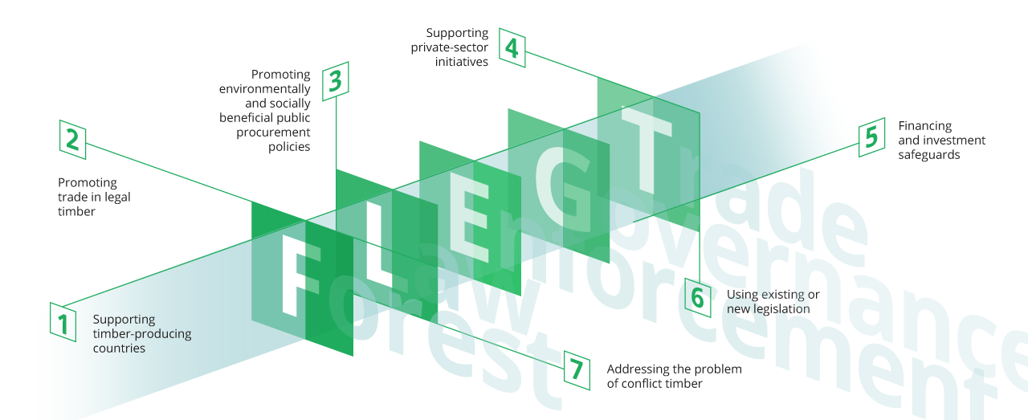
EU Policy Coherence – An example
  EU Cooperation with timber producing countries (FLEGT)
    Linking development cooperation, environment & trade policies, and actions within & outside the EU
Notes:
FLEGT is a good example of policy coherence. Its innovative design binds together, in a mutually supportive manner, development cooperation, environment and trade policies and actions within and outside the EU. It is in line with EU policies on sustainable development, environmental protection, climate change and promotion of fair trade.

Slide 16
Key Messages of Module 4
EU development cooperation on inclusive green economy is steered by clear principles:
  ensure inclusiveness and poverty reduction;
  build on EU domestic experience; and
  ensure EU policy coherence
Key areas of international cooperation on inclusive green economy are also the focus of dedicated EU domestic initiatives, hence the potential for synergies is significant

Slide 17
References
DG DEVCO, Policy Coherence for Development (PCD), information available at: https://ec.europa.eu/europeaid/policies/policy-coherence-development_en
WTO, Aid for Trade, website available at: https://www.wto.org/english/tratop_e/devel_e/a4t_e/aid4trade_e.htm
FLEGT (Forest Law Enforcement, Governance and Trade). Website available at: http://www.euflegt.efi.int/home
European Commission (2010) Europe 2020: A strategy for smart, sustainable and inclusive growth, Communication
European Commission (2011) A resource-efficient Europe – Flagship initiative under the Europe 2020 Strategy, Communication
European Commission (2011) A Roadmap for moving to a competitive low carbon economy in 2050, Communication - COM(2011) 112 final
European Commission (2011) Energy roadmap 2050, Communication - COM(2011) 885 final
Decision No 1386/2013/EU of the European Parliament and of the Council of 20 November 2013 on a General Union Environment Action Programme to 2020 ‘Living well, within the limits of our planet’ (7th Environment Action Programme)
European Commission (2014) Commission Implementing Decision adopting a Multiannual Indicative Programme for the Thematic Programme 'Global Public Goods and Challenges' for the period 2014-2020 - C(2014)5072

