Slide 1
Inclusive Green Economy:
Seizing new opportunities to generate growth, create jobs and help reduce poverty
A DEVCO Training Course
Notes:
1

Slide 2
International cooperation for an inclusive green economy – The SWITCH to Green Initiative
Module 7:

Slide 3
Objectives of Module 7:
Highlight EU and international initiatives promoting green economy, notably the EU SWITCH to Green Flagship Initiative
Outline initial observations and discussion points of the evaluation of EU development cooperation on SCP
Facilitate the selection of appropriate indicators for programme and project monitoring
Explain opportunities to benefit from Technical Assistance on inclusive green economy issues

Slide 4
EU development cooperation initiatives promoting an inclusive green economy

Slide 5
The EU SWITCH to Green Initiative
Coordination
Strategy
Technical Assistance: S2Green Facility
Notes:
IGE programmes under one umbrella initiative
DEVCO strategy paper
TA provided by DEVCO and the S2Green Facility
The Commission will use existing tools and coordination fora to raise awareness and promote dialogue on green economy. The SWITCH TO GREEN flagship initiative entails closer coordination among relevant services of the Commission, including units dealing with relevant sectors of EU international cooperation and development as well as services in charge of EU policy in other fields, such as entrepreneurship and SMEs, research or environment. This coordination should contribute to a better integration of the green economy in the EU's international cooperation and development portfolio. It should also support better synergies with EU's domestic policies, which lessons can contribute to the programming of international cooperation activities. – Source: DEVCO Reference document

Slide 6
Overview of the IGE portfolio managed by DEVCO (HQs)
On-going projects (2007-13 financial framework)
  SWITCH Africa Green (ENRTP)
  Green economy and social and environmental entrepreneurship in Africa
  Actions under the EU-UNEP Strategic Cooperation Agreement, resource efficiency & green economy priority
  SWITCH Asia (RSP 2007-2013)
  SWITCH Med
  EAP Green
Notes:
The Commission will use existing tools and coordination fora to raise awareness and promote dialogue on green economy. The SWITCH TO GREEN flagship initiative entails closer coordination among relevant services of the Commission, including units dealing with relevant sectors of EU international cooperation and development as well as services in charge of EU policy in other fields, such as entrepreneurship and SMEs, research or environment. This coordination should contribute to a better integration of the green economy in the EU's international cooperation and development portfolio. It should also support better synergies with EU's domestic policies, which lessons can contribute to the programming of international cooperation activities. – Source: DEVCO Reference document

Slide 7
Overview of the IGE portfolio managed by DEVCO (HQs)
On-going projects (2014-20 financial framework)
  SWITCH to GREEN facility (GPGC)
  Partnership for Action on Green Economy (GPGC)
  Green Economy Coalition (GPGC)
Future Actions (Indicative)
  Asia MIP 2014-20, green economy sector
  GPGC MIP 2014-20, green economy priority
Notes:
The Commission will use existing tools and coordination fora to raise awareness and promote dialogue on green economy. The SWITCH TO GREEN flagship initiative entails closer coordination among relevant services of the Commission, including units dealing with relevant sectors of EU international cooperation and development as well as services in charge of EU policy in other fields, such as entrepreneurship and SMEs, research or environment. This coordination should contribute to a better integration of the green economy in the EU's international cooperation and development portfolio. It should also support better synergies with EU's domestic policies, which lessons can contribute to the programming of international cooperation activities. – Source: DEVCO Reference document

Slide 8



The SWITCH regional programmes
Asia:
  encourage sustainable growth to reduce poverty and environmental impact from consumers and industries
Med:
  support & connect stakeholders to scale-up social- and eco- innovations, facilitating the shift towards SCP
Africa Green:
  support six countries in Africa towards a private sector-led inclusive green economy, based on SCP patterns
Notes:
SWITCH-Asia entails the promotion of sustainable processes, products, services and consumption behaviour in Asia, using an approach that improves cooperation with European retailers, producer and consumer organisations, and the public sector. The main focus is on supporting the effective implementation of enforcement of (in most cases already existing) SCP policies and legislation. The programme specifically targets small and medium enterprises (SMEs) as these are a major source of unsustainable resource use and pollution in Asia. It includes three strategic components, as follows:
SWITCH-Asia Grant Projects
SWITCH-Asia Network Facility (NF)
SWITCH-Asia Policy Support Components (PSC)
SwitchMed supports industry, emerging green entrepreneurs, civil society and policy makers through policy development, demonstration activities and networking. Main pillars of action include:
The SWITCH-Med Action Network: a community of stakeholders linking similar initiatives and networks, exchanging information, and scaling social- and eco- innovations.
Training green business entrepreneurs and start-ups, empowering grassroots innovations, and providing capacity building for sustainable industry providers.
Engaging with policymakers to establish a regulatory and policy framework to drive the sustainable products and services market.
SWITCH Africa Green supports six countries in Africa (Burkina Faso, Ghana, Kenya, Mauritius, South Africa and Uganda) to enter a sustainable development transition process, towards a private sector-led inclusive green economy, based on sustainable consumption and production patterns. The initiative intends to:
Support policy makers (Policy component) to be better informed and equipped with relevant scientific information and appropriate tools and instruments, such as policies, regulatory frameworks, incentives structures, tax- and market- based instruments that promote private sector led inclusive green growth.
Support private sector (Grants / Eco-entrepreneurship component) in identifying opportunities for green business development and markets (domestic and export) for sustainably produced goods and services.
Facilitate knowledge development and dissemination (Networking component), including lessons learned and good practices from the projects nationally and through regional and Africa-wide networks and programmes to create broader awareness, and increase understanding, buy-in and uptake of Green Economy and Sustainable Consumption and Production ideas among key stakeholders in private sector, governments and the public

Slide 9
Greening Economies in the EU’s Eastern Neighbourhood (EaP Green)
Aims at:
  ‌Mainstreaming SCP into national development plans, legislation and regulatory framework;
  ‌Promoting the use of the Strategic Environmental Assessment (SEA) and Environmental Impact Assessment (EIA) as essential planning tools; and
  ‌Facilitating the greening of selected economic sectors (manufacturing, agriculture, food production and processing, construction)
Notes:
The EaP GREEN programme supports six countries of the EU Eastern Neighbourhood Partnership (Armenia, Azerbaijan, Belarus, Georgia, Moldova and Ukraine) to progress faster on their path to green growth. EaP GREEN responds to commitments made by countries, the European Union and other partners in major international forums including the Rio+20 Earth Summit such as the goal of sustainable development and the transition to a green economy. This involves pursuing growth that is environmentally sustainable, with a view to decoupling economic growth from environmental degradation, thus resulting in higher productivity and competitiveness, better natural capital management, enhanced environmental quality of life, and more resilient economies. EaP Green programme objectives are:
‌Mainstreaming SCP into national development plans, legislation and regulatory framework so that sound incentives are provided for development in line with policy commitments and good international practices, including those encouraged in the EU;
‌Promoting the use of the Strategic Environmental Assessment (SEA) and Environmental Impact Assessment (EIA) as essential planning tools for an environmentally sustainable economic development; and
‌Facilitating the greening of selected economic sectors (manufacturing, agriculture, food production and processing, construction).

Slide 10













Other relevant Initiatives
A gateway to inclusive green economy through the S2Green website

Slide 11
Evaluation of EU development cooperation on SCP: Preliminary observations and discussion points

Slide 12
Impact of
SCP Programme Components

Slide 13
Discussion Points
Context and political conditions for cooperation on Green Economy – impact and how to mitigate?
Private Sector, Multiplication and Scaling Up: how to convince businesses of potential benefits of SCP, scale up private investments?
Need to establish greater links between EU global (e.g. PAGE), SWITCH regional programmes, and geographic (national level) instruments, as well as links to other (non-EU) initiatives – how?

Slide 14
Measuring Progress towards an Inclusive Green Economy

Slide 15
Rio+20 Outcome Document on Broader Measures of Progress
“We recognize the need for broader measures of progress to complement gross domestic product in order to better inform policy decisions…”
Rio+20 Outcome Document, Para 38
From GDP to Systems of Environmental Economic Accounts (UN / EUROSTAT)
Notes:
Economic performance of countries generally being measured through GDP (Gross Domestic Product)
GDP = market value of all officially recognized final goods and services produced within a country in a given period of time
GDP does not account for natural capital and social/human capital
Initiatives to move to beyond GDP
United Nations System on Environmental and Economic Accounting (SEEA)
Wealth Accounting and the Valuation of Ecosystem Services WAVES partnership
EU Beyond GDP initiative

Slide 16
Reporting on SDG Targets
Annual progress reporting on the SDGs
Based on global & regional data aggregates by national statistical systems
Efforts made to fill data gaps & improve international comparability by:
  adopting international standards at national level,
  strengthening national statistical capacity
  improving reporting mechanisms
Notes:
Global monitoring based on comparable and standardized national data (to the greatest possible extent)

Slide 17
SDG Indicators: SCP - Goal 12
Goals and Targets | Indicators
12.1 Implement the 10-Year Framework of Programmes on Sustainable Consumption and Production Patterns, all countries taking action, with developed countries taking the lead, taking into account the development and capabilities of developing countries | 12.1.1 Number of countries with sustainable consumption and production (SCP) national action plans or SCP mainstreamed as a priority or target into national policies
12.5 By 2030, substantially reduce waste generation through prevention, reduction, recycling and reuse | 12.5.1 National recycling rate, tons of material recycled
12.7 Promote public procurement practices that are sustainable, in accordance with national policies and priorities | 12.7.1 Number of countries implementing sustainable public procurement policies and action plans

Slide 18
EU Results Framework for Development cooperation
Reporting on results aggregated from projects and programmes managed by DEVCO
# | Sector | Indicator Level 2 (Development Outcome and Outputs) | Associated to an SDG target (OWG proposal July 2014)? | Corresponding SDG target (OWG proposal July 2014) | Associated to an MDG | Used by other donors in 2013 Frameworks
25 | Natural Resources, Environment and Climate Change | Number of Micro, Small and Medium Enterprises (MSMEs) applying Sustainable Consumption and Production practices with EU support | Partly matches 12.6 | 12.6 Encourage companies, especially large & transnational companies, to adopt sustainable practices and to integrate sustainability information into their reporting cycle | No | No
Notes:
Global monitoring based on comparable and standardized national data (to the greatest possible extent)

Slide 19
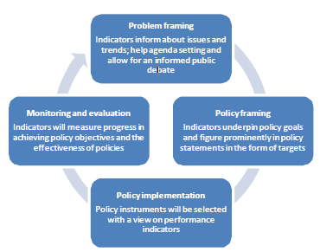
Inclusive Green Economy Indicators for Policy Framing
National indicator set for SCP, RE and IGE:
  headline indicators: justifying policy initiatives
  sector-indicators: guiding policy programs within those sectors
Notes:
A national indicator set for SCP, RE and IGE will need to include headline indicators to justify policy initiatives, as well as more detailed sectoral indicators to guide policy programs in those sectors

Slide 20
Natural Resource Use
Feasibility: well developed and easy to implement at national level
Data availability: national databases, statistics, and green accounting
Policy use: important evidence base for dematerialization and decoupling policies
Total amount of natural resource use, and per capita
Materials and Waste: Domestic Material Consumption (DMC) (tonnes; tonnes/capita)
Energy and Emissions: Total Primary Energy Supply (TPES) (joule; joule/capita), Greenhouse Gas Emissions (GHG) (tonnes; tonnes/capita), air pollution (tonnes; tonnes/capita)
Water: Total Water Use (m³; m³/capita)
Land: Land use and land use change (ha; ha per capita)
Source: UNEP (2013) http://www.switch-asia.eu/

Slide 21
Resource Productivity
Feasibility: combined measure of economic activity & natural resource use
Data availability: based on natural resource use indicators and a measure of economic activity
Policy use: provides information about relative decoupling
Economic output (GDP) per unit of natural resource input
Material productivity: GDP/DMC ($ per tonne)
Energy productivity: GDP/TPES ($ per joule)
GHG emission productivity: GDP/GHG ($/tonne)
Land productivity: GDP/land use ($ per ha or km2)
Water productivity: GDP/water use ($ per m3)
Source: UNEP (2013) http://www.switch-asia.eu/

Slide 22
Consumption
Natural Resource Footprint: Attribution of natural resource use to final consumption in a country
Material Footprint: (tonnes; tonnes/capita)
Energy Footprint: (joule; joule per capita)
Water Footprint: (m³; m³/capita)
Land Use Footprint: (ha; ha/capita)
Carbon Footprint: (tonnes; tonnes/capita)
Feasibility: indicator based on a combination of global data for natural resource use (with country detail) and a multi-regional, global input-output representation of the world economy
Data availability: based on natural resource use data & MRIO capability
Policy use: For high importing and exporting countries this will allow an ‘equal playing field’ regardless of economic structure & role in the global economy
Source: UNEP (2013) http://www.switch-asia.eu/
Notes:
MRIO: Multi Regional (sub-national) Input-Output capability

Slide 23
Guiding Principles for adapting IGE Indicators to the national context (a)
  Measurement at the national scale and for key economic activities
  The value, usability & impact of indicators needs to be demonstrated through case studies
  Focus on environmental hotspots: agriculture & food, construction & housing, transport & mobility, heavy industry, energy supply, and water & sewerage
  High level of collaboration, dialogue, transparency, and knowledge sharing among and within countries.
Source: UNEP (2013) http://www.switch-asia.eu/
Notes:
1) Decoupling of human wellbeing and environmental (and social) costs are key for
developing economies and hence indicators should measure the extent to
which decoupling is achieved at the national scale and for key economic activities.
2) Development and environment are no longer contradictory policy objectives, and
sustainable management of natural resources and environmental systems will
underpin and enable future economic development and human wellbeing. The importance of aligning economic, social and environmental goals is not always understood by the policy community and the public and hence the value, usability
and impact of SCP, GE and resource efficiency indicators needs to be demonstrated
through case studies that show how indicators and evidence have helped to change
policy directions and enabled beneficial outcomes across sustainability goals.
3) When developing indicators for a resource efficient and green economy there needs to be
a focus on common topics that are important for many countries in the region and are
of high priority for the business and policy community. For example, in Asia these topical issues include
energy efficiency, climate change mitigation, supply security of natural resources
(fossil fuels, metals), food security, water security, and pollution abatement. Trends in
these important sustainability domains need to be measured by the indicator set.
Many of the topics are also highly interlinked and hence indicators will need to enable
policymakers to address the issue of connections among resources, as well as
separate resource domains and sectors.

Slide 24
Guiding Principles for adapting IGE Indicators to the national context (b)
  Indicators will need to be understood and shared by different agencies including environment, resources, trade, finance and treasury
  Government-defined objectives and provision of resources
  Indicators developed by researchers in collaboration with national statistical offices
Source: UNEP (2013) http://www.switch-asia.eu/
Notes:
Indicators will need to be understood and shared by different agencies including environment, resources, trade, finance and treasury.
Government defined objectives and provision of resources.
Researchers will need to develop indicators and work with statistical offices to ensure the standard of information reportable by national statistical offices.

Slide 25
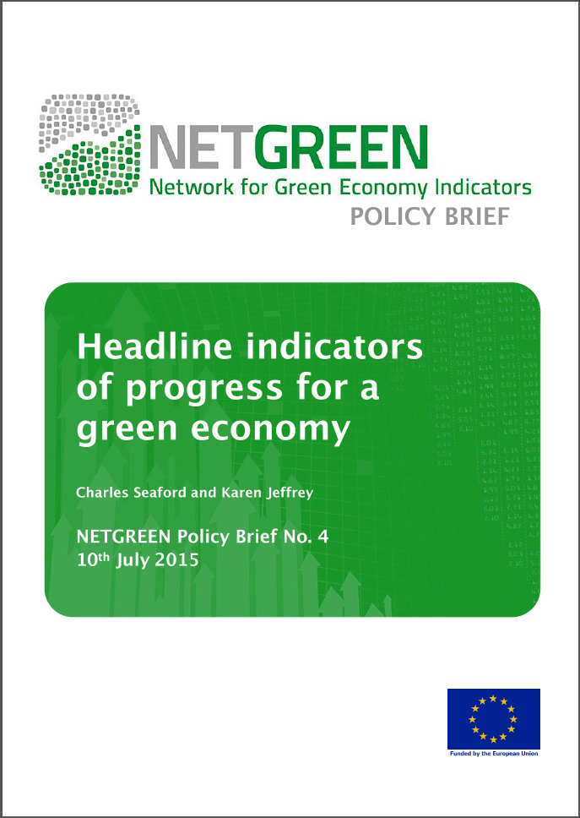
Project-level indicators
  Simple / easy-to-use indicator toolbox:
    Hotspot indicators for key sectors
    Focus on programme/project main aspects: don’t expect to address everything
http://measuring-progress.eu/
Notes:
Measuring Progress is an interactive online tool suggesting green economy indicators for policy-making. The tool was designed to help you identify and understand the best indicators to measure progress towards the green economy. It supports you in the search for the right indicators for your specific policy problem, and helps you interpret the indicators' strengths and their shortcomings.
The tool consists of a database of annotated green economy indicators which cover the five main topic areas of the green economy: environmental sustainability, social justice, quality of life, economic sustainability and resilience, and effective governance. The database currently includes more than 200 indicators from over 50 sources including Eurostat, OECD and UNStats among others.
Develop a simple IGE indicator toolbox, which only includes a small number of “hotspot” indicators, which can be applied across sectors and are easy to be identified and tracked. It is not the target to have a set of indicators that covers everything, but rather a set of indicators that shows the direction of a programme, is in line with the understanding of IGE by project partners, and includes measurements of underlying mechanisms for scaling-up. For example, if an indicator measures the number of SMEs receiving training on SCP, it should not only address the quantification of companies participating, but also if a scaling-up mechanism has been put in place. This must also be combined with indicators assessing the environmental impact of the measured activities.

Slide 26
Project-level indicators
  Identify hotspots:
    Analyse the target sector(s), focusing on Environmental concerns, Social issues and Economic aspects
    Prioritise key issues for each dimension, such as: fresh water quantity/quality; air pollution (e.g. PM₁₀, SO₂, CO₂, NOx, or other pollutant concentration); chemicals or other hazardous substances; employment level; OH&S level; and income level

Slide 27
Project-level indicators
  Identify/select key indicators:
    Specify project impact on selected priority areas, e.g. increased productivity; reduced water consumption; reduced energy consumption; reduced emissions; number of green jobs created; number of jobs with improved OH&S; increase in income / benefits
    Select headline indicators for each project impact, based on data availability & aspects related with the broader project context, e.g. need to feed into relevant programme indicators (Use the RACER concept: Relevant, Acceptable, Credible, Easy and Robust)
Notes:
RACER concept: Relevant, Acceptable, Credible, Easy and Robust

Slide 28
Project-level indicators
  Examples of headline indicators:
    Agriculture: annual savings in water consumption; reduction of chemicals (P, N, ) used per ha per yield
    Energy: annual savings in electricity consumption; reduction in annual CO₂ emissions
    Infrastructure: No of green jobs created/sustained by the project (in a given time period)
    Private sector development: number of SMEs improving economic performance in terms of turnover or earnings (EBITDA)
Notes:
Sources: SWITCH Asia Programme, EU LIFE+ Programme

Slide 29
Project-level indicators
  Define a clear rationale to interpret the indicators / Discuss the results vis-à-vis the broader context:
    Set a clear baseline / starting point
    Compare results against available local and national statistics
    Compare with similar projects (worth scaling-up?)

Slide 30
Indicators for SWITCH Africa Green: An example
 | Aspect | Indicators
IMPACT | Economy | Turnover of targeted (sub) sectors (EUR)
 |  | Investments in targeted (sub) sectors (EUR)
 |  | Contribution of targeted (sub) sectors to GDP (%)
 | Environment | Resource (e.g. energy, water, raw materials, chemicals etc.) consumption of targeted (sub) sectors (KWh/m3/tons, disaggregated per resource)
 |  | Resource efficiency of targeted (sub) sectors (resource unit/EUR)
 |  | GHG emissions of targeted (sub) sectors (tons CO₂ -equivalent)
 |  | Waste generation of targeted (sub) sectors (tons)
 |  | Recycling rate or volumes of targeted (sub) sectors (%/tons)
 | Society | Jobs in targeted (sub) sectors (units, with men / women disaggregation)

Slide 31
Indicators for SWITCH Africa Green: An example
 | Aspect | Indicators
OUTCOME | Economy | Turnover of targeted MSMEs (aggregate, EUR)
 |  | Net income of targeted MSMEs (aggregate, EUR)
 |  | Total SCP investments by targeted MSMEs (aggregate, EUR)
 |  | Average pay-back period of SCP investments at SME level (year)
 |  | Savings generated from reduced resource consumption by targeted MSMEs (disaggregated per resource, EUR)
 | Environment | Resource consumption savings by targeted MSMEs (disaggregated per resource, KWh/m3/tons)
 |  | Uptake of SCP practices by targeted MSMEs (%, disaggregated per type of SCP practice)
 | Society | Number of jobs created in targeted MSMEs (units, with men / women disaggregation)
 |  | Number of targeted MSMEs adopting H&S standards (units)

Slide 32
SWITCH to Green Facility & related support available

Slide 33
SWITCH to Green Facility
Core team of experts
K3: Communication Expert
Mrs. Isabelle Demolin
K2: Technical Expert
Mr. Jens Norgaard
K1: Team Leader
Mr. Alexander Charalambous
Additional expertise: Pool of non-key experts
Consortium Backstopping: Project Director: Thomas Ritter
www.switchtogreen.eu
Notes:
Action identification and formulation contributing to the green economy transition in partner countries
Monitoring and evaluation, as a tool to accelerate the green economy transition

Slide 34
SWITCH to Green Facility
  Technical Assistance
  Action identification and formulation: Scoping missions, support in programme Action Doc elaboration, screening of ADs
  Monitoring and evaluation: Indicator identification & selection, Evaluation of EU development cooperation support on SCP
Notes:
Action identification and formulation contributing to the green economy transition in partner countries
Monitoring and evaluation, as a tool to accelerate the green economy transition

Slide 35
SWITCH to Green Facility
  Coordination
  Policy and learning events: SWITCH to Green coordination meeting, EUDs week, meeting with EU MS
  Creation of knowledge sharing tools: IGE Gateway, incl. interactive Map
  www.switchtogreen.eu
Notes:
Policy and learning events assisting coordination and dialogue among IGE stakeholders
Creation of knowledge sharing tools

Slide 36

SWITCH to Green Facility
  Knowledge Creation & Management
  Lessons from EU domestic experience: EU IGE policies, EU IGE policy implementation process, case studies
  Trainings & (e)publications: IGE training course, webinars, S2Green Initiative brochure, studies, IGE indicators filenote
Notes:
Identification of relevant lessons from EU experience that could feed into the design of inclusive green economy projects
Trainings and (e)publications promoting capitalisation on existing (global) knowledge

Slide 37


Complementarity with other DEVCO Facilities
Sharing resources in:
  Technical Assistance on Action formulation
  International missions
  Event organization / participation
Co-development of outputs, e.g. newsletters, training courses
Environment & Climate Change Mainstreaming Facility

Slide 38
Environment & Climate Change Mainstreaming Facility
Contact:
EuropeAid-C2-MAINSTREAMING@ec.europa.eu
1. Awareness raising and communication
2. Development of procedures & tools
3. Capacity building
4. Technical support
5. Screening & review of Action Documents
6. Investment tracking and reporting
Improve awareness and understanding among EC staff and partner countries of mainstreaming Environment, Climate Change and Biodiversity
Improve, create and implement mainstreaming instruments. e.g. guidelines, sector scripts & notes
Improve the technical capacities of stakeholders (particularly EU staff) through trainings, knowledge sharing and direct communication
Provide on-demand services to target groups, in the various stages of the cycle of operations
Screening of all operations and working documents for the integration of ECCB during the Quality Support process
Financial tracking of ECCB in operations enhanced and EU contributions to ECCB objectives reported.

Slide 39

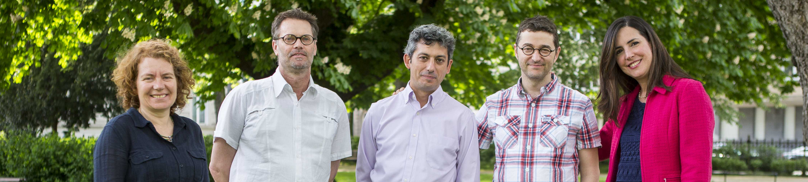
Core team
K4: Technical (Communication) Expert
Mrs. Patricia Rodriguez
K1: Team Leader
Mr. Egger Topper
K2: Deputy Team leader,
Technical Expert
Mr. Juan Palerm
K5: Technical Expert
Mrs. Raffaella Sardi
K3: Technical Expert
Mr. Geraldo Carreiro
Consortium Backstopping:
Project Director: Muriel Vives
Project Manager: Mathieu Pageaux

Slide 40


Biodiversity for Life Facility
Purpose
Provide support to DEVCO, EUDs and partners to increase the quality, consistency and visibility of actions directed or related to conservation/management of biodiversity and ecosystems to contribute to sustainable development and mitigation/adaptation to climate change.
How?
Ad hoc support
Training
Methodological guidance
Elaboration of support material
Review of Action Documents, etc.

Slide 41

Global Climate Change Alliance (GCCA+) Support Facility
Purpose
Provide technical support to the EC and partner countries for the effective implementation of the GCCA+ Flagship Initiative to enhance (1) policy dialogue and exchange of experiences, (2) capacities of LDCs to address climate change challenges, and (3) creation and sharing of knowledge.
How?
In-country support to identification and formulation of new GCCA+ programmes/projects
Remote and in-country ad hoc support on the implementation of GCCA funded programmes
Short term customised TA and training services and exchange of knowledge
Contact:: info@gcca.eu

Slide 42
Key Messages of Module 8
There are numerous EU and other international cooperation initiatives promoting an inclusive green economy. Aligning actions with these initiatives is both a challenge and a necessity.
The SWITCH to Green Initiative supports the IGE transition process with strategy, coordination, technical assistance, knowledge management and communication.

Slide 43
References:
UNEP, The 10YFP, additional information available at: http://www.unep.org/10yfp/Home/tabid/133135/Default.aspx
ILO, The ILO’s Green Jobs Programme, additional information available at: http://www.ilo.org/global/topics/green-jobs/WCMS_213842/lang--en/index.htm
UNEP & UNDP, Poverty – Environment Initiative, website available at: http://www.unpei.org/
SWITCH Asia, website available at: http://www.switch-asia.eu/
SWITCH Med, website available at: http://www.switchmed.eu/en
SWITCH Africa Green, website available at: http://switchafricagreen.org/
The Economics of Ecosystems and Biodiversity (TEEB), website available at: http://www.teebweb.org/
UN (2012) Rio+20 Outcome Document: "The Future We Want“
UNEP (2012) Measuring Progress Towards an Inclusive Green Economy
UNEP, SWITCH Asia (2013) Indicators for a Resource Efficient and Green Asia. Available at: http://www.switch-asia.eu/policy-support-components/rpsc/policy-dialogue/scp-indicators/
DG ENV (2016) Qualitative and quantitative outcome indicators for LIFE projects. Available at: http://ec.europa.eu/environment/life/toolkit/pmtools/lifeplus/monitoring.htm

