Slide 1
Key international and EU initiatives promoting an inclusive green economy

Slide 2



The 10YFP
Accelerate the shift towards SCP in all countries by supporting regional and national policies and initiatives
Increase RE and decouple economic growth from environmental degradation, creating decent jobs and contributing to poverty eradication and shared prosperity
Serve as an
information and
knowledge sharing
platform on SCP to
enable all stakeholders
to exchange policies, tools, initiatives and best practices, enhancing cooperation
Support capacity-
building and facilitate access to financial and technical assistance for developing countries, to implement SCP activities at all levels
Source:
Notes:
A global framework of action aiming at improving international cooperation to accelerate the shift towards Sustainable Consumption and Production (SCP) in both developed and developing countries. The framework supports capacity building, and facilitates access to technical and financial assistance for developing countries for this shift. The 10-YFP aims at developing, replicating and scaling up SCP and resource efficiency initiatives, at national and regional levels, decoupling environmental degradation and resource use from economic growth, and thus increasing the net contribution of economic activities to poverty eradication and social development. It is meant to encourage innovation and cooperation among all stakeholders. Interested actors from all countries can be involved in the implementation of the 10-YFP activities: governments, private sector, civil society, researchers, UN agencies, financial institutions, and other major groups. The main objectives are:
Accelerate the shift towards SCP, supporting regional and national policies and initiatives.
Contribute to resource efficiency and decoupling economic growth from environmental degradation and resource use, while creating decent jobs and economic opportunities and contributing to poverty eradication and shared prosperity.
Mainstream SCP into sustainable development policies, programmes and strategies, as appropriate, including into poverty reduction strategies.
Support capacity building and facilitate access to financial and technical assistance for developing countries, supporting the implementation of SCP activities at the regional, sub-regional and national levels.
Enable all stakeholders to share information and knowledge on SCP tools, initiatives and best practices, raising awareness and enhancing cooperation and development of new partnerships – including public-private partnerships.
The following 6 programmes of the 10-YFP have been launched so far:
- Consumer information (CIP)
- Sustainable Public Procurement (SPP)
- Sustainable Lifestyles and Education (SLE)
- Sustainable buildings and construction (SBC)
- Sustainable Tourism, including Eco-tourism (STIE)
- Sustainable Food systems (SFS)

Slide 3
The 10YFP
Actors from all countries can be involved in the implementation of the 10-YFP activities, under 6 on-going Programmes:
  Consumer information;
  Sustainable Public Procurement;
  Sustainable Lifestyles and Education;
  Sustainable buildings and construction;
  Sustainable Tourism, including Eco-tourism;
  Sustainable Food systems

Slide 4

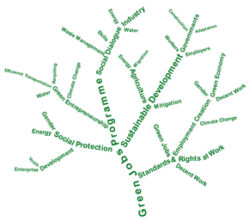
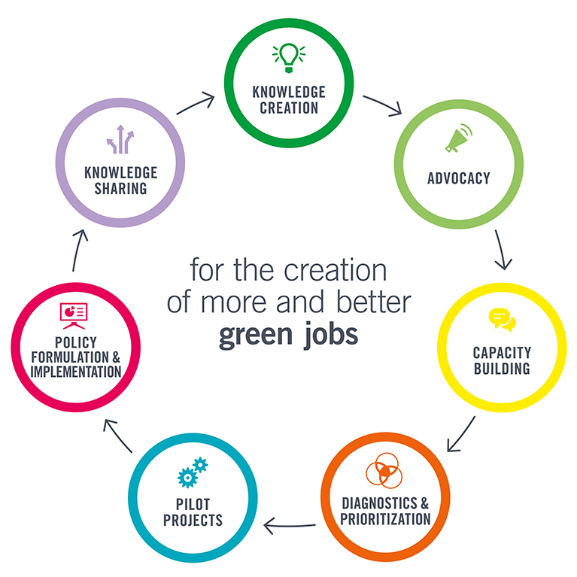
ILO’s Green jobs programme
Making green jobs feasible:
  promoting a green economy
  creating a productive employment
  decreasing poverty
Notes:
(ILO) Green Jobs Programme started in 2010. It aims at making green jobs feasible, by means of fostering the potential of a green economy, creating a productive employment, and decreasing poverty. Indicative programme activities include:
Support to constituents at national level, through policy and technical advisory services;
Promotion of international policy coherence, through research and advocacy; and
Capacity development of constituents and partners, through training and knowledge sharing.
Generally, ILO promotes the greening of enterprises, workplace practices and the labour market as a whole, by engaging governments, workers and employers as active agents of change. These efforts create decent employment opportunities, enhance resource efficiency and build low-carbon sustainable societies. ILO’s Green Jobs Programme already operates in Asia, Africa and Latin America.

Slide 5
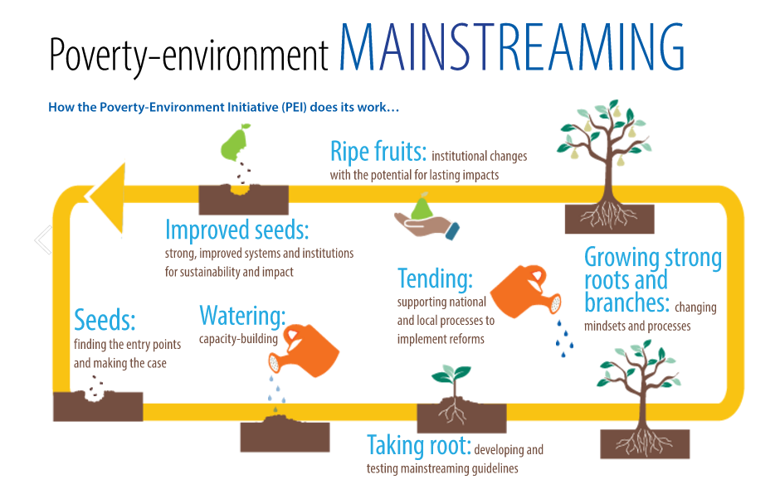
The Poverty Environment Initiative (PEI)
Source: PEI Annual report 2015
http://www.unpei.org/about-the-poverty-environment-initiative
Notes:
PEI was formally launched in 2005 and significantly scaled-up in 2007 at the UNEP Governing Council meeting, created by UNDP and UNEP. It is a joint global UN-led programme supporting national level efforts to mainstream poverty-environment linkages into country development planning and processes, from policymaking to budgeting, implementation and monitoring. UNEP Divisions for Regional Cooperation (through its Regional Offices) and for Policy Implementation (DEPI) work jointly to manage the Initiative. By providing both financial and technical support, UNDP and UNEP assist government decision-makers and a wide range of other stakeholders to manage the environment in a way that enhances livelihoods and leads to sustainable growth.
PEI operates in Africa, Asia-Pacific, Eastern Europe, Central Asia, and Latin America and the Caribbean, through a global Facility, four regional teams and the UN country teams. Implementation is already on-going in the following countries: Botswana, Burkina Faso, Kenya, Malawi, Mali, Mauritania, Mozambique, Rwanda, Tanzania, Uganda.

Slide 6




Private sector initiatives
Environmental impact of global supply chains: traceability
End-of-life products: Recycling of materials through global logistics centres
Globalised green practices: chain retailers investing in eco-efficient stores, use of Renewable Energy, etc.
Sustainable lifestyles: global promotion of sustainable consumption

Slide 7
Coordination with international actions promoting IGE
The case of the SWITCH regional programmes and the 10YFP

Slide 8

Linking SWITCH-Asia with the 10YFP
Selection of Grant projects (CfP):
  Activities should focus to address one or several of the programmes being developed under the 10YFP
  Applicants have to ensure that the selected 10YFP priority area is clearly mentioned in the application form
  Possible activities to be covered in conjunction with the 10YFP by the projects are listed in the Guidelines for Grant Applicants
Notes:
Activities should focus to address one or several of the programmes being developed under the 10YFP:
consumer information,
sustainable lifestyles,
sustainable public procurement,
sustainable buildings,
sustainable tourism and
food production, distribution, waste disposal.

Slide 9

Linking SwitchMed with the 10YFP
Support in the organisation of 10YFP related events, e.g. the 1st International Forum on Sustainable Lifestyles
Development of National SCP Action Plans in line with the 10YFP
Sharing of information on 10YFP related activities, e.g. calls for proposals

Slide 10

Linking SWITCH Africa Green with the 10YFP
Policy support component:
  ‘Support to establish or strengthen the enabling conditions for target sectors in the respective countries, complementing efforts underway through other programmes, including SCP programmes, global 10YFP and green economy initiatives in Africa’
Networking facility:
  Support to the Africa Roundtable on SCP (ARSCP)
Notes:
eaching out to policy-makers, the private sector and other stakeholders in the region: developing and disseminating SCP tools, guidelines/manuals, technologies and practices to stakeholders and policy makers. The networking facility will aim to strengthen existing networks and induce further partnership opportunities to leverage SCP and green economy uptake.
In order to combine the expertise and knowledge of relevant institutions, UNEP will contract the African Roundtable on SCP (ARSCP ), RECPnet and other institutions in Africa promoting SCP, green economy transformation and eco-entrepreneurship. - Source: www.switchafricagreen.org

Slide 11
From GDP to Total Wealth Accounting
Economic performance of countries generally being measured through GDP (Gross Domestic Product)
  GDP = market value of all officially recognized final goods and services produced within a country in a given period of time
  GDP does not account for natural capital and social/human capital
Initiatives to move to beyond GDP
  United Nations System on Environmental and Economic Accounting (SEEA)
  Wealth Accounting and the Valuation of Ecosystem Services WAVES partnership
  EU Beyond GDP initiative

Slide 12
UK Environmental Accounts
Satellite accounts to the main UK National Accounts
Statistics on the environmental impact of UK economic activity:
  natural asset accounts (e.g. oil and gas reserves, forestry, land)
  physical flow accounts (e.g. greenhouse gas emissions, air pollutants, energy consumption, consumption of raw materials)
  monetary accounts (e.g. environmental taxes, environmental protection expenditure)
Facilitate environmental-economic analyses
Notes:
Produced to high professional standards and approved by the UK Statistics Authority

Slide 13
EU Indicators – Eurostat
EU Environmental economy – statistics on employment and growth
European environmental accounts - Environmental goods and services sector (EGSS) accounts
Data on the output, employment, exports and value added generated in the production of environmental goods and services
Notes:
Measuring the impact of the EU green economy on growth and employment
Goods and Services that are used to measure, prevent, limit, minimise and correct environmental damage and manage natural resources in a sustainable way.
Statistics on employment and growth for the European Union’s (EU’s) environmental economy, as defined in the European environmental accounts, and particularly in the environmental goods and services (EGSS) accounts.
Demand for data on the environmental goods and service sector (EGSS) by the European Statistical System
Necessity to clarify more precisely what is considered as an environmental good or service
EGSS module aims to collect data on the output, employment, exports and value added generated in the production of environmental goods and services

Slide 14
Indicators at Different Stages of Inclusive Green Economy Policy
Initial stages
Indicators for environmental issues and targets
Intermediary stages
Indicators for policy interventions
Final stages
Indicators for policy impacts on well-being and equity
UNEP 2012

Slide 15
SDG Indicators: Decent Work for All - Goal 8
Goals and Targets | Indicators
8.1 Sustain per capita economic growth in accordance with national circumstances and, in particular, at least 7 per cent gross domestic product growth per annum in the least developed countries | 8.1.1 Annual growth rate of real GDP per capita
8.5 By 2030, achieve full and productive employment and decent work for all women and men, including for young people and persons with disabilities, and equal pay for work of equal value | 8.5.1 Average hourly earnings of female & male employees, by occupation, age group & persons with disabilities 8.5.2 Unemployment rate, by sex, age group & persons with disabilities
8.6 By 2020, substantially reduce the proportion of youth not in employment, education or training | 8.6.1 Percentage of youth (aged 15-24) not in education, employment or training

Slide 16
Discussion Points
How complex is the existing nexus of websites and portals of inclusive green economy related initiatives? How helpful is a gateway portal navigating the user through the relevant information (www.switchtogreen.eu)?
What is the added value of aligning action with EU and other international cooperation initiatives promoting an inclusive green economy? What type of support is needed to promote an effective coordination process?

Slide 17
Discussion Points
What are the key factors in developing a mechanism to measure progress in the path to an inclusive green economy?
What are the main sources of inclusive green economy data globally / regionally / nationally?
What aspects should be taken into consideration when adapting global/regional indicators to the national context?

