Slide 1
COOPERATION DAYS 2017
Working Group on OPSYS result management and contract management
23 March 2017
Opsys
Beyond IT systems –
Status and next steps on roll out

Slide 2
The future of Result Management
State of play and how to improve the quality of our interventions
Perspectives from NEAR and DEVCO

Slide 3
State of play with indicators – NEAR perspective
“Translating project level outputs into results and impact has not been as good as it could have been" – 2nd Interim evaluation of IPA, 2013
Based on recent ROM Western Balkans and Neighbourhood evidence, when projects appear problematic in terms of capacities to reach the expected outcomes (MQ 3.3), this is frequently associated with the fact that:
  indicators were not well defined and relevant (MQ 1.7 – 71% of cases in which the projects were problematic in the WB, 72% in the Neighbourhood),
  the action was not adequately monitored by implementing partners, governments and other key stakeholders (MQ2.6 – 52% of cases in which the project was problematic in the WB, 66% in ENI)

Slide 4
Lessons on recurrent issues in LogFrames
In the results chain: results poorly formulated, hierarchy of expected results incorrect
Indicators: relevance (viz. expected result), measurability, link to programming document, too many, no disaggregation (by sex, age group…)
Baselines/targets: often missing (or reference year missing), often not corresponding to the indicator (different measurement unit), no disaggregation
SoV: Often not specified
Too many indicators: with a very marginal level of overlapping, encoded in inconsistent way it is not possible aggregating them and having an overall monitoring and reporting at country/ sector, corporate level.

Slide 5
Some mixed feedback from MIS DG NEAR (encoding AD indicators)
Baseline value, target and source of verification compulsory fields (useful)
Both quantitative and qualitative indicators can be encoded (useful)
Process, output and outcome indicators can be encoded (good)
Indicators are encoded with free text (problem)
After discarding many indicators (bad indicators, key elements missing), 1012 indicators have been encoded in the MIS (AP 2014 and 2015 for IPA II)
  Only 11 indicators have been encoded 3 times in the same country
  Only 32 indicators have been encoded 2 times in the same beneficiary
  Only 1 indicator ("Progress made towards meeting accession criteria") has been encoded in two different beneficiaries (once in Bosnia, once in Turkey)
Limited scope for aggregation, monitoring at country/sector/corporate level, and reporting!

Slide 6
Findings after analysis 2016 EAMRs

Slide 7
Findings after analysis of ROMs

Slide 8
The future of Result Management
Snapshot of where we are with the development of OpSys results

Slide 9
Solutions foreseen under OPSYS
Encourage re-use of already validated results (from MIP, from Action)
Encourage re-use of quality-controlled indicators
  Library of Core indicators (by sectors)
  Free text is possible
  Compulsory fields at certain check-points
Accept diversity of context-based indicators of and country ownership, but:
  mirror them – whenever possible - with corporate matching indicators
  Aggregate the matching values

Slide 10
Solutions foreseen under OPSYS
Matching indicator:

Slide 11
Solutions foreseen under OPSYS
The system should be designed as a management tool first (vs as a reporting tool)
  Data is entered by the Contractor / the Implementing Partner / the Technical Assistance of the Programme
  There is a contractual obligation
  Data is checked by the Operational Manager through is "Certified Correct'"
Reinforce Quality control / Quality "support"
  Possibility to put in place external and internal layer
  Tag good practice / encourage reuse

Slide 12
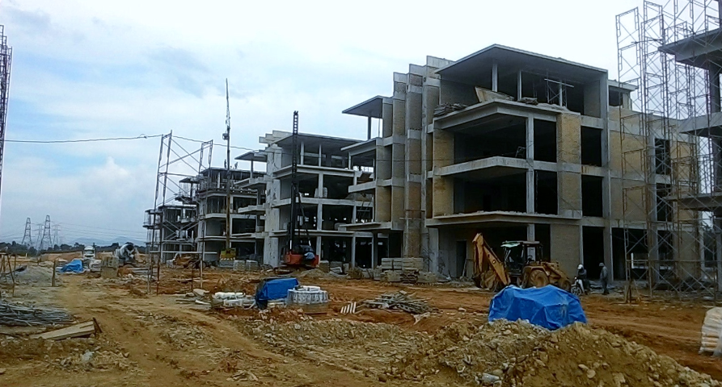
Solutions foreseen under OPSYS : Under construction !

Slide 13
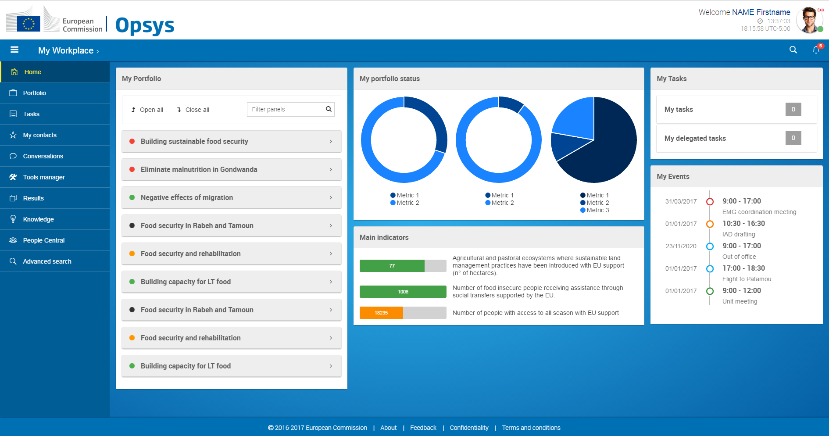
a. My Workplace
Solutions foreseen in OPSYS

Slide 14
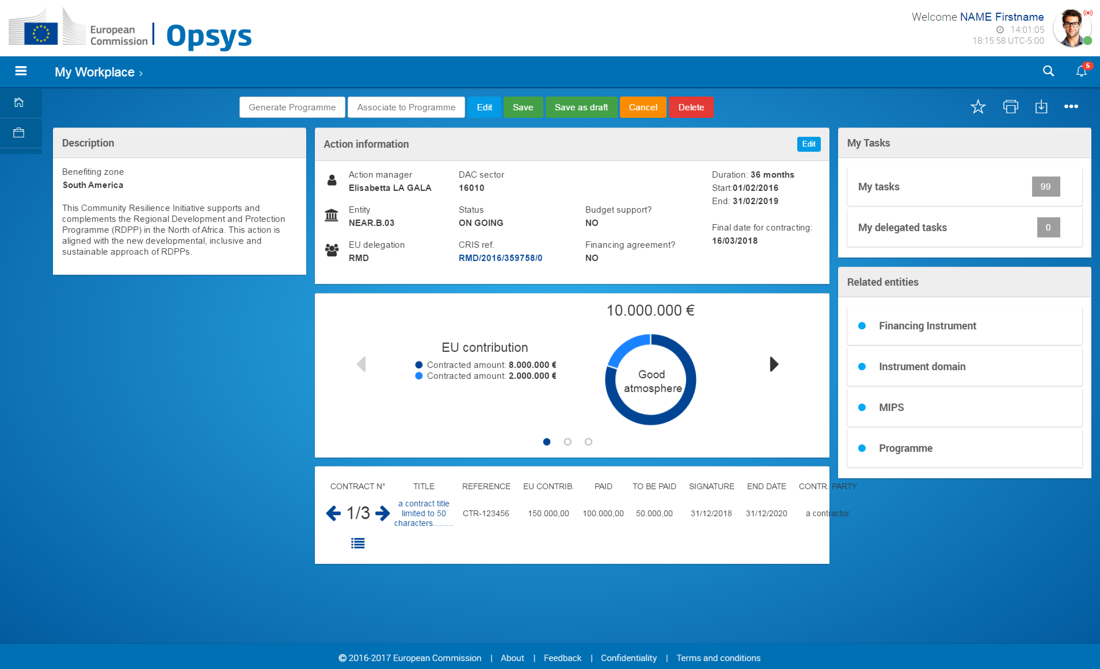
Solutions foreseen in OPSYS
b. Action page

Slide 15
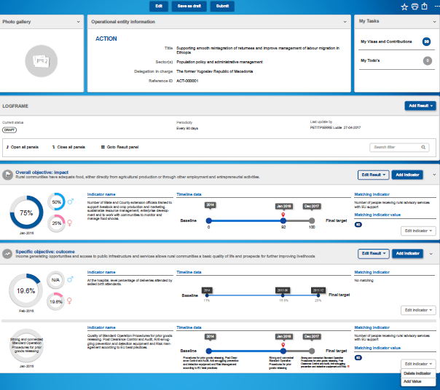
Solutions foreseen in OPSYS
c.
Logframe page

Slide 16
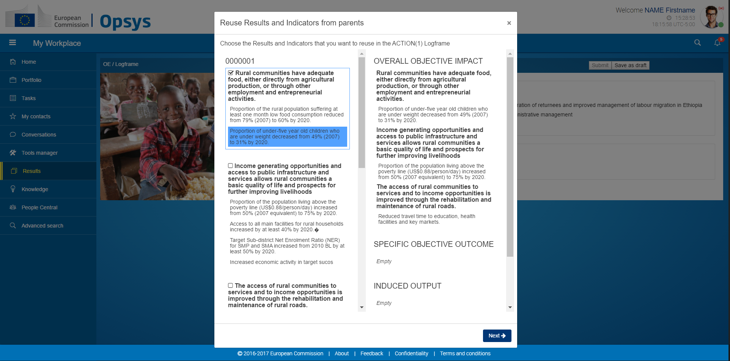
Solutions foreseen in OPSYS
Logframe creation
Logframe creation: reuse from MIP and instruments

Slide 17
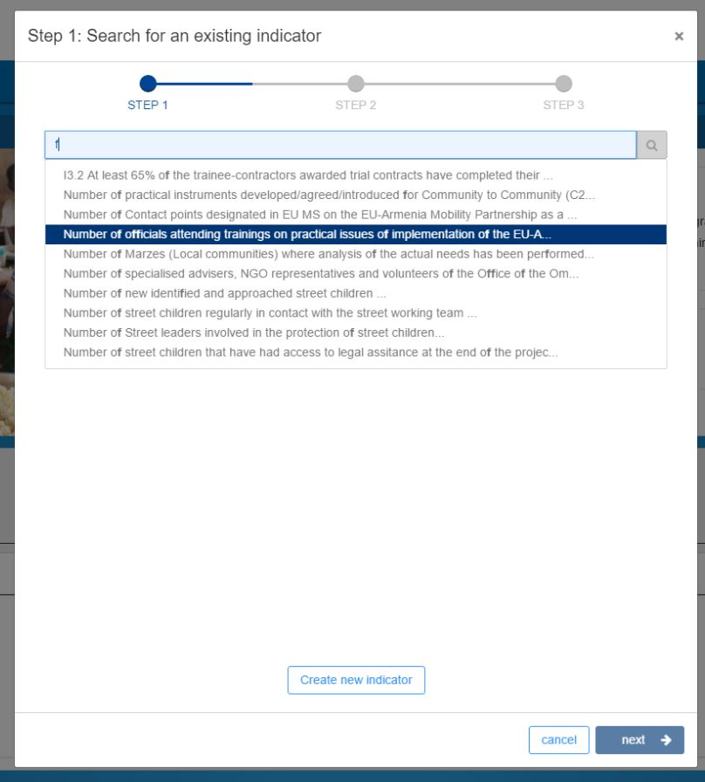
Solutions foreseen in OPSYS
Logframe creation
Logframe creation:
search for an indicator

Slide 18
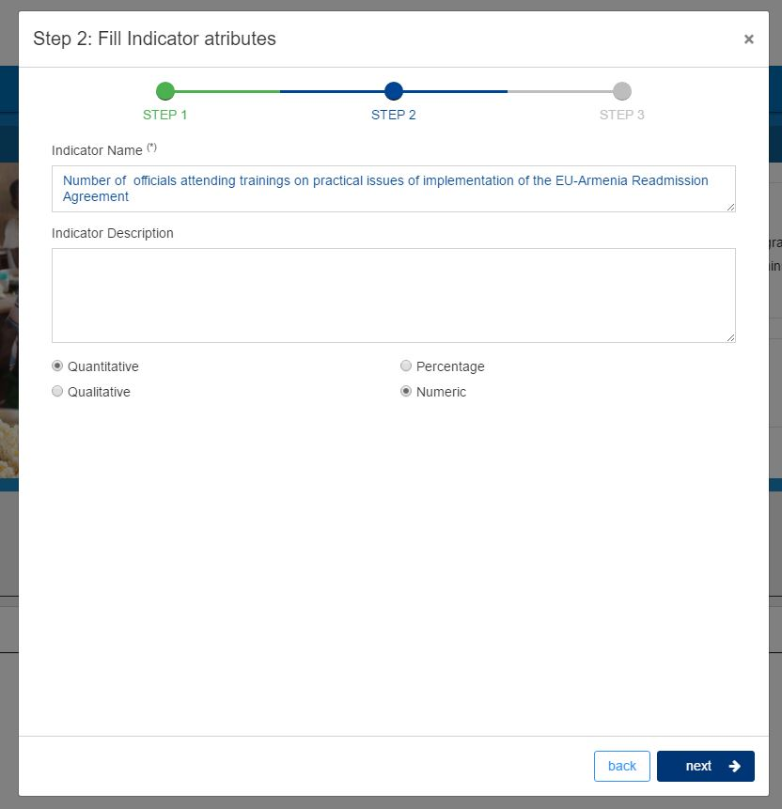
Solutions foreseen in OPSYS
Logframe creation
Logframe creation:
Add attributes

Slide 19
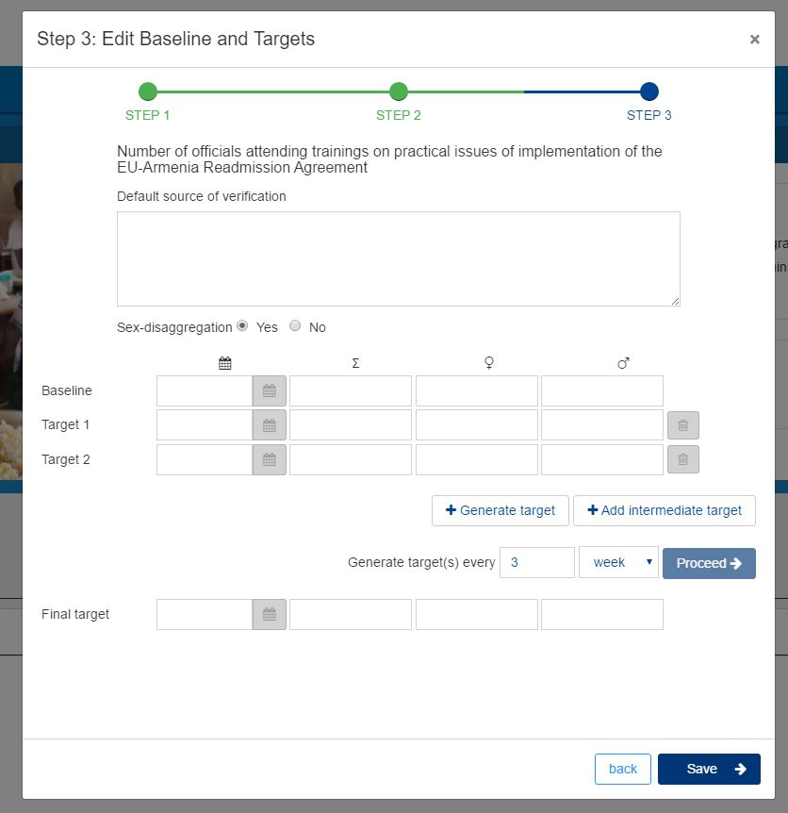
Solutions foreseen in OPSYS
Logframe creation
Logframe creation:
Add baseline and target

Slide 20
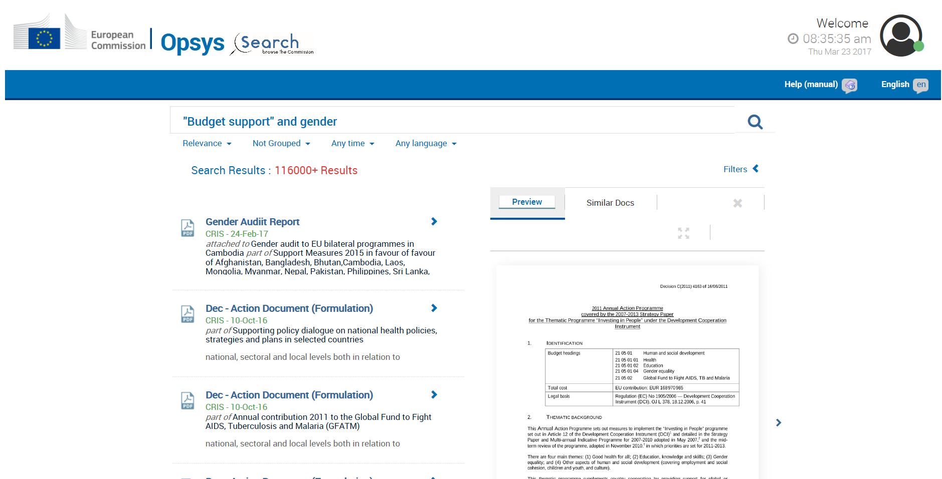
Search related programmes…
Want to test?
Please enrol

Slide 21
What’s next?
Questions:
How can the system help address certain issues ?
What needs to be done beyond the system to ensure quality and relevance of log frames and indicators?

Slide 22
The future of Contract Management
Corporate move tailored to the needs of external action: presentation and discussion

Slide 23
Corporate context
Rationalisation of central services (HR, Financial, IT..), harmonisation, reuse: More with less + Simplification for users/recipients of EU funds
Synergies and Efficiencies in the Commission - SEC(2016) 170):"e-procurement and SEDIA shall become mandatory.., the new e-Grants solution ..e-signature shall be mandatory.."
EU eGovernment Action Plan 2016-2020 COM(2016) 179:"The Commission will .. introduce the 'digital by default' principle when interacting online with external stakeholders.."

Slide 24
Financial Rules
Article 95 FR
e-Government
The institutions.. shall apply uniform standards for the electronic exchange of information with third parties participating in procurement and grant procedures…
Reinforced in draft revised FR
4 articles (instead of 1) on "IT systems and e-government"

Slide 25
Contract Management module – the project
Preparation of the project : 2016
Starting : Early 2017
Duration : 4 years, until 2020
Pilot (or first release) content :
  A single type of contract : FWC BENEF 2018
  All the EUDs, HQ
  Principal functionalities in first release, others functionalities in following releases
Pilot will be deployed early 2018 for the launch of BENEF 2018

Slide 26

Contract management: Re-using and adapting corporate blocks

Slide 27
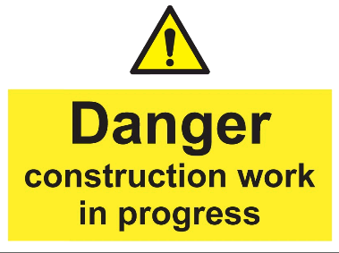
The pilot (first release) : manage a specific contract of the "FWC BENEF 2018"
We will see now :
A guided tour based on simplified and non-exhaustive representation of the overall process
Example of workflow based on existing RTD screens (re-use….)
  PROCESSES AND SCREENS TO BE REVIEWED AND HARMONISED WITH OPSYS MY WORKPLACE / CORPORATE STANDARDS

Slide 28
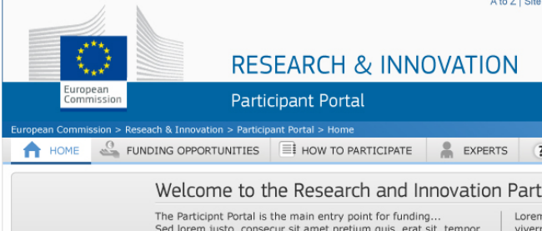
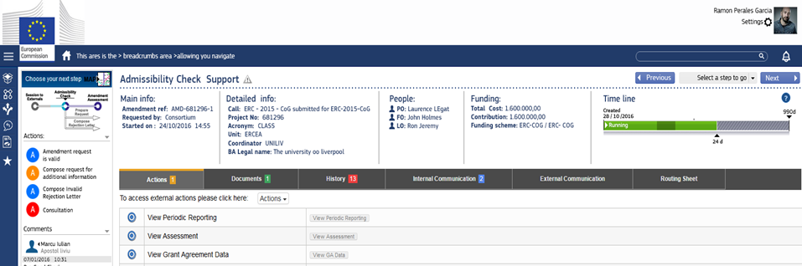
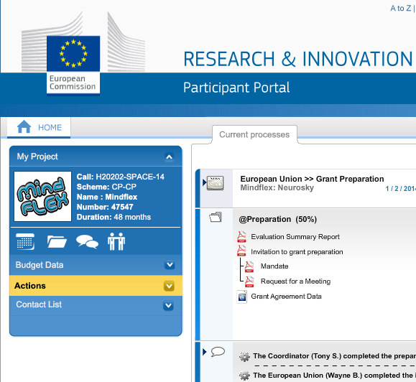
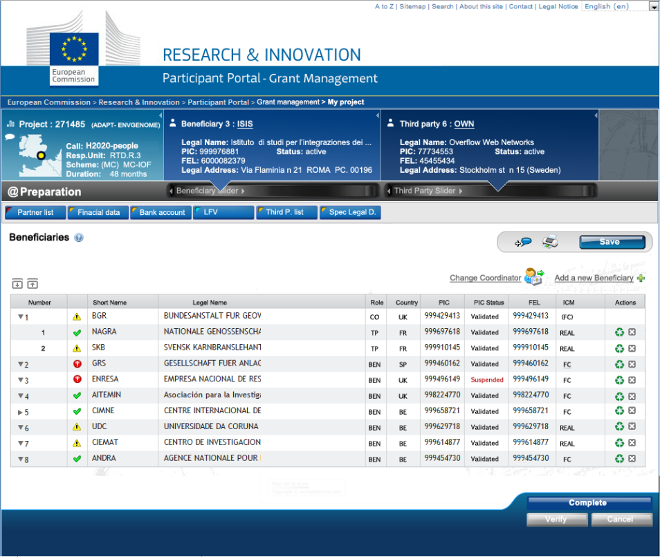
One single system for:
External Users
Internal Users

Slide 29
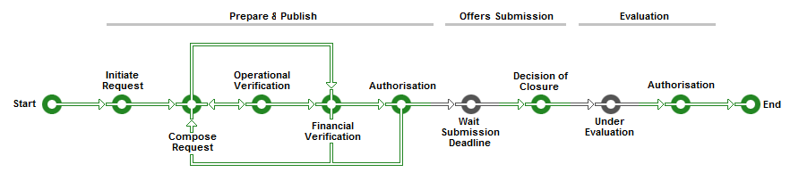
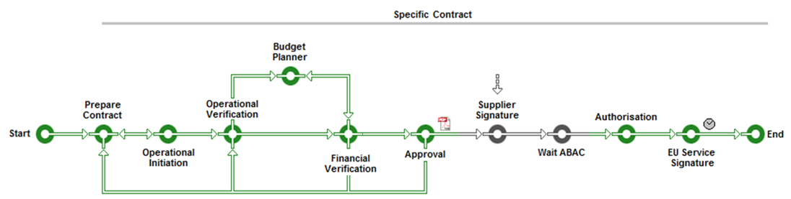
Specific Contracts automatically launched

Slide 30
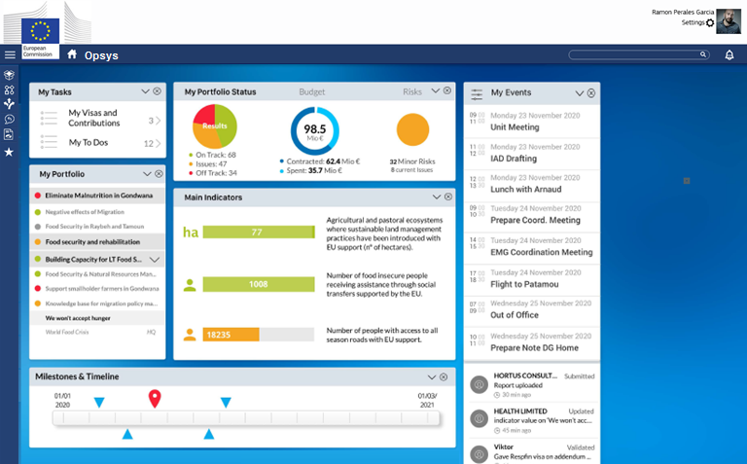
Start from your Workplace
– OpSys Portal –
Select My Tasks

Slide 31
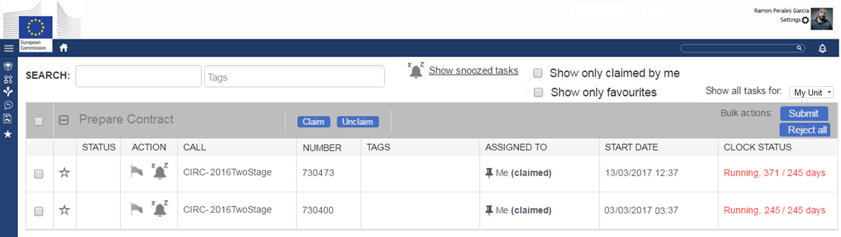
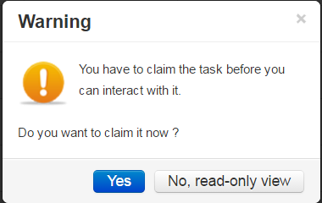
Enter your Task Box
You have a task to Prepare a Contract !
Quick Access menu

Slide 32
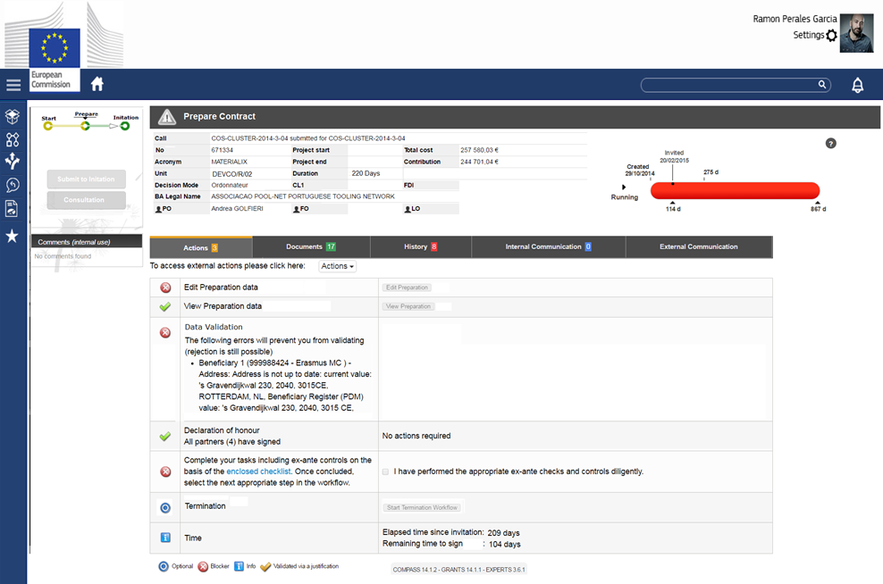
Access the Task
to Prepare the Contract
Header
Workflow
Directions
Task Info
Everything in one view

Slide 33
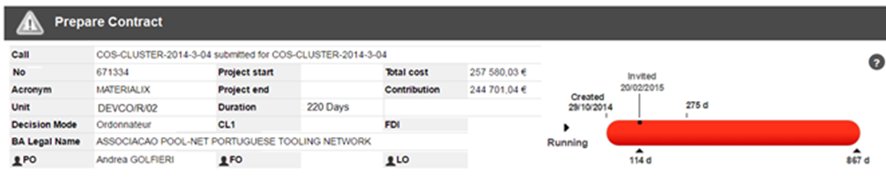
Closer look at the Task Header
Clock information according to context:
-Time to Sign clock
-Payment clock
Contextual information to help
the person executing the task:
-What is the SC about
-Who is the Beneficiary
-When does it start
..
Header information changes depending the Task always aiming
to provide the actor context about his/hers task.

Slide 34
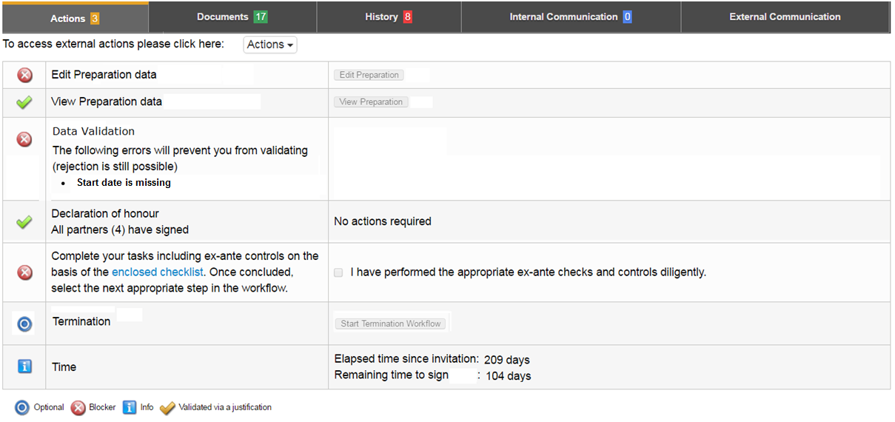
Closer look at Task Info
Access to Contractual Data
Automated Checks
Relevant Launch Actions

Slide 35
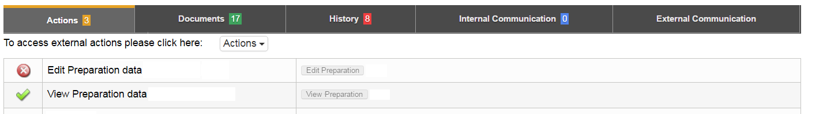
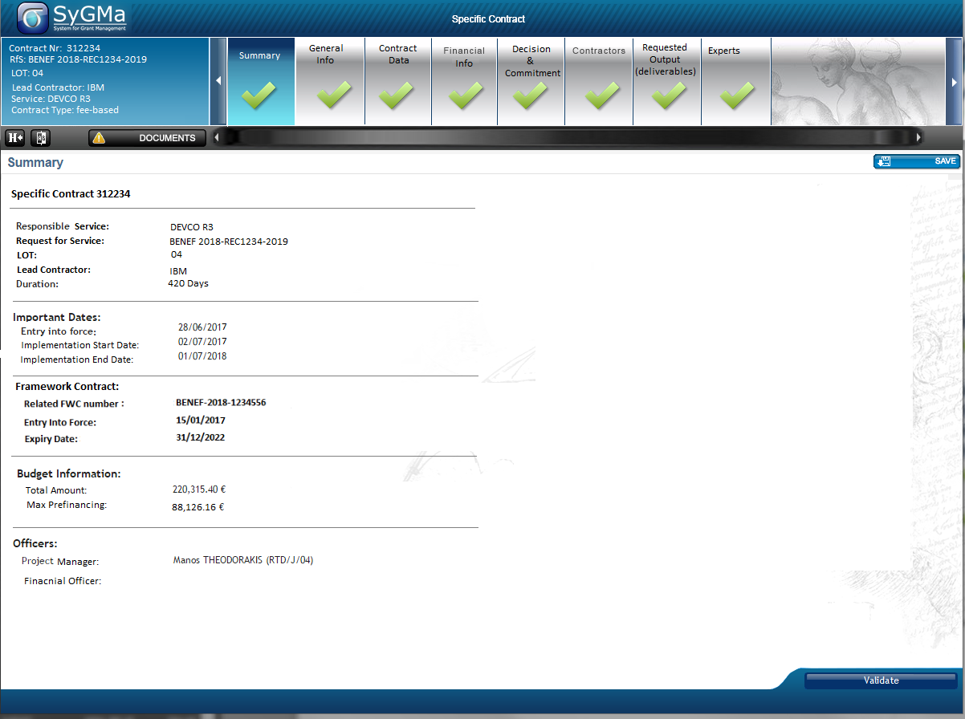
From within the Task Details:
Access to Contractual Data
Prepare the Contract:
A popup lets you enter
(like in CRIS) – the
data necessary.

Slide 36
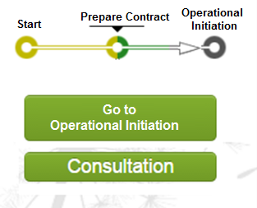

All Actions are ? ?
You can move the flow!

Slide 37
Preparation is done – the workflow moves to the next task in the business process !

Slide 38
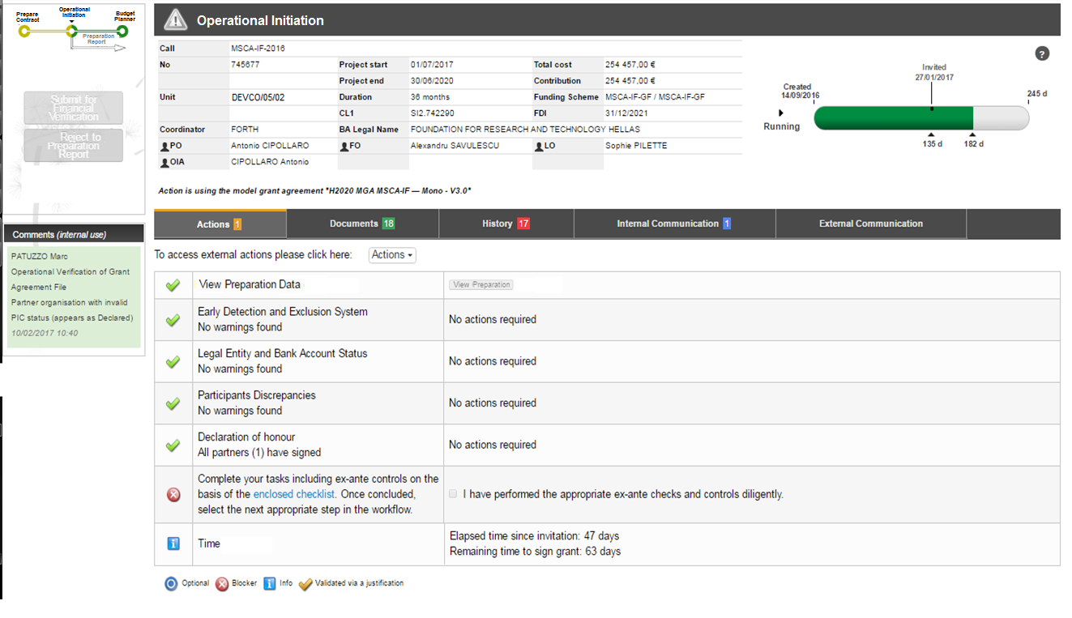
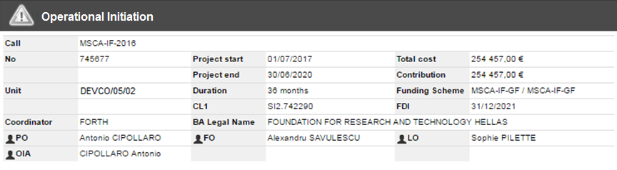
Access the Task of the first
Operational Visa
Context
Workflow
Directions
Relevant information
Everything in one view

Slide 39
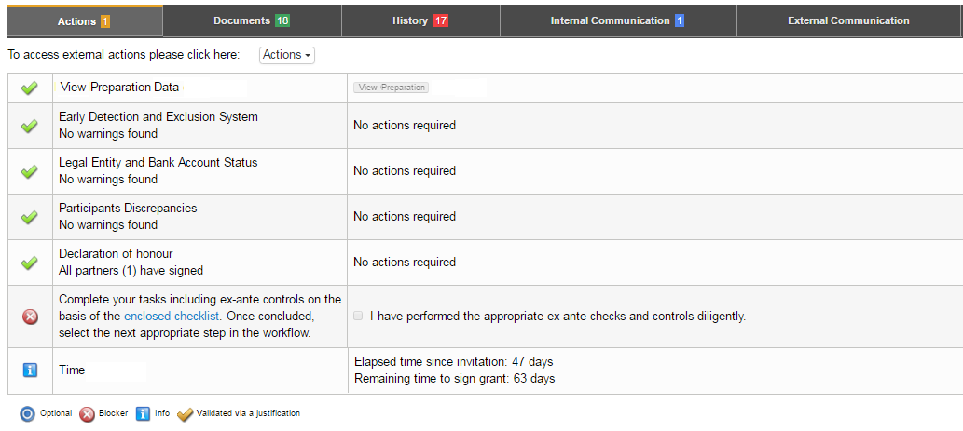
Closer look at Task Info
for Operational Visa's
Checklist ABAC VISA
Automated
In line with DG BUDG
Ex ante requirements
Following Financial Regulations

Slide 40
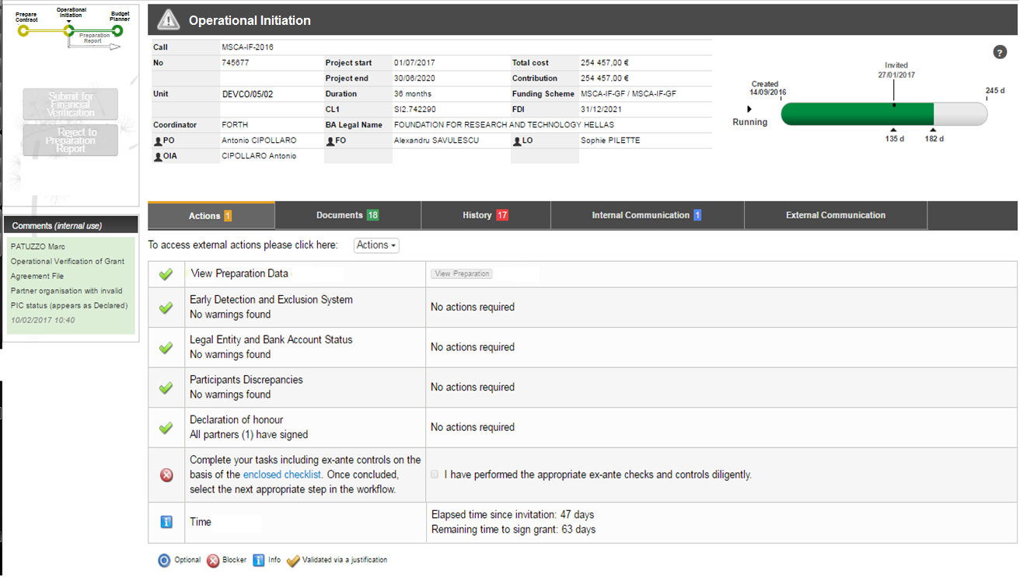
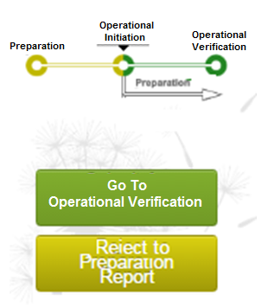

Slide 41
OIA is done – the workflow moves to the next task in the business process !

Slide 42
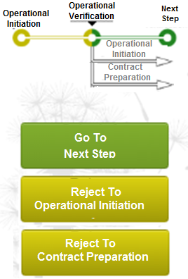
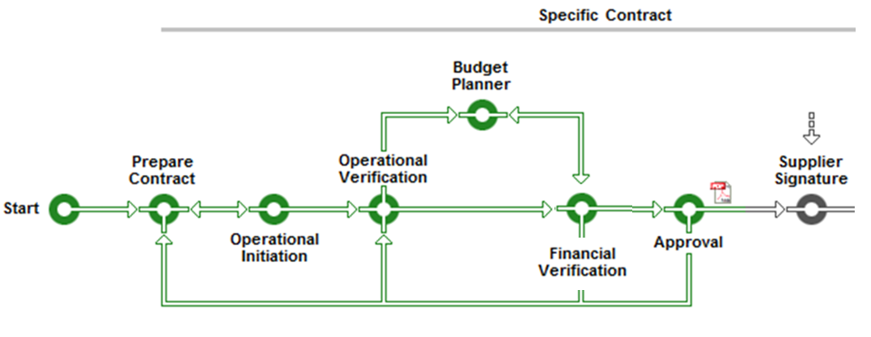
Task Decision
Moves the flow
OVA is done – the workflow moves to the next task in the business process !

Slide 43
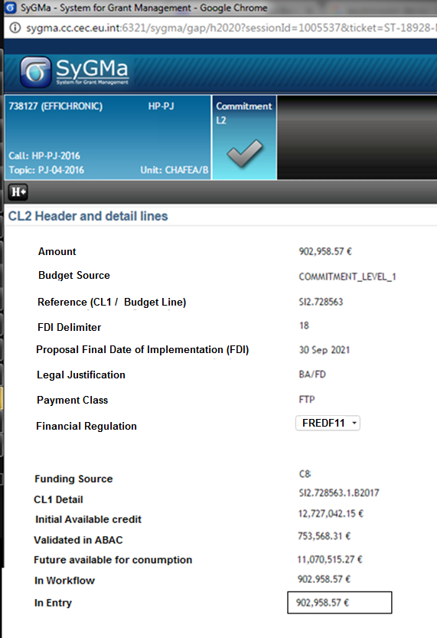
Budget Planner ?
99% of the CL2 data for BENEF can be deducted and derived from the contract.
Therefore, the budget planner is involved conditionally only when..
there are multiple funding sources..
Otherwise..
Automatic assignment to the only available funding source.

Slide 44
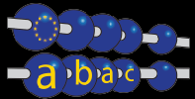
Hey but…how about ABAC… ?!
  OpSyS takes care of..
  Automatic creation of the CL2
  With all visa’s of IA-OVA-FVA given in OpSyS
  With all checks done by OpSyS
  Signed in OpSyS..and only in..OpSyS !
  So do I need to go into ABAC ? NO
  except…
  AOSD visa signed in

Slide 45
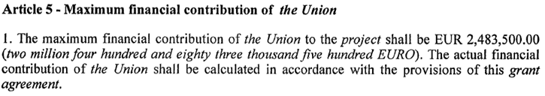

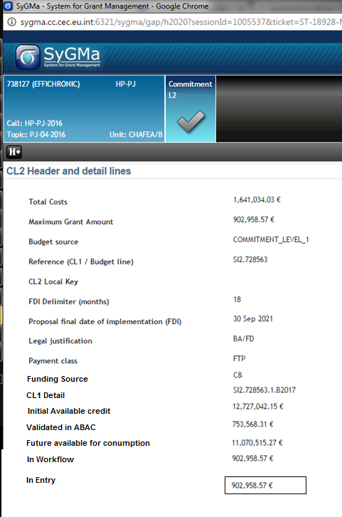
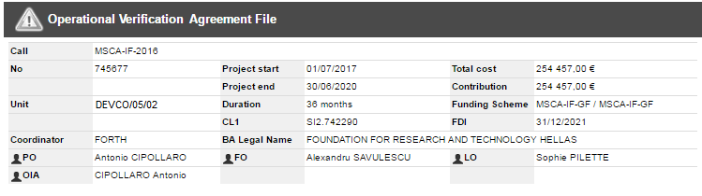
Contract document, as generated
Consitency between systems and the contractual documents

Slide 46
Local Visa-chain
One last step before sending out
the contract for signature

Slide 47
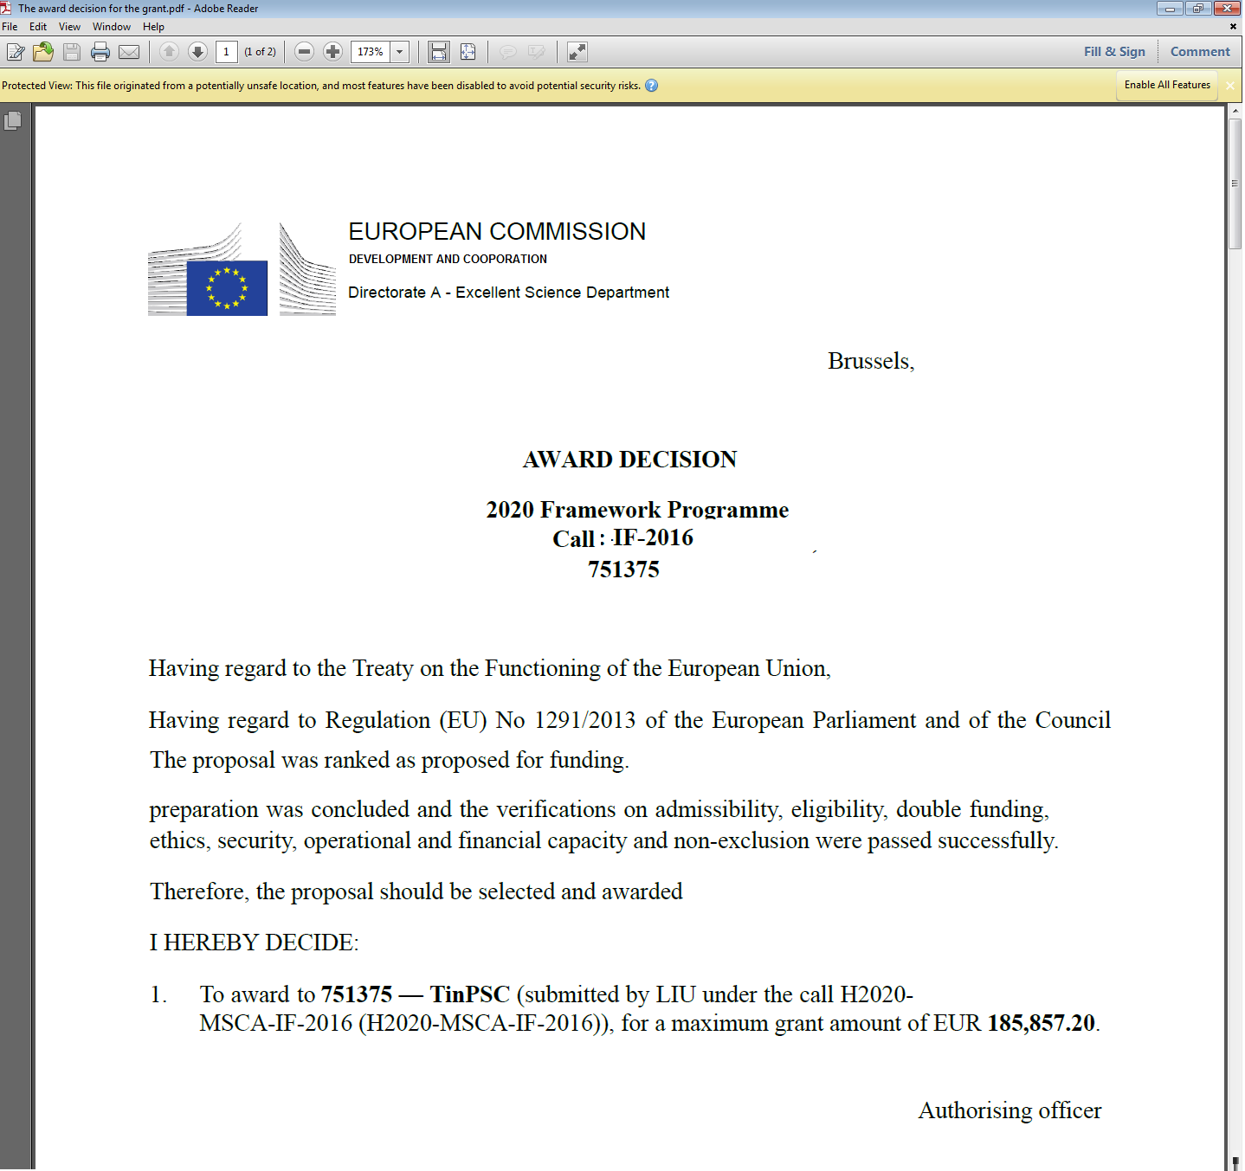
Approval?
For the AOSD – final review before
requesting contract signature
The task provides all the
relevant information as all previous
actors
Shows the award decision as
generated at the start of the flow

Slide 48
But how about these documents… ?!
  All documents are automatically:
  Registered in Hermes
  Externalised to externals when needed
  Generated and pre-filled
  Transperantly available cross business processes

Slide 49
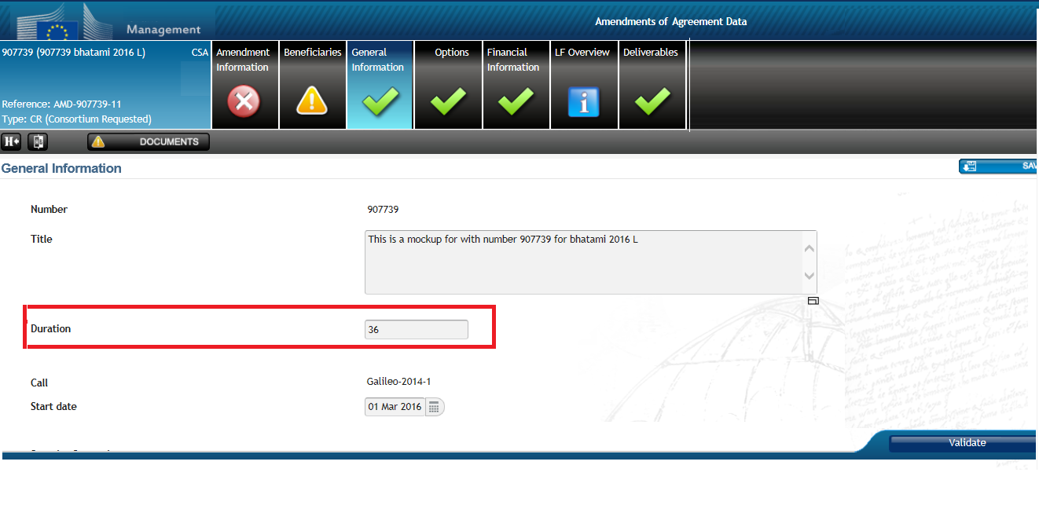
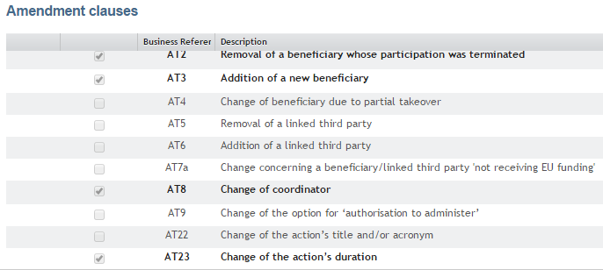
Templating example: Amendment
Automatically the system will select the correct
Amendment clause
Adapt some
Contract data

Slide 50
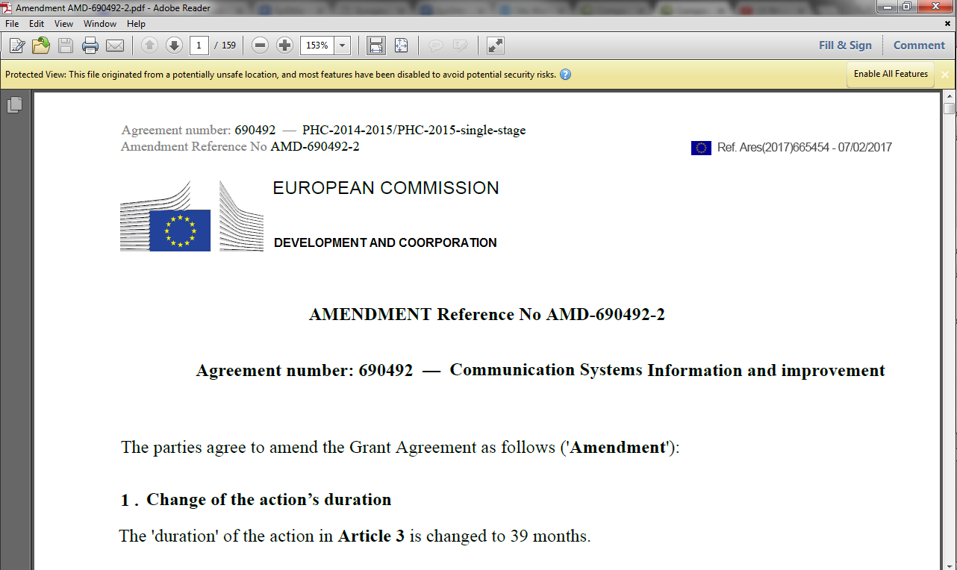
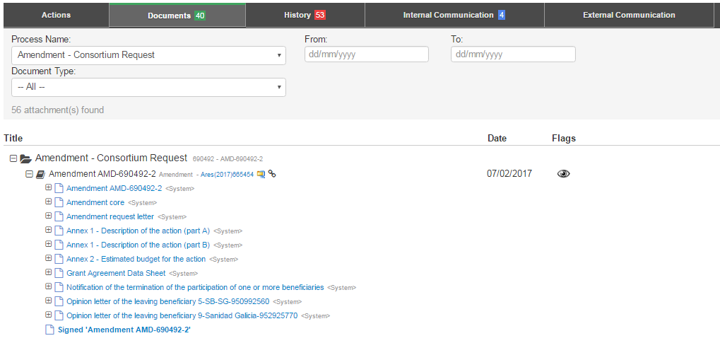
Templating example: Amendment
Auto generated
Aresized
Transperantly available
Auto generated
Registered in Ares
Transperantly available

Slide 51
Approved !
Ready to
receive the
signatures

Slide 52







Externals are notified via the
SEDIA
Portal
Coherent
Transparent
Integrated
Improved services
No mail
No blue ink signature

Slide 53
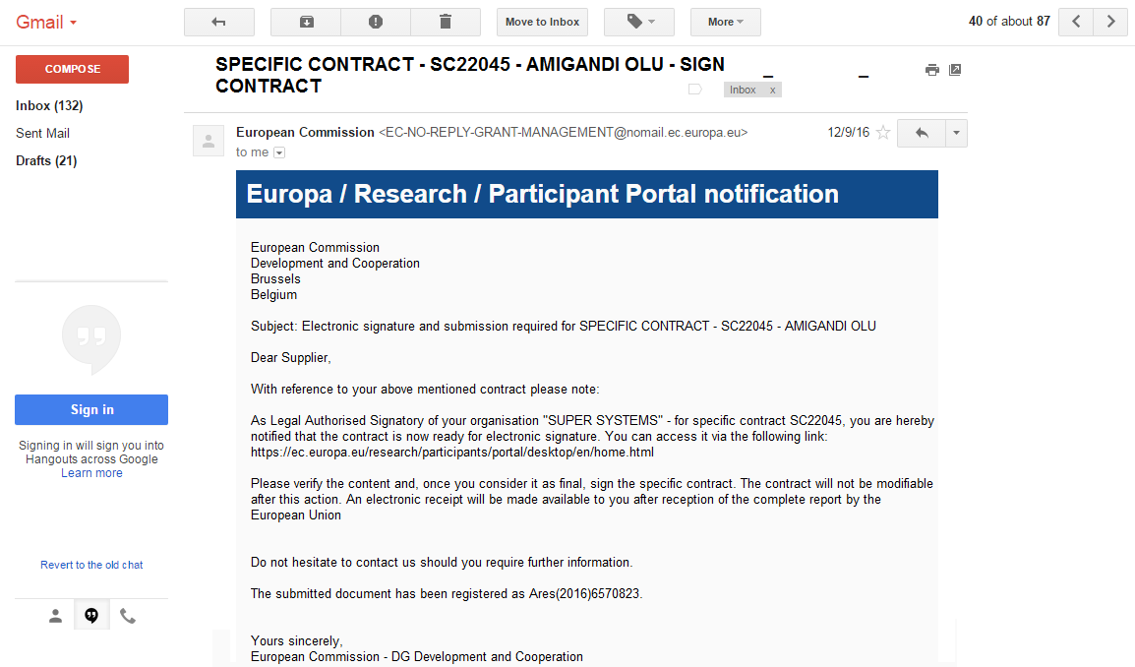
An email is send to the supplier
Provided contact address
Link to the
SEDIA
Portal

Slide 54
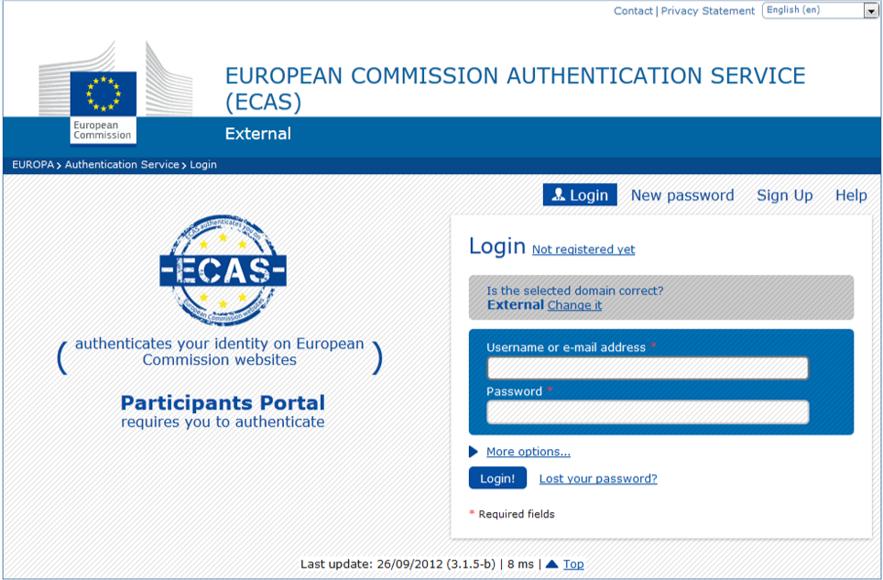
External suppliers are requested
to logon via ECAS

Slide 55
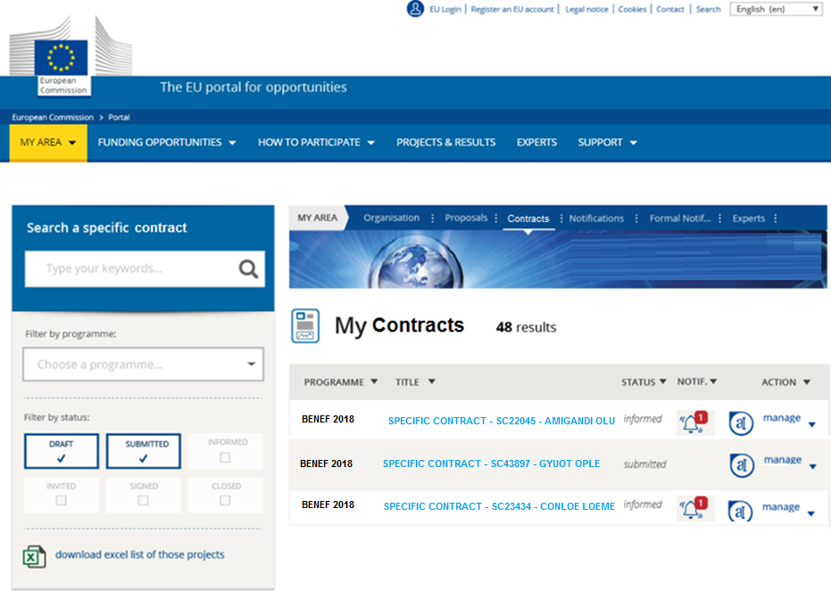
Suppliers find all contracts within the Portal
Typical navigation bar towards
notifications, organisation data,..

Slide 56
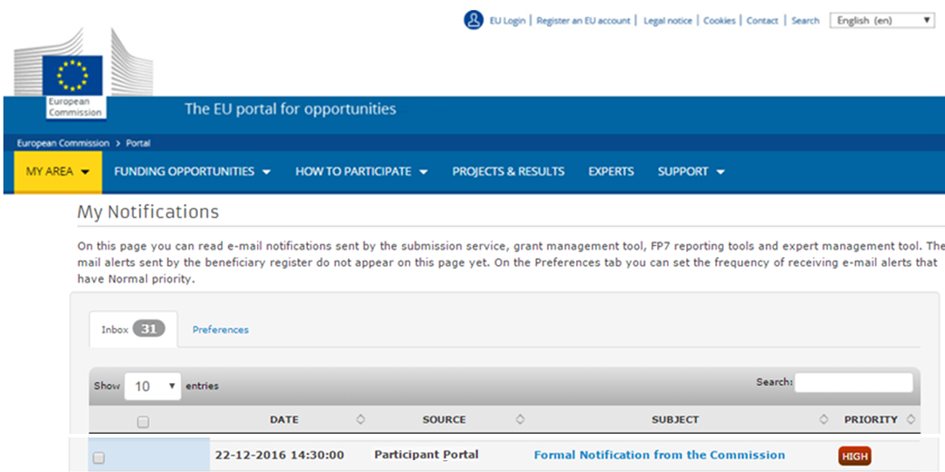
Externals have also an inbox in which all
notifications are appearing (Copy of the
Email)

Slide 57
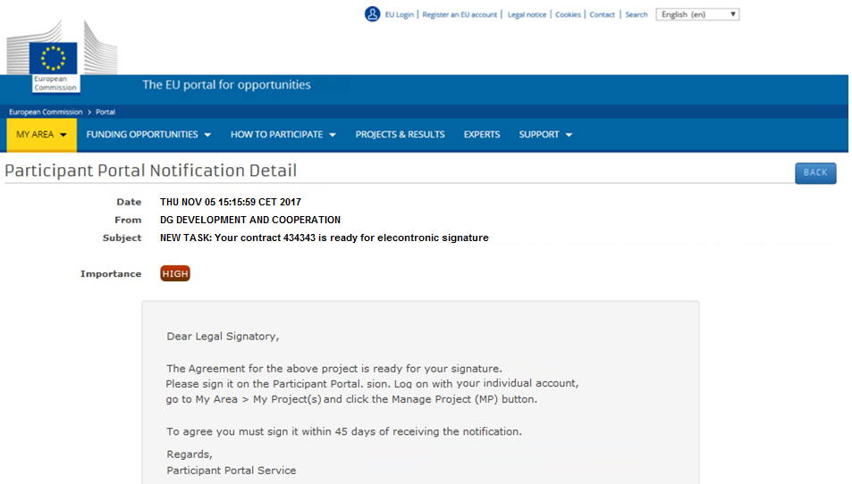
Notifications, such as requests to sign
a contract

Slide 58
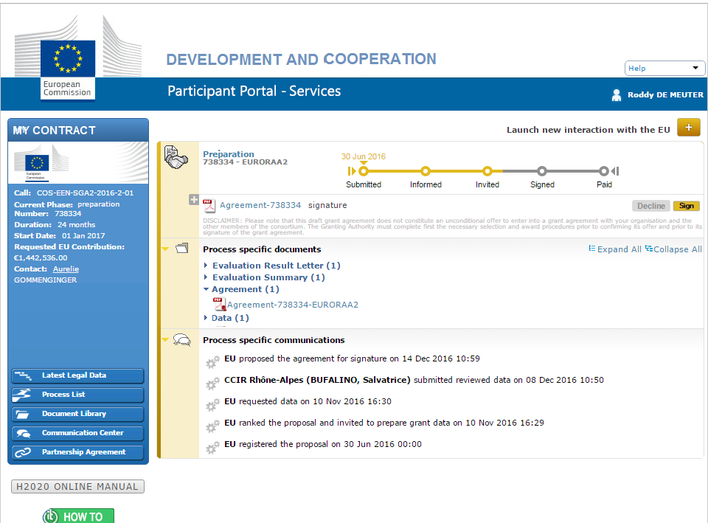
Signing a contract goes like

Slide 59
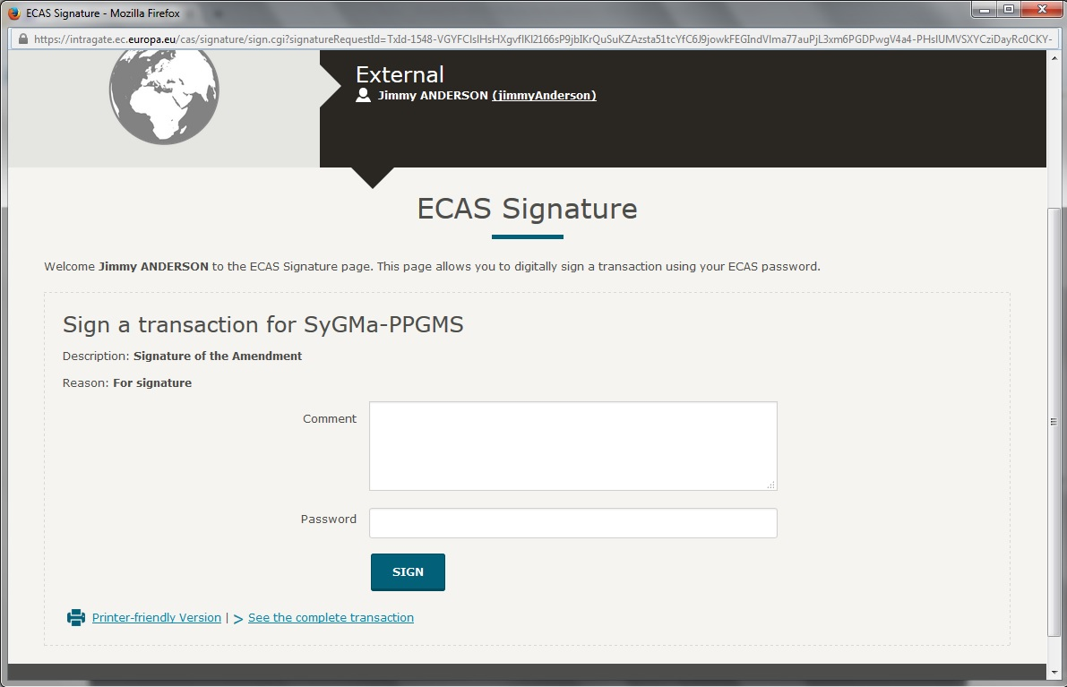
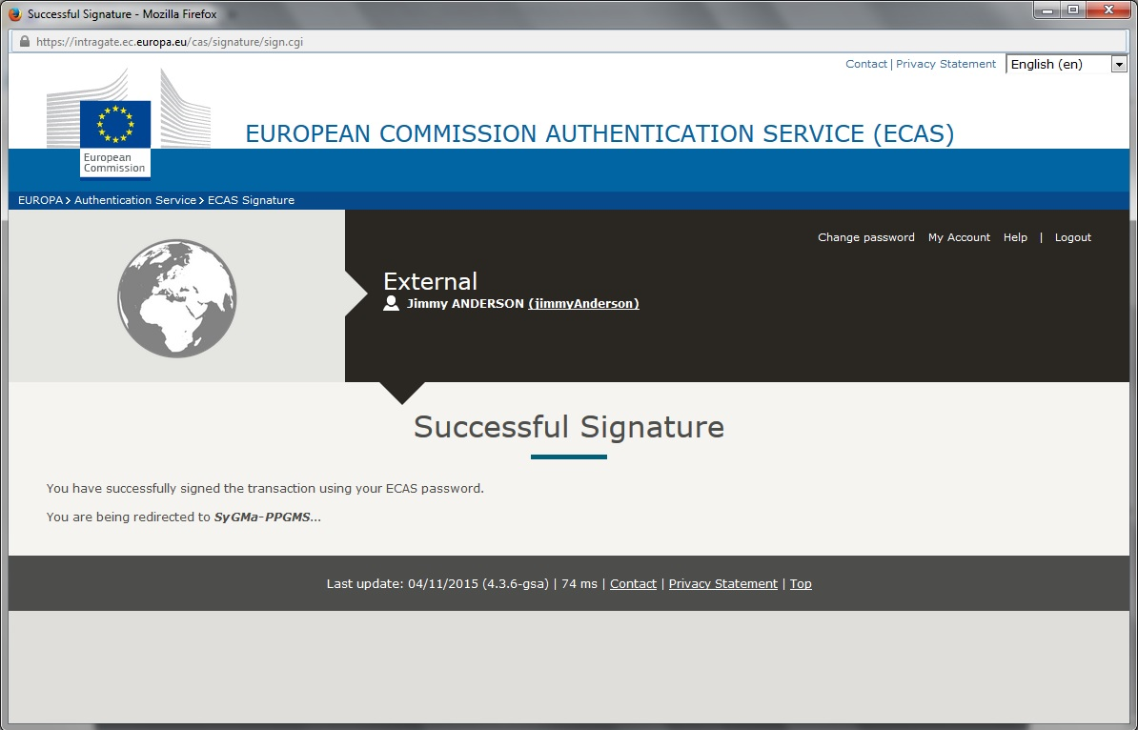

Slide 60


..and updates the systems..
but also the documents

Slide 61

End game:
System will take of creating the CL2
AOSD requested to sign off in ABAC
AOSD requested to sign the Contract

Slide 62

..ABAC is updated automatically
Visas from OpSyS

Slide 63





..ABAC is updated automatically
With all the correct data !

Slide 64

..AOSD receives task with underneath
task details
Checklist for AOSD
Automated
Deep-link into ABAC on the Budgetary Commitment

Slide 65


.. Budgetary CL2 in FIN/100 ?
Then ready to Sign the Contract
Checklist for AOSD
Automated

Slide 66


..AOSD is requested to confirm by
Password, which triggers the
Electronic signature of the Commission

Slide 67

..updated contract immediately available
in the Portal

Slide 68

..Possibility to contact the external supplier,
always available from within a task detail

Slide 69

..Possibility to contact the EC, equally available from within the Portal

Slide 70

..Full traceability on the business process,
always available in the Task Details

Slide 71
How about to pay… ?!
  Prefinancing payment
  with all visa’s
  …signed in Compass
  except…
  AOSD visa task in Compass signed in

Slide 72

..Simplified Process..
Checklist is fully automated
Consistency between IT systems
Low ex ante risk

Slide 73
..Simplified Process..
Payment Positions conditionally
to be reviewed when multiple positions are available
No need for intervention, CL2 is known

Slide 74

..Supplier receives a notificaion after contract signatures to invite for pre financing

Slide 75
Suppliers find all contracts within the Portal
Typical navigation bar towards
notifications, organisation data,..

Slide 76

A new Process has started

Slide 77

The supplier may enter the
request for pre financing

Slide 78
..Once the request is received – the workflow for the
internals is triggered

Slide 79

..Budget Planner
– conditionally changes payment positions

Slide 80

..Initiating Agent Task Details looks like:
Necessary info from ABAC – live – for guided
Assessment.
Conflicting processes warn the Agent before paying

Slide 81
..After Initiating visa.. OpSyS takes over..
Pre-financing document is created in ABAC
Payment request is created in ABAC
Payment order is created in ABAC

Slide 82












Creates Payment Request
Creates Payment Order
..ABAC invoice
is created
READY TO SIGN

Slide 83
..After creation of the 3 ABAC transactions,
A Task is created for the AOSD

Slide 84


..AOSD Task Details look like:
Link to the payment order in ABAC

Slide 85


..After AOSD visa – Payment letter is externalised on the Portal

Slide 86
But how about supervising/monitoring
… ?!
  All contracts, are always:
  Retrievable from My Workplace -> My Tasks
  Retrievable from My Workplace -> Business Processes
  Retrievable from My Workplace -> My Portfolio
  Transparantly available cross business processes

Slide 87

Go to -> Workflows -> And choose the Process to monitor
OPSYS

Slide 88

Go to -> Workflows -> And choose the master process
Processes can be monitored at
Meta data level

Slide 89


Monitoring of a specific business process
OPSYS
Direct actions

Slide 90


Example Quick Action: Show me
what the supplier sees

Slide 91


Go to -> My Tasks -> And choose the show all tasks for..
OPSYS
Pops up advanced criteria to see ongoing tasks

Slide 92

Go to -> My Tasks -> My Portfolio.
OPSYS
Shows the overview of contracts

Slide 93


Go to -> Reports and choose the desired report format.
OPSYS
The user can select extra criteria when
generating the report e.g. for Workflow follow up report:

Slide 94


e.g. Payment Report

Slide 95

e.g. Workflow Report

Slide 96

e.g. Workload Report

Slide 97

e.g. Deliverable Report

Slide 98
But how about managing my team… ?!
  All tasks, are always:
  Routed to the person indicated by the SPOC of your organisation
  The SPOC tells us the names of the person who can perform a task in each business process
  The Team Leader however, can dispatch from the permission list for efficient task assignment and team management
  Transperantly available cross business processes

Slide 99




Go to -> Routing and select
the desired action

Slide 100

QUESTIONS?
REMARKS?

Slide 101
Questions/ Issues
1. Results Management
Core Issues
  OPSYS is seen as an important opportunity to support the day to day work
  Quality of logframes is a key issue, can be supported by OPSYS only to a certain extent.Beyond we have to look at
      Improving on QSG processes , collaboration HQ-Delegation, increase participation in training on LFA/indicators, better awareness of the possibilities offered by the current legal framework
  Security management particular on sensitive issues

Slide 102
Questions/ Issues
1. Results Management
Apart from sensitive projects access should be as wide as possible (full transparency)
Learn from lessons: good lesson is PROSPECT, bad lesson is BPC forecasting tool
Ensure you have enough testing, piloting phase before roll-out
Start early enough with training preparations: ensure availability of licences (lessons from BPC)

Slide 103
Questions/ Issues
1. Results Management
Take new pilot Delegations on board which are interested for testing, e.g. Macedonia
There is an opportunity to move completely away from parallel paper process
Opsys reflects a new era of IT interface: it will be much closer to the user (used more often) but also simpler, ensuring faster access => e.g. Smartphone usage, workload on admin and encoding should decrease after peak time of initial learning

Slide 104
Questions/ Issues
1. Results Management
Other issues questions
How can we make the feedback on quality of logframes during QSG make more visible to Delegations?
Baselines should be mandatory?
It’s very good that contractors can populate data
Delegations need stronger communication on macro level indicators/result chains which will serve a basis for OPSYS

Slide 105
Questions/ Issues
1. Contracts
Core issues
Paperless is an opportunity but we need to be aware of capacity of local beneficiaries; and allow bypass where needed (like in Prospect)
We should not underestimate the question on collaboration with the NAO/ partner governments who have contracting mandate => post Cotonou ; how far will he still be involved in contract management

Slide 106
Questions/ Issues
1. Contracts
Paperless office needs a transition but OPSYS will trigger this through ensuring that every process step is automated generating templates and documents from the outset and including also contractors and contracting authorities which are not EU (counterparts)
It is still possible to print out if requested

Slide 107
Questions/ Issues
1. Contracts
Contractors will have selective access to the system: his contracts, tasks and notifications
Issues with low connectivty, offline: systems foresees adaptability to issues linked to connectivity
Mobility: DIGIT working on developing mobility requirements=> key requirement for Delegtions
Impact on staffing : rather improving possibility to focus on quality
The reduced visa chain suggested by DIGIT still needs to be evaluated including regulatory implications and directions from Management at DEVCO, NEAR and FPI

