Slide 1


Making Growth Inclusive and Sustainable: Approach Paths to the 2030 Agenda
Steven Stone
Economics and Trade Branch
Economy Division
UN Environment

Slide 2

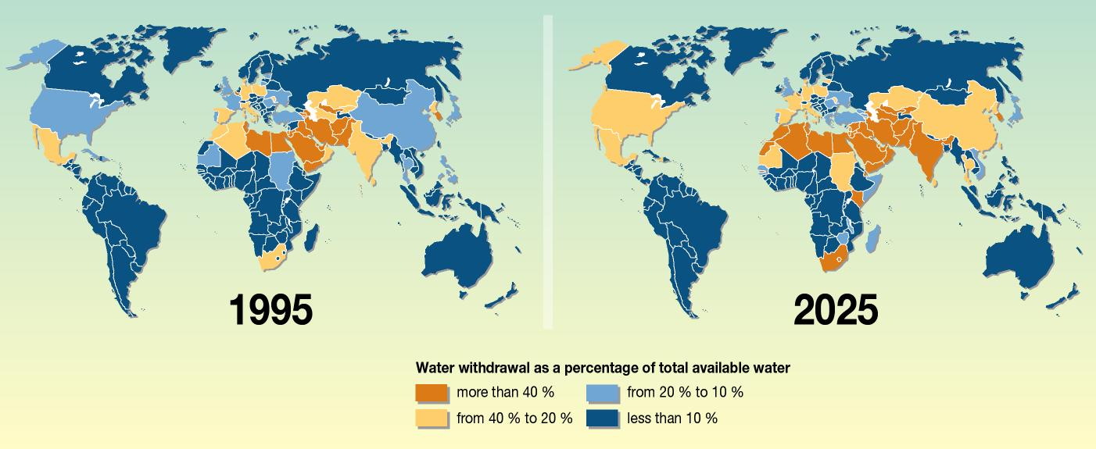
Increasing water scarcity presents a food and human security risk
A new approach is needed
Notes:
By 2050, the number of countries facing water stress or scarcity could rise to 54, with a combined population of four billion people – about 40% of the projected global population
http://www.unep.org/dewa/vitalwater/article141.html

Slide 3
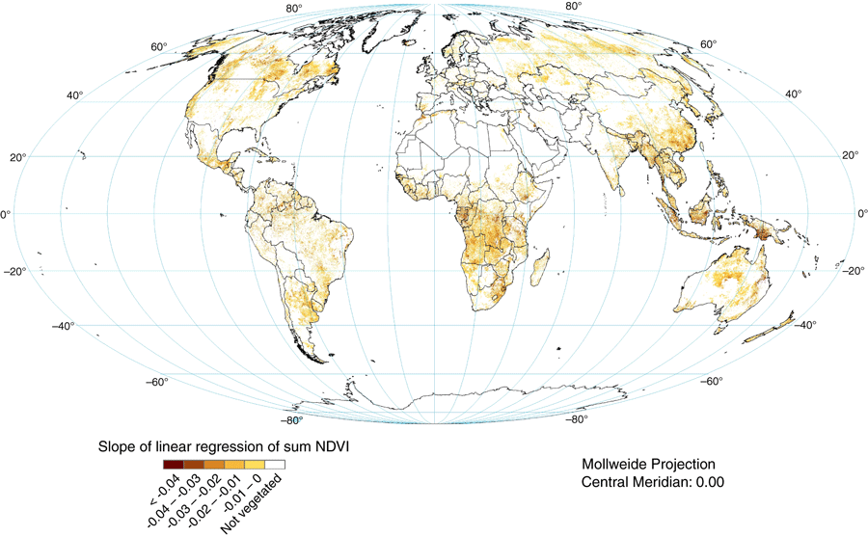
In the last three decades, the world lost 24% of its vegetation
Notes:
This map shows: Proxy global assessment of land degradation
Global negative trend in rain‐use efficiency‐adjusted normalized difference vegetation index, 1981–2003.
Soil Use and Management
Volume 24, Issue 3, pages 223-234, 24 JUL 2008 DOI: 10.1111/j.1475-2743.2008.00169.x
http://onlinelibrary.wiley.com/doi/10.1111/j.1475-2743.2008.00169.x/full#f3

Slide 4
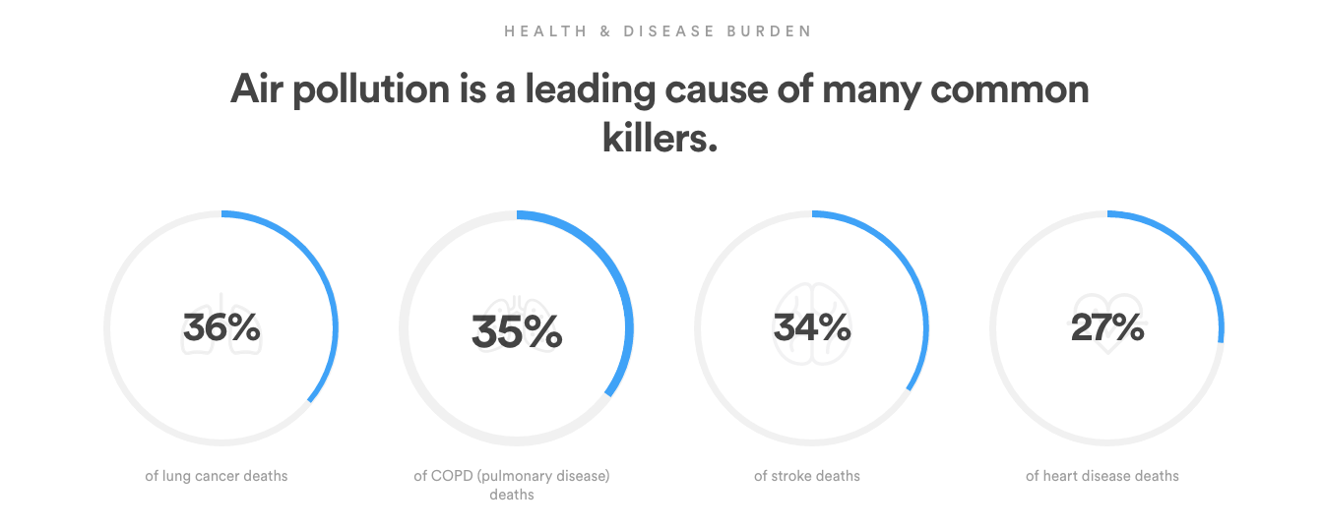


92% of the world’s population breathes unhealthy air
Notes:
http://breathelife2030.org/the-issue/health-and-climate-impacts/

Slide 5
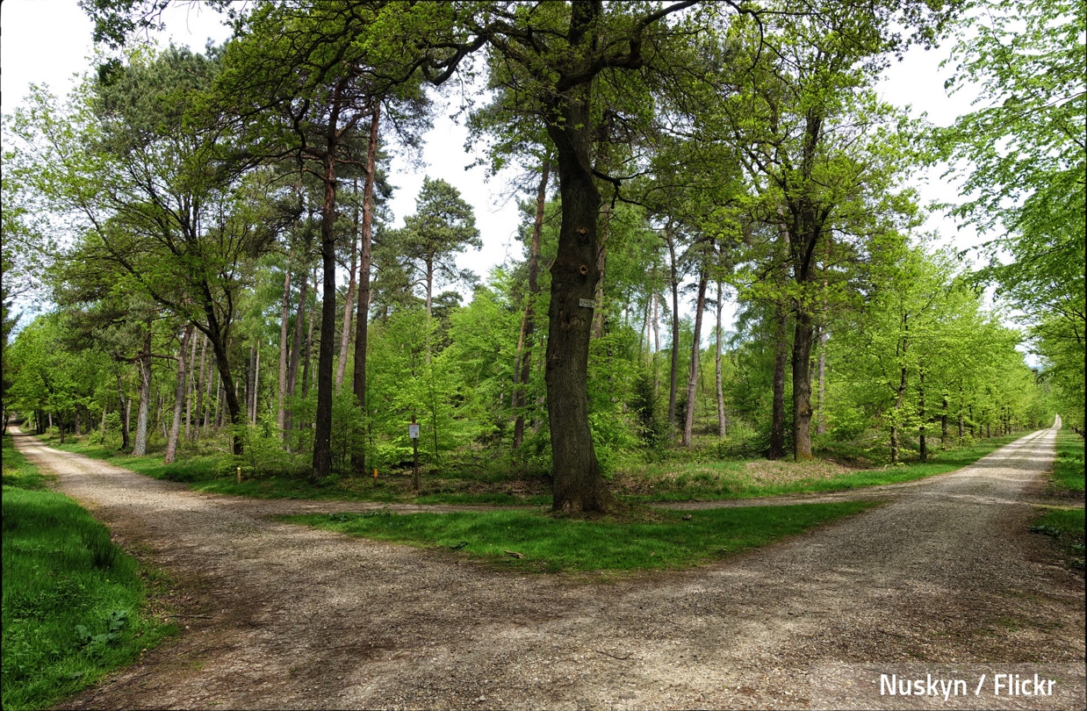
We are on our way, but what is the way forward?

Slide 6

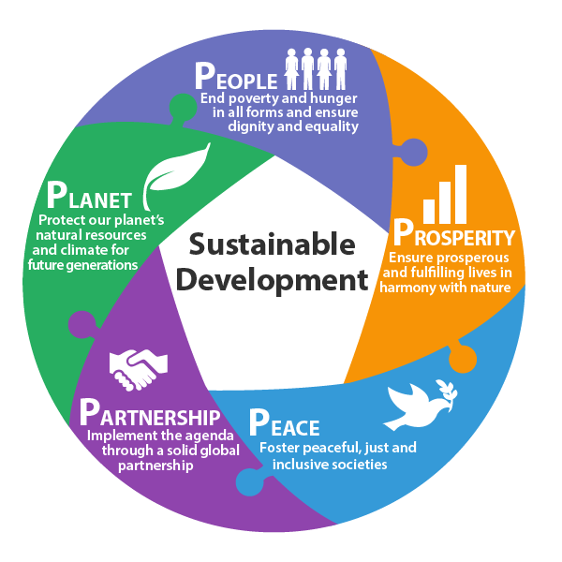
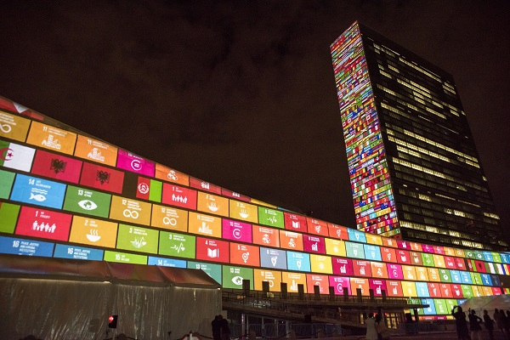
The 2030 Agenda for Sustainable Development

Slide 7

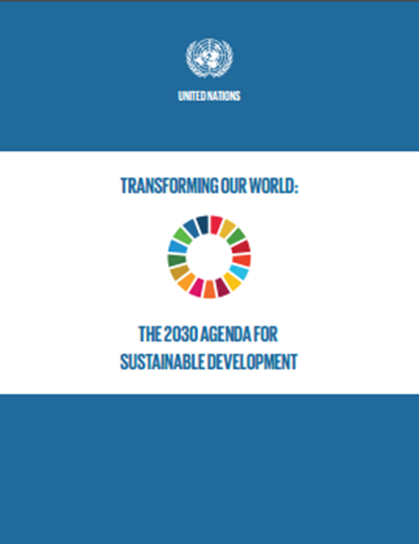
The New 2030 Agenda for Sustainable Development
“A Plan of action for people, planet and prosperity”, adopted 25 September 2015
Time frame: January 2016 – December 2030
Consists of
    A declaration
    17 Sustainable Development Goals (SDGs), 169 targets
    a renewed global partnership
    framework for review and follow-up – still in the making
The EU played a key role in shaping the agenda
Continued EU leadership in its external and internal policies is crucial for progress
Notes:
At a UN Summit (25-27 September 2015), Member States of the United Nations adopted the new sustainable development agenda entitled “Transforming Our World: 2030 Agenda for Sustainable Development.”
It officially comes into effect upon expiry of the Millennium Development Goals on 1 January 2016, and will run through 2030.
The 2030 Agenda sets forth “a plan of action for people, planet and prosperity” and seeks to strengthen universal peace in larger freedom.
It consists of a Declaration, 17 Sustainable Development Goals (SDGs) and 169 targets, a section on means of implementation and renewed global partnership, and a framework for review and follow-up.
The 2030 Agenda envisages a world of universal respect for human rights, equality and nondiscrimination, and the overriding message of the new agenda is “to leave no one behind”. It commits stakeholders to work together to eradicate poverty in all its forms, promote sustained and inclusive economic growth, social development and environmental protection.

Slide 8
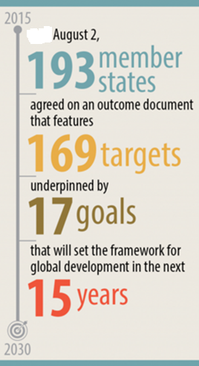
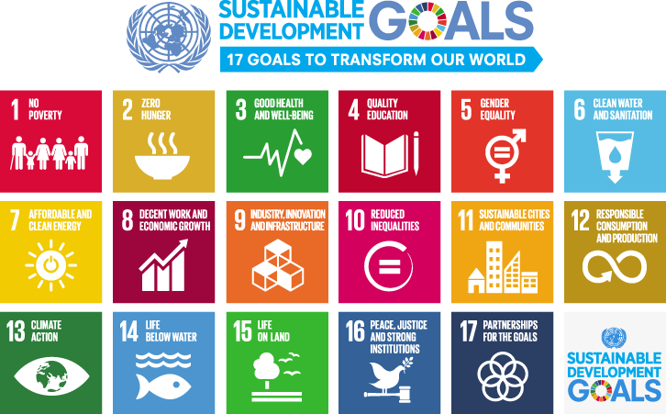

A new frame of reference for concerted action…

Slide 9
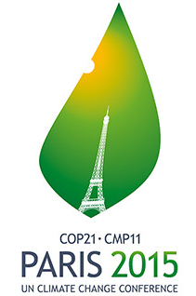
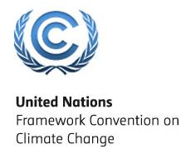
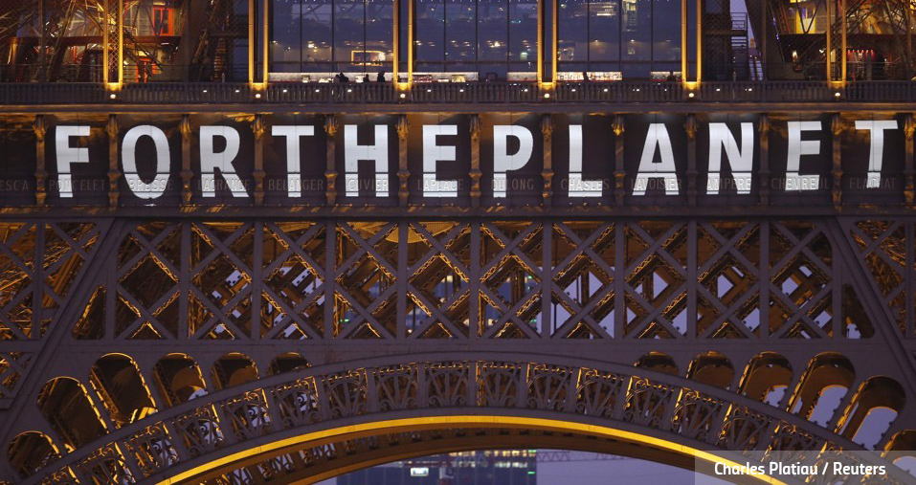
The Paris Agreement
on Climate Change

Slide 10
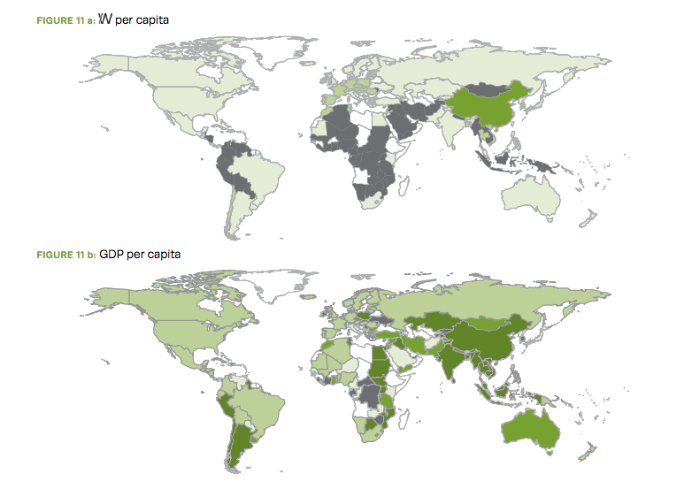

We need to change how we define economic success

Slide 11
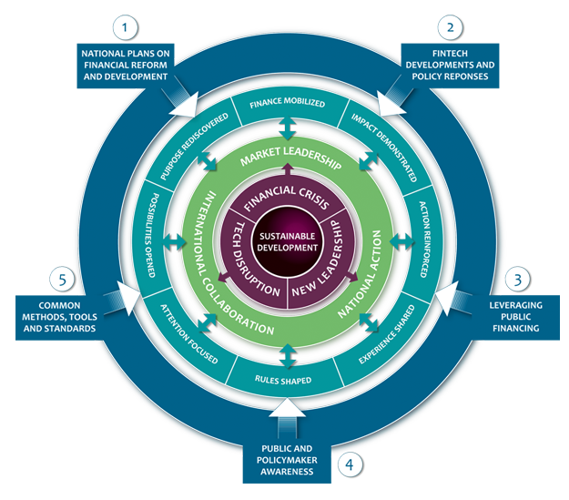

2. We need to redirect finance towards sustainable investments
Notes:
http://unepinquiry.org/onlineviewerPR2016/

Slide 12
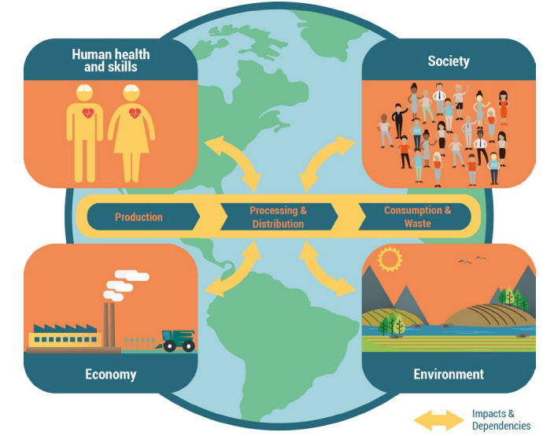

3. We need to recognize the value of the environment to our health and well being
Notes:
http://img.teebweb.org/wp-content/uploads/2015/12/TEEBAgFood_Interim_Report_2015_web.pdf

Slide 13
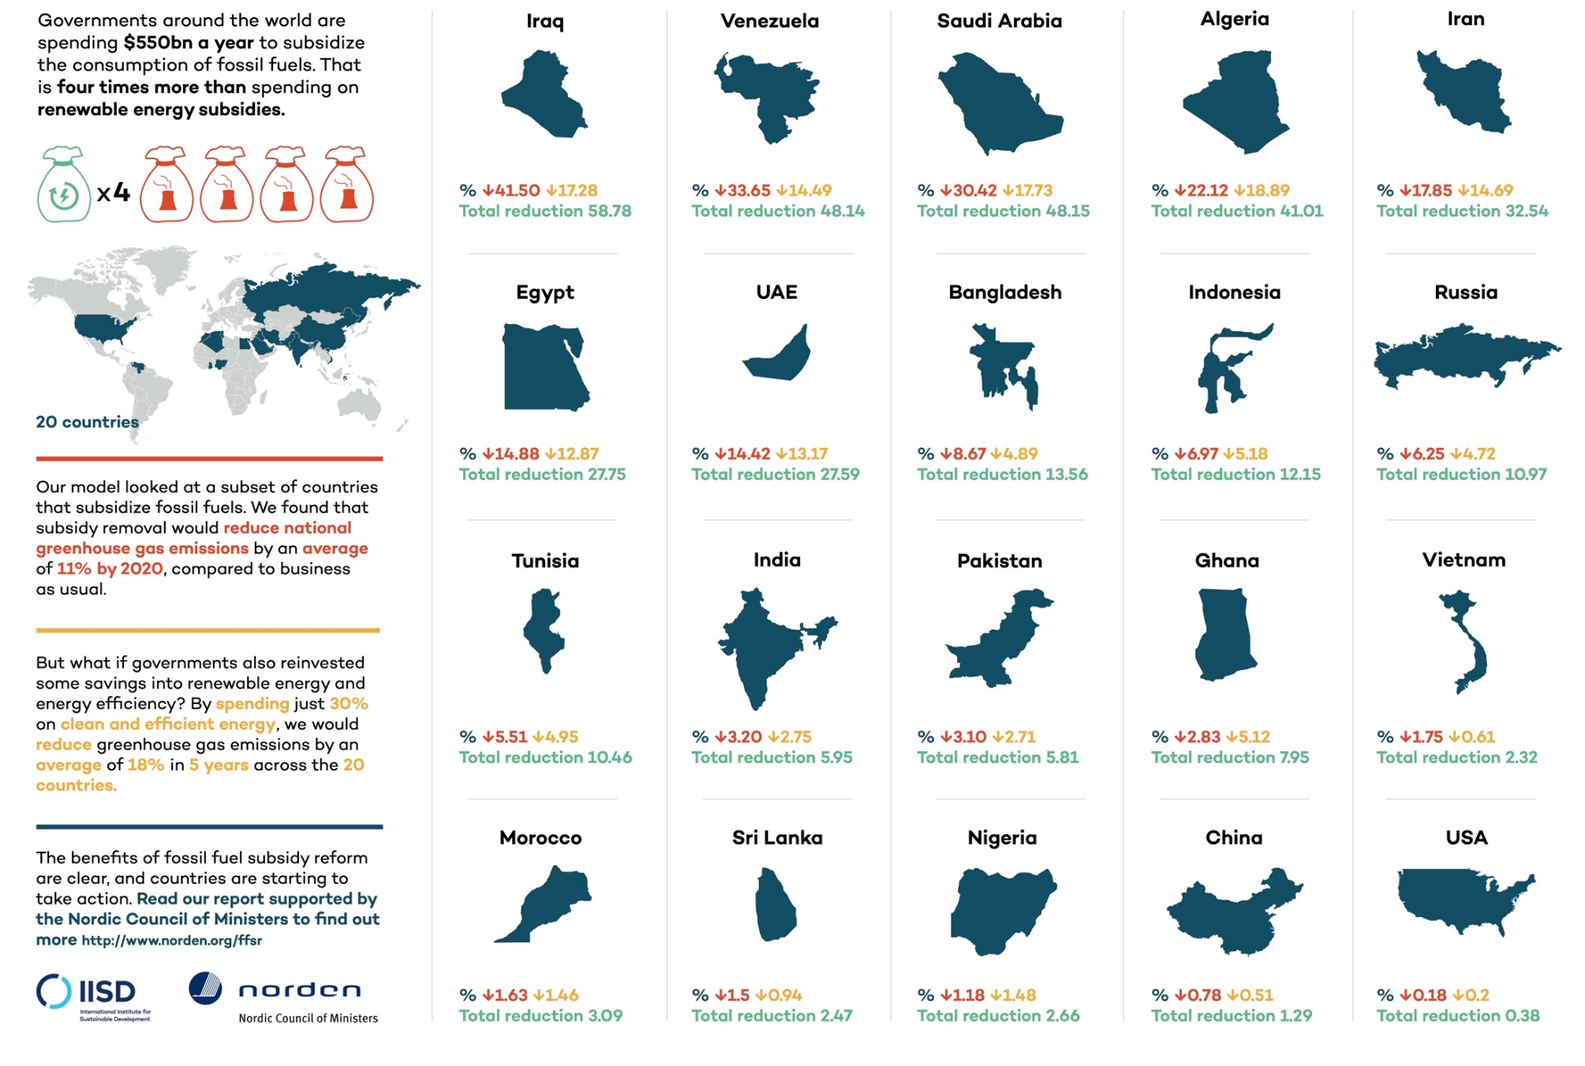
4. We need to reform markets and institutions so that environmental costs are accounted for
Notes:
Another option? http://www.iisd.org/gsi/sites/default/files/FFSR_and_climate_infographic_snd10-12_0.jpg

Slide 14
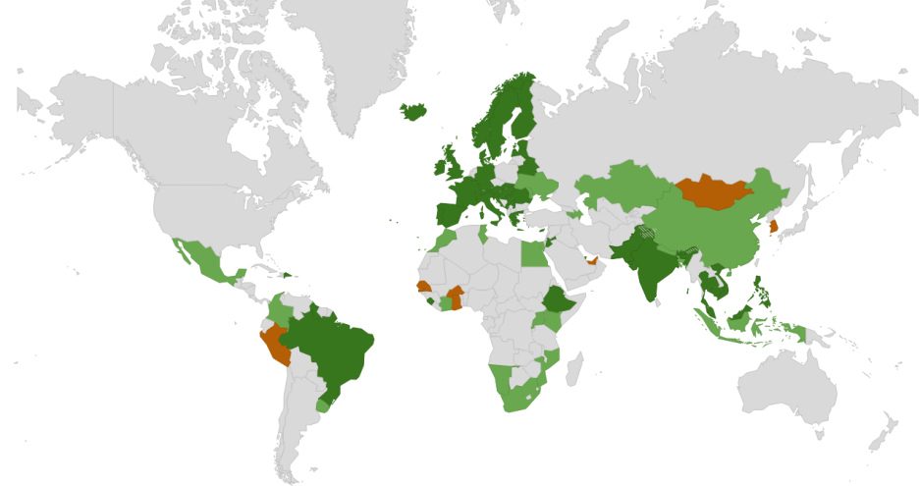
Over 65 countries globally are pursuing green growth or green economy strategies in different ways…
UNEP advisory services
National strategies, and other GE initiatives
PAGE countries
Notes:
14

Slide 15
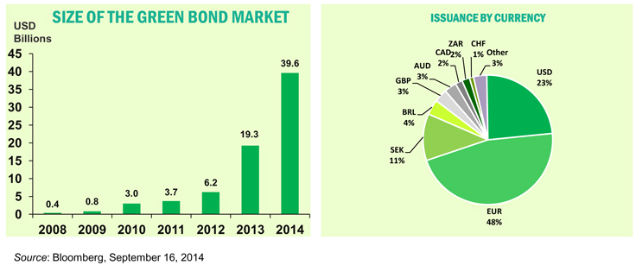
Momentum is building behind
green financial instruments

Slide 16
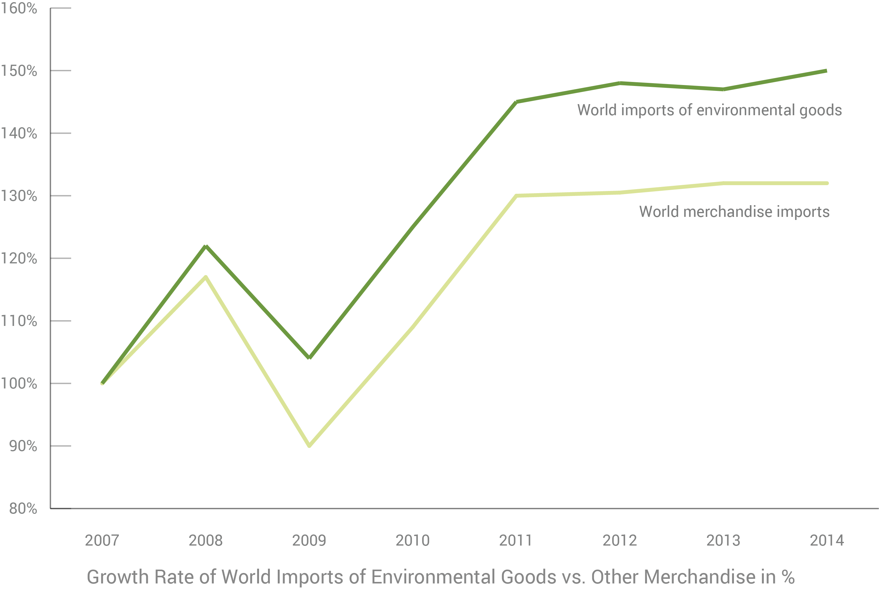

… as well as trade in environmental goods and services

Slide 17

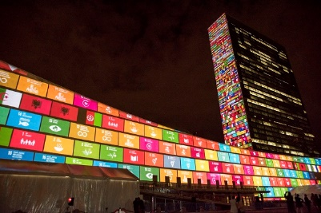
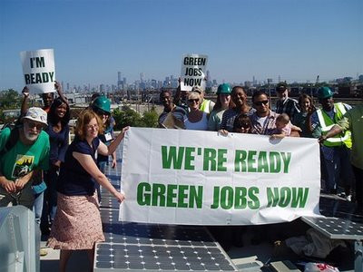
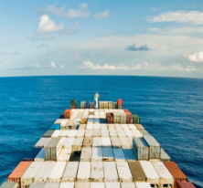
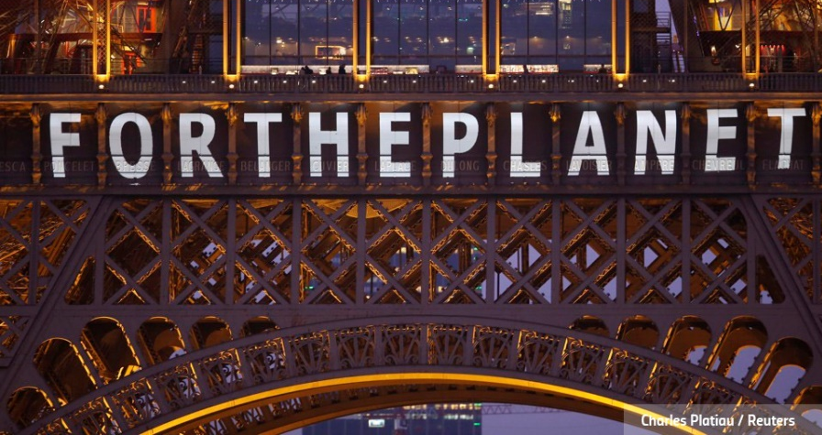
Key Questions
How does the principle of universality in the 2030 agenda change the way we conceive of development cooperation?
How can we build on and support country efforts to green their economies and make consumption and production more sustainable?
How can we improve the way we cooperate and partner to deliver on the 2030 agenda?

Slide 18



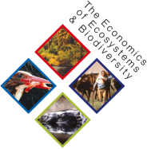


Approach Paths to the 2030 Agenda
Steven Stone
UNEP
steven.stone@unep.org

