Slide 1
19 April 2017
Opsys
Programme User Committee
7th meeting
Agenda & State of Play

Slide 2
Agenda
Approbation agenda + former minutes
Opsys State of Play
New Opsys Governance
AOB
  Next DEVCO IT SC

Slide 3
State of Play on OPSYS "Projects":
Track/project 1: Result & Monitoring
Track/project 2: Contract & Procurement
Track/project 3: Programming, Action & Decision

Slide 4
1. Results & Monitoring:
The creation and monitoring of the project/programme, Log-Frames and indicators.
Implementing entities enter achieved results
Aggregation per project/programme, EUDs/HQ units, Sector, country, region, year, and financing instrument.

Slide 5
"Results" upcoming Business milestones
Next results reporting exercise starting 10/2017 in the system (mostly for completed programmes).
Pilot Delegations and FPI start pilot phase for new and ongoing programmes in 10/2017
All Delegations and HQ units on board for encoding ongoing programmes: 02/2018

Slide 6
2. Contract & Procurement:
For all types of contract (procurement, grants, PAGODA, Budget support..) covering all aspects of contract management lifecycle (from call publication to contract finalisation) for both direct and ex-ante indirect modes.

Slide 7
"Contract" upcoming Business milestones
"FWC 2018" electronic management (Request for services, Submission of offers, Specific Contract signature, Amendment, Submission of deliverables) delivered to delegations 10 months after a validated tender dossier
"Plan B" in CRIS to guarantee business continuity - Deployment strategy in preparation

Slide 8
3. Programming, Action & Decision:
The preparation and validation of the Multiannual Indicative Programmes, Actions, Action-Programmes and decisions.
Their articulation into a portfolio of programmes accompanied by the appropriate financial forecasts and budget allocations.

Slide 9
OPSYS Project status:
Result & Monitoring
  New business governance not yet in place
Contract & Procurement
  Business governance not yet in place
  FWC-2018 legal basis not yet available
  Architecture conception ongoing
Programming, Action & Decision
  Not yet started

Slide 10
Result & Monitoring Status:
Analysis of major use cases is completed
First prototypes are available
IT Architecture (transitional phase) designed
To be done:
Business governance to validate intermediary deliverables, proposed user scenarios and release planning
Set-up a result indicator curating process.
Change management

Slide 11

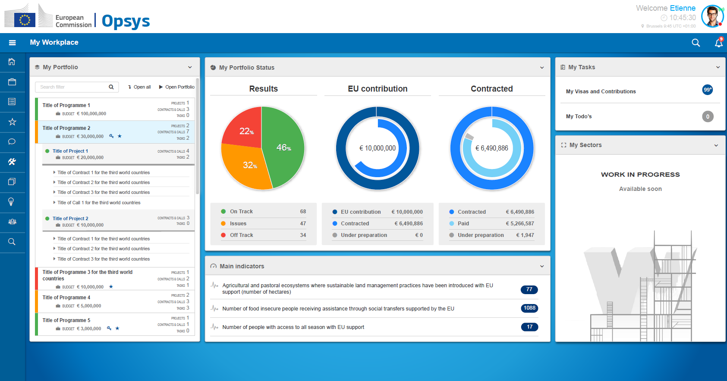
Entry point: My Workplace
Solutions foreseen in OPSYS

Slide 12
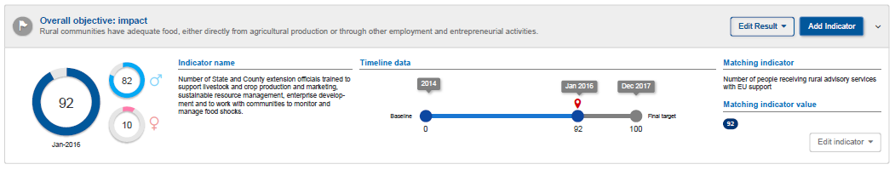
Logframes and indicators
Link between Policy and implementation
Re-use Quality-controlled indicators
Mirror local indicators with corporate matching indicators
Aggregation

Slide 13
Contract & Procurement Status:
Process analysis based on BENEF-2013 completed (to be validated)
IT Architecture (transitional phase) designed
Business Manager recruited since 1st February
To be done:
Waiting for FWC-2018 legal basis in order to finalise data models and proposed business processes
Business governance to approve business processes, scope and release planning

Slide 14
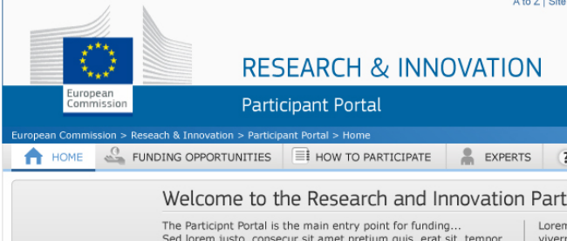
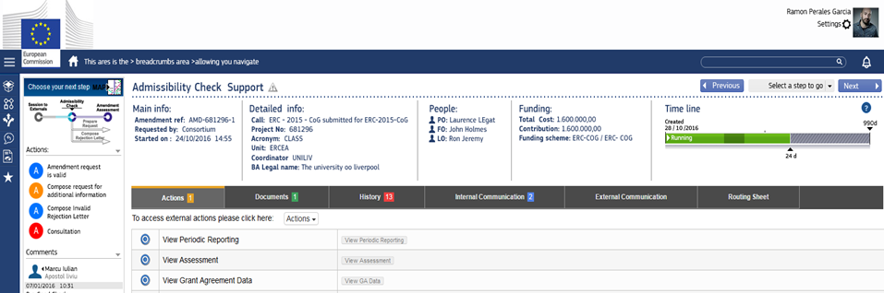
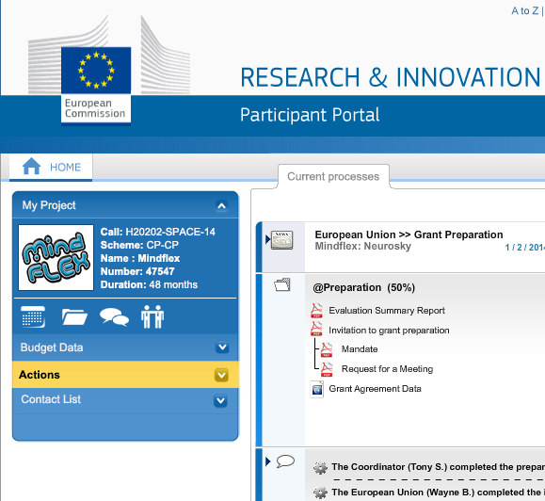
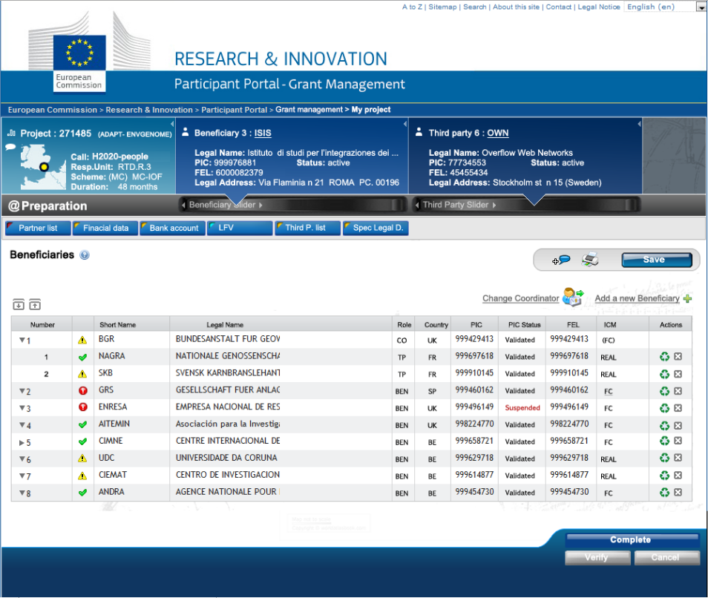
One single system for:
External Users
Internal Users

Slide 15
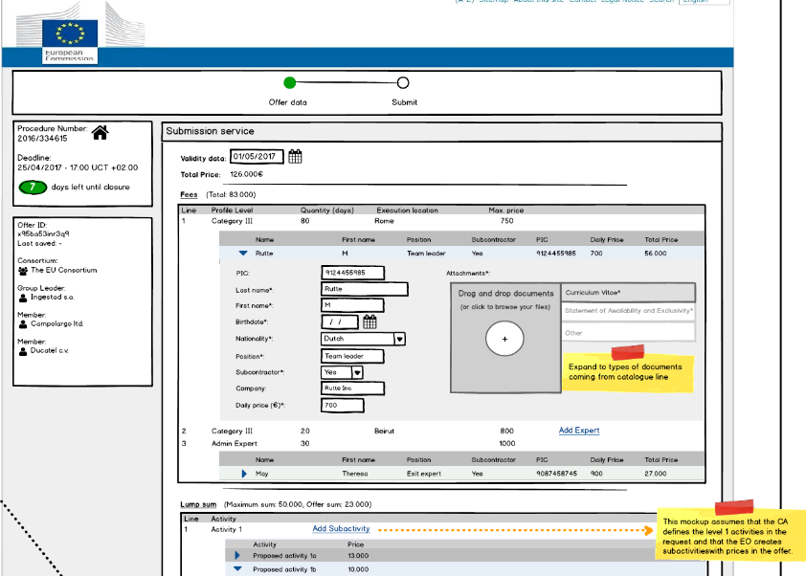
Request for services
The FWC
contractor encodes most data into the system

Slide 16
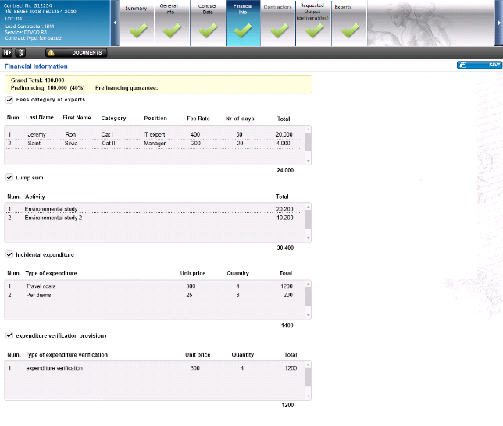
Draft specific contract
Complete structure of the contract recorded and managed in the system

Slide 17
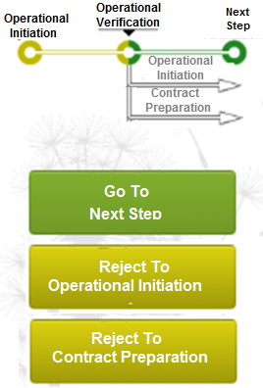
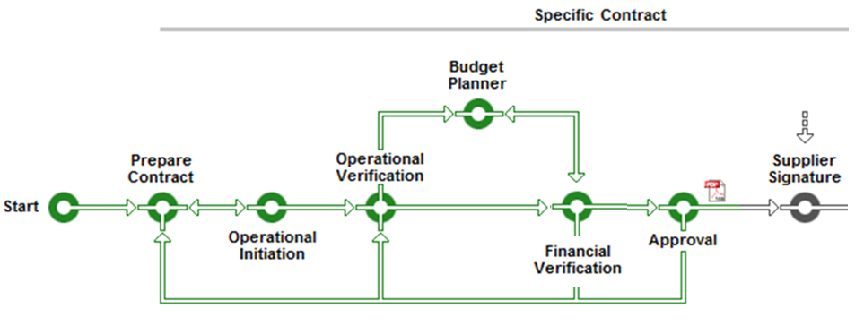
Validation: Metroline gives permanent overview on the workflow
OVA is done – the workflow moves to the next task in the business process !

Slide 18
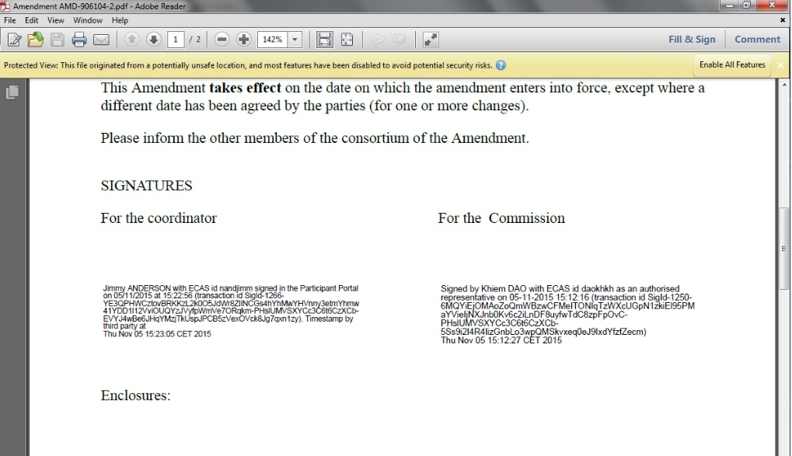
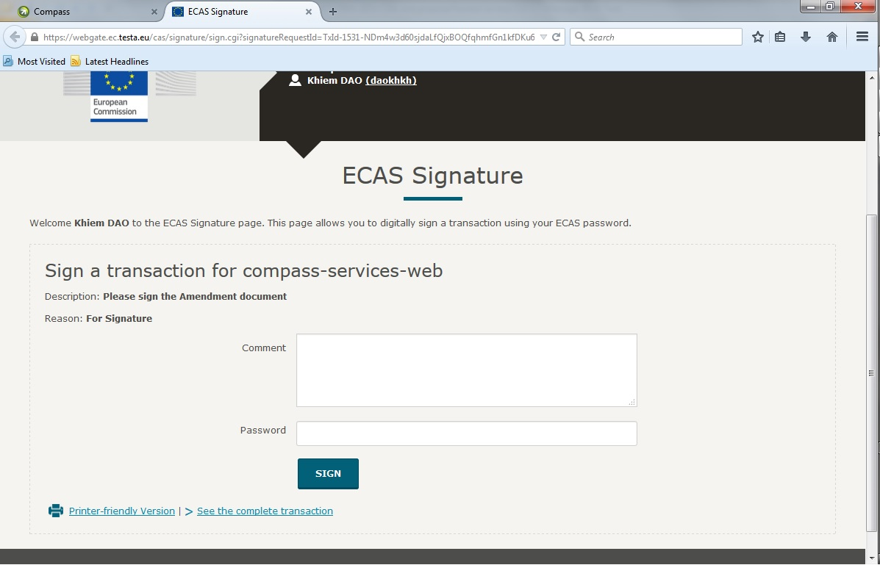
AOSD visa triggers:
Electronic signature of the Commission
Automatic registration in ARES

Slide 19
OPSYS Short term Planning:
04/17
07/17
10/17
01/18
04/18
Governance
Set-up
OPSYS 1st release
Results Release
BENEF
Release
Follow-up
Release
Approval of use case specifications and scope of both Results and Contract projects.
Validate IT architecture and usability features
Availability of all key use cases that enable result management
Launch BENEF requests and sign BENEF specific agreements.
?
Complement Result release with indicator management and BENEF release with amendment management.

Slide 20
OPSYS Risks 1:
Business governance
  New governance not yet fully set-up
  Potential misalignment between Partners (NEAR-DEVCO-FPI)
  FWC-2018 legal basis not yet available
Delivery risks
  Optimising interests between corporate and external action objectives
  Newly formed project team by people coming from different DGs, takes time to reach homogeneity, and common ways of working with Business
  Integration of multiple corporate systems (still better than building from scratch)

Slide 21
OPSYS Risks 2:
Human Resources
  OPSYS is currently at 40% of foreseen man-power
    Recruitment on-going, difficulties in finding good experts
  Delays in transferred posts
    Can't launch 3rd project (Programming-Action)
    Delays in supporting additional contract types
  No colocation (part of staff to be moved rue de Genève)
SEDIA implementation

Slide 22
OpSys Draft
Product Roadmap March 2017
04/17 | 07/17 | 10/17 | 01/18 | 07/18 | 10/18 | 01/19 | 06/19 | 01/20 | 06/20
Vision Demo | 1st working release | Results release | BENEF release | Action Release | Prospect Release | Full Grant Release | Full Procurement | Programming Release | Feature Complete
Communicate the user stories | Validate technology and integration decisions | Result management for internal & external users | Support of BENEF FWC and specific contract | Action mng for RELEX programme | Corporate version of Prospect | All types of grants supported | All types of procurement supported | Programming Cycle support for the new MFF/EDF | All RELEX contract modalities supported.
MyWorkPlace, SEDIA Portal, Results, Task list etc .. | IOP integration, i.e. CCM, SEC, IAM, ERIS, AUX | LogFrame and sector tagging support | E-Submission, Procedure, SyGMa, COMPASS | CCM extension, workflow driven approval | COMPASS driven pre-award process, SEDIA integration | Full grant lifecycle support, ex-ante indirect grants workflows Full Result +MIS integration | Full Procurement Standard compliance, SEDIA portal | Workflow based decision making process | Support for all types of implementation modalities
Key User approval | Performance , stability | Covers all CRIS contracts, user satisfaction | User satisfaction, measurable efficiency gains | User satisfaction, | Smooth transition with at least the same rate of user satisfaction | User satisfaction measurable efficiency gains | User satisfaction, measurable efficiency gains | Process automation, user satisfaction | User satisfaction, measurable efficiency gains

Slide 23
Logframe migration:
List of decisions in CRIS
Template for migration designed (excel -> RR)
Collection of data started (Action Documents + FPI)
To be done:
Encode in template (> 2000 logframes)
Quality control / Validation (EUD to confirm)
Develop, test loading tool (DIGIT) + Load in Opsys

Slide 24
General approach Roll out of system in 3 waves
Comprehensive workshops - train-the-trainer in 10 Delegations and HQ
Objective
capacitate stakeholders (EU operations and key external stakeholders) on new IT system and process/ methodology for result based management
2017/18
Results & monitoring/eval
2019
Contracts & procurement
2020
Programming, Action Docs and Decisions
1 pilot WS
at HQ with pilot EUDs
Roll out Regional WS in 10 hubs + HQ
1 pilot WS
at HQ with pilot EUDs
Roll out Regional WS in 10 hubs + HQ
1 pilot WS
at HQ with pilot EUDs
Roll out Regional WS in 10 hubs + HQ
Training
Testing
Lessons learnt and further testing, improvement
Lessons learnt and further testing, improvement
Lessons learnt and further testing, improvement
Breakthrough projects
Support
HOTLINE/ E-LEARNING/ COACHING

Slide 25
Roll out Results management – regional workshops February 2018
Comprehensive workshops - train-the-trainer in 10 Delegations and HQ
Objective
capacitate stakeholders (EU operations and key external stakeholders) on new IT system and process/ methodology for result based management
Oct
2017
Nov
2017
Feb
2018
April
2018
Work-shops
11Pilot DEL+HQ @Brussels
FPI HQ
@ Brussels
FULL ROLL OUT
EUDEL @ 10 HUBS +HQ @ Brussels
Support/ Follow up encoding LF Pilots/ system adaptation
Nov 2017-Jan 2018
Support/ follow up encoding LF
Feb2018-…
Suport & Follow up
HOTLINE

