Slide 1
19 April 2017
Opsys
Programme User Committee
7th meeting
Governance and AOB

Slide 2
FORMER GOVERNANCE
System owner = DEVCO 05
DEVCO IT SC
Incl. NEAR and FPI rep.
informs
NEAR IT SC
DGs level
endorses
DDG level
EU Del: (first time) BRAZIL/S AFRICA & NEAR area
OpSys PSC
DEVCO & NEAR dir. + FPI + DIGIT + ad hoc DGs
Technical level
EU Del: ETHIOPIA, MALAWI, PERU, BRAZIL, AFGHANISTAN, PAKISTAN & NEAR area
OpSys Programme User Committee (PUC)
HQ & EUD rep. from DEVCO/NEAR/FPI/ECHO/EEAS dir.
Technical level
Business needs and testing
EU Del to be identified
OpSys Domain User Groups
Results Management
Contract Management
Other domains and focus group
Contract Management
Other domains
Other domains
2
Notes:
OpSys system owner: DEVCO.05

Slide 3
New Opsys Governance
Issues to be addressed:
Former Steering Committee efficiency (many members, overlap with IT SC, bottlenecks)
Rich stakeholder landscape
From the New Opsys Approach:
  Better securing business adherence to system functionalities
  Increased corporate ambition

Slide 4
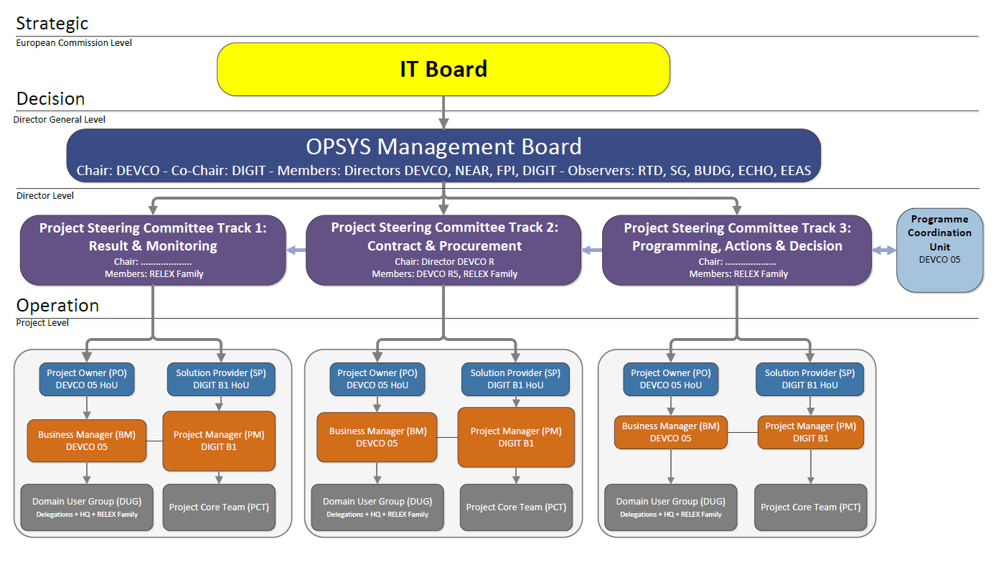

Slide 5
Opsys Management Board
chaired by the business owner, DEVCO DDG
reflects
  business interests: business is in the driving seat
  coherence with corporate interests
last stop for decision making
guardian of the OPSYS vision
Decides on priorities/workplan/deviations

Slide 6
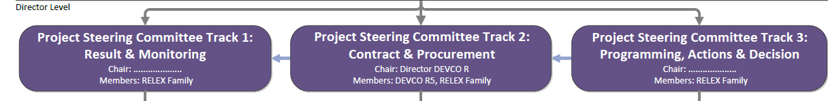
Project Steering Committees
chaired by a senior manager
are operational committees/ flexible format
responsible for piloting the concerned OPSYS project:
  defines business objectives
  supervises the implementation and takes decision
  decides go/no-go of the deliverables before roll-out
reports to the OPSYS Management Board on key decisions

Slide 7
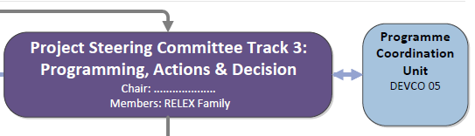
Programme
Coordination Unit
mission ensured by DEVCO 05:
  Business Process Coordination
  Programme Management together with DIGIT
  Change Management, Stakeholder management
to guarantee cross-domain coherence
advisory entity for all the PSCs chairs
liaising with the User Committee

Slide 8
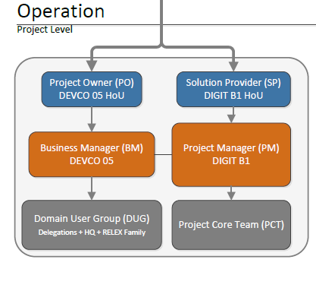
PUC & DUG
PUC
Dissemination of information
Discussions over transversal issues on an ad-hoc basis
DUG
Composition: key contributors/standing members & pool of experts
discuss/help finalizing business requirements
involved in design & pilot exercise
take part in UAT
support harmonization of processes, terminology & definitions
Discuss change management options

Slide 9
OpSyS Business governance actors
Articulation
of the 2 DUGs
OpSys Programme User Committee (PUC)
HQ & EUD rep. from DEVCO/NEAR/FPI/ECHO/EEAS dir.
Domain User Group 1
Results & Sectors
Domain User Group 2
Contract management & Procurement
Geographic & thematic units
Operational units Representatives from DEVCO, NEAR, FPI
Geographic, thematic & F/C units
Operational & Finance and Contract units Representatives from DEVCO, NEAR, FPI + SJ,BUDG (ad hoc)
Pilot EUDs (NEAR & DEVCO EUDs, including with FPI staff)
Bosnia, Brazil, Ukraine, Ethiopia, Morocco, Peru, Pakistan, Turkey, Malawi, Afghanistan, Georgia
Pool of experts
Experts on specific topics
Pool of experts
Experts on specific topics
Business management
Lucile PETITPIERRE/Michel LONNEUX Loic ELIES/Iason FOSCOLOS
(Results/Operational entities/sectors) (Contract management & procurement)
Key contributors/ Process owners
Results
DEVCO 06, NEAR A4-A3, FPI 01
Key contributors/ Process owners
Sector
DEVCO R1 -06, NEAR A4-A3, FPI 01 + others
Key contributors/Process owners
FWC
DEVCO R5-R3-06, NEAR R2, FPI 01
+ SJ, BUDG
9

Slide 10
AOB
DEVCO IT SC on 24/04/2017
  Presentation New Opsys Approach
  Endorsement New Opsys Governance
  2017 and 2017-2020 Opsys budget (effort on ATA credits, frontloading EDF, partners contribution)
Savings generated by Opsys (stricto sensu) | 2015-16 | 2017 | 2018 | 2019 | 2020 | total
scenario New Opsys Approach
in million euros
initial estimate 30/11/2016 | 4 | 11.75 | 16.3 | 19.9 | 11.2 | 63.15
revised estimate 20/02/2017 | 4 | 11.3 | 14.1 | 14.1 | 8 | 51.5
savings |  | -0.45 | -2.2 | -5.8 | -3.2 | -11.65
percentage |  | 3.8% | 13.5% | 29.1% | 28.6% | 18.4%

Slide 11
AOB
DEVCO IT SC on 24/04/2017
  2017 and 2017-2020 Opsys budget
savings generated by Opsys (stricto sensu) with IT and business share | 2015-16 | 2017 | 2018 | 2019 | 2020 | total
scenario New Opsys Approach
in million euros
IT part initial estimate | 1 | 8.47 | 11.5 | 14.9 | 7.3 | 43.17
IT part revised estimate | 1 | 8.47 | 9.3 | 9.8 | 5.4 | 33.97
savings IT |  | 0 | -2.2 | -5.1 | -1.9 | -9.2
 |  | 0% | 19% | 34% | 26% | 21%
Business part initial estimate | 3 | 3.28 | 4.8 | 5 | 3.9 | 19.98
business part revised estimate | 3 | 2.83 | 4.8 | 4.3 | 2.6 | 17.53
savings business |  | -0.45 | 0 | -0.7 | -1.3 | -2.45
 |  | 14% | 0% | 14% | 33% | 12%
nota: additional transfers from business to IT are being analysed

