Slide 1
Opsys
Contract management
Key contributors (Subgroup of DUG)
First meeting
27 04 2017

Slide 2
Agenda
Quick view of Opsys program
Role of key contributors (versus Domain User Group [DUG])
Functional scope of track 2 : description of capabilities, type of contracts
Implementation of the solution
How will we work together ?
Preparation of the next DUG

Slide 3
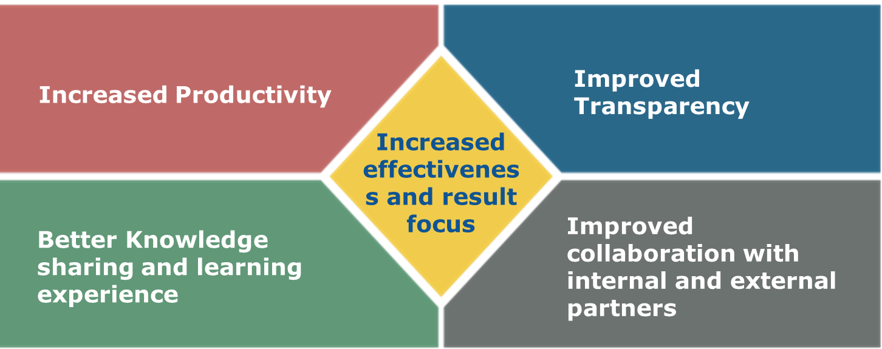
What is the Opsys program ? (1/3)
Output : Deliver a new information system by 2020, for DEVCO, NEAR and FPI activities, in which information is recorded by the authors themselves, covering end-to-end business, with a single entry point, and made with corporate "bricks".

Slide 4
What is the Opsys program ? (2/3)
Organization :
  DEVCO.05 :
    leads the Program
    Expresses the business requirements (defined with the help of units of External Action family)
    Validates the solution delivered by the IT supplier
    Manages the change (roll out, training, data migration, communication …)
  DIGIT :
    Delivers the solution as defined by DEVCO.05
    Makes the solution "corporate" as much as possible

Slide 5
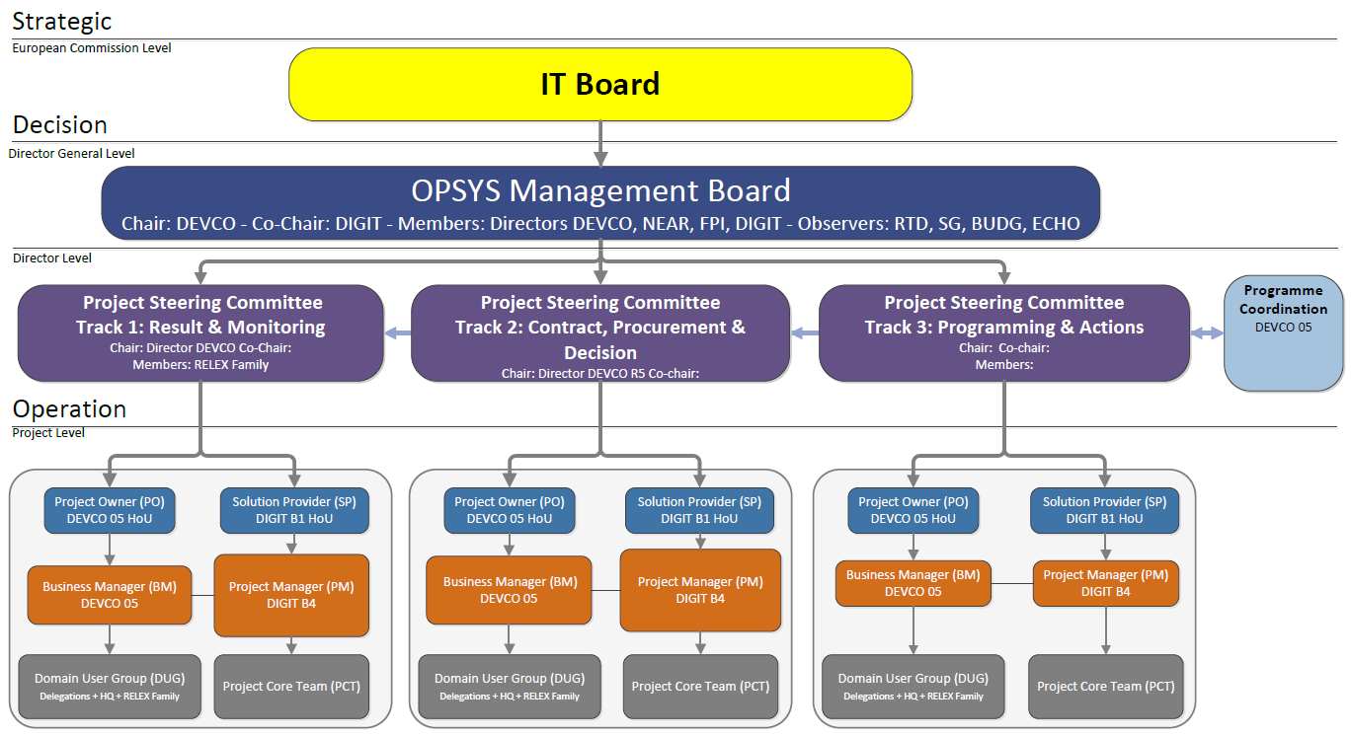
What is the Opsys program ? (3/3)
Governance

Slide 6
Role of key contributors
The Key contributors team is a subgroup of Domain User Group (DUG) of track 2
DUG-2 role versus Key contributors role
DUG | Key Contributors
Approve the business case | Help DEVCO.05 to draft the business case
Ensure that the scope of track 2 encompasses the needs of all users of the ex-Relex family
Approve the HL business requirements | Help DEVCO.05 to define the business requirements
 | Contribute to writing business rules, detailed specifications
 | Participate to validation of the artefacts produced by IT supplier
Support the harmonisation of processes, terminology and definitions
 | Discuss change management options
Approve change management strategy
 | Perform the user acceptance tests (first levels)
Perform the user acceptance tests (final level)

Slide 7
Functional scope of track 2 (functional architecture)
Defining the list of type of contracts (conceptually synonymous with procedure) – about 40 procedure identified
Defining the capabilities for implementing a procedure, as conceptually as possible (i.e. with a high level of abstraction). Ex: Launch a new contract; Submit an application ; Define contract payment terms (= conditions of payment) ; … About 35 capabilities identified
Defining which actors use the capabilities (5 actors identified)
Defining which procedure uses which capabilities

Slide 8
Implementing the solution
AGILE approach (instead of "waterfall" approach):
  Have a good idea of the outline of the Opsys solution, but not a detailed view of all its contents.
  Define a roadmap with releases of the solution. Release 1 of contract management module is scheduled for January 2018. Release 2 in March 2018, etc.
  Define Program Increments (PI) of 10 weeks focused on delivery of features. Then, review the deliverables of the previous PI, and define the content of the new PI.
Our next objective, which we must focus on, is to roll out a first release of the contract management module for the BENEF 2018 FWC in January 2018.

Slide 9
How will we work together ?
(i) We receive many questions of clarification from the IT supplier, (ii) we need to streamline some business processes, (iii) we need to rationalize and define some business rules, etc. ➔ on many topics we have to produce detailed specifications.
Example of topics to be addressed :
  Signature order of a contract
  How to manage the "Balance Payment modalities" ?
  Should the contract budget breakdown be allocated on the CRIS decision budget breakdown (component) ?
  Should it be possible to have different template of Terms of References according to the type of service contract ?
  In a FWC, sub-contractors should be declared in the system?
Example of business topic to be addressed :
  The terms "contractor", "implementing partner", "economic operator", "supplier" are currently used. Are they all synonyms ? Which one must we implement in Opsys ?

Slide 10
How will we work together ?
Proposition :
  We will set up a tool (JIRA) to list, centralize and monitor all topics (=ticket) to be addressed.
  We will write a procedure to define how a ticket must be processed, from the step of its identification to the closing step. Procedure could be (simplified view) :
    Identification of the topic (ticket), qualification, description.
    Address the ticket to the appropriate person (automatically sent be e-mail).
    The designated person drafts a response, or addresses the ticket to someone else. If needed, escalades the ticket.
    Validation of the response, sending to IT supplier
    Closure of the ticket

Slide 11
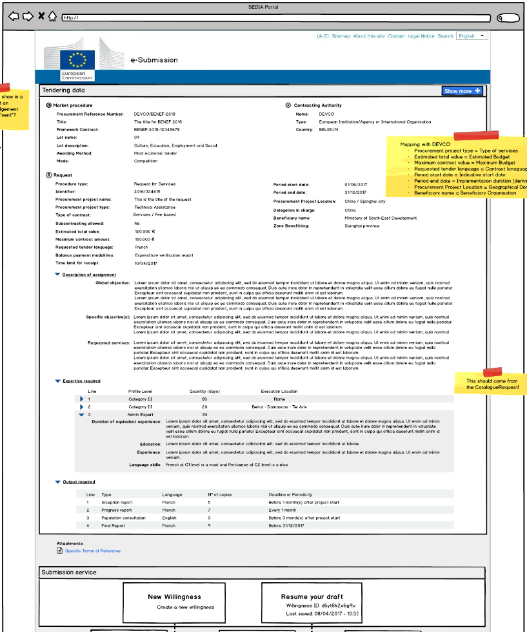
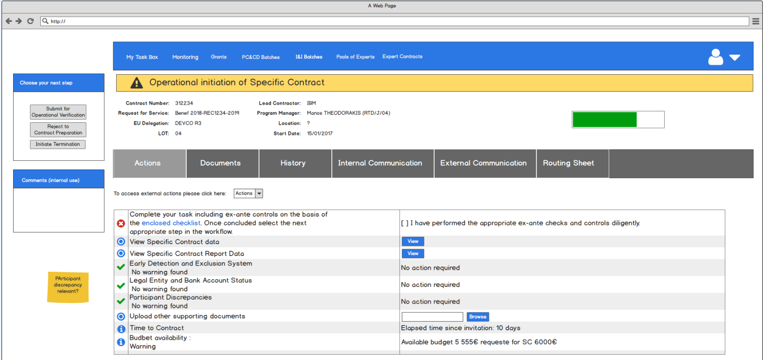
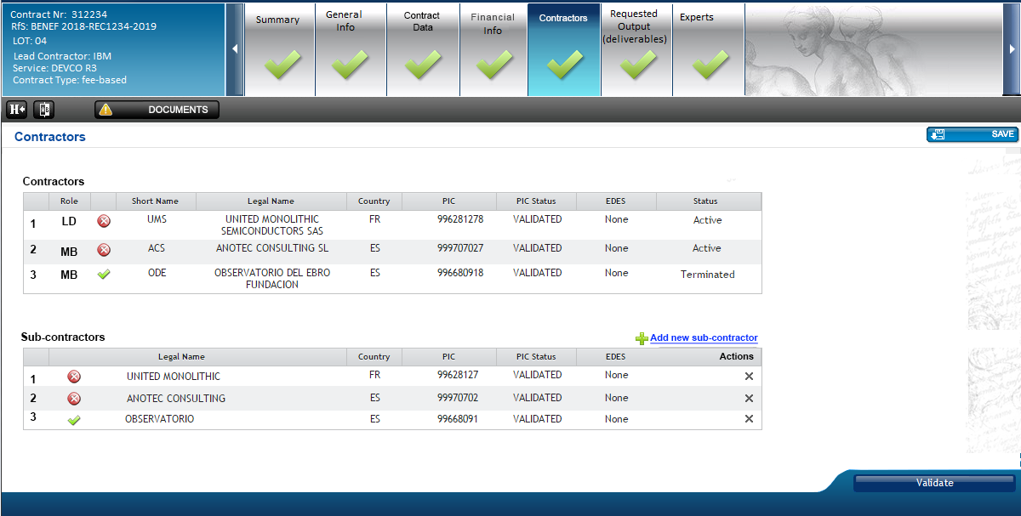
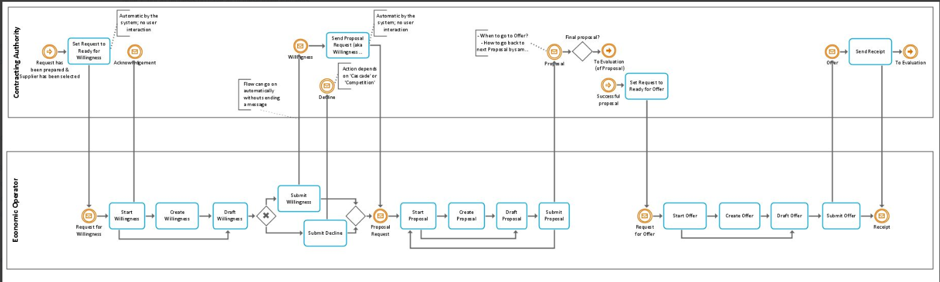
How will we work together ?
Example of artefacts produced by IT provider that we must validate

Slide 12
How will we work together ?
Proposition :
  Depending on the artefact to be validated, the Business Management Team (Paul Riembault, Loïc Eliès, Cédric Yao, Iason Foscolos) will contact some of the key contributors, in a formal or informal way.

Slide 13
Preparation of the next DUG-2

Slide 14
Thank you,
See you on 03/05/2017 for the DUG!

Slide 15
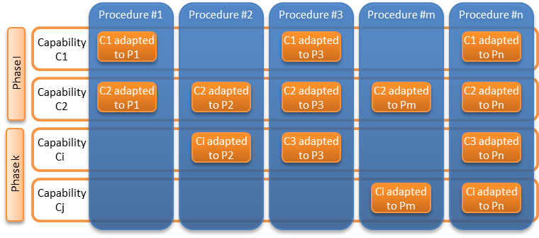
Matrix procedures / capabilities
Back

Slide 16
Main actors
Committee
OPSYS CORE
SEDIA Portal
Contractor
EU (Deleg & HQ)
Partner Country
Technical Assistance
Back

Slide 17
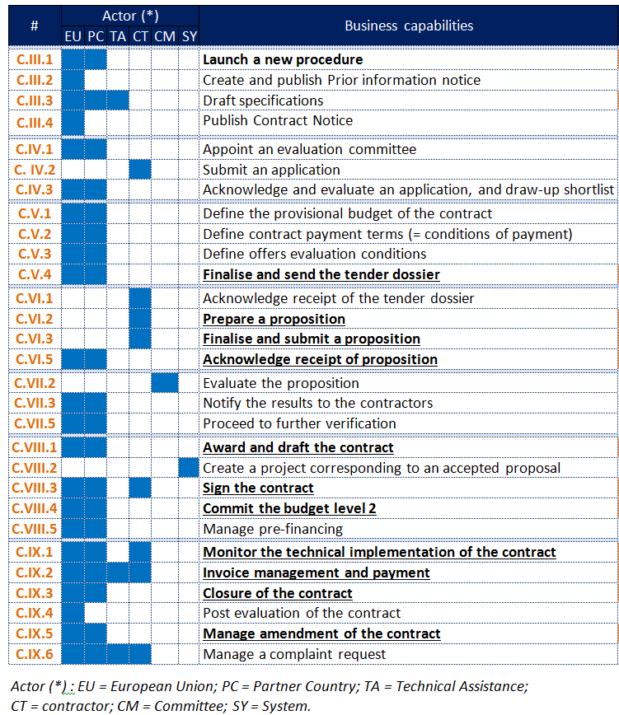
Contract Forecast Phase
Draw-up short list Phase
Define tender dossier Phase
Submission Phase
Evaluation Phase
Award and signing Phase
Implementation and monitoring Phase
Back

Slide 18
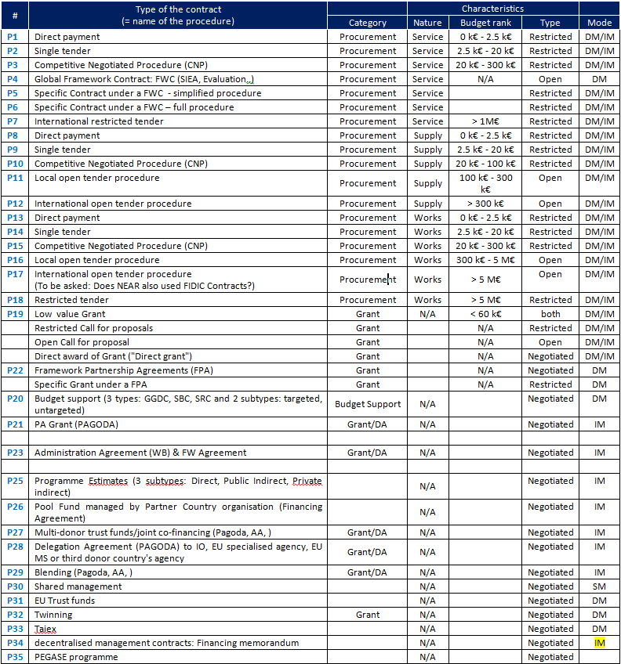
Back

Slide 19
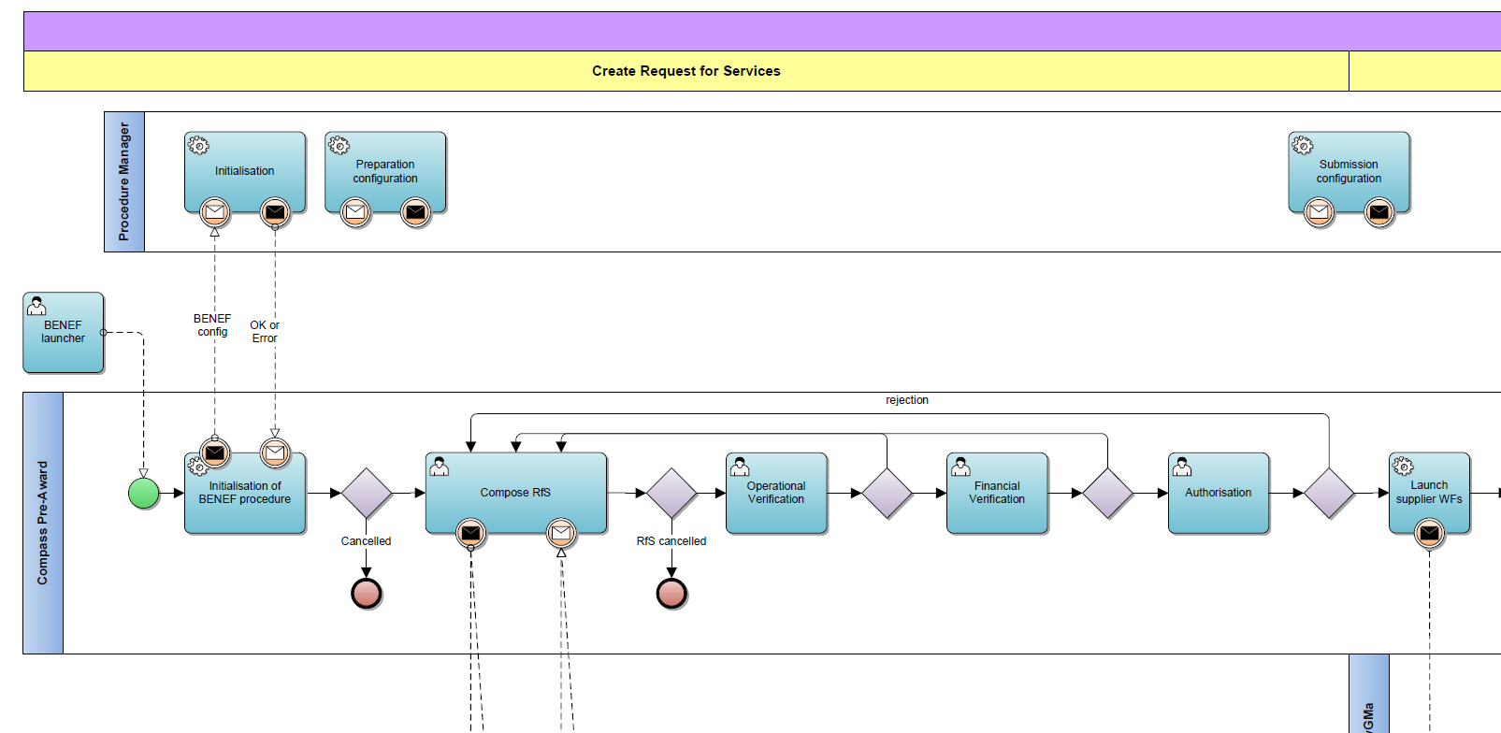
Artefact: Business process mapping

Slide 20

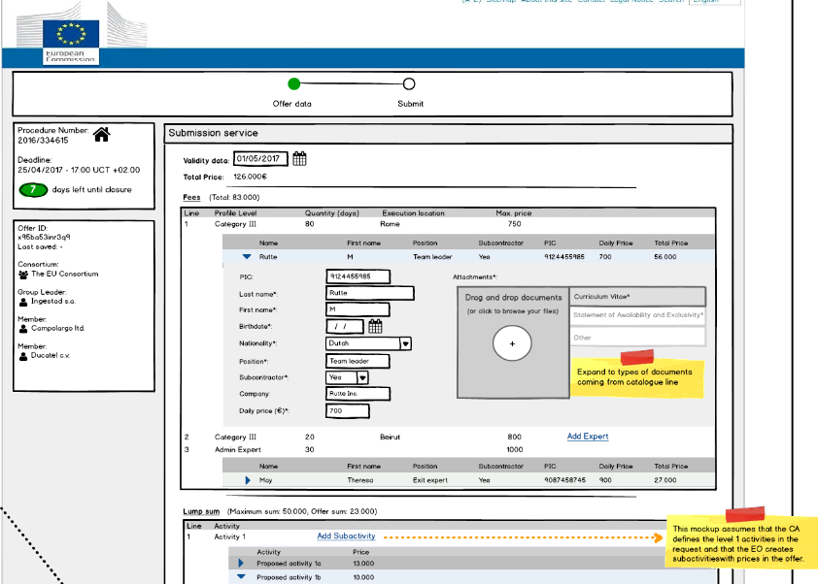
Artefact: "Content mock-up"
The FWC
contractor encodes most data into the system

Slide 21
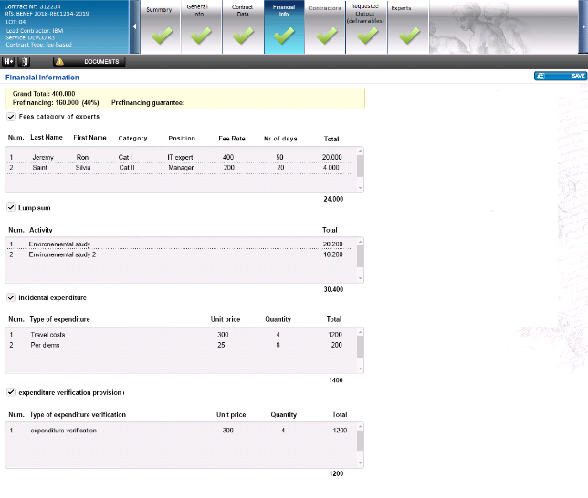
Artefact: "Content mock-up"
Complete structure of the contract recorded and managed in the system

