Slide 1

Structural Change and Rural Diversification in Developing Countries: What suggestions for action?
Hot Topic Seminar
« Rural transformation, jobs creation and migration: an inclusive approach”
Brussels, 10-12 April 2017
Sandrine Fréguin Gresh
Bruno Losch
Denis Pesche
Jean-Michel Sourisseau

Slide 2
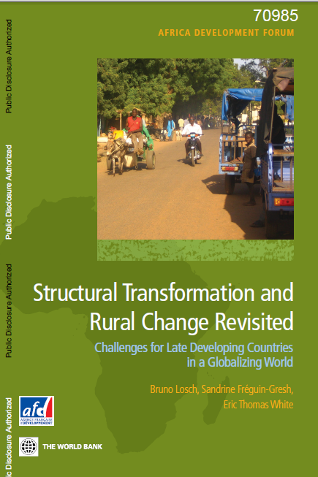
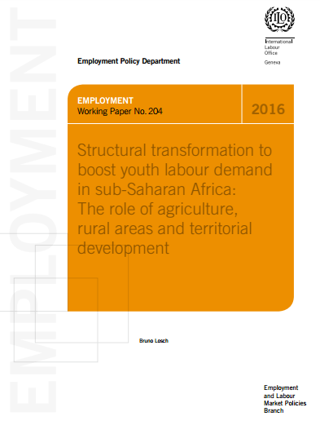
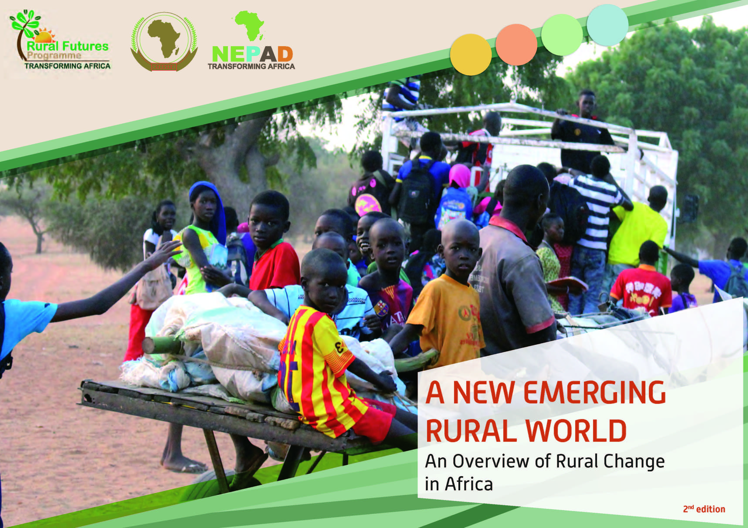
References

Slide 3
Understanding Structural change
What is Structural Change?
  Process of change in the macro-economic structure based in a shift from agriculture to industry and services
Underlying dynamic:
  Increased productivity in agriculture (innovation)
  Release of labor and capital to other economic activities
  Broad geographic restructuring → flow of labor from scattered to more concentrated activities → urbanization
Results:
  Higher incomes, greater wealth, and improved living conditions
  Along with medical progress→ demographic transition
  Growing agricultural incomes → rural demand → opportunities for rural activity diversification

Slide 4
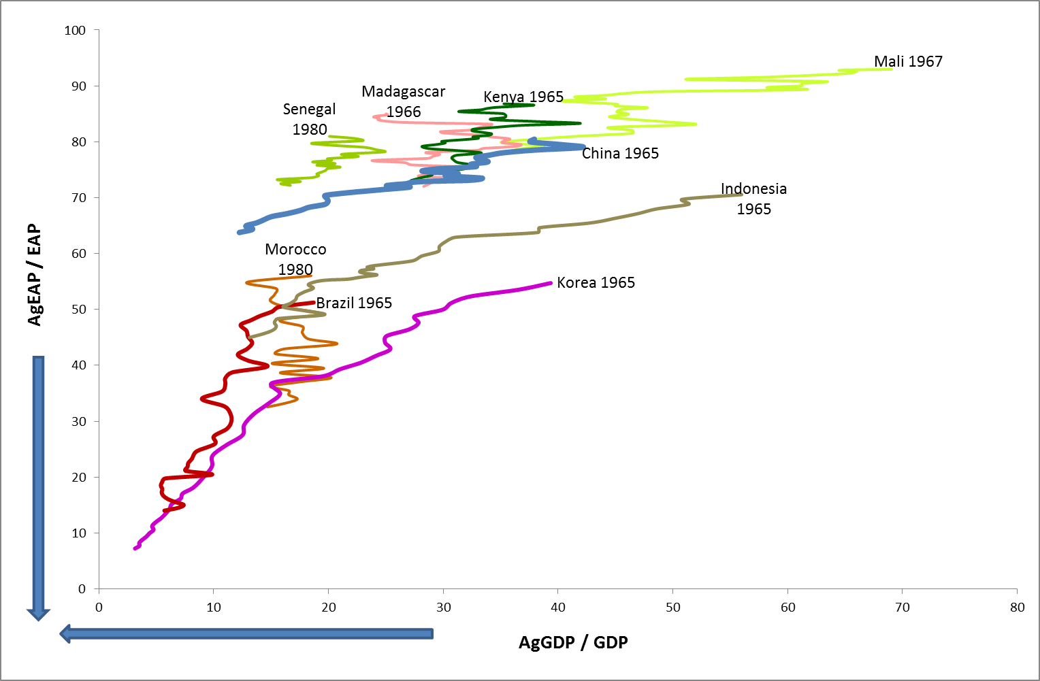
Understanding Structural change
Main world regions have followed this historical pathway, at different paces
  Initiated in Europe with the industrial revolution
  Followed by European offshoots + Japan (until WWII)
  Then spread in LAC, South Korea, Eastern Europe
  The situation is more diverse in Asia and Africa
The historical pathway of Structural Change (1965-2005)
Source: RuralStruc program

Slide 5
Challenges of Structural change for late developers in Today’s World
Late developers, which include most of SSA countries, are simultaneously confronted with:
  Incipient economic transition
  Unachieved demographic transition
  Growing urbanization without industrialization
The “moment in time” matters in a context of a global open economy → high international competition
  Existing opportunities → benefits of technological progress and past experience, advantage of new opportunities to access global markets
  But critical constraints → instability of the international environment, CC, pressures on NR, environment degradation, etc.

Slide 6
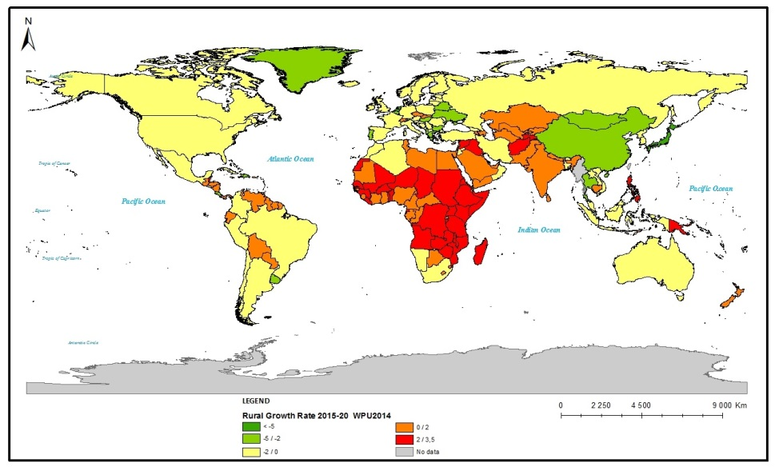
Challenges of Structural change for late developers in Today’s World
Inertia of macro-economic structures
  Agriculture → major share of aggregate output (GDP) and activity sector
  Tiny industrialization
  Services → informal, urban, odd jobs
Continuing growing population
  Rapid urbanization in mega-cities
  But: population remains rural, and is still growing
  Migration → massive, but limited (compared to past transitions) → not a viable option
Today’s Rural Population Growth
Source: authors, based on WUP 2014
Notes:
Employment:
Difficulties to develop a strong industrial sector in a context of growing international competitiveness
60-80% of the EAP makes a living from agriculture
Formal jobs are <10%
While rural population will decrease by 150 millions at the world level, it will continue to increase by 60% in SSA (+350 millions) over the next 35 years
These challenges are insufficiently considered:
This situation is a historically unique configuration
Past transitions occurred in other geopolitical and economic contexts (Western Europe and its offshoots, Latin America, East & SE Asia)
The responses will determine our common future

Slide 7
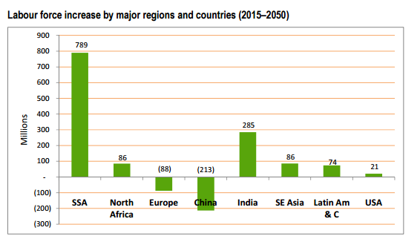
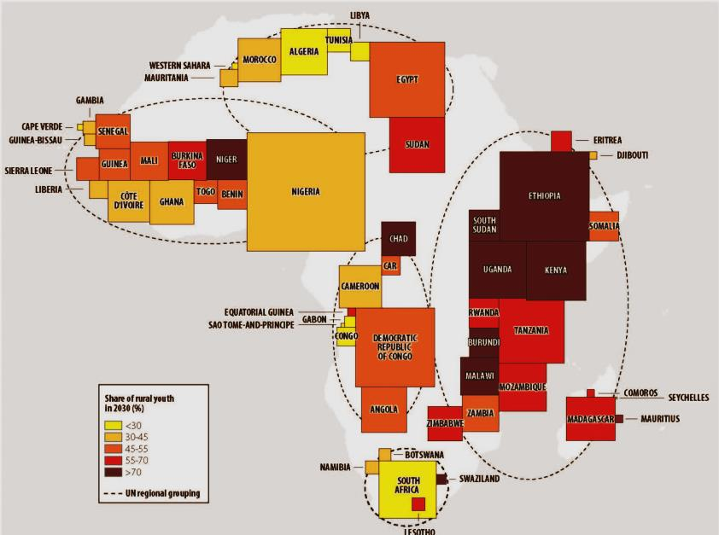
Rural Pop. Growth and Employment
Labor force increase is critical in most region of the developing world
  Labor demand in SSA will represent 790 millions youth people by 2050
  It will « only » represent 300 millions people in India, 90 millions in SE Asia and 75 millions in LAC
As said: most of these peoples live and will remain in rural areas
Source: Losch, 2016, based on WPP 2015
Source: A new emerging rural world (2016)

Slide 8
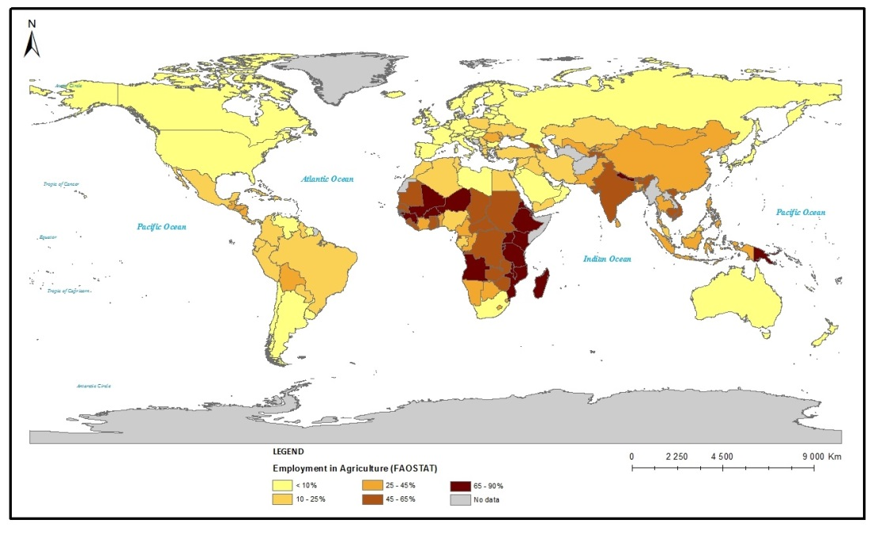
Rural Pop. Growth and Employment
Today, agriculture is still the main activity in rural areas and in most of the developing world
  In SSA (mostly), India and some of SE Asia countries: 45-65%; up to 90% of jobs
  In most LAC: 25-45%, up to 65% of jobs
But agriculture is one among other activities of rural peoples….
Employment in Agriculture Today
Source: compilation by the authors

Slide 9
Rural Diversification: a common Feature of Structural Change
Rural peoples, who still largely depend on agriculture in most of the developing world, increasingly derive incomes from non farm activities (local or in migration)
→ intensification of rural diversification
A large body of literature has investigated the extent, nature, and drivers of rural diversification
  Among others: FAO, 1998; Barrett et al. 2001; Haggblade et al., 2007; Winters et al., 2009; Davis et al. 2010; Winter et al., 2010; 2008 WDR; 2011 IFAD Rural Poverty Report, etc.

Slide 10
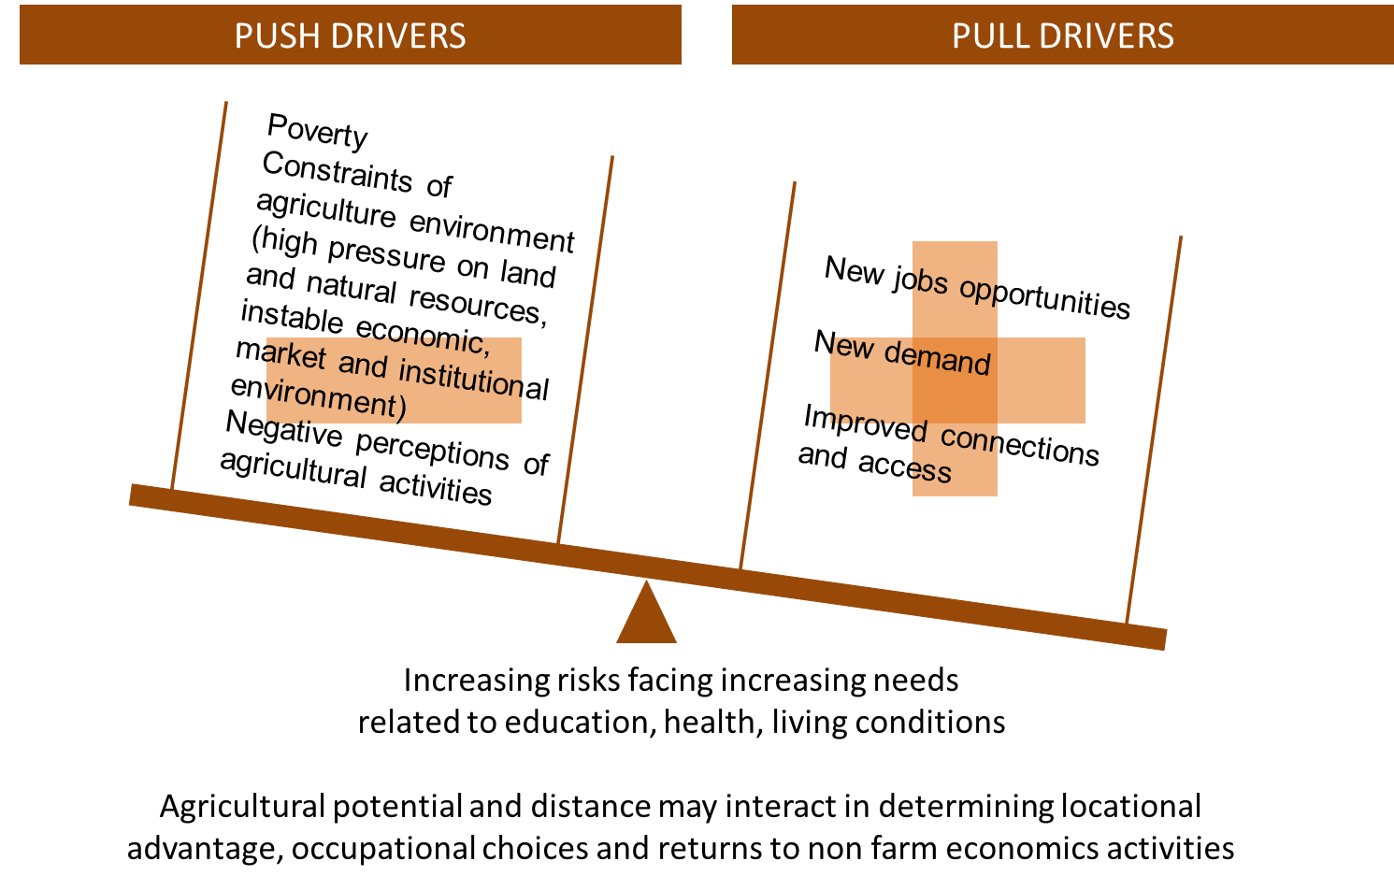
Why Rural Peoples diversify?
Notes:
An highly debated issue since the mid-90s

Slide 11
Rural Diversification: Definition?
No uniform definition of “rural”
  Size features, Urban structure, Social features, Economic features, Public administration, etc.
Complexity of defining the Rural Non Farm Economy
  By sector (I, II, III), by function (self vs. wage employment), by location: local vs. elsewhere
  Questions the « old » divide rural/urban
  Misses the role of migration (spatial mobility)
What evidence?
  National statistical systems → quality, accuracy, period, and availability of data
  International data → research/survey objectives (e.g. income or activities), locally-based data

Slide 12
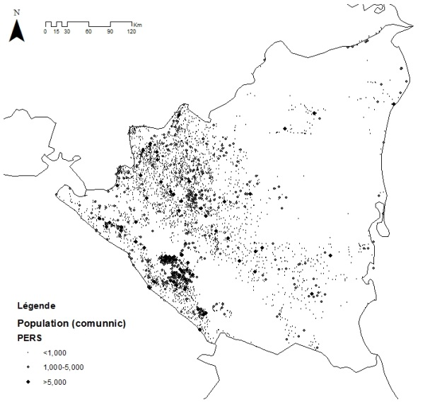
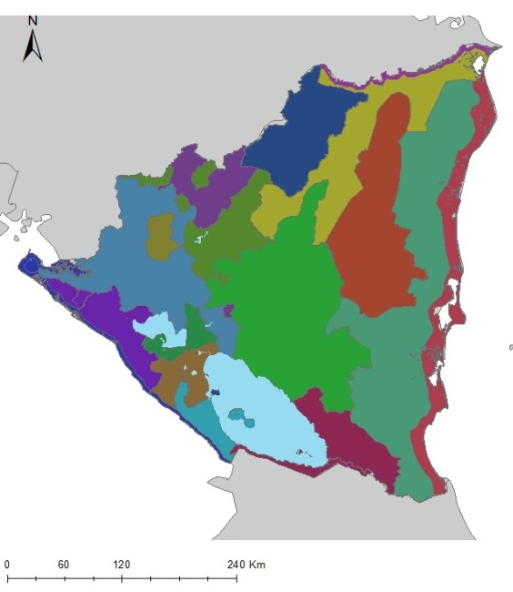
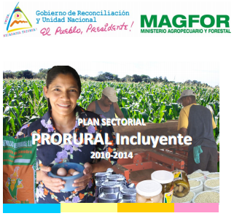
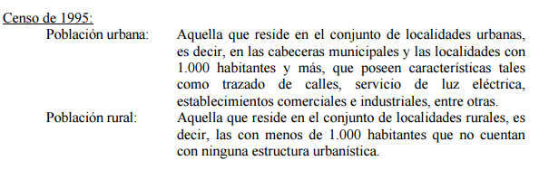

Ex. What is « rural » in Nicaragua?
Administration
Socio-economic
reality
Policy
The policy for rural development is sectorial and focus on the development of activities based on the use of natural resources

Slide 13
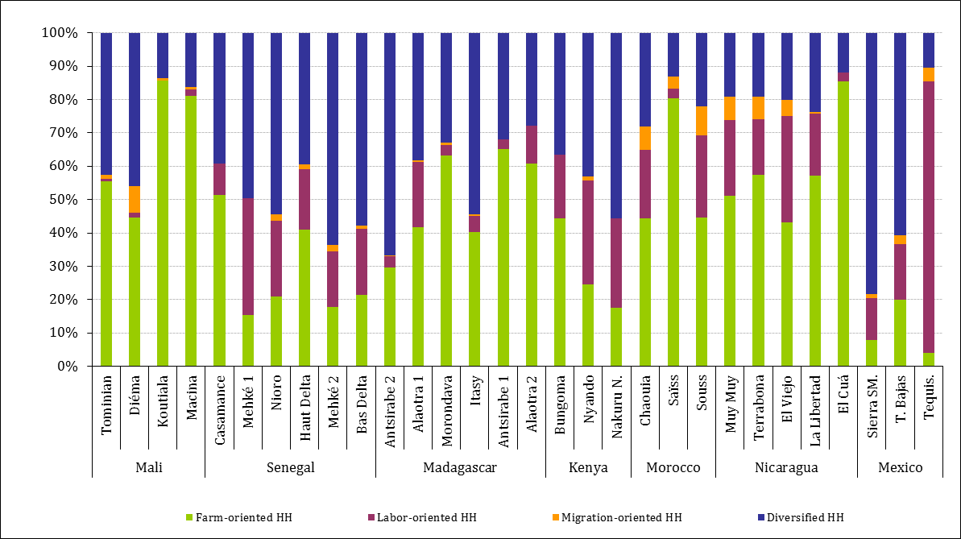
Ex. of Rural diversification
Source: RuralStruc program
Data obtained based on the same gathering instrument applied to about 8,000 rural households in 2008-09

Slide 14
Ex. of Rural diversification
Strong regional and quintile effects → uneven opportunities
  Importance of on-farm activities (in green)
  Agricultural wage labor:
    A common off-farm activity
    Mostly seasonal, low returns
  Non Ag. wage labor:
    Limited, sporadic, mainly informal and poorly paid
    Exceptions with jobs in agro-industries, public administration or tourism
% of overall income in $PPP per quintiles of income and regions
Source: RuralStruc program

Slide 15
Ex. of Rural diversification
Self-employment:
  The most common source of off-farm income
  Two patterns:
    Coping strategies, very low return (odd jobs)
    Full-time activity → better assets, investment
Transfers:
  Mostly remittances
  Variable
    Importance of historical patterns of migration
    Form of migration (nature, length, destination, …)
% of overall income in $PPP per quintiles of income and regions
Source: RuralStruc program

Slide 16
The diversification – income relationship: an inverted U pattern
Increasing returns and risk reduction
HHs begin to specialize
Household Diversification
Diversification strategies
Full
specialization in agriculture or
other activities
Low diversification centered in subsistence farming
Household Income
Source: RuralStruc Program

Slide 17
Why understanding rural diversification is important?
The rural economy is the major part of the economic structure of most of the developing world
  Rural areas host the main share of the population, which is still growing (in late demographic dividend countries)
Rural diversification has to do with structural change which is a major challenge for the late developers, in particular in SSA
Rural diversification not only plays a major role in generating income (poverty alleviation), but also in ensuring food security and in empowering women and the youth

Slide 18
Ex: An integrated framework to better the rural-urban linkages at the micro level
Other HH
Consumption
SOCIAL RELATIONS BASED ON DOMESTIC ADMINISTRATION
(Self consumed production)
MARKET-BASED RELATIONS
(sales of farm products, in kind and monetary rents , wages)
NON MONETARY NON MARKET-BASED RELATIONS
(unilateral and/or reciprocity donation)
MONETARY NON MARKET-BASED RELATIONS
(remittances)
Production
(agriculture
+ other activities)
Circulation
Food
Money
Food
Migrants
Money and food
Other HH
Public policies and projects
Food and other resources
Source: Fréguin-Gresh & Cortès, 2017

Slide 19
Summing it up
Three out of every four poor people in developing countries live in rural areas
Agriculture and other activities developed by rural peoples (locally or in migration) provide (and will continue to provide) employment, income, and food to the many in most of the developing world
Development strategies cannot ignore rural transformation (and the interlinks between rural and urban areas) and must address these new challenges, supporting the existing dynamics

Slide 20
Going forward
Supporting knowledge creation and strategy design (1/2)
  Improving the knowledge base
  → Strong statistical systems, with national analysts, should provide the means for policy makers to identify tailored priorities
  → A strong national research base should renew a contextualized approach of complex, multidimensional and evolving rural economies, including migration

Slide 21
Going forward
Supporting knowledge creation and strategy design (2/2)
  Re-engaging with development strategies
  → Multi-level and multi-stakeholders’ policy processes are critical for the success of a development strategy based on a shared vision, commitment, and participation
  → But it takes time, requires adequate planning, phasing, and a significant effort (including $) in capacity building

Slide 22
Going forward
Adopting an integrated framework to support agriculture and rural diversification (1/2)
  Agriculture remains key and should have a core role in a development strategy
  → The majority of the workforce is employed in agriculture, mostly family farms
  → There are room for manoeuver to improve agricultural growth (increase of land and work productivity, increase of VA with processing, etc.)
  → If family farming largely dominate and should be supported, other agricultural models, in their plurality, can provide employment (if controlled by PP…)

Slide 23
Going forward
Adopting an integrated framework to support agriculture and rural diversification (2/2)
  Rural Diversification, including migration, is not (only) to be considered as an exit strategy out of agriculture and rural areas
  → A significant share of incomes generated by rural peoples (locally or in migration) is reinvested in agriculture (men), education, and health (women)
  → Rural peoples, through social relations and circulations, do not divide rural/urban, and national/international incomes

Slide 24
Going forward
Supporting local/territorial dynamics
  Reinvesting in rural territories by fostering local policy processes
  → Improving local governance and promoting territorialization of public policies
    Multi-stakeholders concertation at various levels
    → ex. of rural policy development Platforms in LAC
    From “Territories of Projects” toward “Project Territories”
  Favoring small and secondary infrastructures and services development to improve rural-urban linkages
    Improvement of rural life, livelihoods, and economic environment for the development of opportunities

Slide 25
Thank you for your attention
Contact: freguin@cirad.fr

Slide 26
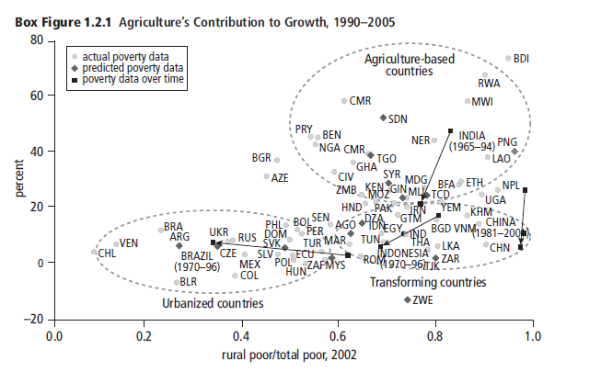
The « three worlds » of WDR08

