Slide 1

Linking rural and urban development
Julio A. Berdegué and Felicity Proctor
Presentation in the “Hot Topics” Seminar Series
Rural transformation, jobs creation and migration: an inclusive approach
European Union, Brussels, April 10, 2017

Slide 2
The Presentation:
The Structural and Rural Transformation
The Rural-Urban Interface
Recommendations

Slide 3
Structural Transformation
Structural transformation is both a cause and an effect of economic development
Rural transformation is an integral part of wider structural transformation
It is a process of comprehensive societal change whereby rural societies:
  diversify their economies and reduce their reliance on agriculture;
  become dependent on distant places to trade and to acquire goods, services, and ideas;
  move from dispersed villages to towns and small and medium cities, and;
  become culturally more similar to urban societies

Slide 4

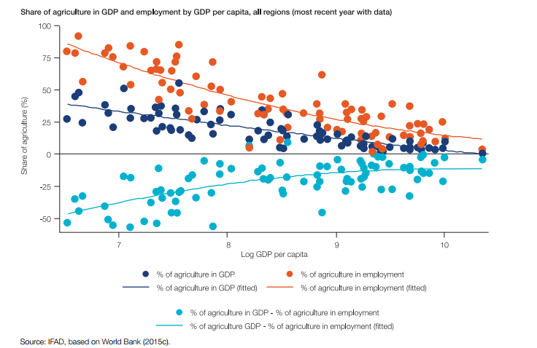
Ingresar Titulo
The structural transformation as a driver of “rurbanization”

Slide 5
BUT rapid structural transformation does not automatically lead to rapid rural poverty reduction
IFAD (2016) analysed the speed of structural transformation, rural transformation and poverty reduction in 60 countries from 5 developing regions
Concluded: Inclusive rural transformation will not happen automatically, it must be made to happen
One factor that contributes to inclusive rural transformation, is the quality and strength of rural-urban linkages
Notes:
Notes:
39 countries experienced rapid structural transformation and 19 also rapid rural transformation
but for 30% of the countries, fast transformation processes have not guaranteed fast rural poverty reduction
and of those with mixed experience of structural and rural transformation, poverty reduction varies and is least likely without rural transformation

Slide 6
The Presentation:
The Structural and Rural Transformation
The Rural-Urban Interface
Recommendations

Slide 7
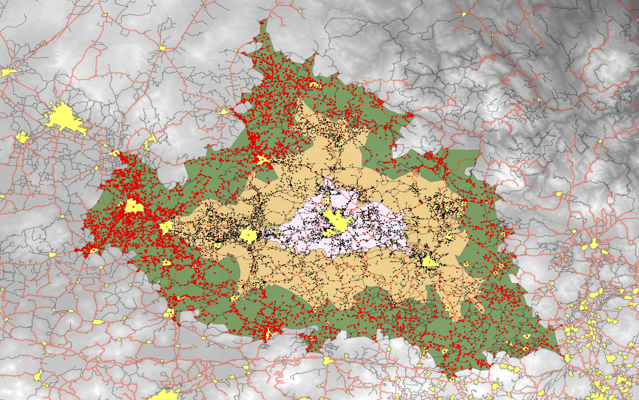

Slide 8
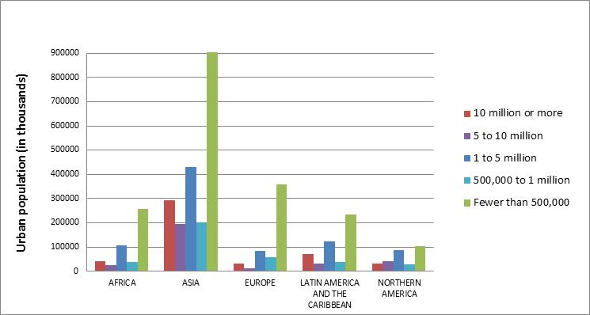
The character of urbanization
Urban population by city size, 2014
Source. UN DESA 2014

Slide 9
Population at the rural-urban interface, 2015
Notes:
5.3 billion people in the rural-urban interface, this is 73% of the world’s population. About 37% on the urban side, about 63% on the rural side
A more conservative figure, subtracting rural people living farther away from a town or small and medium city, would give us around 4.7 b people at the rural-urban interface, 47% urban and 53% rural. This is still 64% of the world population.-

Slide 10
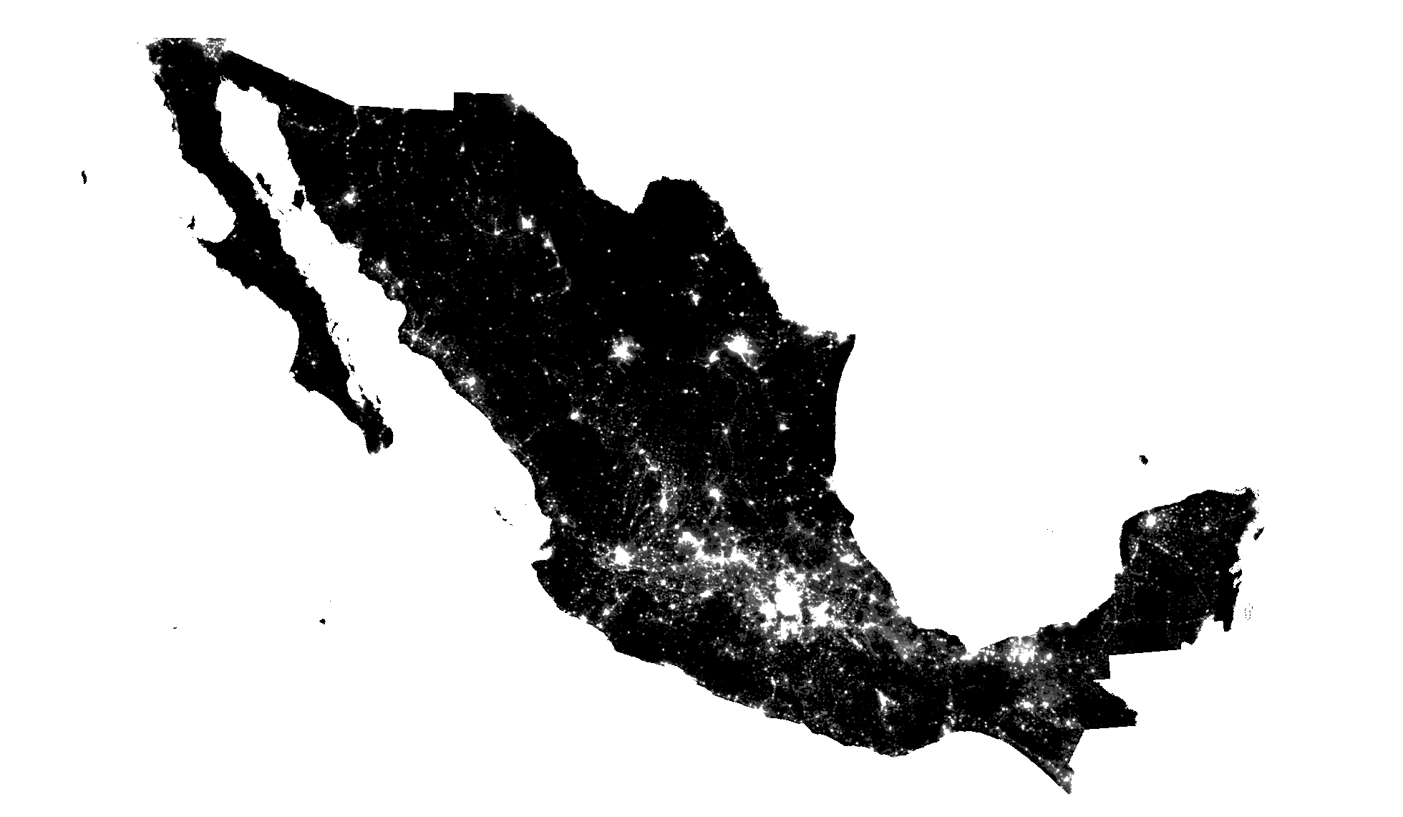
Where do people live their lives?

Slide 11
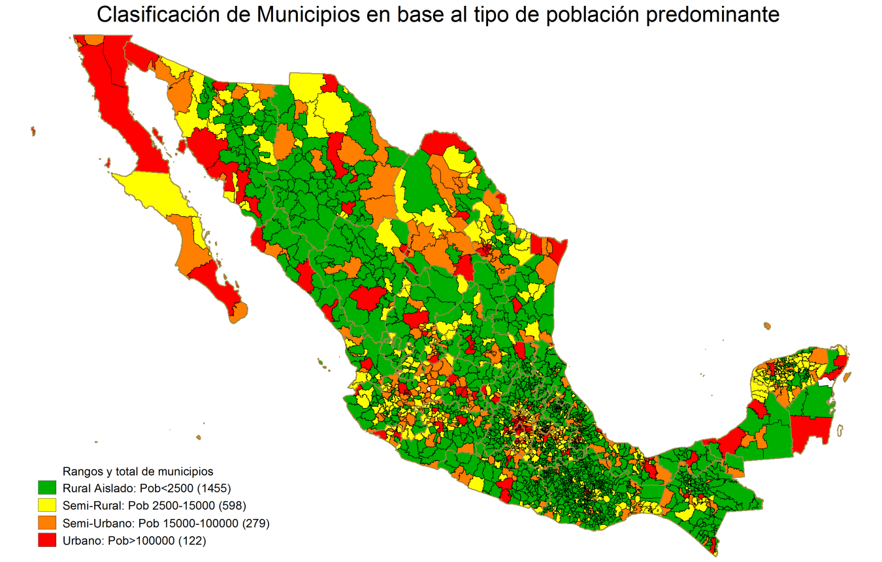
7% of the population in “deep rural” green
43% of population in “rural-urban” yellow
50% of the population in “urban” red

Slide 12
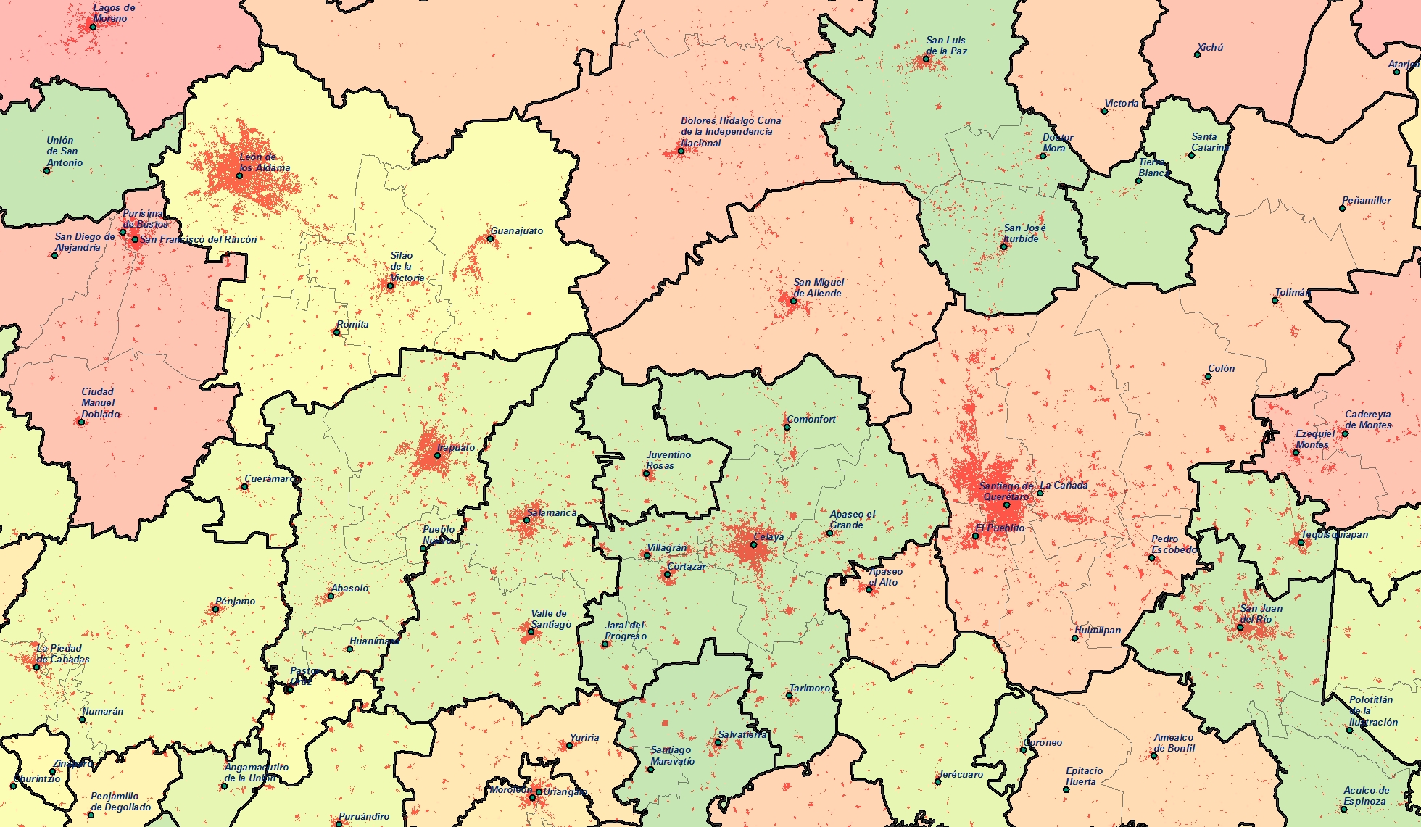
Where do people live their lives?

Slide 13
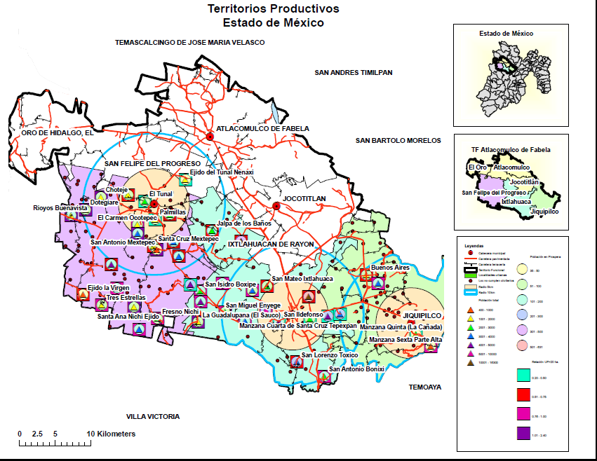
Rural-Urban places as functional socio-economic units
Notes:
NW of Mexico City – state of Mexico
Six municipalities
Nine towns and small cities of between 20,000 and close to 100,000 inhabitants Dozens of rural villages
Held together by daily commuting, nonfarm activities, labor market, market transactions in both directions, services based in towns…
A distinct socioeconomic unit, so that if you built a wall around each village, or around each town or each city, they would all suffer tremendously… they are bound together, this is the place where 464,000 live, work, and interact with each other
So, if a large majority of the world’s poor live in these intermediate, rural-urban places, AND if it is true that these rural-urban places are functional socioeconomic units, are distinct societies, or places with a socially constructed identity, could it perhaps be that a single set of investments could deliver simultaneously rural AND urban poverty reduction AND rural and urban economic growth?
The dots, squares and triangles, are population size of each locality, number of people under poverty line, and number that receive conditional cash transfer programs.
The circles around the main towns are 5-10km distances,

Slide 14
Rural–Urban linkages: a conventional definition
Rural–Urban linkages are flows of goods, services, environmental services, people and money between rural and urban locations
Indispensable to achieve objectives of:
  Market access for smallholders
  Access to jobs for rural people with little or no land
  Rural economic development
  Agricultural development
  Urban economic development in many towns and intermediate cities
  Access by rural people to “urban” public services beyond the very basic
  Environmental services for cities
  Urban expansion
  Effects of migrant remittances on growth and poverty
  And more
Notes:
“Reciprocal” in the sense that for one flow in one direction, there is a reciprocal flow of something else in the other…
Rural sells food to urban, urban pays money to rural
Urban sells manufactured products to rural, rural pays money
Rural demands labor during harvest season, urban people respond, and come back with their salaries

Slide 15
Rural–Urban linkages: an alternative definition
Reciprocal and repetitive flows of people, goods, services, money and environmental services between specific rural and urban locations that become interdependent and constitute new socio-spatial arrangements, places with a distinct socially-constructed identity
What emerges is the possibility of place-based development at the rural – urban interface i.e. the development of “functional territories”
Notes:
The key ideas here are two:
Flows between specific, concrete, rural areas and concrete, specific, urban locations – not just indetermined such as flows of food that is retailed and consumed in many cities around a region, a country or the world; or manufactured good that come out of a factory and are sold all over the place.
These flows are iterative, repeated over a period of time, that can be years or decades. Such sustained interaction creates bonds of a nature that is different than that which is present in a casual exchange, or an exchange with an indetermined, quasi-anonymous counterpart
Here we are talking about rural and urban places that are “paired” over many years, establishing iterative, repetitive, exchanges between identifiable localities.
Analogy – you exchange ideas with dozens of people in many organizations, but with your colleagues in this room you exchange certain types of ideas, with certain routines, for certain purposes… and that creates a group, a team, and organization – a new identity, that is different, distinct, from the individuals involved in it.

Slide 16
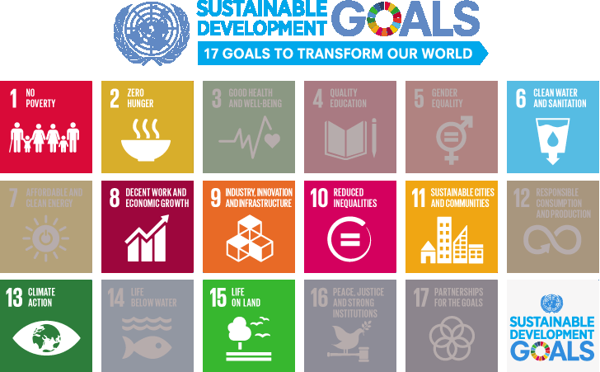


Slide 17
The Rural-Urban spaces in the transforming food systems
The transformation of food systems
  Creates new opportunities for rural-urban spaces: new investments, new actors, new sources of employment and of local economic dynamism
  Not all rural-urban spaces are equally competitive in attracting these investments
  Not all changes are positive from the perspective of the poor, smallholders and consumer health
Notes:
Not all changes are positive from the perspective of the:
Poor – lack access to multiple retail choice
Smallholders – rising barriers excluding them from market opportunity and at same time wholesale markets – the main entry point for many in an increasing state of disrepair (e.g. India)
Consumer health – increased consumption of low cost low nutrient energy-dense foods with –ve health impacts - RSA; China
Environment – poor environmental controls in intensive agribusiness and food processing often located small urban centres (water contamination; air pollution) where controls are less stringent
How can such Rural-urban spaces be competitive and be vibrant - exploit opportunities arising from food system changes?

Slide 18
Food systems at the rural-urban interface
Multiple entry points for action
  Effective local economic development plan
  Agriculture strategy which recognizes ‘place’
  Food manufacturing is more decentralized that other manufacturing sectors and will usually locate in small towns and i-cities
  Tax and other investment incentives to food industry
  Public procurement- link with social sector/safety nets
  Urban planning
    Zoning/land use planning
    Wholesale market plan and management
    Retail food plan and licensing – formal and informal
Notes:
Again, these are recommendations IN ADDITION to the work on market access, value chain projects, new business models, and so on.
Emphasize “what else” can be added by place-based development at the rural-urban interface
Urban zoning – wholesale retail (supermarkets – location and scale; retail street markets) food industry- peri-urban agric
Wholesale market management – PPP new models e.g. JoBurg; investment
Retail food licensing – informal food sector
Public infrastructure (roads, water)
Public procurement – e.g. school feeding programme and local procurement e.g. Brazil
Tax and other investment incentives to food industry - - Food manufacturing is more decentralized that other manufacturing sectors and will usually locate in small towns

Slide 19
Recommendations:
Change the lens
Bring rural and urban closer together
Improve the democratic governance of Rural–Urban places
Notes:
rural-urban linkages in the broad or conventional sense contribute to improving the efficiency of these flows and their effects on the opportunities and wellbeing of smallholders, the rural poor AND the urban poor.
not focussing into the purely sectorial or thematic issues, of food systems, access to markets, access to education, creating nonfarm and urban jobs, and so on – which matter. Concerned here with the “what else” in addition to what you are doing about specific rural-urban flows, e.g., market access, financial services... what are key elements of a RUL agenda?
In the Berdegué/Proctor paper on Inclusive R-U linkages there is an appendix with almost 30 quite specific recommendations, and without any difficulty there could have been added several more

Slide 20
1. Change the lens
The status quo since the 1950s is to think and act in terms of distinct, separate, rural and urban localities
The debate has been about who wins or loses
There are gains to be realized in social inclusion AND in economic growth, by thinking and acting at the interface of rural and urban
This requires understanding and acting upon:
  The distinctiveness of rural-urban places
  The idea that ‘space and place’ matter, not only ‘flows’
  Spatially-disaggregated analysis of population, growth, poverty and inequality patterns and dynamics
  Advocacy at the national and international levels
Notes:
Change the analytical lens
spatial issues and implications of any entrepreneurship policy and industrialisation strategy
Research:
Understanding rural-urban places and the people thereiin
Spatially-disaggregated analysis of population, growth, poverty and inequality patterns and dynamic
Urban data sets and urban development analysis more finely disaggregated by city size and city categories
Advocacy at the national and international level:
Definitions are political and have very practical implications for who leads the agenda and who gets what

Slide 21
2. Bring rural and urban closer
Public investment to:
  Improve the connectivity between the rural and the urban parts of rural-urban places
  Urban-based public goods that service the rural population and producers and entrepreneurs
  Rural-based public goods that service the economic activities in the rural areas starting with agriculture
  Increase focus on towns and intermediate cities
  Generate and share evidence
Private investment to:
  Stimulate agriculture/NR, processing, value-adding and trade of agricultural/NR products
  Create nonfarm enterprises and jobs (including in the informal economy)
  Reduce the barriers to social and economic opportunities at the rural-urban interface
Notes:
Mention that PUBLIC is critical to getting private in this places
targeted investment by governments, social mobilization by social movements, and development and advocacy programs by civil society organizations and, to the extent possible, credible commitments by medium and large businesses to develop more inclusive business models.
Remove barriers to access opportunities in r-u places:
Rural-urban linkages are not always inclusive, nor are they always equally inclusive of everyone involved. It is safe to say that as a rule, the poorer sections of the rural and urban populations, and those that face social exclusion for reasons such as their ethnicity, race, religion, or social class or cast, will tend to be excluded from the better opportunities that emerge with closer rural-urban linkages. This is why many studies find lower poverty (e.g., as a result of greater nonfarm employment) but, at the same time, higher income inequality or social polarization.
targeted investment by governments, social mobilization by social movements, and development and advocacy programs by civil society organizations and, to the extent possible, credible commitments by medium and large businesses to develop more inclusive business models.
Rural-urban linkages are not always inclusive, nor are they always equally inclusive of everyone involved
A very wide range of issues and options, from quality education in rural areas, to improving the quality, transparency and fairness of product and labour markets and so on
How to bring all of these initiatives together? Place-based development at the rural-urban interface”

Slide 22
3. Improve democratic governance of Rural-Urban places
Indispensable to govern places, societies, and flows at the rural-urban interface
Combine social science research, advocacy and policy action:
  Solve coordination failures across the many component parts
  Facilitate and support democratic collective action that builds legitimate development agendas and helps get things done
  Develop innovative models and strategies for improving the capacities of local governments including mechanisms for coordinated action by neighboring rural and urban local governments /municipalities that co-exist in the rural-urban place
Notes:
very little understanding and practical knowledge about the principles or criteria and the mechanisms and tools to get it done; it is so because we have organized ourselves to govern the component parts and not the whole of rural-urban societies. These parts can be value chains, smallholders, urban and nonfarm household and small enterprises, local governments, wholesale or retail markets, financial services, and so on. But how to govern the societies where they all come together?
Innovative models and strategies for improving the capacities of local governments including the mechanisms for coordinated action by neighboring rural and urban local governments that co-exist in the rural-urban place
ADD:
The issue of land, land use planning
Environmental goods and services including waste management, watersheds, fuel /energy…

Slide 23
Linking rural and urban development
Julio A. Berdegué and Felicity Proctor
jberdegue@rimisp.org
fjp@proctorconsult.org

