Slide 1
May 3rd, 2017
Opsys
Domain User Group (DUG)
Track 2 – Contract management
1st meeting

Slide 2
Agenda
Presentation of DUG members and Opsys team
Presentation of OPSYS: what we are "buying" and why ?
OPSYS Governance and role of the DUG: what is expected from the DUG members ?
Users mapping: who will use the new application ?
How will the Opsys Solution be built ? What are the improvements when compared to CRIS ?
Sharing preliminary ideas on the approach to change management
Wrap-up: summing-up the DUG members' feed-back and views

Slide 3
Objectives of the DUG first meeting
The objectives are :
  To know each other
  To share knowledge about Opsys
  To agree on how we will work together
The objective of this first meeting is not :
  To review or validate any document or deliverables

Slide 4
1. DUG Members
Notes:
9:30-9:45

Slide 5
DUG-2 Members
# | Name | Unit | Back up | Unit
1 | Christian MEUNIER | FPI.1 | BANTI Matteo | FPI.1.001
2 | FERNANDEZ Raul | NEAR.B1
3 | JUAN LINARES Victor | NEAR.B2
4 | VAN NYEN Isabelle | NEAR.C1
5 | VISSER Henk | NEAR.D5
6 | LEPRI Pier Luca | NEAR.SGUA
7 | KVARACIEJUS Saulius | NEAR.R4 | BOCKEN Anne-François | NEAR.R4
8 | BATTISTON Carlo | NEAR.R5
9 | PESADO LLOBAT José Manuel | NEAR.R1 | NOVAK Judith | NEAR.R1
10 | OPREA Camelia | BUDG.D2
11 | Nadia Cristoforetti | ECHO
12 | Michel Bucher | ECHO
13 | PELLACANI Enrica | DEVCO.06
14 | PAPE Elisabeth | DEVCO B7 | KOLEVA Petya | DEVCO B7
15 | NEACSU Alina | DEVCO.H2
16 | IMPENS Shana | DEVCO.H3
17 | Luis ARAQUE DE JUAN | DEVCO.R3
18 | Cristina GONZALEZ CASAL | DEVCO.R3
19 | Jean-Yves PONCELET | DEVCO.R1
20 | Eric MERTENS | DEVCO.R1
21 | Gionata MAIORCA | DEVCO.R5

Slide 6
OpSys Track 2 team(s)
PROGRAMME Level
  Programme Manager : Denis THIEULIN
    IS Governance : Radu NICULIU
    Programme Management Office: Kay BURING
  Business managers coordinator : Paul RIEMBAULT
  Change management coordinator : Daria FANE
PROJECT (TRACK) 2 Level
  Business team
  Business manager (Loïc ELIES)
  DUG : support and review
  Key contributors (subgroup of the DUG) : contribute to the elaboration of documents
  IT teams
  IT project manager pre-award process (Emilian MIHAILESCU, DIGIT)
  IT project manager post award process (Magda HAGIU, RTD)
  IT integration CRIS – OPSYS (Christophe CHAUVIERE, DEVCO)

Slide 7
2. Presentation of OPSYS: what we are "buying" and why
Notes:
9:45 – 10:00

Slide 8
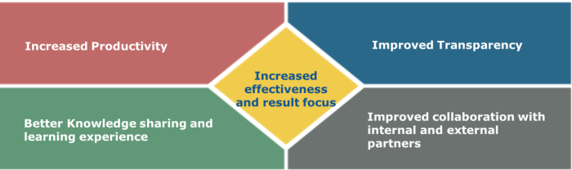
Quintessence of Opsys
Not a dream: an ambition
Starting point: CRIS phase out, white page, DEVCO+NEAR+FPI
    Better impact of our operations: results beyond financial performance; thinking project wise, not contract only
Productivity, ease staff work: digest staff cuts, more time on substance (user centric/Ux, no re-encoding, notifications, NFR: mobile and change proof…)
External access: contractors, implementing partners, partner countries; also EEAS, other DGs, EU MS locally

Slide 9

Quintessence of Opsys
New ways of working
    Improving our business processes, not only harmonization
    Collaboration vs silos/sequential work
    Connecting people, who does what, easy access to information
Ready to pay 51 M€, but only for a Quantum Leap
Flagship program: IT Board, SG, BUDG
Re-use of corporate solutions vs specific needs

Slide 10
3. OPSYS Governance and role of the DUG: what is expected from the DUG members
Notes:
10:00 – 10:15

Slide 11
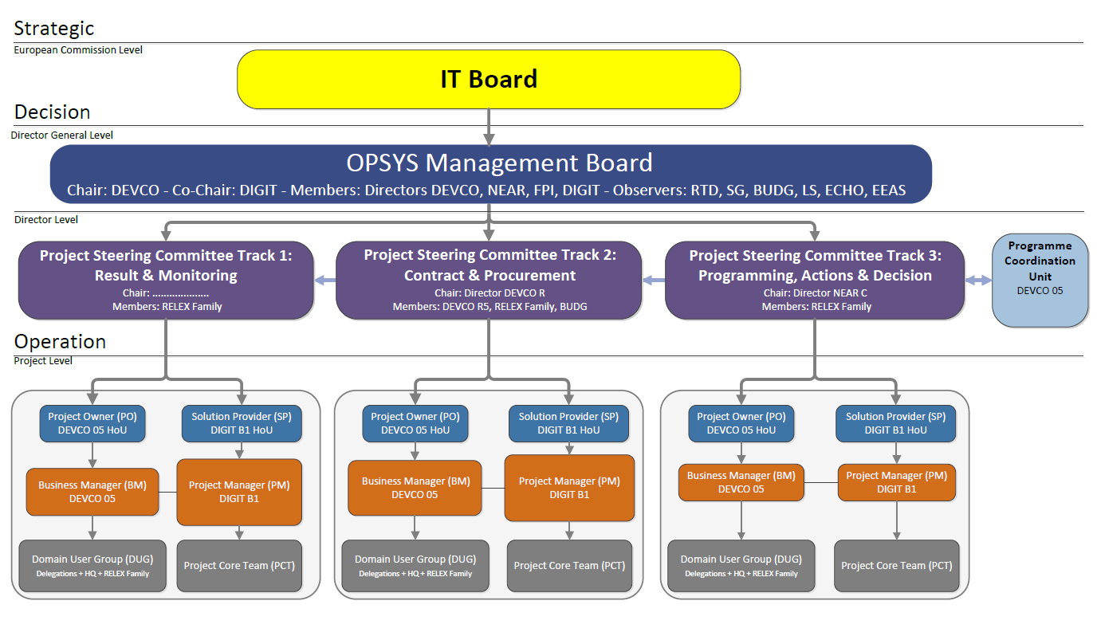

Slide 12


OPSYS Management Board

Slide 13


Project Steering Committee chairs

Slide 14

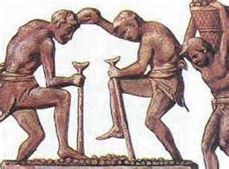

Normal (i.e. working) people

Slide 15
WHO ?
U = YOU

Slide 16
WHY ?
Custom tailor your dream tool

Slide 17
WHAT ?
Support & Review

Slide 18
HOW ?

Slide 19
Q & A
Thank you !!
Radu NICULIU
radu.niculiu@ext.ec.europa.eu

Slide 20
4. Users mapping: who will use the new application ?
Notes:
10:15 – 10:20

Slide 21

Main types of stakeholders
Evaluation
Committee
OPSYS CORE
Contractor
Applicant
SEDIA Portal
EC (Deleg & HQ)
Partner Country
Technical Assistance
Back

Slide 22
5. How will the Opsys Solution be built ? What ARE THE improvements WHEN compared to CRIS?
Notes:
10:20 – 11:00

Slide 23
What do we have to deliver ?
January 2018 : A first release of OpSys Contract management modules to support the management of specific contract under the new FWC SIEA 2018
April 2018 : A second release, improved for the specific contract
2018 - 2020 : Successive releases with new type of implementation modalities of the External Action family.
➔ Our priority is to focus on the first release.
Yet, we should always keep in mind the final target.

Slide 24
Which capabilities in Release 1 ?
Create a new specific contract
Draft ToR
Draft the specific contract
Commit the budget level 2
Sign the contract
Manage pre-financing
Pre-AWARD CAPABILITIES
Post-AWARD CAPABILITIES
Appoint an evaluation committee
Establish the short list
Monitor technical implementation
Manage invoice and payment
Closure of the contract
Manage modifications
Manage correspondence
Recommend/find good practices
Manage deviation and prior approvals
Manage experts / contractors
Work Flows / metro line
CROSS CAPABILITIES
Define the provisional budget
Define conditions of payment
Define conditions of evaluation
Finalise and send the RfS
Contractor acknowledge receipt of RfS
Contractor prepare and submit a proposition
Contracting authority acknowledge
25 capabilities identified to date
Evaluation of the propositions
Notification of results
Back

Slide 25
How will the DUG be involved ?
Describe in detail the 25 capabilities of release 1
Validate the capabilities
Deliver the specifications to the IT provider
IT provider : build the solution in accordance with the specifications
Deliver the solution to the customer (i.e. Relex)
Test the solution
Roll out the solution
RELEASE 1
TODAY
No
capability
25
capabilities
DUG deeply involved 2 times
This would be a “Waterfall” approach ☹

Slide 26
How will the DUG be involved?
Describe High Level capabilities of release 1
Define the PI backlog
Process an iteration
Demonstrate the release
Programme Increment (PI)
Programme Increment (PI)
Programme Increment (PI)
Roll out the solution
RELEASE 1
TODAY
No
capability
25
capabilities
DUG actually involved every 10 weeks, after each PI
Complies with the AGILE approach ☺

Slide 27
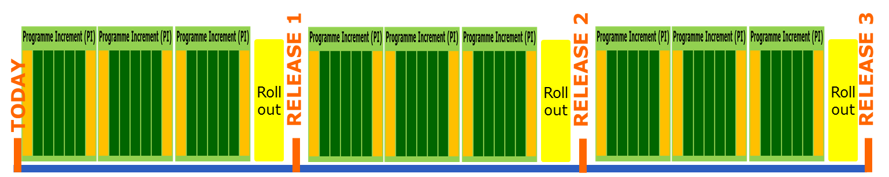
How will the DUG be involved ?
Specific contract
Specific contract improved
Implementation modality #2
Implementation modality #3
…
Within each release, we will add new types of contracts
Type of contract = implementation modality =
e.g. Specific Contract, international restricted tender for service contract, local open procedure for supply contract, grant, Programme estimates, etc.

Slide 28
How the DUG will be involved ?
Implementation modality #1
Capability “Sign contract”
Implementation modality #2
Capability “Sign contract”
Implementation modality #3
Capability “Sign contract”
Some capabilities can be reused by different implementation modalities
However a capability must be adapted to each implementation modality

Slide 29
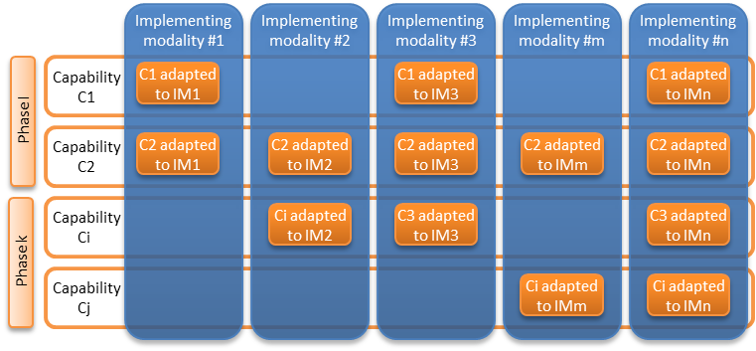
Matrix
Implementation modalities / Capabilities

Slide 30
Conclusion about capabilities
When we define a capability, we must :
  On first instance, think of the capability as a concept/abstract
  Think of the capability in terms of re-use (factoring)
  Make the capability configurable (adaptable)
For a start, we will have a list of implementation modalities to be addressed within the scope of project 2. The list may be reviewed all along the implementation.
The Business case proposes :
  A list of implementation modalities
  A list of capabilities
  A matrix of capabilities used by implementation modalities

Slide 31
Improvements brought by OpSys when compared to the current solution?
End to end automation. For example :
  OpSys provides guidance: to draft ToR, dashboard to show tasks to perform, etc…
  Tender dossier / call for proposal sent by Contracting Authority via the SEDIA portal
  Contractors / applicants write and submit offers via the SEDIA portal
  Evaluation committees enter details of the evaluation via the application
  Contract signed electronically by Contracting Authority and contractor
  Manage the experts (TBC)
  Etc.
Application open to partners
Up-to-date technologies (Internet low bandwidth, smartphone, better user experience …)

Slide 32
What applications for the CM modules ?
Forecast plan
eProcedure
eSubmission
[DIGIT]
SYGMA
[RTD]
Contract forecast
Drawing-up, award and signing the contract
Establish shortlist (restrictive procedure)
Implementation / Monitoring
COMPASS [RTD]
SEDIA portal
Prospect
[DIGIT, DEVCO]
CROSS CAPABILITIES
Define tender dossier
Integration of a set of a “corporate” applications, already used by DGs
Submission
ABAC, ARES
[BUDG, SJ]
Evaluation of the offers

Slide 33
A few mock-ups of the solutions
Let's see 3 capabilities amongst the 25 ones identified for release 1
Contractor submit an offer
Metro line of SYGMA / COMPASS
Sign a contract

Slide 34
Next steps
Within the next days, the Business Management team will send you the BUSINESS CASE in which you will find :
  High Level description of capabilities
  (First) List of implementation modalities to take into account in the scope of the project
  Global roadmap
The DUG will be involved in the demonstration of the next PI (July).

Slide 35
6. Sharing preliminary ideas on the change management strategy
Notes:
11:00 – 11:25

Slide 36
Change management
Sharing preliminary ideas
Change management strategy
STAKEHOLDERS – CLUSTERS
Headquarters management
Units: Geographic, thematic, Policy, Methodological, Financial control, etc..
Delegations
International organisations
Member states
Implementing partners (including Contractors, grant beneficiaries, technical assistants, NAOs)
Civil society, NGOs
ROM and Result reporting teams
General public
Key interests
Needs
Expectations
CHANGE MANAGEMENT STRATEGY
CHANGE MANAGEMENT PLANNING
COMMUNICATION
TRAINING
SUPPORT FUNCTIONS

Slide 37
Planning and roll-out
Change management
Sharing preliminary ideas
Rollout options
Different options to consider and assess: advantages and risks of each option to discuss with the DUG
Lessons to learn from Track 1 Results management / Pilot Delegations
Follow up of data migration
Milestone:1st release by January 2018

Slide 38
Training
Change management
Sharing preliminary ideas
Track 1
Lessons to be learned from Track/project 1 – Results management
Current approach: roll out and comprehensive workshops
Training of trainers
Extent to which:
Relevant
Applicable
to Contract management and procurement
Assumptions
Needs for training on procurement procedures are not substantial
Focus on users and the new system
Training of external stakeholders (e.g. NAOs staff, contractors)?

Slide 39
Training
Change management
Sharing preliminary ideas
Training users
How much is needed?
Who? When? How?
Training of trainers : develop a network of trainers who will deliver training and advisory support in Brussels and in Delegations?
Develop Users manuals
Progressive update of PRAG, eCompanion, etc
Training external stakeholders
Who?
When?
How?

Slide 40
User support functions
Change management
Sharing preliminary ideas
Users 'support
Follow-up and management of :
  FAQ
  First Level: helpdesk phone or internet support based
  Second Level: remote team with more specific knowledge then First level Support
  Third Line: more specialised individuals or teams

Slide 41
Potential resistance
Change management
Sharing preliminary ideas
Small sample of the types of resistance
to anticipate
Loss of stability: uncertainty regarding the future expectations (roles, required skills, etc), difficulties with understanding concepts
Perceived loss of personal control: individuals have little or less or no involvement
Big picture not understood: only a partial understanding of the overall approach
To discuss: other issues in your respective fields ?

Slide 42
Communication
Change management
Sharing preliminary ideas
Communication strategy
Outlines objectives and guiding principles
Broadly defines stakeholder groups and the purpose of communications with each group
Identifies the communications approach
Defines risks related to and/or mitigated by communication.
Communication plan
Communications activities
Responsibilities
Timeframe
Audience
Key messages
Communication vehicles: e.g. key events, presentations in Directorates, platforms such Capacity4Dev

Slide 43
Conclusion
Change management
Sharing preliminary ideas
Discuss with the DUG what the best options are
Regular exchanges with you to hear your views on options we/you may propose
Views and concerns expressed by users (Cooperation days) not forgotten

Slide 44
7. Wrap-up: summing-up the DUG members' feed-back and views
Notes:
11:25 – 11:30

Slide 45
WRAP-UP
Opsys is a necessary ambition
DUG: supporting definition of business requirements to create your dream tool
DUG will be involved at the end of each programme increment (10 weeks)
The list of capabilities can evolve all along the process according to the respective implementation modalities / types of contracts (agile methodology)
Change management: clustering stakeholders to develop a change management strategy (planning, communication, training, support functions). The DUG will be opportunity to assess together the best options

Slide 46
WRAP-UP
Questions raised:
When to address the rationalization of processes ?
Order of signature will be discussed and decided at the management board level
Signature of budget support is artificial (no signature of contract)
The starting of any operation process is operational: there should then be more operational staff in the DUG
How and when will pilot EUDs be involved in the DUG2 ?

Slide 47
WRAP-UP
All documents on the sharepoint where you will be able to comment and provide feedback
Applications will be open to partners and upload on the system will be mandatory for all stakeholders from the start
How are we going to manage the various inputs in the system (comments, etc) ? The sharepoint will enable the co-drafting of documents
Will data quality checks be performed in the system ?

Slide 48
WRAP-UP
ECHO uses APEL where partners submit proposal but will start using SEDIA as of this year for grants management. Need to organize properly the transition
Le logistics of organization the venue of people for training will be very complicated. The possibility of e-learning should be assessed
Webstreaming could also be envisaged
Training of contractor raise many issues (selection transparency, etc)
Next DUG will focus on validation of first mock-up, definition of business processes and capabilities in the next programme increment

Slide 49
WRAP-UP
The principle in the development of SEDIA is to focus on user experience to minimize trainings
Next DUG will focus on validation of first mock-up, definition of business processes and capabilities in the next programme increment

Slide 50
Thank you
See you AT the next PI demonstration !
Notes:
11:25 – 11:30

Slide 51
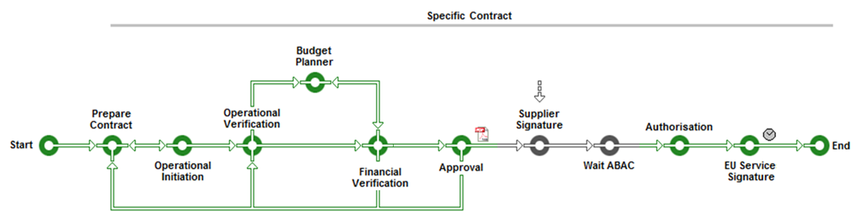
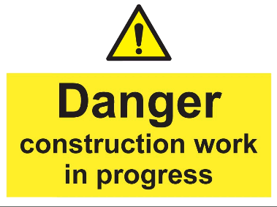
Metro line view of the business process
Back

Slide 52
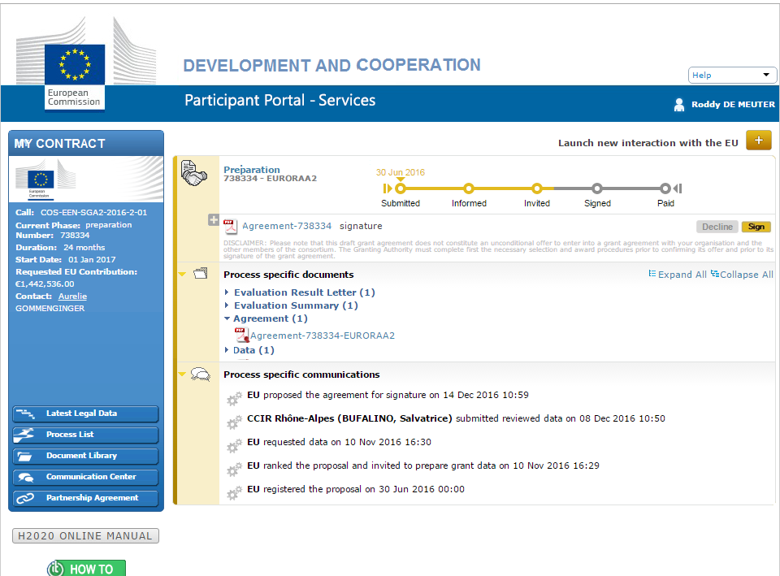
Signing a contract goes like

Slide 53
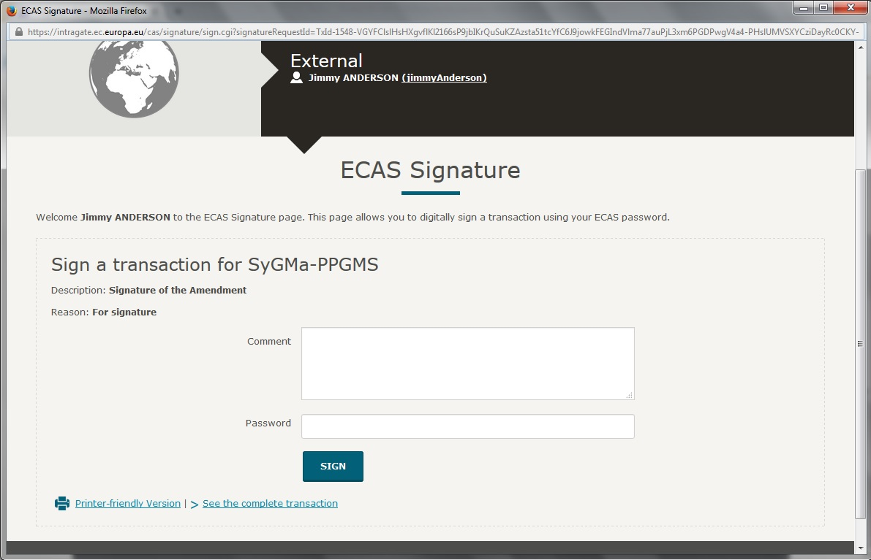
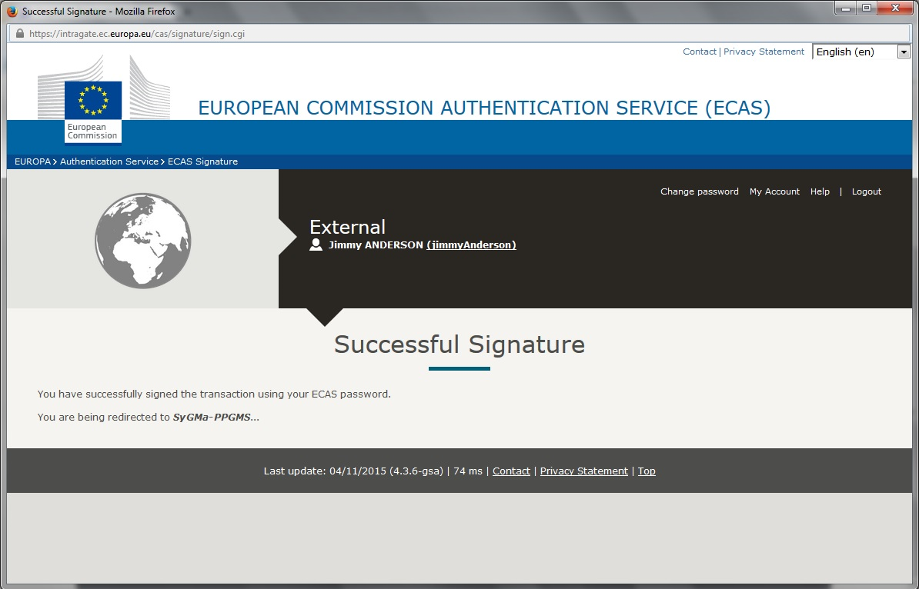

Slide 54
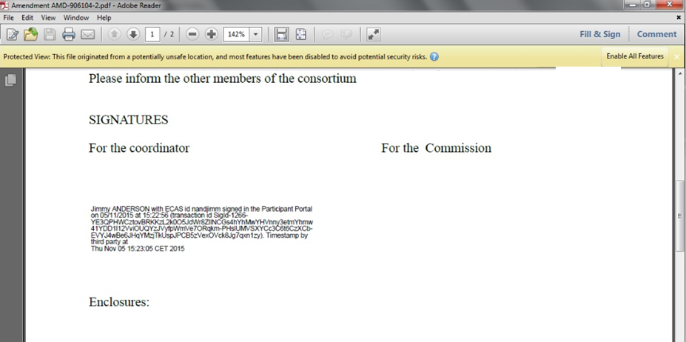
..and updates the systems..
but also the documents

Slide 55
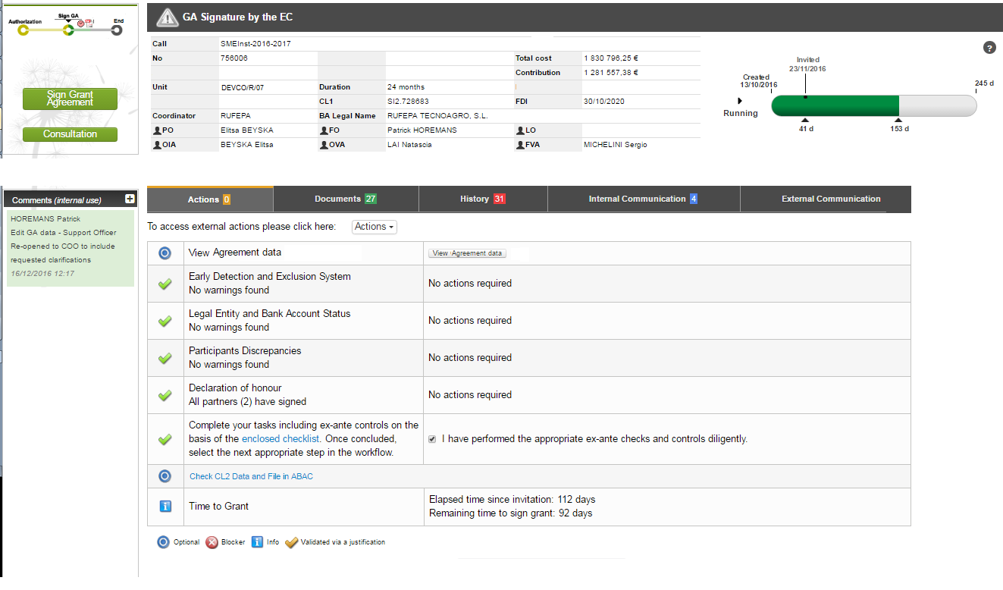
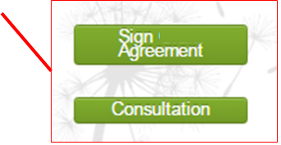
.. Budgetary CL2 in FIN/100 ?
Then ready to Sign the Contract
Checklist for AOSD
Automated

Slide 56
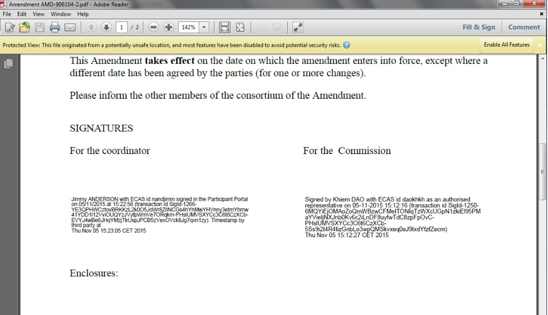
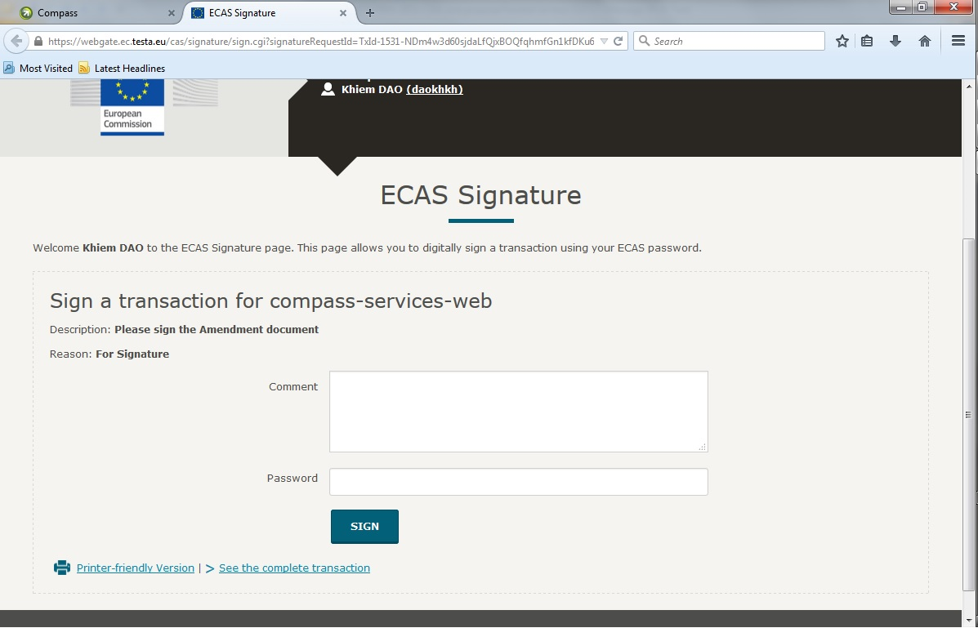
..AOSD is requested to confirm by
Password, which triggers the counter
Electronic signature
Back

Slide 58
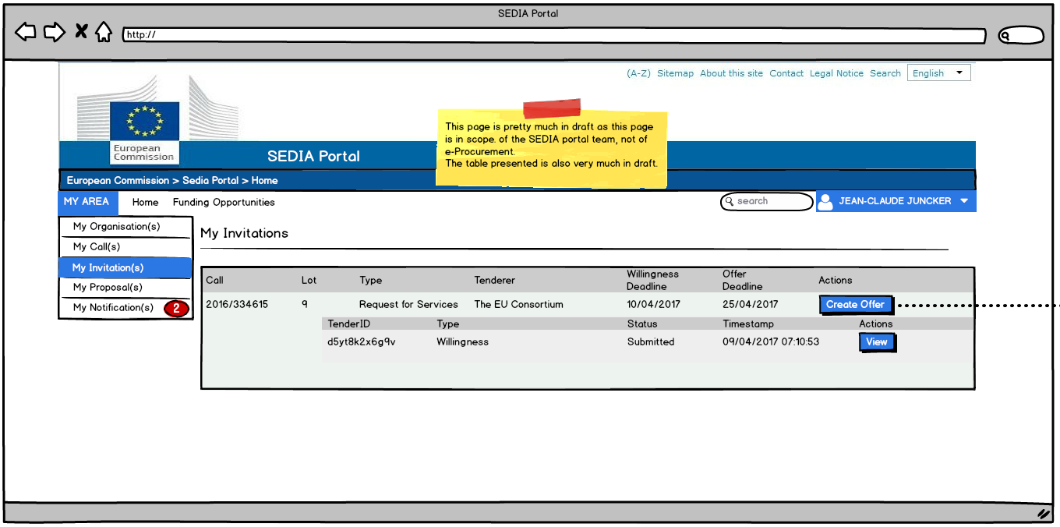

Slide 59
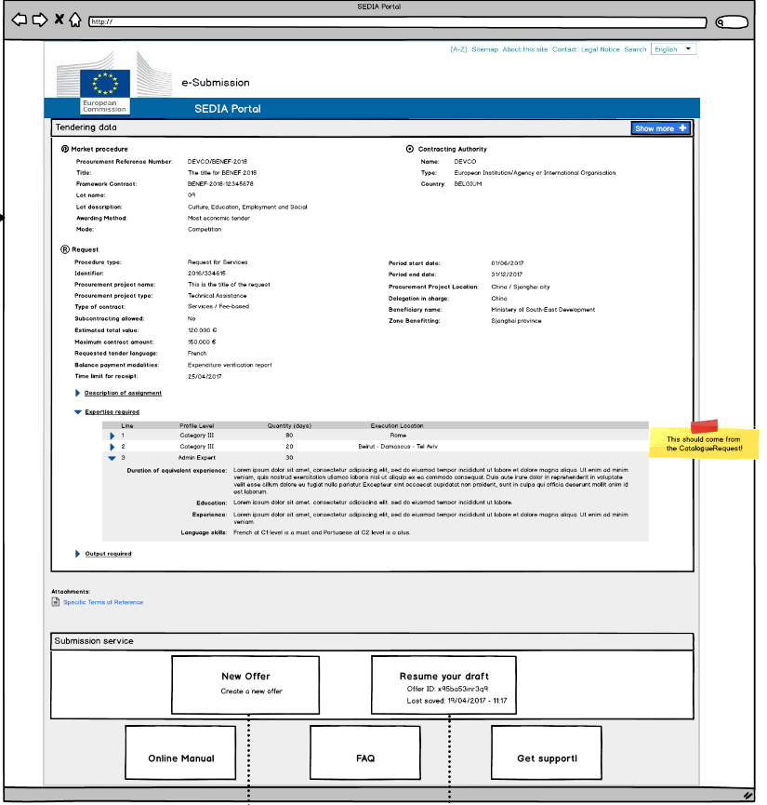

Slide 60
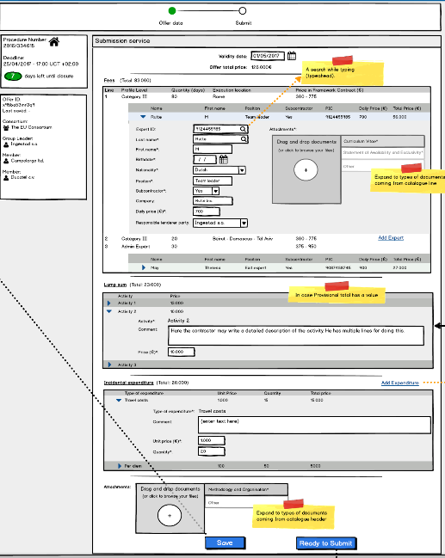

Slide 61
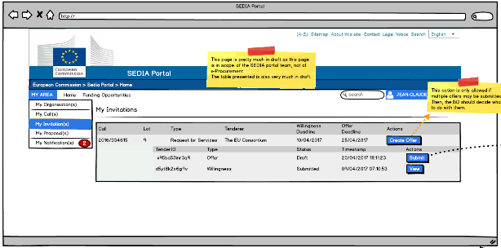

Slide 62
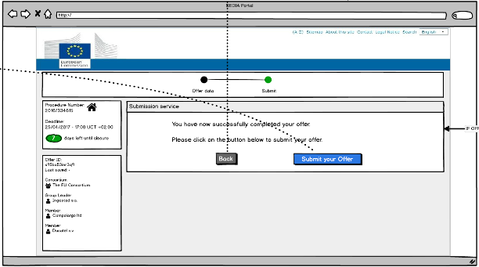

Slide 63
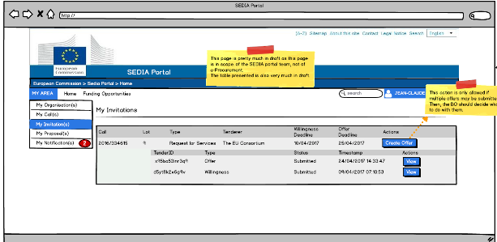
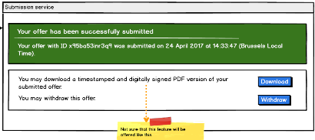
Back

