Slide 1
DUG meeting
Track 1
10-05-2017

Slide 2
Agenda
1 – New Opsys Approach
2 – Opsys track 1 – scope and milestones
3 – Demo of working software "create a logframe" and feedback
4 – Change management and migration
5 – Next steps

Slide 3
1. New Opsys Approach
Opsys Initial Approach
Multiple IT suppliers
Ad-hoc reuse of IT corporate components
Unaffordable cost
Delays in delivery
Opsys New Approach
One integrated team
Maximum Reuse of corporate IT components
Stick to initial budget
Securing timing in delivery

Slide 4
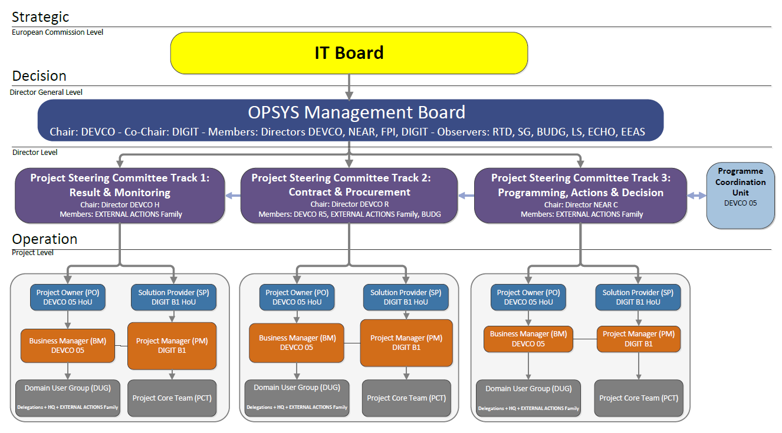
1. Opsys new approach - Governance

Slide 5


1. Opsys new approach - Roadmap
2017
Set-Up new Programme structure, set-up corporate architecture and launch a pilot version of the OPSYS system for RESULTS and 2018 FWC programme
Pilot Phase
1
2018
Rollout all major functionalities for contract, result, and action management including sector tagging.
2
Roll-out Phase
2019
Implement all contract modalities in OPSYS and fully replace the CRIS system.
Implementation Phase
3
2020
Deploy programme management features, optimise and prepare the system for the next MFF/EDF
4
Optimisation
Phase

Slide 6
2. OpSys track 1 – Planning and milestones 2017-2018
 | Jun-16 | → | Oct-16 | → | Jan-17 | → | Mar-17 | → | May-17 | → | Jul-17 | → | Oct-17 | → | Dec-17 | → | Feb-18
10 June 2016
Project Charter approved
Jan 2017
DIGIT appointed as System supplier
End Oct 2017
Pilot in select EUDs and HQ units
From Feb 2017
Progressive
roll-out
10-12 Oct 2016
EUD
Workshop
10 May 2017
DUG meeting
End July 2017
DUG meeting
Early Oct 2017
DUG meeting with Pilot EUDs
Programme Increment 1
Workplace, Portfolio, Action, programme, Create Logframe
Programme Increment 2
Project, contract, Task manager, Encode results, Implementing partners
Programme Increment 3
Corporate indicators, traffic lights
Programme Increment 4
Results consolidation, embedded guidance, remaining features
IT developments
Technical tests, bug fix, User acceptance tests
Draft Training package
migration of OE and logframes for Pilot
Training in pilot EUDs and HQ units
Change management strategy, communication plan, training plan, migration plan
Change management
e-learning, business support, field missions and training

Slide 7
2. OpSys track 1 – Scope for 2017-2018
  My workplace of single entry point for every EC managers
  Build and access a portfolio of programmes and projects
  Follow cycle of operation: Instrument, MIP, Action, programmes, projects, contracts
  Create and encode logframes
  List of suggested indicators including matching with corporate indicators (EURF, etc.)
  Access by implementing partner with validation process
  Tasks manager including notification
  Display and aggregate results for result reporting
  Corporate search functionality

Slide 8
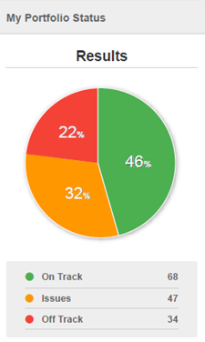
3. Demo
  Screens and scope available here:
  https://europa.eu/capacity4dev/opsys/documents/result-management-and-operational-entities-scope-and-screens

Slide 9
4. Change management & migration
Merging change management and migration:
- test the approach and collect feedbacks
- learning exercise for OMs involved
- ensure the quality of the data migrated
In collaboration with OMs (according to their availabilities):
- Build their portfolio: create the Operational Entities
- Logframes: quality control (or creation) and migration the logframes

Slide 10
Logframes will be quality checked (if needed) and transferred in an excel file (similar to the Results Reporting template), then imported into OPSYS
4. Migration and QC of the logframes

Slide 11
4. Roll out Results management – regional workshops February 2018
Comprehensive workshops - train-the-trainer in 10 Delegations and HQ
Objective
capacitate stakeholders (EU operations and key external stakeholders) on new IT system and process/ methodology for result based management
Oct
2017
Nov
2017
Feb
2018
April
2018
Work-shops
11Pilot DEL+HQ @Brussels
FPI HQ
@ Brussels
FULL ROLL OUT
EUDEL @ 10 HUBS +HQ @ Brussels
Support/ Follow up encoding LF Pilots/ system adaptation
Nov 2017-Jan 2018
Support/ follow up encoding LF
Feb2018-…
Suport & Follow up
HOTLINE

Slide 12
5. Next steps
  DUG involvement
  Demonstration every 10 weeks after each Programme increment
  Access to working software to test functionalities in July
  Feedback tool embedded in the system and Business focal point available for comments and suggestions

