Slide 1
Seminar on strengthening water operator partnerships in development cooperation
Context: - 2nd call for proposals funded 23 water operator partnerships – what did we learn and how to move forward
Purpose: to discuss
the findings of the rapid assessment,
the overview of associations and water operator partnership initiatives and
approaches to strengthen water operator partnerships in development cooperation.
Schedule
0830-0900 | Arrival
0900-0915 | Opening DEVCO
0915-09.45 | Outline of the rapid assessment and overview and approaches to strengthening water operator partnerships, Eric Buhl-Nielsen, PEM
09.45-11.15 | Snapshot presentations of experiences (10 mins each) GWOPA Associations Water operators (mentee/mentor) Water operator initiative (WaterWorx)
11.15-11.45 | Break
11.45- 12.15 | Snapshot presentations cont’d
12.15-13.00 | Discussion on lessons learned and approaches to strengthening water operator partnerships
12.30-13.30 | Wrap up – DEVCO, GWOPA, IFIs, Member state water expert group

Slide 2

Rapid assessment of the 2nd call for proposals on water operator partnerships – countries where the 23 water operator partnerships took place
Mentee country
Angola
Botswana
DRC
Ethiopia
Ghana
Kenya
Mali
Mozambique
Namibia
Rwanda
Senegal
St Lucia
Suriname
Tanzania
Uganda
Zambia
Mentor country
Belgium, France, Germany, Italy, Netherlands, Portugal

Slide 3

Rapid assessment of the 2nd call for proposals on water operator partnerships
 | Relevance: Did the Water Facility link to EC Development Policy and ACP Countries’ political priorities and contribute to the achievement of the water and sanitation MDGs?
 | Added value: To what extent was WF coordinated, coherent & complementary to other Member States’ development actions and what has been its added value?
1
Well aligned - The call and 23 projects well aligned to the EU policies and national agenda as well as the needs of the target population
1
Frameworks – The projects benefitted from well-established sector coordination and consultation frameworks and supported these frameworks.
2
Focus on urban areas – but also partnerships for increasing low income access, basic services in fragile and post conflict situations
2
Innovation – complementary and added value by supporting the development and implementation of innovative approaches .
3
Rehabilitation – where partners needed a complete rehabilitation the timing of the WOP was less relevant
Evidence
3 principles of governance, ownership and innovation well supported e.g. Kenya water regulator (256444/256486)
National agendas supported e.g. national reforms in Rwanda (303181);
Evidence
Zambia, cooperating partners coordination framework (288059)
Mozambique support through FIPAG (256380)
Enhanced member state support (the Netherlands) Uganda (256375)

Slide 4
Rapid assessment of the 2nd call for proposals on water operator partnerships
 | Efficiency: Did the Projects lead to appropriate and cost effective delivery?
 | Effectiveness: Did the projects contribute to governance and management of water resources and to increased access to safe, sustainable water and sanitation services?
1
Co-funding – The demand for co-funding was easier for some mentor operators than others – considerable frustration over “ineligible expenses”
1
Results – both of a direct operational performance and capacity development nature
2
Multiple WOPs – Wider networking and knowledge management at a sector level has been achieved especially where a project involved multiple WOPs
2
Ambition high –Operation/financial improvements in water operator performance are ambitious and not aimed at or achieved in many cases.
Evidence
In some countries e.g. Germany, public operators cannot subsidise external projects – but mentees could potentially raise the funds
In Kenya, Uganda, Zambia and Mozambique multiple WOPS (up to 10) were supported via a single call off.
Evidence
Rwanda (303181) costs savings from NRW (24%), energy (44%) and chemical use (18%) more than paid for the projects
Zambia (288059) average NRW reduced from 42% to 35%
However, less than a third of the 23 WOPs targeted and achieved direct and measurable operational improvements

Slide 5
Rapid assessment of the 2nd call for proposals on water operator partnerships
Factors that supported achievement of results
Credible reforms, especially the regulatory function (Mozambique, Kenya, Zambia, Rwanda and Uganda)
Top management support and good governance in the board of the mentee (Mwanza 278990)
Earlier cooperation - (Hamburg Wasser and the Rwanda water sector (303181)
Investment prospects - network functioning or with prospects of early investment Dar-es-Salaam where an EIB loan was under consideration).
Tariffs - High electricity tariffs (Rwanda, 303181)
Structured mentorship - and capacity development (on the job training, qualification related and cascaded ) (e.g. Uganda 265375, Rwanda, 303181)
DMAs - “district metering areas” and development of specific pressure zones (DRC, 291830)
Factors that worked against achievement of results
Deteriorated network - A water network
Management instability - institutional restructuring (e.g. Tanzania 283768), fragmented operations (e.g. Botswana, 256427) operator a department in a municipality (Namibia, 275759)
Failure to internalise the project - in the mentee corporate planning so that the project is considered an additional activity with staff having to work over time if they are attend to their main job as well.
Short time frame – given the challenges (delays in start up and imports), long enough to consolidate changes (Ethiopia, 277703)
Poor project design -inconsistent logframes and insufficient knowledge of the current operational state (e.g. Angola, 276329).
Poor data and mapping – making GIS and intervention hard to plan and implement(DRC, 291830, Tanzania 283768)
Unrealistic assumptions –on : i) tariff increases (example in Dar-es-salaam, 283768); ii) the prospects of levying fees (Ghana, 256367) and iii) the imminent arrival of investment funding.

Slide 6
Rapid assessment of the 2nd call for proposals on water operator partnerships
 | Impact: What were the positive and negative, primary and secondary long-term effects produced by the WF, directly or indirectly, intended or unintended?
 | Sustainability: How did the WF ensure the continued operation of the intervention after the ACP-EU Water Facility funding ends
1
Funding – no examples of WOPs continuing at scale in the absence of external funding - although help desk models function and others donors entered.
1
Capacity development – Capacity is at the core of the WOPs and the main contributor towards longer term impacts and sustainability.
2
Self sustainability - where capacity development has succeeded and the sector provides an enabling environment the prospects are good.
2
Environmental - A number of the water operator partnerships focussed on water quality and the safe management of waste.
3
Consolidation needed - despite improvements in performance longer term support would be needed
Evidence
Most WOPS targeted improvements in underlying systems e.g. network mapping, GIS, water metering billing etc.
In Ethiopia a project focused on water resources monitoring (277703)
Evidence
WOPS in Northern Uganda have continued under Dutch funding
HamburgerWasser is providing a help desk for the Rwanda WOPs and Dar-es-Salaam (303181)
NWSC (Uganda), NAMwater (Namibia) WSTF (Kenya) all provide promising sector environments

Slide 7
Rapid assessment of the 2nd call for proposals on water operator partnerships
 | Cross cutting - To what extent did the WF contribute to strengthening institutional frameworks that promote mainstreaming of gender, environment and good governance principles?
Evidence
In Ethiopia much of billing and financial improvements were carried out in in units headed by women. (277703)
monitoring and evaluation was improved and the projects were linked directly to sector regulators in the case of Kenya, Rwanda (303181), Zambia (288059) and Mozambique (256380) and to sector authorities in other cases such as Ethiopia (277703) and Uganda (256375).
A project in Ghana (256367) aimed at improving the water quality monitoring and laboratory services for the water sector.
A project in Rwanda (303181) focussed on improving the performance of water treatment units in a number of towns.
A project in Senegal (256424) improved water quality management in a wide rural area by adopting an integrated approach to planning
1
Gender – Considered in the proposal documents but not explicitly and not monitored.
2
Participation and governance -The 2nd call for proposals grant enhanced the participation and good governance of the public and private utilities. .
3
Water the main focus - but some projects also involved water quality and also sanitation (no specific sanitation partnerships)

Slide 8

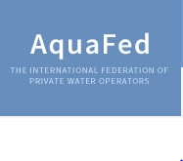


Water operator associations in Europe – there are many at national level but 4 capture the majority
EU based platforms
Drivers and constraints

Slide 9
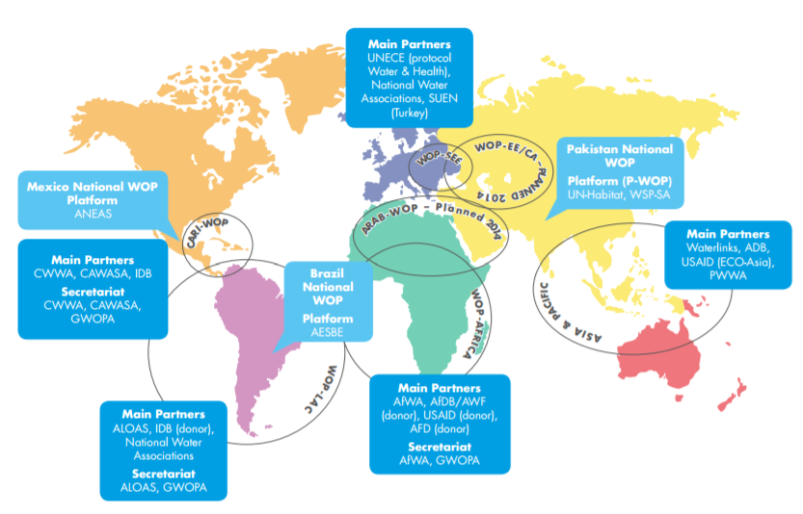




The GWOPA regional platforms water operator associations
Global platforms
Main platforms for ACP region

Slide 10
Water operator partnership initiatives
Water Operator Partnerships and investment – 3 types
WOPs that focus purely on operations and do not involve investments.
WOPs that aim to prepare the ground for investments.
WOPs that occur along side ongoing investment programmes or after such investments in order to enhance sustainability.
Water Operator Partnerships – numbers
Water Operator Partnerships roles
Roles | Description
WOP promoter | identifies, advocates for, supports and promotes potential WOPs
WOP knowledge management | contributes to information sharing generically & learning and access to knowledge at the individual WOP level
WOP – third part facilitator | manages a programme supporting WOPs, provides operational support
Multi-WOP fund manager | manages a programme that channels financial support to a number of WOPs
WOP mentor/ mentee | the direct water operator implementing parties
WOP financier | resources funding for WOPS and similar
Source GWOPA

Slide 11




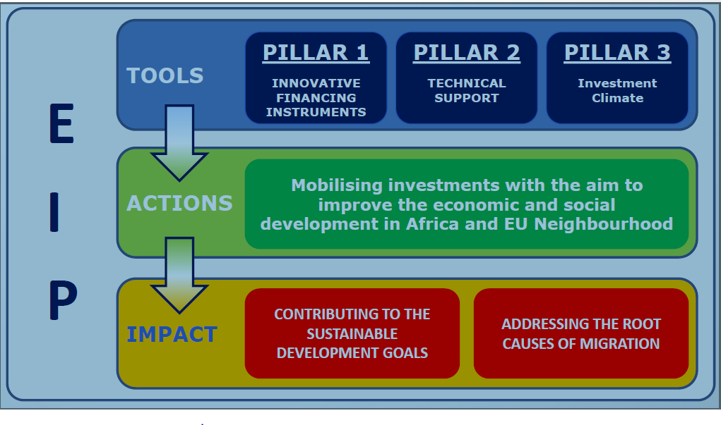

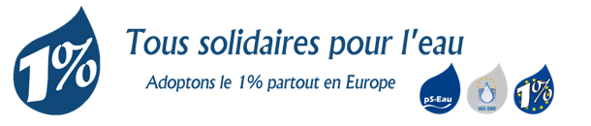
Water operator partnership initiatives
Main type of initiatives | Initiatives considered
Promotion and knowledge management based initiatives | BEWOP Regional WOP platforms Waterlinks European water association platforms
Projects and programmes that finance and support WOPs | EU 2nd Call for Proposals under the water facility WaterWorx RASOP Other projects and programmes – blending and the EEIP
Self funded and national WOPS | PERPAMSI (Indonesia)
Funding initiatives | One percent initiative Dutch and French initiatives

Slide 12
Strengthening water operator partnerships in development cooperation - rationale
Rationale for strengthening water operator partnerships
Principles - strengthening water operator partnerships
What WOPs are
Water operator partnerships are partnerships to harness the skills, knowledge and goodwill within a 'mentor' utility to build the capacity of another utility – the 'mentee’.
Partner owned – supported by mentee management and governance structures
Demand led - demand at consumer, management and governance levels
Results orientated - measurable performance & capacity development.
Make use of current and planned initiatives –rather than invent new ones.
Link to finance for investments –European External Investment Plan (EEIP) is relevant.
Link to reform programmes –and institutional strengthening initiatives.
Project preparation, monitoring and facilitation – High quality, where relevant use third part facilitation.
Engage with water associations in EU and ACP - promoting demand among mentor and mentee water operators.
Why relevant for the EU
WOPs respond to a European solidarity movement
There is a demand among the European operators/ associations
WOPs mobilise considerable expertise and capacity
WOPs support blending/ investment operations
Where and how do WOPs support the SDGs
Advanced countries under the partnership instrument
Medium and lesser developed countries to create enabling environment for growth and increase access to services in deprived areas
Fragile states – restoring basic services and reducing conflict
∑ The objective of strengthening water operator partnerships in development cooperation is to create the basis for long-term partnership between water operators in Europe and the developing world.

Slide 13
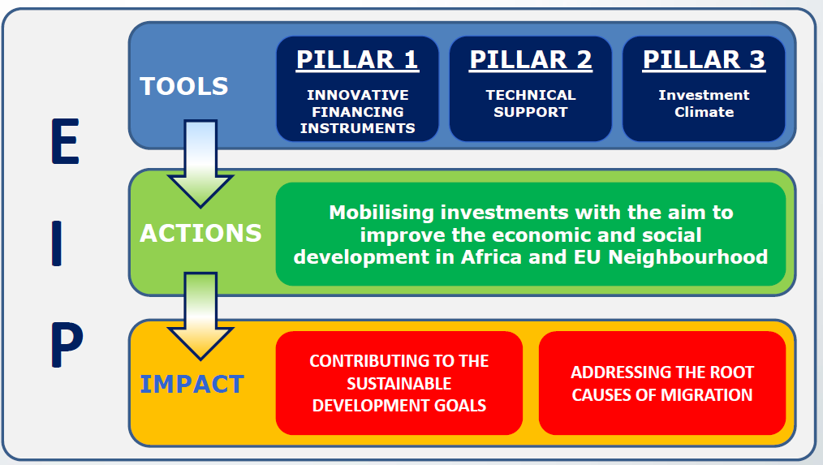
Strengthening water operator partnerships in development cooperation – blending and linking with the EIP
Options
Immediate way forward
New call for proposals
EEIP (municipal services window)
“WaterWorx” set up/ expand/ co-fund Europe wide initiative similar to WaterWorx
PROMOTION/ KNOWLEDGE MANAGEMENT -Software GWOPA/Associations (EU-ACP
OPERATIONAL GRANT SUPPORT / PROMOTION/ KNOWLEDGE MANAGEMENT Combined software and operational support for managing the granting of individual water operator partnerships GWOPA/Associations (EU-ACP)
EU Delegations working closely with IFIs can stimulate, finance and make use of WOPs to enhance the sustainability of investments.
EU Delegations can approach GWOPA/Associations to assist in setting up, managing the partnerships

