Slide 1
water | waste water | resources | operation & management
INTEGRATED UTILITY KNOWLEDGE TRANSFER
WATER OPERATORS PARTNERSHIPS
02/06/17, Brussels
Contact
CONSULAQUA Hamburg Beratungsgesellschaft mbH
Ausschläger Elbdeich 2, 20539 Hamburg, Germany
Phone: +49 (0) 40 7888 89555
www.consulaqua.de / www.hamburgwasser.de
Email: consulting@consulaqua.de

Slide 2

Company structure
Free and Hanseatic City of Hamburg, Germany
100 %
100 %
HWW – WATER SUPPLY
Hamburger Wasserwerke GmbH
HSE – SANITATION
Hamburger Stadtentwässerungs AöR
50.1 %
49.9 %
CONSULAQUA Hamburg
Beratungsgesellschaft mbH

Slide 3


HAMBURG WASSER UTILITY SERVICES
2.3 million
people
450,000 m³
HAMBURG WASSER takes care of about 800,000 customers
and supplies excellent drinking water for
more than 2 million people every day.
At our central clarification plant we treat and clean
450,000 m³ of waste water every day.- while the plant produces 27 million kwh of electricity each year

Slide 4

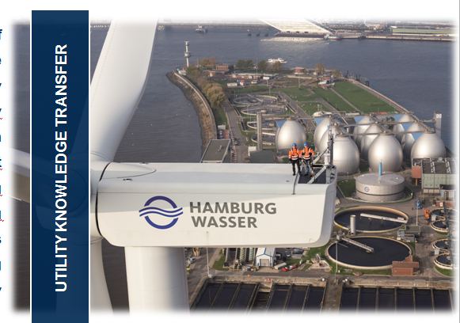
External Services of HAMBURG WASSER are conducted through CONSULAQUA, especially for consulting initiatives in the frame of development cooperation in emerging and transitioning economies as well as national engineering services in Germany

Slide 5
Portfolio international projects
International Cooperation and long-term utility partnerships with the backup of HAMBURG WASSERS experiences gained within 160 years.
Core elements for Capacity Development initiatives are:
Utility Knowledge Transfer
Peer-to-Peer Coaching
Expert staff Twinning
Job-Shadowing
50 % I Sub-Saharan Africa
40 % I MENA-Region
2 % I Latin-America / CARICOM
8 % I Others (e.g. India)

Slide 6
HAMBURG WASSER
OPERATOR PARTNERSHIP EXAMPLES

Slide 7
HAMBURG WASSER UTILITY PARTNERSHIPS
TANZANIA
RWANDA
2012 - 2016
2013 - 2016
Sustainable Service Delivery in Dar es Salaam
FOCUS:
Organizational Development, GIS , Net-work Management & revenue collection improvement, Sanitation mapping
Optimization of water supply using performance indicators – OWASUPI
FOCUS:
Reduction of operational costs (chemicals for water treatment, energy costs), Service delivery improvement
SAINT LUCIA
BURKINA FASO
Since 2015
Since 2013
WASCO Utility Management Support
FOCUS:
Organizational Development, Reduction of Non Revenue Water, Energy Efficiency
Trainings and Optimization for water supply and sanitation system of ONEA, Quagadougou
FOCUS:
Optimization of surface WTP, Supply Network operation and Energy Efficiency

Slide 8
LESSONS LEARNED – BENEFITS AND CHALLENGES
Trustful relationship between WOP Partners
Cultural Exchange
”Peer-to-Peer” approach – From utility to utility
Social Responsibility
Continuous and long-term exchange and development
W O P
benefits
Human Resources Development (Skills, Experience, Motivation)

Slide 9
LESSONS LEARNED – BENEFITS AND CHALLENGES
Sustainability of initiated procedures after completion of partnership
Organizational changes affecting acceptance of WOP
Ownership / Governance
W O P
challenges
Integration in daily operation / WOP-Manager
Financing

Slide 10
LESSONS LEARNED – BENEFITS AND CHALLENGES
TANZANIA
RWANDA
2012 - 2016
2013 - 2016
Sustainable Service Delivery in Dar es Salaam
Optimization of water supply using performance indicators – OWASUPI
As part of EU - financing
SAINT LUCIA
BURKINA FASO
Since 2016
Since 2013
WASCO Utility Management Support
Trainings and Optimization for water supply and sanitation system of ONEA, Quagadougou
Based on MoUs between both utilities and as ‘follow-up’ of GIZ/EU financed consultancies
Additional international financing is fundamental for implementation of measures

Slide 11
LESSONS LEARNED – BENEFITS AND CHALLENGES
Demanded intervention
Suitable Slot for Intervention
Demanded intervention
Integration in daily operation / WOP-Manager
Continuous coordination / management of WOP at partner utility
Demand-oriented allocation of technical / operational management team members to time and activity slots
→ Depending on availability due to day-to-day operations

Slide 12
LESSONS LEARNED – Way forward
First year for WOP baseline assessment
→ Strategic action planning (KPIs), clear vision and harmonized objectives
Adapted legal framework for German utilities
Needs adapted financing guaranteed (differentiated between assessment / investment / fading out phases)
Job Shadowing as essential element
Way Forward
WOP Lifespan > 7 years
Committed utility partners
(competition)

Slide 13
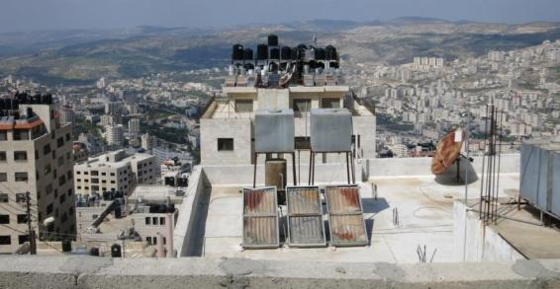
Innovative Water Utility Management starts with the idea to convert new knowledge into water services – aiming at an increased value for consumers, the utility and the environment.
Innovative Water Solution for MENA region: Experiences and Lessons Learned
Contact
CONSULAQUA Hamburg Beratungsgesellschaft mbH
Ausschläger Elbdeich 2, 20539 Hamburg, Germany
Phone: +49 (0) 40 7888 89555
www.consulaqua.de / www.hamburgwasser.de
Email: consulting@consulaqua.de

