Slide 1
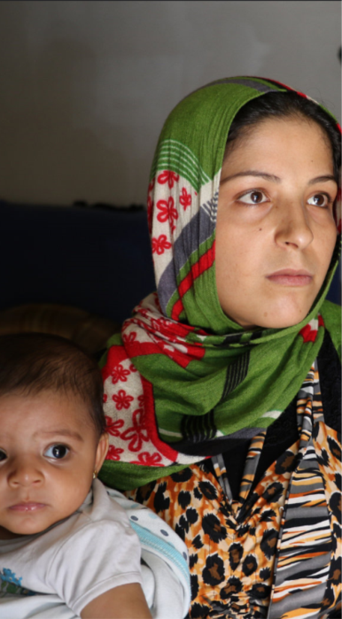
Plenary dialogue on Migration and Mobility
Colin SCICLUNA, Deputy Managing Director for the MENA Region,
EEAS
Jean Christophe FILORI
Head of Unit Maghreb, NEAR B3,
European Commission
Linda ALKALASH, Tamkeen Fields for Aid, Jordan
Moderator: Hassen BOUBAKRI
Thematic Facilitator on Migration

Slide 2

MIGRATION
Workshop 1: Legal Migration and Mobility
Hassen Boubakri, Thematic Facilitator
Myriam Watson, DG HOME
Monica Faro-Murcia, DG HOME
Moderator: Aymen Zohry, EGYMIG

Slide 3
MIGRATION
Workshop 2: Humanitarian and protection imperatives on Migration
Maria Jammal, Humanity Crew
Iris Ibrahim, DG NEAR
Dina Sinigallia, DG ECHO
Moderator: Malek Kefif, FTDES

Slide 4
MIGRATION
Workshop 3: Building tools and mechanisms for EU/Civil Society monitoring of international responses
Ahmad Mroueh, OXFAM
Camila Hagström, DG DEVCO - Europeaid
Corinne André, Centre of expertise on Migration, DG NEAR, European Commission
Moderator: Rachid Badouli

Slide 5

Plenary session
EU representative: Colin Scicluna, Director, MENA Region, EEAS
Jean-Christophe Filori, Head of Unit Maghreb and Center of Expertise on Migration, DG NEAR
Civil Society: Linda Alkalash, Tamkeen Fields for Aid, Jordan.
Moderation: Marie Martin, EuroMed Rights & Hassan BOUBAKRI
(Facilitator & CSO South)
Rapporteur: Marco Di Donato. UNIMED (Mediterranean Universities
Union)/ Italy.
Migration Working Sessions – Main recommendations

Slide 6

PREAMBULE
Stress the necessity to be consequent to the CSOs recommendations through waiting for the responses and feedbacks.
Interrogations about the pertinence of this forum structure, goals and its future activities.
The maintaining of Tunis recommendations (April 2017)

Slide 7
Recommendations sub theme 1 : Enhancing Mobility and Circulation
Civil Society: Hassen Boubakri, Facilitator & CSO South
EU representatives: Myriam WATSON & Monica ALFARO-MURCIA, Unit International Cooperation, DG HOME
Moderation: Aymen Zohry / Egyptian Society for Migration Studies
(EGYMIG)
Rapporteur: Salima M. Alfakhri/ Director | Women & Youth
Empowerment Forum
Concrete measures and tools to respond to Tunis recommendations (action plan and timeline)
Focus on a better coordination between the commission and member states regarding the mobility restrictions and the access conditions to labor market.
Removing the connection between security agreement and mobility partnership agreements.

Slide 8
Recommendation sub theme 2: Humanitarian and protection imperatives on Migration
Civil Society: Maria Jammal, Humanity Crew, Israël
EU representative: Iris Abraham, EU Regional Trust Fund in Response to the
Syrian Crisis, DG NEAR
Dina Sinigallia, Unit Policy Development and Regional
Strategy, DG ECHO
Moderation: Malek Kefif, FTDES, Tunisia
Rapporteur: Najla Chahda Thabet, Consultant on Migration and Human
Trafficking
- Action plan with timeline for the implementation of Tunis Recommendations (create a EU/CSOs observatory for shared evaluation of the various mechanisms adopted by the EU in order to monitor EU Policies and programmes).

Slide 9
Recommendation sub theme 3: Building tools and Mechanisms for EU-CSOs monitoring of International responses
Civil Society: Linda Al Kalash TAMKEEN JORDAN
EU representatives: Camilla Hagström, Deputy Head of Unit Migration and
Employment, DG DEVCO
Corinne ANDRE, Center of Expertise on Migration, DG NEAR
Moderation: Rachid Badouli, Fondation Orient Occident, Morocco
Rapporteur: Manal BENANI / Young Mediterranean voices)
Enhancing medium and small CSOs capacities to allow them to have access to the EU institutional funds (cooperation with EU/ CSOs and universities)
Set up a mechanism allowing local CSOs to improve their representativity and capacities in responding to the EU consultations and programmes (conception, implementation and evaluation)

Slide 10
Main recommendation of Migration Sessions
The urgent need to have a precise action plan with a time line built in cooperation between the two parties for the implementation of CSOs recommendations (Tunis & Brussels).

