Slide 1
Budget support training
Module 5
Implementation of BS contracts
Notes:
See sections 6.2 and 6.3, Section 5.4 and annex 8 of the Guidelines

Slide 2
Outline of module
  Identification and Formulation of a BS programme.
  Performance Assessment Framework, base tranches and variable tranches.
  Policy dialogue and Implementation
  Capacity building and coherence

Slide 3
BS Cycle of Operations
EC Development Policy
Partner Government Policy
EDF:National Indicative Programme:
identify sectors of engagement
BSSC: assessment of fundamental values
Programming
Evaluation: focus on joint evaluations
Pre-formulation support
Evaluation and Follow-up
oQSG1 – Action Document: Validation of kind of BS Contract
focus on context/sector analysis, eligibility criteria, road map (SBC), RMF + next steps
Identi-
fication
Decision process for tranche release:
Monitoring and dialogue, assessment of payment conditions + RMF
Implementation
oQSG2 – Action Document:
focus on eligibility + context+ conditions. Supporting documents, RMF, financing agreement and TAPs
Formulation
Budget Support Steering Committee (BSSC): Continuous political and policy steer of BS programmes. May review budget support financing and disbursement proposals wherever there are substantial or high political and policy implications.
Cf. Note on Simplification of DEVCO Process / Treatment of BS analysis and reporting (July 2014 ARES 2660671)
Action Document to be used for both phases of identification and formulation (see new instructions for Action Document Template Completion)
Notes:
oQSG Office Quality support Group

Slide 4
National policy. Choice of overall objectives/results
Harmonization and synchronization
Choice of sectors
Identification of “global goods”
Results achieved, comparison with what was planned and analysis of the reasons for possible ‘gaps’
Identification
Formulation
Implementation
Closure
Programming
Context analysis
Public Policy Analysis
Stakeholders analysis
Political economy analysis
Sector policy
Objectives and results
Stakeholders identification
Options of modalities
Finalize intervention logic, Choice of stakeholders, Choice of implementing modalities: financial transfers & procedures, CD, PD, M&E
Follow up performance & identify corrective measures…. Policy dialogue…. Monitoring (internal, external)…. Risk management
Notes:
PUTTING CONTEXT ANALYSIS AT THE CENTRE OF THE EC PROGRAM CYCLE:
A CONTINUOUS AND ITERATIVE PROCESS

Slide 5
A unified Action Document (AD) template for identification and formulation of EU funded actions
  Delegation prepares an Action Document per sector of concentration setting out:
    Type of contract and amount (alternative modality) ;
    Objectives and expected results;
    Likelihood of meeting eligibility criteria;
    Needed for prior actions;
    Needed supporting measures (expertise);
    Preliminary proposals for design (formulation) and implementation;
    Main risks.
  First rough draft of the Risk Management Framework should be attached.
  Road map for SBC

Slide 6
List of contents of Action Doc and draft TAP
  Context
    Sector/regional context
    Other areas of assessment (FV, macroeconomic policy, PFM, Transparency and Oversight)
  Risks and assumptions
  Lessons Learnt, complementarity
  Description of the action
  Implementation
  Appendix – Indicative list of result indicators
  (Tot number of pages: 15-18)
Notes:
First time that reference is made to targeted and untargeted BS.
Definition of targeted BS in the Glossary (see annex 1) is very specific, focussed on one form of targeting. There are various other forms of targeting BS (or earmarking BS).

Slide 7
Outline of module
  Identification and Formulation of a BS programme.
  Performance Assessment Framework, base tranches and variable tranches
  Policy dialogue and Implementation
  Capacity building and coherence

Slide 8
Monitoring a BS programme:
a continuous process
Running Head 12-Point Plain, Title Case
Follow up and data collection
Reports from MF, Central Bank IMF/WB Reports Sector reports (implementation) Enacted budget Reports on budget execution Assessments of PFM (PEFA, PEMFAR, PER, OBI) Implementation reports of PFM Action Plan Human rights reports M&E indicators (PAF) Surveys, Statistics ROM reports (if any)
Analysis
Macroeconomic framework Progress in implementing policies Relevance/credibility of the policies Progress of PFM reform Budget execution Availability/accessibility of budget documents Monitoring of performance indicators, achievement of results, specific objectives. Evolution of risks Monitoring of risk and mitigating measures
Payment file/annual report
Verify continued relevance/credibility of policies Macroeconomic assessment Annual report on PFM Assessment of progress in transparency Risk Management Framework (RMF) Performance Assessment Framework (PAF)
POLICY DIALOGUE
Notes:
RMF: Risk Management Framework
Other data collection/analysis:
- for public policy: PAF (indicators), results of surveys, other review documents
Data sources/Surveys (Examples):
Household surveys
LSMS – Living Standards Measurement Study.
It is used to explore ways of improving the type and quality of household data collected by statistical offices. The goal is to foster increased use of household data as a basis for policy decisionmaking.
MIC – Multiple Indicator Cluster Survey
It is a survey program developed by the United Nations Children's Fund to provide internationally comparable, statistically rigorous data on the situation of children and women
DHS – Demographic and Health Survey
PISA – Programme for International Student Assessment
PASEC – Programme d’Analyse des Systèmes Éducatifs.

Slide 9
What to monitor?
For all contracts:
The continued eligibility under the 4 eligibility criteria
The progress towards the specific objectives of the contract and the results achieved
The evolution of the risks
The progress in the implementation of the mitigating measures
The needs and progress of the partner country in terms of capacity development in the areas of importance for the BS programme
Plus:
For GGDC: the continued commitment to the fundamental values

Slide 10

Main issues regarding Performance Assessment/Monitoring Frameworks/Indicators (2)
  Selection of indicators/targets is an important part of the policy dialogue and may sometimes require strong negotiations with the partner countries
  Key issues for BS: Public policy assessment/existence of a common performance assessment framework (PAF) to monitor/measure policy implementation, existence of baseline/ targets/performance objectives with SMART performance indicators (PFM reforms, Sector policy…).
Notes:
-Emphasis on ensuring that the supported policy is strengthened with a quality monitoring and evaluation framework and that it can provide a basis for future policy dialogue and budget support conditions.
SMART INDICATORS:
Specific
Measurable
Attainable
Relevant
Time-bound
RACER INDICATORS:
Relevant, i.e. closely linked to the objectives to be reached (policy support,
Accepted (e.g. by staff, stakeholders);
Credible for non experts, unambiguous and easy to interpret;
Easy to monitor (e.g. data collection should be possible at low cost);
Robust against manipulation.
CREAM Indicators:
Clear (precise and unambiguous)
Relevant (appropriate to the subject at hand)
Economic (available at reasonable cost)
Adequate (able to provide sufficient basis to assess performance)
Monitorable (amenable to independent validation).

Slide 11
VT disbursement indicators
  To be selected from the overall/sector PAF or derived from government’s policy documents
  Indicators/targets and assessment methodology should be agreed during formulation and clearly defined in the TAPs
  Number of indicators should not exceed 8 per tranche
  Preference for using outcome indicators
  Using input, process and output indicators may also be appropriate (SBC, regulatory policy, short term measures…)
Input
Annual budget for training
Output
Number of people having successfully completed a training
Outcome
New practices implemented by trained staff
Impact
Trainee employment rate after 12 months
Notes:
- PAF = Performance assessment framework
- Overall PAF = PAF from the Economic Growth and Poverty Reduction Strategy (EGPRS). To be used in case of GGDC.
Sector PAF to be used in case of SRC.
PAF contains all indicators to be used for monitoring performance of the implementation of either a EGPRS or a sector development programme.
Make distinction between performance indicators (all indicators of the PAF) and disbursement indicators (the performance indicators used for taking a decision about disbursements).
The more focused the programme objectives and the smaller the size of the VT, the fewer the indicators.
https://europa.eu/capacity4dev/macro-eco_pub-fin/document/guide-performance-measurementenglish

Slide 12
How to judge the quality of an indicator?
  Is the indicator clearly defined?
  Does it have a quantified or well-defined target?
  Do baseline and trend data/information exist?
  Is the source of verification mentioned/reliable?
  Is the timing of the availability of the information known?
  How sensitive is the indicator to exogenous factors and non-BS aid programmes?
  What is the statistical quality of the indicator (validity and reliability)? Cf. EC snapshot tool for statistical systems in PC
  Disaggregated by gender, region or population groups?
Notes:
Refer to Box 1 in chapter 4 of Annex 8
Statistical quality of an indicator: Reliability; Validity and Timeliness.
Valididy: Example: The indicator to measure proficiency in statistics of the students of the last year of a course of economy.
80% of the students of the last year of the course of economy are proficient in statistics. How can we be sure that each element of this statement is accurate? What do we consider as ‘statistics’ (descriptive, analytical, econometry?) Do we have an accepted working definition for ‘proficiency’? The way we operationalize these concepts is directly related to the quality of an indicator.
Another example: we want to define an indicator to measure a certain desease, for instance, cardio-vascular deseases. To that end, should we measure incidence or prevalence?
Reliability
It is the extent to which a measure yields consistent estimates.
It refers to the variance in an estimate when it measured the same way, under the same conditions, with the same subjects. Example: Wiil the students performe the same if they are given the test twice?
Can we have a reliable estimate that is not valid? Yes, supose that we estimate properly the incidence of the cardio-vascular deseases, but the indicator that we consider to be valid is the prevalence.
Timeliness: 3 dimensions:
The length of time required to collect the data, analyse and make the results available
The frequency with which data on a specific topic are collected (e.g. data on enrolment in the terciary education level): Example: if we want the measure incidence we need to count the number of cases every year; if we want to measure prevalence we only need to measure it every three years.
The specific timing of a measurement. E.g. if we counting the number of students enrolled in the secondary level of education, should we do it the beggining or in the end of the school year?

Slide 13
Example of indicator fact sheet
p138 Documentation Sheet

Slide 14
coming up.. more focused on policy dialogue

Slide 15
What is a BT and what is a VT?
  Base or fixed tranche : eligibility criteria are (still) met (all contracts);
  Disbursement is ‘all or nothing’
  VT disbursed on basis of additional disbursement conditions
  % of VT that will be disbursed depends on the degree on satisfying the disbursement conditions.
Notes:
This part refers to the annex 8 of the Guidelines. To check whether we keep it for the e-learning module 10.
VT = variable tranche
BT = Base tranche; also called fixed tranche.

Slide 16
VT and predictability
  VT should not put into danger the predictability of disbursements
  Respect budgetary and planning cycles (n-1/n/n+1)
  No VT in first year of a BS contract
  Aid-dependent countries with good track record and low risk profile can get contracts with longer duration and lower VT share
  No definite rules as regards share BT/VT
Notes:
Impossible to apply the n-1/n/n+1 principle for a VT in the first year and difficult to use it in the second year (except in cases of successor contracts).
Performance assessment in first year (determining amount of VT disbursement in the second year) could be focussed on process and short term output indicators in that particular first year (in stead of year n-1).

Slide 17
Calculation of VT disbursement (1)
  A score has to be attributed to each indicator, e.g.:
    0 = no or insignificant progress
    0.5 = significant but partial progress
    1 = target met
    Or a pro rata score in case of a quantitative target
  Weighting each indicator
Notes:
Discuss table on page 84 of annex 8.

Slide 18
Calculating the VT disbursement (2)
  Guidelines: two options for final calculation of disbursement:
    Pro rata payment: overall score x total amount of VT;
    Staged approach, e.g.: 0-29% no disbursement, 30-49% → 40% disbursement; 50-79% → 70%, and 80-100% → full disbursement.
    In practice third option: absolute values per indicator
  In principle undisbursed funds will not be recycled to next tranches. They will be returned to the country’s MIP (EDF) or lost (NEAR).
  In exceptional cases, an indicator can be neutralised and the amount can be reallocated to the other indicators or to the next year.
  Floating tranches, without precise decision and disbursement dates, should be avoided.
Notes:
Discuss table on page 7 of annex 8.
MIP = Multi-annual indicative programme
Is a floating tranche similar to a performance tranche (all or nothing) or could it be a variable tranche, or are both options possible?
In case of non EDF countries, like DCI or NEAR the undisbursed amount is lost and goes back to the Central EC funds

Slide 19
Profile of annual total disbursements
  Profile may vary from country to country.
  Constant, frontloaded or backloaded.
  Will depend on:
    Desired incentive structure;
    MTFF and trend of financing gap of recipient;
    Disbursement plans of other BS donors;
    Partner country’s preference.
  See profiles at the end of chapter 2 of annex 8.

Slide 20
Initial and successor GGDC and SRC
Notes:
Since 2016, recommendation id 70-30%

Slide 21
Low aid dependency and/or high risks ad/or doubts about performance
Common for NEAR and IPA
Notes:
The second figure is the preferred distribution for NEAR and IPA countries: these countries are usually middle income and are frequently of a more specific programme nature. Eligibility criteria are adhered to (hence to real trigger).
The 3rd figure is possibly misleading: it shows that the first fixed tranche is spread over a longer period, followed by a variable tranche at the end. This is, however, just to show that all kind of variations are possible. There us no ‘one size fits all’.

Slide 22
SBCs and variable tranches
  High risk profile and limited track record → large VT (according to Guidelines; But DEVCO: keep VT small; max 30%).
  Short duration → small VT.
  For a SBCs of 1 to 2 year → possibly no VT and emphasis on satisfying eligibility criteria.
  Currently more 2 times 3 years SBC: more use of VT
Notes:
In case of SBC without a VT and emphasis on satisfying eligibility criteria, it could be that certain prior actions are needed, which will become a kind of additional disbursement conditions (preconditions).

Slide 23
State-building contract
Notes:
Since 2015 also 3 year SBCs (not envisagd in Guidelines)

Slide 24
Front and back loading
Notes:
Figures misleading…these are not percentages

Slide 25
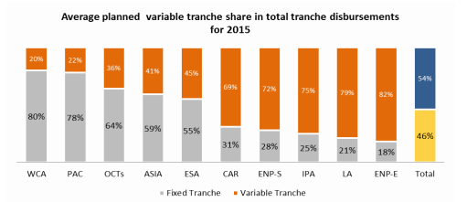
Variable tranche release in practice, 2015 and 2016
Higher than envisaged in guidelines; mainly LA and ENP countries
Notes:
Source: Budget Support. Financial implementation, risk assessment and selected poverty macroeconomic and fiscal results, 2015.

Slide 26
Outline of module
  Identification and Formulation of a BS programme
  Performance Assessment Framework, base tranches and variable tranches
  Policy dialogue and Implementation
  Capacity building and coherence

Slide 27
BS Policy dialogue
Is a key input of BS programmes and the centre piece of mutual accountability.
It provides a framework for:
    taking stock of partner country’s policies and reforms as well as of the donors’ commitments
    assessing progress on both sides on the basis of different information, criteria and indicators and of extensive discussion with the government
  It can be used as a forward looking tool for:
    identifying policy slippages timely
    reaching common understanding with the authorities on corrective measures and refining objectives.
Notes:
Quality of policy dialogue:
In order to strengthen the quality of policy dialogue, a process of reflection and self-assessment of current practices is needed. At present, dialogue is designed as a mechanism for monitoring disbursement conditions, whereas it should also allow for the open exchange of ideas, in the interest of resolving problems of mutual concern (OECD, Pilot Evaluation).

Slide 28
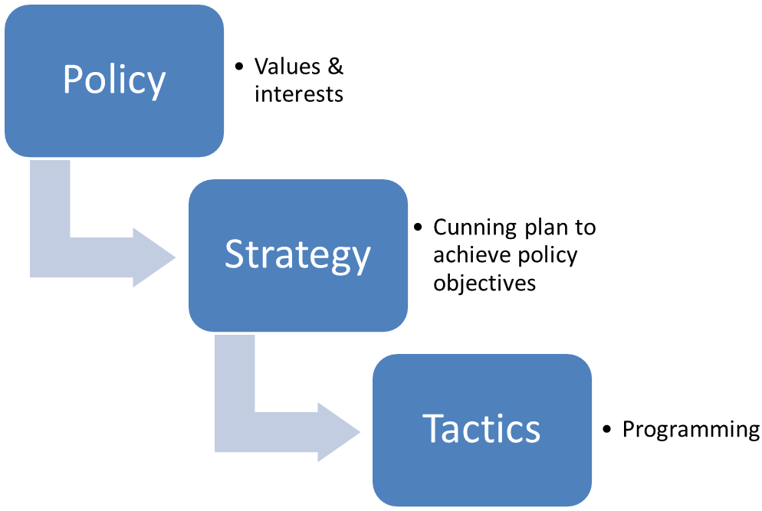

Policy dialogue is an
’open and inclusive dialogue on development policies’.
Accra Agenda for Action (Section 13)
Policy Dialogue
“Policy dialogue is a process of communicating and negotiating values in a landscape of power and knowledge imbalances”
AUSAID 2013
Situational Analysis
Source: AUSAID 2013 Thinking and Working Politically AN EVALUATION OF POLICY DIALOGUE
Notes:
Differentiating ‘policy’ from ‘strategy’ and ‘tactics’
We think it is important to differentiate ‘policy’ from ‘strategy’ and ‘tactics’ (Figure 1).
‘Policy’, we are saying, is fundamentally the expression of the values that an organisation holds to be important in delivering its mandate. In the context of government and public services, policy is inherently political. Administrations—such as a partner government department or AusAID itself—deliver on the policies established (or the values expressed) by ministers.
‘Strategy’ can be seen as the ‘cunning plan’ to achieve stated higher-level policy objectives. Strategy is about how an organisation organises its presence, efforts and resources, and its ways of working, such that they represent the right thing in the right place at the right time to contribute most efficiently and effectively to reaching its goals. Strategy will involve a consideration of the mix and focus of the aid program, and the types of aid that should be employed, where and when. That is, the ‘how’ of the aid program, or the Delivery Strategy in AusAID’s Country Strategy Architecture.
‘Tactics’ are the programming decisions made in operationalising a strategy. They are the choices made about inputs and activities—for example the deployment of technical assistance or the allocation or reallocation of assets and resources, to achieve the required results efficiently and effectively.
This concept derives in part from: D. Nabarro, Special Representative of the UN Secretary General, personal communication.
AUSAID 2013 Evaluation of Policy Dialogue

Slide 29
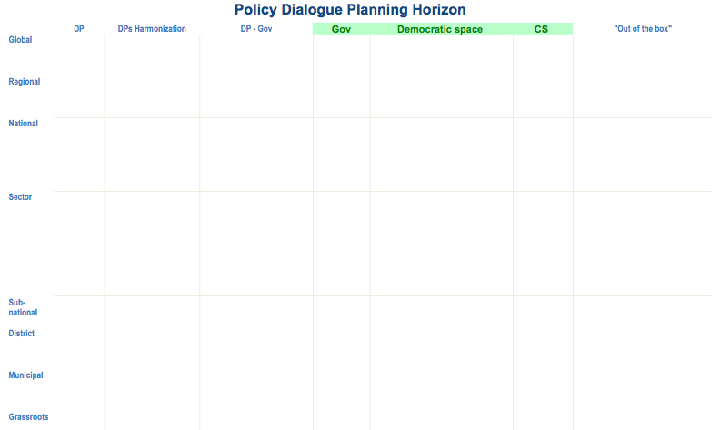

Policy dialogue is a continuous, dynamic,
multidimensional, non-linear, purposeful exchange …
… between:
“As long-term progress can only be driven by internal forces, an approach centred on political, and policy dialogue with all stakeholders will be pursued.”
Agenda for Change (2011)
Intra/ Inter donor
Donor-Country
Domestic stakeholders
(“Democratic Space”)
… at multiple levels:
Global/Regional/national/sub-national levels
Technical and strategic levels
Formal and informal
Content focus and depth
… evolving over time !
Notes:
Domestic stakeholders: also without DPs and other external support there will be (the need for) a policy dialogue
Donor-Country: differs per country, smaller-larger. Even if PD is only linked to operational activities, still domestic change is the key objective. + How does the donor-country PD fit into the wider domestic dialogue, only then the DP is relevant.
Inter-donor: in name always present, not always easy to speak with one voice

Slide 30

“Traction” with domestic policy making
Domestic policy process
Donor-Country
Intra/
Inter donor
EU as active stakeholder
Harmonization/coordination for leverage & coalition building (eg. joint positions)
EU as active stakeholder
Partner – review mechanisms
How to fit PD into national policy making process?
EU as external actor:
How to play a facilitation role?
Policy dialogue is part of the development assistance “toolkit” that aims to support partner’s domestic reform
Notes:
STRUCTURE AND CONNECT POLICY DIALOGUES TO ENSURE SPILLOVER EFFECT IN DOMESTIC POLICY MAKING
COM is an actor in the PD between domestic and external actors. But, in order to reach results it takes into consideration the wider dimension of Policy Dialogue within a country and seeks to connect all policy dialogues. Gives primacy to domestic policy dialogue
CALIBRATING PD OBJECTIVES TO SECTOR CONTEXT & PEA
Exerting influence versus supporting an open ended consensus building process around complex issues
Raise awareness on importance of reforms by bringing in technical inputs
Facilitation by helping structure national dialogue process (eg. Support participation of key domestic actors or convey their views; communicate)
In domestic process:
Broker: bring information =>understanding the context and assessing the content of PD
Capacity Development: support to stakeholders for their effective/owned participation
Table setting becomes a key roles for donors and agencies (including NGOs) to make the process credible and purpose-led: support to stakeholders for their effective participation
In Donor-Country dialogue:
Structuring of the process while leaving the leadership to the national parties around the table
Donor-Donor dialogue:
Division of Labour becomes critical for mobilising resources and coalition building

Slide 31
How to chart meaningful engagement in policy dialogue
Step 1
Understand where PD takes place
Step 2
Map relevant PD streams, events and milestones
Step 3
Identify opportunities & anticipate inputs and action
Step 4
Facilitate and engage in strategic policy dialogue
Clarify agendas, objectives, information flows and exchange, trust and credibility, mandate
Distinguish the types of dialogue and identify upcoming events, studies, milestones along a time line.
Explore relevance and credibility. Identify entry points and how to build bridges between dialogue reinforcing reform.
Support/tailor process keeping in mind the fundamental importance of democratic processes
PEOPLE - PROBLEM - PROCESS
31

Slide 32
Example of a sector coordination & dialogue structure
National level council for policy development and coordination
SECTOR I COORDINATION GROUP
Level 2
SECTOR III GROUP
SECTOR II GROUP
Subsector D working group
Subsector A working group
Subsector B working group
Subsector C working group
COORDINATION GROUP I Secretariat
Secretariat
SECTOR X GROUP
Political Dialogue with EU / EC
Formal Policy Dialogue under the national / sector coordination structure
High-level policy dialogue
General and thematic meetings and working groups negotiating and forming the EC relationship with the country
e.g.: DIR & Cssr visits, Article 8 dialogue, trade negotiations, association councils, committees & subcommittees
Strategic dialogue
Operational dialogue
Notes:
The existing national policy coordination and country-led dialogue structures establish the basis for evaluating the relationships between the different stakeholders, the inclusiveness of the existing frameworks, as well as capacity of the stakeholders to engage in and to coordinate the dialogue. A correctly aligned budget support programme benefits from domestic policy coordination and monitoring and evaluation processes, as well as existing dialogue structures between the EU/EC and the partner country and should also be able to strengthen them while avoiding duplication.
FORMAL DIALOGUE
Policy dialogue takes place at all levels, i.e. by all staff members within the scope of their responsibilities. The operational level dialogue comprises the routine interaction between the EU Delegation and the reform coordinators in the implementing ministries and agencies, and the technical working groups.
The strategic dialogue should be led by the government and consists of regular, formal meetings with relevant institutions and external stakeholders, including the Commission, but also (where relevant) with IFIs and other International Organisations and donors. The key moments for the strategic dialogue include the end of an implementing year, when the upcoming year's plans are discussed, and the beginning of the financial year, when the draft of the government's progress report for the previous year is discussed, together with the achievements against the budget support programme targets.
Dialogue at the high level takes place under the lead of the politically elected leaders in the country, and with the appropriate representatives available from the EU side. The permanent representative of the EU in the country is the Head of Delegation, but depending on the type of relations between the EU and the country, this level dialogue could also regularly involve the relevant European Commission and/or EEAS interlocutors from the headquarters. The high level discussions generally involve wider political dialogue issues. Thus, they can only address major issues and/or bottlenecks encountered under budget support operations.
INFORMAL DIALOGUE: The power of informal channels such as personal contacts, social events, retreats, joint missions, informal meetings, etc. is often underestimated.

Slide 33
Factors limiting policy dialogue based on domestic dialogue processes
Unwillingness: to open up the dialogue process or to expand the scope of dialogue to all issues of the sector => Use EU’s position to bring new issues on the agenda or use conditionalities
Weak Civil Society Organisation’s capacity: NSAs are not organised or able to represent their consistencies for lack of capacity => specific support
Disagreement: can arise between government and donors or between donors, leading to uncoordinated efforts => focus effort on informal meetings; trust building around what is agreed and works and coalition building to push a consensual agenda
Notes:
Policy dialogue focusses primarily on the technical and political issues addressed by the country public policies. However, it will not always be easy to ensure policy dialogue is based on domestic public policies and accountability. Limiting factors can be:
governments may accept policy dialogue as part of the aid package but try to limit the areas for open discussion;
weak organisation, capacity and representation of civil society;
disagreement between government and donors;
poor donor harmonisation and divergent interpretations of alignment.
In this context, conditionality is also a tool that shapes, triggers and sustains policy dialogue. Conditionalities can be classified along a continuum from weak to strong impact. Experience shows that imposing conditionality may have a limited impact. In the context of development effectiveness agenda, policy dialogue is rather based on selectivity and on consensual conditionality. Moreover, experience shows that in the initial phase of the policy dialogue process, certain reforms tend to be donor-driven. Yet if credible implementation strategies are defined and agreed, donor agencies can be effective change agents and contribute to an increased ownership of the reform agenda.

Slide 34
Sequencing
  ESTABLISHED
  In Sector/Theme venues
  Formal
  Informal
SWG
SWG
SWG
Health Forum
Budget review
Budget submission
HoD Briefing
Reception
Timeline
  ESTABLISHED
  Related cycles / venues
  Formal
  Informal
TWG FNS
Budget debate
Parliament
Budget adopt.
TWG FNS
Civil Service Salary Review
Presid. Breakfast
  POSSIBLE
  Complementary venues
  Formal
  Informal
Parliament. Hearing
Press Conf.
Consult Univ.
Meet Opposition leader

Slide 35
Outline of module
  Identification and Formulation of a BS programme
  Performance Assessment Framework, base tranches and variable tranches
  Policy dialogue and Implementation
  Capacity building and coherence

Slide 36
Dialogue and capacity building
Running Head 12-Point Plain, Title Case
  Set up agenda for policy dialogue, particularly for the first year
  Make distinction between strategic issues and short term objectives and measures
  Capacity development should be one of the issues
  Prior agreement on institutional arrangements for policy dialogue is needed

Slide 37
Capacity Development complements BS financial transfers (1/2)
Provision of Capacity development/Technical Assistance (CD/TA) remains at the heart of design and implementation of budget support to improve quality and capacity of systems and institutions.
National ownership and demand-driven process (ref. “EU backbone strategy”)
CD/TA needs to be informed by policy/sector analysis, eligibility criteria assessments, risk management framework, and policy dialogue with the government
Needs for CD/TA to be identified and support designed “up front” during programme formulation
CD/TA needs to be timely delivered at key stages of the programme implementation

Slide 38
Capacity Development complements BS financial transfers (2/2)
Areas for CD interventions: address weaknesses in sector policy/reform design or in critical sector PFM for services delivery inputs and provisions at central and local level: public procurement and distribution, control of expenditure, systems of financial accountability such as book keeping and financial reporting …)
CD may directly related the fulfilment of specific conditions (drafting of new legislation, design of asset management system for drainage infrastructure…)
Coordinated approach with donors involved in the sector (SWAP, sector working groups)
Ensure sustainably approach to and building in incentives for capacity development (affordability in the long term, involvement of institutions and individuals involved in sector policy, financial management and service delivery)
Focus policy dialogue on critical areas for service delivery that are not covered specifically by generic PFM reforms

Slide 39
Donor coordination
Nature of donor coordination: Government-led, formal/informal, participation and roles
Existence of common framework and its functioning: harmonisation without unanimity
How does the donor-partner country coordination work?
  Existence of a Budget Support Group
  Leading role of Government
  Predictability of donor funding
  Existence of a common Performance Assessment Framework (PAF) and use of disbursement criteria
  Existence of complementary initiatives (training, TA,...)
How does the donor-donor coordination work?
Notes:
This is ‘on the move’, since traditional bilateral donors tend to follow increasingly ‘national’ development agenda’s (or opt for other financing modalities), while ‘non-traditional donors and global partnerships’ either do not join in, or have different working modalities.

Slide 40
EU Coordination and Coherence
Coordination:
Systematic information exchange
Sovereign decision making (individual MS authority)
Supportive of wider donor coordination and country-led coordination
Involves both HQ and field levels
Builds on existing bodies, mechanisms of cooperation, and existing legal frameworks (legally binding agreements)
Coherence
With the EU policies, such as on international security, trade, agriculture, etc.
With EU policies on FV (Human Rights consultations Art 8; observance of democratic elections) and sanctions
Notes:
Sovereign decision making:
Individual MS retain ministerial authority over BS operations
EU needs to comply with its legally binding agreements and financial regulations

Slide 41
Thank you very much for your attention

