Slide 1
Seminar Sector Reform Contract and Policy Dialogue
Module 4
Risk Management Framework
Notes:
This presentation covers page 42-46 of the BS Guidelines Part II (Tools and methods) as well as Annex 7 (pp126-133).

Slide 2
Learning flow
Day 1
Background
Day 2
Day 3
(half day)
GGDC
Day 4 and 5
Basic concepts
Eligibility
Intervention logic
Risk Management
Performance indicators
Fixed and variable tranches
Additionality
Disbursement file
BS Evaluation
Policy dialogue, CD
Formulation (macro and / or PFM eligibility)
Fragile state
MTEF and Results-based budgeting
SRC and SBC
Mozambique example
Rwanda, Afghanistan

Slide 3
Outline
What is risk, risk management and risk management framework?
Why is risk management important for BS?
How to identify, assess and manage risks?
Notes:
This first section sets out the definitions of RM and RMF and provides a general description of the risk management framework elaborated by the Commission for BS operations.

Slide 4
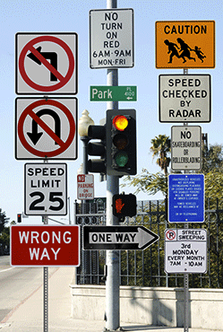
Signalling the direction and risks

Slide 5
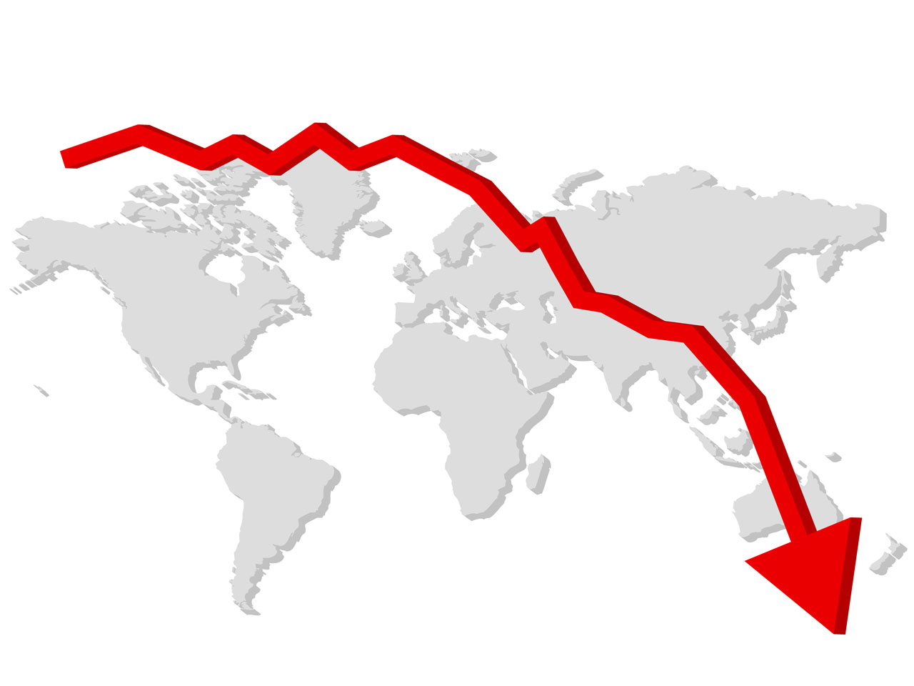
Three types of risk: external risk, inherent risk and behaviour (1/2)
A risk is defined by the Commission as
“any event or issue that could occur and adversely impact the achievement of the Commission’s political, strategic and operation objective. Lost opportunities are also a risk.”
(1) External risks: from outside the system: world economic outlook; climate; political unrest
Notes:
Definition of risk: Risk management in the Commission, Implementation Guide, Updated version October 2010.

Slide 6
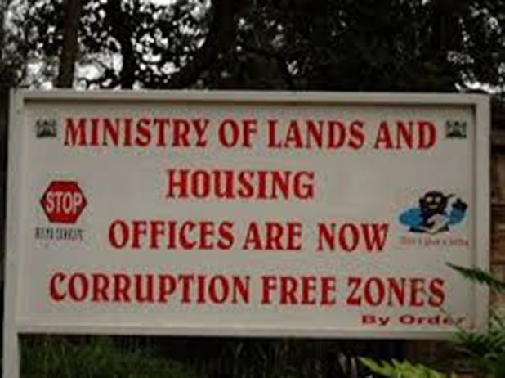
External risk, inherent risk and behaviour (2/2)
(2) Inherent risks: risks from within the system (omissions in oversight, weaknesses in control, lack of credibility)
(3) Behavioural risks: deliberate
misappropriation, fraud, abuse of power
(social appreciation,
adherence to the rule of law)

Slide 7
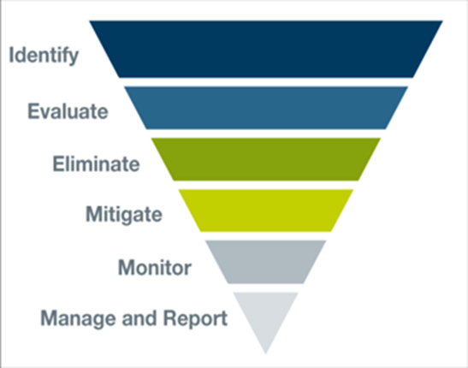
What is risk management?
Risk management is a continuous, proactive and systematic process of assessing, mitigating, and monitoring risks.
Risk assessment:
an input into BS programme cycle: early warning system. But not an eligibility criterion!
Risk Response
& Mitigation
Monitoring
& Reporting
Identification &
Assessment

Slide 8
Main functions of the RMF
RMF provides basis for decision making process by:
Identifying specific risks linked to the provision of BS (or cost of non-intervention) leading to a decision on risk level
Identifying mitigating measures and risk responses (risk strategy)
Informing Budget Support policy dialogue
Monitoring the identified risk and mitigating measures during implementation
Identification of changes: the framework reacts to deteriorations of a partner country’s situations.
One RMF for all contracts (whatever n° of SRCs)

Slide 9
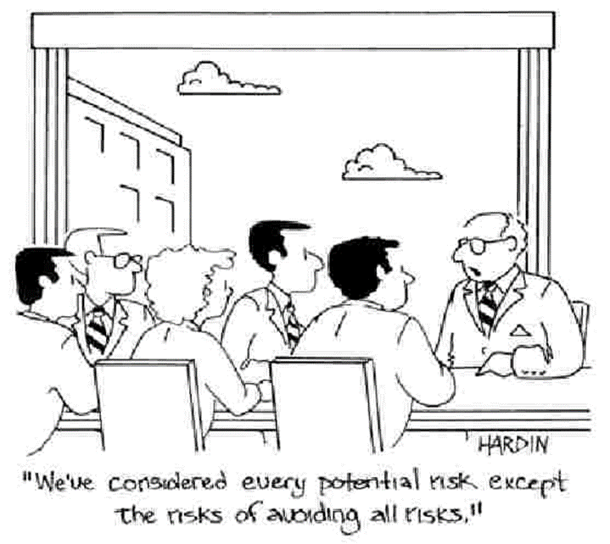
Risk management

Slide 10
Outline
What is risk, risk management and risk management framework?
Why is risk management important for BS?
How to identify, assess and manage risks?
Notes:
This first section sets out the definitions of RM and RMF and provides a general description of the risk management framework elaborated by the Commission for BS operations.

Slide 11
Why do we need a RMF?
  Special Report on BS Management (ECA Dec 2010)
  Need to assess fiduciary and development risks at the outset and during implementation.
  Budget Support Communication (10/2011): Specific budget support risk profile covering five risk categories: (political, developmental, macroeconomic, PFM, corruption and fraud)
  RMF tool
  Link with eligibility criteria and FV?
  Anticipating potential eligibility problems
  Management rather than avoidance of risks to strengthen country systems (fragile countries)
Notes:
The need has been pointed out by the European CourtOf auditors and was repeated in the budget support communication.
It is useful for anticipating potential eligibility problems, and similar tools for managing risks are increasingly being used by donors and international organisations.
The intention is not to avoid risks, but to manage them.

Slide 12
RMF enables the BS process
RMF can be used to streamline BS analysis and reporting requirements
RMF to be used to streamline BSSC consultation and decision process (including DEVCO A4-BS unit involvement)
If necessary (mainly GGDC): contingency plans, early warning systems

Slide 13
Outline
What is risk, risk management and risk management framework?
Why is risk management important for BS?
How to identify, assess and manage risks?
Notes:
This first section sets out the definitions of RM and RMF and provides a general description of the risk management framework elaborated by the Commission for BS operations.

Slide 14
How to assess risks
Notes:
The risk categories are the five column headers.
Under each risk category the various risk dimensions corresponding to that category.
This slide shows the categories and the dimensions that are covered in the risk management framework template.
Specific case: for OCT only 4 of the categories need to be assessed since political risks do not need to be assessed.

Slide 15
Risk categories, major risks and risk management (1)
Category of risks
Major risks
Risk monitoring
The partner country's overall commitment and adherence to the fundamental values
Regularly monitor the commitment
and adherence to the fundamental
values
Fundamental values
prerequisite
Analyse risk of political and social destabilisation
Monitor regional situation
Analyse emerging forces and related policies
Political
Political and social destabilisation
Regional tensions
Support of policies and powers that may exacerbate tensions
Macroeconomic policies cease to
be stability oriented
Macroeconomic
Eligibility crit. 2
Regularly monitor the main
economic development and policies
External shocks
Policies put in place by the
Identify the main factors:
government will be discontinued
inadequate policy design, lack of
Developmental
or may not attain their desired
ownership of policies, lack or
outcomes.
participation of stakeholders,
Eligibility crit. 1
insufficient capacity.
Notes:
1. Political risks:
universal values: fundamental rights, conflict and insecurity. The risk framework is used to regularly monitor the commitment and adherence to the fundamental values of human rights, democracy and rule of law. The risk of conflict and insecurity, including political and social destabilisation, regional tensions and the support of policies and powers that may exacerbate tensions, are also part of the political risk assessment, as they also need to be carefully analysed.
Other: the parliament does not approve key draft legislation elaborated by the government (which might be part of the BS conditionality).
2. Macroeconomic risks
macroeconomic policies cease to be stability-oriented.
Possible causes:
external shocks, like impact of global economic crises;
volatility in commodity prices;
energy prices
3. Developmental risks:
policies put in place by the government will not be continued or may not attain the desired outcomes (poverty reduction and inclusive economic growth)
Possible causes:
inadequate policy design,
lack of ownership for policies,
lack of participatory consultations with stakeholders,
insufficient institutional capacities and capabilities with regard to implementation and monitoring of policies and programmes.
4. PFM:
Weaknesses in the government’s regulatory framework
Financial compliance and control systems may lead to inappropriate management of public funds.
Take into account to what extent the PFM refoms address the weakenesses identified in the diagnostic studies
5. Corruption/Fraud:
Resources diverted away

Slide 16
Risk categories, major risks and risk management (2)
Category of risks
Major risks
Risk monitoring
Weaknesses in regulatory framework, financial compliance and control systems may lead to inappropriate management of public funds
(eligibility criteria 3 and 4)
Use PEFA assessment.
Assess:
- budget comprehensiveness
- controls in revenue collection and budget execution
- procurement and external audit.
- whether PFM reforms address weaknesses and risks
.
PFM
Resources are diverted away and power is abused for private gain
Linked to PFM and developmental risks.
Focus on:
- Perceived risk level of corruption and fraud
- Legal, regulatory and institutional framework
- Government responsiveness
- enforcement
Corruption and fraud
Notes:
Public Financial Management (PFM) refers to the risks that weaknesses in the government's regulatory framework, financial compliance and controls systems may lead to inappropriate management of public funds. This risk is assessed in terms of the comprehensiveness of the budget, controls in revenue collection / budget execution, procurement and external audit. In principle, PFM risks are assessed on the basis of the PEFA that provides a snapshot of the current situation. However, the risk assessment should also take into account the government PFM reform measures that may (not) address the respective key weakness of the PFM system and its associated risks.
Corruption and Fraud refers to risks that resources diverted away and power is abused for private gain. Large scale corruption and fraud constitute a major obstacle to development objectives. Risks of corruption and fraud are linked to public financial management and developmental risks, but by having a separate risk category, the Commission puts increased emphasis on corruption and fraud. The specific risk category focuses, therefore, on the perceived risk level, the legal, regulatory and institutional framework as well as government responsiveness and enforcement.
Reputational risks and the going concern risks are not covered by a separate risk category due to their cross-cutting nature. The going concern risks refer to a possible insolvency or bankruptcy of a sovereign government and to risks linked to changes in policy direction. These risk dimensions are covered by the macro-economic and developmental risk assessment.

Slide 17
Occurrence and impact
Frequency, likelihood of occurrence
                Impact
low
moderate
substantial
high

Slide 18
Risk levels and acceptance
Risk level | Systems and institutional structures in place | Impact on objectives in case of risk occurrence
Low | Are strong enough to make occurrence unlikely | Limited
Moderate | Should prevent occurrence but monitoring is necessary | Would be limited to a delayed attainment or partial achievement of the objectives
Substantial | Are not sufficiently robust to guard against key risks | Would significantly disrupt the programme or the achievement of the envisaged results
High | Are too weak to prevent the occurrence of risk | Would result in a (quasi-) failure. Results will not be achieved

Slide 19
RMF components
Focus is on country systems and risks that may impede achieving the general objectives of budget support.
The RMF (2017 version) consists of:
A Risk Questionnaire: Risk identification, and mitigating measures
A Risk Profile: Summary for decision-makers
What is new in 2017:
Simplification: There is no risk register anymore (has been merged with the questionnaire)
Differentiation for developmental risks per sector (for SRCs)
PFM: adapted to new 2016 PEFA Measurement Framework (both old and new PEFA)
Notes:
The focus is on risks that can have a negative impact on the achievement of budget support objectives.
The assessment is done using a template which consists of 3 parts:

Slide 20
Risk questionnaire (template)
Notes:
Risk level should take into account both likelyhood of ocurrence and impact.
The questionnaire consists of a total of 44 questions out of 24 apply to OCT's. The question of focuses on existing assessments, in particular of the eligibility criteria. Each of the questions have to be judged in terms of for risk ratings, low, moderate, substantial and high. The ratings should capture both the likelihood and impact of the risk as regards the objectives of budget support. A short narrative is provided for each question the assessment is forward-looking, so the whole contract period of the budget support programme should be taken into account.
Sources of information:
IMF reports
PEFA
PER
Worldwide Governance Indicators (WB)
Human Rights Country Strategy (EU)

Slide 21
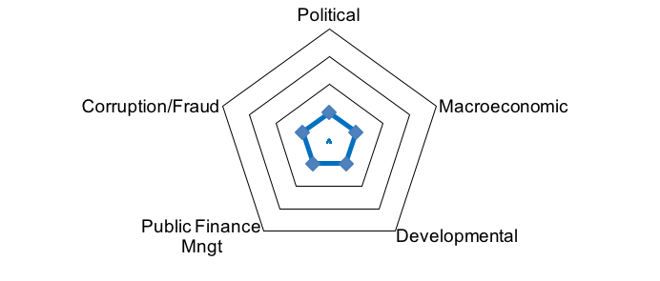
Risk profile (template)
Highlights key elements of the assessment based on the risk questionnaire:
  Major risks and benefits
  Key mitigating measures
  Overall recommendation
  Average ratings on country and category level
  Risk levels and risk trends

Slide 22
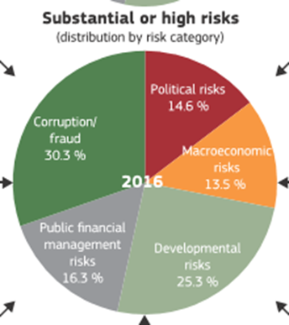
Risk distribution 2016, 90 RMFs
1. Corruption : 30%
2. Developmental: 25%
3. PFM 16%
Notes:
Source: Budget Support real time tool (DEVCO A4)

Slide 23
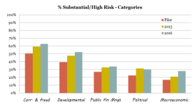
Substantial and high risks over time
Reasons:
More critical?
Better information?
More SBCs
Notes:
Source: Budget Support 2016, DEVCO A4

Slide 24
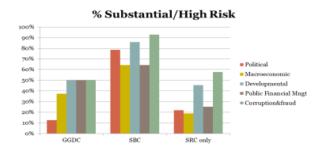
Risk by type of contract, 2015 and 2016
Notes:
Source: Budget Support. Financial implementation, risk assessment and selected poverty macroeconomic and fiscal results. 2015

Slide 25
Risk response: a balancing act
Zero risk does not exist
Non engaging can result in higher risks and higher costs in the long run
High risk may be acceptable in a context where expected impact of BS is higher than the potential risk: particularly the case for SBC.
Risks
Expected
impact
Notes:
Situations of fragility:
Entail higher risks
But call for: actions to ensure vital functions
supporting transition towards development
promoting governance, hr and democracy
deliver basic services to the populations

Slide 26
Identification of mitigation measures
Should be the most common response to risks
It is a joint effort of partner country & donors
If the risk level for a risk dimension is substantial or high :
  definition and implementation of clear and comprehensive action plan
  Satisfactory progress is required during implementation
If the political risk is substantial or high in case of a GGDC:
  Policy matrix needed: clear milestones and benchmarks for action plan’s implementation
  Contingency plans needed.

Slide 27
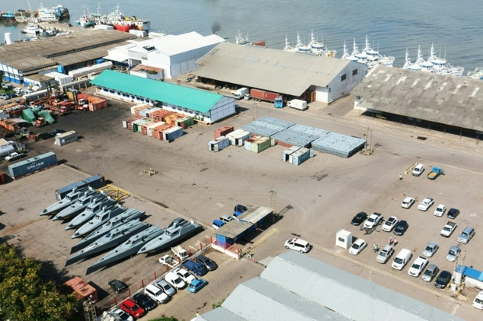
Reputational risk
Fishing vessels happened to be rather fast

Slide 28
Examples of mitigation measures
Further analyses and surveys (e.g. PEFA, PETS, PER…)
Capacity development and technical cooperation
Enhancing transparency, accountability, participation in budget process: to strengthen nationally owned safeguard and oversight mechanisms
Conditions for the disbursement of the variable tranches. (but without jeopardizing predictability)
Requirements: specific controls, legislation and reform steps. May be specified in the financing agreement
Further adaptations regarding the design of a budget support programme.

Slide 29
Risk monitoring and reporting
Risk Management Framework is applicable to all contracts and will be updated annually in order:
In case of important developments which imply a significant change in the level of one the risk categories , the RMF should also be updated at any moment during the year.
Notes:
During the implementation phase, the risk management register will be updated in January/February and, if necessary in June/July or as part of the disbursement file. The geographical directorates (DG DEVCO and EEAS for political risks), with support from Delegations, regional teams and thematic directorates, have the responsibility for ensuring consistency and coherence across countries in their regions and the implementation of the risk management framework. Questions of intra- or inter-regional consistency may be referred to the BSSC. In case of a deterioration of a risk category from a previously lower assessment to substantial or high, the budget support contract should be re-discussed in the BSSC before a disbursement decision.

Slide 30
Thank you very much for your attention

