Slide 1
JOINT PROGRAMMING REGIONAL WORKSHOP
Working Better Together:
Tools for Joint Programming
Djibouti, 26 May 2017

Slide 2
Videoclip:
  Palestine HoC Viezzer
Communication for Joint Programming:
  Capacity4dev group, JP tracker, EEAS website, social media
New Operational Manual for Joint Programming
HQ SUPPORT
  Technical assistance, helpdesk, communication materials
Other tools
  Development Finance Assessments, EU Aid Explorer and IATI

Slide 3

New version online:
More features available for better usability such as surveys, blogs, training videos and audiovisual media
CAPACITY4DEV - JOINT PROGRAMMING group
Training videos to be uploaded soon featuring Heads of Cooperation and technical experts/consultants on Joint Programming
https://europa.eu/capacity4dev/joint-programming

Slide 4
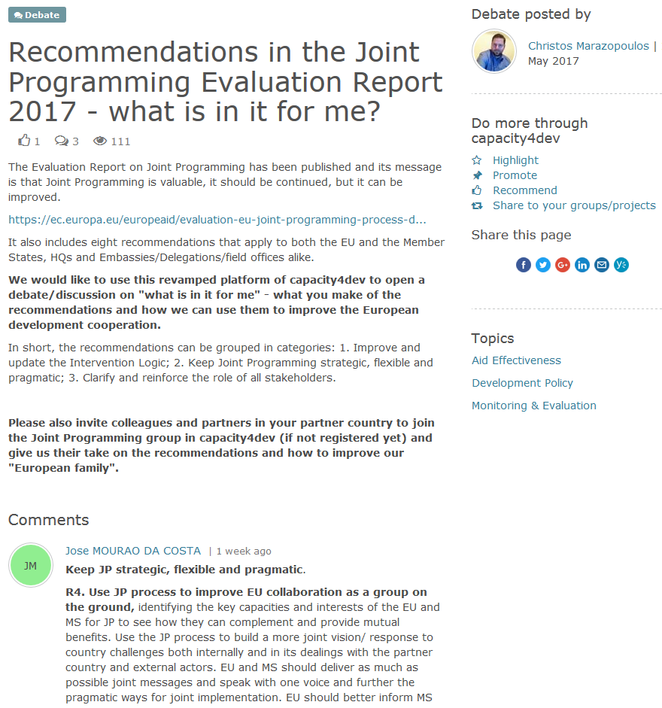
Debating the Recommendations of the Evaluation Report:
CAPACITY4DEV –
JOINT PROGRAMMING
group
Notes:
Mention to encourage MS to sign up to Joint Programming group, and also to comment on evaluation report and recommendations

Slide 5
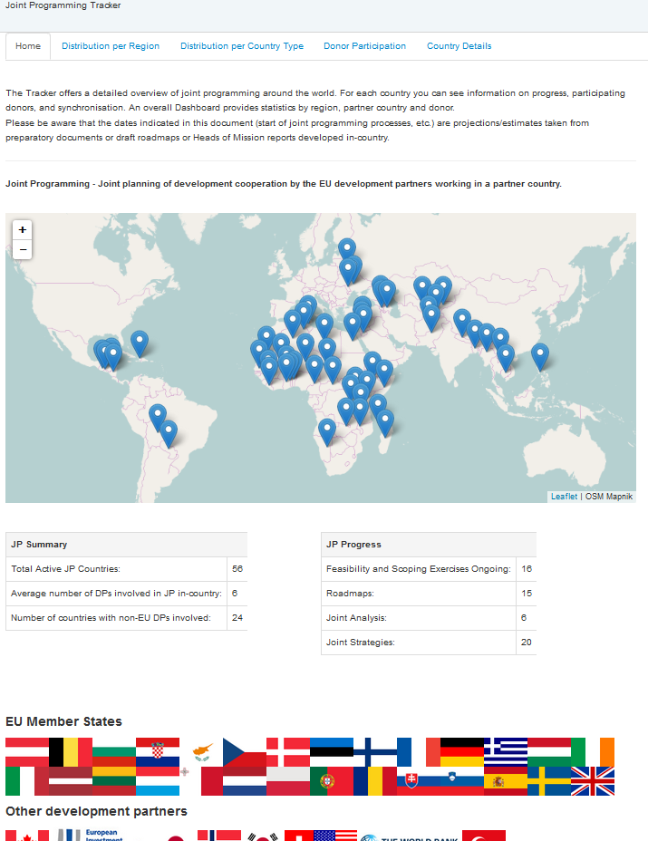
JOINT
PROGRAMMING
tracker
https://jptracker.capacity4dev.eu/

Slide 6
Joint Programming tracker
https://jptracker.capacity4dev.eu/
Soon to be fully updated / up and running
Useful and ease-to-access information on Joint Programming
Please request login, so as to access information not available to the wider public
You will each be eligible to amend the information on your partner country and add data

Slide 7
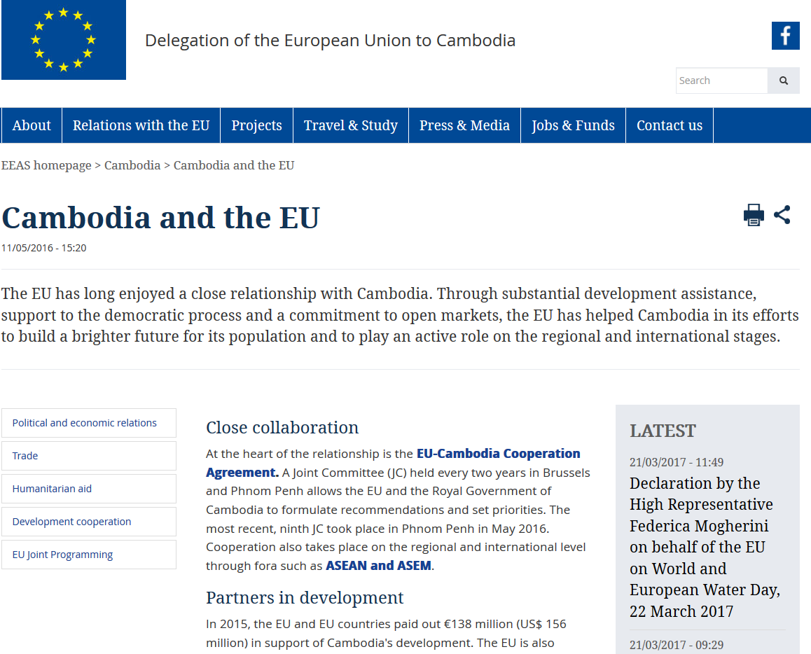
Joint Programming in the EEAS public website (1)

Slide 8
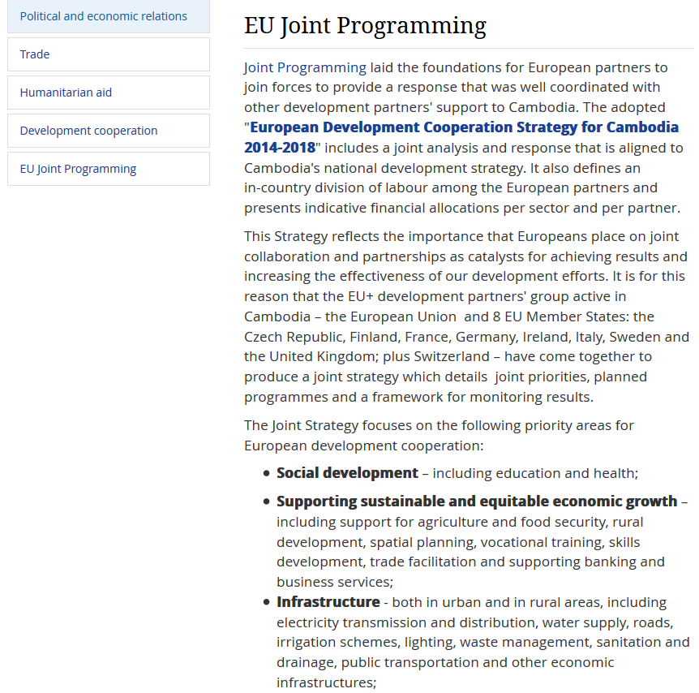
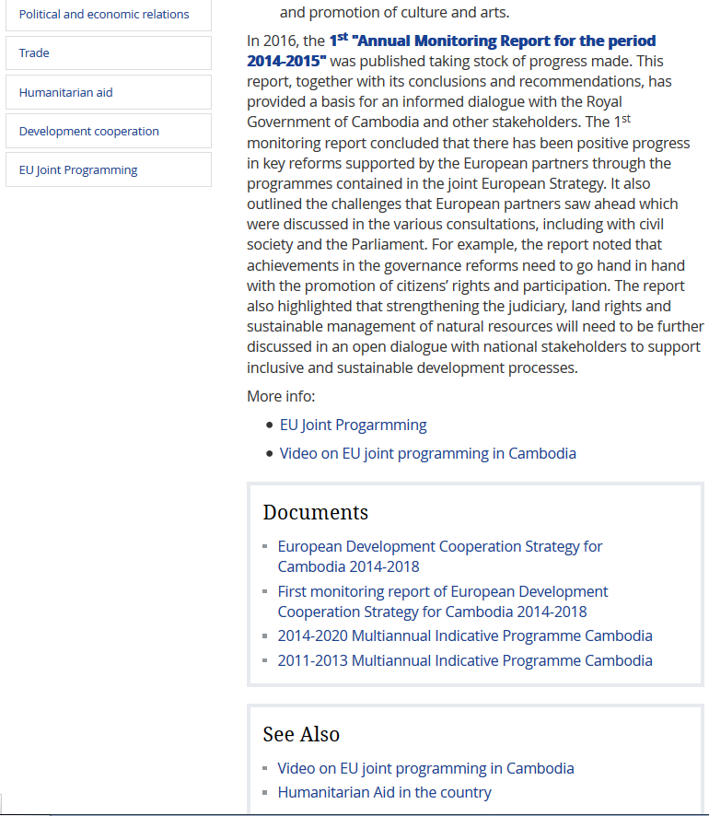
Joint Programming in the EEAS public website (2)
EEAS website - Joint Programming section at Cambodia Delegation

Slide 9
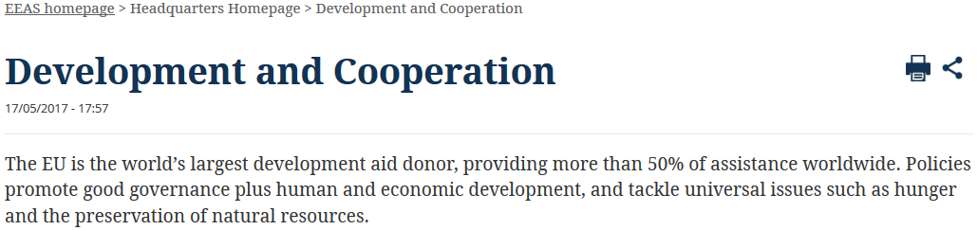
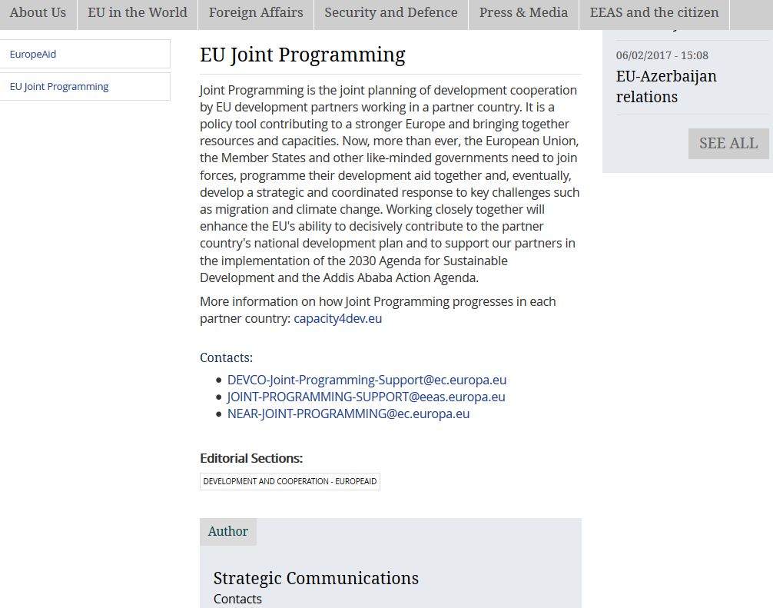
Joint Programming in the EEAS public website (3)
EEAS website - Joint Programming and development section

Slide 10
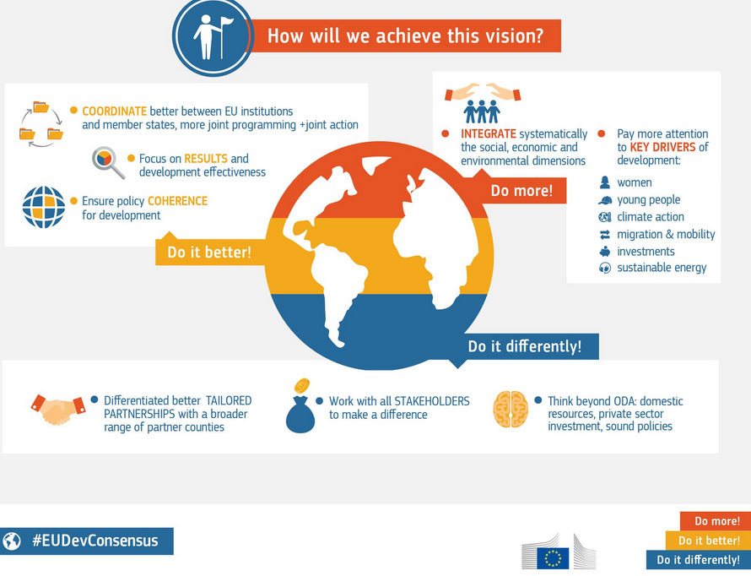
EMBED JOINT PROGRAMMING IN THE BROADER COMMUNICATION STRATEGY
SOCIAL MEDIA

Slide 11
OPERATIONAL MANUAL
Part A:
Feasibility and Scoping exercise
Developing a Roadmap
Starting a Joint Analysis
Starting a Joint Response
  Division of Labour (prep, applying and follow-up)
  Results Framework
Replacing bilateral programming strategies with Joint Strategies
Joint Programming in fragile states
Part B:
Developing a plan for EU Joint Policy Dialogue
Strategic Issues (migration, climate change, resilience)
Joint Programming to strengthen implementation of cross-cutting priorities
Improving visibility through Joint Programming

Slide 12
Communication practices
Consult development partner communications officers and join forces to communicate together the policy
Map out a calendar of key events
Develop a user-friendly brochure explaining the key goals of Joint Programming (support from HQ to be provided if interested)
Consider giving the Joint Strategy an "official look" and professional finish so as to ensure it is appropriate for public circulation
Use smart stats/data to explore new ways of communicating Joint Programming, such as social media, audio-visuals and infographics

Slide 13
Experts:
Alex O'Riordan: missions in Moldova, Philippines, Georgia, Palestine; speaks English
Katarina Courtnadge-Kovacevic: missions in Tajikistan, Laos, Cambodia, Pakistan, Afghanistan; speaks: English, French, Spanish
Iradj Alikhani: missions in Senegal, Benin, Haiti, Mali; speaks French, English, Farsi
Sybille Koenig: missions in Tunisia, Burkina Faso and CAR; speaks German, English, French, Spanish, Portuguese
What HQ can do to help you?
Providing Short-Term Demand Driven Support
Senior experts: analysis, programming, strategy and coordination. Including IT & Communication support.
Initial consultations with MS and clarifying what JP can achieve
Analytical support such as mapping, country analysis
Facilitating Regional Workshops
Support to drafting documents (i.e. roadmaps, joint analysis, joint strategies, etc.)
Identification of joint implementation opportunities
Communication material, such as brochures, and support on audiovisual products
Methodological support (Guidance/Guidelines/helpdesk)

Slide 14

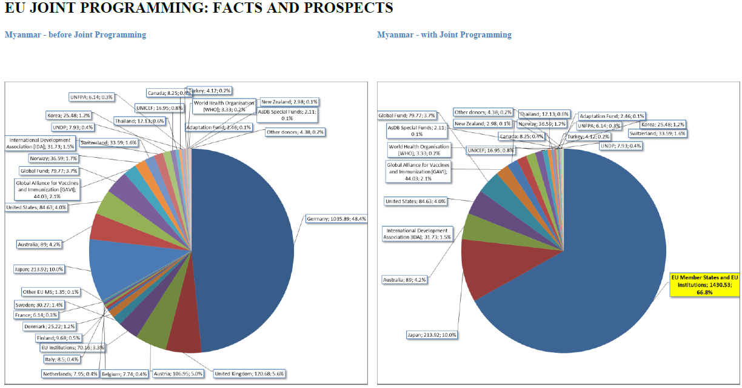

Slide 15
IATI data and Joint Programming
IATI (International Aid Transparency Initiative):
Multi-Stakeholder platform (EU MS agencies, CSOs, Governments, Commission, UN Agencies…)
Common standard: comparable and usable data
Single point of access: http://datastore.iatistandard.org/query
Visualisation tools: D-portal, EU Aid Explorer

Slide 16
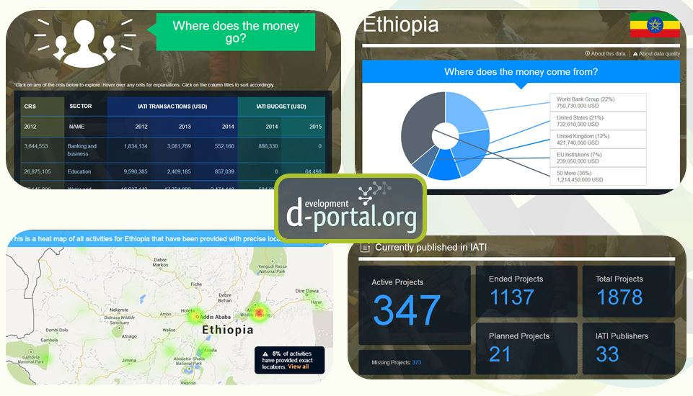
IATI data and Joint Programming
Visualisation tool: D-portal.org

Slide 17
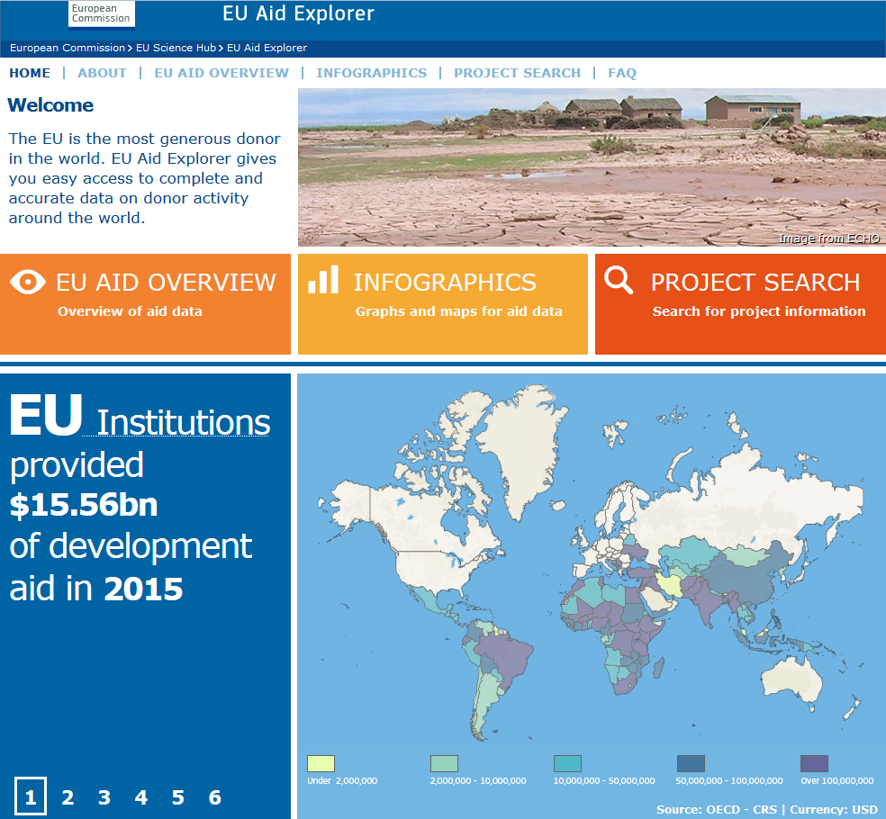
IATI data and
Joint Programming
Visualisation tool: EU Aid Explorer

Slide 18
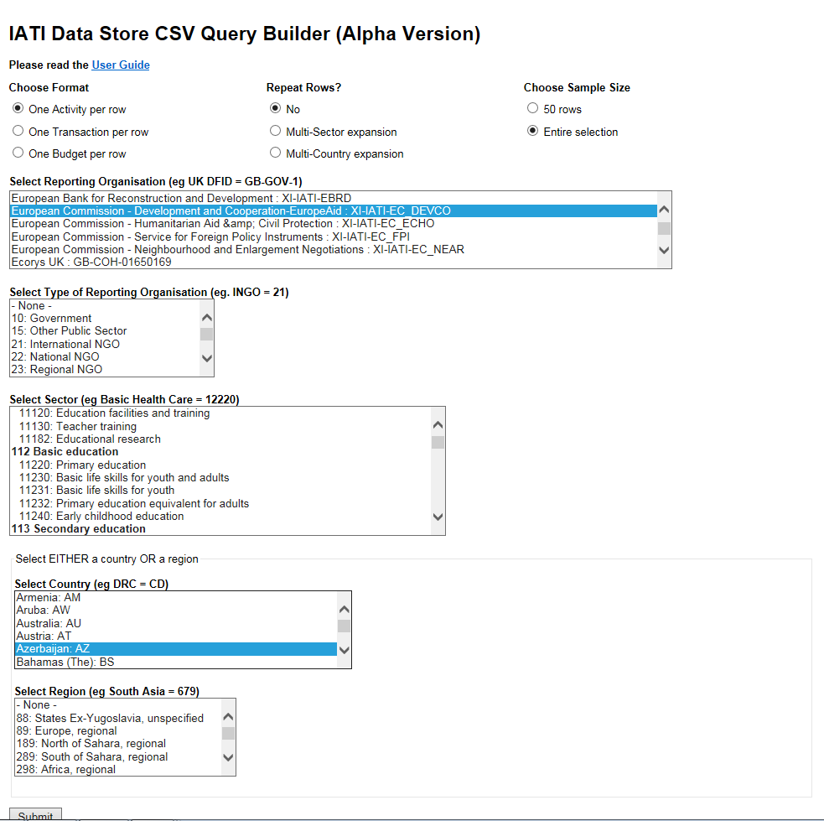
IATI data
and Joint Programming
IATI data extraction: http://datastore.iatistandard.org/query
Example: EU (DEVCO) projects in Azerbaijan

Slide 19
IATI and Joint Programming
Mapping purposes: Information to draft a Joint Analysis (identification of priority sectors)
Monitoring purposes: Is the JP process going as planned? Which sectors of intervention and sector repartition between the EU+ Development Partners?
Accountability purposes: to report on the JP results

