Slide 1


Implementation of Council Conclusions on stepping-up Joint Programming:
Heads of Mission Reports Analysis,
Evaluation Results and
New Tools
JP Session at the EU Regional Seminar
Tashkent, 14 July 2017

Slide 2
Political and Policy framework (1)
EU Global Strategy implementation:
moving towards a joined-up external action / Joined-up Union
“Joint programming in development must be further enhanced. New fields of our joined-up external action include energy diplomacy, cultural diplomacy and economic diplomacy. A more prosperous Union calls for greater coordination between the EU and Member States, the EIB and the private sector. We must become more joined-up across internal and external policies.”
Joint Communication: A Strategic Approach to Resilience in the EU's external action:
"[…] the resilient approach should be taken into account in joint programming processes with MS, which will be further encouraged"

Slide 3
Political and Policy framework (2)
New Consensus on Development:
"Working better together" for Joint Programming and Joint Implementation
2030 Agenda and SDG 17:
Strengthen the means of implementation and revitalize the global partnership for sustainable development
Joint Programming as part of the "Multi-stakeholder partnerships" target
Notes:
THE NEW CONSENSUS: WORKING BETTER TOGETHER
The new Consensus recommends increased coordination and coherence between the EU and its Member States and Joint Programming is a crucial facilitating tool to help pool resources, reduce fragmentation and boost effectiveness.
Joint monitoring and results frameworks will be core elements of the joint responses to maintain momentum, inform dialogue and enhance mutual accountability.
COMMON THREAD BETWEEN THE TWO: joint analysis + monitoring and evaluation frameworks + country-owned shared/joint objectives
- Voluntary, flexible, inclusive and tailor-made to the country context,
- Replacement of bilateral programming as an ambition
- National development strategy and priorities to guide the Partner Country's engagement, appropriation and ownership;
- EU and MS to take account of all available means for development financing, in line with the Addis Ababa Action Agenda;
- Joint monitoring and results frameworks to be core elements of joint responses;
- Remain open to other relevant donors and international actors when assessed relevant at country level (EU and MS)
Joint implementation:
- Joint implementation can be facilitated by Joint Programming and it can become a concrete outcome of this process.
- Joint implementation can also work the other way around, by supporting a bottom-up process to facilitate Joint Programming and other strategies towards partner countries.
However, joint implementation also exists in partner countries where there is no Joint Programming process in place.
Joint Implementation in the new European Consensus on Development includes the following parts:
(1) EU and MS support partner countries through joint implementation in support of 'country-owned shared objectives';
(2) Joint implementation is open to all EU (and non-EU) partners/stakeholders that agree on a common vision;
(3) it is specific to the country-context;
(4) it can be implemented at national, regional or global level and can possibly link to other areas of external action;
(5) it can be implemented through various financial (and non-financial) means/modalities;
(6) it should be based on the sharing of best practices and experiences;
(7) it has to be grounded on joint analysis, as well as being monitored and evaluated.
2030 Agenda for Sustainable Development
SDG17: Strengthen the means of implementation and revitalize the global partnership for sustainable development
Target: 17.16 Systemic Issues: Multi-stakeholder partnerships
- Enhance the global partnership for sustainable development, complemented by multi-stakeholder partnerships that mobilize and share knowledge, expertise, technology and financial resources, to support the achievement of the SDGs
- Encourage and promote effective public, public-private and civil society partnerships, building on the experience and resourcing strategies of partnerships

Slide 4
Council Conclusions:
Stepping-up Joint Programming
EU and its Member States collectively contribute to implementing the policy commitments made at global and EU level
Effort and commitment by EU & MS are necessary in countries where partners have recognised Joint Programming's potential to become the preferred approach
Consolidate and expand JP in fragile & and conflict countries, in prevention/post-conflict contexts, as well as accompany PCs in transition to higher income levels
JP documents should evolve to include strategic issues, such as migration, climate change, fragility, security and democracy
EU AND MS STRONGER as DEVELOPMENT ACTORS

Slide 5
HoM reports: JP State of Play
16
13
Countries with Roadmaps
Azerbaijan, Benin, El Salvador, Haiti, Honduras, Kyrgyzstan, Lebanon, Malawi, Mauritania, Nepal, Pakistan, Philippines, Tunisia
7
Countries with Joint Analysis
Armenia, Belarus*, Burkina Faso*, Egypt, Georgia, Moldova, Morocco*
21
12
7
Countries with Joint Strategy (joint analysis and response)
Joint Monitoring / Results Framework
Bolivia, Cambodia, Comoros, Ethiopia, Ghana, Kenya, Laos, Mali, Myanmar, Nicaragua, Palestine, Rwanda
Replacement
FR in Comoros, FR in Kenya, EU in Laos, DE and FR in Mali, EU in Palestine, EU in Senegal
Feasibility and Scoping
Bolivia (2016), Cambodia (2014), Chad (2014), Comoros (2015), Cote d'Ivoire (2017), Ethiopia (2013), Ghana (2014), Guatemala (2013), Kenya (2015), Laos (2016), Mali (2014), Myanmar (2014), Namibia (2014), Nicaragua (2016), Niger*, Palestine, Paraguay (2015), Rwanda (2014), Senegal (2014), Togo (2016), Uganda (2015)***
7
Second cycle of Joint Programming**
Bolivia, Ethiopia, Ghana, Laos, Mali, Namibia, Senegal
Afghanistan, Algeria, Bangladesh, Cameroon, CAR, Guinea Conakry, Jordan, Liberia, Libya, Madagascar, Somalia, Tajikistan, Tanzania, Ukraine, Uzbekistan, Zambia
Prep steps
Joint Strategy
57 Active countries
*drafts
** "Second cycle" refers to the process of thoroughly revising the Joint Strategy or producing a whole new document
*** Uganda's Joint Strategy is halted due to the political situation in the country

Slide 6
HoMs Reports: Key Findings
Progress and benefits :
  Joint Programming is making headways: EU donors being increasingly recognised as "European family".
  Increased political leverage and visibility towards partner governments and the wider donor community
  JP contributing to development effectiveness AND providing stronger political clout for the EU and MS
  JP as a vehicle in implementing 2030 Agenda/ SDGs
  Increased alignment to national development strategies
  Improved division of labour
  Some joint monitoring and joint results frameworks in place
  Joint implementation actions used as a pragmatic cooperative way
Persisting hurdles:
  Difficulties in reconciling trade, migration and security priorities with JP
  Country ownership
  Synchronisation of programming cycles

Slide 7
HoMs Reports: Way Forward
1. Diversifying approaches to JP
Sectoral Approach
Conflict analysis
Middle-Income Countries
2. Linking JP to other areas of external action
Climate change and environment
Migration/Partnership Frameworks
Trade/ EPA
Security
3. Using JP in policy and political dialogues
Link with other initiatives
Joint messages, declarations, demarches
4. Joint Results Framework

Slide 8
Joint Programming Evaluation: conclusions
Valuable experience for the EU and MS:
  EU Voice: participating donors more visible vis-à-vis the Government
  EU and MS development cooperation more harmonised, working towards commonly agreed objectives and adopting commonly agreed strategic approaches
  Clearer view amongst the EU, MS and like-minded partners about cooperation portfolios, strengths and limitations of each donor
But:
  Not sufficiently involving or late-to-involve the Partner Country, CSOs, etc;
  Limited to those sectors where several EU+MS were already active
  Generally: results on Development Effectiveness slower than expected
  Visibility enhanced for both EU+MS individually but is it used by the EU family to gain more political clout?

Slide 9
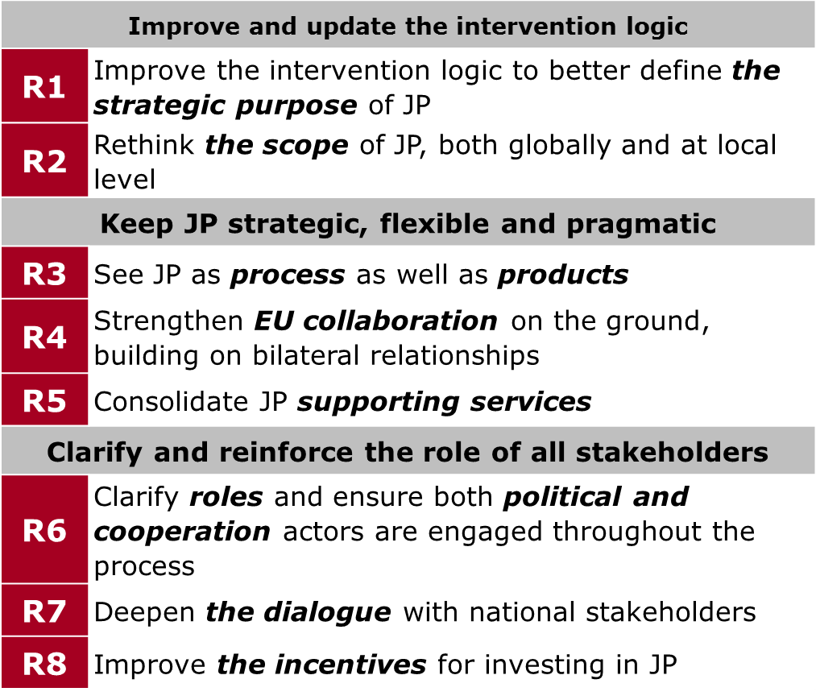
JP Evaluation: Recommendations

Slide 10
JP Evaluation: Follow-up
"Fiche Contradictoire":
Update Guidance (R2)
Expand/support the use of country-based joint results and monitoring frameworks (R3)
Ensure regular reviews/updates in the JP group (R3)
To continue supporting services incl. technical assistance (R5)
EU HoC to involve HoD and Political advisors early on in the process (R6)
Encourage Delegations to allocate sufficient manpower (R8)
Replacement will be pursued wherever possible (R8)

Slide 11
OPERATIONAL MANUAL
Part 1
Feasibility and Scoping exercise
Developing a Roadmap
Starting a Joint Analysis
Starting a Joint Response
  Division of Labour (prep, applying and follow-up)
  Results Framework
Replacing bilateral programming strategies with Joint Strategies
Joint Programming in fragile states

Slide 12
OPERATIONAL MANUAL
Part 2
Developing a plan for EU Joint Policy Dialogue
Strategic Issues (migration, climate change, resilience)
Joint Programming to strengthen implementation of cross-cutting priorities
Improving visibility through Joint Programming

Slide 13
What HQ can do to help you?
Experts:
Alex O'Riordan: supported Moldova, Philippines, Georgia, Palestine…; speaks English
Katarina Courtnadge-Kovačević: supported Tajikistan, Laos, Cambodia, Pakistan, Afghanistan; speaks: English, Khmer
Iradj Alikhani: supported Senegal, Benin, Haiti; speaks French, English, Farsi
Sybille Koenig: supported Tunisia, Burkina Faso, CAR, Honduras; speaks German, English, French, Spanish, Portuguese
Providing Short-Term Demand Driven Support
Senior experts:
Consultations with MS and clarifying what JP can achieve
Analytical support such as mapping and country analysis
Facilitating Workshops/retreats
Support to drafting documents (i.e. roadmaps, joint analysis, joint strategies, etc.)
Identification of joint implementation opportunities
Support on communication material, such as brochures, and on audiovisual products
Methodological /Communication support (Guidance/Guidelines/helpdesk)
Link with focal points in EU Capitals

Slide 14

New version online:
More features available for better usability such as surveys, blogs, training videos and audiovisual media
CAPACITY4DEV - JOINT PROGRAMMING group
Training videos uploaded featuring Heads of Cooperation and technical experts/consultants on Joint Programming
https://europa.eu/capacity4dev/joint-programming

Slide 15
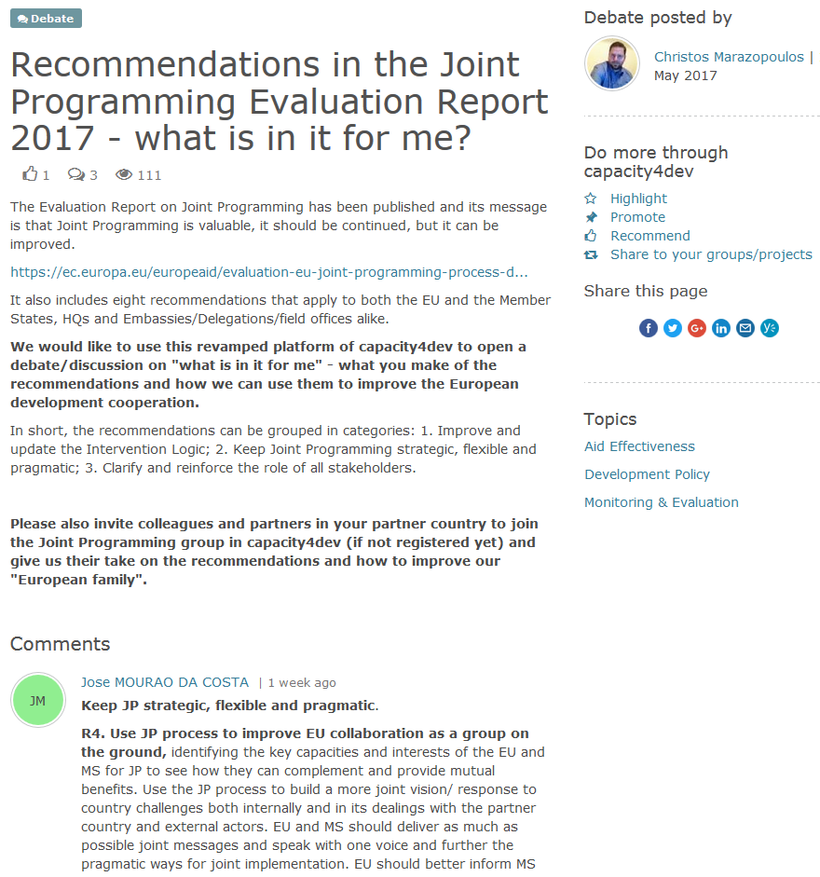
Debating the Recommendations of the Evaluation Report:
CAPACITY4DEV –
JOINT PROGRAMMING
group
Notes:
Mention to encourage MS to sign up to Joint Programming group, and also to comment on evaluation report and recommendations

Slide 16
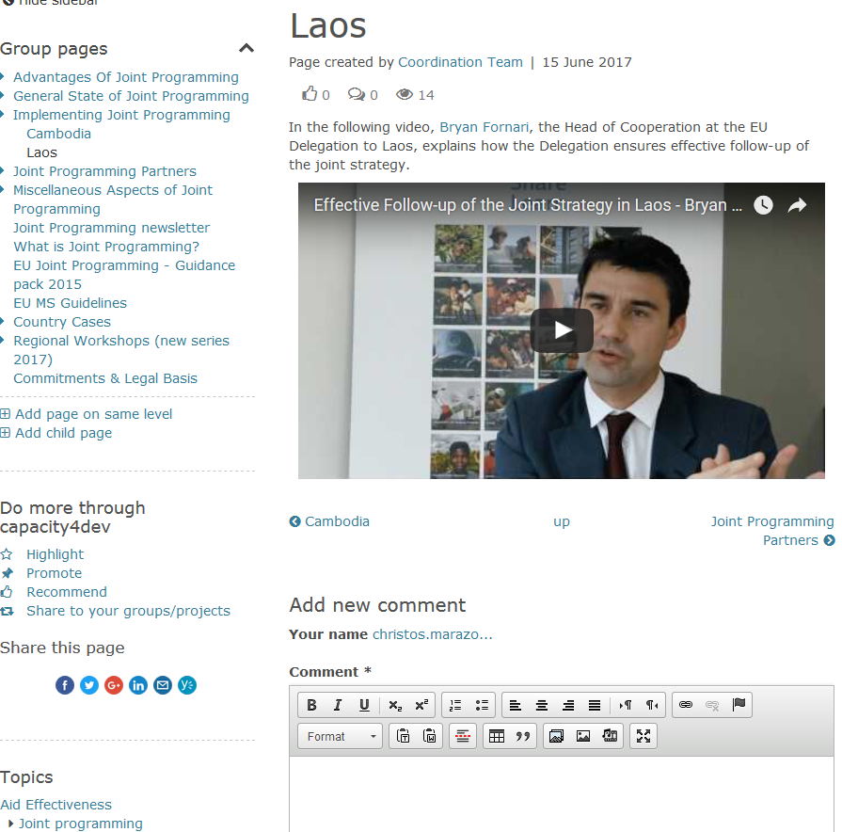
Training videos with interviews from Heads of Cooperation:
CAPACITY4DEV –
JOINT PROGRAMMING
group
Notes:
Mention to encourage MS to sign up to Joint Programming group, and also to comment on evaluation report and recommendations

Slide 17
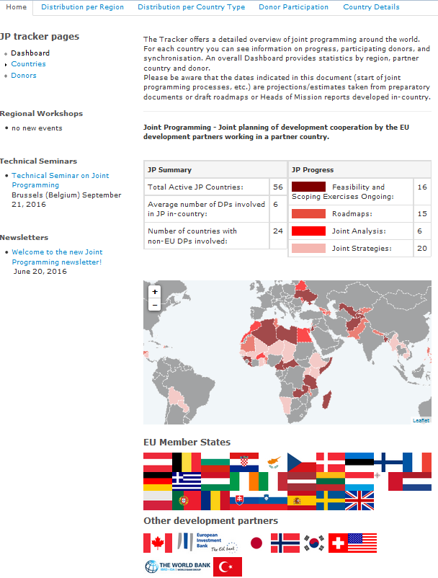
JOINT
PROGRAMMING
tracker
https://jptracker.capacity4dev.eu/

Slide 18
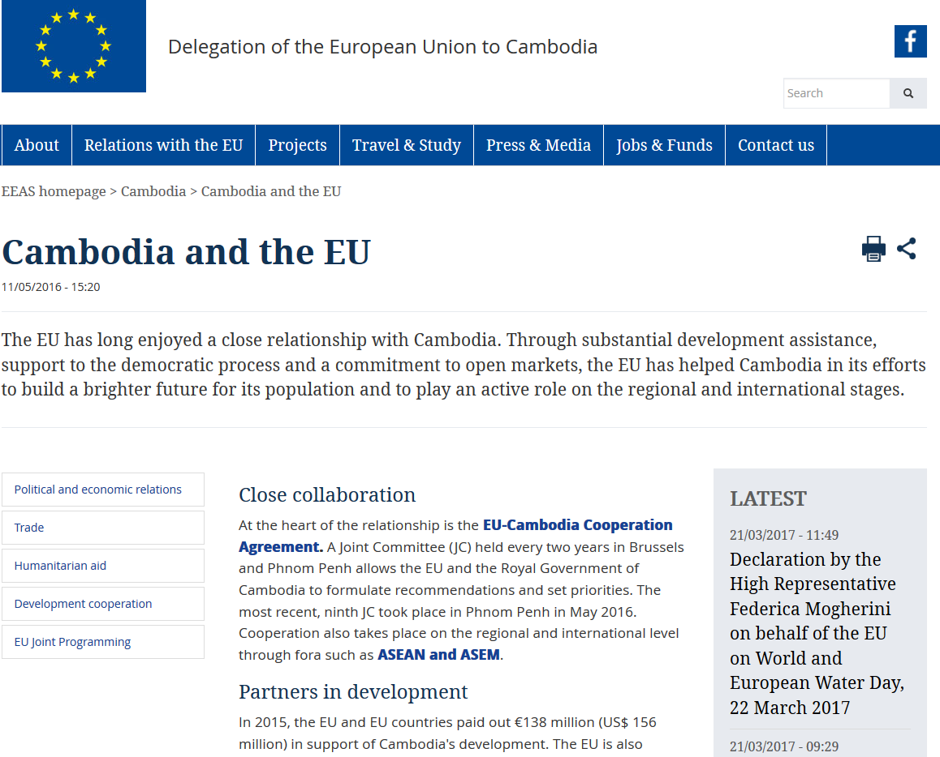
Joint Programming in the EEAS public website (1)

Slide 19
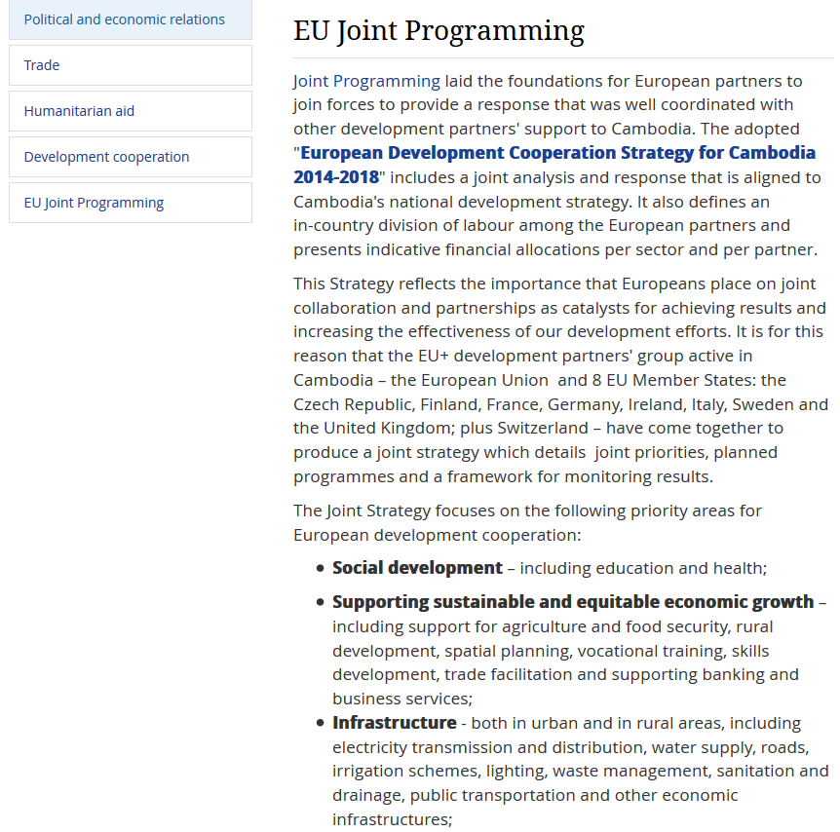
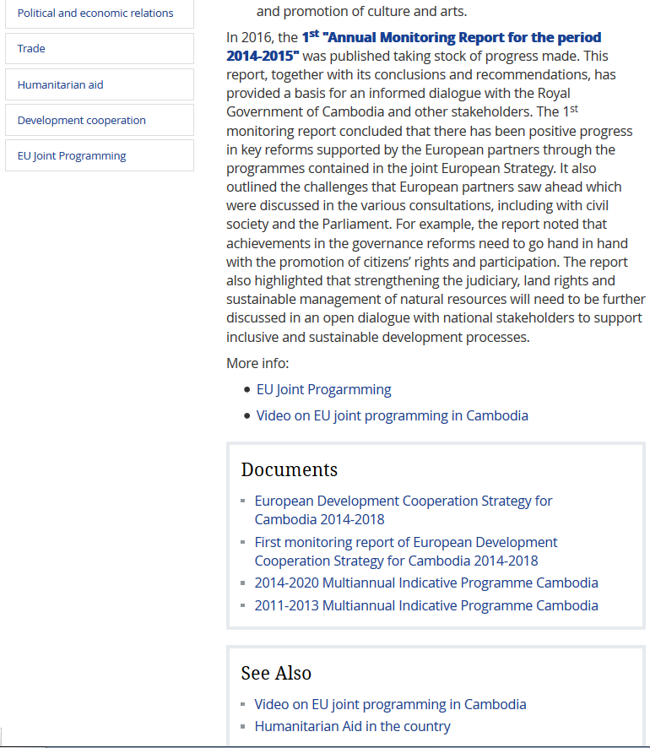
Joint Programming in the EEAS public website (2)
EEAS website - Joint Programming section at Cambodia Delegation

Slide 20
Communication practices
Consult development partner communications officers and join forces to communicate together the policy;
Map out a calendar of key events;
Develop a user-friendly brochure explaining the key goals of Joint Programming (support from HQ to be provided if interested);
Consider giving the Joint Strategy an "official look" and professional finish so as to ensure it is appropriate for public circulation;
Use smart stats/data to explore new ways of communicating Joint Programming, such as social media, audio-visuals and infographics.

Slide 21
Operational challenges
1. Flexibility of Joint Programming processes and documents
=> As recommended by the evaluation, regular updates/reviews recommended. Would also help decreasing the need for full synchronisation (difficult to achieve)
2. Adoption procedures
=> Complex procedures for Commission and EEAS, especially in case of replacement (New Commission Decision). Need to be factored in.
3. Visibility and signature
=> Promote visibility events rather than signature of the Joint Strategies themselves to avoid legal constrains.

