Slide 1
October 17th, 2017
Opsys
Webinar to launch the test phase

Slide 2





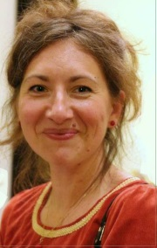





Welcome to the Opsys webinar to launch the test phase
Who is running the webinar ?
Michal Krejza
Polivios Klimathianakis
Andrea Alfieri
Odoardo Como
Ronan Mac Aongusa
Roxana Calfa
Paul Riembault
Joël Neubert
Lucile Petitpierre
Véronique Lena
Ben Eylenbosch

Slide 3
October 17th, 2017
Opsys
Presentation 1: What is Opsys and what benefits will it bring you? Quick overview on governance and key benefits
Michal Krejza, Head of Unit, Results and Business Processes, DEVCO

Slide 4
Agenda of the webinar
Session 1: OPSYS, the overall picture
Presentation 1: What is OPSYS and what benefits will it bring you? Quick overview on governance and key benefits.
Presentation 2: How does OPSYS fit in the big picture?
Presentation 3: OPSYS - Results and Monitoring scope and timeline
Presentation 4: Functionalities & mock-ups of Framework contract
Presentation 5: Programming, actions and decisions
Questions & Answers
Session 2: Focus on results
Presentation 6: Why is the results mind-set important?
Presentation 8: OPSYS - Results and Monitoring demo: My workplace Create a LogFrame and Results
Presentation 8: Communication and user support : Key principles and timeline Testing: Objective, how to proceed with colleagues in EUDs, webinar sessions, on-line feedback
Questions & Answers

Slide 5
Aims of the webinar
To share with you some insights on functionalities developed so far in OPSYS
To present the governance of the overall programme, set in July 2017
To inform you of what you could expect and by when in terms of functionalities
To explain how you can participate in the tasting exercise

Slide 6
Quick reminder: What is OPSYS?
An integrated IT system, i.e. "one stop shop"
Covering the entire project lifecycle from the political decision until the final evaluation
An instrument supporting a new, more collaborative way of working among various stakeholders
An ambitious collective effort

Slide 7
Why do we want OPSYS?
Ease of use:
- Single interface covering all the workflows of the project cycle
- No re-encoding
- Will allow progress and completion reports to be drafted and approved online; faster approval
User centricity:
- User centred: my workplace, my portfolio, my projects and programmes
- User friendly look and feel
- Accessible through all types of devices
YOU
Velocity and trustworthiness:
- Faster link between progress reports and invoices
- Cheaper, easier and safer tendering and grant procedures

Slide 8
Where do we stand now?
  Catching up with delays
  Memorandum of Understanding with DIGIT – April 2017
  Parallel development on 3 complementary aspects of the projects lifecycle
    Track 1: Results and monitoring
    Track 2: Contracts and procurement
    Track 3: Programming actions and decisions
  Start testing: 1st reality check

Slide 9
OPSYS: structure and management
The programme is structured by tracks:
A shared governance between DEVCO, NEAR, FPI and DIGIT:
  Every 6 weeks OPSYS Management Board meeting chaired by DEVCO DDG and vice-chaired by DIGIT DDG
  Monthly Project Steering Committee meetings for each track chaired by Director DEVCO F for T1, by Director DEVCO R for T2, by Director NEAR C for T3
  Monthly Domain Users Group (main consultative body) meetings on business priorities
T1: Results and monitoring
T2: Contracts and procurement
T3: Programming, actions
and decisions

Slide 10
October 17th, 2017
Opsys
Presentation 2: How does OPSYS fit in the big picture?
Polivios Klimathianakis, OPSYS programme manager, DIGIT

Slide 11
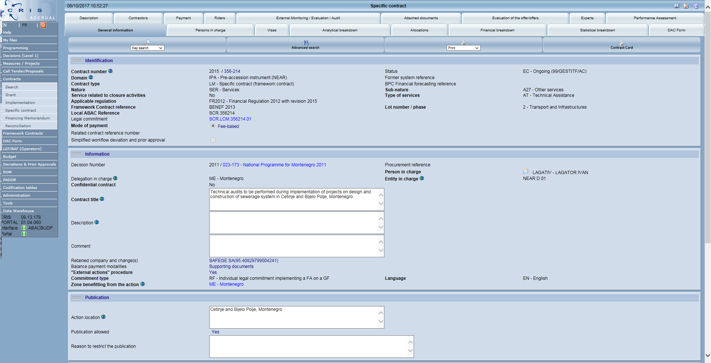
From CRIS (& all the other systems)…

Slide 12
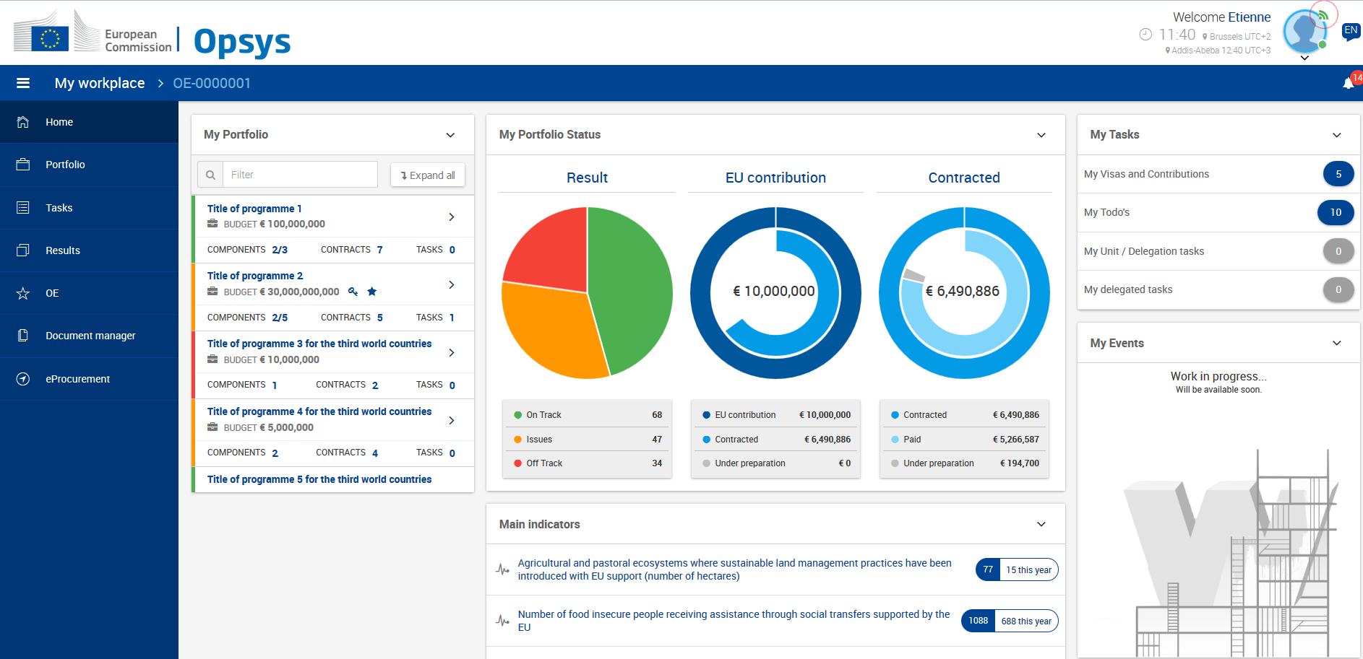
…to OPSYS MyWorkPlace: one single entry point for EC users

Slide 13
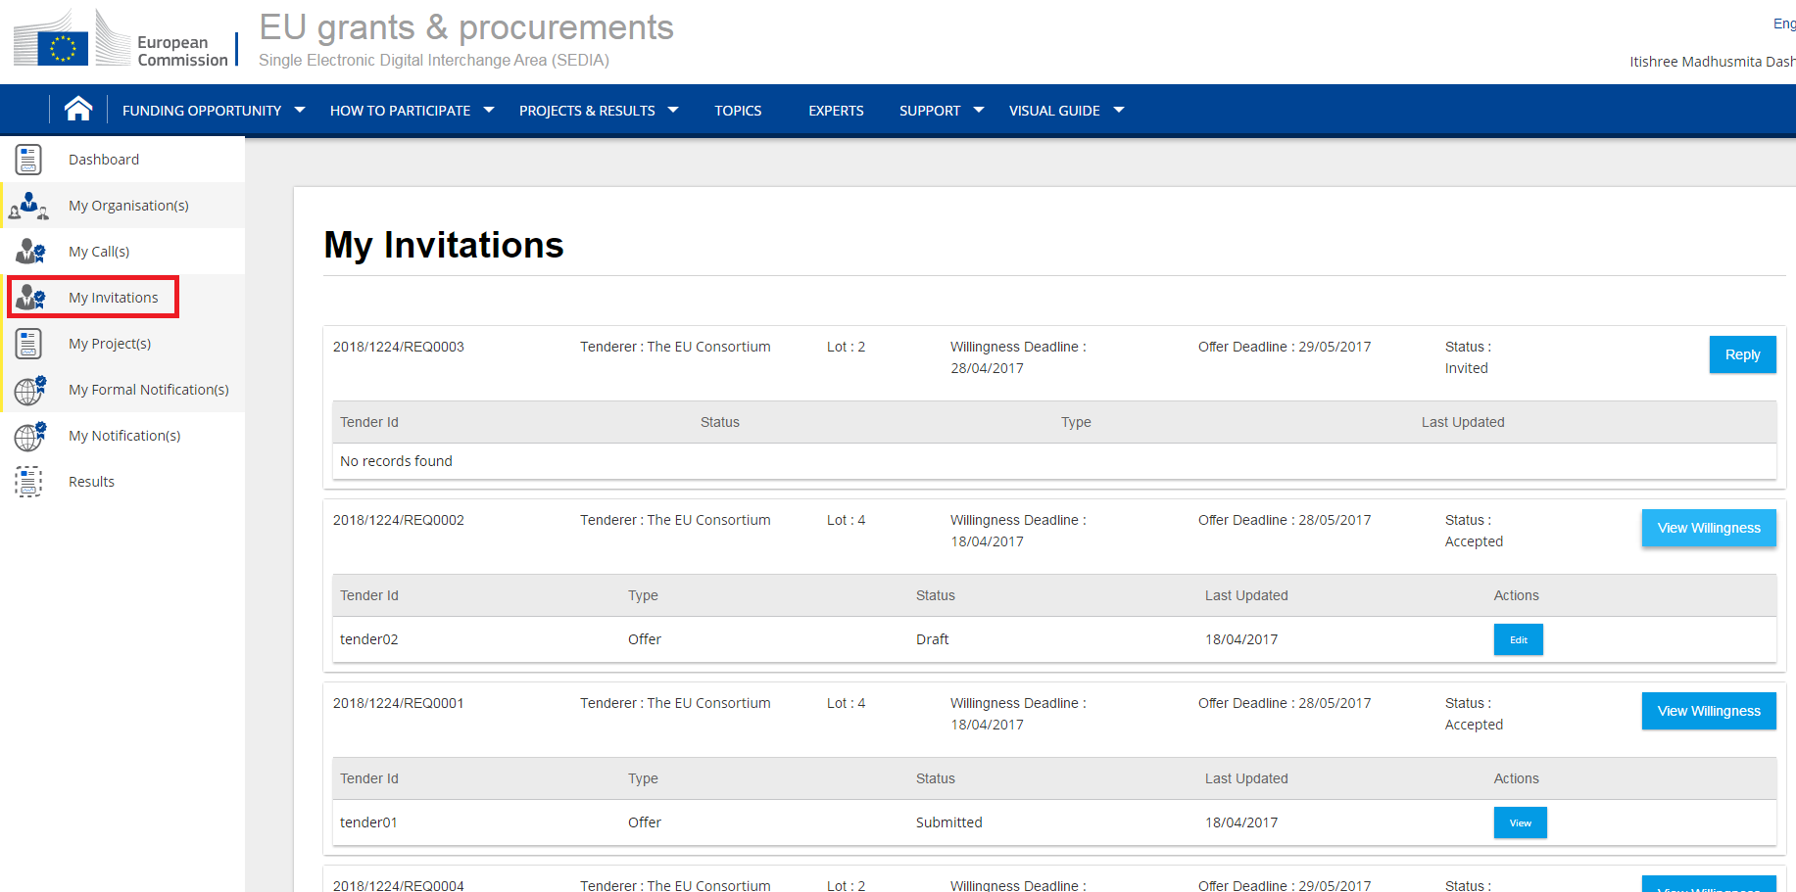
…and SEDIA: one single entry point for all external stakeholders

Slide 14




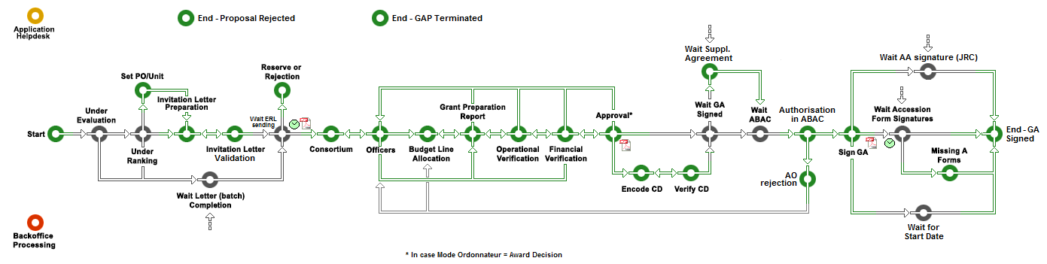
OPSYS is part of EC Corporate strategy for a modern eGoverment service
Process driven – Adaptable
100% Paperless – 100% Mobile
User centric - User Friendly - Secure
Quick information access – Real time
Automated checks – No clerical tasks
Transparency – Collaboration - Performance
External users
EC users
Corporate Services
ABAC
ARES
eSignature
….

Slide 15
OPSYS is an important Programme in the EC IT convergence roadmap
OPSYS BOARD
DIGIT B1, B3, B4
DEVCO 05,R1, R4
RTD J3, J4
NEAR R1
OPSYS Programme Implementation
REST of EC
EACEA—CLIMA—ENV
DEVCO—NEAR—FPI
OLAF—ESTAT—ECHO
HOME—JUST
CHAFEA—INEA—GSA
RTD – CNECT—ENER—MOVE—EAC—REA—ERCEA—EASME
2014 2015 2016 2017 2018 2019 2020

Slide 16
October 17th, 2017
Opsys
Presentation 3: OPSYS - Results and Monitoring scope and timeline
Roxana Calfa, Head of Section, Results and Business Processes, DEVCO

Slide 17
Scope of results and monitoring (T1)
Head of Section: Roxana Calfa
Business manager: Lucile Petitpierre
Manage interventions and not (only) contracts
Improved Aid Transparency
Quality of interventions
Visibility of results achieved
RESULTS
Monitoring results from programming to closure
Facilitation of data aggregation
Better follow-up and time management
during implementation

Slide 18
Key milestones for Track 1/ Results
Q4 2017
Q1 2018
Q2 /Q3 2018
Q4 2018
2019
Release 1
Progressive roll-out
Release 3
Remaining features on Monitoring
User Testing with Pilot EUDs and HQs
Release in Production for Pilot EUDs and HQs
Release 2
Remaining features on Results
Current focus

Slide 19
Your input is welcome!
Question 1:
Would you see Results management as top priority for your EUD/HQ unit?
a. Yes totally
b. Yes partially
c. Not really
d. Not at all
Choose A or B or C or D

Slide 20
Your input is welcome!
Question 2:
How would you rate the quality of your logframes today?
a. Very good
b. Good
c. Average
d. Poor
Choose A or B or C or D

Slide 21
October 17th, 2017
Opsys
Presentation 4: Functionalities & mock-ups of Framework contract SIEA 2018 (successor of BENEF 2013)
Paul Riembault, Head of Section, Results and Business Processes, DEVCO

Slide 22



Current focus = SIEA FWC : 9 business phases
Scope of the 'contract and procurement' solution
Prepares the tender dossier
Evaluates the offers
Sign the contract
The scope of the full contract and procurement management solution is :
9 phases
and
97 functionalities (=business process steps)
identified to date
Invites to submit
Awards
Manages the pre-financing
Opsys
Opsys
Submits an offer
Prepares the contract
Manage the implementation

Slide 23
97 functionalities (10 of which are big and not detailed)
Scope of the 'contract and procurement' solution
Prepares the tender dossier
Evaluates the offers
Sign the contract
Invites to submit
Awards
Manages the pre-financing
Submits an offer
Prepares the contract
Manage the implementation

Slide 24
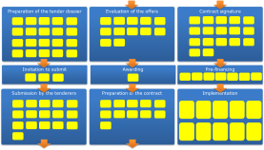
The full scope is 40 procedures types !
Procurement
Grant
Other (BS, PE, …)
All the 'functional bricks' built for the first type of procedure (SC under FWC) are reusable for other types of procedures

Slide 25
Key milestones for Track 2
Extend with other types of contracting modes
March 2018
Q3 2018
Q4 2019
2020
FWC SIEA
first
test-able version
Full FWC SIEA ready
for production
Target date for CRIS phase-out
To be replaced by OPSYS
OPSYS full release in production
Current focus

Slide 26
Your input is welcome!
Question 5:
What are your main expectations related to the Opsys contracts management module compared to CRIS ?
a. More reliable (quality of data)
b. Contractors directly upload their reports and their invoices
c. Tenderers submit their offers online
d. Ability to perform Contract management tasks on a mobile devices
Choose A or B or C or D

Slide 27
Your input is welcome!
Question 6:
On average, how much time do you spend each day on administrative tasks related to contract management (tenders, contract preparation payments, addenda, etc)?
a. Less than an hour
b. Between one and two hours
c. More than two hours
d. More than four hours
Choose A or B or C or D

Slide 28
Your input is welcome!
Question 7:
What are your main expectations related to the Opsys contracts management module compared to CRIS ?
a. More reliable (quality of data)
b. Contractors upload their reports and their invoices
c. Tenderers submit their offers online
d. I can do my contract management tasks on a mobile device
Choose A or B or C or D

Slide 29
October 17th, 2017
Opsys
Presentation 5: Programming, actions and decisions
Joël Neubert, Head of Section, Results and Business Processes, DEVCO

Slide 30
Scope of programming, actions, decisions (T3)
Head of Section: Joël Neubert
Business manager: Iason Foscolos
One single workflow for Level 1 commitment management
Programming (create & manage financial instrument, MIP)
Action management (incl action programme, recovering data from action document, link to prior approvals, link to results)
Main budgetary functionalities
Statistics and reporting

Slide 31

TRACK 3 Core functionalities
Strategic Programme
Capture key elements, sectors, budget, objectives, timeline… in order to report and monitor including rider preparation
Simplified Operation's cycle
Multi Annual
POLICY MAKING
Programming
STRAT. PLANNING
document
Sector 1
Sector 2
Sector 3
CONSULTATION
Actions identification and formulation
Collaborative "QSG" workflow
Tied together in "AAP"
Generally, each sector selected will be subject
of one Action document
Lessons Learned
PROGRAMMING
DECISION
CLOSURE
Financing decision
Single workflow with budget allocation, L1 Abac
Efficient follow up (contracted, paid, RAL/RAC..)
Reuse data from action document
IDENTIFICATION
Action Document
Quality Support Groups
(peer reviews)
AGREEMENT
FORMULATION
Fondation layer
For contracts, results framework
and all reporting, tagging & aggregation needs
QSG
2
FINANCING DECISION
IMPLEMENTATION
Financing agreement and/or
Contractual arrangements

Slide 32
TRACK 3 Action Document design process
Project approach?
Budget support?
Obj.? Outcomes ? Activities ?
Budget? Timeline?
Policy assessment ?
Stakeholders ?
Problem to solve?
Impl. Modalities ?
Fondamental values ?
Macro Eco ?
PFM ? Transparency ?
Tendering,
Contracts type
Legal, financial and
contracts provision
Risks? Assumptions?
Lessons learnt?
Cross cutting issues?
A LONG WAY TO GO
FORM IDEAS TO DECISIONS
BEFORE STARTING ANY IMPLEMENTATION !
Set-up & resp.
Monitoring
Obj.? Outcomes ? Main Activities ? Budget? Timeline?
Audit, Eval,
Visibility
Log Frame
QSG 1 approval
+ Options?
QSG 2 approval
Decision process
COLLABORATIVE TOOL
OP & FC & GEO & THEM & POL

Slide 33
Key milestones for Track 3
Q4 2017
Q3 2018
2020
Business case and project charter
Minimum Viable Product
OPSYS full release in production
Current focus

Slide 34
Your input is welcome!
Any questions until now ?
Please share them with everybody via the chat box.

Slide 35
October 17th, 2017
Opsys
Webinar to launch the test phase:
Session 2: Focus on results

Slide 36
October 17th, 2017
Opsys
Presentation 6: DEVCO - Why is the results mind-set important?
Andrea Alfieri, Head of Section, Results and Business Processes, DEVCO

Slide 37
Results agenda
Improve the way we define, monitor and report our results to communicate better what we do and inform decision making at all levels

Slide 38
Defining results: formulation
Current issues: Structural weaknesses in our formulation: design is the top problem identified by ROM reviews over the last 5 years
Countermeasures:
Technical assistance at QSG2 and roll out of webinars focusing on the formulation of Action Document – logframe and monitoring
New online Sector Indicator Guidance to inform on "best practice" indicators and results by sector (forthcoming in November)

Slide 39
Better monitoring and reporting on results
Current issues: Partners report mainly on activities and financial issues. Project monitoring systems are weak. No link between EUDs and HQ.
Countermeasures:
Provisions in PAGODA2, Grant and Admin agreements focused on enhancing results monitoring and reporting by partners (more to come in new MFF)
Annual exercise of results reporting on completed projects (EPRR) introduced in 2014

Slide 40
Communicating results
Current issues: No consistent report on results achieved by EU development cooperation (scattered reports, conflicting figures)
Countermeasures:
EU Results Framework introduced in 2015 to report results aggregated at corporate level
Annual results reporting exercise to be extended gradually to ongoing projects of current MFF as of 2017 (now)

Slide 41
What does OPSYS have to do with this?
Business requirements for OPSYS designed to support and upgrade all processes above (tracks 1, 2 and 3):
Enhance support at formulation stage by HQ thematic services
Follow up of project performance during implementation
One single platform for reporting: integration of financial and operational information in one platform
Feed external portal for communication

Slide 42
October 17th, 2017
Opsys
Presentation 6: NEAR - Why is the results mind-set important?
Odoardo Como, Team Leader Evaluation and Monitoring, NEAR

Slide 43
The real problem at stake
  Bad formulation of the results chain
  Confusion between outputs, outcomes and impact
  Bad quality of projects; poor indicators, difficult monitoring, poor reporting

Slide 44
The typical problems with indicators
  Too many (or too few) indicators
  Too many interventions without indicators
  Too many indicators without values of measurement, baselines, targets, sources and means of verification
  Weak indicator's wording
  Based on current ROM, indicators were not well defined and relevant in:
    → 71% of cases in which actions were problematic in the WB
    72% of cases in which actions were problematic in the Neighbourhood
  Based on current ROM, the action was not adequately monitored by implementing partners, governments and other key stakeholders in:
    → 52% of cases in which the project was problematic in the WB
    → 66% of cases in which the project was problematic in ENI

Slide 45
Some key ingredients for improving
Make explicit the broad/comprehensive intervention logic of EU intervention
  Identify the key changes (Overall (impact) and specific (outcomes) objectives) we want to contribute achieving (through directly & indirectly influence)
    At output level, identify what we want to generate with our actions' activities, i.e.: what are we in control of?
    Based on this defined IL, figure out the correspondent main impact/outcome indicators (only) and related targets we want to comprehensively achieve within the Action document. These indicators can generate a tentative list of common indicators that could typically be used.

Slide 46
OPSYS - The way forward
  OPSYS a powerful tool to track indicators, monitor and report, but if the intervention logic and the indicators remain weak and indicators are not properly encoded, we would still have a problem. Performance framework and MIS under IPA II did not make yet the expected change

Slide 47
October 17th, 2017
Opsys
Presentation 6: FPI - Why is the results mind-set important?
Ronan Mac Aongusa, Deputy Head of Unit, Budget, Finance and Relations with other Institutions, FPI

Slide 48
FPI and Opsys
For FPI, OPSYS serves as a means to:
Tell the story of our performance & provide accountability
- BFOR (Budget Focused on Results) & Juncker Priority 9 (EU as a Global Actor)
Improve quality of reporting (SPP/ABM) via supply of data for FPI Results Framework
Improve design of all FPI interventions (with clear indicators)
Communicate effectively on results for the wider EU public and for benefit of stakeholder dialogue, including with industry & civil society

Slide 49
How can OPSYS assist ?
OPSYS will help:
Provide greater oversight
- Better management of instruments, actions, programmes & projects (operational entities)
Improve reporting quality
- Identify key milestones/events related to projects/programmes
Improve project management
- Encode, store & consolidate results and related monitoring/evaluations
Increase efficiency & communcation
- External Users (Implementing Partners) able to encode key information directly

Slide 50
October 17th, 2017
Opsys
Presentation 7: OPSYS - Results and Monitoring demo
Lucile Petitpierre, Business Manager Results and Monitoring

Slide 51
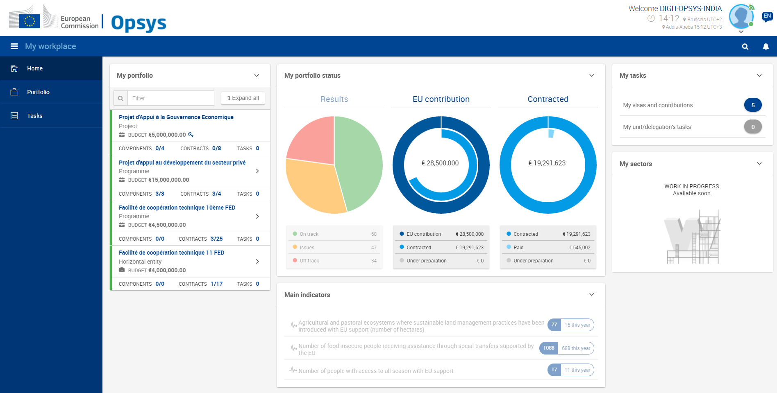
My workplace

Slide 52
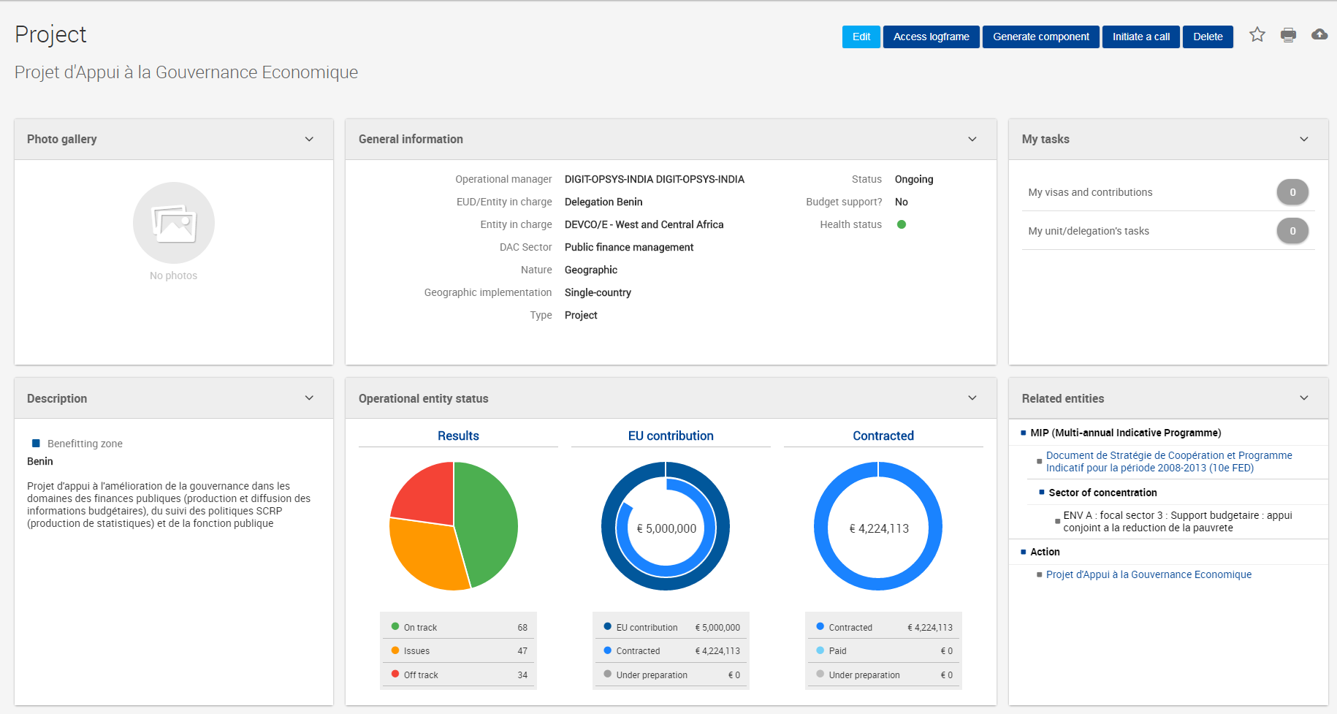
Programme/Project page

Slide 53
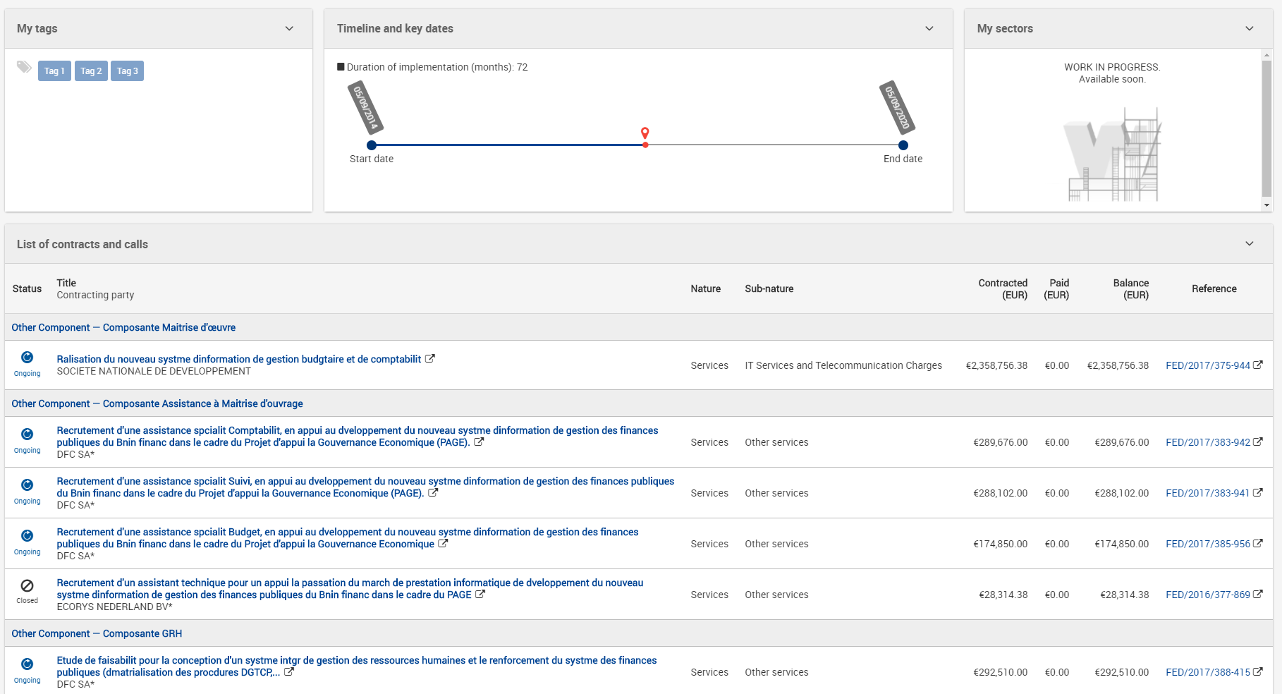
Programme/Project page

Slide 54
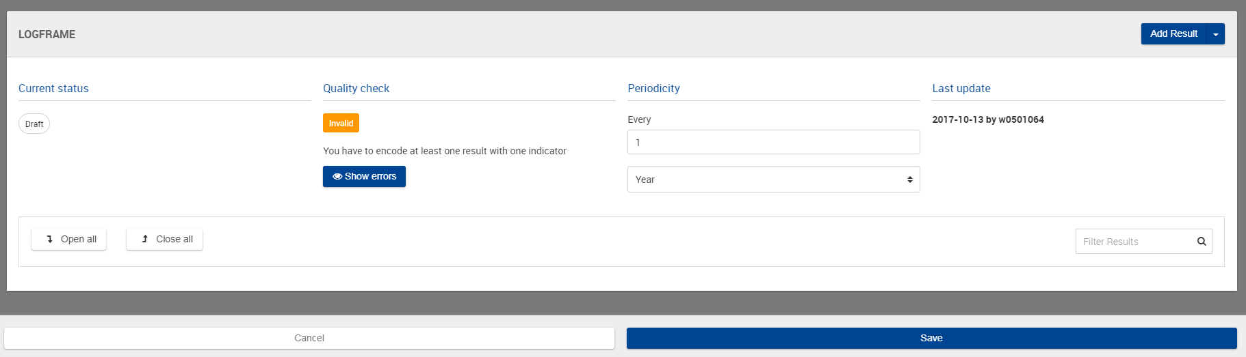
Create logframe

Slide 55
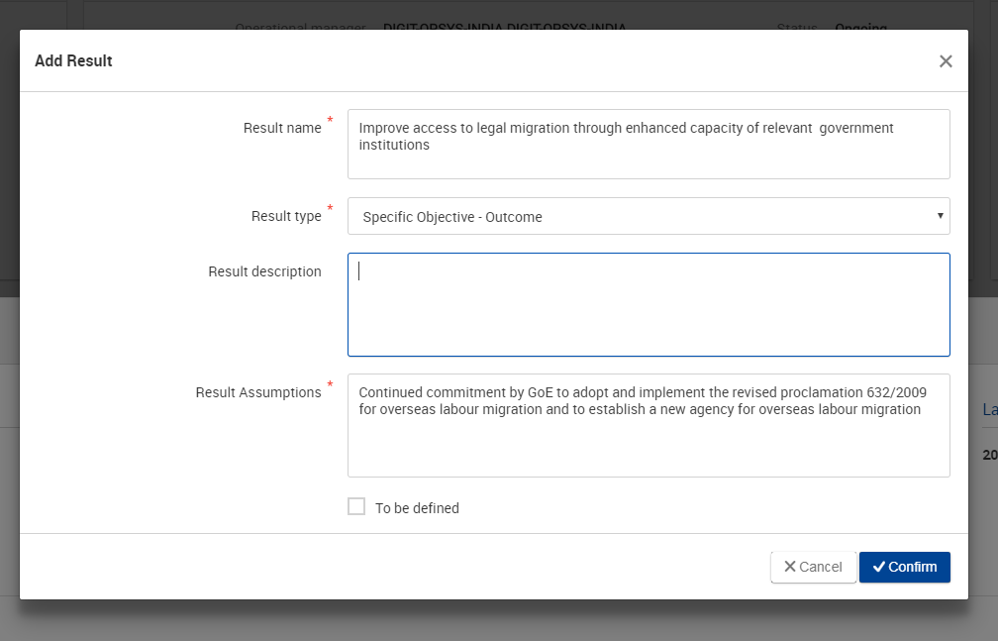
Add result

Slide 56
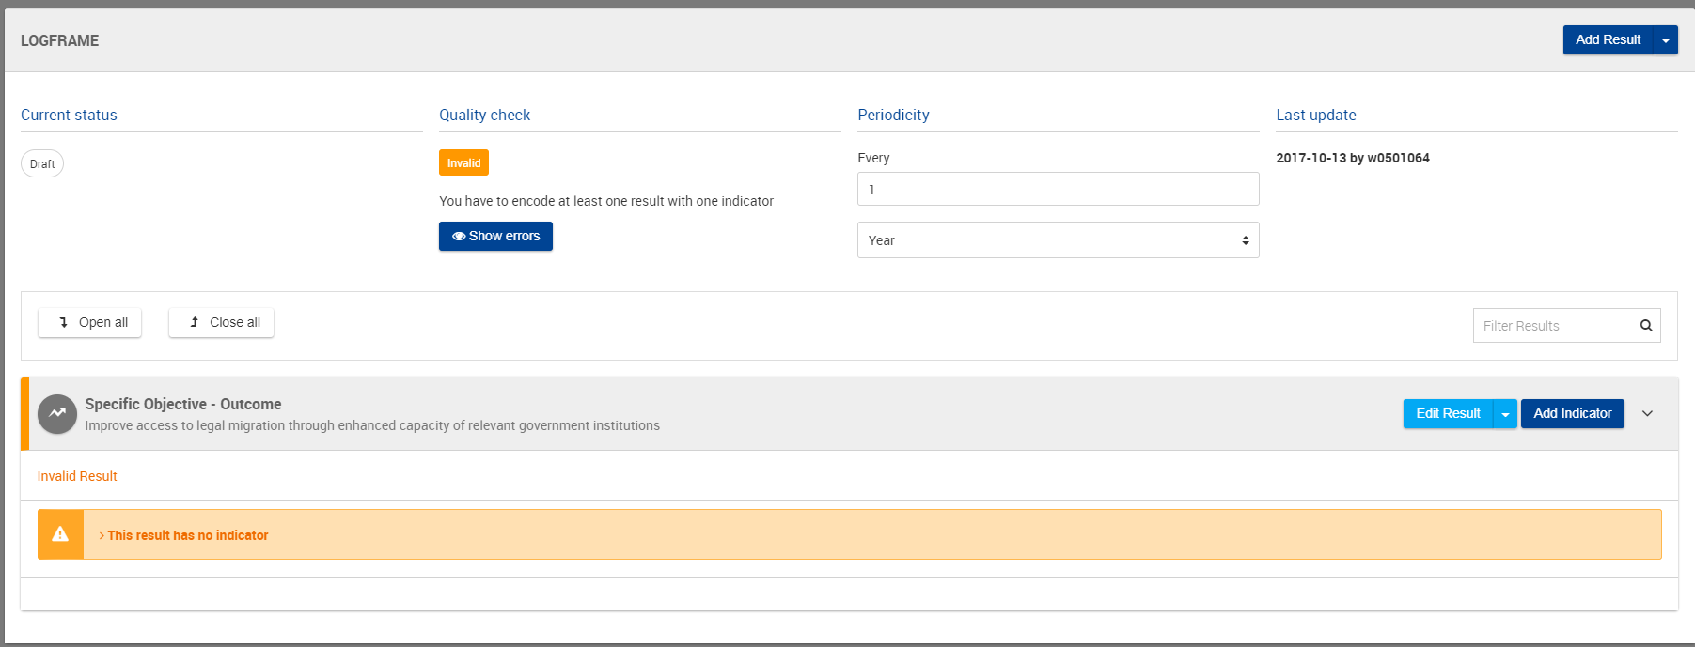
Add result

Slide 57
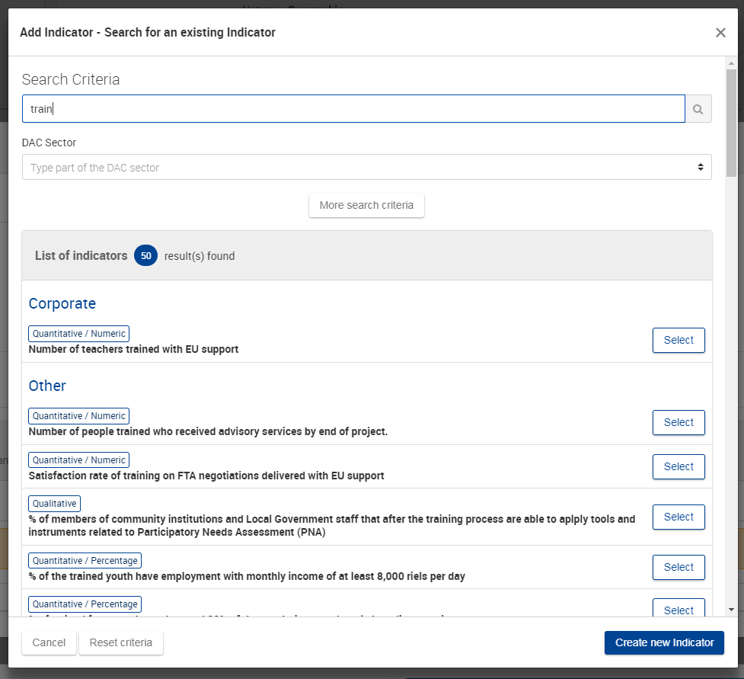
Add Indicator

Slide 58
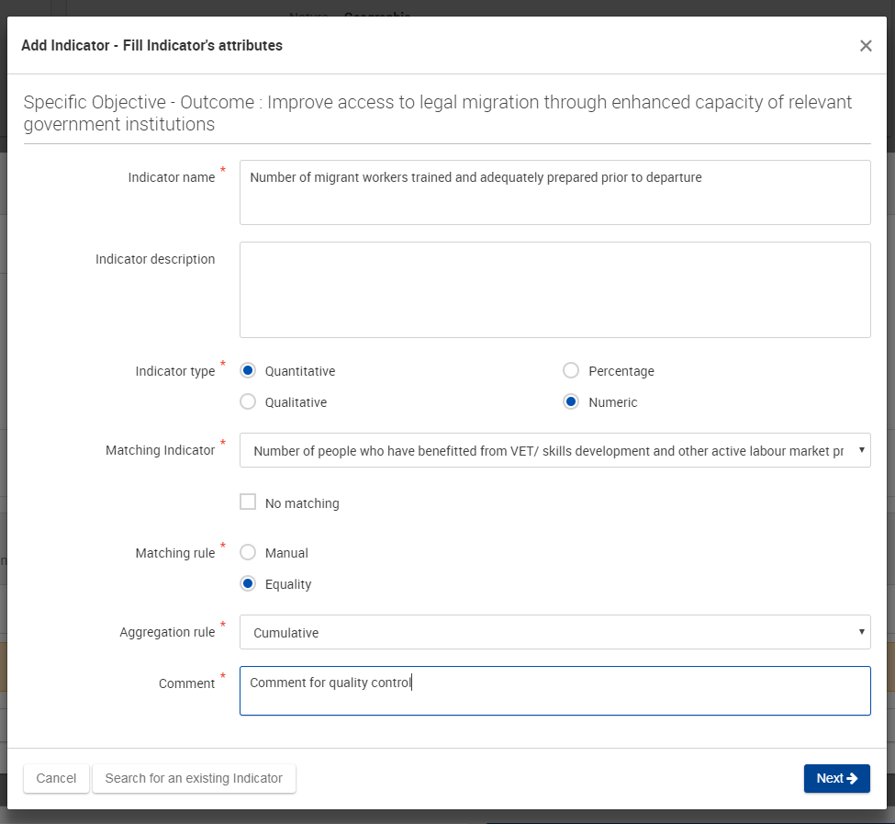
Create indicator

Slide 59
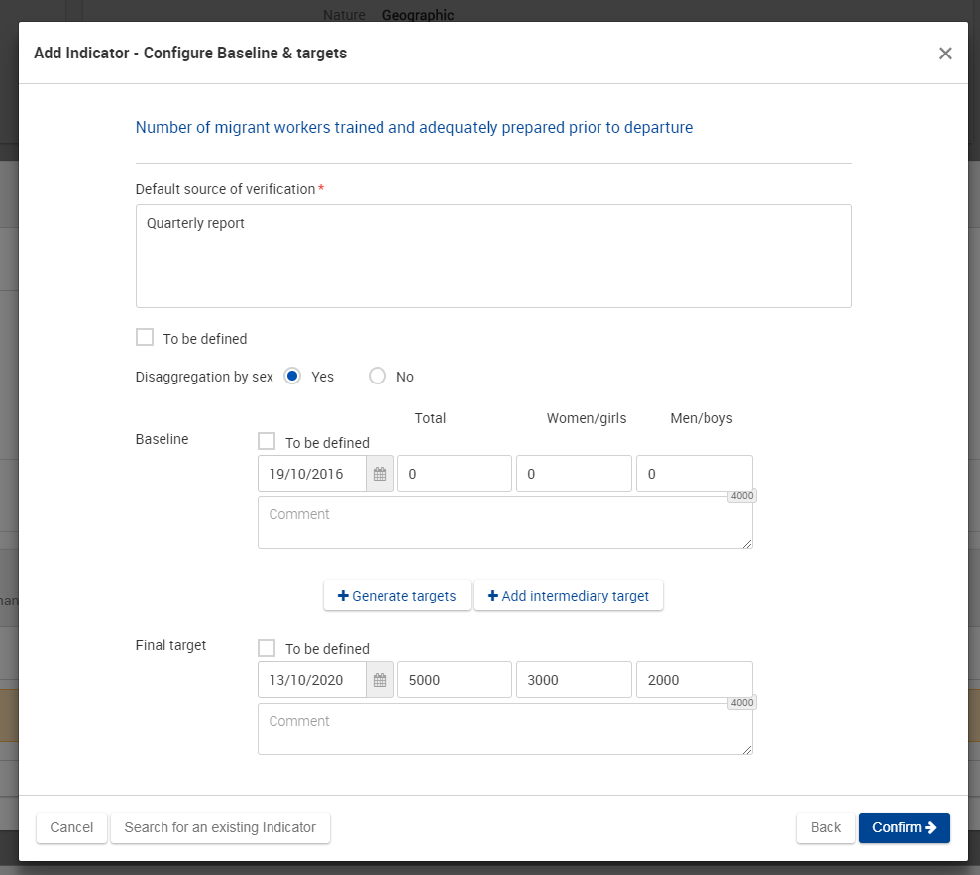
Add baseline and target(s)

Slide 60
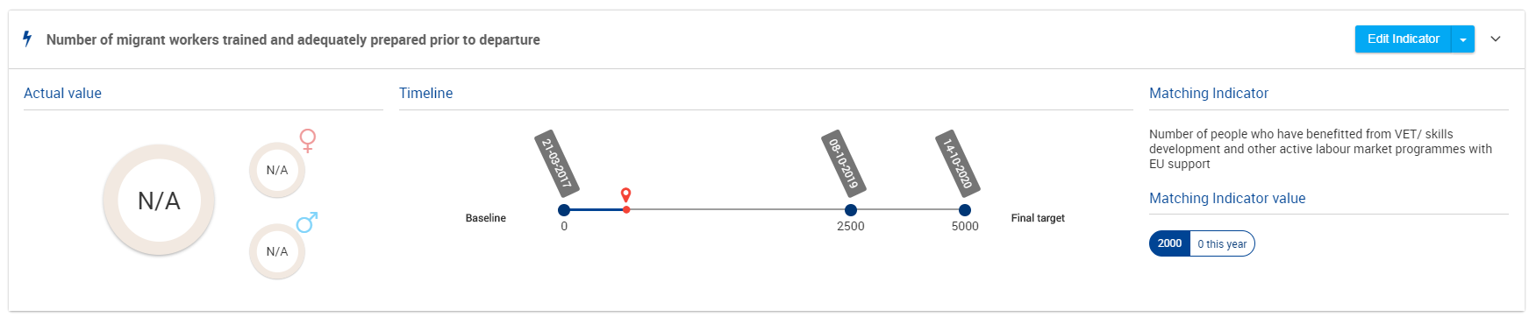
Display indicator

Slide 61
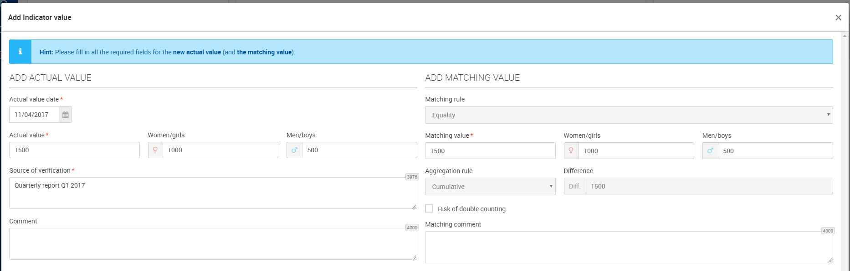
Add value

Slide 62
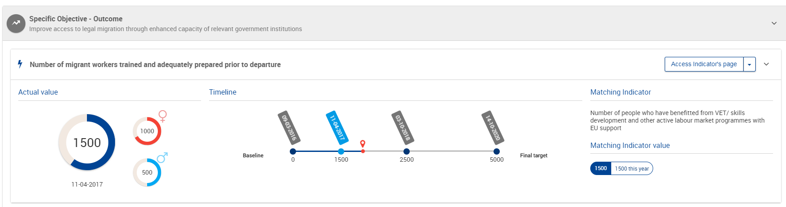
Display value in logframe

Slide 63
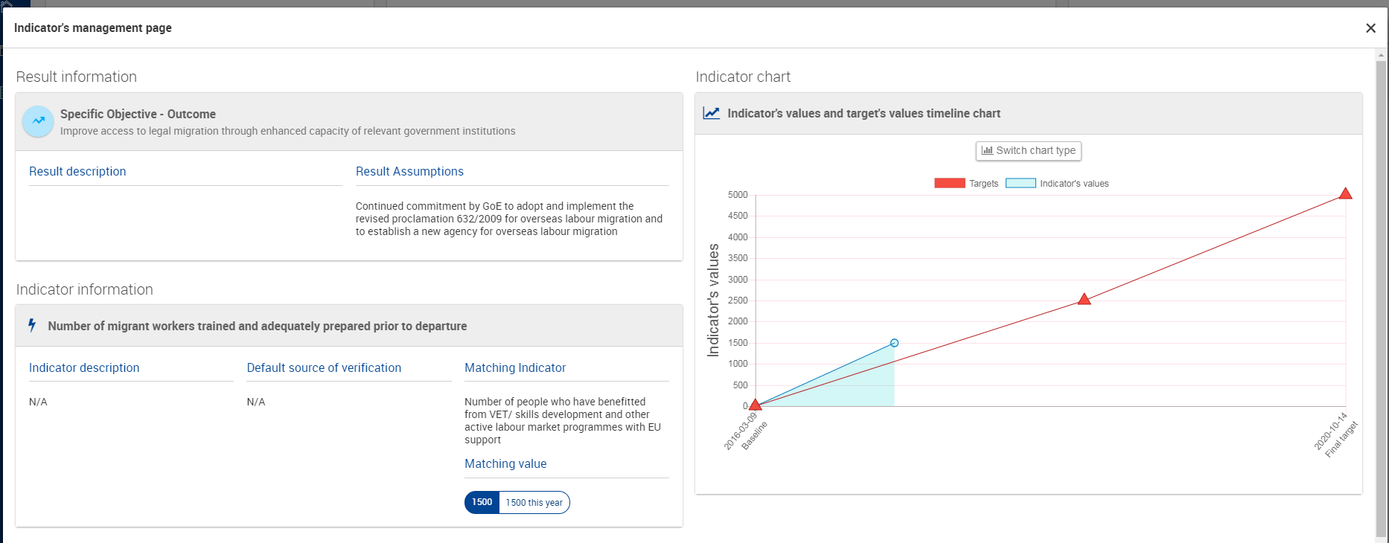
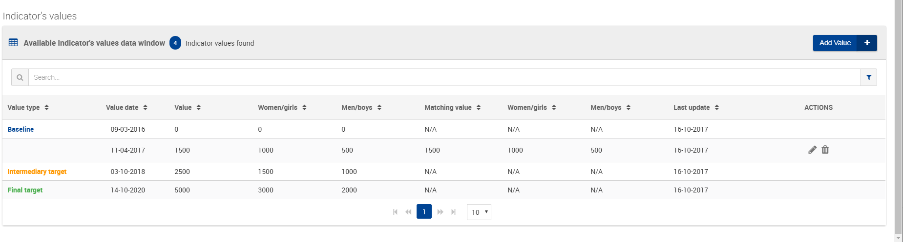
Display indicator page and trend

Slide 64
Your input is welcome!
Question 3:
What would be your next top priority in term of feature available?
a. Quality control of logframe, indicators values
b. Access progress report online
c. Aggregate indicators at EURF, MIP, country, sector level
Choose A or B or C

Slide 65
Your input is welcome!
Question 4:
How should ongoing logframes "in paper" be transferred into Opsys?
a. By your EUD/HQ unit
b. By your contractor
c. With the support of DEVCO 05
Choose A or B or C

Slide 66
October 17th, 2017
Opsys
Presentation 8: Communication, user support and testing
Véronique Lena, Team Leader Change Management

Slide 67
Communication and user support: key principles
    Involvement of users in EUDs and HQ units and feed-back loop to business:
      Webinars
      back-to-back sessions with thematic seminars and finance & contracts seminars)
      Presentation of OPSYS during training sessions on logframes, PCM and evaluation
    Strong coordination of testing and feed-back activities across tracks in order not to burden pilot EUDs and HQ units
    Regular communication to stakeholders on the progress of the OPSYS Programme
    Adjustment of planning according to DIGIT delivery

Slide 68
Test phase
The test phase will start on the 23rd October 2017 (TBC)
For the test, you will have at your disposal a testing scenario with some methodological guidance: results, indicators, targets, baselines, values, etc.
During the test phase, you can provide feedback in two ways:
  Through an online questionnaire for the methodological elements
  Through a feedback tool in the OPSYS system itself
Additional webinars specific to each DG/service are planned, their date will be confirmed shortly
An overall feedback on testing is planned for 16 November, 12.30 to 13.30 (GMT +1)

Slide 69
Get the latest news
Ad hoc support will be provided during the test phase and during the overall development of OPSYS.
Please do not hesitate to contact us at the address : EuropeAid-OPSYS-USER-SUPPORT-COMMUNICATION@ec.europa.eu
If you want to be kept updated, feel free to join us on capacity4Dev group: https://europa.eu/capacity4dev/opsys

Slide 70
Your input is welcome!
Question 8:
How would you like to receive regular information on OPSYS ?
a. Capacity 4 Dev
b. Newsletter
c. Intranet
d. All of the above
Choose A or B or C or D

Slide 71
Your input is welcome!
Question 9:
We need pilot EUDs to be intensively involved in decision making .
As a pilot EUD, what would you propose to streghten your role in users groups ?
Please use the chat room, now, to share your ideas or, later, on the online questionnaire you will receive soon !
Thanks

Slide 72
Your input is welcome!
Any questions until now ?
Please share them with everybody via the chat box.

