Slide 1
Budget support
Module 8
Reporting and evaluation
Notes:
See sections 6.2 and 6.3, Section 5.4 and annex 8 of the Guidelines

Slide 2
Outline Module 8
  Final report on budget operation
  Evaluation of budget support
  Synthesis of country evaluations
  Audit

Slide 3
BS Programming Cycle: implementation
EU External Action Policy
Partner Government Policy
Multiannual Indicative Programme:; Single Support Framework; Indicative Strategy Paper
identify sectors of engagement
Programming
Strategic Steering Committee (DEVCO)
Final Report and possible evaluation
Evaluation and
Follow-up
(SDG-C only) BSSC/FAST assessment of fundamental values
Identi-
fication
oQSG1 – Initial Action Document: Validation of kind of BS Contract
F(or roadmap for SRBC)
Decision process for tranche release:
Monitoring and dialogue, assessment of payment conditions
Implementation
BSSC /FAST: strategic guidance on choice modality, design, policy dialogue
Formulation
BSSC / FAST:
Opinion on disbursement when applicable
Quality Support Group 2: Action Document + Annexes
Budget Support Steering Committee / Financial Assistance Steering Committee: Continuous political and policy steer of BS programmes.. Each year the list of countries requiring submission is agreed, informed by the risk assessment
Notes:
oQSG Office Quality support Group

Slide 4
Final report
Not a formal evaluation
Internal document
To be submitted within 3 months after last disbursement
Special template (4-5 pages)
Notes:
Section 5.7 Monitoring
Final reviews are meant to remain internal and provide an input to future contracts
They are not a formal evaluation.

Slide 5
Five key questions
1. What are the key country/sector results (outcome, induced output) [1 page]
2. How BS contributed to these results (direct outputs) [½ page]
3. What changed and how much the EU paid [½ page]
4. What we learnt [½ page]
5. What the indicators of the variable tranches tell us [1 or 2 pages, table ]
Notes:
NOTE: THESE KEY QUESTIONS ARE ALSO IMPLICIT FOR THE DISBURSEMENT FILE

Slide 6
Template: the operation in a nutshell
Title | Same title as used in the financing decision
CRIS number | 20XX-XXX/XXX | Type | GDDC/SDG-C or SRC or SBC |  |  | DAC Code | XXXXX
Period | Month/Year of first disbursement – Month/Year of last disbursement
General objectives | Summarize the general objectives (chapter 3.1, Action Document) 1- 2-
Specific objectives | Summarize the specific objectives (chapter 3.1, Action Document) 1- 2- 3-
Commitments only budget support, incl. amendments | Total = XX M€ - Fixed = XX M€ - Variable = XX M€ |  |  | Disbursements only budget support, incl. amendments | Total = XX M€ - Fixed = XX M€ - Variable = XX M€
Complementary Support | Split by main beneficiaries or topics (e.g. court of auditors, tax collection, etc.) with management mode and amount (commitment & payments in million €)
Contact point at DEL | One or two names who may be contacted for follow-up by DEVCO/NEAR HQs
Notes:
Please always indicate the date at which the document has been drafted!

Slide 7
Outline Module 8
  Final report on budget operation
  Evaluation of budget support
  Synthesis of country evaluations
  Audit

Slide 8
Two types of evaluation
1. Programme evaluation of budget support
2. Strategic evaluation of budget support

Slide 9
A Comprehensive Evaluation Framework
GOVERNMENT POLICY & SPENDING ACTIONS (STRATEGY)
Inputs to Government policy & spending actions
SB input
Direct Outputs
Induced Outputs
Outcomes
Impacts
Funds
Conditions/indicators
Capacity development
Policy Dialogue
Improvement in the relationship between external assistance and the national budget and policy processes
Improved public policies, public sector institutions, public spending and public service delivery
Positive responses by beneficiaries to government policy management and service delivery.
Sustainable Growth & Poverty Reduction,
Stability
EXTERNAL FACTORS, CONTEXT FEATURES AND FEED BACK PROCESSES

Slide 10
Notes:
Based on intervention logic of BS: hypothesised sequence of effects.
Central notion: BS is a contribution to the implementation of the policy and spending actions of a partner government.
The Comprehensive Evaluation Framework (CEF) consists of five levels: See page ?? of BS Guidelines.
Many external (non-BS) factors determine induced output, outcome and impact.
Broad assessment of outcomes and impact of government policies needed.
Specific CEF needed for a joint BS programme See page ?? of the BS Guidelines

Slide 11
Programme evaluation
For one or two BS operations, focus on EU support; every 3-5 year
Under Framework Contract
Simplified approach (output and outcome)
In FA a financial provision for the programme evaluation

Slide 12
Strategic Evaluation
Relatively long period : 7 to 10 years
Donor independent, preferably joint evaluation
Managed and funded by DG DEVCO / DG NEAR Evaluation services
Focus on impact
Notes:
Preferably joint evaluation…in practice, there are less BS providers

Slide 13
A Comprehensive Evaluation Methodology
A harmonized 3 step approach
  Three step approach :
    An evaluation of the input, outputs and induced outputs of budget support
    An assessment of the outcomes and impacts targeted by the govt. Policy / strategy / expenditure
    An exploration of whether there is a linkage between:
The budget support
induced outputs
The determining factors of outcomes/impacts formulated as BS objectives

Slide 14
Step 1: Evaluation of the chain from inputs to induced outputs of the BS
Government strategy
Impacts | Sustainable and inclusive growth Poverty reduction | Budget support
Outcomes | Positive responses by service users and economic actors to government policy management and service delivery
Outputs | Execution of the budget Monitoring of results Improved macro-economic management Improved public services Etc. | Induced outputs | Improved macro-economic management Improved public services Strengthened PFM Improved policy formulation Strengthened public sector institutions, Etc
Inputs | National and sector policies Budgetary resources Human resources Institutional structures Strategies and operational programmes | Outputs | More aid provided through the budget More funds available for discretionary spending Increased predictability of disbursement of external funds Policy dialogue, conditionalities, TA and capacity building better coordinated and more conducive for government strategies Improved harmonisation and alignment Reduced transaction costs
 |  | Inputs | Transfer of funds to the national Treasury and disbursement conditions Policy dialogue and performance indicators Capacity building and TA
Step 1

Slide 15
Step 2: Evaluation of the results and impacts and assessment of the contributions of Government policies and spending
Step2
Government strategy
Impacts | Sustainable and inclusive growth Poverty reduction | Budget support
Outcomes | Positive responses by service users and economic actors to government policy management and service delivery
Outputs | Execution of the budget Monitoring of results Improved macro-economic management Improved public services Etc. | Induced outputs | Improved macro-economic management Improved public services Strengthened PFM Improved policy formulation Strengthened public sector institutions, Etc
Inputs | National and sector policies Budgetary resources Human resources Institutional structures Strategies and operational programmes | Outputs | More aid provided through the budget More funds available for discretionary spending Increased predictability of disbursement of external funds Policy dialogue, conditionalities, TA and capacity building better coordinated and more conducive for government strategies Improved harmonisation and alignment Reduced transaction costs
 |  | Inputs | Transfer of funds to the national Treasury and disbursement conditions Policy dialogue and performance indicators Capacity building and TA

Slide 16
Step 3: Exploration of the links between the BS and the results and impacts of the Gov. action
Step 3
Government strategy
Impacts | Sustainable and inclusive growth Poverty reduction | Budget support
Outcomes | Positive responses by service users and economic actors to government policy management and service delivery
Outputs | Execution of the budget Monitoring of results Improved macro-economic management Improved public services Etc. | Induced outputs | Improved macro-economic management Improved public services Strengthened PFM Improved policy formulation Strengthened public sector institutions, Etc
Inputs | National and sector policies Budgetary resources Human resources Institutional structures Strategies and operational programmes | Outputs | More aid provided through the budget More funds available for discretionary spending Increased predictability of disbursement of external funds Policy dialogue, conditionalities, TA and capacity building better coordinated and more conducive for government strategies Improved harmonisation and alignment Reduced transaction costs
 |  | Inputs | Transfer of funds to the national Treasury and disbursement conditions Policy dialogue and performance indicators Capacity building and TA

Slide 17
Outline Module 8
  Final report on budget operation
  Evaluation of budget support
  Synthesis of country evaluations
  Audit

Slide 18
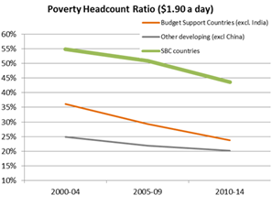
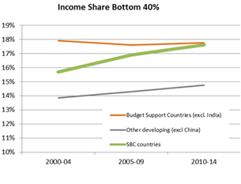
Macro analysis
Positive contribution to poverty alleviation; SRBC also on income distribution
Notes:
Low income BS recipient countries were less affected by the financial crisis than others;
BS recipient countries have lower fiscal deficits;
BS recipient countries have lower debt levels;
BS recipient countries have increased domestic revenue generation (but non-BS countries did so as well);
BS recipient countries have a higher current account deficit (higher imports).
Source: EC Budget Support, 2015

Slide 19
Positive correlation with CPI…..
Notes:
The positive correlation with CPI could mean

Slide 20
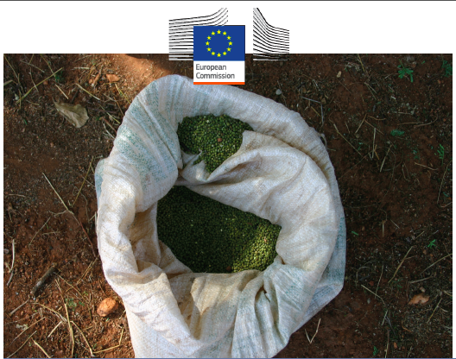
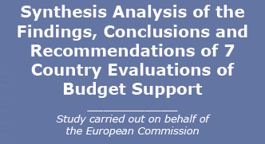

Slide 21
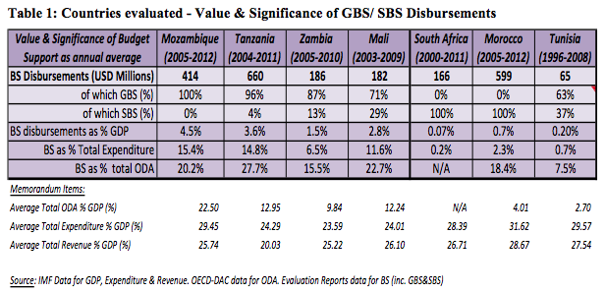
The context for Budget Support (Overview)

Slide 22
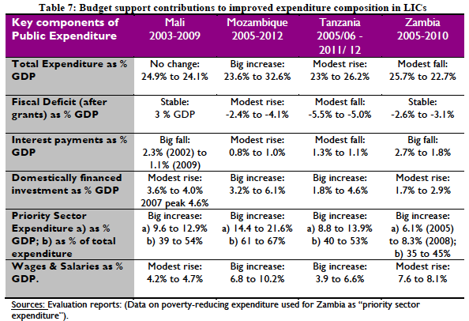
Induced outputs (LICs)
LICs Macro-economic effects: positive changes composition

Slide 23
Induced outputs (LICs)
Increased expenditure on health and education generated additional sector outputs.
Improvements in the quality of public finance management (PFM) have been recorded:
Gains in transparency and accountability Improvements in Transparency, reflected in OBI
Improvements in oversight by Supreme Audit Institution
Legislation and institutional structures for Anti-Corruption work
Notes:
Methodological approach developed by OECD/DAC Network on Development Evaluation.
Reference document: ‘Evaluating Budget Support – Methodological Framework, 2012.

Slide 24
Results BS (MIC)
Predictable financing
A higher level of predictability than other modalities, but...
Predicatability is less relevant, because BS represents a small proportion of total expenditure only.
2. Harmonized delivery structures
The degree of attention devoted to the task of harmonising budget support delivery processes across providers is less in the MICs

Slide 25
Overall Conclusions
Expansion of social service utilisation has been the principal outcome achieved.
PFM systems and governance improved.
In MICs, important reforms linked to market deregulation, tariff reduction and insertion in the international economy.
Money can’t buy reform: budget support funding is not correlated with policy leverage

Slide 26
Synthesis BS Evaluations
Nurture strategic problem-solving dialogue
The design, disbursement conditions and management processes should focus on strategic problem solving and policy orientation.
The scope of dialogue should be consistent with the capacity of the partner government and development partners alike.
Separate the forward-thinking dialogue from the “auditing” for disbursement decisions.
Synthesis of Budget Support Evaluations (2014) Volume 1: Synthesis Analysis of Findings, Conclusions & Recommendations of seven country evaluations
http://capacity4dev.ec.europa.eu/sites/default/files/file/17/02/2015_-_1338/synthesis_of_bs_evaluations_final-9_dec_b_volume_one.docx

Slide 27
Outline Module 8
  Final report on budget operation
  Evaluation of budget support
  Synthesis of country evaluation
  Audit

Slide 28
Audit of BS operations
Audit of BS operation: can that be done? How?
National Supreme Audit Institution
Verification by EU of deposit in Treasury Account
Complementary activities audited by EU
In case of targeted BS: audit of corresponding budget lines (payment ex-post)
Notes:
Strengthening of SAI, as well as internal audit and control institutions usually forms part of the BS policy dialogue and capacity development components
In the case of targeted budget support, where funds are intended to finance a specific and agreed set of budget lines, an audit is required to verify the amount of eligible expenditure which has been made in those budget lines. The budget support payment is made ex-post to reimburse the eligible expenditure in line with the audit findings .

Slide 29
European Court of Auditors
European Court of Auditors is EU’s independent external auditor
Carries out the audit of EU finances
Contributes to improving EU financial management
Promotes accountability and transparency
Acts as the independent guardian of the financial interests of the citizens of the Union

Slide 30
Types of audits
Selected audits (special reports)
Compliance audit
Legality and regularity of transactions
Performance audit
Soundness of financial management
Financial audit
Reliability of the accounts
Obtain evidence on the extent to which transactions, assets and liabilities have been completely, correctly and accurately entered in the accounting records and presented in the financial statements
Obtain evidence on the extent to which EU revenue and spending operations have been carried out in accordance with contractual and legal requirements and are correctly and accurately calculated
Obtain evidence on the extent to which EU funds have been used economically, efficiently and effectively, and provide value for money
Statement of assurance (annual reports)

Slide 31
What ECA expects from Budget Support disbursement files
Clear conclusions on eligibility criteria
Disbursement according to FA (timing/amount/conditions)
        Correct calculation of the variable tranche
        Documentation showing that conditions/indicators were met (Financing Agreement: sources of verification)
Proof of payment
Exchange rate used as defined in Financing Agreement
            Documentation showing which rate was used + the source of the rate
Notes:
What ECA expect from files in general:
Signed versions of documents (Financing Agreement, Service contract etc.)
All pages of a document (including annexes)
Dated documentation
Signature with clarification + title
Scanned documents (pdf) in ”readable” format
If there are calculations, preferably in excel

Slide 32
Thank you for your attention

