Slide 1

AGENDA
9.15 Introductory remarks and outline of the day
9.30 S1: JP update (state of play, regional workshops, follow-up to evaluation, guidance for JP, online tracker)
10.45 Coffee/tea break
11.00 S2: Analysis of Joint Results Frameworks + Building Blocks for Joint Results Frameworks
13.00 Lunch
14.15 S3: JP Tour de Table (update from Member States, JP in Middle Income Countries, JP and SDGs)
15.15 AOB and closing remarks
15.30 Bon Voyage Coffee

Slide 2
JOINT PROGRAMMING UPDATE
Stronger Political and Policy Framework
Global State of Play
Regional Workshops
Evaluation follow-up
Guidances & Tools in support of Joint Programming
JP workshop with Member States
Brussels, 22 November 2017

Slide 3
A Stronger Political and Policy framework
  EU Global Strategy 2016
  Council Conclusions 2016
  Joint communication on Resilience 2017
  New European Consensus on Development 2017
Notes:
EU GLOBAL STRATEGY
“Joint programming in development must be further enhanced. New fields of our joined-up external action include energy diplomacy, cultural diplomacy and economic diplomacy. A more prosperous Union calls for greater coordination between the EU and Member States, the EIB and the private sector. We must become more joined-up across internal and external policies.”
Council conclusions
Consolidation and expansion of JP in fragile and conflict countries
Accompany countries in transition to higher income levels
Inclusion of strategic issues
Joint Programming as the preferred approach in the delivery of the external development assistance
COMMUNICATION ON RESILIENCE
4.3 Integrating the resilience approach into EU programming and financing
"The EU will build on existing practice to make an assessment of risk and resilience factors a standard component of programming processes and project design across EU humanitarian, crisis response and development assistance, including the EU Trust Funds"
"[…] the resilient approach should be taken into account in Joint Programming processes with Member States, which will be further encouraged"

Slide 4
  New European Consensus on Development:
  JP to be kept voluntary, flexible, inclusive, and tailored to the country context
  JP to allow for replacement of EU and MS programming documents
  Taking into account all available means for development financing (in line with AAAA)
  Joint monitoring/results frameworks are core elements of the joint response
  Joint implementation is a way to promote coherence, effectiveness and coordinated EU support

Slide 5
  QUESTIONS?

Slide 6
Global State of Play
17
13
Countries with Roadmaps
Azerbaijan, Benin, El Salvador, Haiti, Honduras, Kyrgyzstan, Lebanon, Malawi, Mauritania, Mozambique, Nepal, Pakistan, Philippines,
6
Countries with Joint Analysis
Armenia, Belarus*, Burkina Faso*, Georgia, Morocco*, Zambia
24
12
7
Countries with Joint Strategy (joint analysis and response)
Joint Monitoring / Results Framework
Bolivia, Cambodia, Comoros, Ethiopia, Ghana, Kenya, Laos, Mali, Myanmar, Nicaragua, Palestine, Rwanda
Replacement
FR in Comoros, FR in Kenya, EU in Laos, DE and FR in Mali, EU in Palestine, EU in Senegal
Feasibility and Scoping
Bolivia (2016), Cambodia (2014), Chad (2014), Comoros (2015), Cote d'Ivoire (2017), Egypt (2017), Ethiopia (2013), Ghana (2014), Guatemala (2013), Kenya (2015), Laos (2016), Mali (2014), Myanmar (2014), Moldova (2017), Namibia (2014), Nicaragua (2016), Niger*, Palestine (2017), Paraguay (2015), Rwanda (2014), Senegal (2017), Togo (2016), Tunisia (2017), Uganda (2015)***
6
Second cycle of Joint Programming**
Ethiopia, Ghana, Laos, Mali, Namibia, Senegal
Afghanistan, Algeria, Angola, Bangladesh, Burundi, Cameroon, CAR, Guinea Conakry, Jordan, Liberia, Libya, Madagascar, Somalia, Tajikistan, Tanzania, Ukraine, Uzbekistan
Prep steps
Joint Strategy
60 Active countries
*drafts
** "Second cycle" refers to the process of thoroughly revising the Joint Strategy or producing a whole new document
*** Uganda's Joint Strategy is halted due to the political situation in the country

Slide 7
Global State of Play – reports from HoMs
Progress and benefits :
  EU and MS being increasingly recognised as "European family".
  Increased political leverage and visibility towards partner governments and the wider donor community
  JP contributing to development effectiveness AND providing stronger political clout for the EU and MS
  JP as a vehicle in implementing 2030 Agenda/ SDGs
  JP helps to increase alignment to national development strategies and improve division of labour
Persisting hurdles:
  Difficulties in reconciling trade, migration and security priorities with JP
  Country ownership due to misconceptions re. loss of bilateral relationship
  Synchronisation of programming cycles

Slide 8
Recent Missions:
Angola: September 1st mission; 2nd mission in February – roadmap expected (PT, ES, PL, IT, FR, DE, SE, NL, UK, IE, FI + NO)
Somalia: October 1st mission; feasibility/scoping study in preparation (DK, FI, FR, DE, IE, IT, NL, SE, UK + CH, NO)
Burundi: October 1st mission; joint analysis prepared that will lead to a “joint response” document (BE, DE, FR, NL + CH)
Cameroon: November 2nd mission: agreement on re-drafted joint analysis expected (BE, DE, ES, FR, IT, UK)
Yemen: November 2017 mission – feasibility/scoping exercise (13 MS + NO, CH)
Benin: beginning of 2018 3rd mission to support joint analysis effort (BE, FR, DE, NL + CH)
Madagascar: mission in February 2018 for roadmap (FR, DE) + exploration of situation in Comoros (FR)
Mauritania: January 2018 1st mission for roadmap (FR, ES, DE)
Mozambique: mission in Spring 2018 (AT, BE, DK, FI, FR, DE, IE, IT, NL, PT, ES, SE, UK)
Kyrgyzstan: mission in Spring 2018 to move beyond the roadmap (FR, DE, FI, UK + CH)

Slide 9
  Follow-up on Fragility and Resilience:
  Study commissioned on Joint Programming in fragile states (end 2017/beginning 2018)
  Support to Lebanon and Jordan on promoting a Joint Humanitarian and Development Framework (together with EUTF Madad)
  Missions to fragile states [Burundi (Oct 2017) and Somalia (Sep 2017)] and mapping work [Iraq and Yemen (Nov 2017)]

Slide 10
Going forward: potential countries
Focus on Least Developed Countries (LDCs) and Lower Income Countries (LICs) that have not yet been part of Joint Programming, or need renewed effort:
PARTNER COUNTRIES
Burundi | Guinea Bissau
Cameroon | Mozambique
Zimbabwe | Sierra Leone
Malawi | Liberia
Nigeria | Gambia
Eritrea | Yemen
Sudan | Vietnam
South Sudan | Sri Lanka
Tanzania | Mongolia
DRC | Haiti

Slide 11
  QUESTIONS?

Slide 12
Joint Programming workshops at EU Regional Seminars (1)
5 EU Regional Seminars in 2017:
  Eastern Africa in Djibouti (May 2017)
  West Africa in Brussels (June 2017)
  Central Asia in Tashkent (July 2017)
  Southern Africa and Indian Ocean (October 2017)
  Latin America and the Caribbean (October 2017)
  Upcoming:
  Southeast Asia (February 2018)
  Middle East (non-ENI) (February 2018)
  South Asia (tbc in 2018)

Slide 13
Joint Programming workshops at EU Regional Seminars (2)
General Conclusions:
High numbers of participants (all Heads of Cooperation and a good number of Heads of Delegation)
Good attendance by Member States, incl. development agencies
Discussions largely confirmed the findings of the Joint Programming evaluation and the 2016 Analysis of the 65 Head of Mission reports and notes
Flexibility in adapting Joint Programming to the local context is generally perceived as crucial and advocated strongly by all Joint Programming practitioners
Political/strategic dimension of trust-building and knowledge-sharing are crucial building blocks in elevating the quality of cooperation
Misperceptions around JP exists among EU+MS staff; they were directly tackled so as to better understand the practical and political importance of Joint Programming policy

Slide 14
  QUESTIONS?

Slide 15
Evaluation Report
Conclusions:
Valuable experience for the EU and MS: to be strengthened and improved
Recommendations:
  Better define the strategic purpose and scope of JP
  Keep JP strategic, flexible and pragmatic: a process and a product that builds on country relationships
  Clarify and reinforce the role of political /cooperation /country stakeholders

Slide 16
Evaluation Report: Fiche Contradictoire
Mid-way check (Recommendations 1-4)
Update Guidance (R1)
  – Commission in process of finalisation JP Operational Manual
Explore how to increase coherence between Joint Programming and other processes (EUTFs, humanitarian, MiC) (R2)
  - Studies and mission to focus on fragile states and humanitarian nexus
Expand/support the use of country-based joint results and monitoring frameworks (R3)
  - Presentation of Study on JRFs and dissemination of final product to EUD and MS
Ensure regular reviews/updates in the JP group in country(R3)
  - Support missions can be mobilised for discussion on common approach to JP
Improve online knowledge-sharing platforms (R4)
  - JP tracker; revamped capacity4dev; JP presence in all Commission+EEAS websites

Slide 17
Evaluation Report (2)
Fiche Contradictoire – half way check (Recommendations 5-8)
To continue supporting services incl. technical assistance (R5)
  - Strengthening missions with inclusion of experts from other fields; webinars on JP to be offered to field
EU HoC to involve HoD and Political advisors early on in the process (R6)
  - Operational Manual to make concrete references in this respect; HQ to continue raising this issue (in HQ or regional)
Engage more with partner country stakeholders (R7)
  - Operational Manual to devote whole chapter on this topic
Encourage EUD+MS to allocate sufficient manpower (R8)
  - Operational Manual to highlight need for anticipating workload
Replacement will be pursued wherever possible (R8)
  - EU replacement in Senegal, Palestine, Laos
Notes:
On REPLACEMENT:
FR in Comoros, FR in Kenya, DE and FR in Mali, EU in Palestine, EU in Senegal, EU in Laos

Slide 18
  QUESTIONS?

Slide 19
Future JP Guidance
Includes three major parts:
  How to practically implement a Joint Programming process:
  B. Linking Joint Programming to:
    Fragility and Resilience
    Strategic Issues and Cross-cutting Priorities
  C. Legal aspect: Replacement and Endorsement procedure for the EU
CHAPTERS IN OPERATIONAL MANUAL
1. Feasibility/Scoping Exercise | 6. Joint Results Frameworks
2. Roadmap | 7. Joint Policy Dialogue
3. Joint Analysis | 8. Joint Stakeholder Consultation
4. Joint Response | 9. Joint Visibility
5. Division of Labour
Notes:
This JP Guidance can well inform and be the basis for MS updated Guidance to their Embassies and field offices.

Slide 20
Example of Chapter: Roadmap
INTRODUCTORY SECTION:
"A Roadmap is a document that sets out who needs to do what […] Its primary objective is to agree on a timeline and a process for developing a Joint Strategy that ensures space and time for consultations and for taking account of inputs by all relevant stakeholders"
KEY ACTIVITIES IN DEVELOPING A ROADMAP:
Draw up a timeline of all steps for a Joint Strategy
Draw up a calendar of key events that will identify the appropriate time sequence
Engage with all MS and, possibly, with like-minded development partners
    Consult with relevant actors in the local development community (development partners, CSO, private sector groups) + humanitarian actors
Hold discussions on actionable next steps and related workload with Development and/or Political Counsellors from EU Member States
…
BOX (or ANNEX) WITH EXAMPLES

Slide 21
EU Approval procedures: Replacement of NIP/MIP/SSF
"A Joint Programming Document replacing a bilateral programming document has the same legal status as the bilateral programming document it is replacing"
The replacement process for Joint Programming Documents will be undertaken by each participating development partner according to its own rules and procedures focusing on its own contribution.

Slide 22
EU Approval procedures: Endorsement (non-replacement of NIP/MIP/SSF):
"The Joint Programming Document should contain a section which explicitly states that the MIP/NIP/SSF remains the legal basis for EU support until the relevant MIP/NIP/SSF expires "
The endorsement process for Joint Programming Documents will be undertaken by each participating development partner according to its own rules and procedures focusing on its own contribution.

Slide 23
EU Approval procedures: Endorsement
Table of Indicative Financial Allocations has to be part of JPD:
JP document cannot be signed as such by the EU when it is a case of endorsement
Alternatives offered are country level visibility events, joint declarations (template text offered) and press releases
Joint Programming Document | Indicative EU contribution | DP x contribution | DP y etc.
Priority 1
Priority 2
Priority 3 etc.
Total

Slide 24
  QUESTIONS?

Slide 25
Tools to support JP – HQ support
Experts:
Alex O'Riordan: supported Moldova, Philippines, Georgia, Palestine, Yemen, Iraq, Somalia, Mozambique
Katarina Courtnadge-Kovačević: supported Tajikistan, Laos, Cambodia, Pakistan, Afghanistan;
Iradj Alikhani: supported Mali, Senegal, Benin, Haiti, Mauritania
Sybille Koenig: supported Tunisia, Burkina Faso, CAR, Honduras, Burundi, Cameroon
1. Demand driven short-term technical assistance for in-country missions:
Missions can support:
Consultations
Mapping/country analysis
Facilitating Workshops/retreats
Drafting documents
Communication material
  BUT, consultants work cannot replace the importance of LOCAL OWNERSHIP
  Participating partners need to plan for longer term support to Joint Programming
2. Methodological advice and inputs regarding JP process and drafting of JP documents

Slide 26
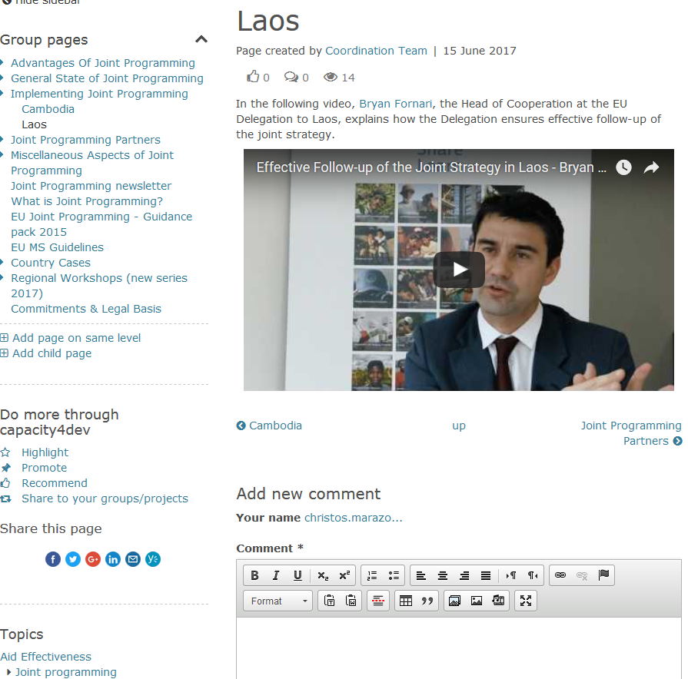
- Training videos with interviews from Heads of Cooperation:
Tools to support JP – web-based support
CAPACITY4DEV
JOINT PROGRAMMING group

Slide 27
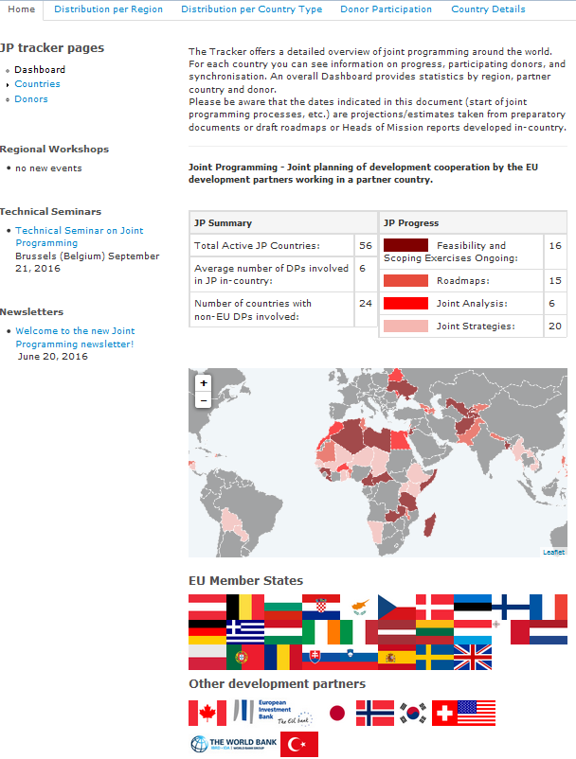
Tools to support JP – web based support
Joint programming tracker on CAPACITY4DEV
https://jptracker.capacity4dev.eu/
state of play by country
country documents being uploaded

Slide 28
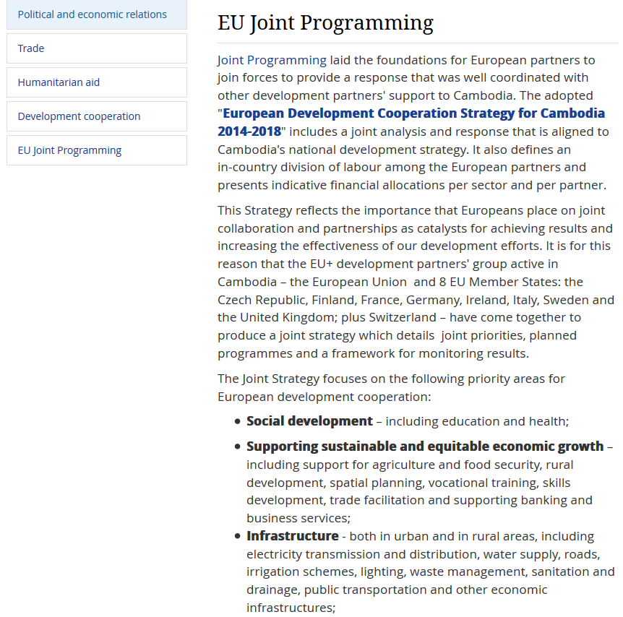
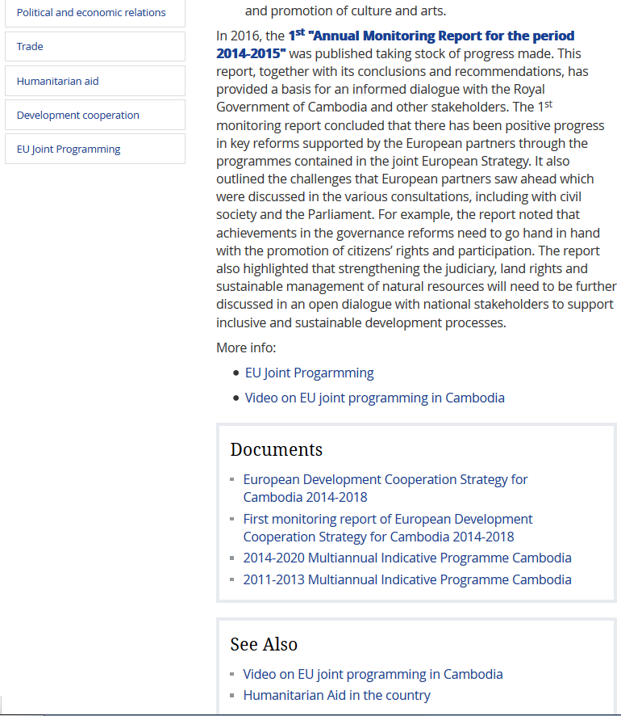
Tools to support JP – web based support
EEAS website (public): JP section Cambodia Delegation

Slide 29
  QUESTIONS?

Slide 30
STRENGHTENING OUR COMMON WORK
Member States are invited to host meetings on JP
Member States are invited to support future studies on JP, such as:
  Contributing consultant /expert
  Participating in study reference group
  Proposing topics for further analysis
Member States are invited to further promote JP at HQ level (communication/visibility events/debates)
Member States invited to update their JP Guidance as appropriate

