Slide 1
December 7th, 2017
OPSYS
Feedback session on the 1st testing phase

Slide 2
Agenda of the webinar
Session | Moderators
Introduction to the Webinar | Michal Krejza, Head of Unit, Results and Business Processes, DEVCO
Feed-back of the test phase: key elements | Véronique Lena, Team Leader, Change management
How to better involve EUDs in the governance of the OPSYS programme? + Q&A | Thierry Dudermel, Head of Cooperation, EUD Brazil Roxana Calfa, Head of Section, Results and Business Processes, DEVCO
Monitoring and reporting: OPSYS needs from a thematic unit perspective OPSYS gap analysis for PI Key indicators for monitoring and disaggregation, challenge of quality How OPSYS can support project management and monitoring and not only results reporting Involvement of implementing partners | 1- Bertrand Jolas, Policy Officer, DEVCO, Private sector and Trade 2- Kamil Valica, Programme and Evaluation Manager, FPI.4|Partnership Instrument 3- Georges Dehoux, EUD Pakistan and Jean-François Moret, EUD Ukraine 4- Lise Paté, EUD Brazil 5- Roxana Calfa, Head of Section, Results and Business Processes, DEVCO
Questions and Answers | Roxana Calfa, Head of Section, Results and Business Processes, DEVCO Andrea Alfieri, Head of Section, Results and Business Processes, DEVCO Massimo Mina, Team Leader Evaluation and Monitoring, NEAR Ronan Mac Aongusa, Deputy Head of Unit, Budget, Finance and Relations with other Institutions, FPI Polivios Klimathianakis, OPSYS programme manager, DIGIT Lucile Petitpierre, Business Manager Results and Monitoring
Next steps and conclusions | Roxana Calfa, Head of Section, Results and Business Processes, DEVCO Michal Krejza, Head of Unit, Results and Business Processes, DEVCO

Slide 3


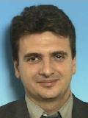

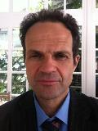


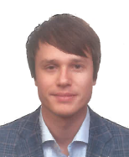
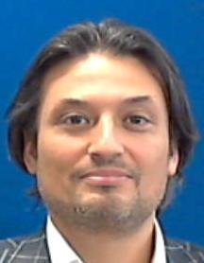


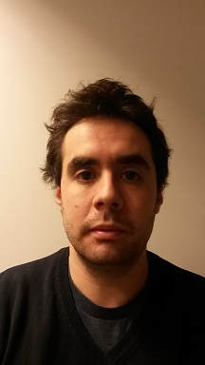
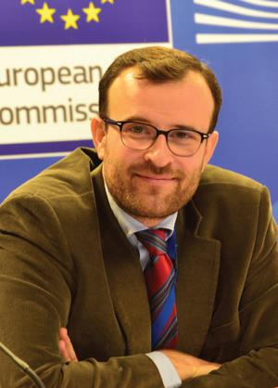
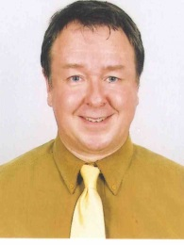
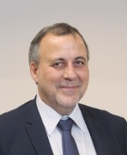
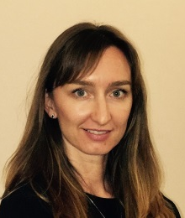
Who is running the webinar?
Michal
Krejza
Polivios
Klimathianakis
Andrea
Alfieri
Massimo
Mina
Ronan
Mac Aongusa
Roxana
Calfa
Kamil
Valica
Bertrand
Jolas
Lucile
Petitpierre
Véronique
Lena
Guido Bilanceri
Brussels
Kiev
Jean-François
Moret
Islamabad
George
Dehoux
Thierry
Dudermel
Lise
Paté
Brasilia

Slide 4
Introduction to the webinar
Michal Krejza, Head of Unit DEVCO.05

Slide 5
"OPSYS is user-centred":
  Success of the Programme depends on whether we succeed in basing it on the real business needs of the users
  EUDs and thematic & geographic units at HQ represent core business of Relex family
Thank you for your participation:
  You are essential players for a reality check needed to steer us in the right direction
  This first testing phase was a test of the business logic more than a real IT test
  Your efforts are greatly appreciated

Slide 6
This is just the beginning of comprehensive
  Consultations
  Test sessions
  Joint decision-making
2018:
  Need to maintain a sustained rhythm between business and IT development
  We count on you to as co-producers of OPSYS

Slide 7
Opsys
Feed-back from the testing phase:
key elements
Veronique Lena, Team Leader Change Management

Slide 8
Objectives of the test phase
Create a dynamic group of users to:
  Test to which extent IT developments meet the business needs
  Set priorities for future developments
  Identify needs for each actor in the system (including Implementing partners, if relevant)
Provide answers to all the comments that have been collected in terms of:
  Business value (importance)
  Time criticality (urgency)
  IT weight (workload)

Slide 9
Key Outputs
72 responses to the online questionnaire
150 qualitative comments collected during interviews in Brussels and by email with Delegations (Bosnia, Burkina Faso, Ukraine, Brazil, FYROM, Pakistan)
Altogether these are more than 400 qualitative comments

Slide 10
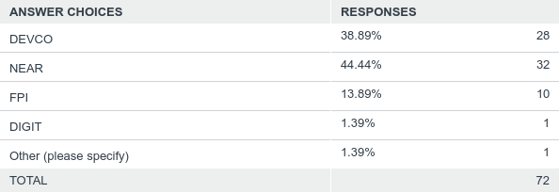
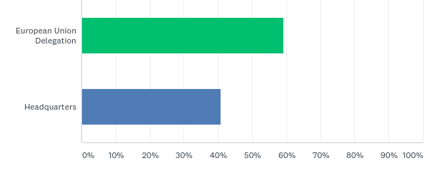
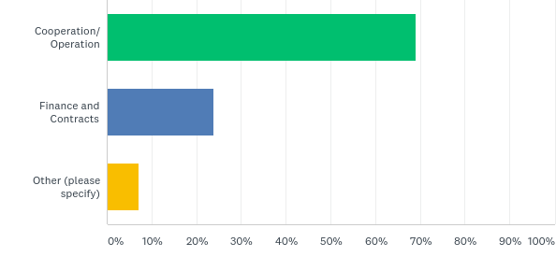
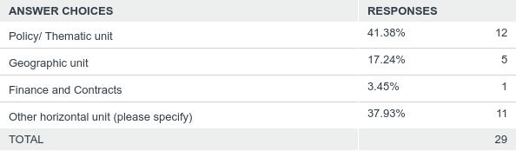
Answers overview – Respondents profiles
By DG / Service
HQ or EUD
By Sector in EUDs
By type of unit at HQ

Slide 11
Answers overview – A sample of common feedbacks on the logframe
We need to report on SDGs as well
We would like to encode the indicator in one single screen
I want to link the different levels of my results
Matching concept and aggregation rule are unclear and might discourage users
When I search for an indicator, I want to see only the indicators at the same level of the related result
When I search for an indicator, the filters for the sector is not user-friendly: we want the DAC code number and see the hierarchical breakdown (sector and subsectors)
The buttons for "Save" and "Cancel" are in a weird position, can we move them?
The difference between "Result name" and "Result description" is not clear

Slide 12
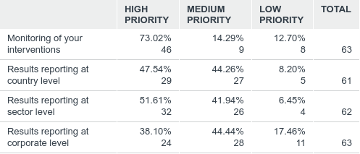
Q: What would be your main use of the Results and Monitoring module?
Answers overview – Use of the Results and Monitoring module

Slide 13
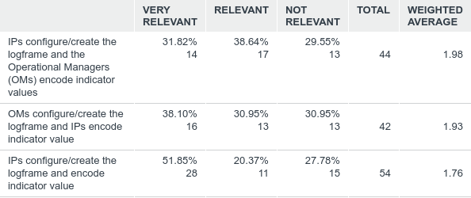
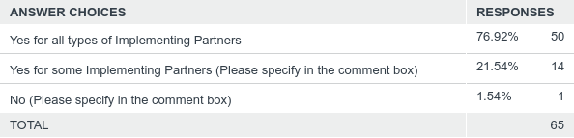
Q: How do you foresee the role of Implementing Partners (IP) in Results management and monitoring?
(assuming that a validation mechanism is implemented for all data encoded by IP)
Answers overview – Role of IP
Many relevant qualitative feedbacks to be analysed
Q: Would you foresee the possibility for Implementing Partners to deliver progress reports directly in OPSYS?

Slide 14
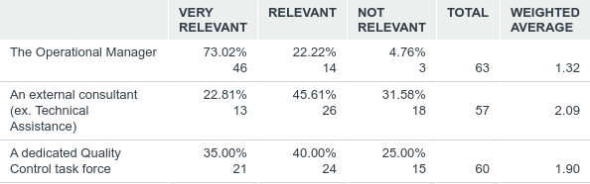
Q: Who do you expect to carry out the Quality Control of the values of the logframe during implementation?
Answers overview – Quality Control

Slide 15
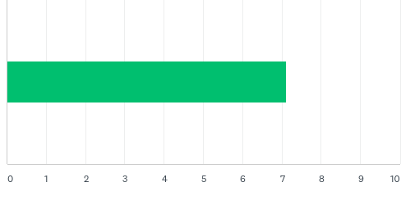
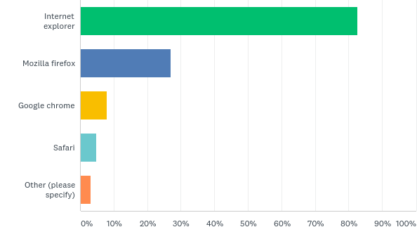
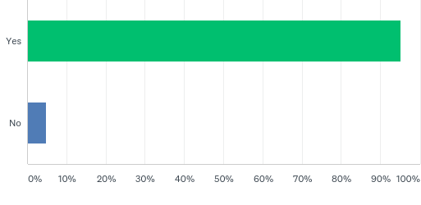
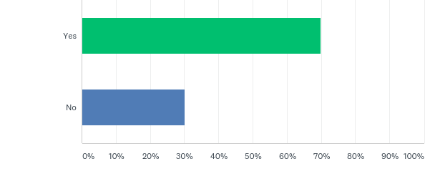
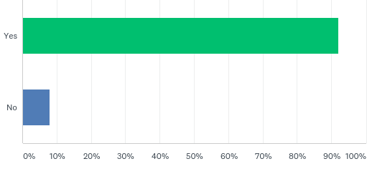
Answers overview – Step by step scenario
How clear was the scenario?
Which browser do you use?
Could you…
…switch language?
…perform a CRIS search?
…access an intervention from MyWP?

Slide 16
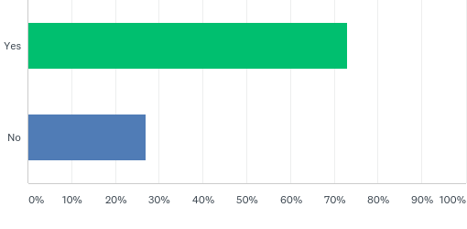
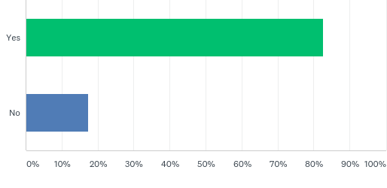
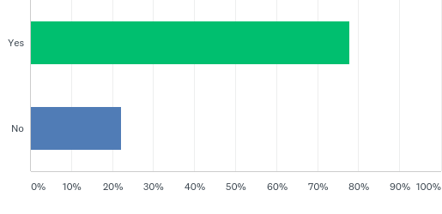
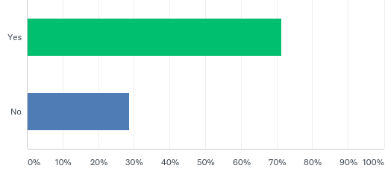
Answers overview – Logframe functionalities: could you…
…create a logframe?
…access a logframe?
…add a result?
…add an indicator to a result?
…add a value to an indicator?

Slide 17
Opsys
How to better involve EUDs in the governance of the OPSYS programme?
Thierry Dudermel, Head of Cooperation EUD Brazil
Roxana Calfa, Head of Section DEVCO 05

Slide 18
How to better involve the EUDs in the governance of the OPSYS programme?
Thierry Dudermel, HoC EUD Brazil
Delegations need to be part of the governance of the OPSYS programme as staff in delegations represent a large majority of active users.
OPSYS = an operational management tool – shall allow managers to have an overview of their portfolios.
Tools to involve delegations: webinars, webex, one-to-one contacts with the OPSYS team, working groups on operational specific aspects for OPSYS to be tailored to needs, etc.

Slide 19
How to better involve the EUDs in the governance of the OPSYS programme?
Roxana Calfa, DEVCO 05
  POLL
  How to reach an effective involvement of stakeholders?
  Sharing supporting documentation (ad-hoc notes, minutes)
  Interactive webinars (every 2 months)
  Customized bilateral meetings when in Brussels
  Other (please specify via the chat)
  Choose A or B or C or D

Slide 20
Opsys
Monitoring and reporting
Bertrand Jolas, DEVCO C04
Kamil Valica, FPI.4
Georges Dehoux, EUD Pakistan
Jean-François Moret, EUD Ukraine
Lise Paté, EUD Brazil
Roxana Calfa, Head of Section DEVCO 05

Slide 21
Opsys
Monitoring and reporting:
OPSYS needs from a thematic unit perspective
Bertrand Jolas, DEVCO C04

Slide 22
OPSYS needs from a thematic unit perspective
Bertrand Jolas, DEVCO C04
Thematic functions/needs
Programme management:
same needs as any operational manager
Thematic analysis and support:
capacity to identify and access relevant thematic interventions

Slide 23
OPSYS needs from a thematic unit perspective
Bertrand Jolas, DEVCO C04
Overall suggestion:
Allow maximum personalisation, as the needs will defer even from one operational manager to the other, and from an operational manager to a policy officer. System of Widgets?
Allow an exporting feature at any time
Other suggestions:
Add a box: "My region"
Search feature: Ok by text (allowing Boolean combinations), but also by DAC Code.
Rationalising the types of filter and allowing filter combination.
Indicators: allow indicator analysis across projects/sectors

Slide 24
Opsys
Monitoring and reporting:
OPSYS gap analysis for the Partnership Instrument
Kamil Valica, FPI.4

Slide 25
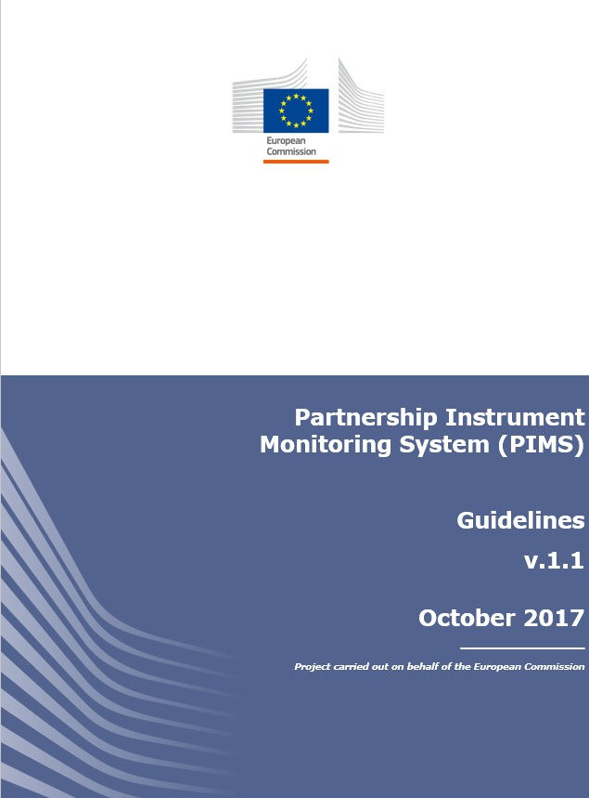
OPSYS gap analysis for the Partnership Instrument
Kamil Valica, FPI.4
Guidance document
Full explanation of PI monitoring system (logframes, indicators, reporting)

Slide 26
OPSYS gap analysis for the Partnership Instrument
Kamil Valica, FPI.4
PI indicators
Category |  | Definition
Core |  | Set menu of standard indicators, defined in relatively general terms to capture results of the PI Actions (more detail is provided below).
Customised | Matched | Action-specific indicators developed by tailoring core indicators to particularities of a PI Action. The objective is to capture results which core indicators don’t.
 | Non-matched | Completely new, action-specific indicators that you develop. To capture results which other indicators don’t.

Slide 27
OPSYS gap analysis for the Partnership Instrument
Kamil Valica, FPI.4
PI core indicators
Level | n. | Area
Impact | 5 | Partnership EU 2020 Collective action against global challenges Trade & market access
Outcome | 14 | Process influenced Perception & engagement
Output | 7 | People & companies participating in an event and the benefits from the event Products Outcome statement
Activity | 3 | Events Expertise Communication

Slide 28
OPSYS gap analysis for the Partnership Instrument
Kamil Valica, FPI.4
PI core indicators
Activity | Output | Outcome |  | Impact
A1 Number of events organised or supported | OP1 Number of participants in an event | OC1 Number of processes related to state-level and sub-state level (bilateral, regional, multi-lateral) partnership strategies and policy dialogues which have been influenced | OC8 Number of processes related to partner country practices on trade, investment and business which have been influenced | IMP1 Number of EU bilateral, regional, inter-regional and multi-lateral cooperation partnership strategies which have been enhanced
A2 Person days of expertise or technical assistance provided | OP2 Percentage of participants who report having benefited from an event | OC2 Number of processes related to non-state level partnership/agreements which have been influenced | OC9 Number of processes related to the removal of barriers to market access, investment and business which have been influenced | IMP2 Number of collective approaches and/or practices to challenges of global and/or mutual concern which have been developed/adopted/implemented
A3 Number of public/media/communication campaigns designed and implemented | OP3 Number of EU companies that participated in an event | OC3 Number of processes related to partner country approaches to challenges of global concern which have been influenced | OC10 Number of processes related to the negotiation, implementation or enforcement of EU trade and investment agreements with partner countries which have been influenced | IMP3 Number of approaches and/or practices beneficial to the achievement of the EU2020 strategy which have been taken up in partner countries
 | OP4 Percentage of EU companies which report having benefited from an event | OC4 Number of processes related to partner country practices on challenges of global concern which have been influenced | OC11 Percentage of EU companies which acknowledge a positive change in their perceptions of the business, trade and investment climate in partner countries | IMP4 Number of regulations and standards relating to trade, investment and business in partner countries which have been aligned to EU/international standards
 | OP5 Number of outcome statements emanating from an event | OC5 Number of processes related to the positions partner countries take in the run-up to or during regional/international fora which have been influenced | OC12 Percentage of participants targeted by outreach and advocacy events who acknowledge a positive change in their perception of the EU and/or international policies and standards | IMP5 Number of barriers to market access, investment and business development which have been removed
 | OP6 Number of knowledge-based products developed | OC6 Number of processes related to partner country approaches beneficial to the achievement of the Europe 2020 strategy which have been influenced | OC13 Percentage of participants targeted by outreach and advocacy events who acknowledge having engaged further on the topic on their own initiative as a result of their exposure to the events
 | OP7 Number of communication products developed | OC7 Number of processes related to partner country practices beneficial to the achievement of Europe 2020 strategy which have been influenced | OC14 Number of articles published in print and/or digital media about an event

Slide 29
OPSYS gap analysis for the Partnership Instrument
Kamil Valica, FPI.4
PI core indicator fiches
Title | The indicator statement
Type | The group to which the indicator belongs: Activity, Output, Outcome, Impact
Definition | Further explanation of the indicator and how it is designed
Unit of measurement | Number, number and narrative, percentage, ratio
Disaggregation | An indicator may measure different sub-features of the unit it measures. In that case it has a disaggregation. The disaggregation types present in PI core indicators are: Type of event Gender Sector of participant
Indicator created by | FPI Unit XX, EUD in XX Implementing Partner XX Name of the person who created the indicator Contacts
Sources and methods | Where the data can be found and recommended ways of collecting the data
Guidance for use | Remarks on correct use of indicator, where necessary
Other issues | Remarks on any other useful issues concerning the indicator

Slide 30
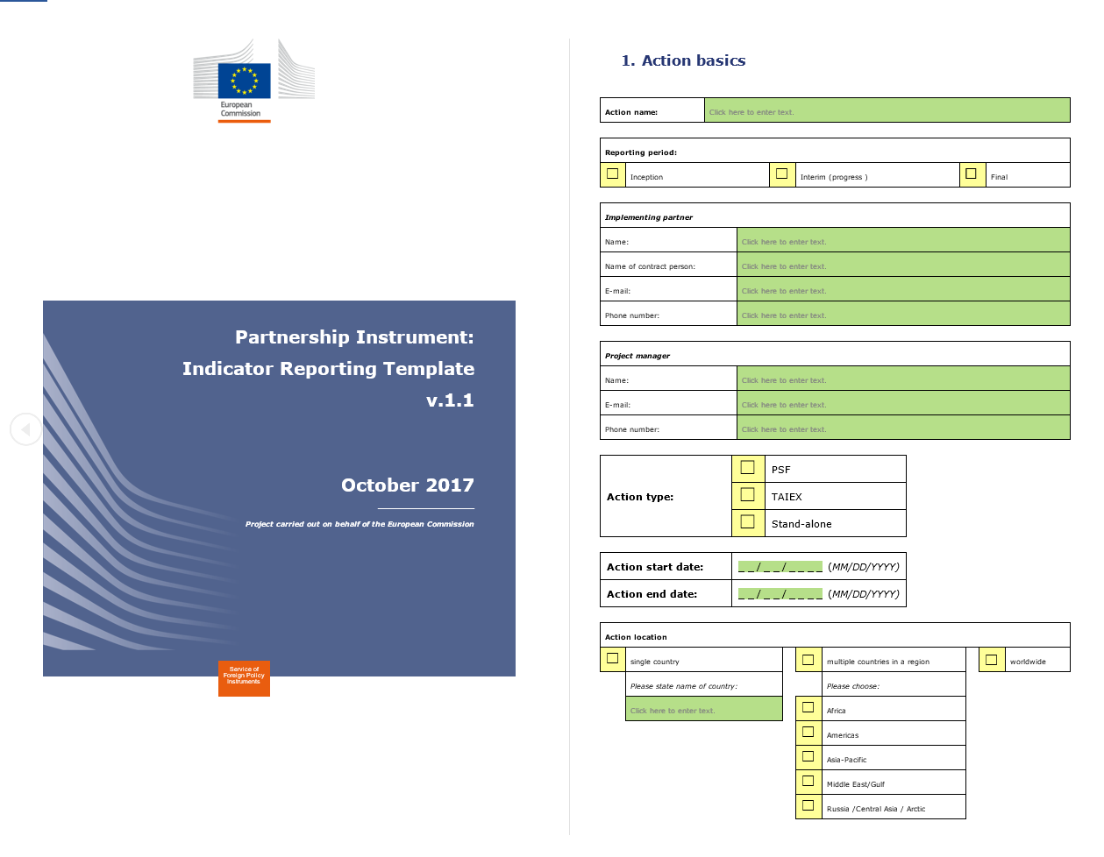
OPSYS gap analysis for the Partnership Instrument
Kamil Valica, FPI.4
PI indicator reporting template

Slide 31
OPSYS gap analysis for the Partnership Instrument
Kamil Valica, FPI.4
Ad hoc features requested in OPSYS
What | Indicators concerned | Comments
Ad Hoc Disaggregation | A1, OP1, OP2, OP3, OC12 and OC13. | Gender; Sector of participant; Type of event.
Mandatory comment (qualitative narrative) | A1, A3, OP3, OP5 to OP7, OC1 to OC10, OC14 and IMP1 to IMP5. | For value, baseline and target (depending on the indicator)
Replicate obligatory features for indicator matching with core indicators | All
Indicator code in front of the indicator name | All

Slide 32
OPSYS gap analysis for the Partnership Instrument
Kamil Valica, FPI.4
Additional feedbacks
Filter by instrument when you search for an indicator
System to be tailored to the needs of each Instrument and unnecessary features (like induced and direct outputs) not to be replicated when not relevant
Confusion between the term "cumulative" and "net value"
The term "corporate" indicator is not to be visible for PI project managers and implementing partners – only the term "core"
Activity level needs to be added in a clear way to the logframe
When choosing level of indicator, "activity" needs to be included in addition to output, outcome and impact in the selection menu

Slide 33
Opsys
Monitoring and reporting:
Key indicators for monitoring and disaggregation, challenge of quality
Georges Dehoux, EUD Pakistan

Slide 34
Key indicators for monitoring and disaggregation, challenge of quality
George Dehoux EUD Pakistan
Poll
1. How do you rate the general quality of logframes you are dealing with?
Poor
Average
Good
Beyond expectation
Choose A or B or C or D

Slide 35
Key indicators for monitoring and disaggregation, challenge of quality
George Dehoux EUD Pakistan
Poll
2. Generally, do these logframes satisfy your management needs?
Yes
No
Choose Yes or No
3. If no, where does the problem mainly lies?
Quality of Intervention Logic
Quality of Indicators
Both
Choose A or B or C

Slide 36
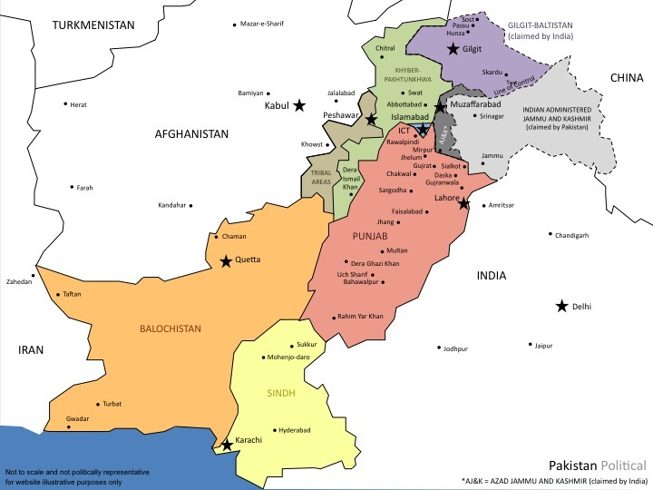
Key indicators for monitoring and disaggregation, challenge of quality
George Dehoux EUD Pakistan
Consolidation of EU Coop Programme in Sindh
An illustration of importance of LF, Indicators and OpSys tool
4 DEC; > 20 CTR; > EUR 230 M
+ federal-wide projects (PFM, democratization, Human Rights…)
Consolidation under one Provincial Programme / Framework

Slide 37
Process … through OpSys?
Key indicators for monitoring and disaggregation, challenge of quality
George Dehoux EUD Pakistan
Alignment of Programmes and Projects - "nested" logframes
Alignment-harmonisation of indicators
Coherent and Strategic Programme planning, monitoring, evaluation and reporting
Support to Policy Dialogue
PCM Training Handbook 2004

Slide 38


Logframe and Indicators – the Challenge
Key indicators for monitoring and disaggregation, challenge of quality
George Dehoux EUD Pakistan
  Basic Logframe Issue: general lack of understanding, from all/most parties, on the importance of logframes as a management tool… not only for programmes and projects but also for more strategic needs such as Policy Dialogue.
    Poor quality LF, quickly discarded during implementation (i.e. not used for management purposes);
    Often poor and/or inadequate indicators that do not allow for effective monitoring, evaluations and reporting;
    Aggregation of indicators within and between "operational entities" levels nearly impossible.
  Indicators and the need satisfy so many different masters:
    International level requirements and commitments: SDG, OECD…
    Alignment on, or factoring-in of National Policies and Strategic Frameworks
    EU Corporate Indicators or Result Framework indicators
    International/EU/local Thematic/Sector indicators (nutrition, climate change, gender, human rights…)
    Specific Policy Dialogue indicators
    … and, once in a while, specific programme/project indicators
      And all often linked to specific reporting requirements

Slide 39

OpSys – Expectancies
Key indicators for monitoring and disaggregation, challenge of quality
George Dehoux EUD Pakistan
  Allow to treat MIP/Programmes as self-standing "operational entities" with their own LF/indicators overarching projects/contracts LF ("nested" LF)
  Simplification and better guidance on choice of indicators
    Particular case of SDGs
  Interface for LF/indicators encoding does not only have to be more user-friendly (not sure about series of drop-down menus) but it must allow for a complete overview of the LF at all times.
  Analysis of reporting needs => to be generated under OpSys
  OpSys will also be needed as a support to Policy Dialogue (example of EU-funded's Government of Sindh local dev sister programme evaluation)

Slide 40
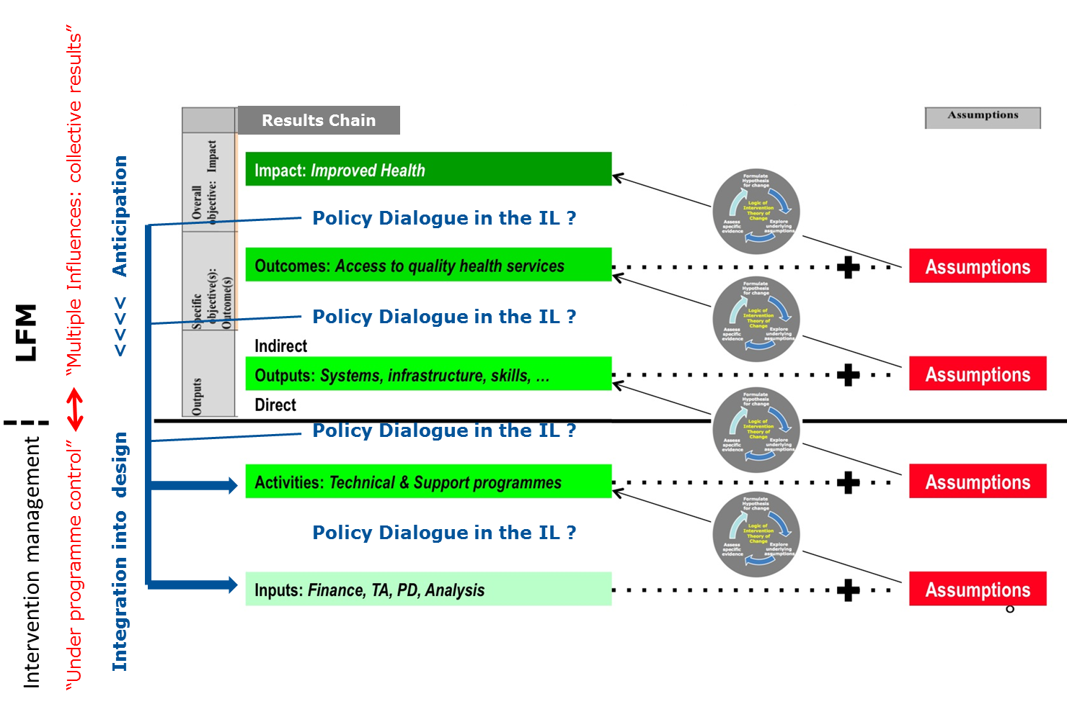
Policy Dialogue and LF
Key indicators for monitoring and disaggregation, challenge of quality
George Dehoux EUD Pakistan

Slide 41
Opsys
Monitoring and reporting:
Key indicators for monitoring and disaggregation, challenge of quality
Jean-François Moret, EUD Ukraine

Slide 42
Key indicators for monitoring and disaggregation, challenge of quality
Jean-François Moret, EUD Ukraine
Who encodes these RESULTS and INDICATORS in OPSYS, and when?
If it is the programme manager, will they be checked and validated by the Head of Section/Contract & Finance section – like the Annual Risk Assessment we have in MIS for instance? How?
Main point: ensure the relevance, quality and coherence of these results and indicators.
Reference to the SDGs indicators when available/applicable; see: https://unstats.un.org/unsd/statcom/48th-session/documents/2017-2-IAEG-SDGs-E.pdf Annex III.

Slide 43
Key indicators for monitoring and disaggregation, challenge of quality
Jean-François Moret, EUD Ukraine
Example (results on the left, indicators on the right):
Goal 4. Ensure inclusive and equitable quality education and promote lifelong learning opportunities for all
4.1 By 2030, ensure that all girls and boys complete free, equitable and quality primary and secondary education leading to relevant and effective learning outcomes | 4.1.1 Proportion of children and young people: (a) in grades 2/3; (b) at the end of primary; and (c) at the end of lower secondary achieving at least a minimum proficiency level in (i) reading and (ii) mathematics, by sex
4.2 By 2030, ensure that all girls and boys have access to quality early childhood development, care and pre-primary education so that they are ready for primary education | 4.2.1 Proportion of children under 5 years of age who are developmentally on track in health, learning and psychosocial well-being, by sex 4.2.2 Participation rate in organized learning (one year before the official primary entry age), by sex

Slide 44
Key indicators for monitoring and disaggregation, challenge of quality
Jean-François Moret, EUD Ukraine
How can RESULTS and INDICATORS be updated during the project's life, and by whom?
The essence of a project cannot be changed during its implementation, but targets in terms of time, populations concerned, etc. might need to be revised to reflect changes in the overall context.
If not revised, the visual overview of the project's performance could turn red ("problematic project") when there is actually no problem to be addressed by the Project Manager.
He/she might be unduly penalized/criticised for these red signals ("you're a bad manager!")

Slide 45
Key indicators for monitoring and disaggregation, challenge of quality
Jean-François Moret, EUD Ukraine
He/she could be tempted to lower the overall expectations from his/her project, so that all indicators always remain green, i.e. to get always (or as often as possible) the signal from his/her hierarchy "you're a good project manager" (CDR/promotion?...)
This might encourage (too) conservative approaches and a non-maximization of the use of the EU budget.
Example, still in the area of education:
My initial intended result is: "by 2024, all girls and boys of country a complete free, equitable and quality primary and secondary education".
My indicator is: "proportion of children and young people: (a) in grades 2/3; (b) at the end of primary; and (c) at the end of lower secondary achieving at least a minimum proficiency level in (i) reading and (ii) mathematics, by sex" (NB: I use on purpose SDGs indicators).

Slide 46
Key indicators for monitoring and disaggregation, challenge of quality
Jean-François Moret, EUD Ukraine
The indicator's management page shows a graphical representation of these indicators values and targets.
Let's imagine our baseline (situation today) is: 50% girls and boys of country a complete free, equitable and quality primary and secondary education. Our intended result is 100%.
But legislation changes, funds are cut, etc. and a realistic result by 2024 becomes only 60%– and not 100%.
If no update in OPSYS, all my indicators will turn red, sending to my hierarchy the signal "project wrongly designed – actions needed"

Slide 47
Key indicators for monitoring and disaggregation, challenge of quality
Jean-François Moret, EUD Ukraine
To "protect" myself from these "red signals" (or: avoid deviation from results), I might be tempted to put a lower target that I am sure to reach in all cases - possibly only 70% - when my initial intention was to educate 100% of the girls and boys, and certainly I have enough resources for that.
How can this be addressed? …

Slide 48
Opsys
Monitoring and reporting: How can OPSYS support project management and monitoring more than just results reporting?
Lise Paté, EUD Brazil

Slide 49
How can OPSYS support project management and monitoring more than just results reporting?
Lise Paté, EUD Brazil
OPSYS should value the monitoring work of EU programme managers
A space is offered to enter EU programme managers' monitoring comments beyond measurement of indicators
A space is offered for us to enter lessons learned

Slide 50
How can OPSYS support project management and monitoring more than just results reporting?
Lise Paté, EUD Brazil
OPSYS should also be a tool to help us improve EU visibility
Visibility activities and of activities that bring forward EU visibility → interface with implementing partners /platform of information
Possibility to map in one click what the EU is doing in a country in a given sector or in a given region

Slide 51
Opsys
Monitoring and reporting:
Involvement of implementing partners
Roxana Calfa, Head of Section DEVCO 05

Slide 52
Involvement of implementing partners
Roxana Calfa, DEVCO 05
Implementing partners
Background
Approach
Next steps
(see note "Role of Implementing Partners")

Slide 53
Opsys
Next steps
Roxana Calfa, Head of Section DEVCO 05
Michal Krejza, Head of Unit DEVCO 05

Slide 54
Next steps
Throughout 2018 | Presentations on Opsys in all training sessions in Brussels
January | Consolidate feedback and share it with you
February | Start of the test phase with Implementing partners selected by you DUG on progress reports and dashboarding
1-2 March | Workshop in Brussels across Tracks
5-9 March | Cooperation Days: workshop and stand (demos on demand)
19-27 April | FPI seminar (back to back to FPI days)

