Slide 1
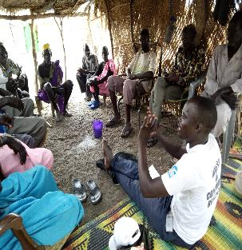
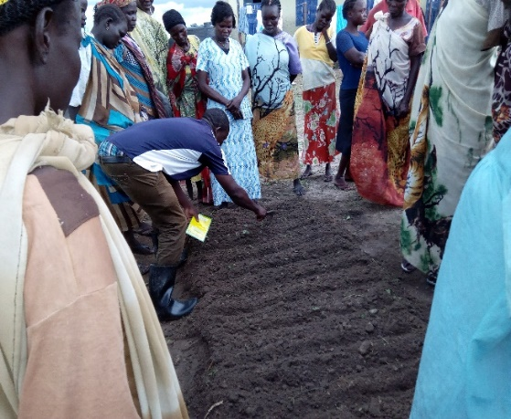

Enhancing food security and Resilience
EU Pro Resilience project

Slide 2
context
Upper Nile State
Upper Nile experiences both natural hazards and conflict.
The security situation in the Western Bank of River Nile, the project site, deteriorated from late 2016 till September 2017.
Conflict continued in 2017 that affected project implemention. For example:
    Insecurity in operation areas of Wau Shiluk, Fashoda and Panyikang
    January / February 2017, Wau Shiluk was faced by government offensive that led to displacement of population from the whole Makal West as a result the project implementation was scaled down for 2 months
    March 2017, Panyikang attacked: People displaced and insecurity increased hampering any movement in the area.
    April 2017, Kodok (Fashoda) attacked displacing population further to Aburoc and Sudan. Humanitarian workers evacuated including Cordaid and SSUDA.
The volatile situation is putting humanitarian interventions on constant emergency mode.
Clashes between opposition forces, influx of small arms, has worsened the food security and increased vulnerability while slowing down PRO-ACT activities at some point.

Slide 3
Basic Project information
Basic project data
Contract beneficiaries: Cordaid and co-applicant SSUDA
Project title: Enhancing the Food Security and Resilience of Vulnerable communities in Upper Nile state, South Sudan
Project ref. EUROPEAID/136723/DD/ACT/SS
Project locations: Upper Nile State - 3 counties Fashoda, Malakal, Manyo - 9 communities / payams
Project period: 09/12/2015-08/12/2018
Project budget: 2,654,379 EUR
Project utilization rate as December 2016: 20%

Slide 4
Project objective
Project objective and results
Overall objective:
Enhancing Food Security and Disaster Resilience of Vulnerable Communities Selected payams Fashoda, Makal West and Manyo Counties (Upper Nile State)
Expected key-results
Improved knowledge and capacity of 9 payams, 4 county government departments and 3 local NGO’s to enhance food security and disaster resilience in an integrated manner (incl. peace building and disaster prevention and mitigation);
Enhanced food security of 9 payams (3,000 Households) through the implementation of food security disaster resilience measures, including improved agricultural income generation, natural resource management, access to clean water and peace building.

Slide 5
Implementation approaches
Project implementation methodologies
Capacity building training of partners staff, local authorities and facilitators in CMDRR;
Community Managed Disaster Risk Assessment and Analysis – (using different tools to analyze hazards, vulnerabilities and capacities of people);
Community Level Action Plans – (prioritizing identified capacity gaps, development of contingencies (disaster preparedness) plans, and development of (disaster risk reduction) plans and based on plans, providing scenario on how to act in cases of disasters;
Agriculture extensions: Farmers Field School Approach (FFS) and peace builing
People’s organization – through formation of DRR Forums or DRR Committees – (Committee are responsible for joint planning, implementation and monitoring of the DRR action plans
Participatory Monitoring, Evaluation and Learning System (MEALS) – Ability to learn from events and activities can further enhance resilience

Slide 6
Linking Relief Rehabilitation and Development
Upper Nile, steps taken to resume operation after April 2017 incident
Conducted assessment in Kodok, Wau Shiluk and other payams of Fashoda and Malakal county (June 2017)
Verification of IDPs return and resumption of livelihoods in the project areas
Restoring destroyed livelihoods and limited options to stay in the village and run to POCs and IDP camps (priorities of communities shifted to emergency lifesaving, livelihood protections and recovery)
Cordaid realized the need to protect livelihoods and prevent communities from resorting to negative copying strategies
Provided relief for PROACT beneficiaries and began livelihood restoration and protection with humanitarian funding

Slide 7
Linking Relief Rehabilitation and Development
Preparatory action to resume operation after April 2017 incident
Conducted rapid assessment on June 2017
Developed scenarios (scenario 1: continue in the original proposed operation areas, scenario 2: If the situation deteriorates change project location with the same characteristics and similar beneficiaries
    Panyikang replaced by Mayno county
    Continue in Malakal and Fashoda
Organized review meeting at Juba (18 participants)
    Review the context
    Review work plan and prioritize actions
    Ensure coordination with government sector ministries at state and county level and other stakeholders
Regular and frequent coordination meeting among program team (SSUDA and Cordaid)
Start with immediate seeds, tools and livelihood kits distribution to restore livelihoods and prevent negative coping strategies
Conditional and unconditional cash transfer (market stimulation, rehabilitation of market facilities, cleaning of debris and rehabilitation of community infrastructures and etc.)

Slide 8
Project Progress
No | Target & Type of support | Location
 |  | Malakal County | Fashoda County
 |  |  | Kodok | Dethuk | Lul | Total
1 | Fishing kits - (Fishermen) | 55 | 140 | 0 | 0 | 195
2 | Unconditional cash - (CFV) | 18 | 95 | 51 | 234 | 398
3 | Conditional cash - (CFW) | 267 | 300 | 0 | 0 | 567
4 | Seeds & tools - (Farmers) | 39 | 90 | 0 | 0 | 129
5 | 82 vegetable farmers trained | 42 | 40 | 82 trained farmers among the 129
 | Total target received support | 378 | 625 | 51 | 234 | 1288

Slide 9
Project progress
The basic interventions
Revise PDRA and reaffirm community priorities
Training of 100 farmers on vegetables production (82: 66 F, 20 M) farmers on vegetable production or modern vegetable farming practices with aim of impacting knowledge and skills as part of community empowerment that will enable boosting nutrition and household income.
Revitalized the DRR committees
Identification and registration of Farmers Field School beneficiaries
Provision of seeds and tools linked with training

Slide 10
Project Results
Result 1: Improved knowledge and capacity of 9 communities, 4 county government departments and 3 local NGO’s to enhance food security and disaster resilience in an integrated manner
Outputs/activities | Planned | Achievement
Training of local authorities and community members in CMDRR & PDRA | 50 trainers (ToT) | 12 trainers
 | 270 communities | 122 participated
PDRA/ CLAPs that can act as operational plan in case of a disaster | 9 PDRA/CLAPs | 5
Training on and support on peace building & reconciliation processes | 150 selected person | Community mobilization done
Establish 100FFS gropus representing 3000 communities | 100 FFS (30 member each) | -30 FFS groups registered and established in 3 counties
Number of feasible and promising agri-business opportunities developed | 9 communities | y3

Slide 11
Project Results
Result 2: Enhanced food security of 9 communities (3,000 households) through the implementation of food security and disaster resilience measures
Outputs/activities | Planned | Achievement
All 9 communities have taken action in reducing flood risks | Conduct survey in 9 communities to Flood Risk reduction plans developed in each of the 9 communities Construction of dykes, check dams, reinforcement of river banks by planting trees | PDRA undetaken in 5 communities in two counties Consultation started
All 9 communities have access to clean drinking water | A survey in each of the 9 communities to assess the drinking water situation | Survey in progress
 | Construction./rehabilitation of water sources in 9 communities | Feasibility study on going
Baseline and impact data available on FFS members productivity | Conduct baseline assessment of agricultural produce | Baseline assessment conducted

Slide 12
Project Results
Result 2: Enhanced food security of 9 communities (3,000 households) through the implementation of food security and disaster resilience measures
Outputs/activities | Planned | Achievement
300 persons, especially women and adolescents, have acquired skills and knowledge to successfully implement a new agri-business model | Training of 150 people on feasible and innovative agri-business | Participants to be identified from already formed 30 FFS groups in 3 counties
 | 300 persons are implementing the agri-business model taught | 0
300 persons, especially women and adolescents, successfully implement a new agri-business model | 300 people implement new agri-business model | 0
 | Establishment of VSLA in each community (9 communities) | Ground working started for establishment of VSLA in 2 counties

Slide 13
Plan for the remaining project period
Overview plan
Boost project activities implementation using window of opportunity – the relative stability & return of beneficiaries to their location
Facilitate FFS training and establish the remaining FFS groups (2017)
Establish VSLAs, training, mentoring and coaching of the groups (2017 / 2018)
Rehabilitate water infrastructure based on the community prioritization
Prepare and submit 2nd year PRO-ACT interim report (Jan / Feb 2018)
Conduct annual review workshop that will focus on:
    Project progress against planned activities and outputs
    Mapping existing gaps and challenges and identify solutions
    Gauge and review stakeholders (including beneficiaries) feedback
    Identify changes to and improve modalities for successive year project implementations
Conduct mid-term evaluation (2018)

Slide 14
Lessons learnt
Lessons drawn
Working on resilience includes working at different time scales, which means the ability to switch between development modus and early response and emergency modus. A crisis modifier or LRRD allow for flexibility and adaptation to changing contexts.
Program scaling down during crisis and scaling up when window of opportunities are available to minimize loss of investments, optimize impacts / realize outcomes
Effectiveness of adaptive and innovative LRRD approach
Good relationship with existing structures – local Government vs Opposition
Maintaining good relationships with the communities, Payam & Boma Chiefs
Good coordination with clusters and stakeholders

Slide 15
Key challenges
Challenges & risks
Challenges:
Volatile security situation and access to project locations
Local procedures and clearance
Inflation and high costs of operation
Lot of mines in the targeted area
People leaving in IDPs / host communities are forced to move to PoCs
Relations between different ethnic communities and their political affiliations
Unpredictable rainfall patterns leading to high flooding
Communities priority need
Risks:
Security threats
Conflict and displacement

Slide 16
Any questions?
Thank you

