Slide 1
“Strengthening the resilience of pastoral and agro-pastoral communities in South Sudan’s cross border areas with Sudan, Ethiopia, Kenya and Uganda”
FAO South Sudan
Juba, November 2017
WITH FUNDING FROM THE EUROPEAN UNION

Slide 2
Project Overview
European Union Funded project
August 2017 – July 2020
Project overall objective to improve governance and conflict prevention to reduce forced displacement and irregular migration in cross-border areas of South Sudan.
Project fills the nexus between humanitarian and development programming in the areas of South Sudan to promote resilience of vulnerable households and communities.

Slide 3
Project Thematic Results

Slide 4
Project Implementation Areas

Slide 5
Project Status
Project builds on the activities already initiated and implemented through actions previously funded by the European Union; and Other Donor Agencies including Agriculture and Food Security Information System and livestock activities in the Abyei Administrative Area, and alternative livelihood options.
Several of food security information system (decision making tools) and activities are on going:
Market and agro-climatology
Crop monitoring – Crop Watch and input to CFSAM
IPC analytical products
CFSAM from the 38 CCMS
FSNMS – 21 round
CLIMIS portal
Inception phase until end of January 2018.

Slide 6
Inception Phase
Operational Aspects
Determining operational areas within the Cluster Areas
Finalizing the revised logframe
Adjusting the work plan
Finalizing the revised risk log
Procurement of required project items
Finalizing Recruitment of Project team
Identification of implementing partners

Slide 7
Inception Phase
Programme Aspects
Baseline studies to refine log frame, indicators and targets
Formation of Project Steering Committee
Information collection
Mobilization of technical support
Engage with FAO/RTEA, ECTAD (Emergency Center for Transboundary Animal Diseases) and IGAD

Slide 8
Project Implementation Modalities
Direct implementation
Implementation through partners (Letter of Agreement modalities)
Collaboration with Ministries; I/NGOs; UN Agencies, Funds and Programmes; UNMISS; IGAD; The African Union; EU Institutions; FAO offices (including ECTAD); and private sector

Slide 9
Project Strategy
Demand driven interventions
Strategic peace-building and conflict sensitivity programming
Communication for development
Support communities to connect to humanitarian and resilience opportunities
Regional approach and cross-border coordination
Partnership and collaboration

Slide 10
Project Impact Evaluation Strategy
Baseline study
Mid-term evaluations and reviews – annual reporting
Final evaluation

Slide 11
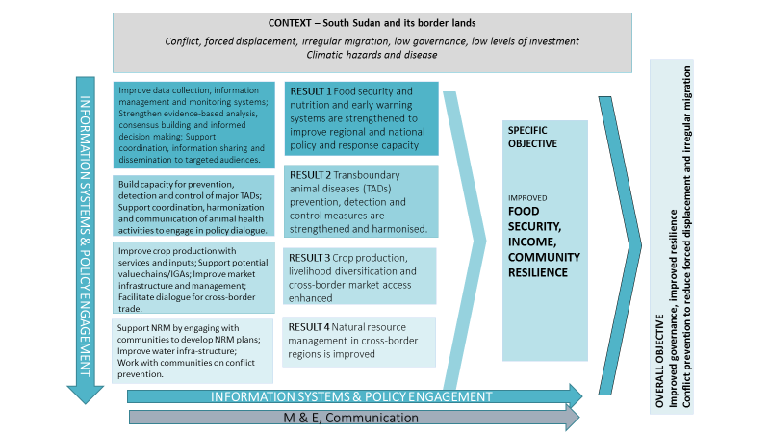
Project Theory of Change

Slide 12
Project Communication Mechanisms
Communication with general public, beneficiaries, government, private sector, civil society, donors and media
Use of radio, special events, social media, information sharing sessions, print material, photography and video, press conferences

Slide 13
Thank you!

