Slide 1
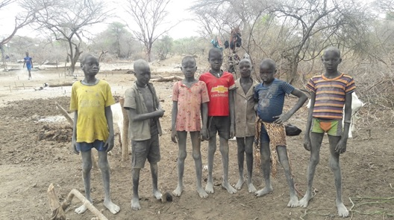


Enhanced Knowledge and Education for
Resilience Pastoralist Livelihoods in South Sudan
Funded by the European Union
Government of South Sudan
16th November 2017

Slide 2
Project Background
Pastoralist communities in South Sudan receive limited services to improve their livelihoods due to seasonal mobility.
To bring about attitudinal & behavioral change, & improve lives of pastoralists, there is need to extend livelihoods, literacy, numeracy, life skills & basic skills training interventions.
Pastoral Field School (PFS) provides excellent entry point & platform to improve pastoralist knowledge & skills.
Pastoralist Livelihood and Education Field School (PLEFS) approach initiated that combine livelihood interventions with an education component
The pilot project integrates the PFS with pastoral education to enhance resilience of pastoralist communities livelihoods.
Notes:
Most social services are designed for sedentary lifestyle and pastoralist are transhumance that move seasonally between villages, grazing areas and different topographic zones.

Slide 3

Beneficiaries and Partners
Operation areas/ Counties :
  Yirol East, Yirol West, Awerial,
  Rumbek Center & Wulu
Target Beneficiaries
  Pastoralist in cattle camps: Young children ( 8-12ys); Youth ( 13+ years); Adults ( >18)
  Ministries staff and community facilitators/teachers
Project Partners
  National level: MAFS, MLFI, MoEGI;
  State: SMAF, SMARF, SMoEST; IIRR and NPA.

Slide 4
Impact
Resilient pastoral livelihoods
Outcome
Livelihood security & empowerment
Institutional capacity
Outputs
CMDRR
Livelihood Diversification
Skills transfer
PLEFS model Development
Coordination mechanisms
Activities
DRR mobilization
CMDRR action plans
Support action plans
Training members on IGA
Support IGA activities;
VICOBA
Train facilitator
PLEFS
Literacy, numeracy, ALP
Survey
Curriculum Devt
Regulatory framework
Master trainers
Visibility
Technical WG
Regional exposure
Pool of trainers

Slide 5
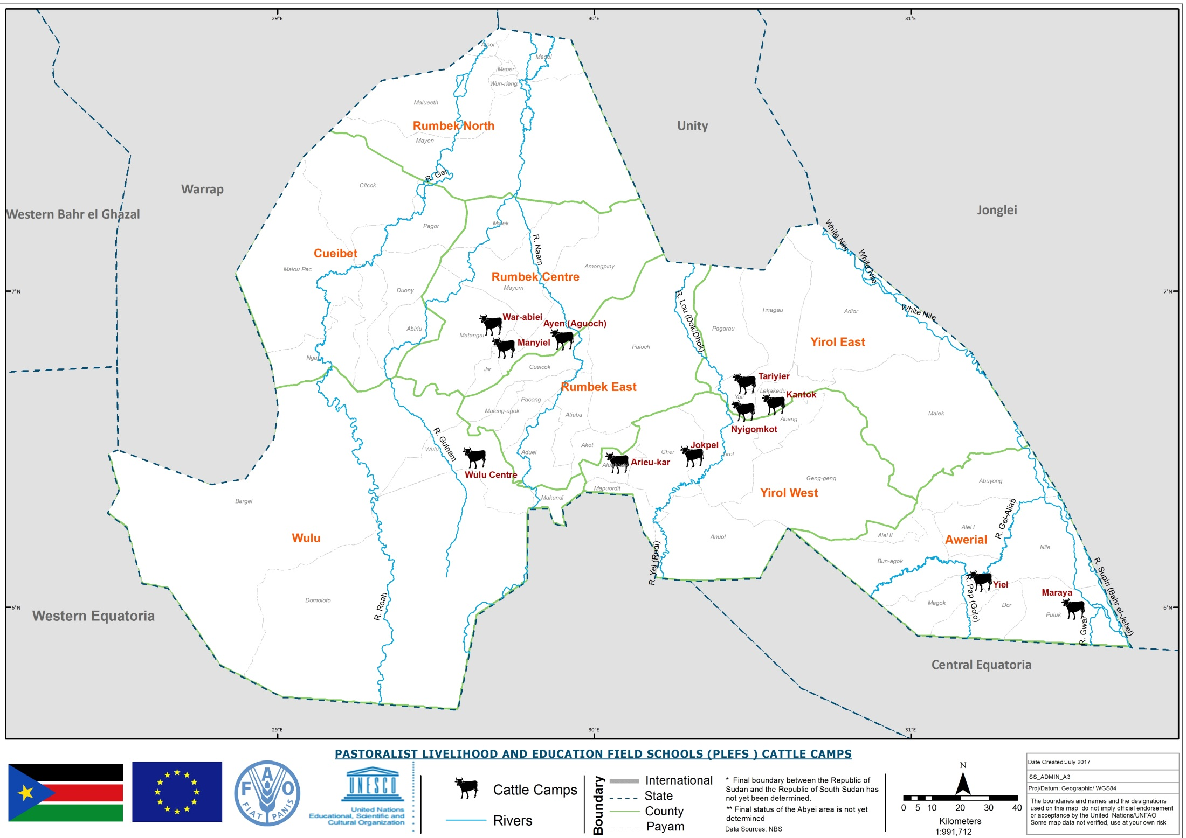

Slide 6
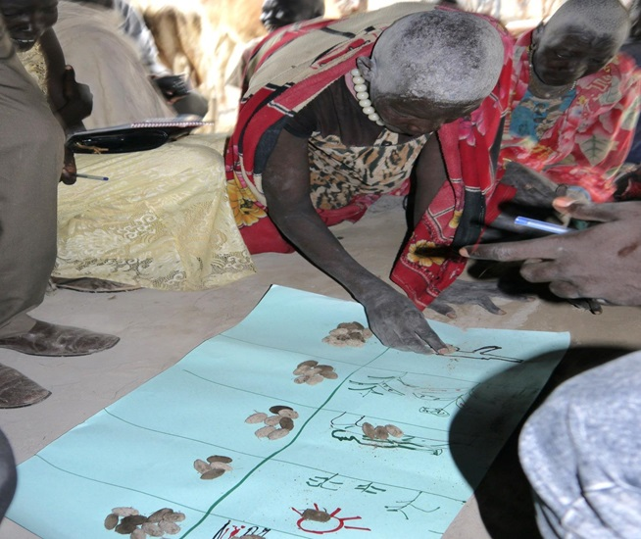

II. Key progress made so far
Output 1.1: Community Disasters Risk Reduction & Planning Capacity
Community mobilization and CMDRR meetings in all target cattle camps to identify main disasters, vulnerability analysis & CMDRR plans developed
Hazard
Ranking
Notes:
Main disasters identified include:
Conflict, Livestock diseases, Drought, Human diseases, Crop pests and diseases
awareness meetings with the state & counties stakeholders to introduce the project;

Slide 7
Key progress Cont..
Community action plan implementation
  22 CAHW & 3 partners trained in collaboration with partners (IIIRR & NPA, SMARF) for 2 weeks on Animal Health and 22 supported with VET KIT
  Animal vaccination and treatment on going targets as Table below:
Types of animals | Target | To date | # of HH Benefiting
Cattle | 450,000 | 334,930 | 15,224
Shoat | 75,000 | 84,308 | 3,832
Dogs | 290 | 110 | 110
Notes:
Remarks
Anthrax, HS
PPR
Rabies

Slide 8
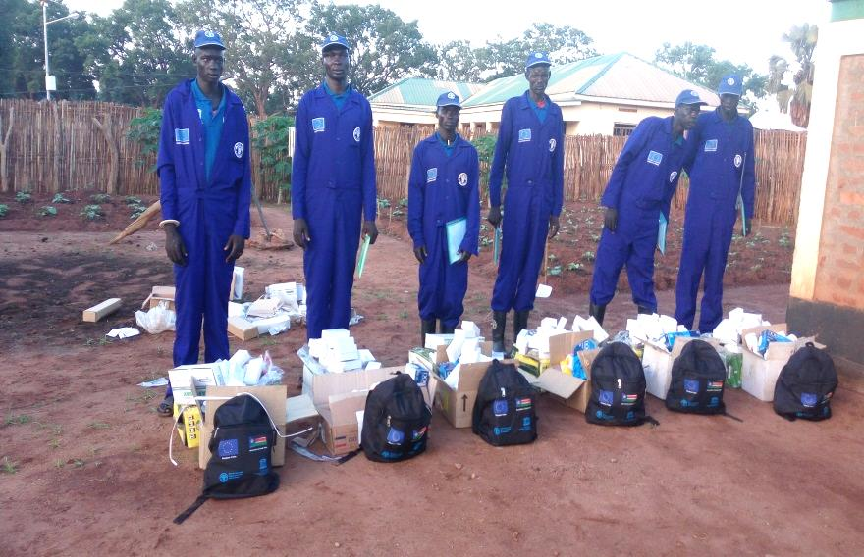
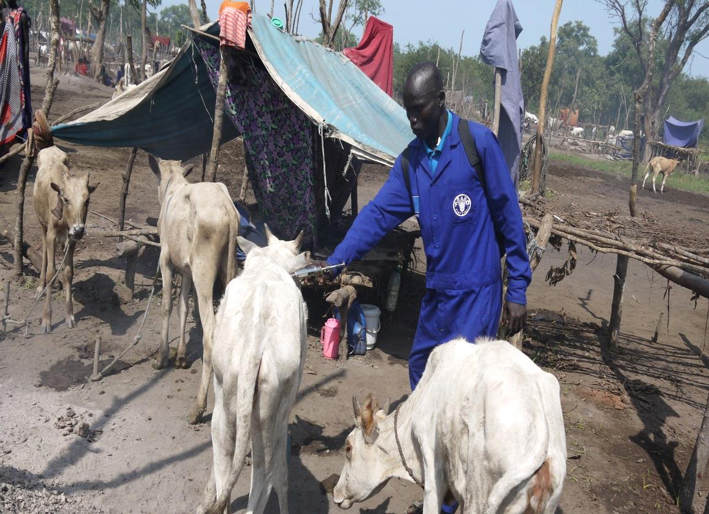
Key progress Cont..
CAHW kits
Vaccination

Slide 9
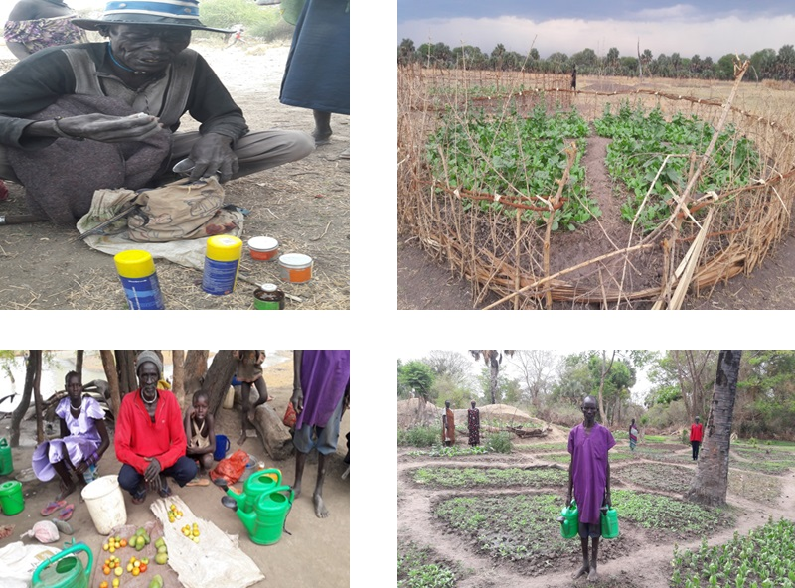
CMDRR plans implementation

Slide 10
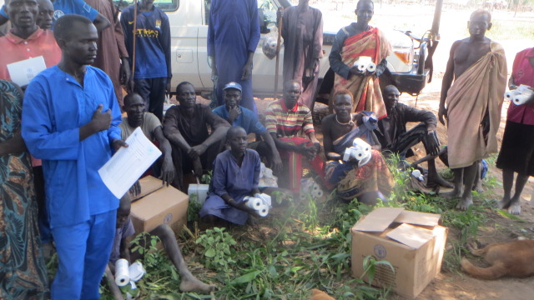
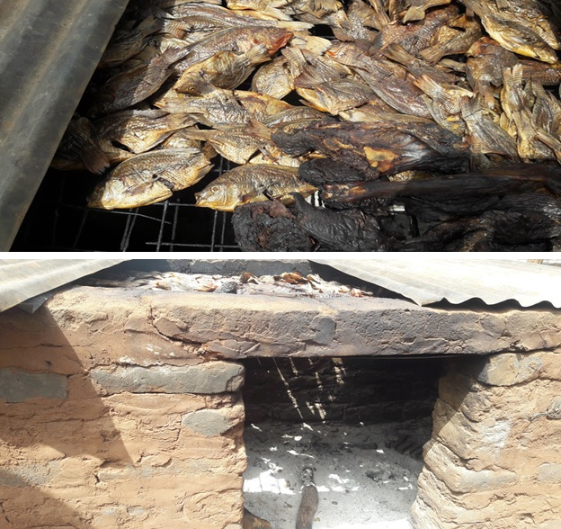
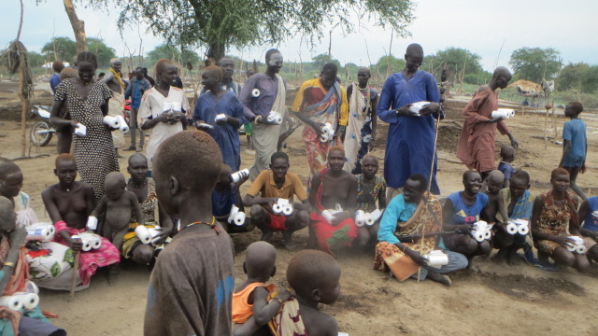
CMDRR plans

Slide 11
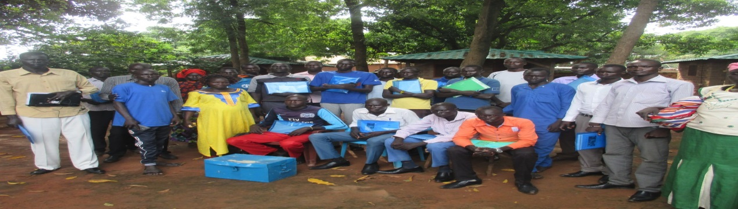

Key Progress
Output 1.2: Livelihoods & income sources among the target communities are diversified and enhanced
Organized workshop to adopt VICOBA to cattle camp context
Trained 33 facilitators on adapted VICOBA approach 16 VICOBA groups formed & provided with kits
Notes:
VSLA kit ( contains a metallic box, 3 money bags, 30 pass books, a calculator, a ledger book, a ruler and pens)

Slide 12
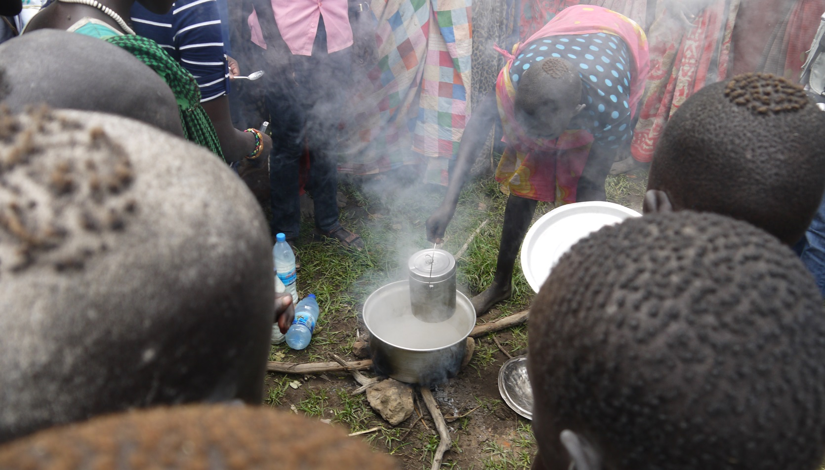
Key Progress cont..
Milk hygiene and handling training ongoing in the cattle camps

Slide 13
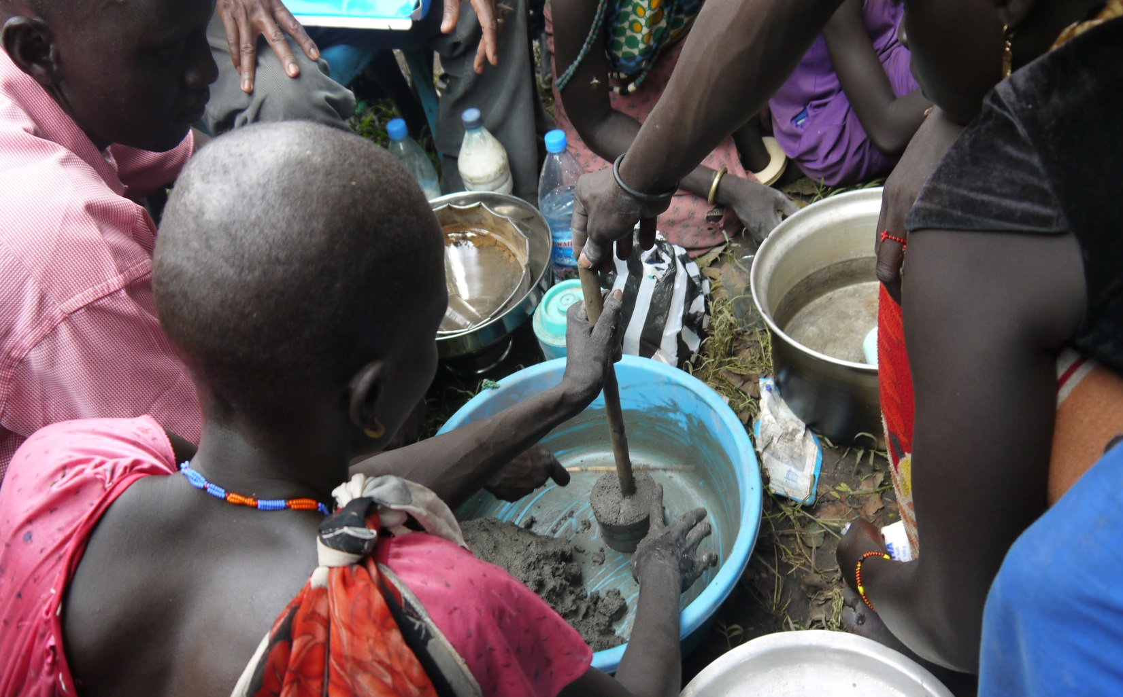
Key Progress Cont..
Making of mineral lick blocks training ongoing in cattle camps

Slide 14

Key progress
Output 1. 3: Skills, strategies and education essential for resilient pastoral livelihoods acquired by target communities
33 Community Facilitators/Teachers (2 female) trained for 8 weeks in total on PLEFS curriculum
32 learner groups in 10 cattle camps and one special community established and functioning
A total of 1647 (419 Female and 1228 Male) learners including children, youth & adults are attending learning sessions in the cattle camps.
Center management committees (CMC) formed & trained to support learning
Training of facilitators/teachers on connect teaching mobile application done
Notes:
429 (340 boy and 89 girl) are children;
752 (592 boy and 161 girl) are youth; and
466 (297 Male and 169 Female) are adult learners.

Slide 15
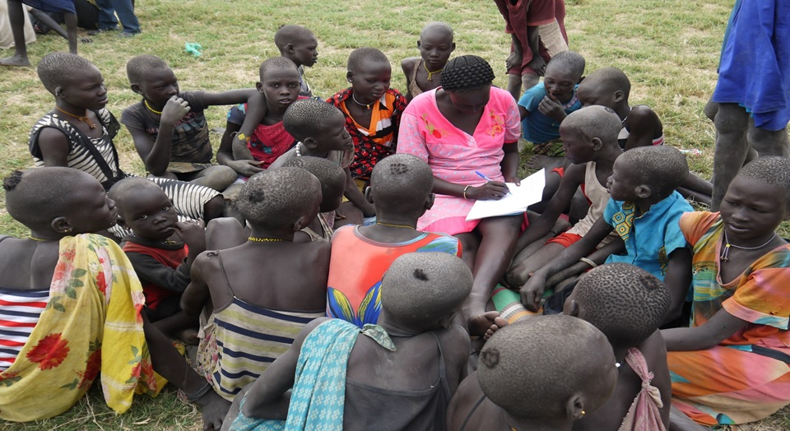
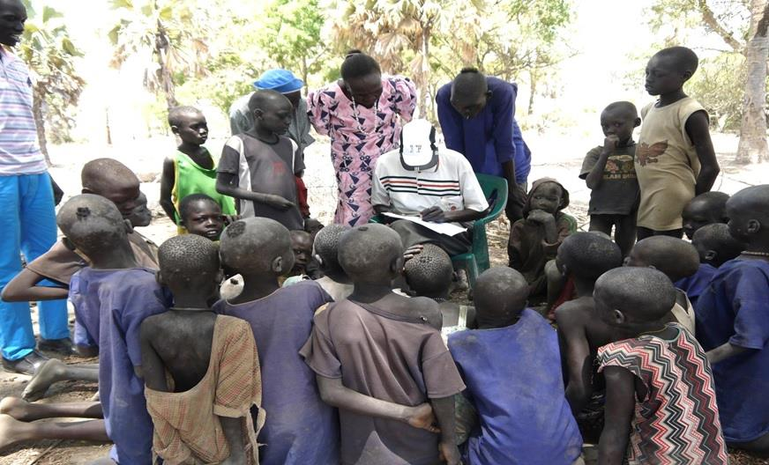

Key progress: Learners Registration

Slide 16
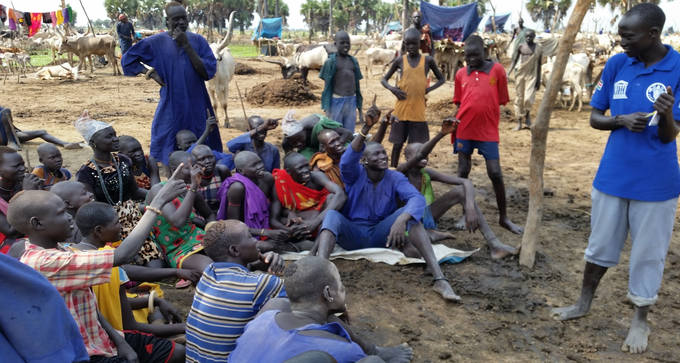
Key progress: Learning in cattle camps
Notes:
awareness meetings with the state & counties stakeholders to introduce the project;

Slide 17
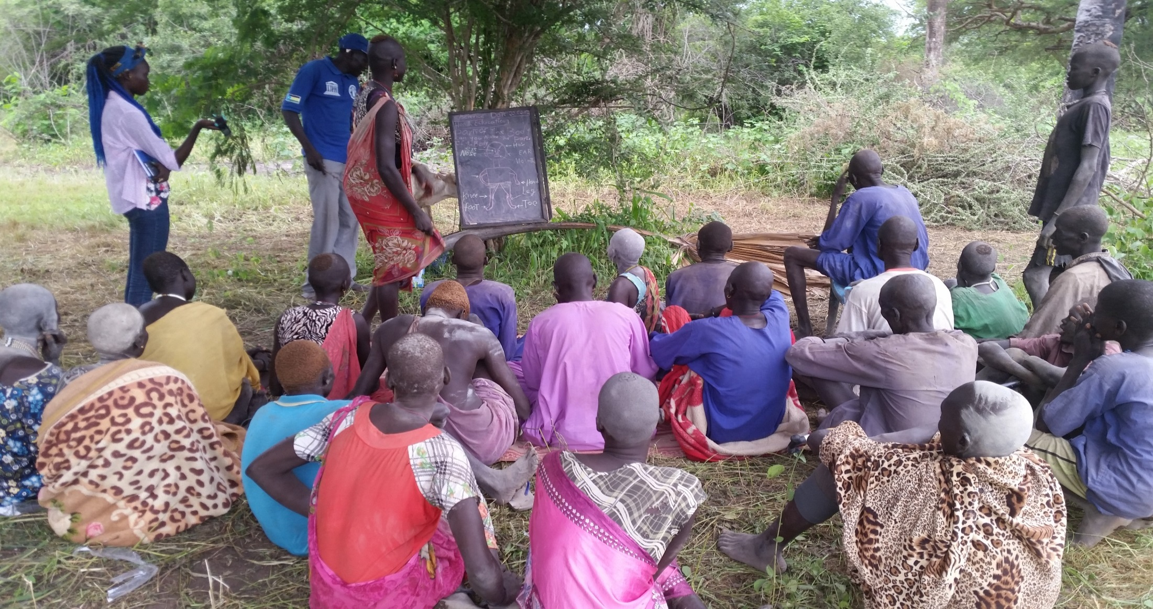
Key progress: Learning in cattle camps

Slide 18
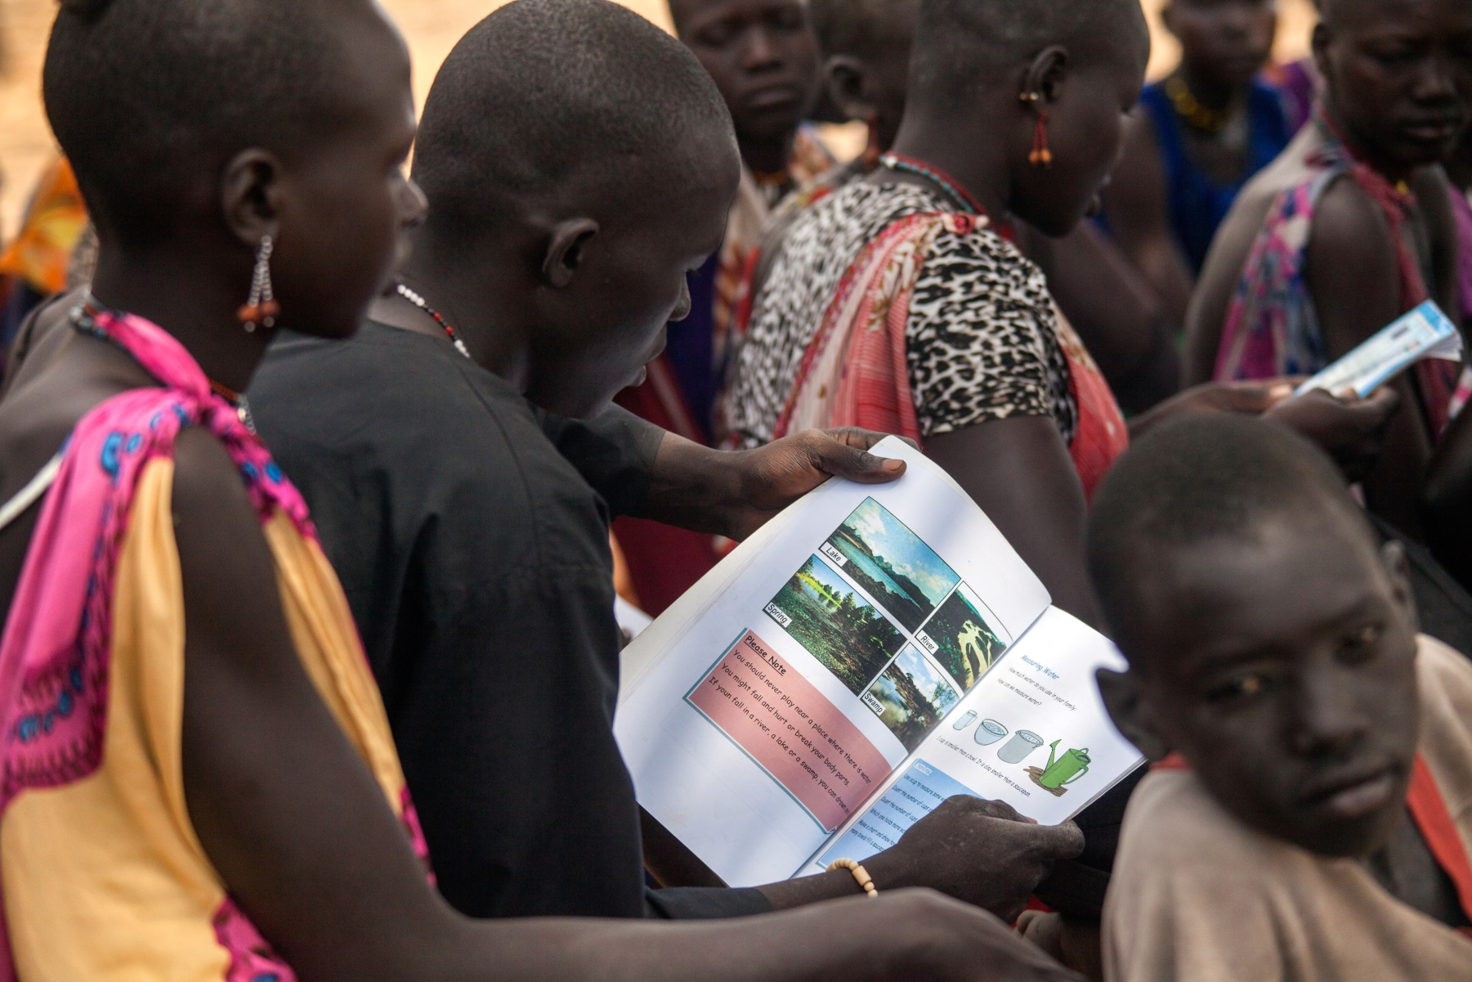
Key progress: Learning in cattle camps

Slide 19
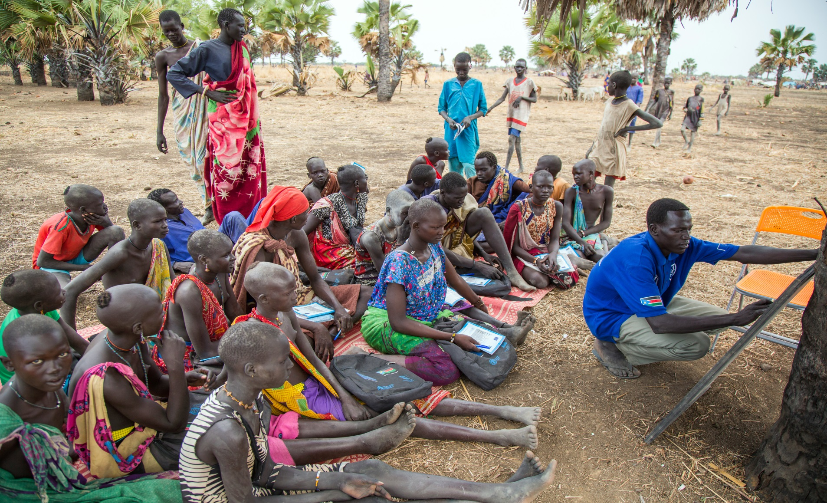
Key progress: Learning in cattle camps

Slide 20
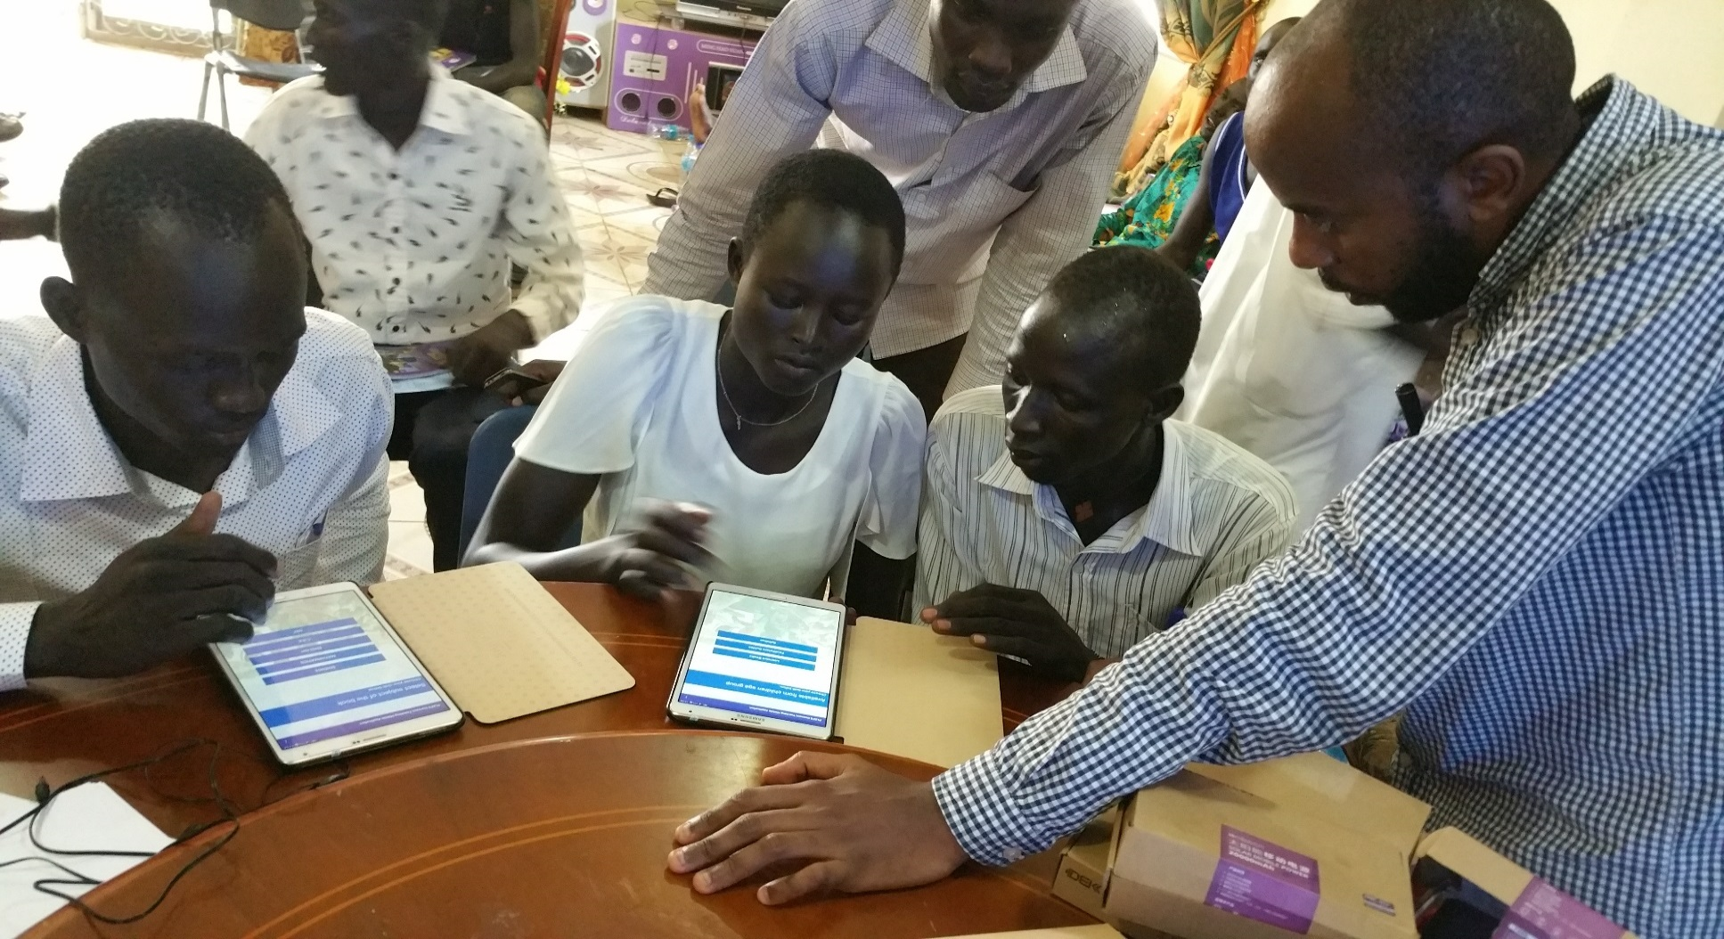
Training on connect teaching mobile applications

Slide 21

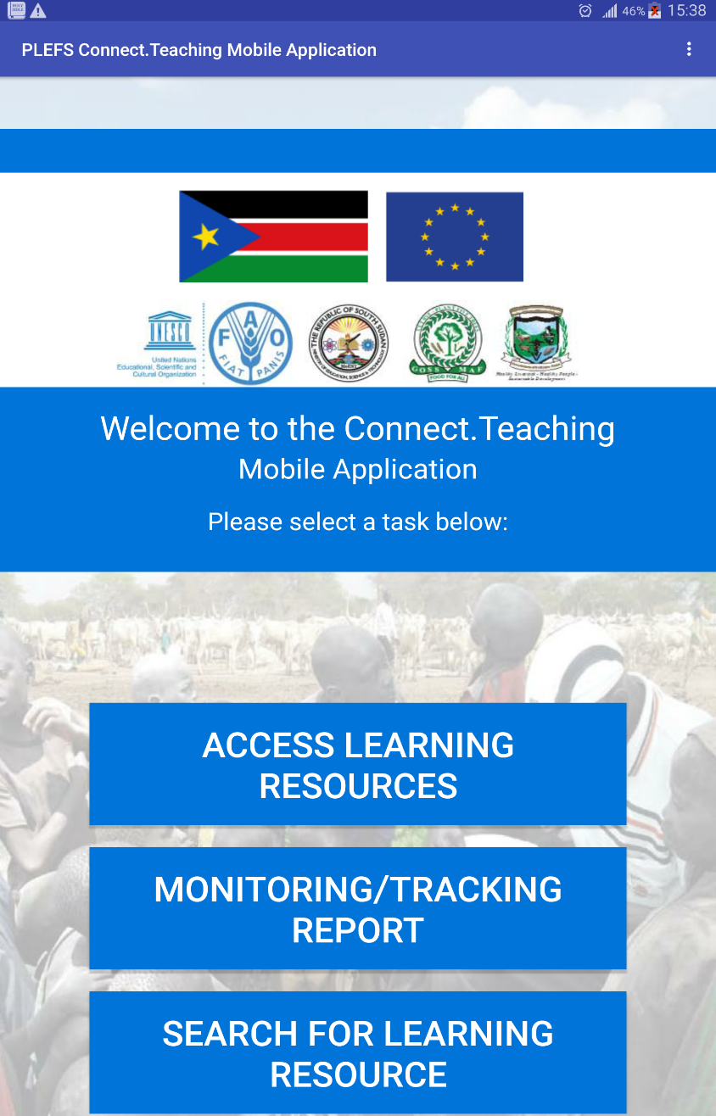
Connect.Teaching Mobile App

Slide 22
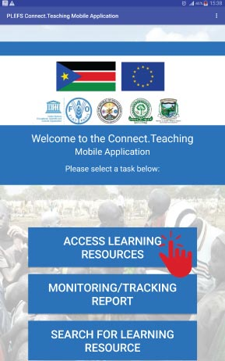
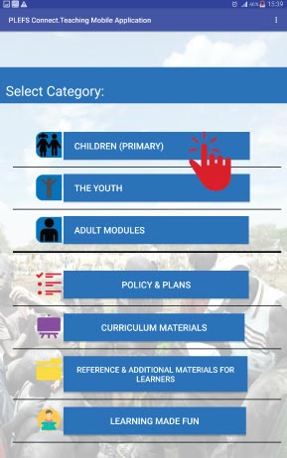

Slide 23
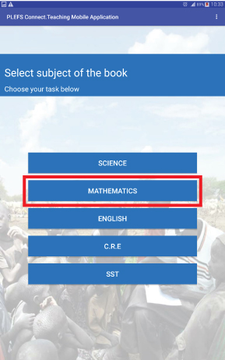
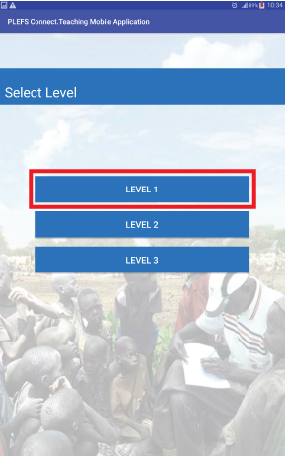

Slide 24
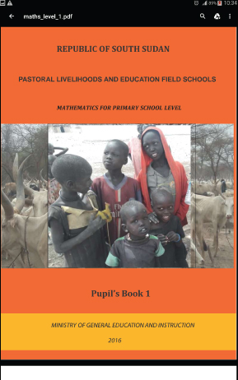
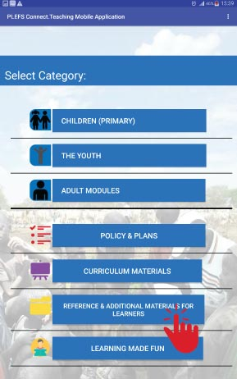

Slide 25
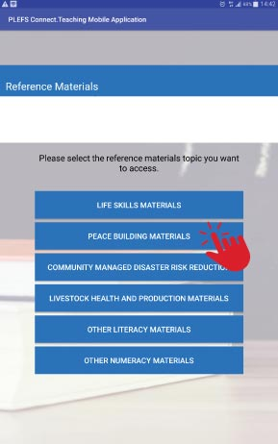
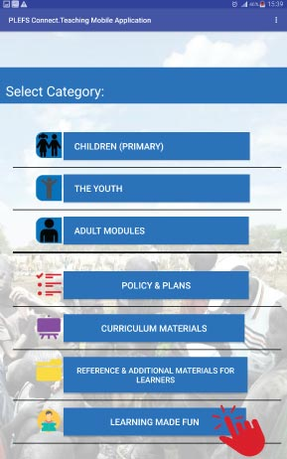

Slide 26
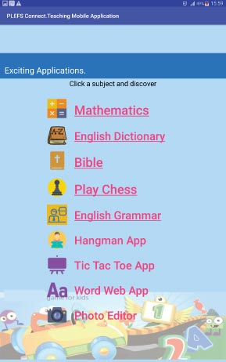

Slide 27
Key Progress Cont..
Output 2.1: A replicable model for enhancing skills, strategies and education for resilient pastoral livelihoods is jointly developed with the relevant institution
Geographic & Demographic Survey conducted
Awareness and educational Radio Program with Radio Good News in Rumbek launched and on air 1x week
Curriculum for the pastoralist Livelihood and Education Field Schools (PLEFS) developed validated and is on piloting

Slide 28
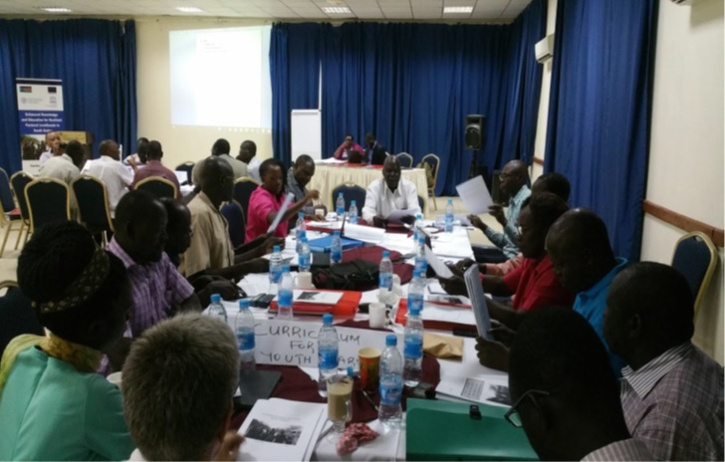

Key progress Cont.
Curriculum Validation Workshop 6-7th April 2016:

Slide 29
Key progress Cont..
Output 2.2: Ability of relevant institutions to effectively coordinate service delivery system is enhanced
State and National Technical working Groups (TWG) established and regular meetings conducted
County level supervisors trained in PLEFS curriculum and equipped with Motorbike to ease supervision
A Monitoring & Evaluation (M & E) tool developed for PLEFS
Capacity building trainings on M & E conducted to TWGs and county Supervisors
Line ministry staff at national and state level participated in monitoring activities.
Exposure visit of National and State level TWG members to Kenya and Uganda conducted

Slide 30
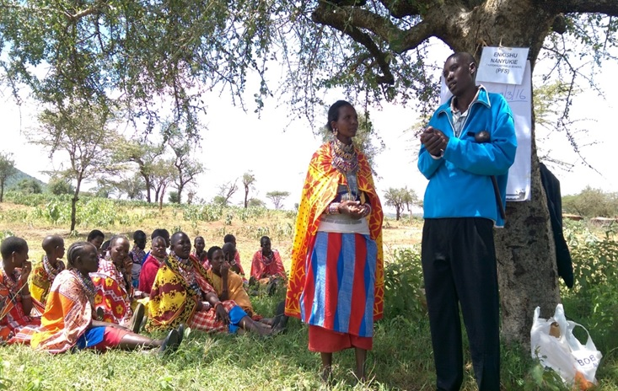
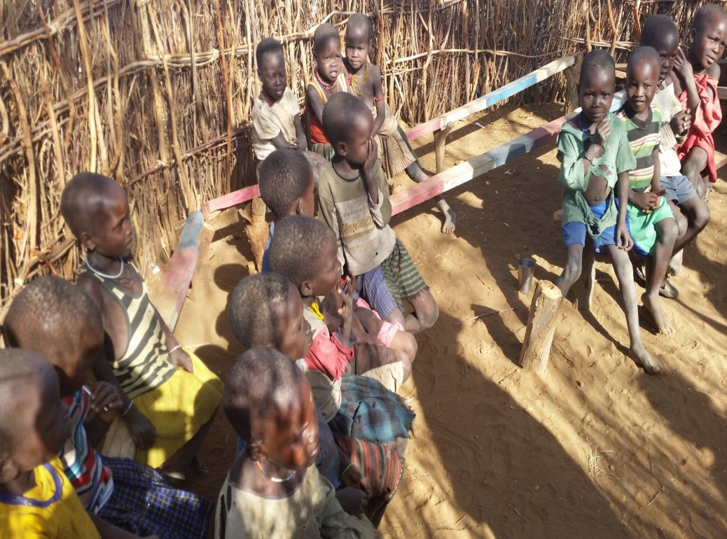
Key progress Cont..
Activity: Create opportunities for exposure visits

Slide 31
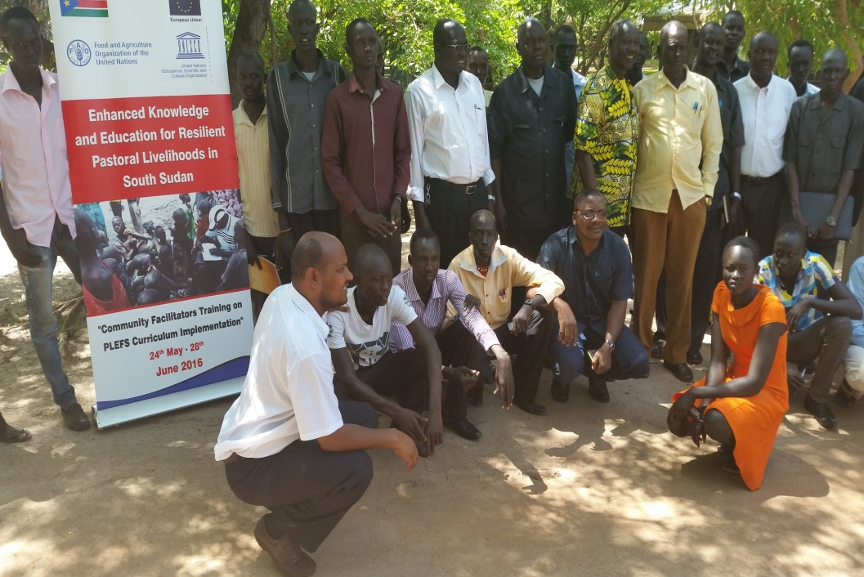
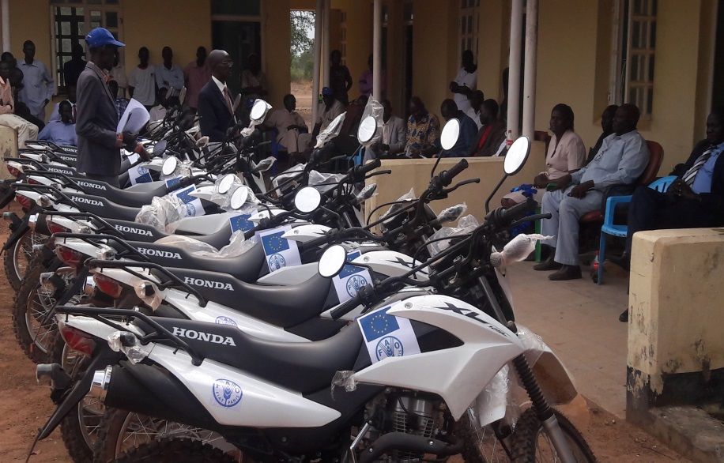

Key progress Cont..
County supervisors training
Motorbike handover

Slide 32
III. MAIN CHALLENGES
Insecurity due to cattle raiding, revenge killing and criminal activities on the highways
Splitting of cattle camp due to frequent movements (pasture, water and insecurity)
Livestock diseases outbreak, e.g Food and Mouth
In accessibility of cattle camps and rough road conditions
Hyper Inflation
Inefficient banking process

Slide 33
IV. Lessons learnt
Incorporation of the practices from exposure visit in Kajiado and Karamoja in the current PLEFS activities (making of Mineral lick Blocks, re-usable sanitary pads & Center management committees)
Seasonal movement of pastoralist provide them with diverse livelihood opportunities
Selection of facilitators from cattle camps is crucial
Facilitators Refresher Training enhance self confidence and better understanding of teaching methods
Joint inter-ministrial curriculum development process enhanced ownership
Literacy and numeracy interventions enhances youth and adult participation in livelihood activities such as VICOBA/VSLA
Youth participating in learning sessions are more peaceful and children are said to be disciplined as per CMC observation

Slide 34
V. Way forward
Continue CMDRR plan implementation
Continue with learning sessions in cattle camps
Supporting income generating activities and livelihood diversification
Supporting regulatory frameworks for PLEFS approach
Promotion of PLEFS approach at national & regional levels
Standardization of curriculum following ongoing testing
Establishing pool of trainers
Advocacy for scale up of PLEFS to other cattle camps in Lakes and to other pastoralist communities in South Sudan

Slide 35
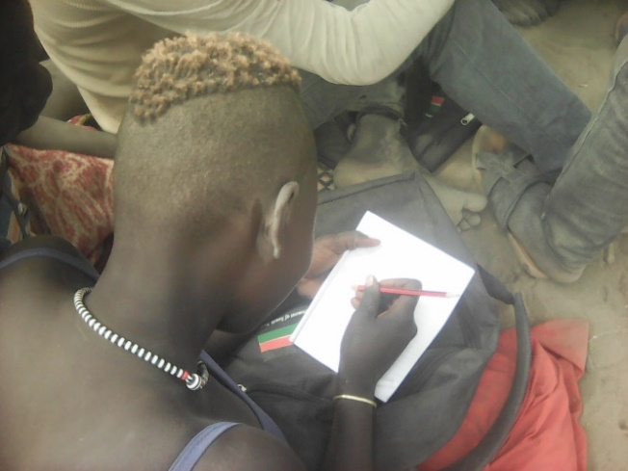
Success stories
Yom Makat Alak just like other youth girls enrolled counts her benefits from the PLEFS program. Yom says, I never attended school in my life time. The literacy classes introduced in our cattle camp has given me a great opportunity to recover my lost opportunity to attain education.
After learning for about 7 months, I have gained skills in reading and writing. I am now able to read pieces of work in book on my own. I am also able to write my own name and names of other people in the VSLA group. I can also dial and make calls which was not there before I was enrolled in the project. Because of my writing skills, I was elected to serve as the secretary of the group.

Slide 36
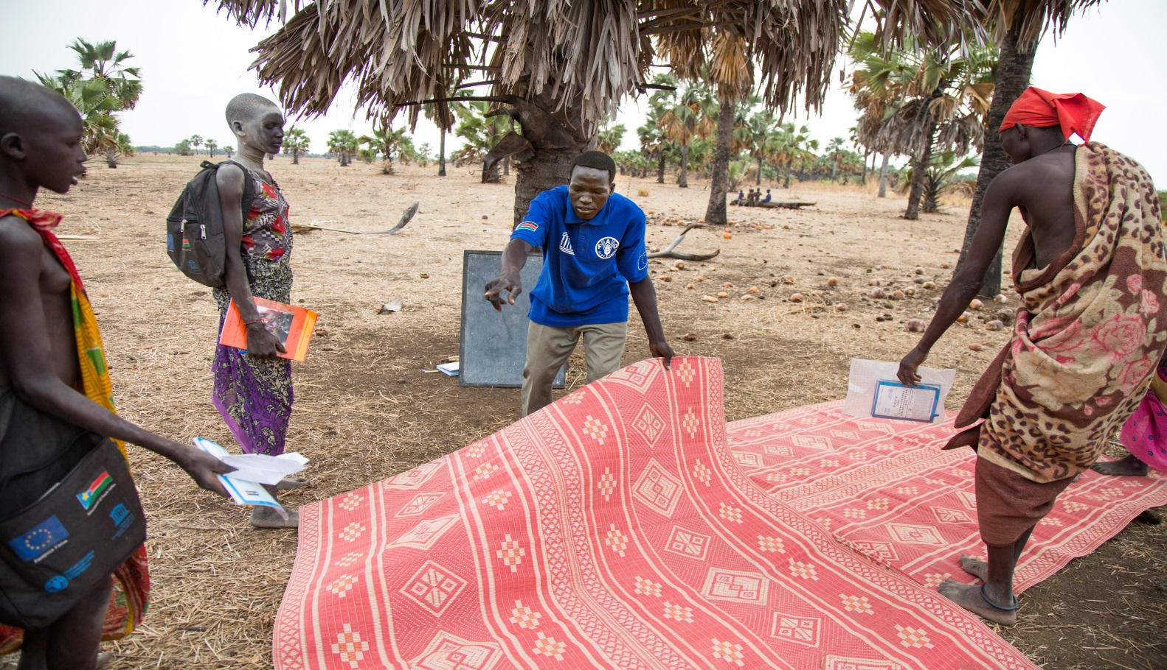
Cattle camps as
Learning Space
Funded by the European Union
Government of South Sudan
Thank you

