Slide 1
Lessons from SORUDEV Project: Experiences of HARD in WBeG State
By
Dennis Ochieng and Dominic Kparivuru
Hope Agency for Relief and Development (HARD)

Slide 2
Outline of the presentation
Recap of the SORUDEV framework,
Lessons learnt from SORUDEV project implementation (7 key lessons),
Conclusion.

Slide 3
1. A recap of SORUDEV framework

Slide 4
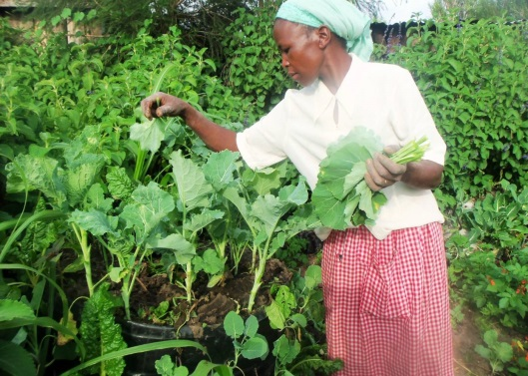
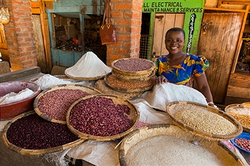
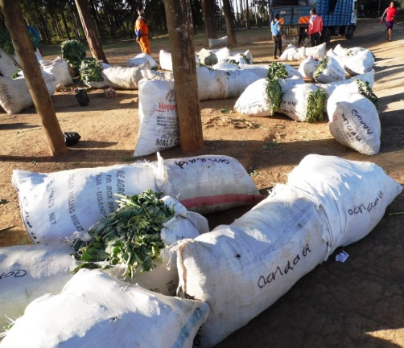
Lessons from implementation:
On effective extension: The localized bottom-up approach (CORPS, CAD)
Building capacity of community extension staff to complement Government extension services – (CORP training and deployment, input sourcing, production and marketing).
Encourages knowledge retention and sustained gains in extension reach.

Slide 5
Lessons from implementation cont…
2. From relief to development approach
Through dialogue and continuous sensitization, farmers are able to invest in agriculture with less reliance on relief interventions (e.g. purchase of animal traction equipment).
Farmers can gradually transition from aid-dependence to market-oriented systems of farm input acquisition, food production and marketing.

Slide 6
Lessons from implementation cont…
3. Private sector led input provision: The key to sustainability
Strengthening capacity of agro-dealers to provide inputs to farmers at market price (e.g. linking them to farmers; transportation of ox-ploughs)
Farmers can slowly begin to purchase inputs at market price (e.g. ox-ploughs, seeds, spare parts;650 ox-ploughs sold through agro-dealer).

Slide 7
Lessons from implementation cont…
4. Lessons on project design: Maximizing value for money
Need to focus on key intervention areas, channel resources there for better outcomes
Retrospectively, increasing agricultural production was our main strength.

Slide 8
Lessons from implementation cont…
5. Flexibility in strategy: Lessons from negative externalities
Insecurity and worsening economic situation disrupted project activities i.e. displacement of beneficiaries.
Response: shifting to other locations and getting new beneficiaries (requires a balance between relief and development approaches).

Slide 9
Lessons from implementation cont…
6. VSLA approach: Strengthening the gains
Successful adoption recorded – 49 active VSLAs before the conflict.
The conflict eroded the gains – default on loans.
Future agricultural loans to farmers could be staggered into phases depending on activities to minimize fungibility of funds and scale up intended investments.

Slide 10
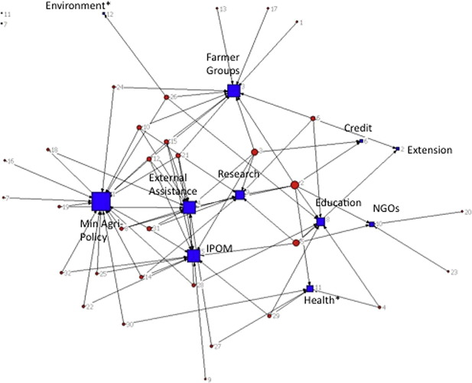
Lessons from implementation cont…
7. Coordination with other partners:
Well coordinated with other SORUDEV, ZEAT-BEAD and food security partners. This avoids duplication of activities by NGOs.
The quarterly meetings are useful to standardize approaches and share ideas.

Slide 11
Conclusion
Future interventions could be better informed by the lessons learnt and disseminated through: Stakeholder workshops; publications (i.e. handbooks, on-line resources); partners meetings.

Slide 12

Thank You/Shukran Lek

