Slide 1


The European Union’s Food Security Thematic Programme for
South Sudan
Food security through enhancing sustainable agricultural production
(FESAP) Gogrial East and West Counties, Gogrial State – South Sudan
Project duration-8August2014-8November 2017
Implemented by VSF-Germany in partnership with SEDA and INFRAID
VSF-GERMANY FSTP PRESENTATION

Slide 2
OVERALL OBJECTIVE
To contribute to increased food security, reduced vulnerability and enhanced livelihoods of rural communities by supporting household subsistence farmers in Warrap State of South Sudan
R1 : Increased agriculture production and productivity through strengthened extension services and innovative farming.
R2: Animal traction is adopted as a viable, cost-effective and sustainable technology and contributes to annual increase in cultivated farmed land, improved tillage and increased productivity per acreage.
R3: Increase in household income as a result of access to microfinance, local markets, and linkages to value chain actors.
R4: Increased resilience to shocks in climatic/ environmental changes and manmade disasters such as conflict.

Slide 3
Current project status
Project closure phase
Impact assessment, End-term evaluation concluded-reports to be shared with the Final Project Report.
Final Audit ongoing

Slide 4
Result1 : Increased agriculture production and productivity through strengthened extension services and innovative farming.
Lead farmers significantly extended their farm sizes by 150% – 400% over the project period through adoption of animal traction and strengthened extension services.
A greater proportion of the beneficiaries (47%) increased their farm sizes compared to a limited proportion (18%) of the control group.

Slide 5
Result 1-contd….

Slide 6
Result 1-contd

Slide 7
Result1-contd
Influence of farm expansion on food production
Nature of Influence | Frequency | %
Increased availability of food at household level | 112 | 39.4
Extra food available for sale | 74 | 26.1
Increased crop production | 58 | 20.4
Reduced costs | 19 | 6.7
Others | 21 | 7.4
Total responses | 284 | 100

Slide 8
Result1-contd
Mean G/nuts production at HH level
Payam | Ground-nuts in Harvest Kilograms
 | 2014 | 2015 | 2016 | % Change 2014 to 2015 (Harvest) | % Change 2015 to 2016 (Harvest) | % Change 2014 to 2016 (Harvest)
Kuac North | 323.10 | 406.9 | 692.10 | 25.9% | 70% | 114%
Kuac South | 328.61 | 689.39 | 1066.25 | 109.78% | 54% | 224%
Toch North | 321.19 | 438.09 | 735 | 36.4% | 67.7% | 129%
Pathuon East | 313.45 | 405.08 | 711.16 | 29.20% | 75% | 127%

Slide 9
R2: Animal traction is adopted as a viable, cost-effective and sustainable technology and contributes to annual increase in cultivated farmed land, improved tillage and increased productivity per acreage.
Variance in sorghum productivity versus farm size

Slide 10
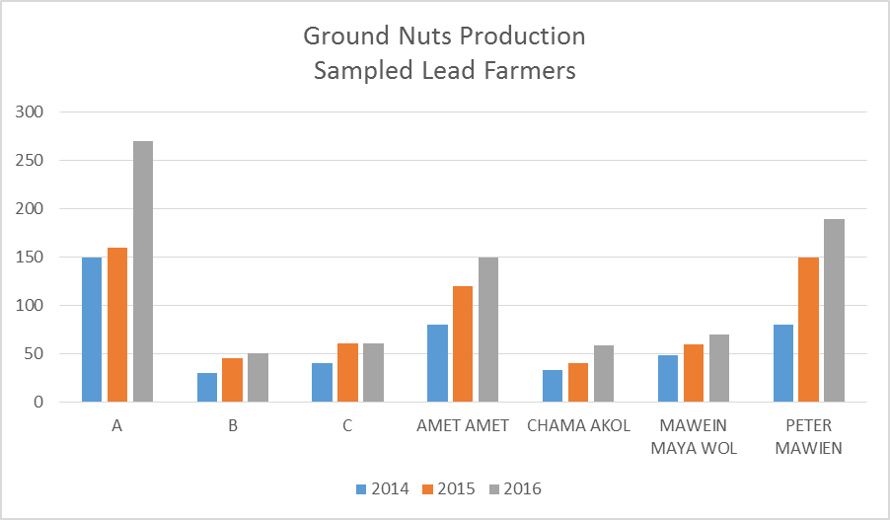
Result 2-contd…..

Slide 11
Result2-contd
SURPLUS CROP PRODUCTION

Slide 12
Result2 -contd
Seed source in year 3
Source | Frequency | %
Selected from your previous crop | 168 | 52.8
Shop in local market | 113 | 35.5
From neighbors | 37 | 11.6
Total | 318 | 100.0

Slide 13
Result 3-Increase in household income as a result of access to microfinance, local markets, and linkages to value chain actors.
Household income source

Slide 14
Result3-contd
Adoption of savings through ASCAs at household level

Slide 15
Result3-contd
Household income use

Slide 16
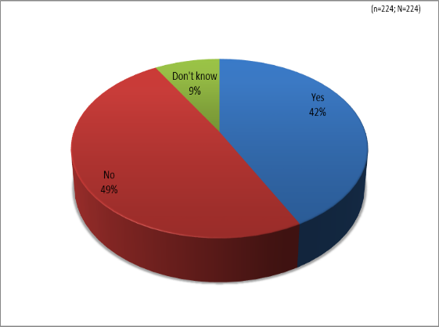
Result 4-Increased resilience to shocks in climatic/ environmental changes and manmade disasters such as conflict.
42% of beneficiary HHs were food secure by the end of the project compared to 7% of non-beneficiary HHs.
The updated FESAP baseline on the food security status denoted that harvested foods lasted only for 2-3 months (hunger gap of 9 months) while the impact evaluation, shows that a significant proportion of the beneficiary respondents (42%) harvested enough to last them to the next season.
Hunger Gap reduction

Slide 17
Lessons learnt
Livelihood diversification initiatives have proved to be viable schemes for enhancing the scope for coping with food insecurity and livelihoods vulnerability (to a large extent related to low crop production and productivity linked to inaccessibility of seed and planting materials when needed), this in turn significantly contributing to increased resilience of the beneficiary communities;
Promote the establishment of woodlots to counter the adverse effects of the local community’s poor harvesting of trees;

Slide 18
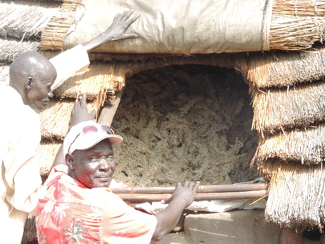
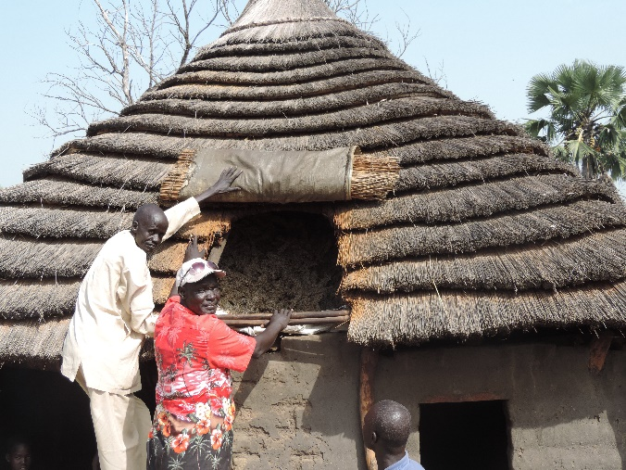
.Farmers increasing their storage space due to increased crop production.

