Slide 1


Improving
Food Security & Nutrition Project
Major Achievements & Key Learning
Presentation on 7th QRM of
EU Partners in South Sudan
November 22-23, 2017
Juba
European Union

Slide 2
Project Background
European Union
Project Name: Improving food and nutrition Security for Vulnerable groups in Warrap State
Project Duration: 36 Months, Started : November 1, 2014 & Ended : October 31, 2017
Project Budget: 1,500,000.00 EUR
Operation Area : 4 Counties, 8 Payams & 16 Bomas
Project Target:- 7,000 HHs with 42,000 family members.
Implemented by : WVSS & THESO
Overall Objective: To improve food security and nutrition for vulnerable groups in Warrap State, South Sudan
Result 1 : Strengthened farmer groups and build networks among farmer groups.
Result 2 : Increased crop yields, farm income and reliability of agricultural production
Result 3 : Improved utilization of food, particularly for pregnant and lactating mother and children under 2

Slide 3
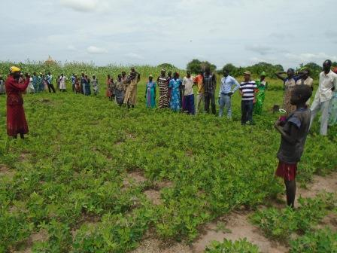
Group Extension
European Union
:
Farmer Field School( FFS) : 50 FFS organized and facilitated ( Plan = 40)
Farmer Demonstration ( F-2-F) : 50 demonstration plot established and facilitated ( Plan = 40 )
Farmer Field Days : 40 farmer field days organized for consolidating the learning. ( Plan = 40)
Good group learning on some of the key farming problem.
Good level of adoption of improved farming practice.
Observed Result
Top Pic: Farmer demo in Tonj North
Down: Field Day in Tonj North

Slide 4
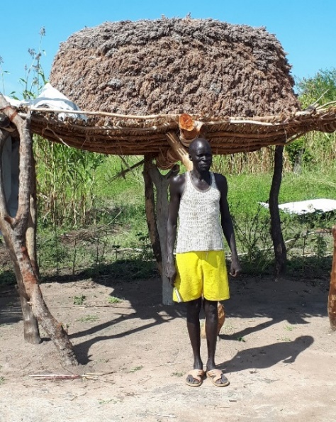
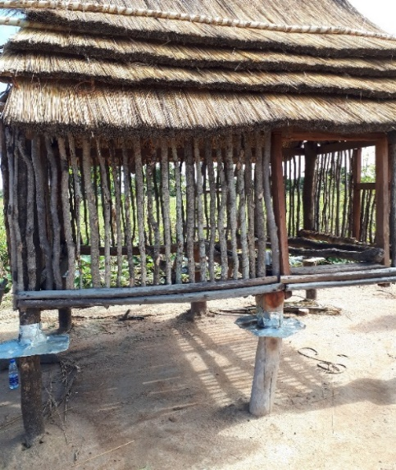
Seed Multiplication
European Union
:
Rational: Improve access to seed, Modality for group extension-encourage both individual and group learning.
Learning;
Achievement; Almost all farmers group received seeds of G/nuts , Sorghum & sesame
Modality; Used group approach, Seeds purchased locally, Seed paid back in kind after harvest. ( 85% repayment)
Next action; Considering the key learning from this project, variety improvement for open pollinated sorghum launched using 5-10 the best sorghum Varity in Warrap.
Improves group learning, Encourage the local seed supplier, Seeds distributed timely & Cost effective.
Top: Seed multiplication in GW County
Down: Traditional & Improved storage in TN County

Slide 5
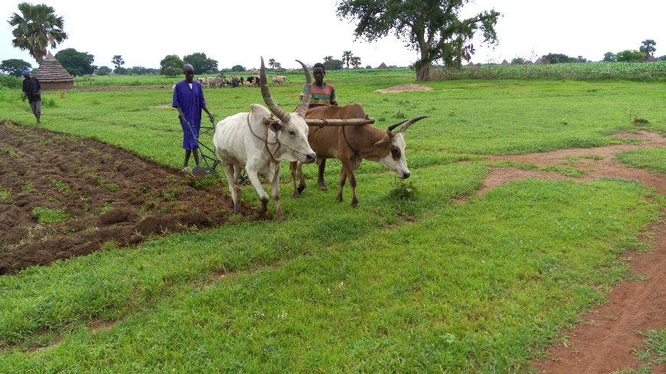
Farm Tools & Ox-plough Distribution
European Union
:
150 Ox-plough purchased and distributed for 150 farmers groups. ( Plan = 150 ox plough)
Farm tools ( 5 Hoe & 5 watering cane) for 6o farmer group ( plan = 40 groups)
Key Learning;
It is possible to increase production by increasing area under cultivation through provision of farm tools.
Farmers Group using ox-plough for land cultivation in Gogerial West County

Slide 6
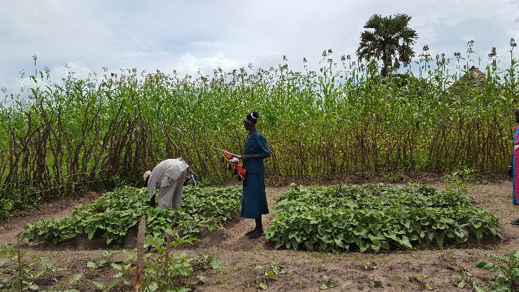
Mother Garden Development
European Union
:
112 Mothers trained & supported (Project plan was 100) for establishment of mother garden.
WV : Improving Knowledge & skills of vegetable growing.
THESO: Improving knowledge and skills of vegetable utilization.
Partner Role on Integration;
Key learning;
It is possible to integrate food security and nutrition at HH level.
Top: Mother garden 10 x 12 design
Cooking demonstration in Twic & Mother garden in TN County

Slide 7
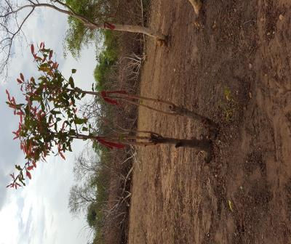
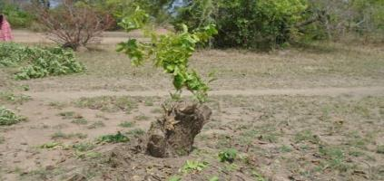
FMNR: Farmer Managed Natural Regeneration
European Union
:
Properly clearing bush and unwanted trees together with proper pruning of trees will speed up trees growth.
Mass awareness : 320 HHs( 134 F )
Importance of retaining useful trees on farm land rather than clearing all.
Training for farmer group : 38 groups
This project did the introduction and promotion of FMNR to South Sudan.
FMNR closed area : 20 closed area( project plan was 20
ToT for Gov’t & Project staffs : 19
Key learning:
Tree stamps rehabilitated through FMNR( Top –Tonj North & lower Gogerial West)

Slide 8
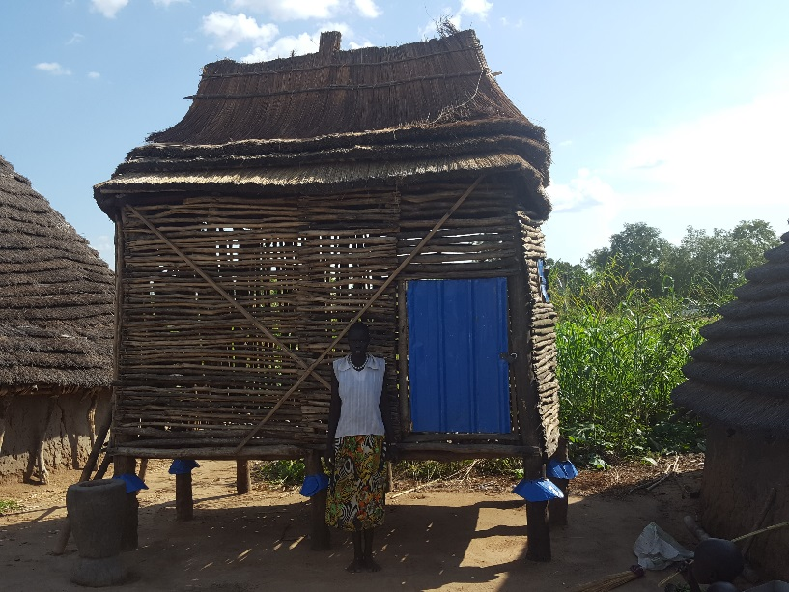
Construction of Improved granary
European Union
Assessment Done, other partner experience. Design prepared;
Implementation : at HH level with cost sharing modality
Modality:
Improved the design in such a way it will be low cost and easily replicated
:
16 Improved grainer constructed.( Project plan was 8)
Key Learning:
So far a lot of farmers replicated the improved grainer by their own.
Decrease the crop loss by 20-30%

Slide 9
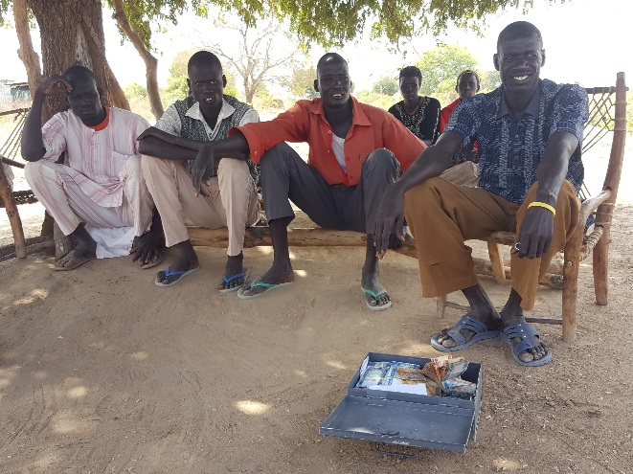
Village Saving & Loan Association
European Union
VSLA Member on monthly saving in Gogerial East County
Training given for 50 farmers group
Poor people have the capacity to save even though it is small.
Modality
VSLA Kits support for 40 group
Key learning:
Possible to establish financial institute in rural area just by mobilizing their own saving.
Integrated adult literacy numeracy class
It is possible to ensue ownership and continuity of the service with member capacity building
Technical support during VSLA set up

Slide 10
Evaluation Report: Average Harvest
European Union
Locations | Baseline | MTE | FE | RD1*, p-value | RD2*, p-value | Target
 | (n=643) | (n=337) | (n=300) | (kg increase) | (kg increase)
Sorghum- Avg Harvest (kg/Feddan) | 78 | 51 | 225 | 174, p<0.001 | 147 (188%), p<0.001 | 40%
Ground nut- Avg harvest (kg/Feddan) | 30 | 89 | 140 | 51, p<0.001 | 110 (275%), p<0.001
RD1*: Risk Difference and cluster adjusted p-value to show the significant difference between MTE and FE RD2*: Risk Difference and cluster adjusted p-value to show the significant difference between Baseline and FE p<0.0001 indicated that the risk difference (RD) was statistically strongly significant

Slide 11
Evaluation Report- On Project Indicator
European Union
Objectively verifiable indicators | Baseline | Project Target | MTE | Final Evaluation | Remark
% change in average household food deficit months | 4.33 | 1.33 | 3.88 | 3.09 | ↓↓↓ 1.24
SO: % small holder farmers who report improved capacity for food production: 75 % | 33.5 | 75 | 76.6 | 81.1 | ↑↑↑ 47.5
SO: % of farmer group members who report improved skills to support mother and child nutrition: 0.75 | 52.6 | 75 | 82.1 | 97.7 | ↑↑↑ 45.1

Slide 12
Project Closing Workshop
European Union
Opening of the workshop by A/ZPM
Cooperation that Counts.

Slide 13
European Union
Thank You!

