Slide 1
Thematic seminar on Culture
Brussels, Tuesday 23-25 October 2017
Introduction to Heritage in
development cooperation
Ines ALVES, International Aid Policy Officer – Culture DEVCO B4
International
Cooperation and
Development
DEVCO

Slide 2
Culture in EU development policy
New European Consensus: the primary objective of EU development policy, as laid down in Article 208 of the Treaty on the Functioning of the European Union, is the reduction and, in the long-term, the eradication of poverty.
Tackling discrimination and inequalities and leaving no one behind are at the heart of EU development cooperation policy.
Human Rights Based Approach crosscutting
Culture represents a core component of human, sustainable and inclusive development, and can significantly influence political, economic and social outcomes.
International
Cooperation and
Development
DEVCO

Slide 3
EU policy and Heritage
Joint Communication Culture 2016: Heritage as one of the axes to advance cooperation with partner countries that needs to be protected.
The EU and its Member States, with a Human Rights Based approach, will protect cultural heritage (European Consensus 2017).
New program Investing in Creativity (GPGC 2017), Silk Roads
Heritage rehabilitation can foster economic growth and joint action with partner countries to develop sustainable strategies for heritage protection through training, skills development and knowledge transfer
International
Cooperation and
Development
DEVCO

Slide 4
Heritage and social capital
Heritage: linked to regeneration of urban area and identity/memory & healing/traditional knowledge; tourism and jobs
Heritage may be a tool, medium or space/places of encounters and community hubs to promote social capital (social networks and the trust)
Activities linked to heritage of a group are seen as a means of social inclusion (excluded for socioeconomic reasons, digital exclusion, physical exclusion…) with symbolic meaning
Value of culture enhancing resilience and facilitating recovery through physical infrastructure and urban planning (cities as living space);
Cultural rights and cultural cleansing;
Museums, libraries and heritage sites as "community hubs"; local community involved as narrators; owners and managers of sites have important role.
International
Cooperation and
Development
DEVCO

Slide 5
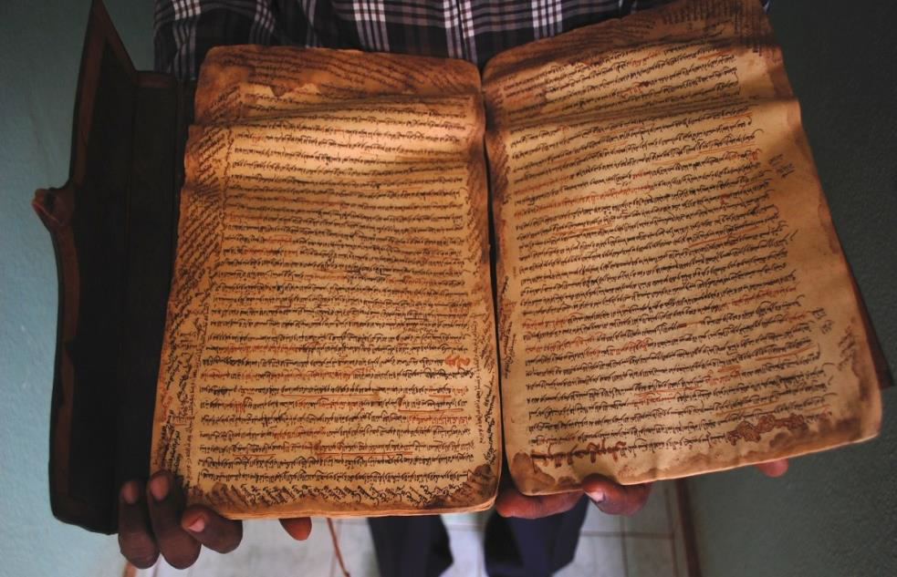
EU funded programmes on Heritage, Mali (1)
Endangered heritage in the Northern regions of Mali: safeguarding, reconstruction, rehabilitation, restoration and revitalisation (2014-2018)
International
Cooperation and
Development
DEVCO
Notes:
The project implemented by UNESCO aims at supporting the Government to rehabilitate cultural heritage (mosques, mausoleums) and safeguard old manuscripts in the region of Timbuktu after the conflict in the country from 2012 to 2013 and the rehabilitation of 3 museums including the main museum of Timbuktu.

Slide 6
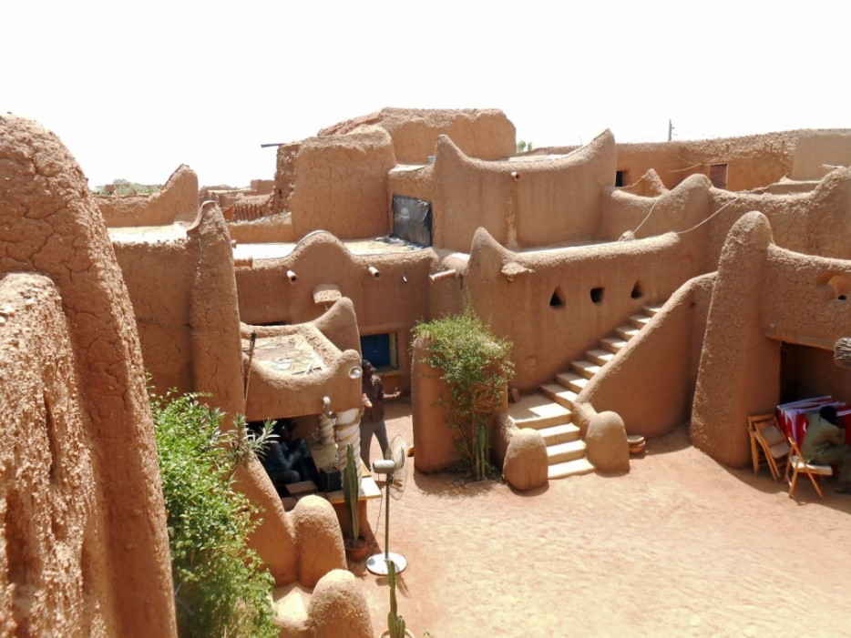
EU funded programmes on Heritage, Niger (2)
Earth based architecture
Identification and preservation; awareness;
Public-private partnerships in culture.
Results
116 people trained (technical and entrepreneurial capacities)
50 jobs created
1 pavilion for earthen architecture built
Network of eco-materials set up
Photo: Restaurant «Le Pilier», Niamey, Niger, 2015
International
Cooperation and
Development
DEVCO
Notes:
Based on the cultural, social, economic and environmental dimensions of earth-based architecture, this project aims to reinforce this “cultural industry” through a series of actions:
- an inventorying and promotion of this cultural tradition in Niger,
- the creation of an exhibition gallery in the Boubou Hama Museum in Niamey,
- training activities for professionals,
- the creation of an African earth-based architecture network.
The project was designed around six axes:
an inventory of earthen architectural heritage;
creation of teaching tools,
construction and design of earthen architecture pavillon and construction of habitat prototypes within the MNBH;
organization of training for earthen architecture professionals;
organize a series of conferences called "The morning of earthen architecture";
organization of the international conference "The week of earthen architecture".
Among the 116 people trained, we can note the immersion of 15 masons and craftsmen trained on the construction site of the earth Pavilion within the Niamey National Museum ;
The 50 jobs created are partly durable because the project has generated local enthusiasm for the techniques of earthen architecture to the public authorities and the private sector ;
The Earthen Architecture Pavilion is a visible and permanent building, but the organization of a symposium and conferences have also given a new contemporary face to earthen architecture. This promotion helps to explore the economic potential of this sector to attract investors (Luxembourg cooperation has decided to construct its buildings in BTC and learn from the vaults technique for the roofing ; an institutional brickyard project in Niger to build resistant habitats against natural disaster) ;
The established network is active and allows the exchange of knowledge between professionals from different African countries

Slide 7

EU funded programmes on Heritage (3)
In the context of cooperation with 79 ACP (Africa Caribbean and Pacific), the Intra-ACP programme is fully relevant for example for the cinema and audio-visual sector.
Results show a positive impact, namely as regards production capacity, technical skills and quality of the works. Established partnerships have resulted in lasting collaborations and exchanges between operators from different countries, strengthening impact, and taking advantage of synergies in production, technical skills, circulation and market access.
Sudplanète : 22 internet portals managed by local teams
based in 22 ACP countries from a common international
interface www.spla.pro.
International
Cooperation and
Development
DEVCO
Notes:
The Sudplanète project responds well to the global information and promotional needs of culture sector professionals in ACP countries, while additionally contributing to networking activities. 22 websites dedicated to national culture sector operators (for 11 different African countries, 7 Caribbean countries, and 4 Pacific countries), all linked to a common international interface; www.spla.pro. These web sites offers culture sector professionals information, communication and networking tools.
In time, the Sudplanète portal will become a database of information on the artists of the ACP.

Slide 8
    Yemen
The objective of the programme is to promote livelihood opportunities for urban youth through preservation and restoration of cultural heritage.
Reconciliation through memory in Rwanda
Through cultural activities encouraging freedom of expression and creation across the country, the project enlarges space for the psychological healing and social development of people in Rwanda.
Protecting Cultural Heritage and diversity in complex emergencies for stability and peace(IcSP/FPI ) Iraq, Libya, Syria and Yemen
to enhance UNESCO's capacity to respond more rapidly to needs associated with the protection of culture in diversity in complex emergencies
EU funded programmes on Heritage (4)
International
Cooperation and
Development
DEVCO

Slide 9
Useful Links
Capacity4dev http://capacity4dev.ec.europa.eu/
Intra ACP
www.acpculturesplus.eu
Europeaid (grants and procurement)
http://ec.europa.eu/europeaid/about-funding_en
International
Cooperation and
Development
DEVCO

