Slide 1


Brussels, 23 October 2017
Guillemette Madinier
Project Officer, Cultural Diplomacy Platform
The content of this document does not reflect the official opinion of the European Union. Responsibility for the information and views expressed therein lies entirely with the author(s).

Slide 2
EU policy framework for international cultural relations
UNESCO Convention on cultural diversity, 2005
European Agenda for culture and its third pillar, 2007
European Parliament report, 2011
Preparatory Action “Culture in EU External Relations” (requested by European Parliament), 2013-2014
Council conclusions on culture in the EU’s external relations with a focus on culture on development cooperation, 24 November 2015
EC- EEAS Joint Communication “Towards an EU strategic approach on international cultural relations”, 8 June 2016 + Council Conclusions, 23 May 2017
Cultural Diplomacy Platform, 2016-2019

Slide 3
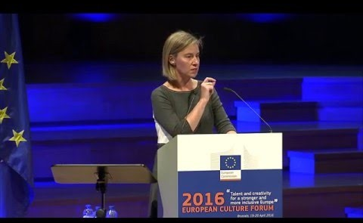
Joint Communication “Towards an EU strategy for international cultural relations”
Main objectives
  Support culture as an engine for sustainable social and economic development
  Promote culture and inter-cultural dialogue for peaceful inter-community relations
  Reinforce cooperation on cultural heritage

Slide 4
Joint Communication - Guiding principles
Promote cultural diversity and human rights
Foster mutual respect and intercultural dialogue
Ensure respect for complementarity and subsidiarity
Encourage a cross-cutting approach to culture
Promote culture through existing frameworks for cooperation
Council Conclusions underlined that
  The EU strategic approach should be bottom-up and respect the independence of the cultural sector.
  International cultural relations can only develop in parallel to embracing the cultural diversity within the EU
  Efforts must be consistent and coherent

Slide 5
Active stakeholders in the field
  Others/CSOs
  networks, foundations, research centres, individual artists, universities international organisations, & all stakeholders in partner countries
EU institutional actors
EP, EEAS, FPI Commission, (EAC, DEVCO, NEAR, etc.), EU Delegations
MSs actors
individual national cultural institutes,
MS’s cultural attachés, EUNIC (100 branches all over the world),
development cooperation agencies, etc.)

Slide 6






The Cultural Diplomacy Platform is an interface for the European Commission, the EEAS and EU Delegations to engage meaningfully with audiences and stakeholders in third countries, in the field of culture.
The Platform is funded by the FPI as a service contract and is run by a consortium of European cultural operators.
Its geographical coverage is global, with a focus on the 10 Strategic Partners: Brazil, Canada, China, India, Japan, Mexico, Russia, South Africa, South Korea and the USA.

Slide 7
Cultural Diplomacy Platform - Management
EU institutions Steering Committee (FPI, EEAS, EAC, DEVCO, NEAR etc.)
+
Programme Managers (FPI.4)
Goethe-Institut (Consortium Leader)
Team Leader
Sana Ouchtati
Consortium members
• British Council
• BOZAR
• ECF
• EUNIC Global
• Institut français
Project Office
• Guillemette Madinier
• Jermina Stanojev

Slide 8
Cultural Diplomacy Platform
Tools
Current areas of focus
Policy support and advice, via mappings, studies, policy papers, assessments and consultation meetings
Thematic workshops, roundtables and seminars on themes of international cultural relations (CH, CCIs, etc.)
Global Cultural Leadership Programme, for young cultural leaders
Website and database
Training modules through video-courses & webinars
Cultural heritage (EYCH 2018)
City-to-city international cooperation
People-to-people exchanges and intercultural dialogue, including with diasporas and migrant communities

Slide 9
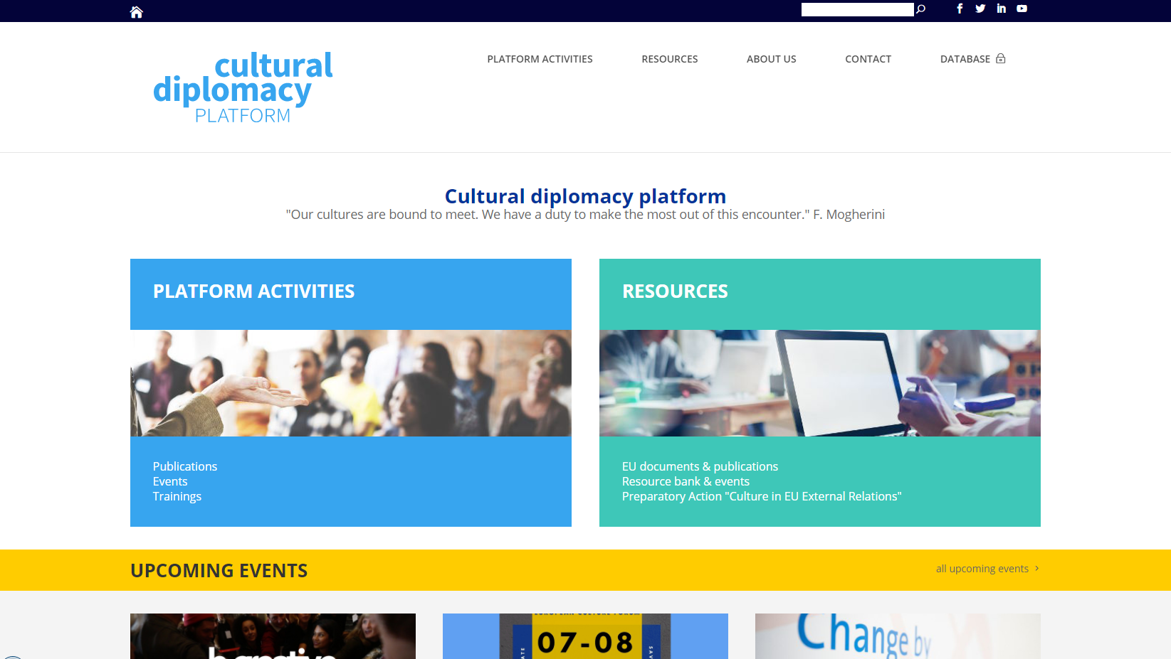
Cultural Diplomacy Platform – Website & Database

Slide 10
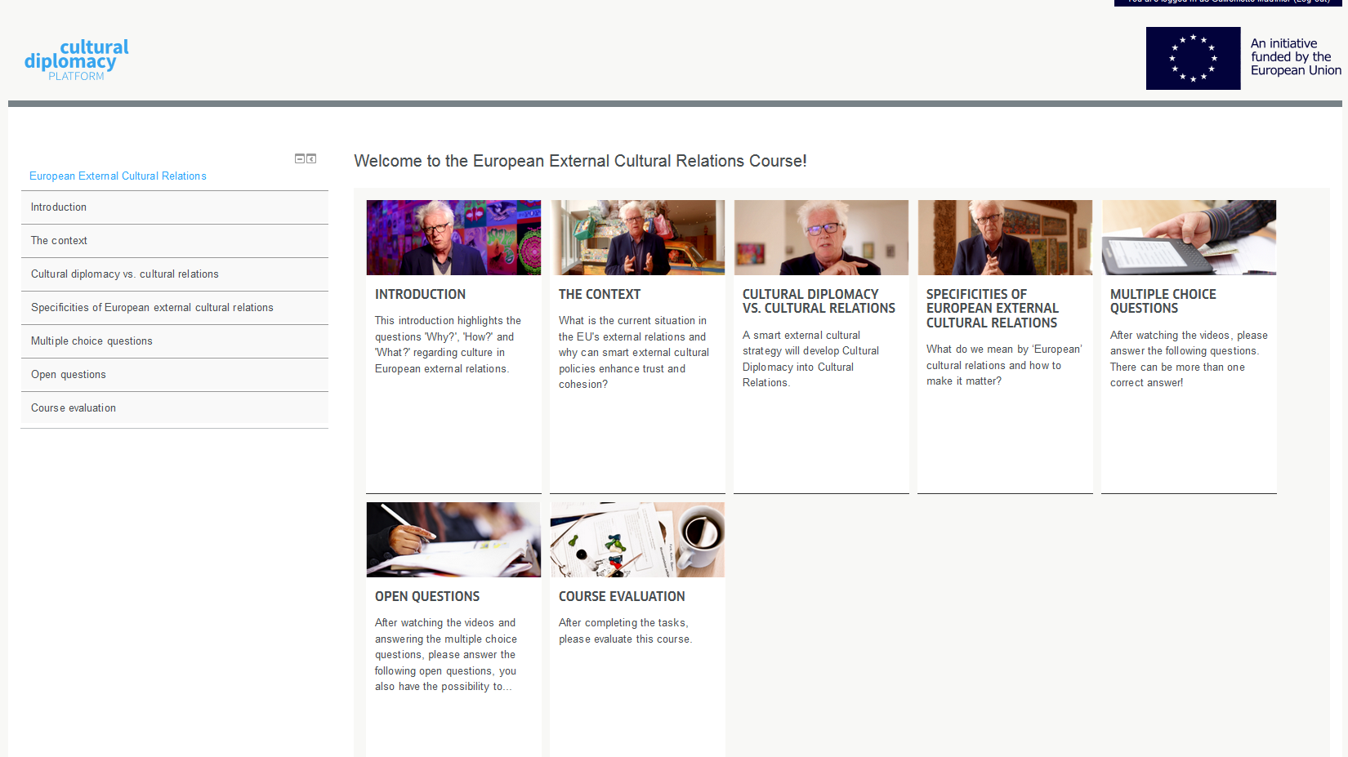
Examples of activities
Global Cultural Leadership Programme
  2016 Valletta (Malta)
  2017 Athens (Greece)
Assessment of EU Delegation to the USA’s cultural programme
Roundtable on Arts & Migration at European Forum Alpach
Brainstorming meeting on EU strategy for cultural relations with Western Balkans
Cooperation between ECoCs & East Asia Cities of Culture
Video-course on shift from cultural diplomacy to cultural relations

Slide 11
Examples of EU Delegations’ requests
Brazil
  European Heritage in Brazil
USA
  Assessment of current cultural activities
China
  Cooperation between ECoCs & East Asia Cities of Culture
  EU-China Film Industries
India
  Visual arts residency
  Museography/conservation of cultural heritage
  European Literature in India
  Performing arts & new technologies/Dance & Technology Festival
Japan
  European Literature in Tokyo

Slide 12
Activities planned for 2018
EU Guest of Honour at New Delhi Book Fair
Workshop on “International Cultural Relations in Practice”
Workshop on the international dimension of European Year of Cultural Heritage 2018
Training of Tunisian diplomats on cultural diplomacy
Following-up development EU strategy for cultural relations with the Western Balkans
Global Cultural Leadership Programme

Slide 13
Thank you for your attention

