Slide 1

How to get involved?
Agenda 2017 Culture seminar
Brussels, 24 October 2017
L42, rue de la Loi 42
Notes:
City of Lodz, Poland
European Heritage Label Candidate site

Slide 2
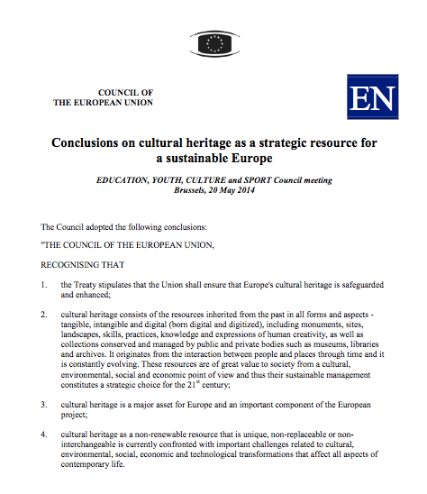
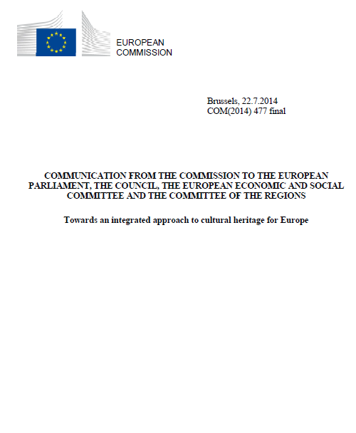
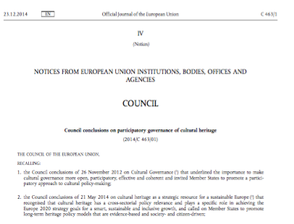
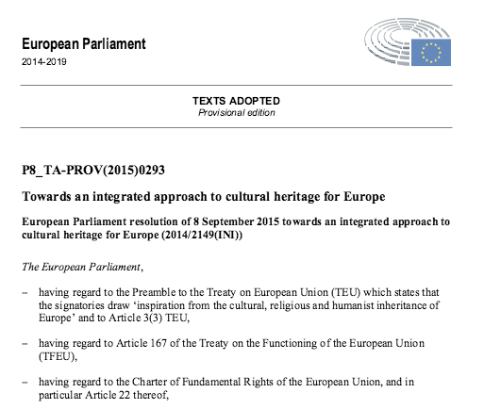
Cultural Heritage and the EU
May 2014 Council Conclusions on cultural heritage as a strategic resource for a sustainable Europe
July 2014 Commission Communication Towards an integrated approach to cultural heritage for Europe
November 2014 Council Conclusions on participatory governance of cultural heritage
November 2014 Priority in the Work Plan for Culture 15-18
April 2015 Opinion of the Committee of the Regions
September 2015 Resolution of the European parliament
2018 European Year of Cultural Heritage

Slide 3
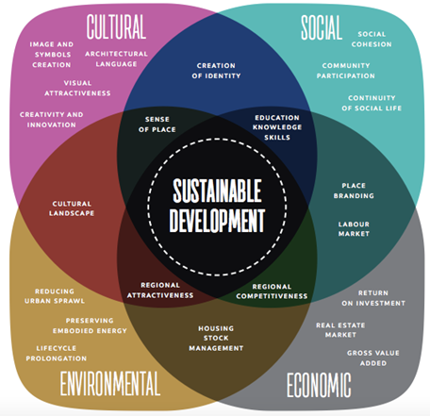
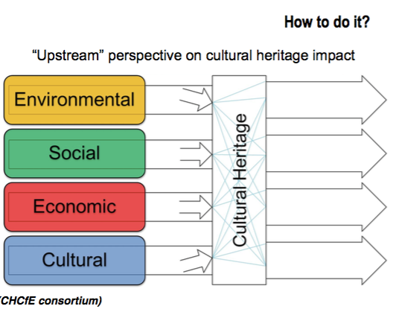
Holistic / Cross-cutting nature of heritage
Cultural dialogue
Notes:
Heritage benefits the EU: it plays a key role in socio-economic development on the territories
EU policies impact heritage: Culture; Education; Cohesion Policy; Digital Agenda; Research; Competition; Internal Market; the Common Agricultural Policy; Maritime Policy; Environment; Citizenship and External Relations. (Mainstreaming heritage - Art 167 TFUE)

Slide 4
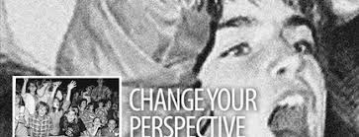
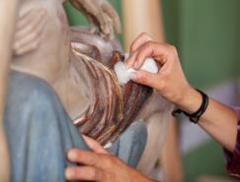
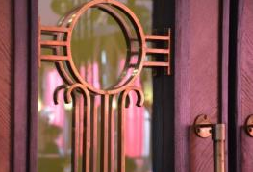
Why a Year for
Cultural Heritage?
To encourage the sharing and appreciation of Europe's cultural heritage as a shared resource;
To raise awareness of common history and values;
To reinforce a sense of belonging to Europe; and
To better protect, safeguard, reuse, enhance, valorise and promote Europe's cultural heritage.
© European Heritage Label
Notes:
© Pol Englebert Joutes

Slide 5
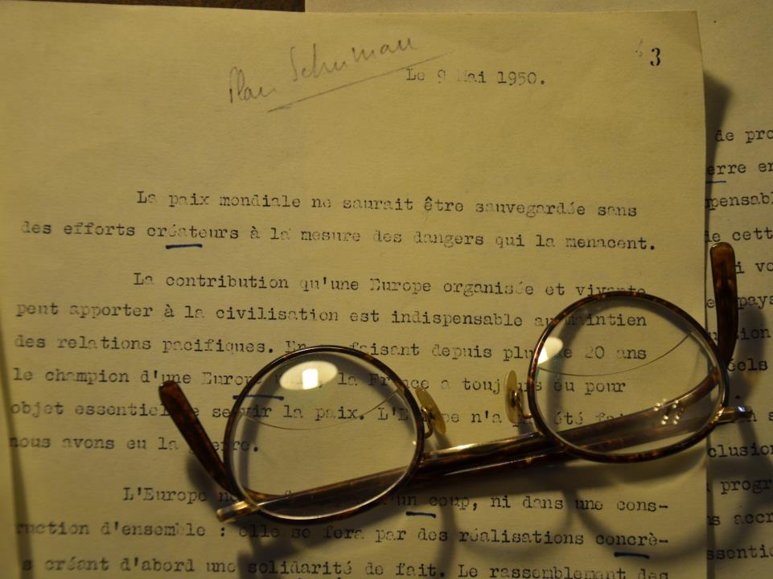
© European Heritage Label
Our cultural heritage:
where the past meets the future

Slide 6
What is cultural heritage?
Resources inherited from the past in all forms and aspects: tangible, intangible and digital. Including:
Monuments and sites
Landscapes and natural sites
Skills, knowledge and expressions of human creativity (oral traditions, festivals, songs, etc.)
Collections in museums, libraries and archives (paintings, books, artefacts, etc.)
Film heritage

Slide 7


© Shutterstock
Part I
Where and for whom?
Notes:
Flamenco, Spain

Slide 8
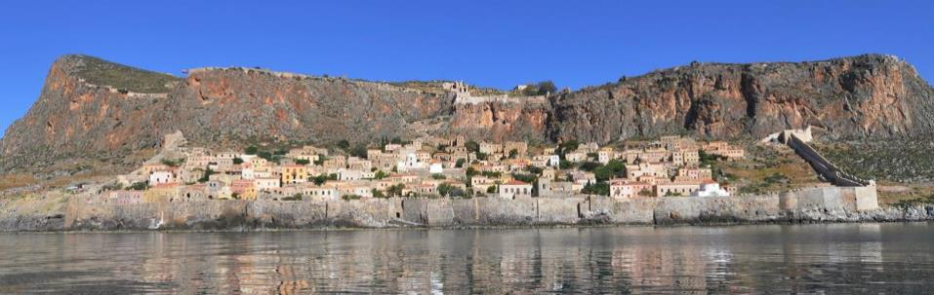
Where?
Projects and events will take place all across Europe
EU delegations will also help promote the Year outside the EU
© European Heritage Label

Slide 9
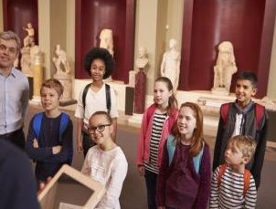
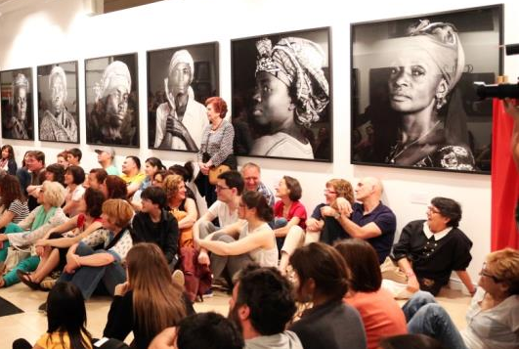
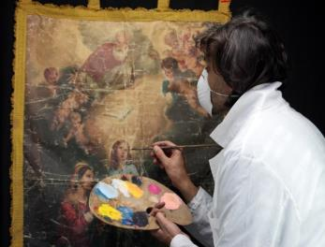
For whom?
Children (10-15)
Young people (15-25)
The wider public
Cultural heritage professionals
And all curious people!
© European Heritage Label
© Shutterstock
© Javier Rodríguez
© Shutterstock

Slide 10

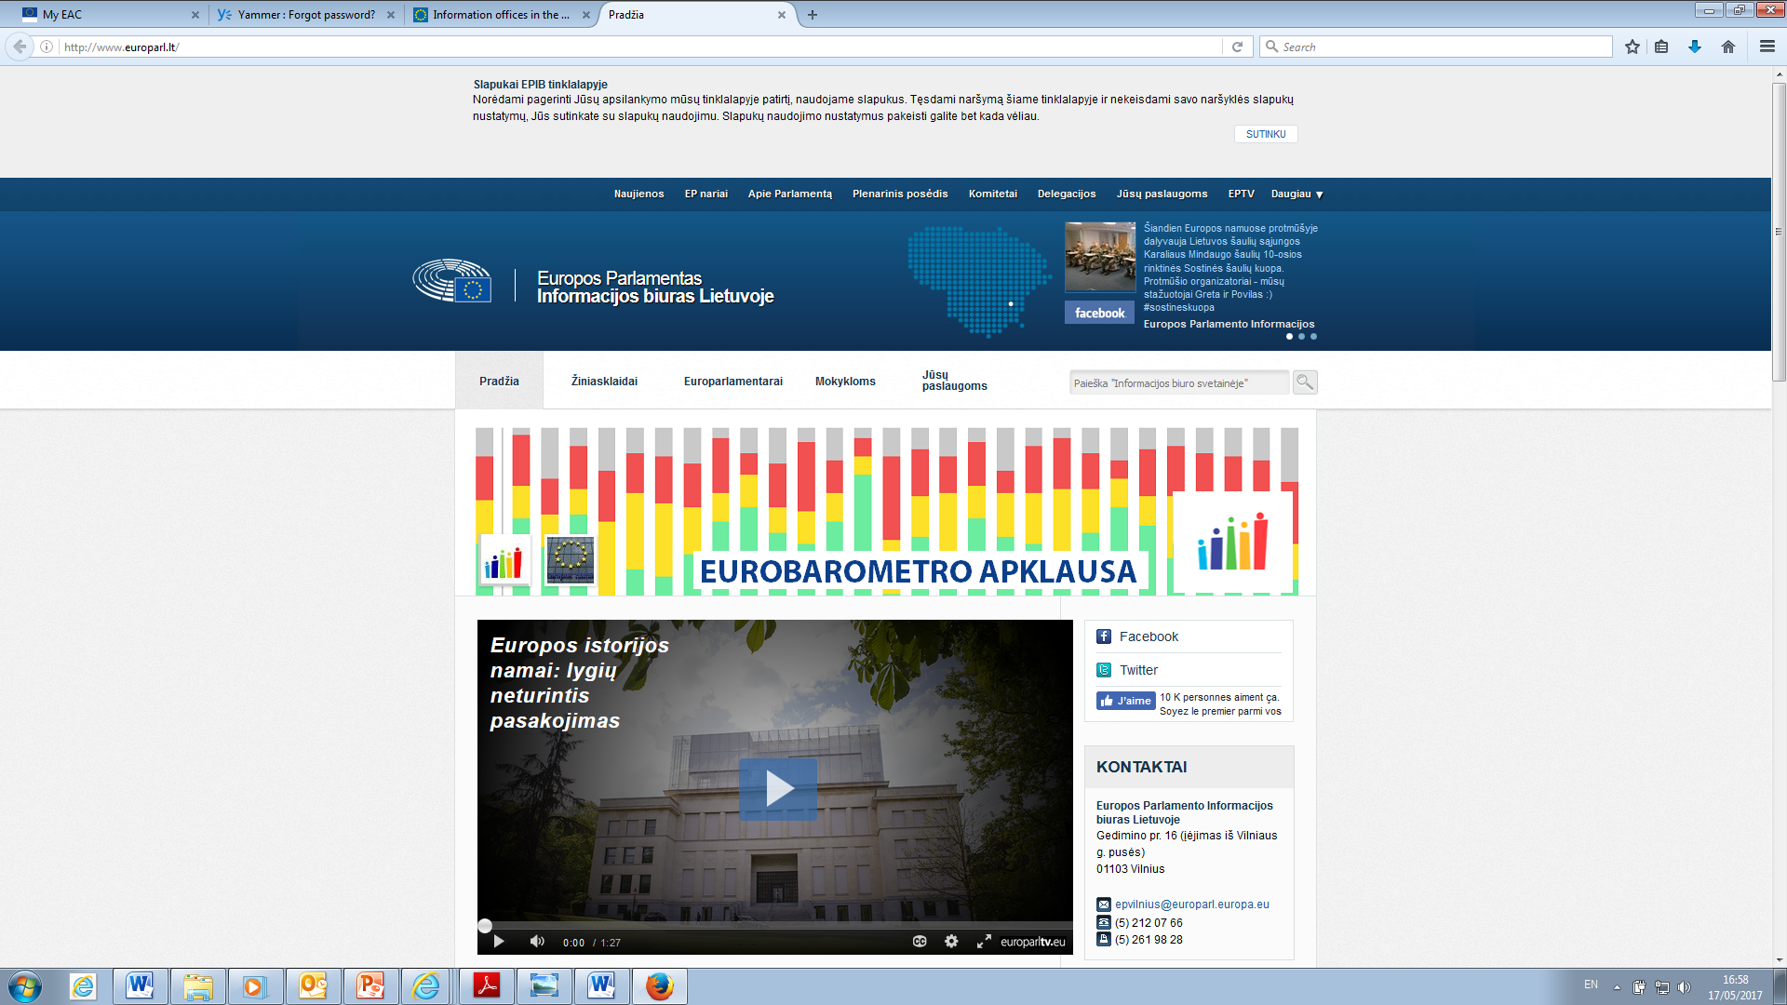
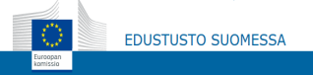
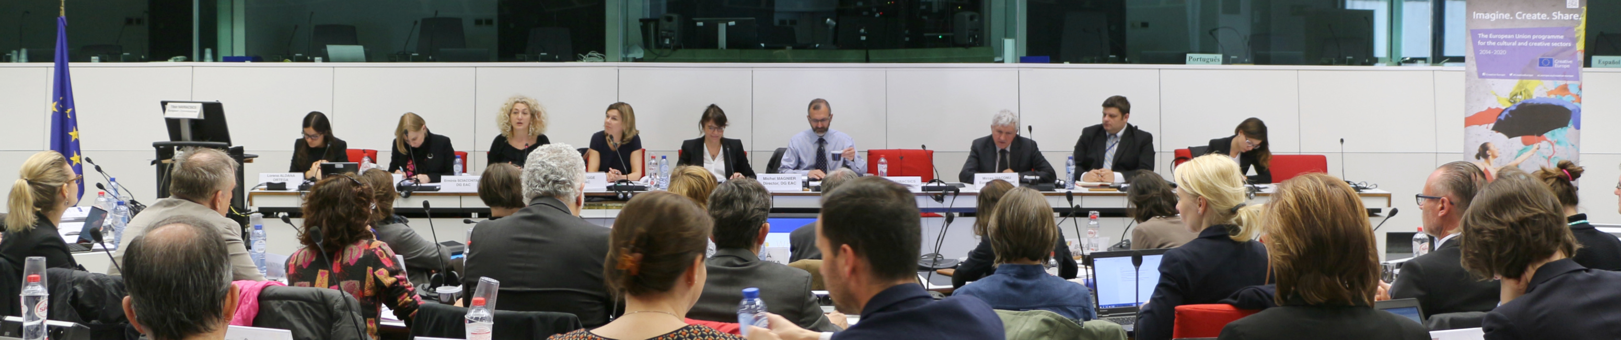
How?
Management of the Year at national level
National Coordinators manage the Year in Member States.
Supported by Multipliers: Creative Europe desks, Commission and European Parliament representations, cultural heritage stakeholders, the cultural sector, etc.

Slide 11
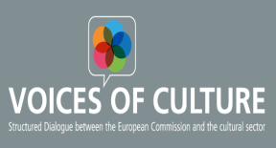
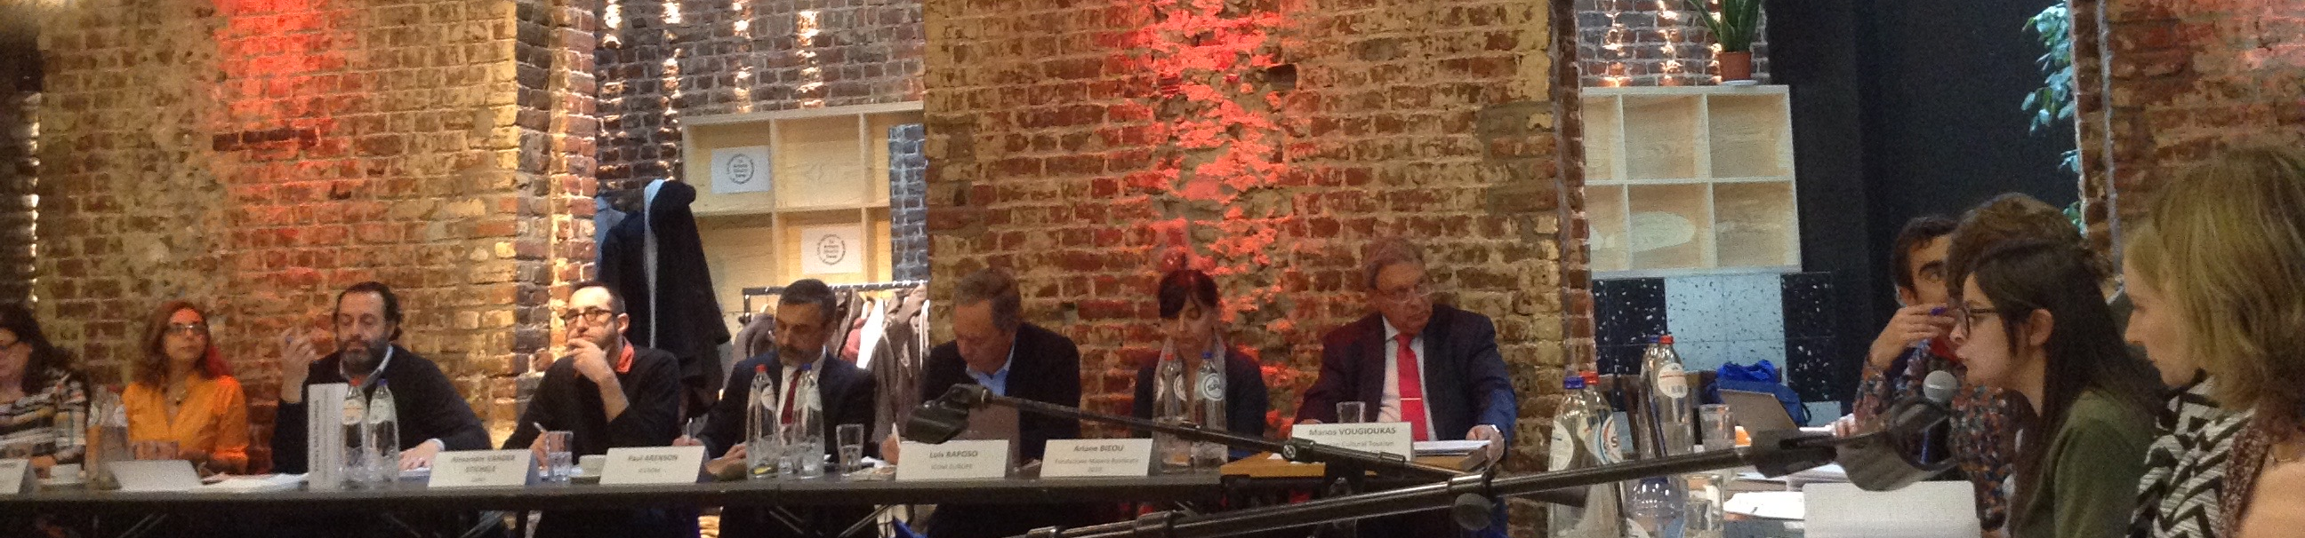
How?
Management of the Year at European level
Joint effort of European Institutions: Commission, Parliament, Council of the EU, European External Action Service, Committee of the Regions and European Economic and Social Committee.
With DG Education and Culture in the lead, a Joint effort of different departments of the Commission
a Committee of stakeholders, composed of 35 representative organisations, including UNESCO and the Council of Europe. EICR is a member
http://www.voicesofculture.eu/

Slide 12
National Coordinators
28 EU MS
EU Pres: BG
AT
StakeholderCommittee
35 Members
+ Unesco,
CoE
+ EP observer
RTD
COMM
ENV
SPORTS
Culture
EDUCATION
Other EU institutions
EEAS
CoR
EESC
European
Parliament
REGIO
GROW
YOUTH
MARE
HOME
EUROPEAN COMMISSION
EYCH Task Force
EYCH Governance

Slide 13
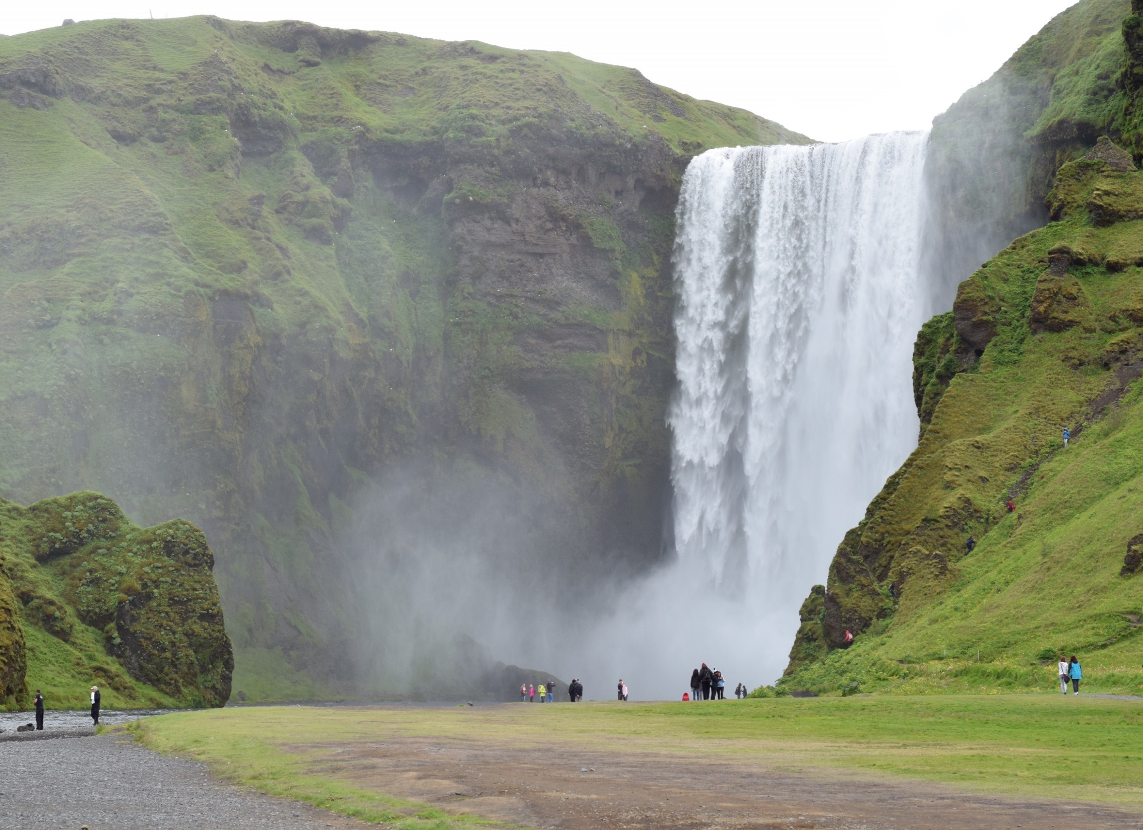
Projects and Initiatives
Projects and Initiatives

Slide 14
Projects at EU level
Transnational cooperation projects through the dedicated Creative Europe call
Ten highly-visible European initiatives, implemented by the Commission in cooperation with partners that will ensure the legacy of the Year after 2018
Total budget of EUR 8 million for 2017 and 2018

Slide 15

Creative Europe call dedicated to the EYCH
Key features:
€5 million in total
3 participant countries
Up to € 200 000 per project, representing maximum 60% of the total eligible budget.
https://ec.europa.eu/programmes/creative-europe/culture/european-cooperation-projects_en
NB- Cultural heritage remains
eligible under the 2 categories of the other 2018 CE call (smaller and larger cooperation projects)
Culture

Slide 16
Creative Europe call dedicated to the EYCH 2018
2 themes:
Reinforcing a sense of belonging to a common European space
Promoting cultural heritage as a source of inspiration for contemporary artistic creation
© European Heritage Label

Slide 17


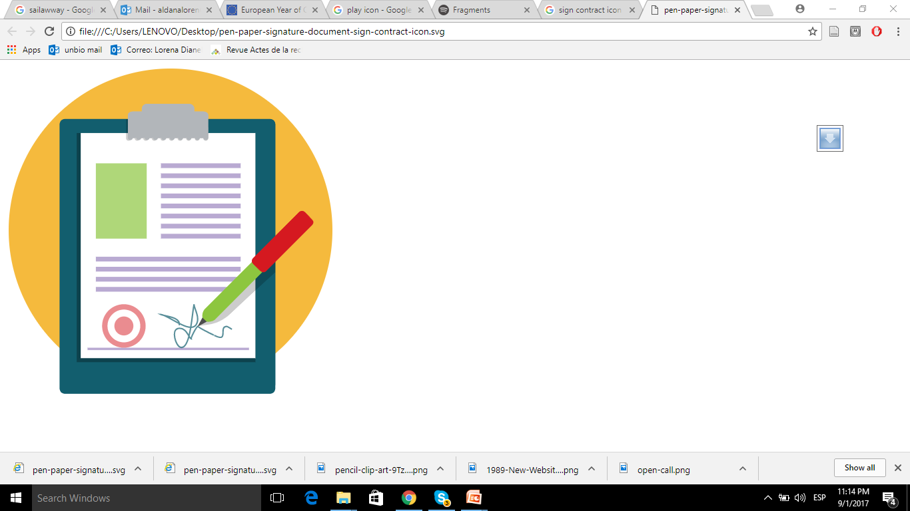
Creative Europe call timeline
Launch of call
18 September 2017
Deadline for submissions
22 November 2017
Signing of contracts
May/ June 2018 (TBC)
Culture

Slide 18

How?
IN ADDITION :
Funding for cultural heritage will be available through different EU programmes:
Erasmus+,
Horizon 2020,
COSME,
Europe for Citizens,
EU structural and cohesion funds, etc.
"A remarkable publication"
The Budapest Observatory
Notes:
A dedicated Creative Europe call of 5-7 MIO EU

Slide 19
Ten European initiatives
four pillars
  Shared heritage: cultural heritage belongs to us all
  Heritage at school: children discovering Europe's most precious treasures and traditions
  Youth for heritage: young people bringing new life to heritage
Engagement
  Heritage in transition: re-imagining industrial, religious, military sites and landscapes
  Tourism and heritage: responsible and sustainable tourism around cultural heritage
Sustainability
Protection
Cherishing heritage: developing quality standards for interventions on cultural heritage
Heritage at risk: fighting against illicit trade in cultural goods and managing risks for cultural heritage
  Heritage-related skills: better education and training for traditional and new professions
  All for heritage: fostering social innovation and people's and communities participation
  Science for heritage: research, innovation, science and technology for the benefit of heritage
Innovation

Slide 20
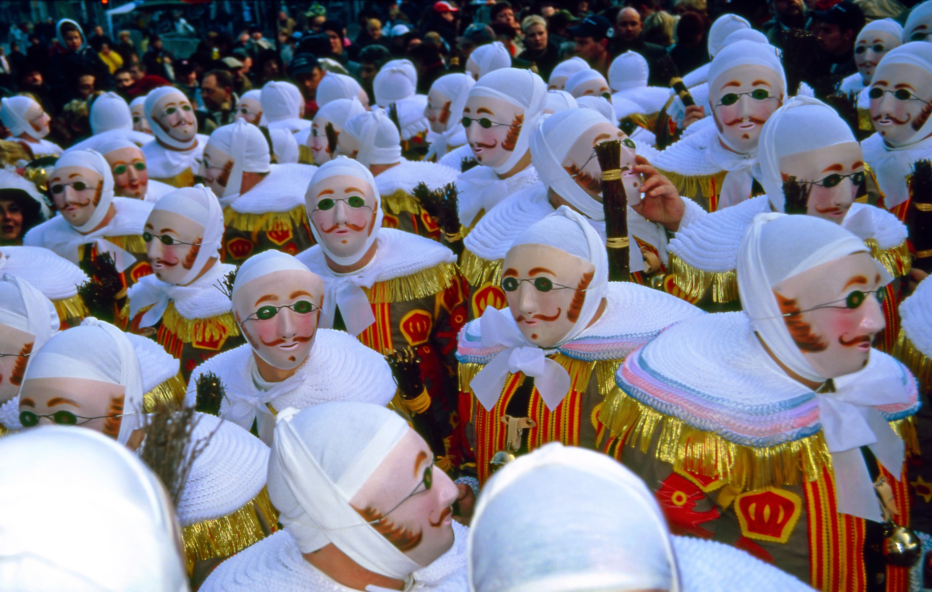
Part III
Events and communication

Slide 21
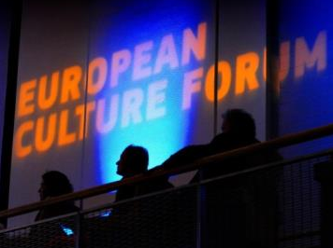

Key events in 2018
College meeting and Launch of the
Year by the Bulgarian Presidency
11-12 January 2018, Sofia (date tbc)
European Culture Forum
Launch of the Year, 07-08 December 2017, Milan
http://ec.europa.eu/culture/forum/
European Heritage Days
September 2018
Thousands of events and access to rarely opened sites; over 30 million participants
http://www.europeanheritagedays.com/

Slide 22
Key events at European level
Opening Ceremony of ECoC Valletta 2018
20 January 2018
Opening Ceremony of ECoC Leeuwarden 2018
27 January 2018
Joint RTD -EAC high level Conference on European Research for Cultural heritage
20 March 2018, Brussels
Bulgarian Presidency conference on Cultural heritage
End of March 2018, Bulgaria
European Heritage Label Ceremony 2018
April 2018, Brussels
Culture

Slide 23
Key events at European level
European Summit of Cultural Heritage/European Union Prize for Cultural Heritage / Europa Nostra Awards 2018 Ceremony
20-24 June 2018, Berlin
European Heritage Days 2018
August- September 2018, throughout Europe
Congress on Cultural Heritage
18-19 October 2018, Vienna
Closing conference by Austrian Presidency
11-12 December 2018, Vienna
Culture

Slide 24
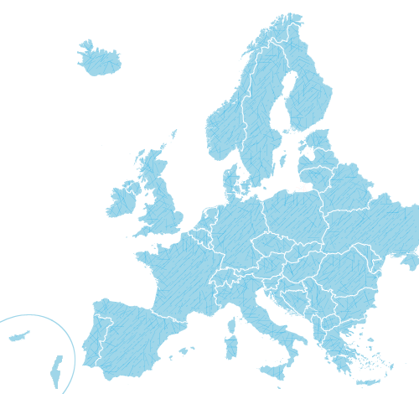
Key events at national level
A list of planned events in Member States
19 Member states
Over 230 events
(as of 4 September)
Culture

Slide 25

Highlighted events in EYCH campaign website
Up to 5 events per Member State will be flagged
The selection will aim at showcasing inspiring events taking place across Europe
Culture

Slide 26
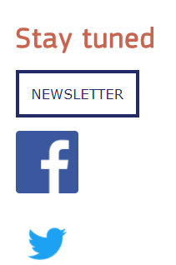
Communication campaign
Visual identity, logo and slogan
PPTs and flyers in all EU languages
Website
EYCH communication toolkits
Newsletter

Slide 27


Labelling of events
National coordinators will award the label to projects and initiatives taking place in Member States
Commission and the members of the stakeholders' committee will award the label to cross-border projects and EU funded projects
IMPORTANT: all projects and events have to respond to one of the objectives of the Year

Slide 28

Fill-in the online form and request the EYCH label:
https://ec.europa.eu/eusurvey/runner/RequestLabelEYCH2018
Culture

Slide 29
Your role as multipliers in the Communication Campaign
Make use of these materials in your communication and promotional activities including:
  Online (via your website, social media channels and newsletters)
  Offline (organising events and meetings, print publications)
  And sharing within your networks!
Use the visual identity of the Year (please see the guidelines)
Use the hashtag #EuropeForCulture
Culture

