Slide 1
The work of Special Envoy on Freedom of Religion or Belief
Supporting respect for diversity of religion or belief
V. Manzitti. Policy assistant to Jan Figel
Brussels, 25 10 2017

Slide 2
Presentation
Special Envoy mandate
Religion and religious diversity
What is Freedom of Religion or Belief and your take into this
Synergies with your work and highlights on interreligious dialogue..

Slide 3
Special Envoy for the Promotion of Freedom of Religion
Jan Figel appointed as Special Envoy for the Promotion of Freedom of Religion or Belief outside the EU in May 2016 by J.C. Juncker
Promote Freedom of religion/belief within development assistance via HR agenda and in the framework of EU's dialogues and assistance programmes
Located in Cabinet Mimica, works in close cooperation with EEAS and DGNEAR
Missions: sudan, jordan, UAE, Iraq, marocco
Soon: Pakistan and Senegal
https://ec.europa.eu/europeaid/special-envoy-jan-figel_en

Slide 4
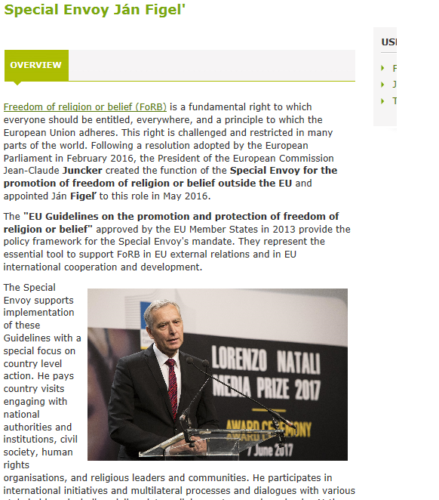
…. on DEVCO internet

Slide 5
Freedom of concience, thought, religion, belief (FoRB)
Under international law, two components:
(a) The freedom to have or not to have or adopt (which includes the right to change) a religion or belief of one’s choice, and
(b) The freedom to manifest one's religion or belief, individually or in community with others, in public or private, through worship, observance, practice and teaching

Slide 6
Religion and FoRB in the world
Source: Pew Research Centre
Changing religious demographics
Today 85% of world population : religiously affiliated
By 2050 % of "non religious" people will decrease from 16% to 13% - 21st will it be "furiously religious"?
Fundamentalisms trends on the rise in all religions
Muslims increase by 73% by 2050, Christhians by 35%
In 2050 Muslims and Christians will reach parity (+/- 2.8 bn)
in 2050: 40% of Christhians in Africa, 20% of Muslims in middle East and 10% in Europe
Pentecostals and evangelical grow faster (to 700 million by 2020, more than a tenfold increase since 1970)
Increasing religious diversity – many Christians in traditional Muslim countries
Notes:
In 1999, the sociologist Peter Berger noted that: “the world is as furiously religious as it ever was, and in some places more so than ever”. He called the process ‘desecularization’. Yet, to what extent have we absorbed the implications that in most parts of the world the most powerful actors in civil society are religious? The 2012 Pew Survey, ‘The Global Religious Landscape’ stated that 85% of the world’s population identified themselves as belonging to a specific religion.
Peter Berger, ed., The Desecularization of the World, (Grand Rapids: Eerdmans, 1999), p. 2.
http://www.pewforum.org/2012/12/18/global-religious-landscape-exec/

Slide 7
Freedom of religion or belief under pressure
40% of countries: high /very high levels of restrictions ( 34% in 2014)
= 78% of world population
53% countries : widespread government harassment of religious groups (43% in 2014 )
27% of countries = high /very high levels of social hostilities increased (23% in 2014)
Social hostilities on the rise in Africa

Slide 8
Countries with …
High Social hostilities
CAR
Kenya
Nepal
Niger
Uganda
Guinea
Maldives
Bosnia
Italy, Danemark, US
……….
Very high social hostilities
Nigeria
Syria
Irak
India
Afghanistan
Pakistan
Egypt

Slide 9
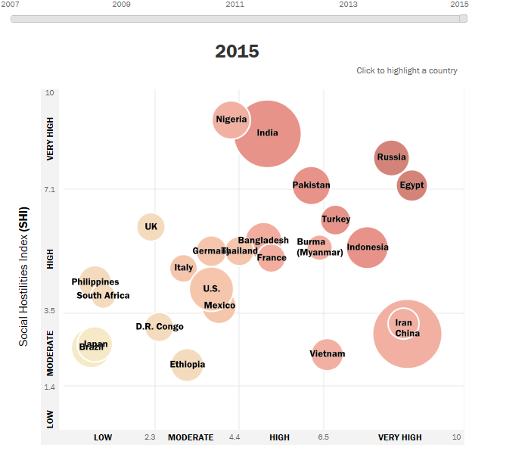
Restrictions on religion among the 25 most populous countries, 2007-2015

Slide 10
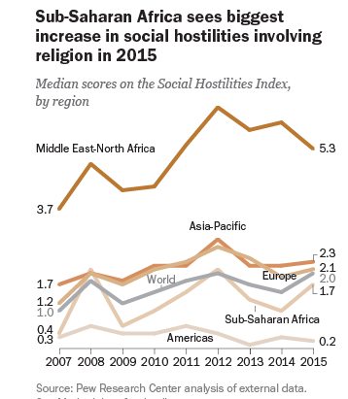

Slide 11
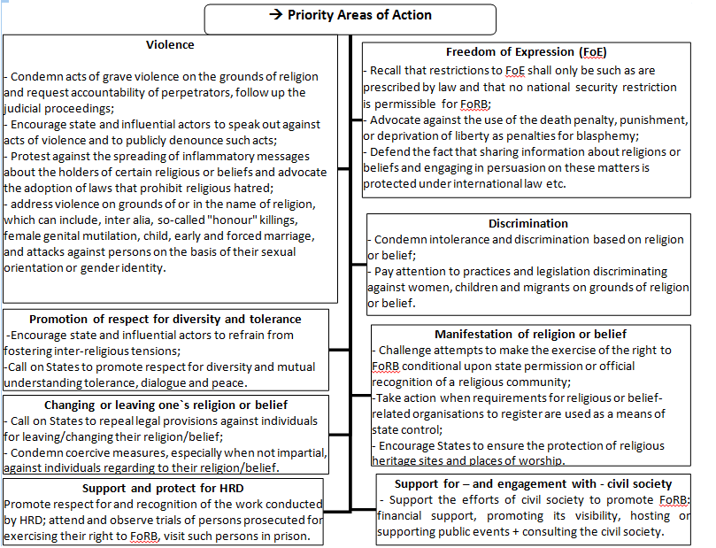
EU Guidelines on FoRB, adopted by EU and ME, FAC 2013

Slide 12
Guidelines on FoRB : "Promotion of respect for diversity and tolerance"
The promotion of religious tolerance, respect for diversity and mutual understanding are of utmost importance… The EU will:
Encourage state and other influential actors, whether religious or non-religious, … to support initiatives to promote an atmosphere of respect and tolerance
Call on states to promote, through the educational system and other means, respect for diversity and mutual understanding by encouraging a wider knowledge of the diversity of religions and beliefs within their jurisdiction.
Make use of all available tools, including the financial instruments, to promote a culture of mutual respect, diversity, tolerance, dialogue and peace and coordinate, as appropriate, with regional and international organisations in order to do so.

Slide 13
FoRB is not only legal and Human Right issues
It has an essential soft dimension
"collective responsabilitiy" + massive effort needed
  "To tackle the root causes of intolerance, a much broader set of policy measures is necessary, for example in the areas of intercultural dialogue – reciprocal knowledge and interaction – or education for pluralism and diversity "UN Rabat Action Plan on advocacy against religious hatdred

Slide 14
Support to FoRB can be activated via ….
  Intercultural + Interreligieuse dialogue
  Initiatives and projets in the cultural area
  Media
  Initiative in the area of education and youth
  … with a gender and age sensitive touch

Slide 15
Inter-religious dialogue : « how to …»
Broad, elusive, umbrella concept
Overall after 9/11 a lot has been done , but ….
Need for « better dialogue » and « up-grade »
State sponsored, grass root initiatives, peace building, social cohesion, …
Dialogue among religious actors on theological matters - handle with care , it is not a good for « free consumption »
Apply and adapt good practices on intercultural dialogue
Notes:
SFCG take away are : 1) focus on areas of common interest and concern. It’s much easier to get people to cooperate to solve a common problem than to get them together face to face on a regular basis simply to dialogue. See sucessful implementation of the Universal Code of Conduct on Holy Sites in countries as disparate as Bosnia- Herzegovina, Indonesia, Nigeria, Sri Lanka, India and the Holy Land ; 2) it’s important to not limit engagement with religious actors to those who are the most ‘official’ or high level leaders. Sometimes the real authority or influence is at the community level or the person a community believes most represents them. Engaging with religious actors also means throwing the net out as wide as possible – being as inclusive as you can. In peace-building, we also need to meet with the people we would not choose to have dinner with! 3) the word religious ‘actor’ also includes women. All too often traditional religious authorities don’t view women as leaders and the women themselves can’t imagine themselves as religious leaders. What results is a perpetuation of the religious male leadership cycle which absents half the world’s population. Women are totally underrepresented in multi-religious meetings dealing with conflict ; 4) engage other stakeholders in addition to religious leaders , such as politicians at the national and local levels, the police and sometimes even the media ; 5) it important to institutionalize engagement with religious leaders. don’t do one-off events as it takes time to build relationships of trust and they need to be constantly sustained ; 6) it helps to build trust by learning about other religions and demonstrating respect for them and their adherents.

Slide 16
Do not neglect the political dimension
Requires good preparation
Context is key : political, social and historical
Clarify the purpose : jointly agreed and clearly stated
Dialogue is a mean not an end in itself – ‘problem solving’ perspective can help
Expected results (tangible and intangible):
  Individual learning and transformation
  Changes in societies /communities (behaviour, MoU, concrete policies..)

Slide 17
Selection of participants is key: voluntary basis, “equal footing”, credible, diversified, representating or on personal basis, be gender + age sensitive
Methodologies beyond talk-talk towards - doing things jointly
Manage expectations
Manage risks : IRD can backfire and solidify prejudices/walls
Moderation + political, cultural sensitiveness

Slide 18
Search for Common Ground – Take away on engaging with religious actors in peace building
Focus on areas of common interest and concern (code of conduct on holy sites Bosnia- Herzegovina, Indonesia, Nigeria, Sri Lanka, India and the Holy Land);
not limit engagement with the most ‘official’ or high level leaders.
include women, totally underrepresented in multi-religious meetings dealing with conflict
engage also other stakeholders
don’t do one-off events as it takes time to build relationships of trust and they need to be constantly sustained ;
it helps to build trust learning about other religions and demonstrating respect for them and their adherents.
Notes:
It’s much easier to get people to cooperate to solve a common problem than to get them together face to face on a regular basis simply to dialogue. See sucessful implementation of the Universal Code of Conduct on Holy Sites in countries as Sometimes the real authority or influence is at the community level or the person a community All too often traditional religious authorities don’t view women as leaders and the women themselves can’t imagine themselves as religious leaders. What results is a perpetuation of the religious male leadership cycle which absents half the world’s population. believes most represents them. Engaging with religious actors also means throwing the net out as wide as possible
All too often traditional religious authorities don’t view women as leaders and the women themselves can’t imagine themselves as religious leaders. What results is a perpetuation of the religious male leadership cycle which absents half the world’s population.

Slide 19
Your take…..
Situation in your country
Actions in place
Possible synergies
Bilateral and regional funds, IcSP, EIDHR and other Budget Lines

