Slide 1
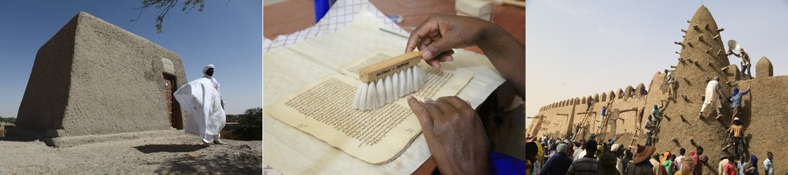
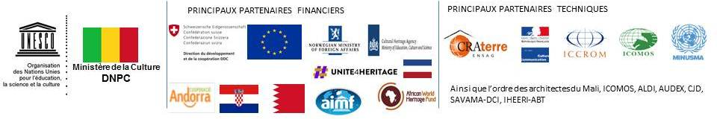
DAMAGED CULTURAL HERITAGE IN
NORTHERN MALI
Reconstruction - Rehabilitation - Restoration - Revitalisation - Safeguarding
A programme financed by the EU and several other partners

Slide 2
DAMAGED HERITAGE IN NORTHERN MALI : SAFEGUARDING, RESToRATION, REhabilitation, Revitalisation
4 components:
Component 1 - Study to understand: Document and analyze the situation before, during and after the conflict in a multidisciplinary approach.
Component 2 - Restore and reconstruct: Restore and reconstruct cultural heritage, safeguard ancient manuscripts and revitalize the socio-economic fabric related to the cultural sector.
Component 3 - Reinforce institutional and professional capacities: Re-establish appropriate conditions for the preservation, conservation, maintenance and proper management of cultural heritage and ancient manuscripts.
Component 4 - Capitalise and disseminate: Document all actions, and ensure that project results are capitalised on and widely disseminated.

Slide 3
DAMAGED HERITAGE IN NORTHERN MALI : SAFEGUARDING, RESToRATION, REhabilitation, Revitalisation
2 Phases:
  Phase 1 (2013-2017): 3,635,000 USD, including 850,000 USD funded by EU
  Phase 2 (2017-2020): 1,170,000 USD, including 600,000 USD funded by EU

Slide 4
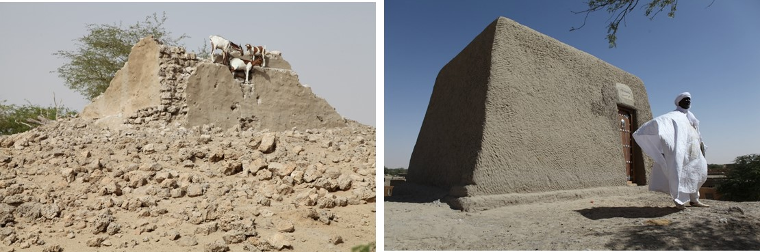
^{RESULTS}
20 mausoleums reconstructed
Mausoleum Alpha Moya before reconstruction
Mausoleum Alpha Moya after reconstruction

Slide 5
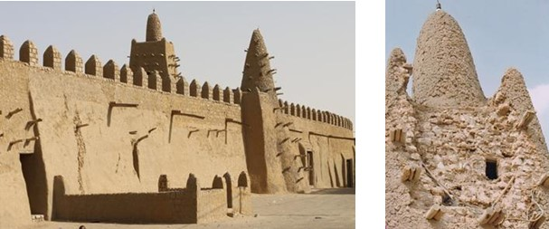
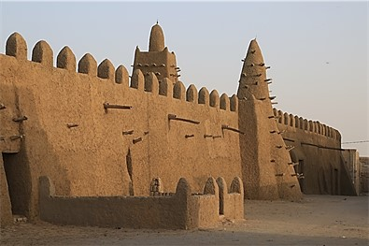
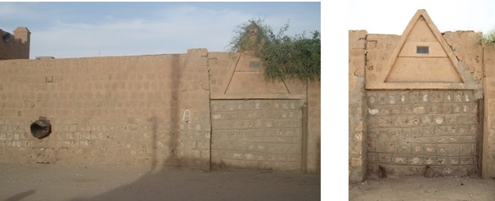
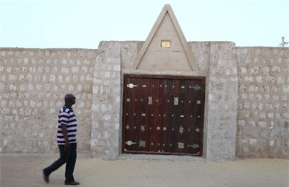
^{RESULTS}
3 mosques rehabilitated
Mosque Djingareyber before rehabilitation
After rehabilitation
Secret door Mosque Sidi Yahia before rehabilitation
After rehabilitation

Slide 6
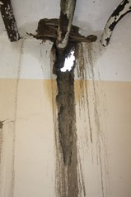
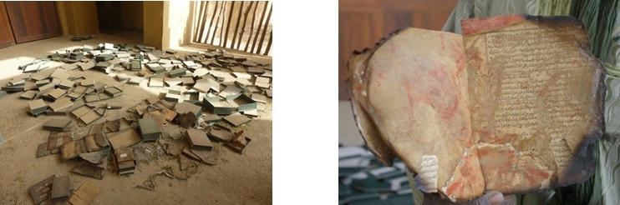
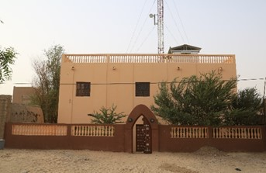
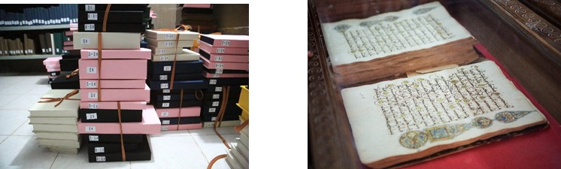
^{RESULTS}
6 libraries containing restored ancient manuscripts, 60 600 manuscripts saved
Library Fondo Kati - before
Manuscripts - before
Library Fondo Kati - after
Manuscripts - after

Slide 7
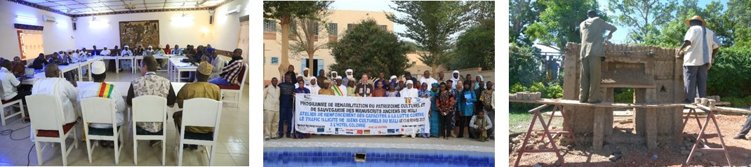
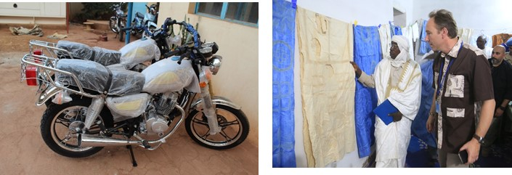
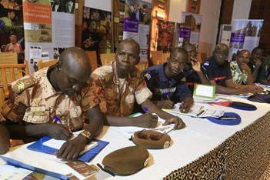
^{RESULTS}
Strengthened capacities
Training workshops, material and logistical support
Workshop on combating illicit trafficking of cultural properties
Training masons in Mopti
Equipment provided for site managers
Project to re-energize the socio-economic fabric by revitalizing traditional hand embroidery
Training defense and security forces in heritage protection

Slide 8
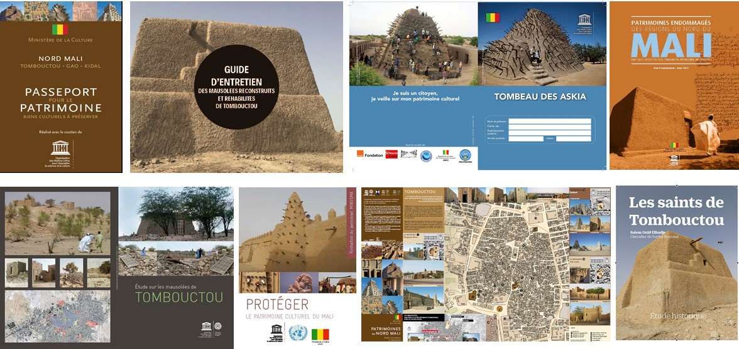
^{RESULTS}
Strengthened capacities
Improved knowledge: several brochures developed

Slide 9
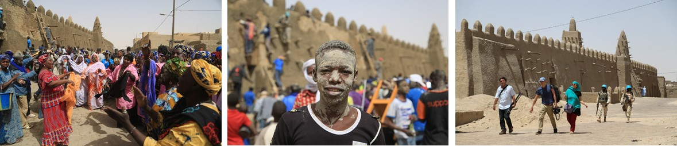
Impact
Restoring dignity to the communities: reconstructing moral and hope
Visible EU contribution to peace efforts in Mali, social cohesion and national reconciliation
Unprecedented cooperation with the ICC: arrest and conviction of the individual responsible for the destruction of the mausoleums
Unprecedented cooperation with MINUSMA: first case of protecting culture within the mandate of a peacekeeping operation

Slide 10
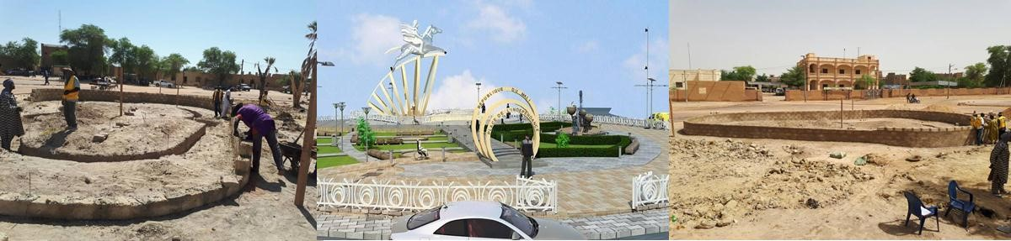
Encountered difficulties
Instability of security situation leading to delays in the implementation of certain activities, including the reconstruction of the Monument Al Farouk
Inadequate funding for the effective implementation of the activities of the second phase.

Slide 11
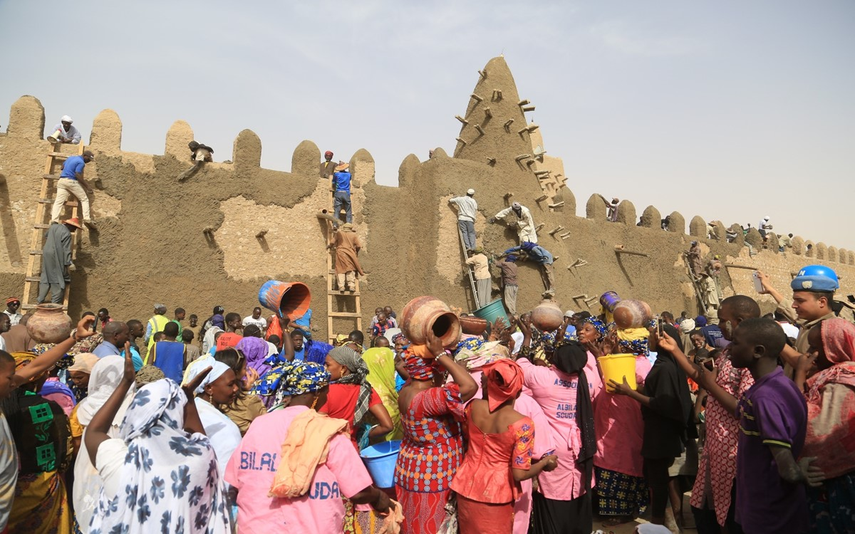
THANK YOU

