Slide 1
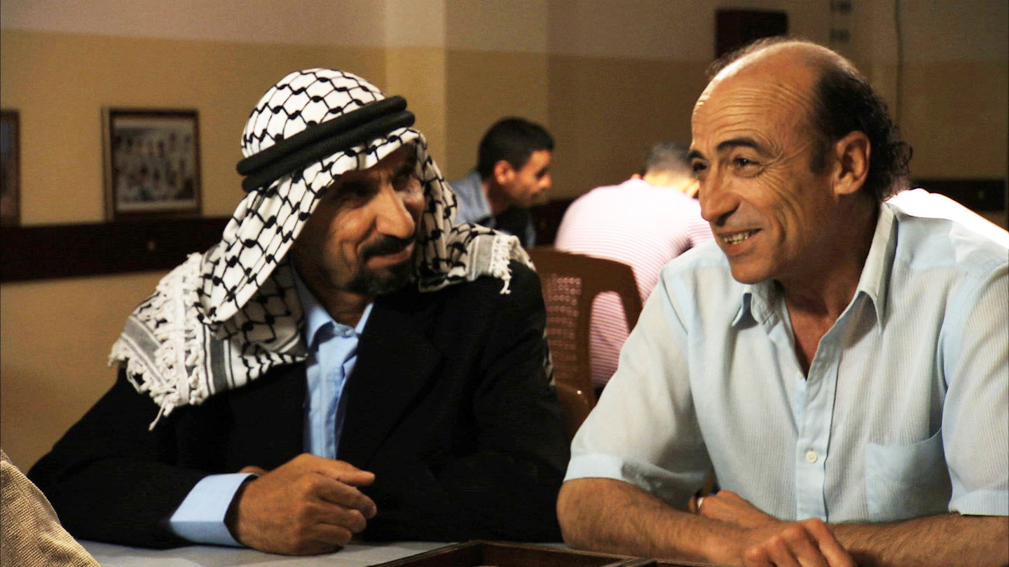

CASE STUDY:
LESSONS LEARNED FROM THE FIELD IN DIFFICULT CIRCUMSTANCES.
October 23, 2017
2017 Culture Seminar DEVCO, Brussels
Sandra Djuvara Melone

Slide 2
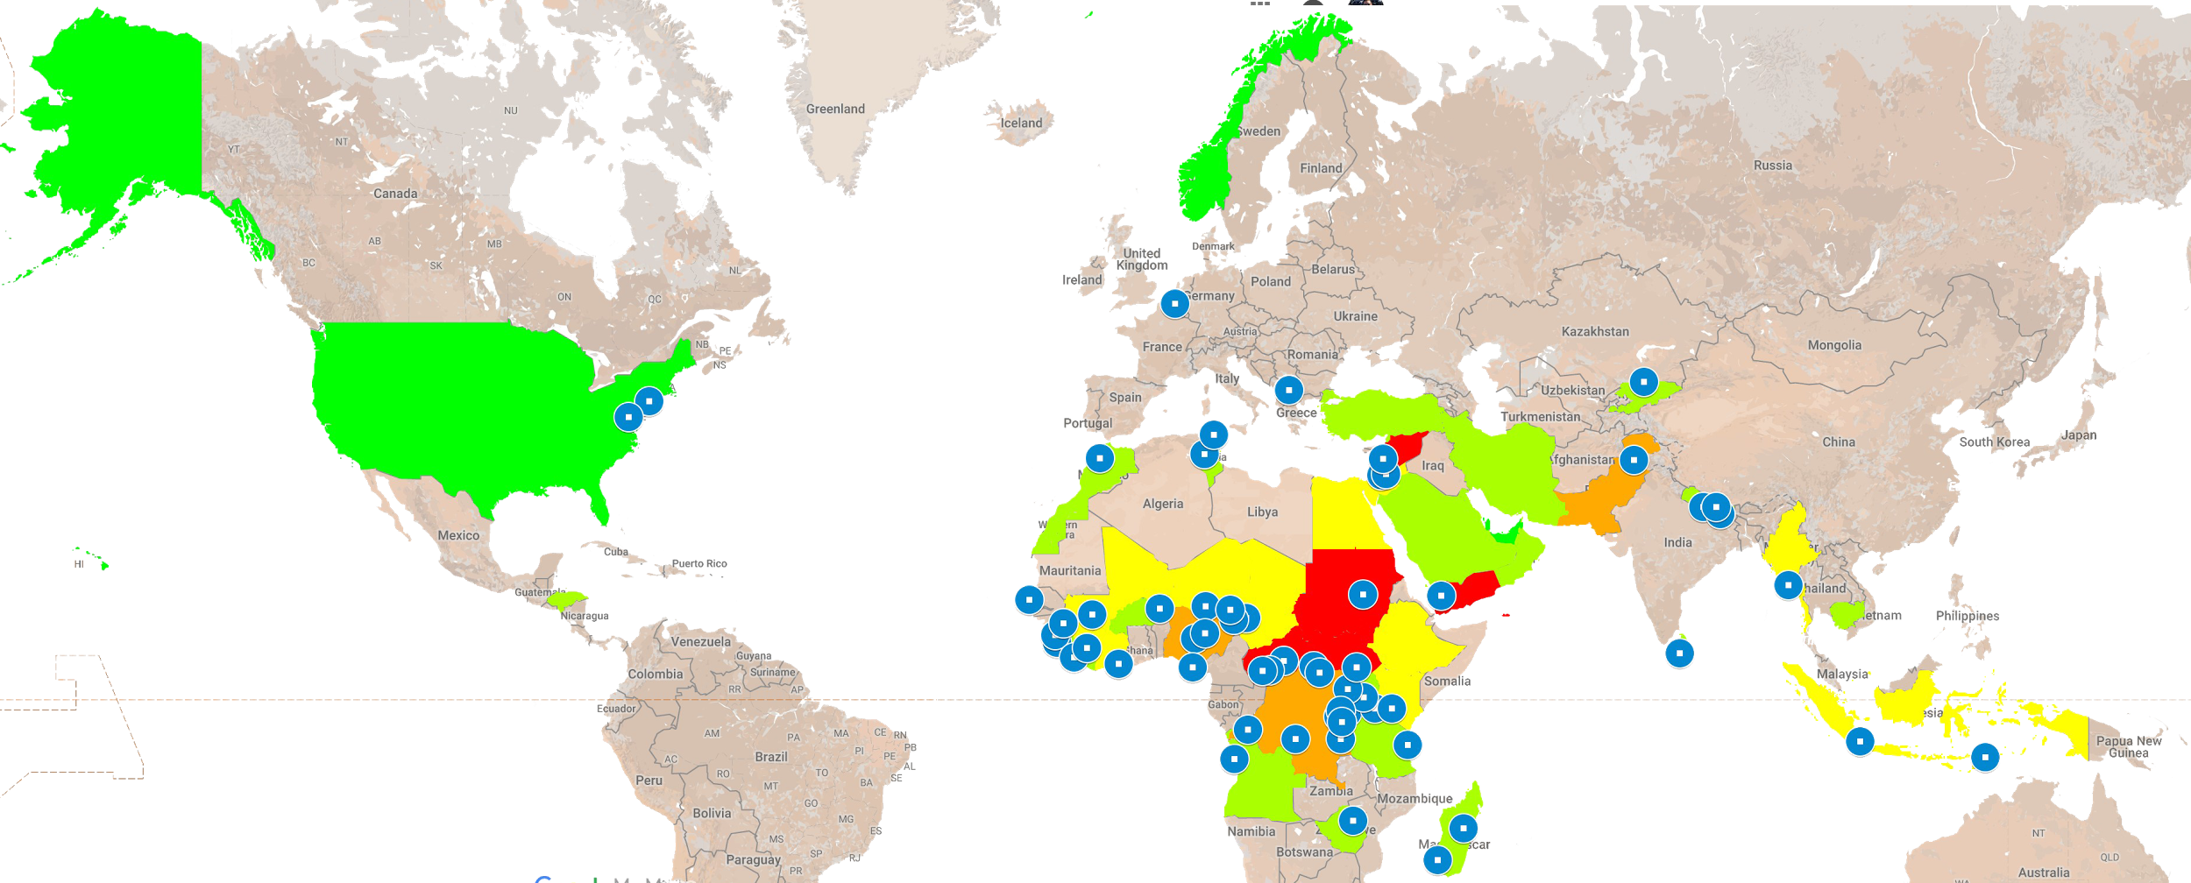
Search for Common Ground 2017
www.sfcg.org
Europe
Staff 13
Projects 0
Offices 2
United States
Staff 49
Projects 17
Offices 2
West Africa
Staff 111
Projects 25
Offices 16
MENA
Staff 75
Projects 34
Offices 7
Asia
Staff 87
Projects 15
Offices 9
Security Level
Safe
Mostly Safe
Somewhat Safe
Somewhat Unsafe
Unsafe
East Africa
Staff 76
Projects 20
Offices 9
C&S Africa
Staff 154
Projects 13
Offices 14
STAFF
565
PROJECTS
124
COUNTRIES
33
OFFICES
59

Slide 3
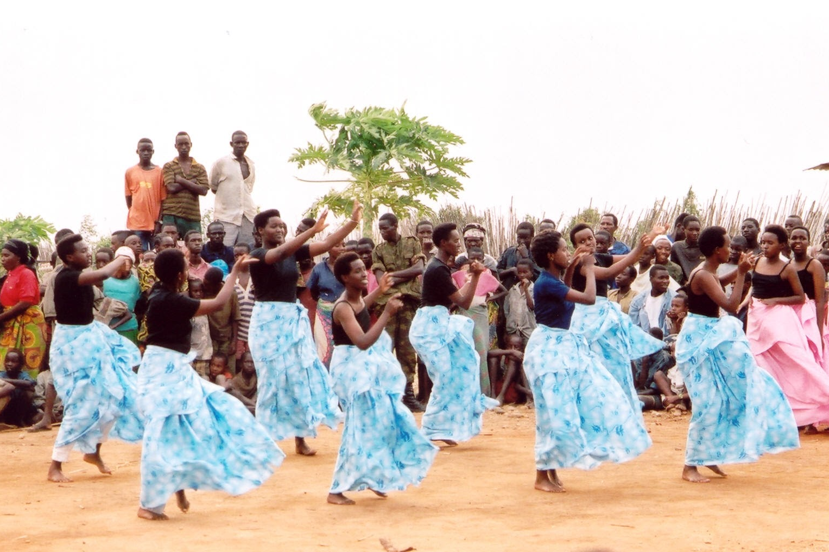

Slide 4
WHY USE ARTS & CULTURE?
Contribute to peace in a unique way
Complement other methods by rooting it in emotion, culture, traditions
Open doors to enable other tools to be employed
Present an opportunity for choice, and change
Capture dynamics of identity.

Slide 5
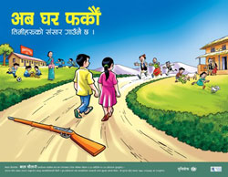
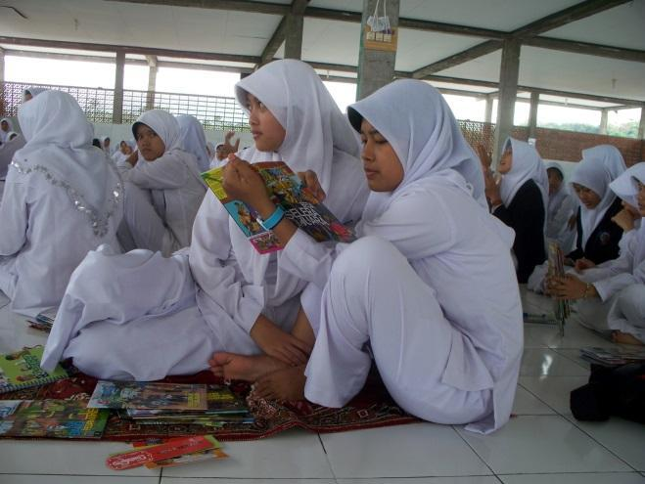
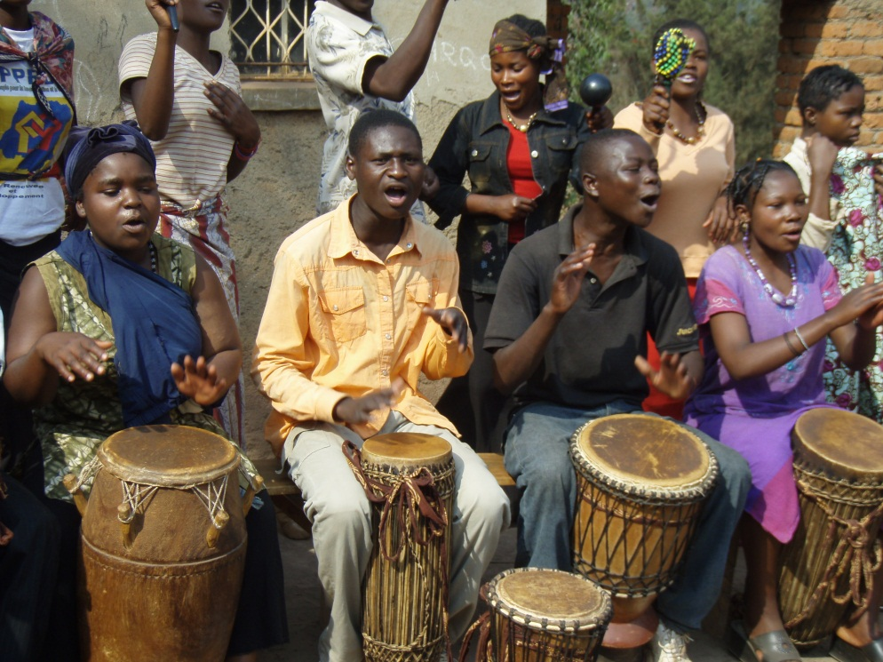
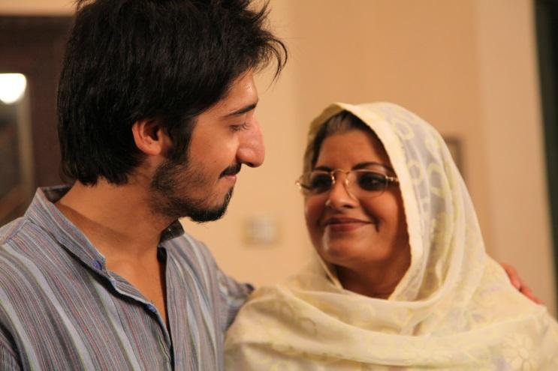

Slide 6
WHAT DO ARTS & CULTURE DO?
Create safe, ‘neutral’ spaces
Reach a wide audience with messages about social reintegration and coexistence
Provide an aesthetic focus to address sensitive issues
Reflect back diverse realities, encouraging listening
Enable being in a non-threatening way to address underlying issues
Facilitate participation in non-verbal ways
Contribute to the healing of memories; creates a place of witness
Reinforce self-esteem; makes us feel good; brings us into the present
Inspire hope; reminds us of our cultural wealth, diversity
Strengthen local collaboration between diverse interest groups.

Slide 7
WHY OTHER TOOLS DON’T ALWAYS WORK?
Bad news fatigue
Illiteracy
Access
Cynicism, apathy, mistrust towards information sources
Engrained stereotypes and prejudices.

Slide 8
WHAT DOES IT LOOK LIKE?
Theatre - including participatory theatre
Film & TV - including soap opera, reality, documentary, mobile cinema & discussions
Radio - including soap opera & roundtables
Virtual exchange
Comic books
Music - including peace songs
Festivals
Arts camps

Slide 9
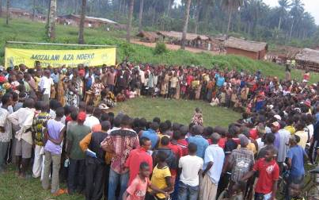
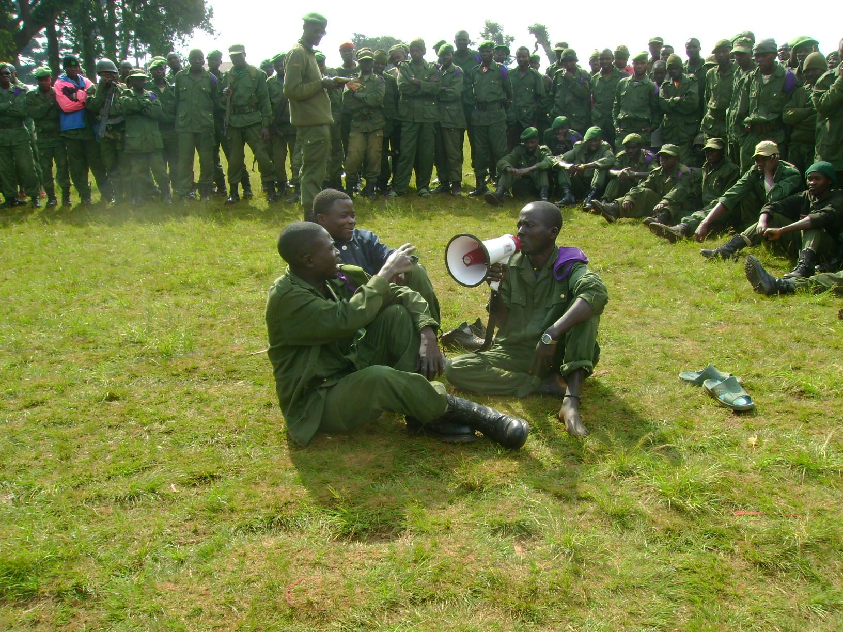
See ‘Theory of Change’
at end of presentation.
Participatory Theatre, DRC https://youtu.be/ph7_nJP5MQs?t=1m6s

Slide 10
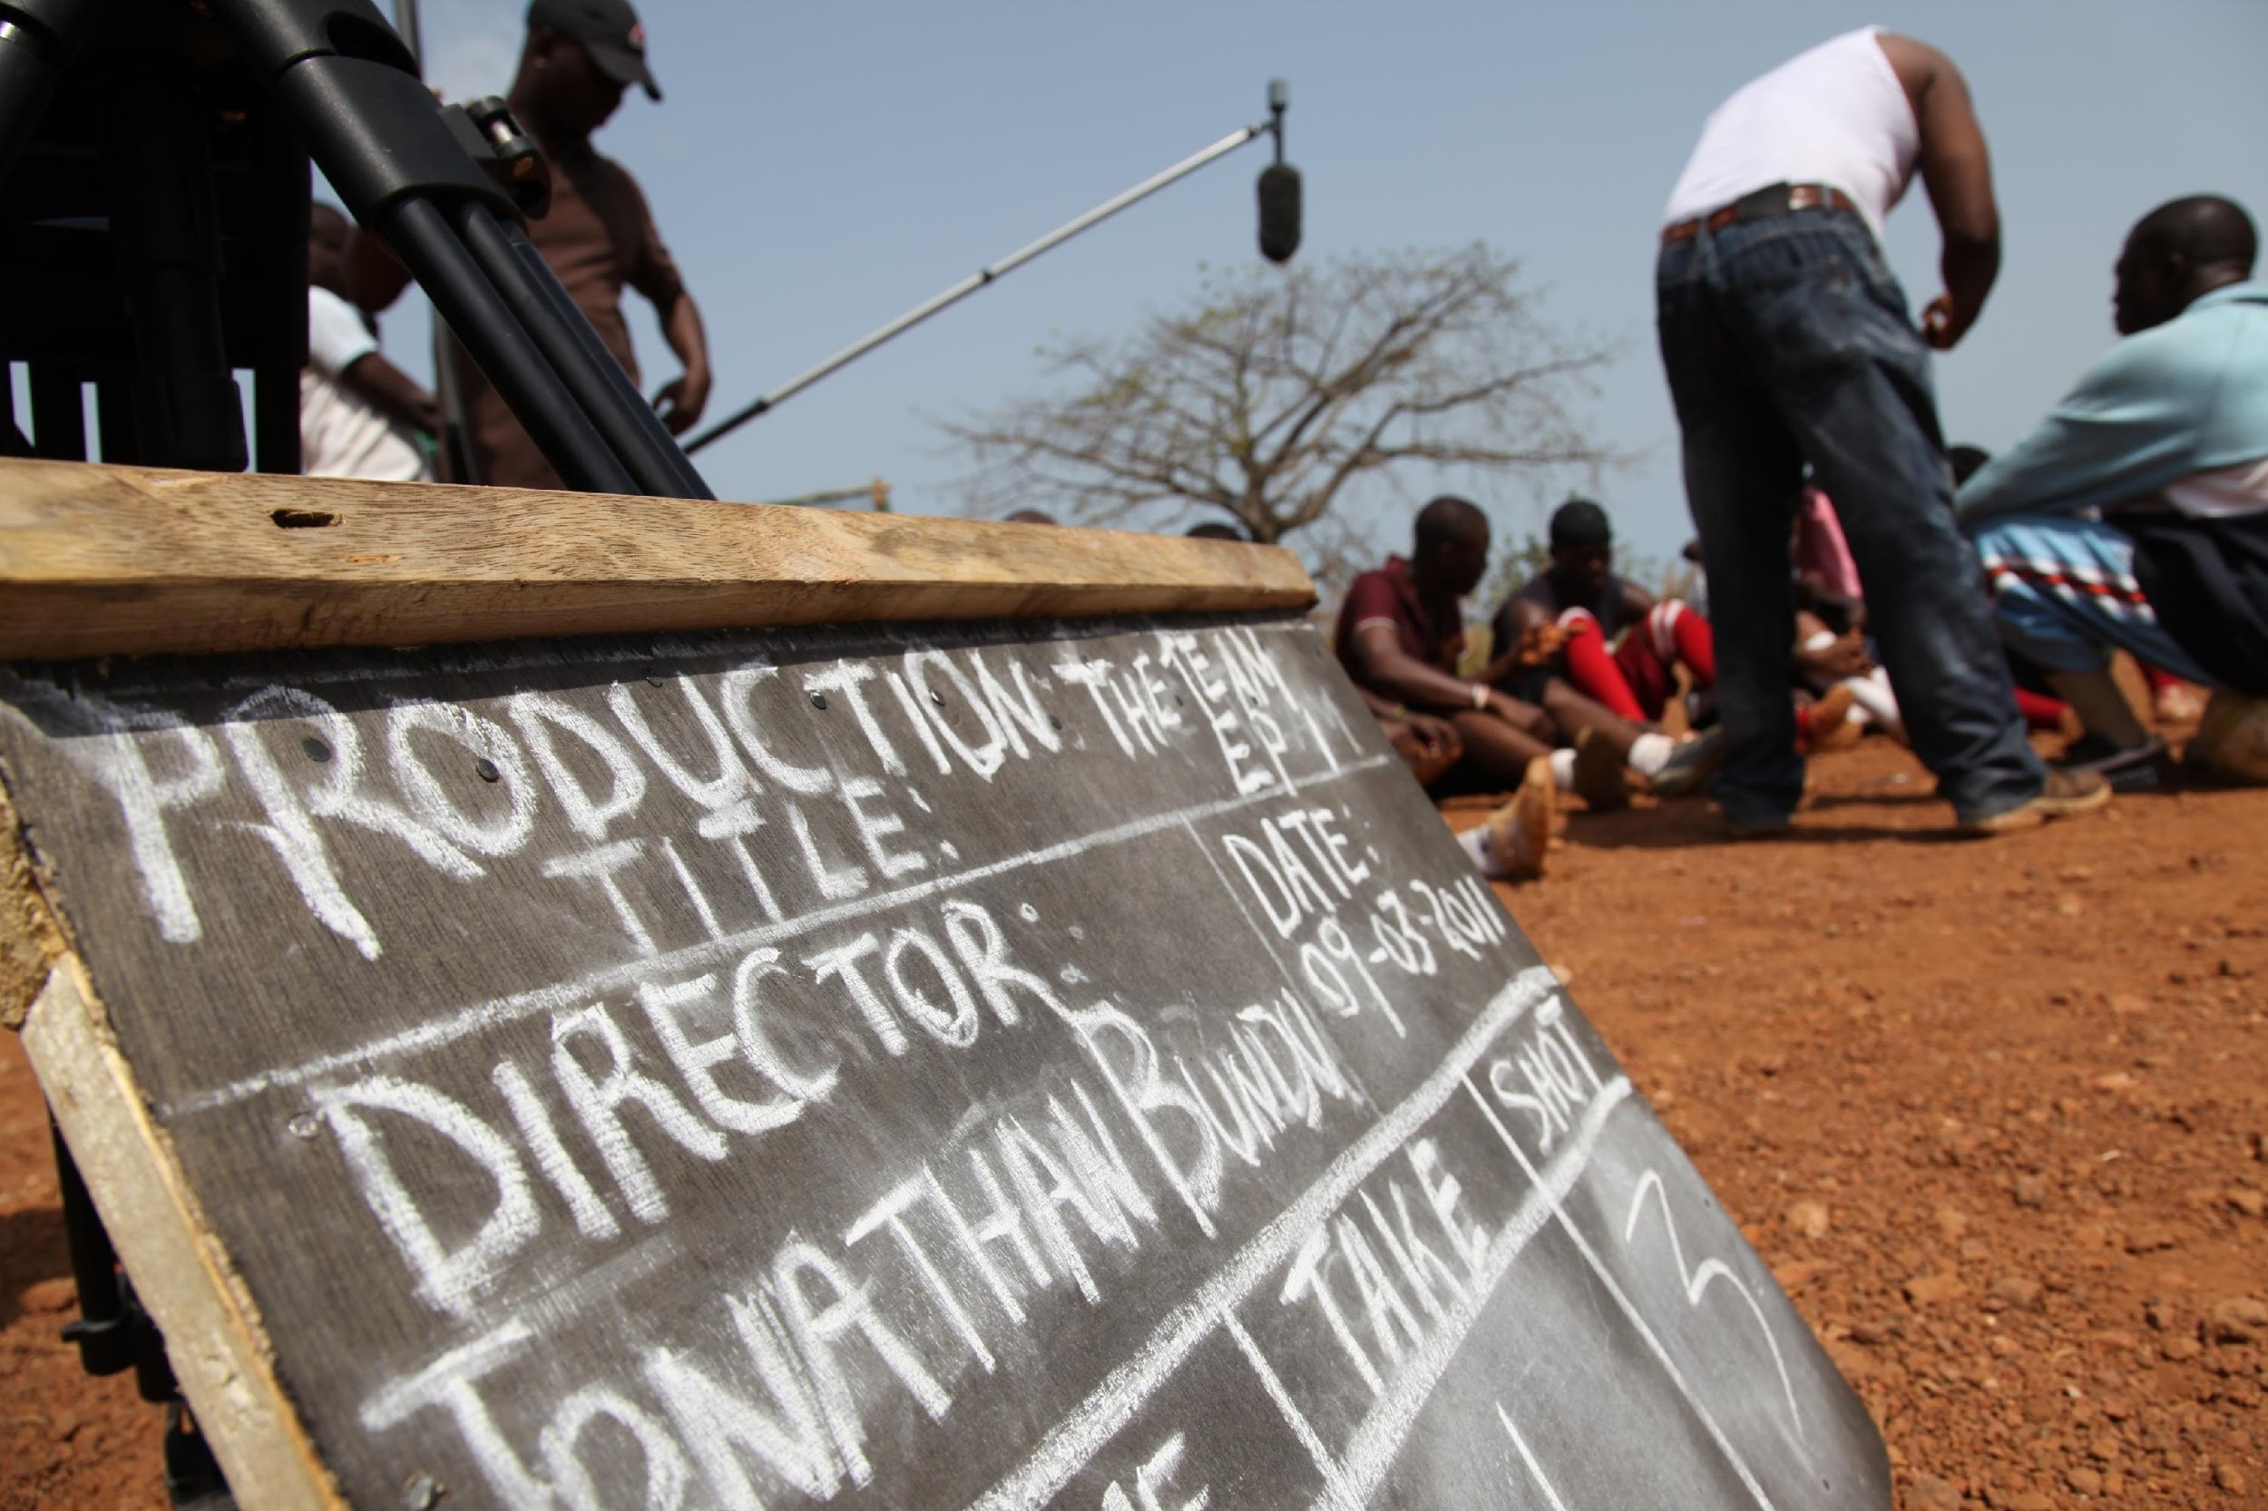
“The Team” TV Soap Opera, Yemen: https://www.youtube.com/watch?v=elyeodOJ-tk

Slide 11
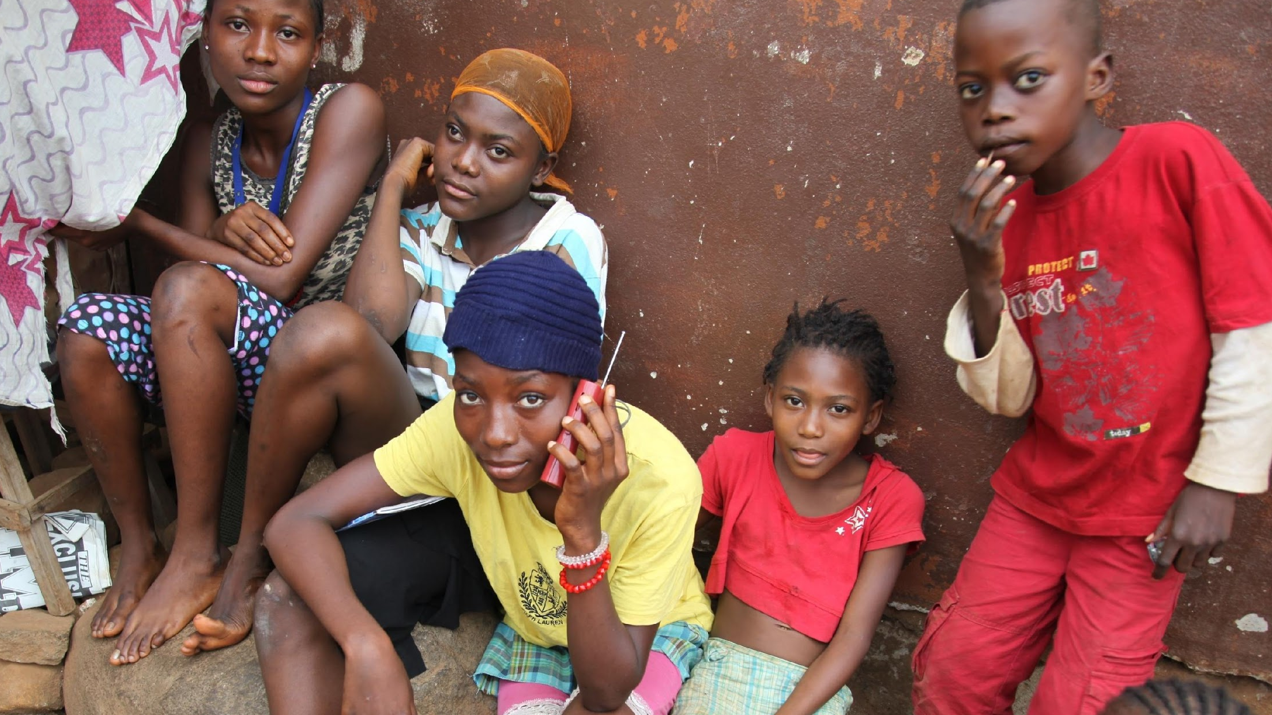
RADIO

Slide 12
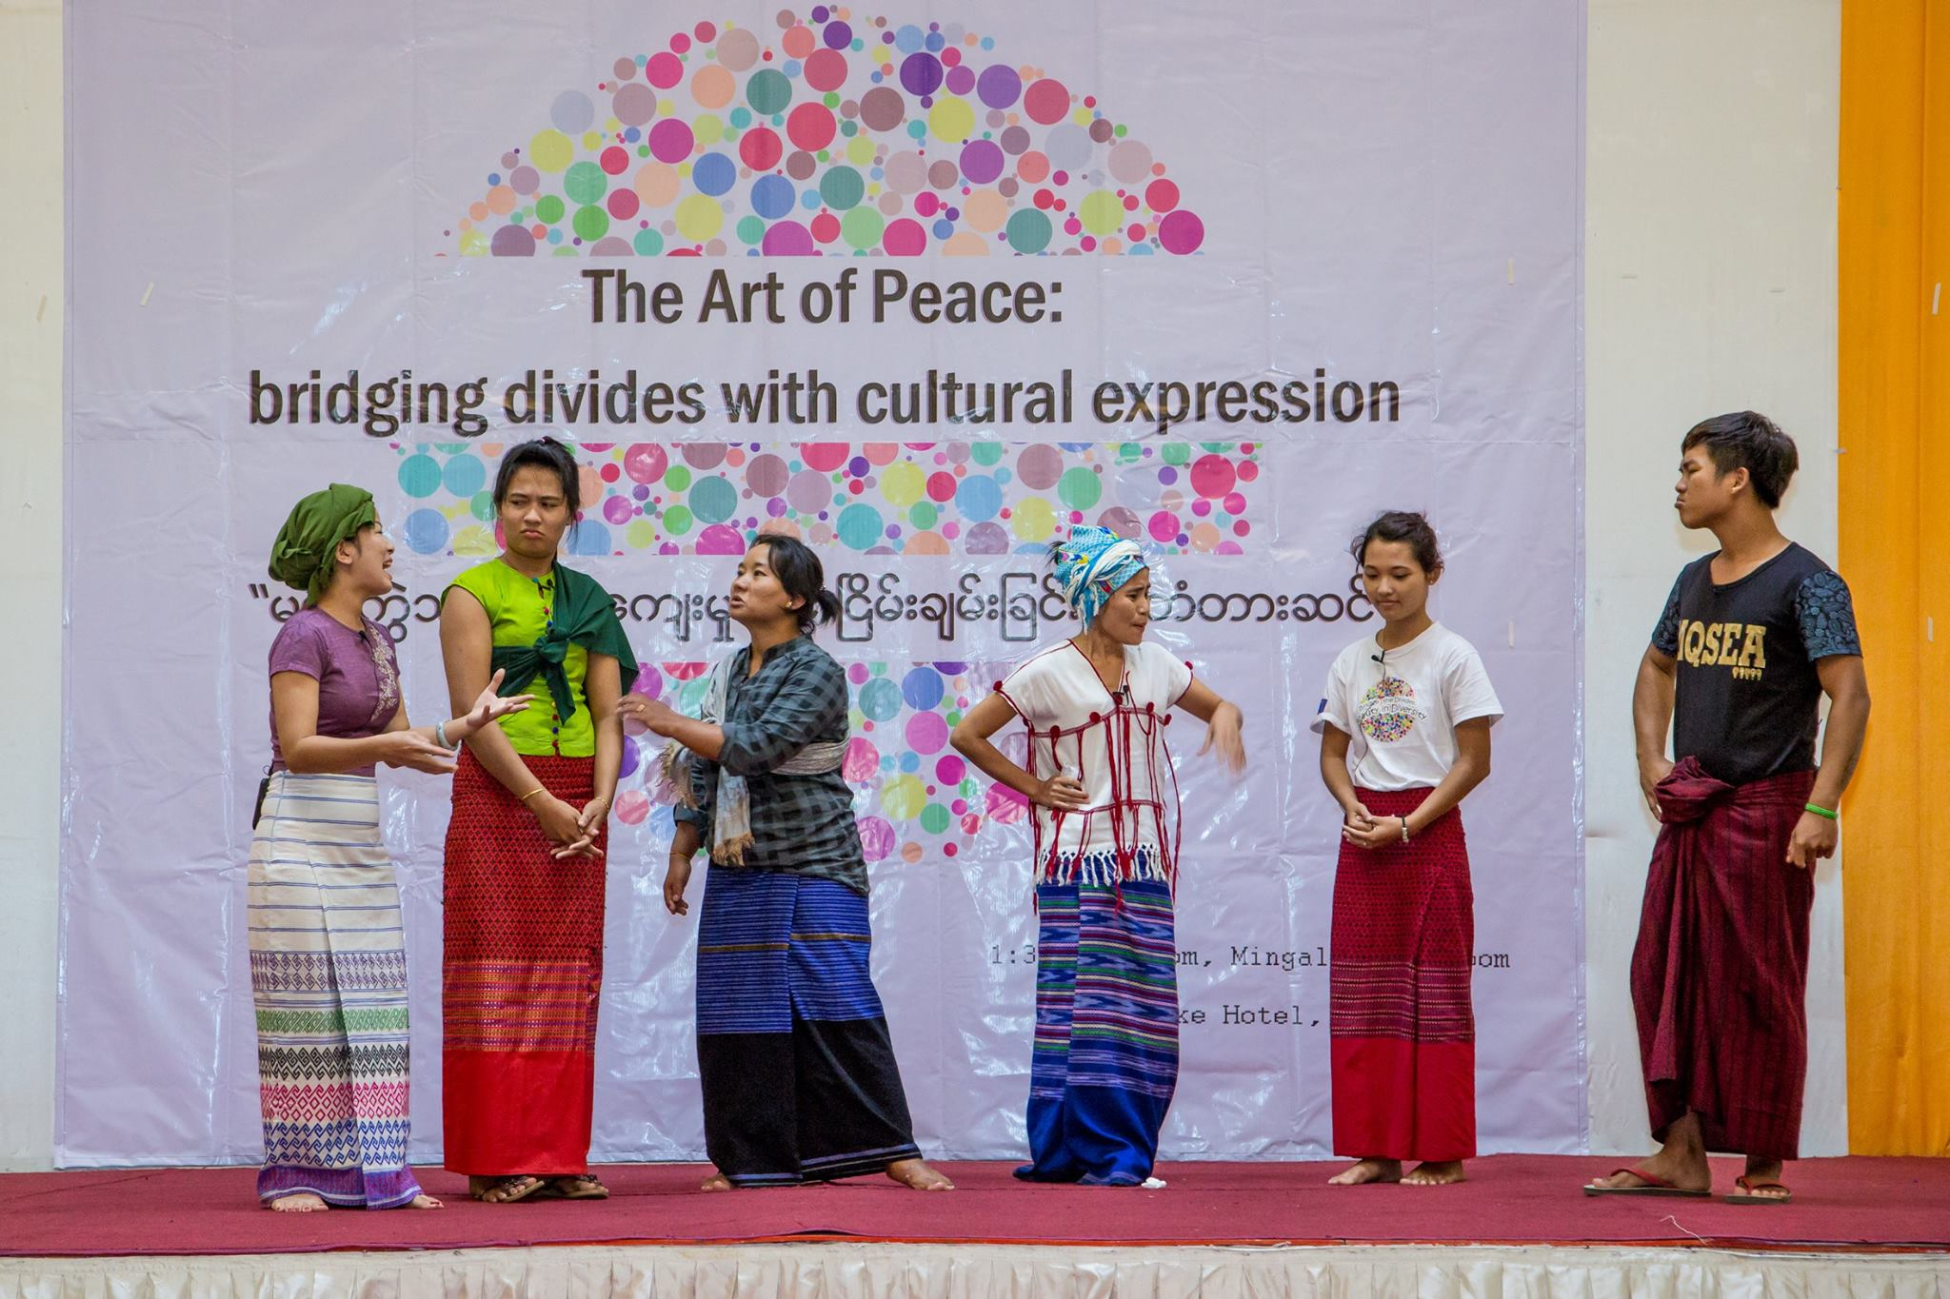
Myanmar Radio Talk Show: https://www.youtube.com/watch?v=1-lrxZWcojs&feature=youtu.be

Slide 13
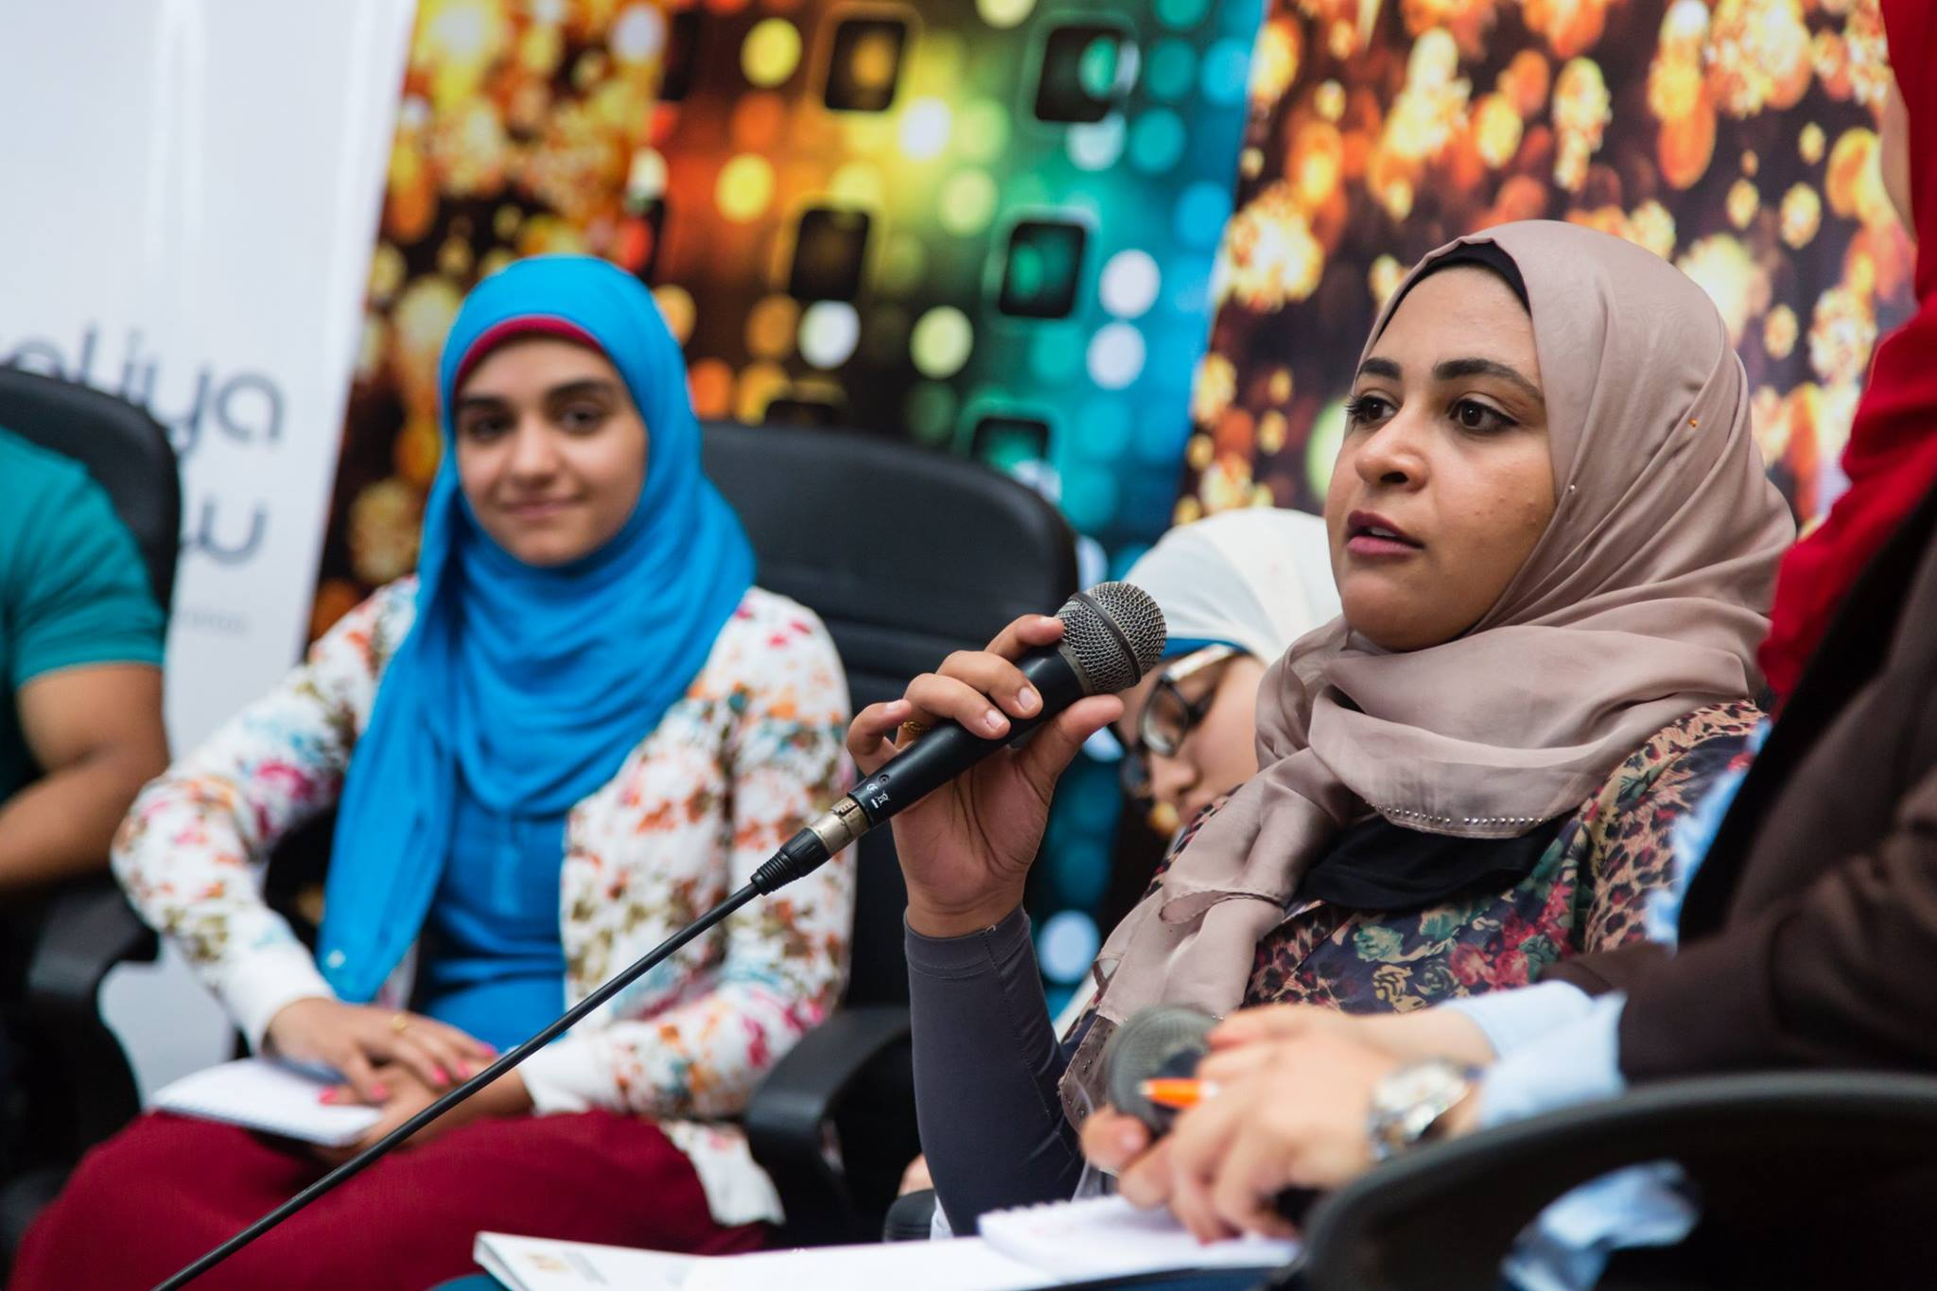
Virtual Exchange: https://www.youtube.com/watch?v=heIbE-ylLyQ

Slide 14
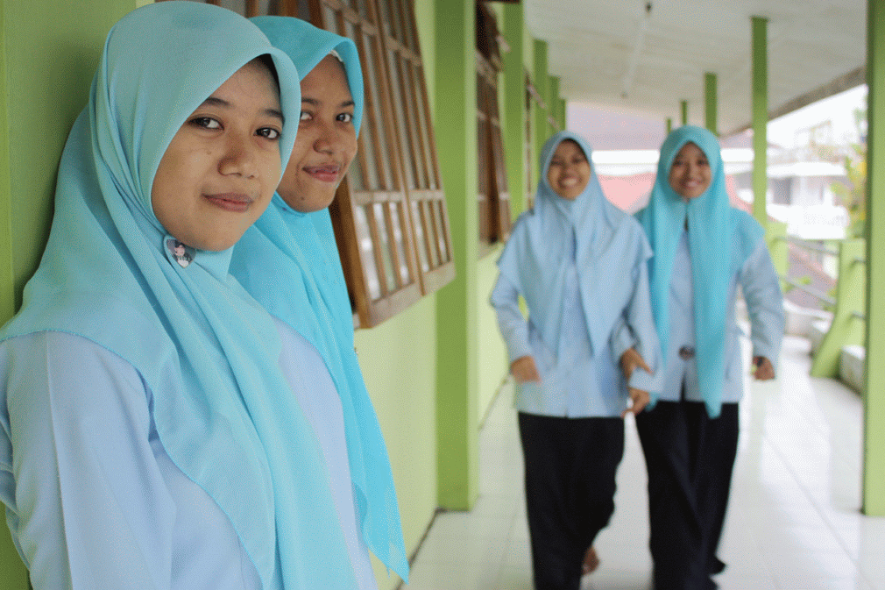
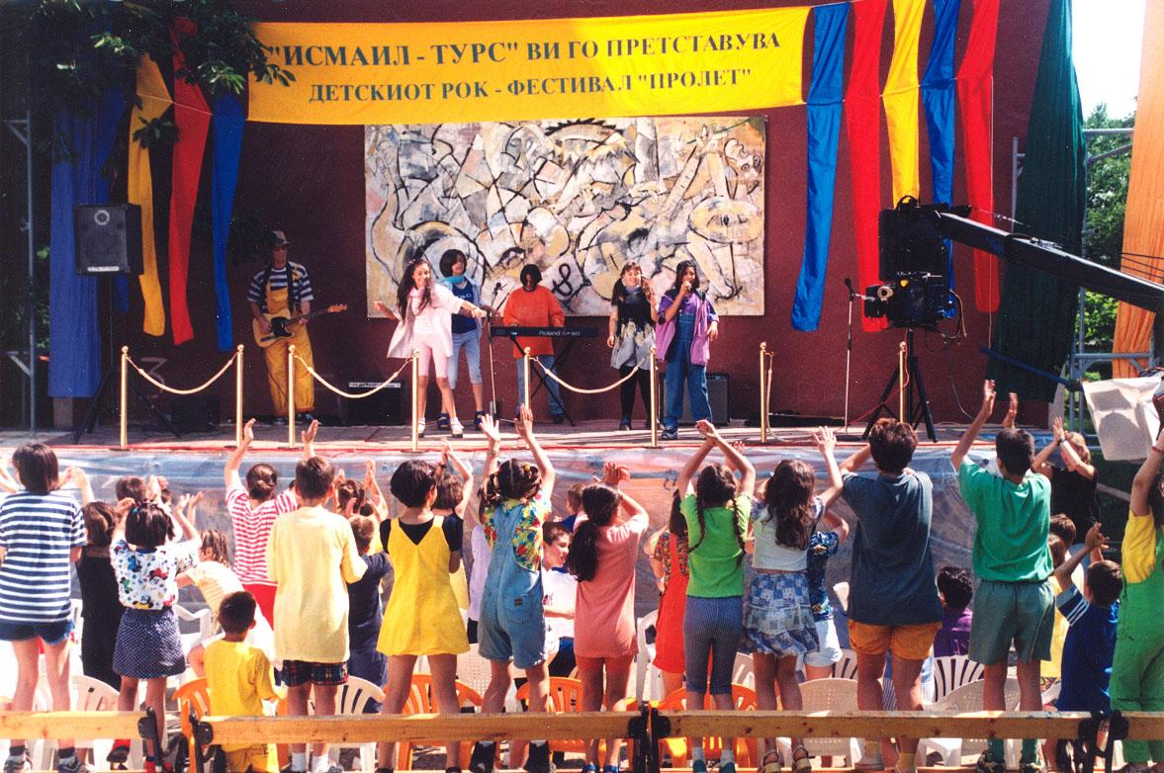

Slide 15
Participatory Theatre for Change
Participatory Theatre for Change is a creative approach used with and by communities and groups to collectively research and critically analyse their own situation, develop and perform artistic and cultural content that reflects their reality, and actively engage participants in dialogue, analysis, planning, and action towards positive social transformation.
The underpinning Theories of Change (TOC) for Participatory Theatre for Change (PTC) programming are multidimensional, moving from individual emotional engagement and response towards attitudinal, behavioural, and social changes which can culminate in larger social and institutional changes. The six core, interrelated Theories of Change underpinning the working definition of the PTC process include:

Slide 16
If the issues present in the community are accurately identified in a collective and participatory manner, then there is added potential for social and behaviour change, because of heightened awareness created through the issue identification process and enhanced resonance of the performance itself to multiple perspectives in the community. (Resonance)
If real issues present in the community are expressed through an interactive safe space, then participants can clarify and grow their knowledge, shift their attitudes and beliefs, and experience empathy for how others experience that issue in the community, because presentations in this manner allow for experiential learning and an emotional connection/experience that affects a person’s perspective of an issue. (Resonance)
If individuals are presented with safe spaces to ‘practice’, experiment with, and experience alternative approaches to a particular behaviour (such as addressing conflict), then they are able to think of new ways to behave and respond to those issue when presented with them in their lives, because safe spaces through participatory theatre create the potential to reimagine what is possible beyond the existing social relationships and norms. (Resonance, Response)

Slide 17
4. If practices and behaviours which are rehearsed in the safe spaces are valued and accepted as beneficial by key people or groups in a society, then more people are likely to adopt such behaviours leading to a shift/change in social norms, because modelling of new responses and behaviours gives implicit permission to behave differently without threat of negative consequences. (Reach, Response)
5. If practices and behaviours which were rehearsed in safe spaces are valued, accepted, and taken up in real life by a critical mass of people in a society, then social norms related to an old behaviour or practice will change, because social norms are dependent on judgement, threat, and passive acceptance grounded in a group of people’s daily responses in a society. (Reach, Response)
6. If theatre participants are provided access to new information, knowledge, and are empowered to speak about policy issues that impact their community to key government influencers, then community groups will organise collective action and advocate to change laws and/or institutions in their favour, because sharing information and building feelings of confidence to affect change create an enabling environment that can shift traditional power dynamics. (Response)

Slide 18
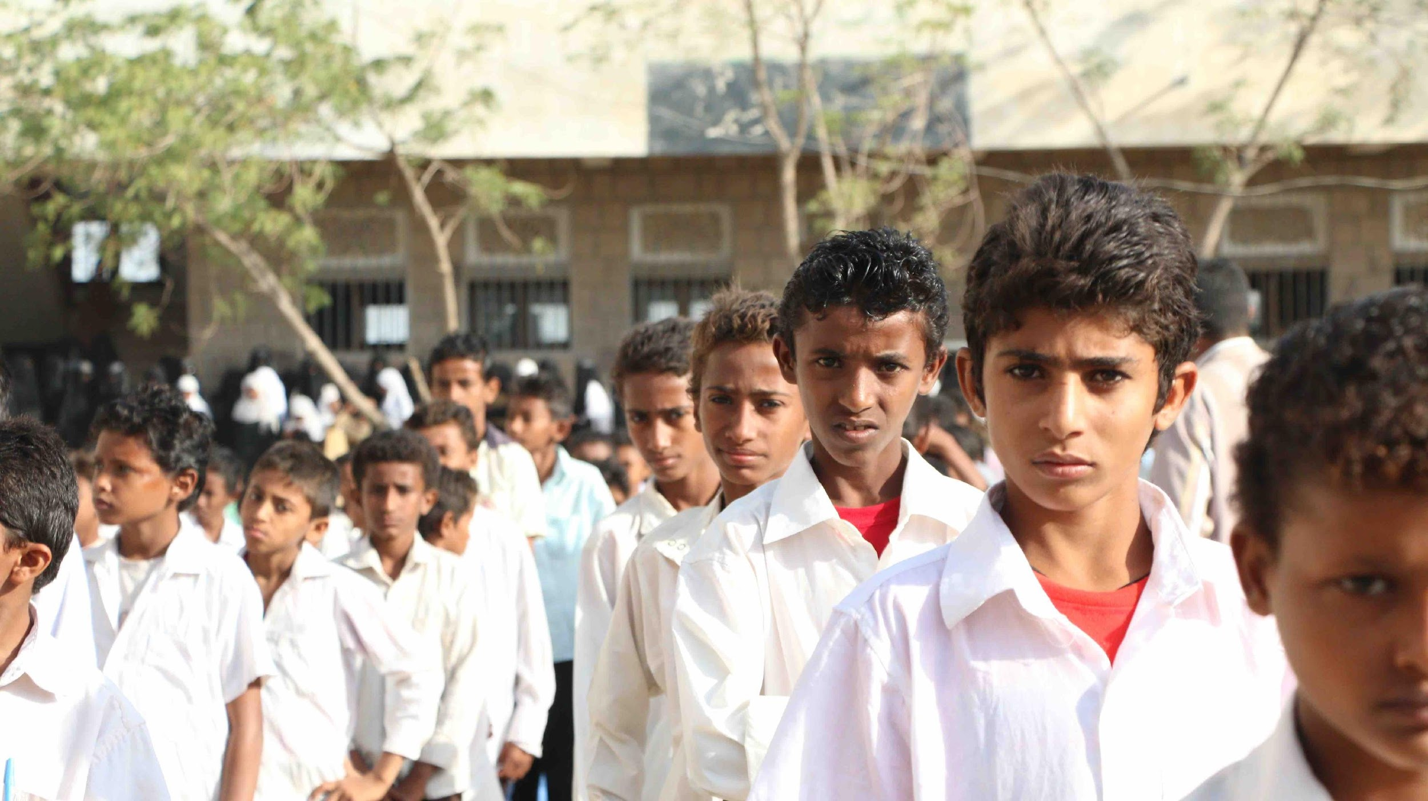
Photo: Students in Search’s Yemen Schools Programs

Slide 19
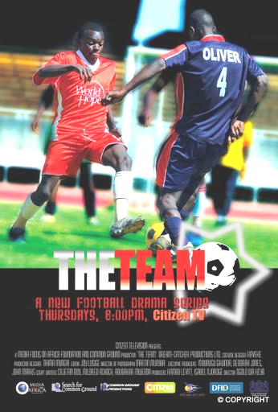
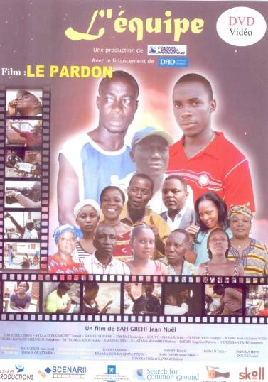

Slide 20
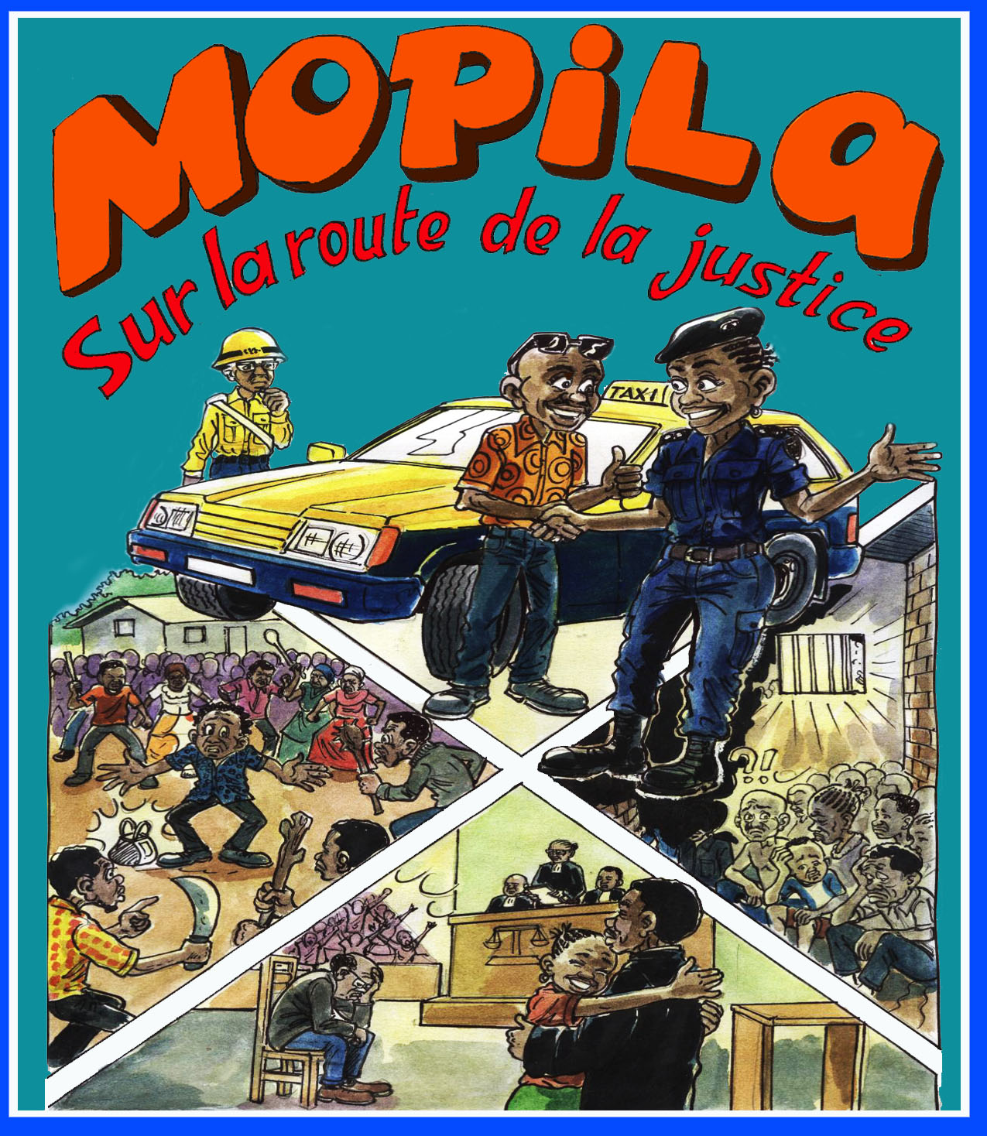
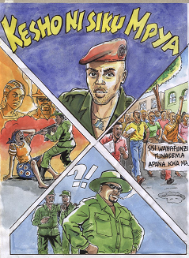

Slide 21
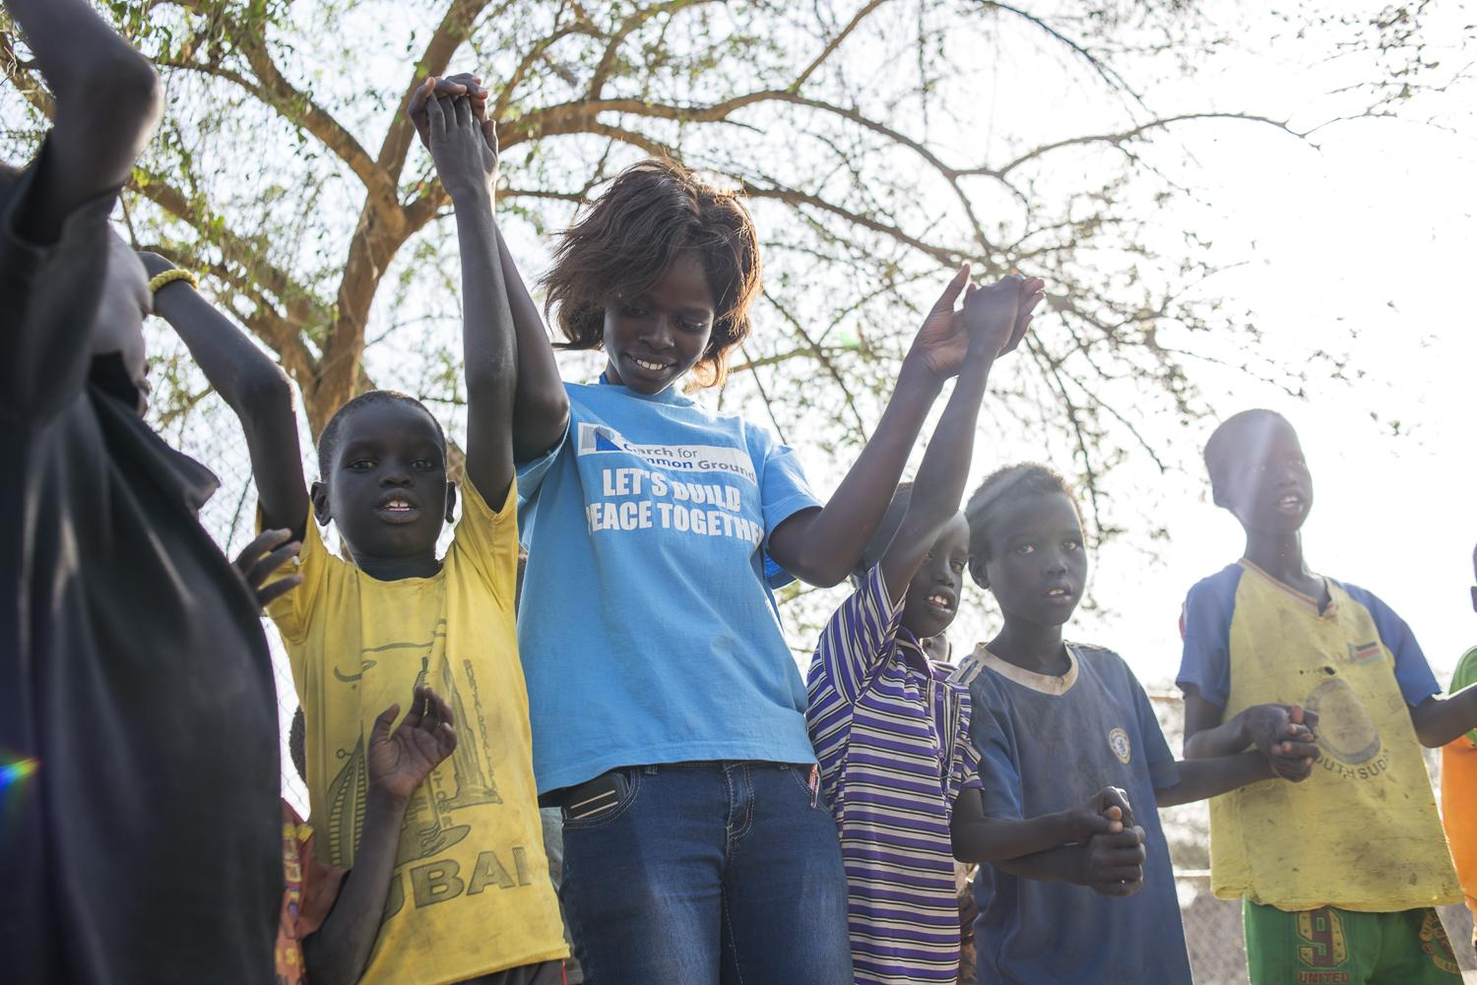
Thank you.

