Slide 1
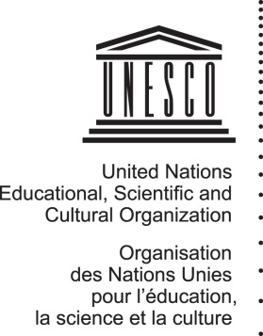
Cultural Heritage as an Engine for
Social Recovery:
UNESCO’s Action and Follow up to the World Reconstruction Conference
Giovanni Boccardi
Emergency Preparedness and Response Unit, UNESCO CULTURE SECTOR
Brussels, 24 OCTOBER 2017

Slide 2

An Overview of UNESCO’s Action
for the Protection of Culture from Disasters and Conflicts

Slide 3
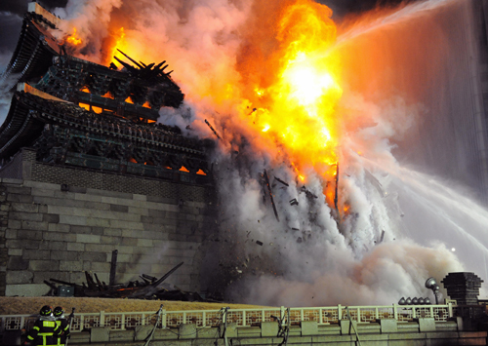
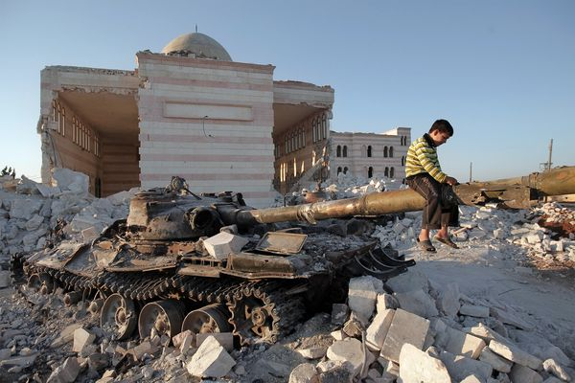
Setting the Context
An unprecedented rise in the number of disasters
and conflicts affecting the culture sector

Slide 4
Challenges
Disasters
Disconnect between culture and DRM fields
Cultural attitude (e.g. fatalism, superstition, reluctance to raise issues with superiors, etc.) and priority given to issues that can be “seen”
Conflicts
Disruption of governance in areas of conflict
Limitations of UNESCO’s mandate in conflict situations
Cross-cutting
Lack of funds and reliable data
Lack of adequate mechanisms to respond to emergency situations
Misperception of nature and costs of mitigating strategies
Lack of awareness of potential positive role of culture

Slide 5
Culture as a Security Imperative and a Humanitarian Issue
Growing recognition of the role of culture for resilience, including in humanitarian response;
Protection of cultural rights as enablers of Human Rights and condition for preventing violence and conflict;
Growing number of intra-State conflicts exacerbated by ethnic or religious identification, with cultural considerations playing an increasingly important role;
Financing of terrorism, armed groups and organized crime through illicit trafficking of cultural objects;
Correlation between conflicts and disasters;
Crisis situations as « niche » where UNESCO has comparative advantage and added value.

Slide 6
UNESCO’s Emergency Preparedness
and Response Unit
Established in 2014;
Acting as a Focal Point and coordinating platform among Conventions, Field Offices as well as humanitarian, security and peace-building actors;
Covers all emergencies (conflicts and disasters);
Works to operationalize all existing UNESCO Conventions in emergencies through an integrated approach.
Notes:
The Unit:
Coordinates, linking with other UNESCO services and external partners
Provides technical support to programme implementation
Offers policy advice, and develops inter-institutional cooperation
Supports communication and resource mobilisation

Slide 7
Policies and Plans developed recently
Strategy for the Reinforcement of UNESCO’s Actions for the Protection of Culture and the Promotion of Cultural Pluralism in the Event of Armed Conflict, adopted by UNESCO’s General Conference in November 2015;
Strengthen Member States’ ability to prevent, mitigate, and recover the loss of cultural heritage and diversity as a result of conflict
Incorporate the protection of culture into humanitarian action, security strategies and peacebuilding processes
Action Plan for the implementation of the Strategy, endorsed by UNESCO’s Executive Board in April 2017
Addendum to the Strategy on natural disasters, endorsed by Executive Board and to be adopted by General Conference in November 2017

Slide 8
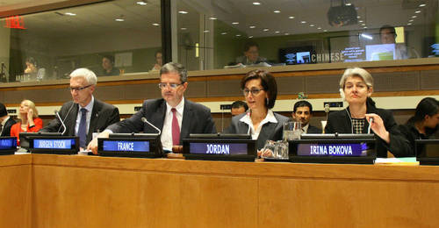
Advocacy, Facilitation &
Technical Coordination
Statements by Director-General;
Work with Member States to influence policy decisions (e.g. UNSC resolutions);
Coordination of reports to UN SC (e.g. 2199, 2347);
Thematic conferences and technical coordination meetings, including at local level.
Director-General at UN Security Council, 27 April 2015

Slide 9
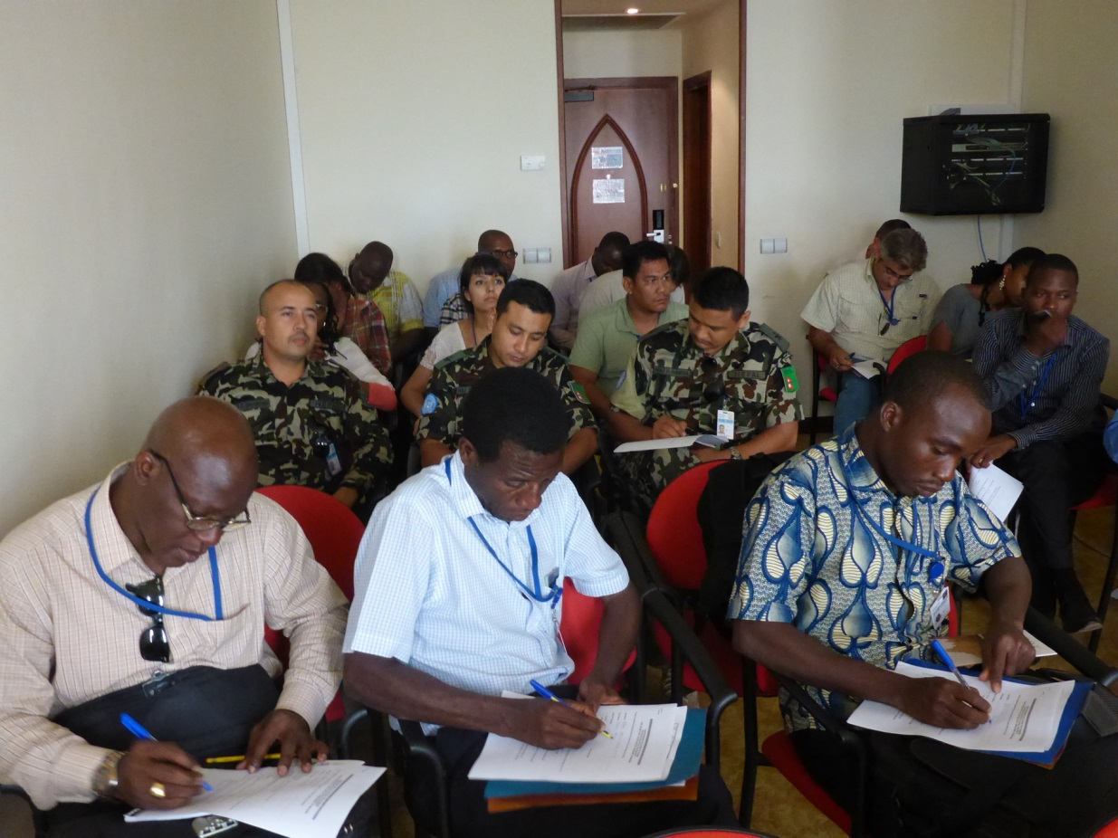
Technical Assistance &
Capacity-Building
Rapid assessment (including PDNA, RPBA);
Training of civilian, military, customs and police staff;
Support to urgent safeguarding measures;
Development of new tools (e.g. Manuals, IT tools, methodological guidance, etc.)
Training of MINUSMA personnel, Mali

Slide 10
Monitoring
Analysis of satellite images in cooperation with UNOSAT;
Documentation on the ground, including community-based mapping of intangible cultural heritage;
Support to the development of inventories.

Slide 11
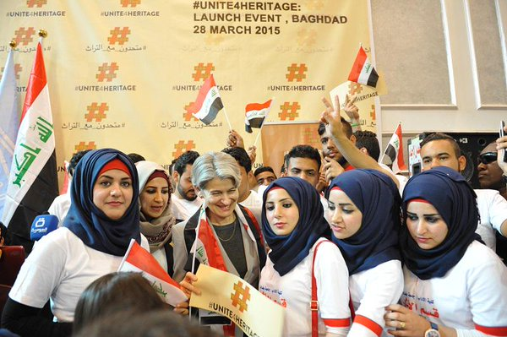
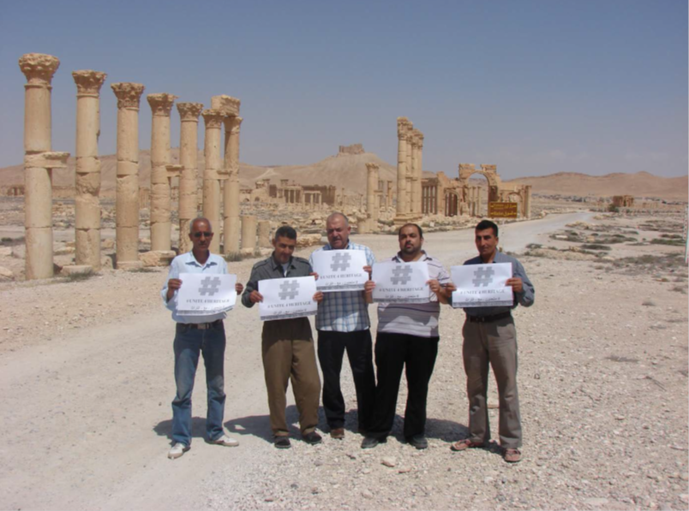

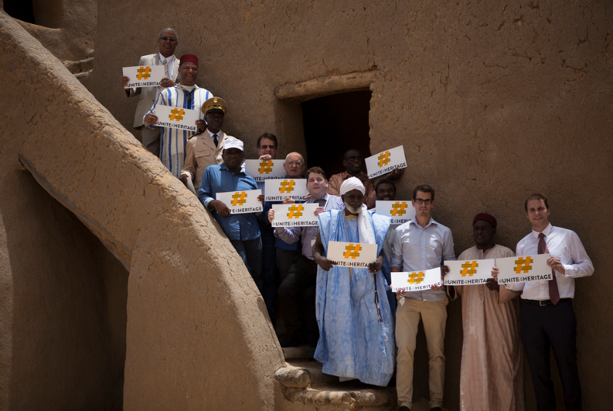
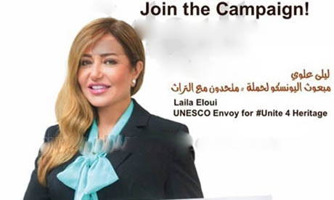
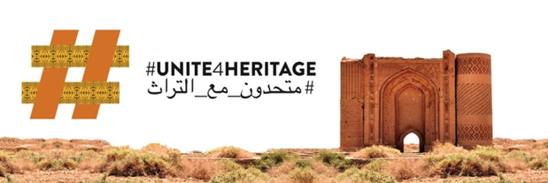

Awareness-Raising

Slide 12
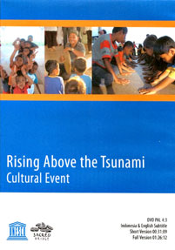
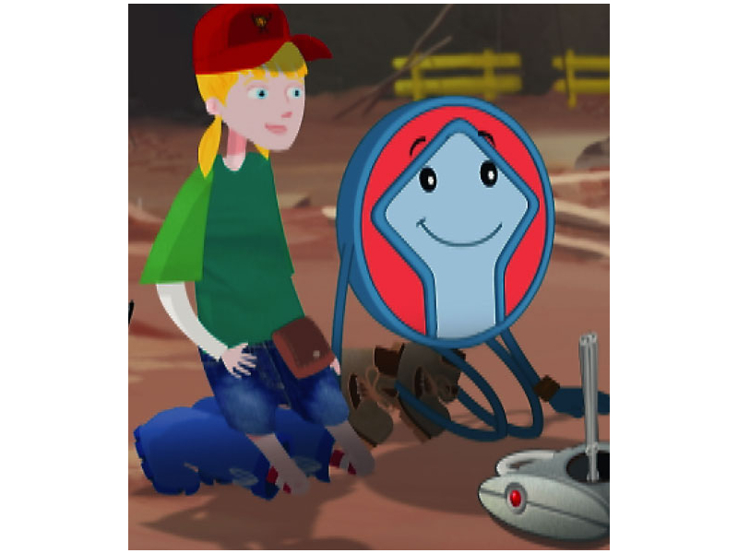
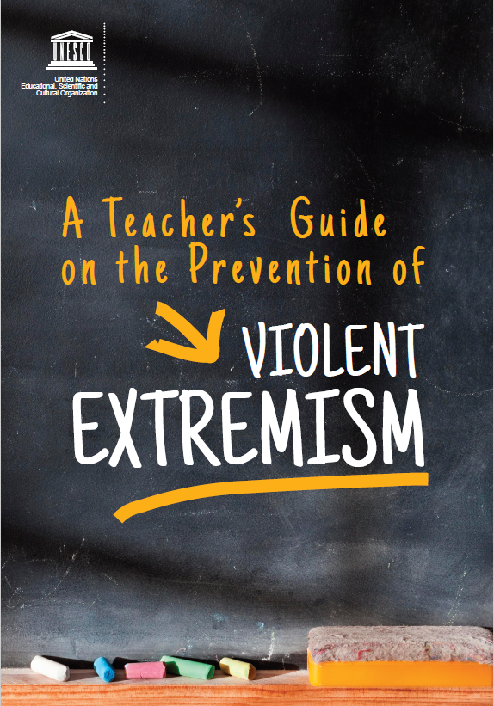
Education and Communication
Notes:
Education and communication is an area where there is a lot of potential.
In Indonesia, following the tsunami of 2005, UNESCO organised cultural and psychotherapeutic healing programmes addressed to traumatised children, focusing on their heritage. The programme was a great success.
WHC, in the meantime, produced a new episode of the “Patrimonito” saga, devoted to disaster risks: Patrimonito in Avila. This is accessible from: http://whc.unesco.org/uploads/activities/documents/activity-50-12.mov It describes, in a language accessible to children, the main stages of DRR…We might have a look at it, if time allows…it is only a few minutes.
More recently, UNESCO has developed a cross-sectoral Teachers’ Manual on the Prevention of Violent Extremism

Slide 13
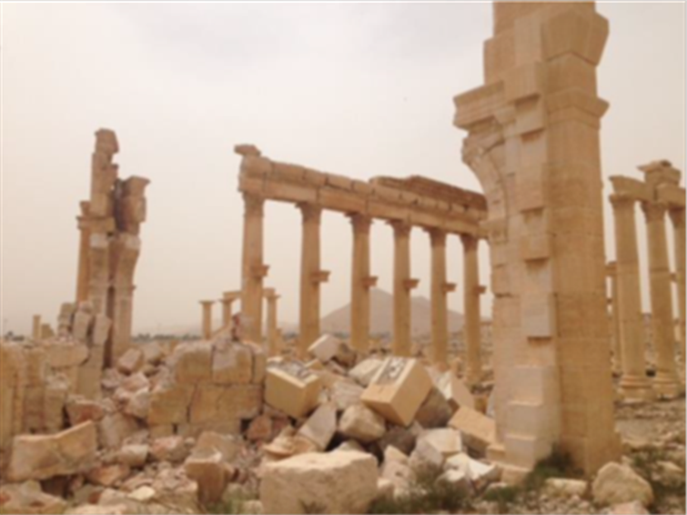
.
The Heritage Emergency Fund
Multi-donor and non-earmarked funding mechanism
Covers cultural and natural heritage in disasters and conflicts
Finances activities related to emergency preparedness and response
Deals with all dimensions of culture: immovable, movable and intangible heritage, cultural repositories, and the diversity of cultural goods and services

Slide 14
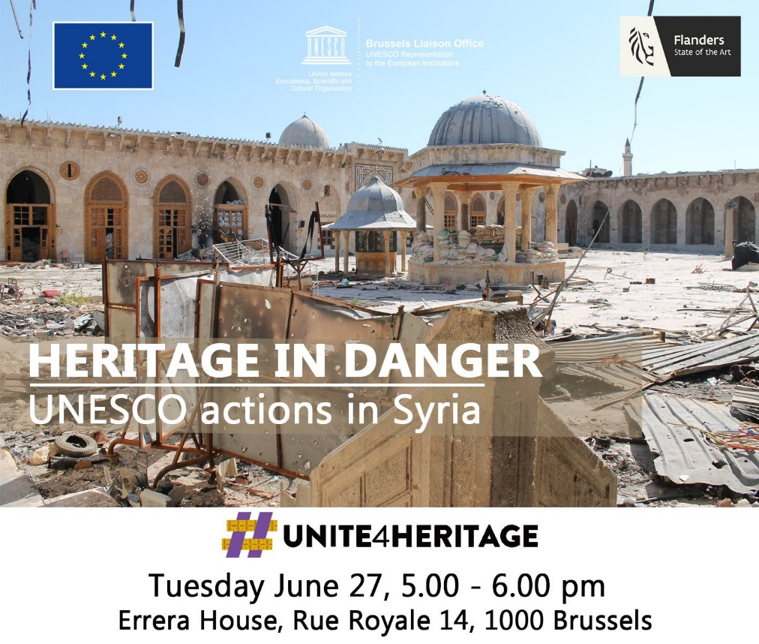
.
Cooperation with the EU
Ca 40 projects implemented by UNESCO worldwide in partnership with the EU;
In field of culture:
country-based: eg. Syria, Mali, Yemen (under negotiation);
related to policy and advocacy
high-level meetings
Notes:
Ca 40 projects implemented by UNESCO worldwide in partnership with the EU, and the cooperation has been steadily increasing since 2011.
In the field of culture, UNESCO and the EU have recently joined forces to
rehabilitate cultural heritage and safeguard manuscripts in Mali,
establish UNESCO cultural world heritage routes in Europe,
strengthen systems of governance of the cultural sector in developing countries through means of an expert facility and
provide an operational response to halt the on-going loss of cultural heritage and prepare post-conflict priority actions in Syria.
In 2015, the partnership between UNESCO and the EU has been reinforced thanks to various high-level meetings, notably the participation of the Director-General in a Public Hearing at the European Parliament (15 September 2015) to strengthen cooperation for the protection of culture and education in emergency situations. The Hearing coincided with the 10th anniversary of UNESCO’s 2005 Convention on the Promotion and Protection of the Diversity of Cultural Expressions, one of UNESCO’s most important contributions for the protection of human rights and for building an open citizenship in a globalized world.
In June 2016, the European External Action Service was also a key partner in the UNESCO High-Level event and Conference on “#Unite4Heritage. Cultural Diversity under Attack: Protecting Heritage for Peace” that took place in Brussels. The important relations between the EU and UNESCO, notably around the role of culture for foreign policy and for building sustainable peace, were highlighted as one of the key outcomes of the meeting

Slide 15
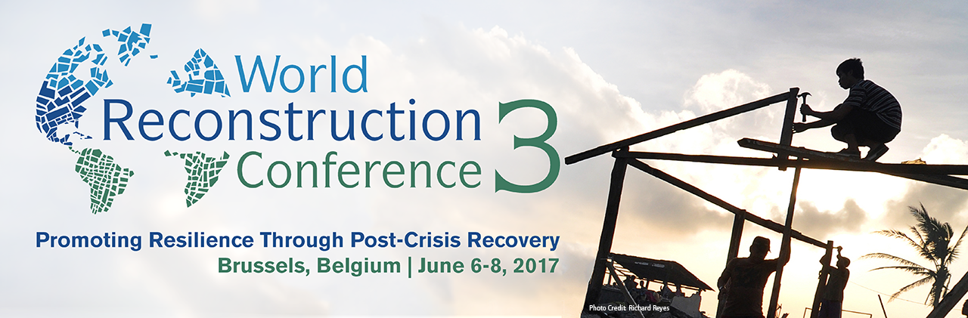
Technical Session on Culture
“Cultural Heritage – an Engine for Social Recovery”
Brussels, June 6-8, 2017

Slide 16
Session Objectives
Impact of armed conflicts and disasters on culture;
Impact on resilience of the concerned communities;
Benefits of including a concern for culture, in both its physical and intangible manifestations, in recovery efforts;
Potential of new technologies.

Slide 17
Panelists
Mr Sameh Wahba, Social, Rural, Urban and Resilience Global Practice, World Bank
Ms Amra Hadzimuhamedovic, International University of Sarajevo and Center for Cultural Heritage at the International Forum Bosnia
Mr Glafkos Costantinides & Mr Ali Tunkay, Technical Committee on Cultural Heritage in Cyprus
Mr El-Boukhari Ben Essayouti, Cultural Mission of Timbuktu, Mali
Brigadier General Fabrizio Parrulli, Comando Carabinieri Tutela Patrimonio Culturale, Italy
Mr Rohit Jigyasu, ICORP (ICOMOS International Scientific Committee on Risk Preparedness)
Mr Yves Ubelman, ICONEM

Slide 18
Key messages (1)
Fundamental role of culture and heritage for resilience and recovery;
Destruction of cultural heritage represents dual loss:
1) for the affected populations
2) for the economy
Physical recovery of heritage and education for cultural pluralism can support the reconciliation of communities and sustain peace;
Cultural heritage as tool to rebuild confidence and trust

Slide 19
Key messages (2)
Involvement of communities in rehabilitation of cultural assets strengthens resilience and enhances their own recovery;
Role of traditional knowledge in reconstruction and opportunities provided by reconstruction to revive traditional knowledge;
Use of new technologies for preparedness and to support the social recovery of people by providing alternative means of accessing their cultural heritage and thereby enjoying their cultural rights.

Slide 20
Session Outcomes
To protect culture and harness its potential, the culture sector must strengthen its capacities and be better prepared;
Gap to be filled for the full integration of culture into humanitarian, security and peacekeeping policies;
Events such as the World Reconstruction Conference, in this regard, represent critical opportunities to further sensitize international stakeholders, including at the technical level, which is often driving concrete initiatives on the ground.

Slide 21
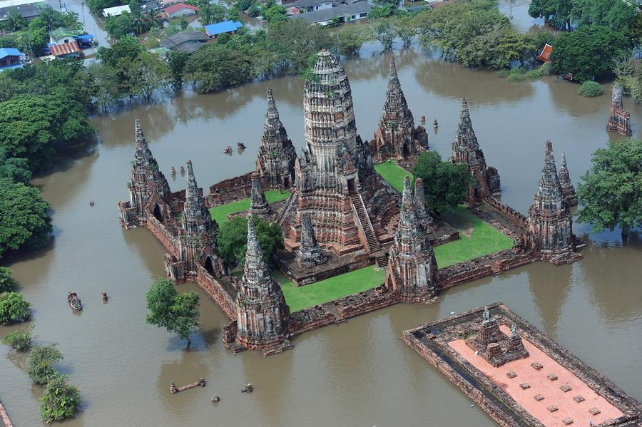
Strategic priorities for 2018 and beyond
Inventorying and risk assessment of cultural heritage;
Establishment and deployment of Rapid Response Mechanism;
Capacity-building for preparedness and response to emergencies, including through new methodological tools (e.g. integration of First Aid to CH capacities into CH organizations and EU Civil
Protection mechanism);
Support to social-economic recovery through
culture (e.g. Yemen etc.);
Inclusion of culture within PDNA and RPBA
exercises and other international processes;
Education and awareness-raising (Unite4Heritage)
Use of IT for preparedness and recovery

Slide 22
Thank you!

