Slide 1
February 8th, 2018
OPSYS
Webinar to launch the test phase with Implementing Partners

Slide 2

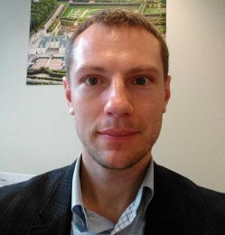


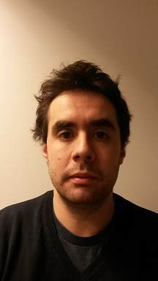
Welcome to the OPSYS webinar to launch the test phase
Who is running the webinar ?
Michal Krejza
Tomasz Kaminski
Lucile Petitpierre
Véronique Lena
Guido Bilanceri

Slide 3
OPSYS
Presentation 1: What is OPSYS and what benefits will it bring you? Quick overview on governance and key benefits
Michal Krejza, Head of Unit, Results and Business Processes, DEVCO

Slide 4
Agenda of the webinar
Agenda
Presentation 1 What is OPSYS and what benefits will it bring you? Quick overview on governance and key benefits.
Presentation 2 OPSYS: the overall picture
Presentation 3 How does OPSYS fit in the big picture for implementing partners?
Presentation 4 OPSYS - Results and Monitoring: Results portal Create and manage a logframe
Presentation 5 Communication and user support : Key principles and timeline Testing: Objective, how to proceed with colleagues in EUDs, webinar sessions, on-line feedback
Questions & Answers

Slide 5
Aims of the webinar
Introduce OPSYS to external stakeholders
Share with you some insights on functionalities developed so far
Present the governance of the overall programme
Inform you of what you could expect and by when in terms of functionalities
To explain how you can participate in the testing exercise

Slide 6
Quick reminder: What is OPSYS?
An integrated IT system, i.e. "one stop shop"
Covering the entire project lifecycle from the political decision until the final evaluation
An instrument supporting a new, more collaborative way of working among various stakeholders
An ambitious collective effort

Slide 7

Why do we want OPSYS?
Ease of use:
- Single interface covering all the workflows of the project cycle
- No re-encoding
- Will allow progress and completion reports to be drafted and approved online; faster approval
User centricity:
- User centred
- User friendly look and feel
- Accessible through all types of devices
YOU
Velocity and trustworthiness:
- Faster link between progress reports and invoices
- Cheaper, easier and safer tendering and grant procedures

Slide 8
Where do we stand now?
  Parallel development on 3 complementary aspects of the project lifecycle
    Track 1: Results and monitoring
    Track 2: Contracts and procurement
    Track 3: Programming, actions and decisions
  Start testing:
    1st testing with European Commission users in November 2017
    1st testing with external stakeholders in February 2018

Slide 9
OPSYS: structure and management
The programme is structured by tracks:
A shared governance between DEVCO, NEAR, FPI and DIGIT:
  Every 6 weeks OPSYS Management Board meeting chaired by DEVCO DDG and vice-chaired by DIGIT DDG
  Monthly Project Steering Committee meetings for each track chaired by Director DEVCO F for T1, by Director DEVCO R for T2, by Director NEAR C for T3
  Monthly Domain Users Group (main consultative body) meetings on business priorities
T1: Results and monitoring
T2: Contracts and procurement
T3: Programming, actions
and decisions

Slide 10
OPSYS
Presentation 2: OPSYS – The overall picture
Véronique Lena, Team leader Change Management Results and Business Processes, DEVCO

Slide 11
Scope of results and monitoring (T1)
Head of Section: Roxana Calfa
Business manager: Lucile Petitpierre
Manage interventions and not (only) contracts
Improved Aid Transparency
Quality of interventions
Visibility of results achieved
RESULTS
Monitoring results from programming to closure
Facilitation of data aggregation
Better follow-up and time management
during implementation

Slide 12
Key milestones for Track 1
Q1 2018
Q2 2018
Q3 2018
Q4 2018
2019
Release 1
Progressive roll-out
Release 3
Remaining features on Monitoring
User Testing with Pilot EUDs and HQs
Release in Production for Pilot EUDs and HQs
Release 2
Remaining features on Results
Current focus

Slide 13



Current focus = SIEA FWC : 9 business phases and 97 functionalities
Scope of the 'contract and procurement' solution (T2)
Head of Section: Paul Riembault
Business manager: Loic Elies
Prepares the tender dossier
Evaluates the offers
Sign the contract
Invites to submit
Awards
Manages the pre-financing
OPSYS
OPSYS
Submits an offer
Prepares the contract
Manage the implementation

Slide 14
97 functionalities (10 of which are big and not detailed)
Scope of the 'contract and procurement' solution
Prepares the tender dossier
Evaluates the offers
Sign the contract
Invites to submit
Awards
Manages the pre-financing
Submits an offer
Prepares the contract
Manage the implementation

Slide 15
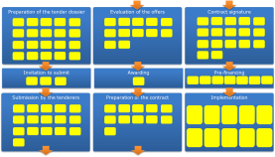
The full scope is 60 procedures types !
All the 'functional bricks' built for the first type of procedure (SC under FWC) are reusable for other types of procedures
Procurement
Grant
Other (BS, PE, …)

Slide 16
Key milestones for Track 2
Extend with other types of contracting modes
Q2 2018
Q3 2018
Q4 2019
2020
FWC SIEA
first
test-able version
Full FWC SIEA ready
for production
Target date for CRIS phase-out
To be replaced by OPSYS
OPSYS full release in production
Current focus

Slide 17
Scope of programming, actions, decisions (T3)
Head of Section: Joël Neubert
Business manager: Iason Foscolos
One single workflow for Level 1 commitment management
Programming (create & manage financial instrument, MIP)
Action management (incl. action programme, recovering data from action document, link to prior approvals, link to results)
Main budgetary functionalities
Statistics and reporting

Slide 18
Key milestones for Track 3
Q4 2017
Q3 2018
Q2 2019
Q3 2019
Q2 2020
Business case and project charter
Minimum Viable Product
Release 2
Release 3
OPSYS full release in production
Current focus

Slide 19
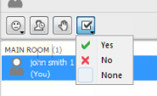
Some questions for you!
Remember to use the polling tool and not the chat box!

Slide 20
Your input is welcome!
Question:
How would you rate the quality of your logframes today?
a. Very good
b. Good
c. Average
d. Poor
Choose A or B or C or D
Remember to use the polling tool and not the chat box!

Slide 21
Your input is welcome!
Question:
How often do you update your logframe during the project implementation?
  Never
  At each progress reports
  Ad hoc for key events
  At the end of project
Choose A or B or C or D
Remember to use the polling tool and not the chat box!

Slide 22
Your input is welcome!
Question:
Do you include your lograme in the progress reports?
✓Yes
x No
Choose Yes or No
Remember to use the polling tool and not the chat box!

Slide 23
Your input is welcome!
Question:
How do you communicate the progress on your key indicators?
  Informally to the OM
  Only through the progress reports
  Don't report on key indicators
Choose A or B or C
Remember to use the polling tool and not the chat box!

Slide 24
Your input is welcome!
Question:
Who is in charge of updating the logframe?
  The backstopping team of the consulting company / NGO central office
  The team leader and/or the experts in the field
This is key to provide credentials to external users
Choose A or B and elaborate in chat box

Slide 25
Your input is welcome!
Question:
Who should submit the logframe in OPSYS for approval by the OM?
  The backstopping team of the consulting company / NGO central office
  The team leader and/or the experts in the field
This is key to provide credentials to external users
Choose A or B and elaborate in chat box

Slide 26
Your input is welcome!
Question:
  Which steps should mostly be improved in your Collaboration/communication with EC staff?
  Tendering/call for proposals
  Reporting and invoicing
  Other
Choose A or B or C and elaborate in the chat room

Slide 27
Your input is welcome!
Question:
Have you already used e-procurement (online submission of calls or tenders)?
  Yes, with other DG of the European Commission
  Yes, with PROSPECT (DG DEVCO)
  Yes with other donors
  Never
Choose A or B or C or D
Remember to use the polling tool and not the chat box!

Slide 28
OPSYS
Presentation 3: How does OPSYS fit in the big picture?
Tomasz KAMINSKI, DIGIT

Slide 29
OPSYS is part of EC Corporate strategy for a modern eGoverment service
Art. 95.2 of the Financial Regulation commits the Commission (even more widely, the institutions) to the design and implementation of "solutions for the submission, storage and processing of data submitted in grant and procurement procedures". To this end, "a Single Electronic Data Interchange Area [SEDIA] for applicants, candidates and tenderers" shall be put in place

Slide 30


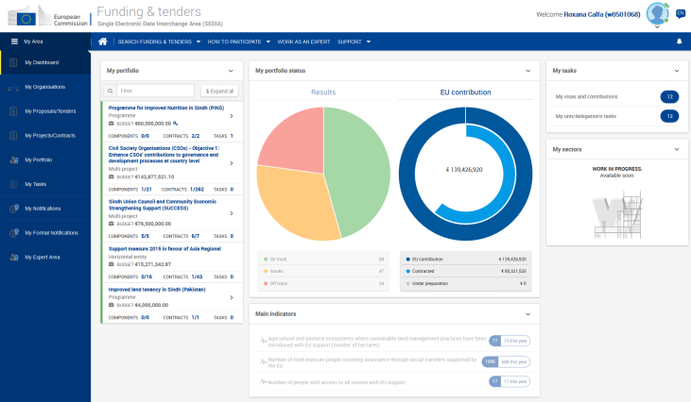
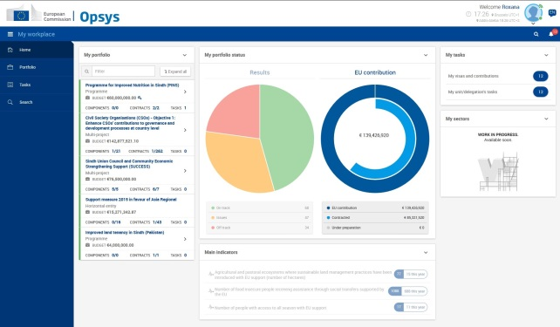
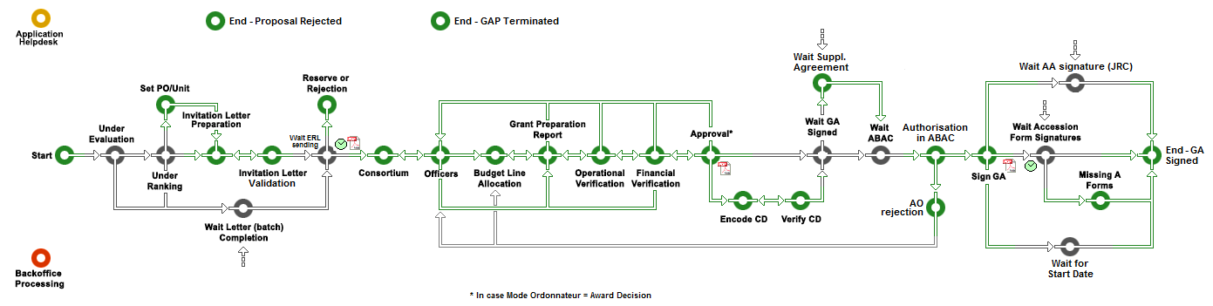
OPSYS is part of EC Corporate strategy for a modern eGoverment service
Process driven – Adaptable
100% Paperless – 100% Mobile
User centric - User Friendly - Secure
Quick information access – Real time
Automated checks – No clerical tasks
Transparency – Collaboration - Performance
External users
EC users
Corporate Services
ABAC
ARES
eSignature
….

Slide 31

One stop shop for implementing partners
Manage Legal Entities
Create and manage proposals and tenders
Manage awarded contracts and projects
Manage results
Consult tasks, notifications & formal notifications
Work as an expert
31

Slide 32
OPSYS
Presentation 4: OPSYS - Results and Monitoring
- Results portal
- Create and manage a logframe
Lucile Petitpierre, Results and Business Processes, DEVCO

Slide 33
Results and monitoring in OPSYS: what will you be able to do?
    Plan, monitor and report on your interventions: create and submit the logframe, encode results, export the logframe
    Store and consolidate the results of your interventions
    Manage and follow up on your activities, key events and milestones
    Collaborate directly with EC staff and receive faster approvals
    Submit progress reports and upload relevant documents
    Coordinate easily with your consortium and partners

Slide 34
What can you do as (Lead) IP at this stage?
    Be accredited by your Operational manager
    Access OPSYS
    Access interventions you are in charge of
    Access logframe and submit them for approval
    Report on indicator progress and submit for approval
    This is what you will test!

Slide 35
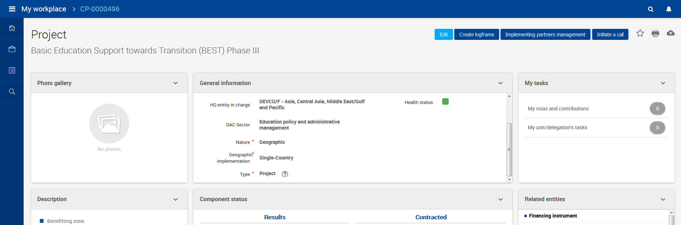
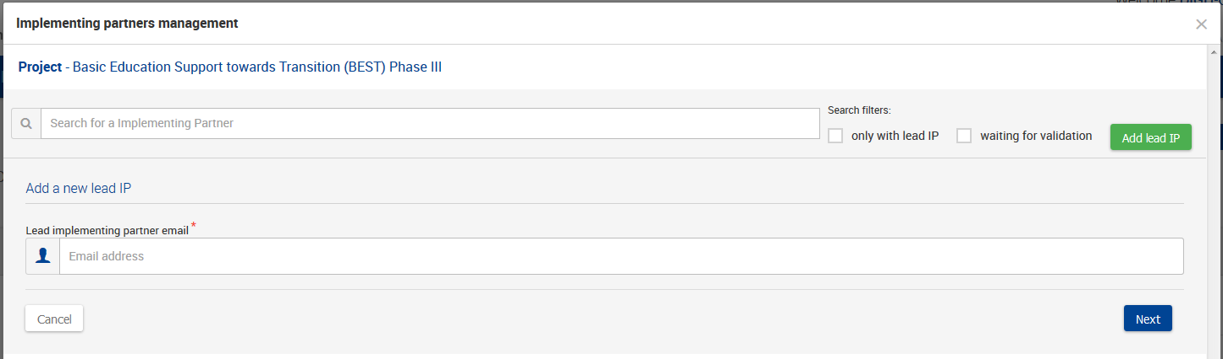
Operational Manager assigns you as Lead-IP
1
2
3

Slide 36
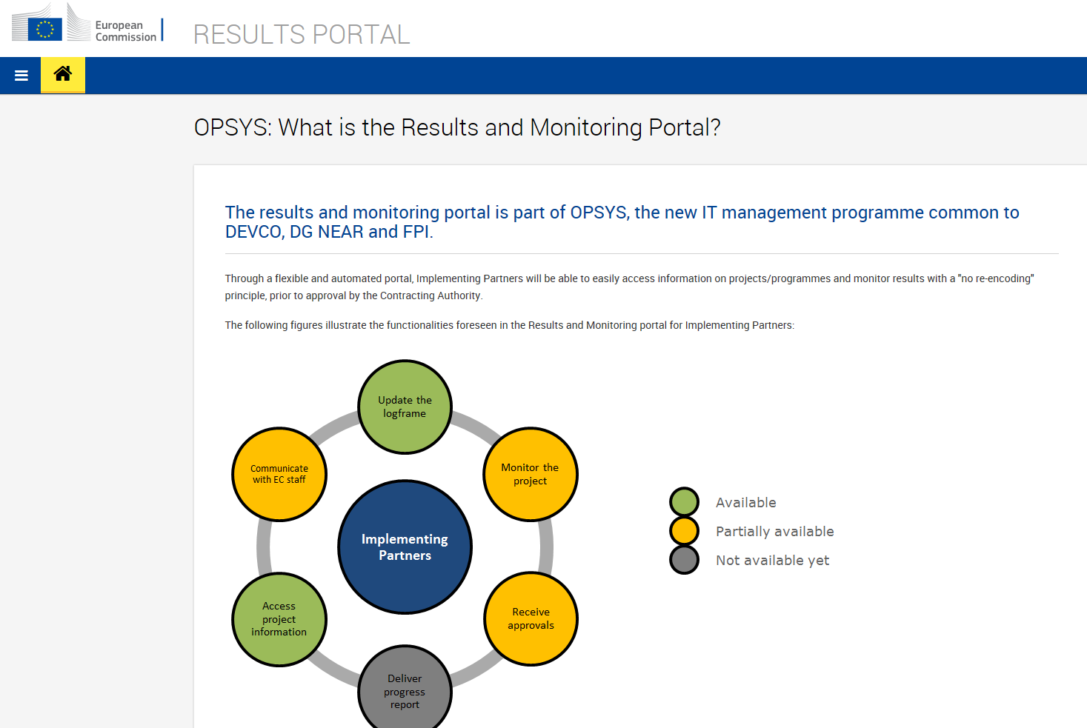
Lead-Implementing partner accesses Result portal

Slide 37
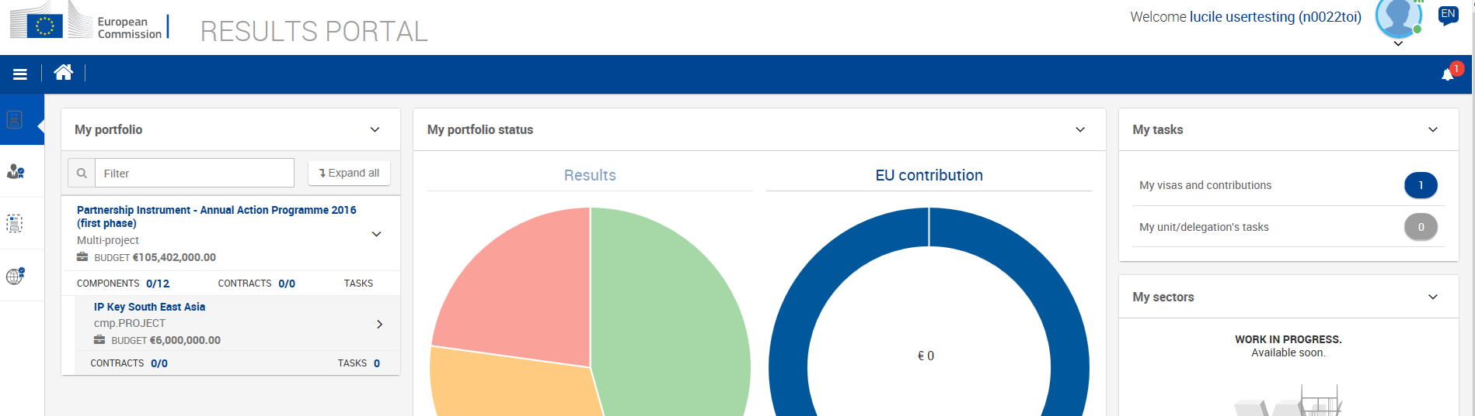
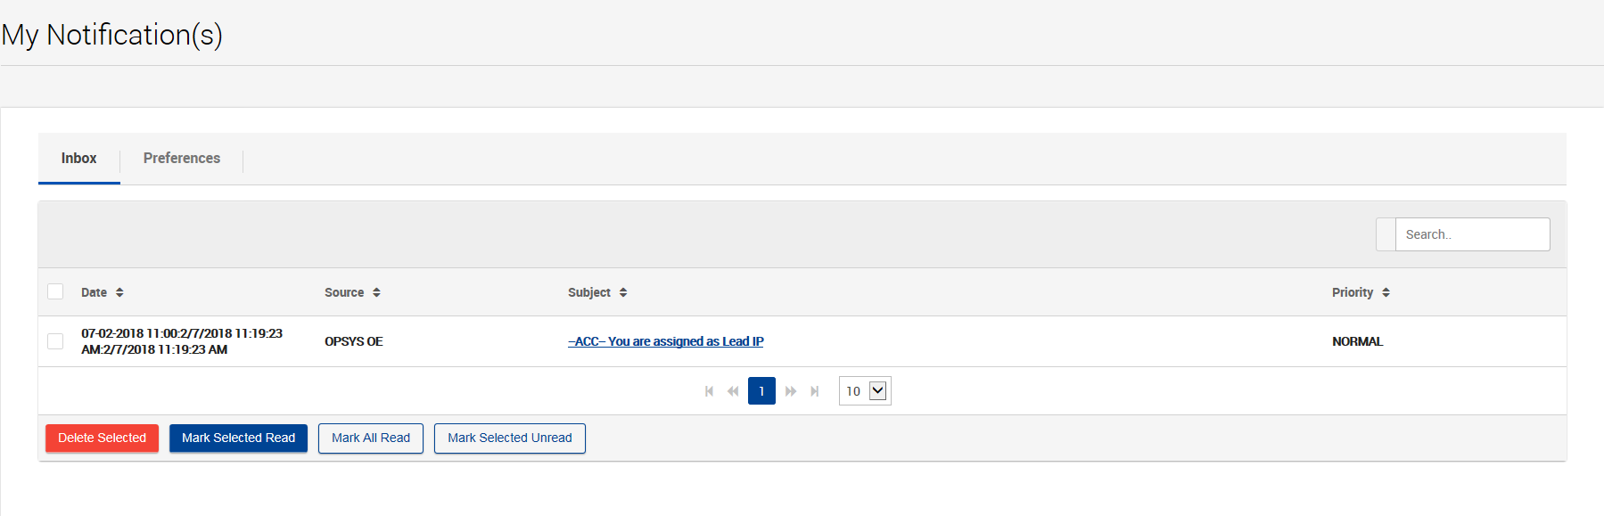
Access personal dashboard

Slide 38
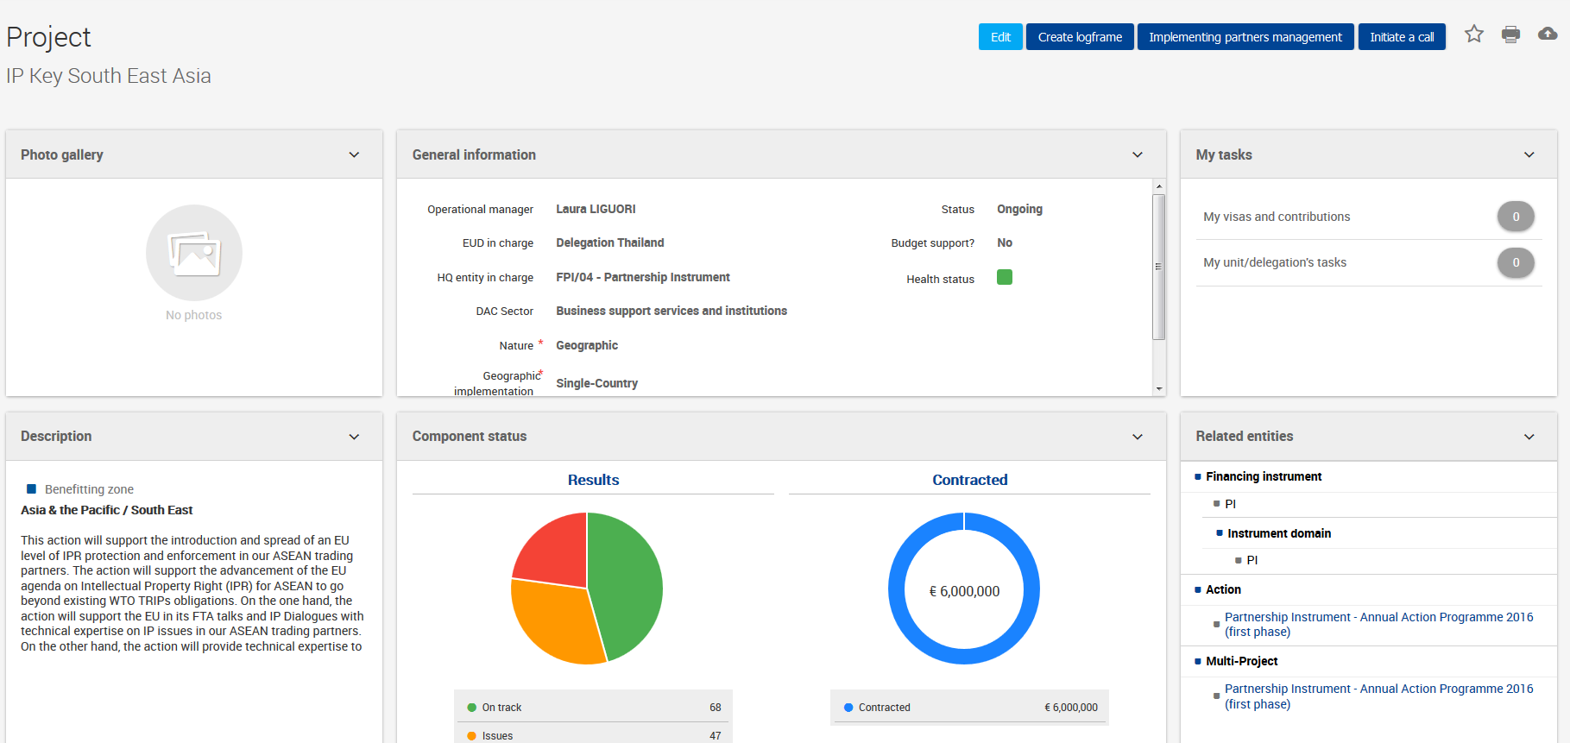
Access intervention and create logframe

Slide 39
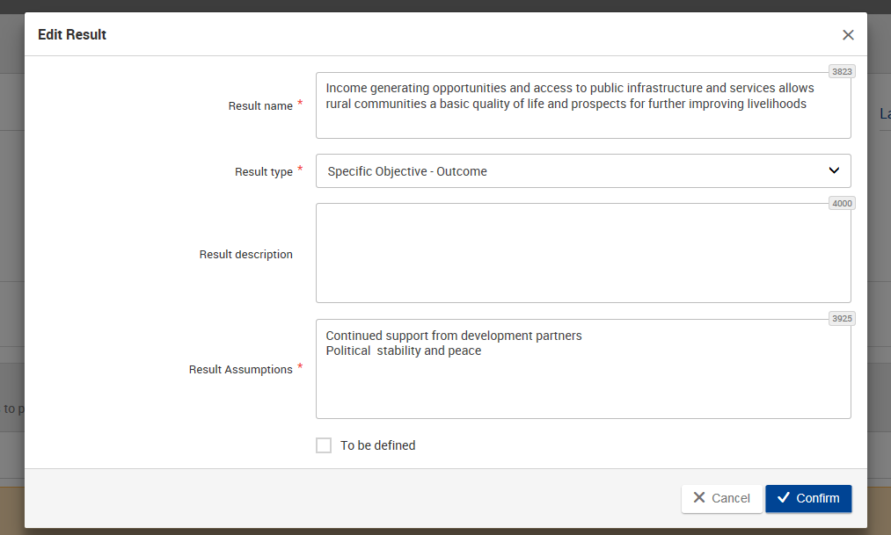
Create logframe: add results

Slide 40
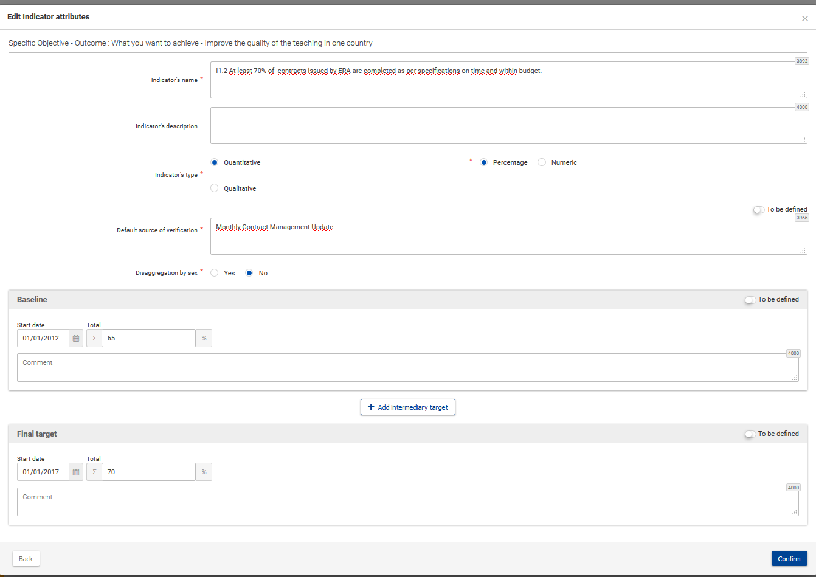
Create logframe: add indicators

Slide 41
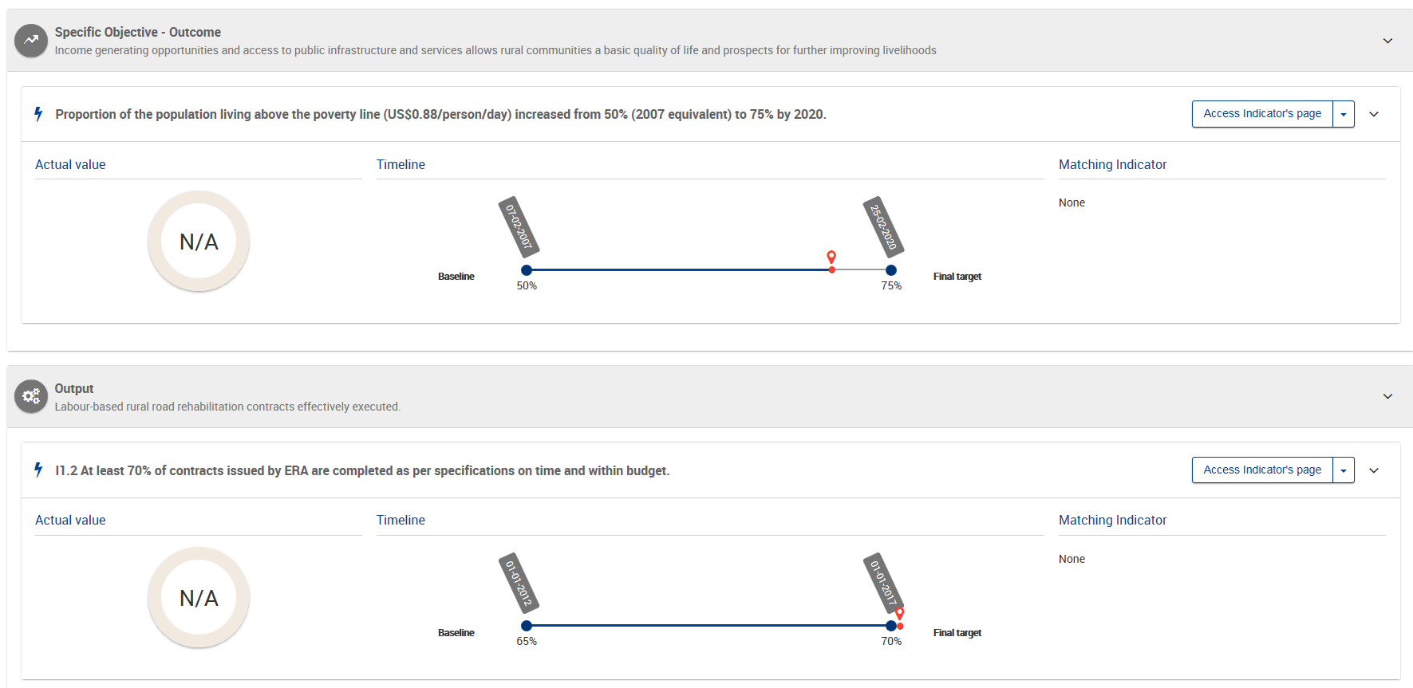

Save logframe and submit

Slide 42
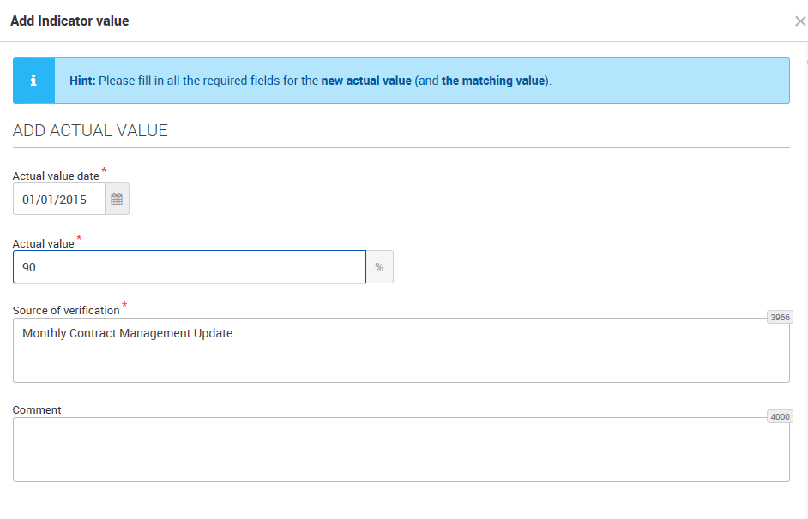
Once logframe validated, add value

Slide 43
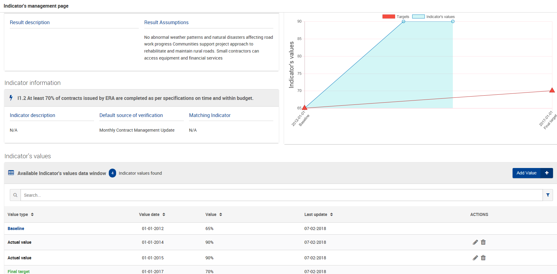
Access Indicator page: visualise indicator trend

Slide 44
Next steps: upcoming features
    Short-term (2018)
    Assign Implementing partners under your responsibility
    Receive comments and feedback from your OM on logframe and indicators values (review mode)
    Export your logframe
    Medium-Long term (2019)
    Monitor progress (activities)
    Upload key documents
    Complete and submit progress reports (with the updated logframe)

Slide 45
October 17th, 2017
OPSYS
Presentation 5: Communication, user support and testing
Véronique Lena, Team Leader Change Management

Slide 46
Communication and user support: key principles
    Strong coordination of testing and feedback activities across tracks
    Regular communication to stakeholders on the progress of the OPSYS Programme

Slide 47
Test phase
The test phase will start on 19 February 2018
For the test, you will have at your disposal a testing scenario with some methodological guidance: results, indicators, targets, baselines, values, etc.
During the test phase, you can provide feedback:
  Replying to an online questionnaire for the methodological elements
  Sending us an email

Slide 48
Get the latest news
Ad hoc support will be provided during the test phase and during the overall development of OPSYS.
Please do not hesitate to contact us at the address : EuropeAid-OPSYS-USER-SUPPORT-COMMUNICATION@ec.europa.eu
If you want to be kept updated, feel free to join us on capacity4Dev group: https://europa.eu/capacity4dev/implemeting-partners---opsys

Slide 49
Your input is welcome!
Any questions?
Please share them with everybody via the chat box.

