Slide 1
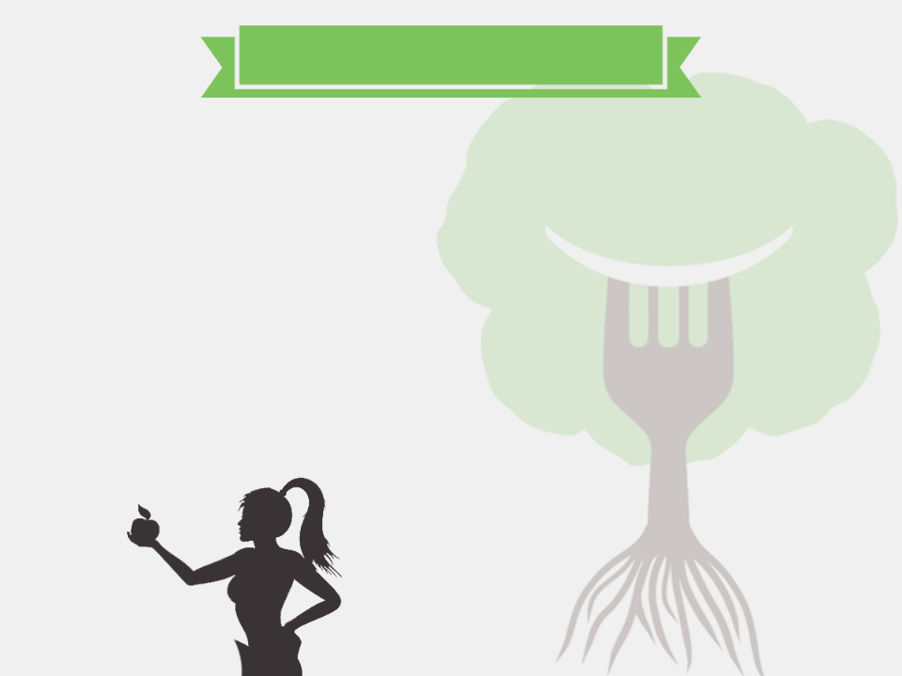

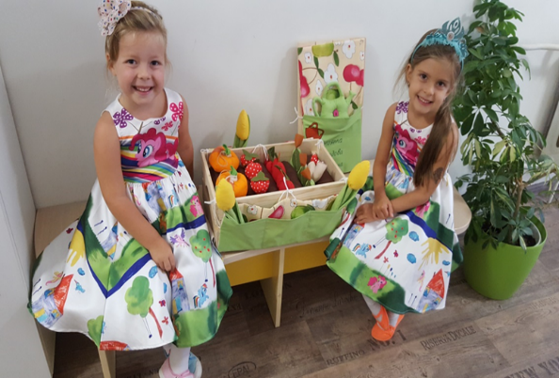
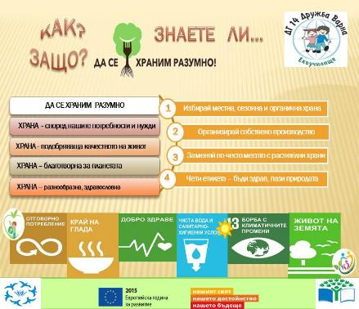
We Eat Responsibly - BULGARIA
video

Slide 2
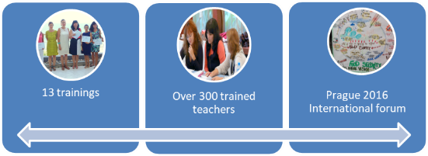
We Eat Responsibly - BULGARIA
Schools
50
Students
20 000
Teachers
1200
Families
20 000
Action days
157
Final products
200

Slide 3

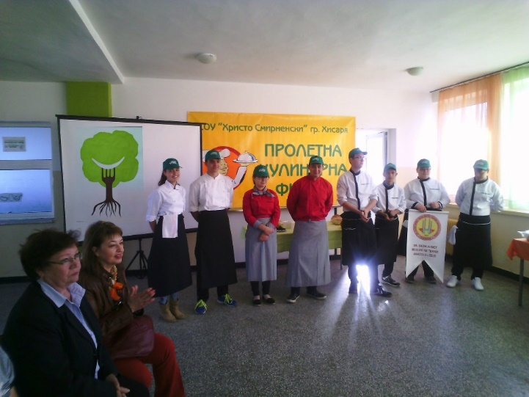
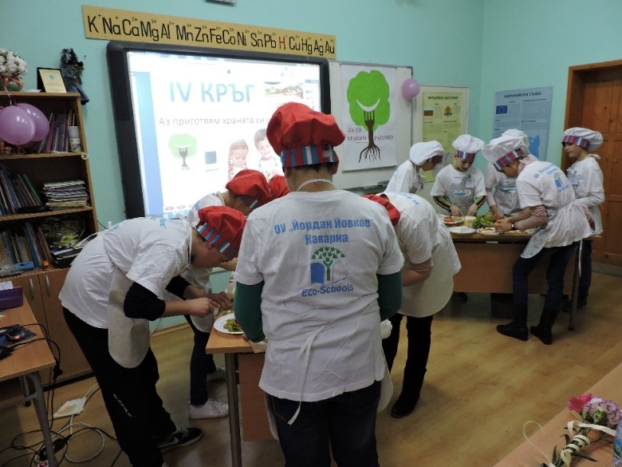
What have we learned?
About the CO2 footprint of food
Palm oil and Fair trade
The world hunger and unequality
The hidden water, energy and land
Loss of biodiversity
How to grow food
How to reduce food waste
Local and seasonal food, foodmiles
New methods and philosophies

Slide 4


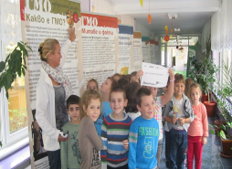
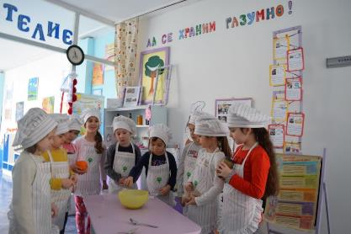

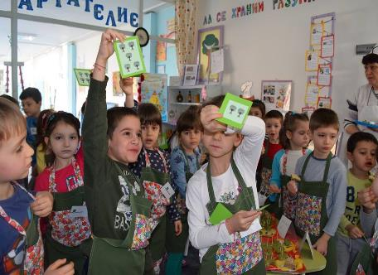

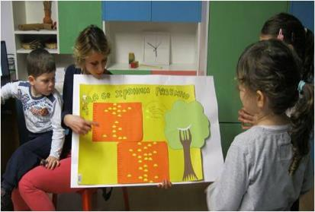
Incredible activities in kindergartens
and parents’ involvement

Slide 5
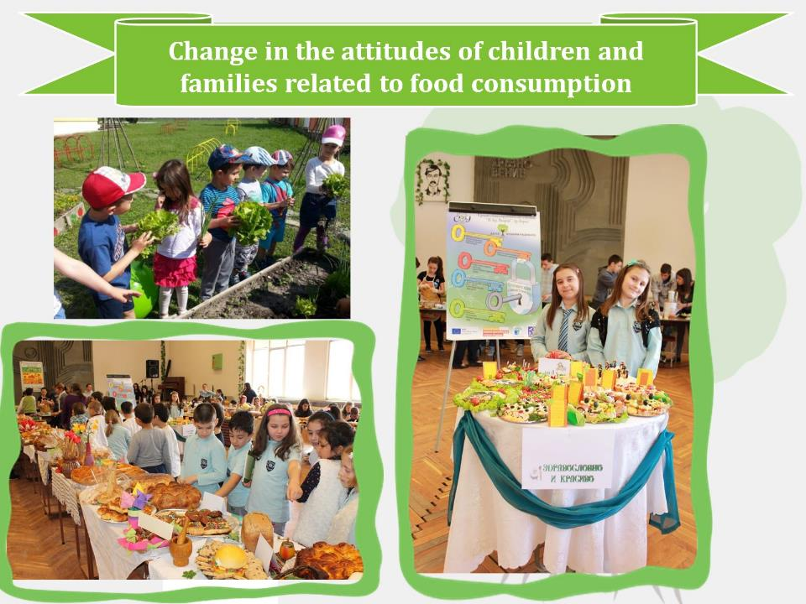

Slide 6
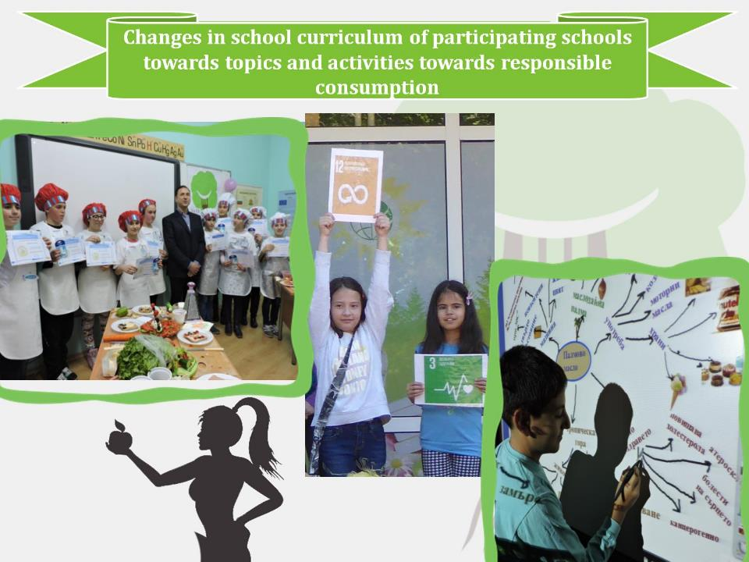
Changes in school curriculum towards responsible food consumption and the global food topics

Slide 7
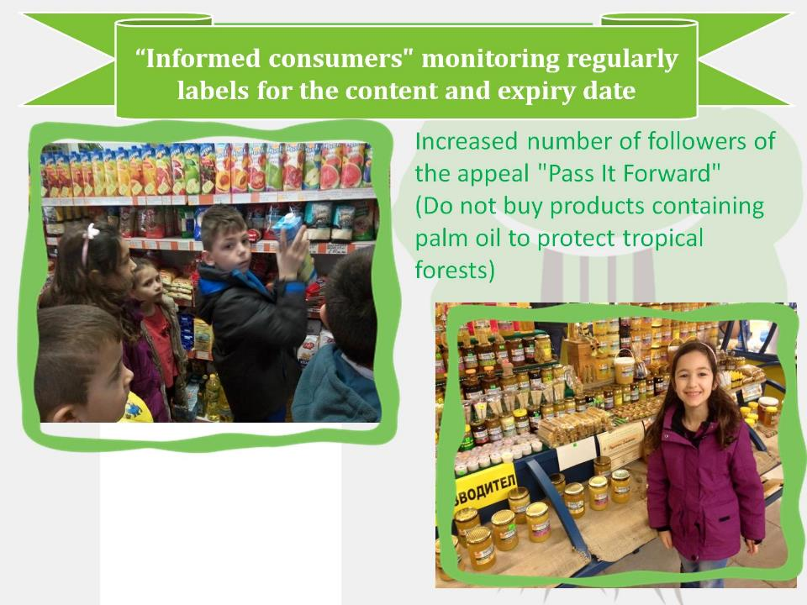

Slide 8
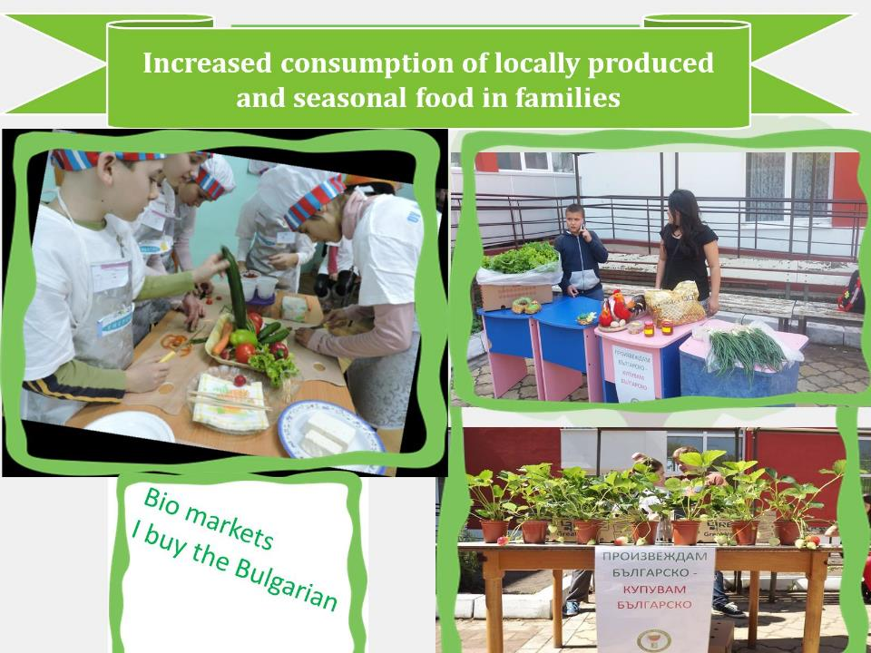

Slide 9
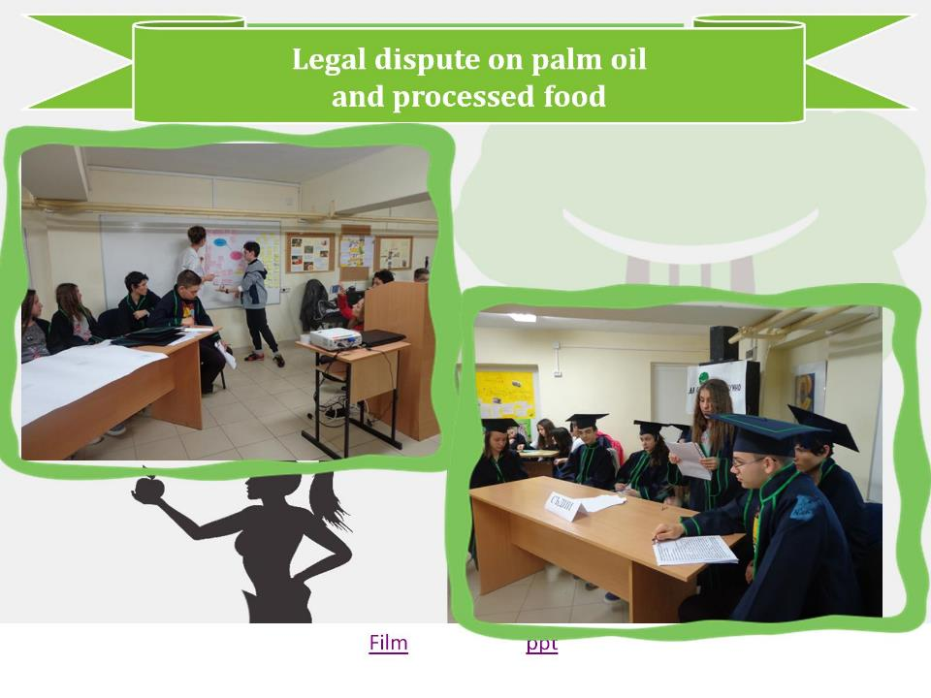
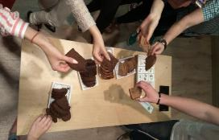

Slide 10
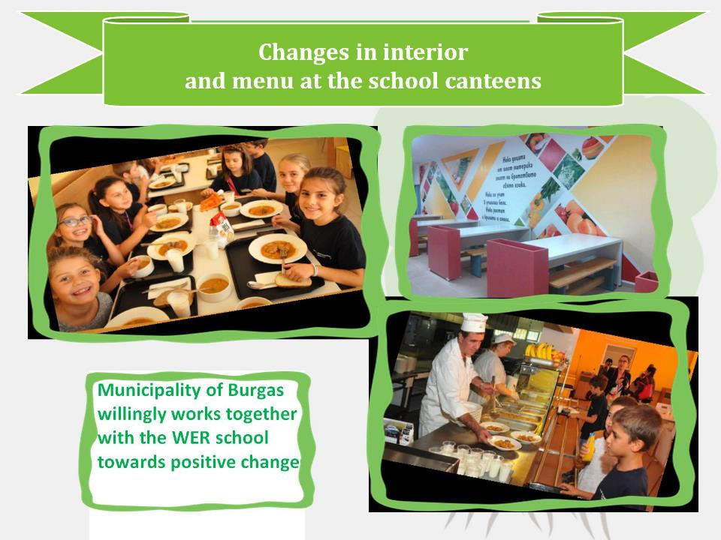
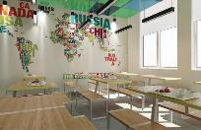

Slide 11

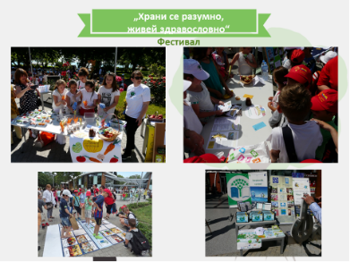

Slide 12

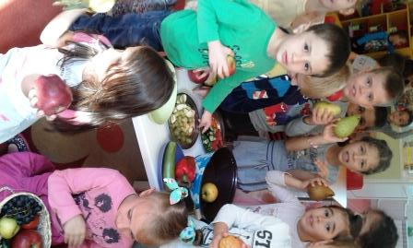
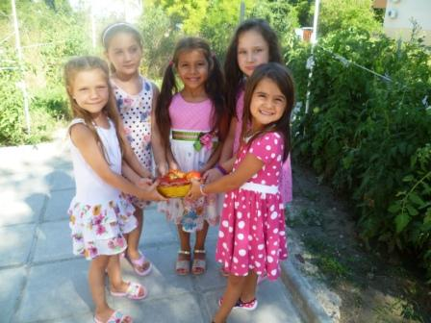
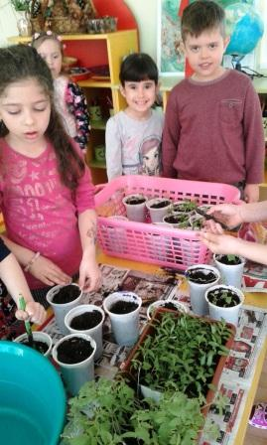
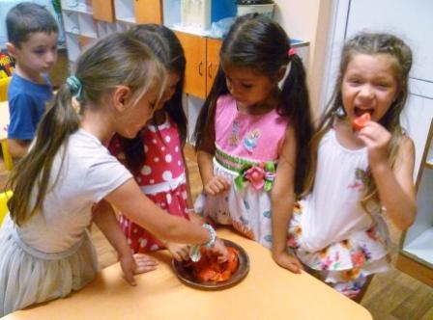
Kindergarten 14 “Druzhba”
Children have learned to produce bio products themselves.
2. More and more children are willing to consume fruit-
local and own production.

Slide 13

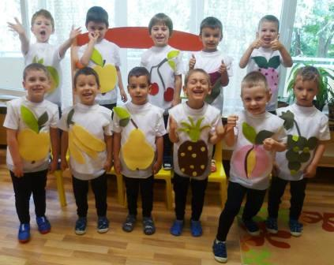
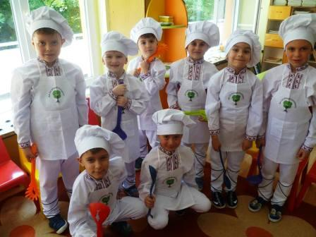
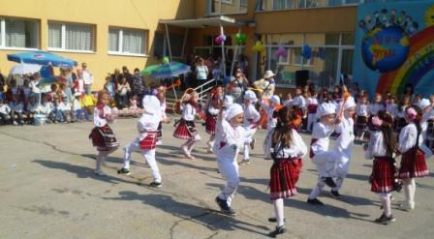
Kindergarten 14 “Druzhba”
Sustainability in the knowledge, skills and attitudes towards the environment and the sensible selection of food:
published a book “We eat responsible" with eco tales, tasks and messages, a basis for provoking the child's curiosity about the topic;
provoked public interest in a universal celebration "Traveling to the country of health and responsible eating".

Slide 14

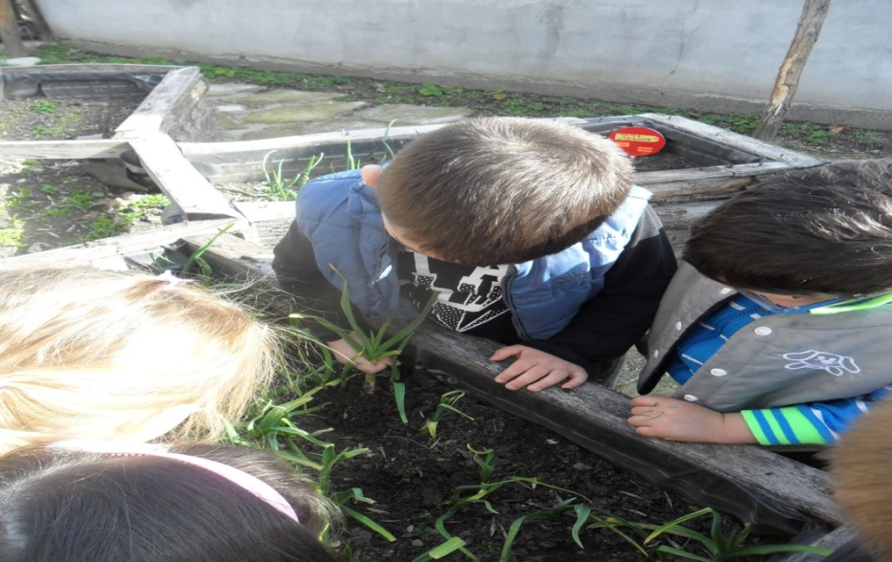
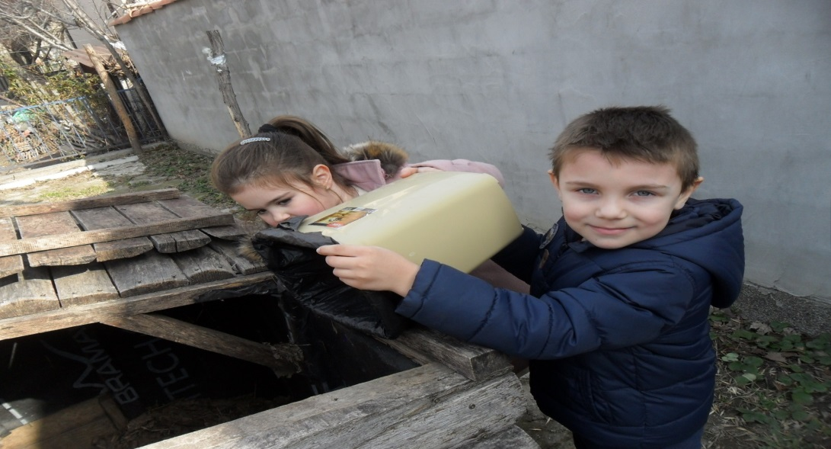
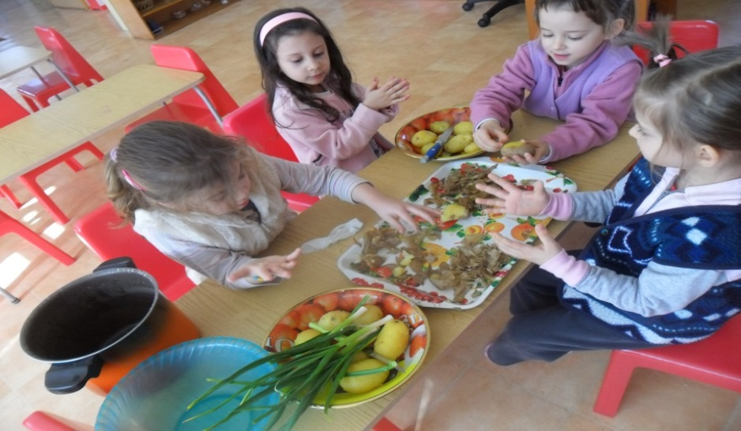
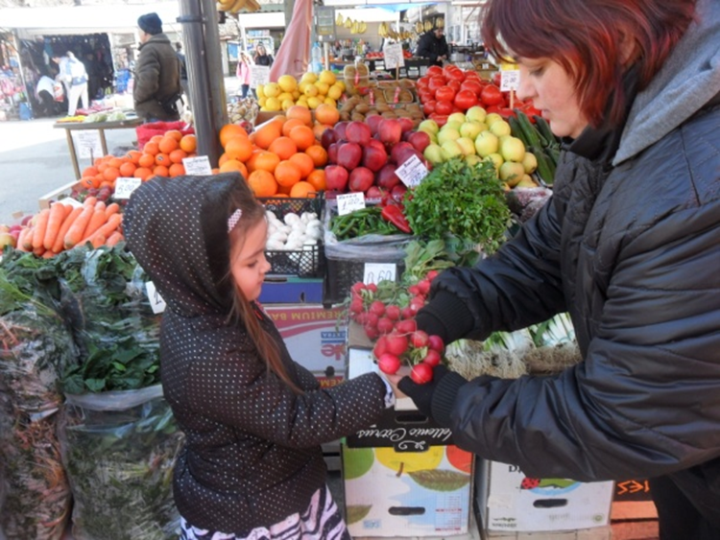
Arabella kindergarten
The children are learning how to grow friuts and vegetables in the biogarden
After eating we know that it is right to compost the food
Preparing our food alone is fun

Slide 15
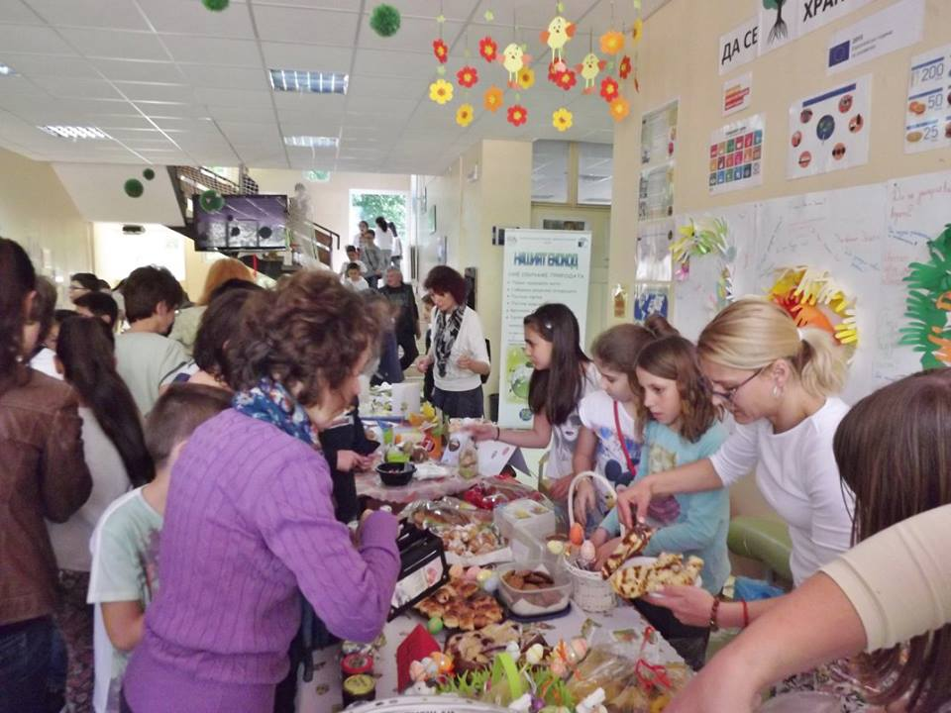
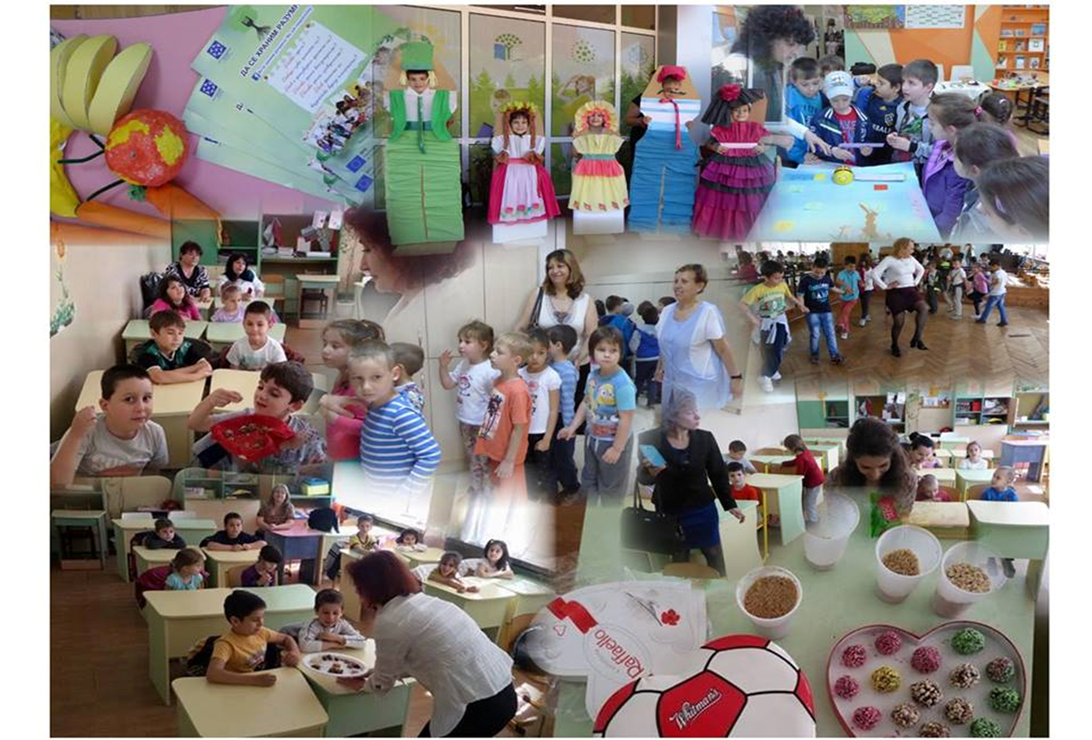
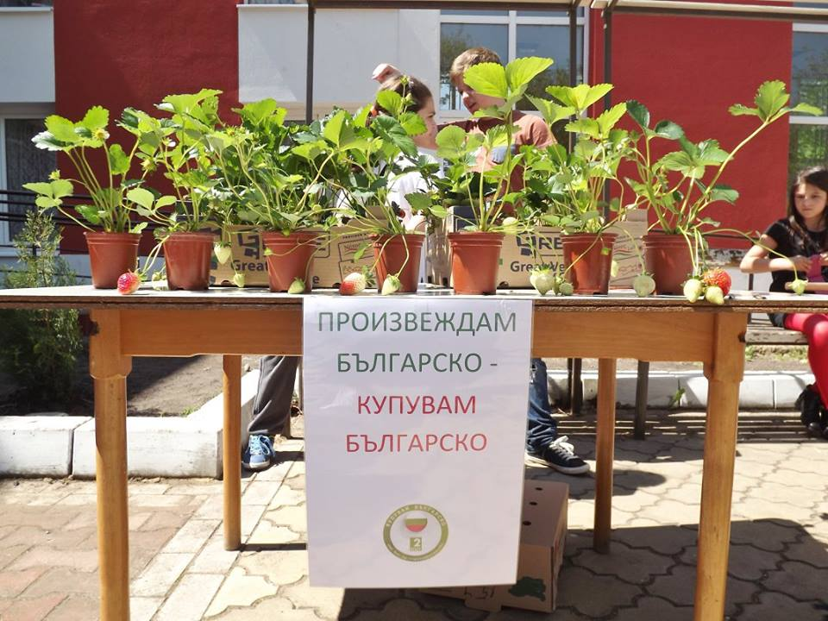
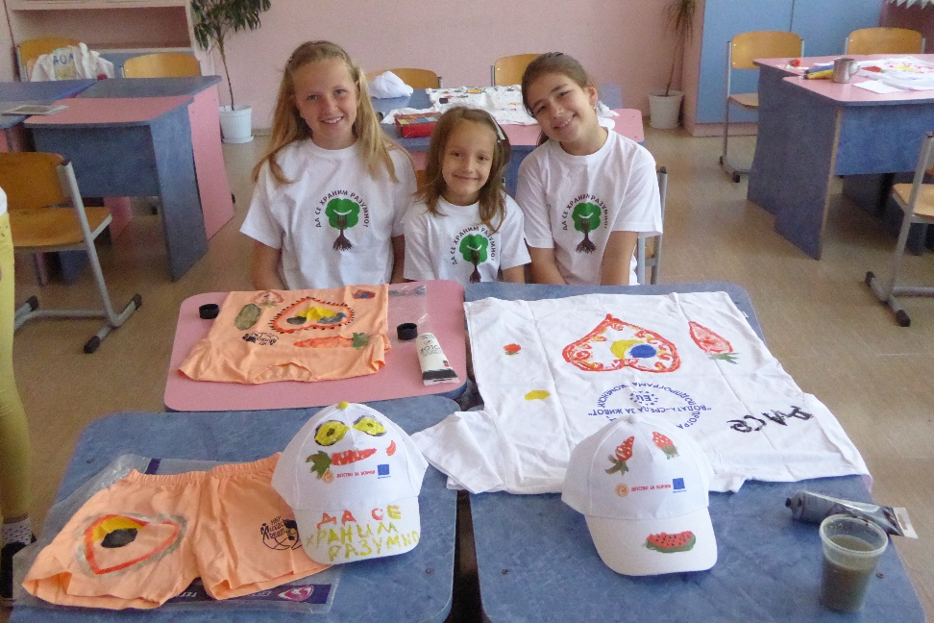
Mihail Lakatnik school
Social activities, Action days, Media coverage

Slide 16
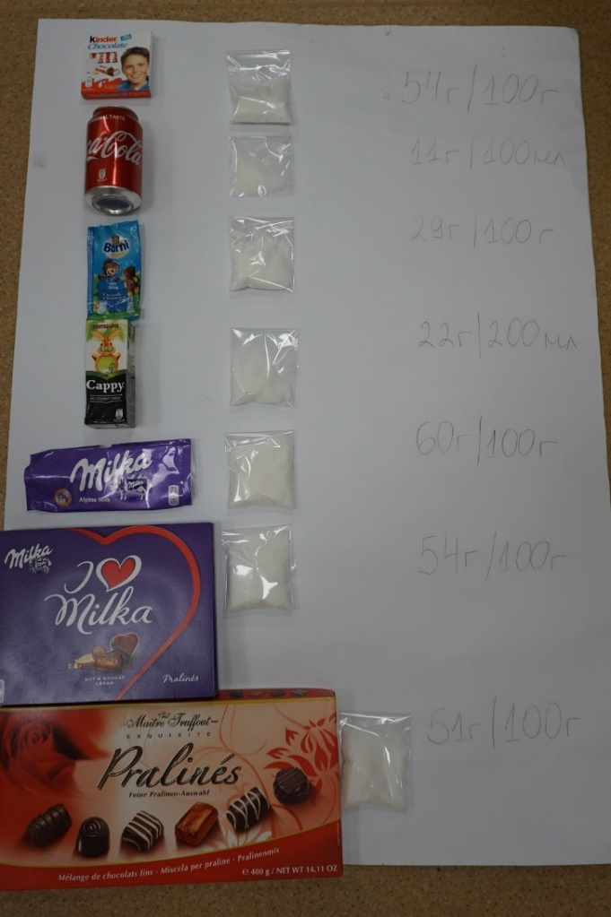
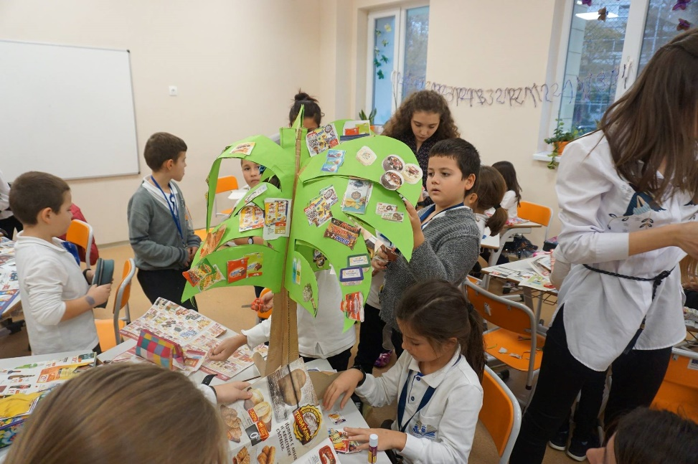
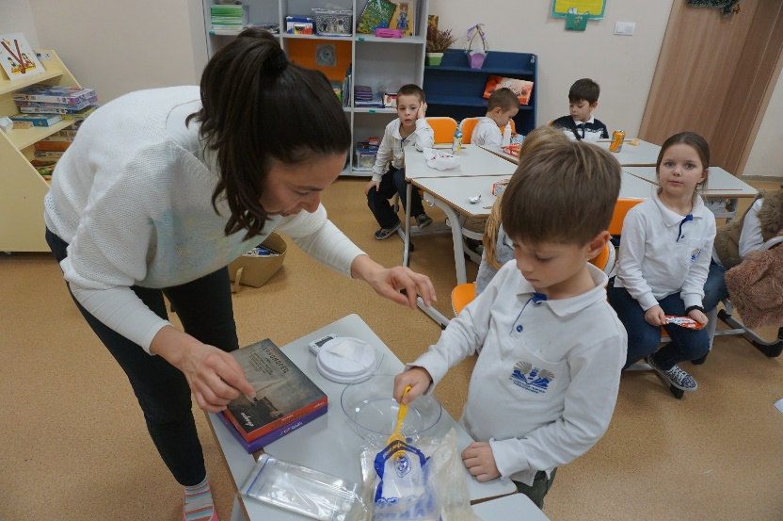
“Alexander Georgiev-Kodzhakafaliyata”
Secondary School
We are aware of the sugar content in the food and drinks and we make responsible choices.
We don’t sell products, containing palm oil in our school.

Slide 17
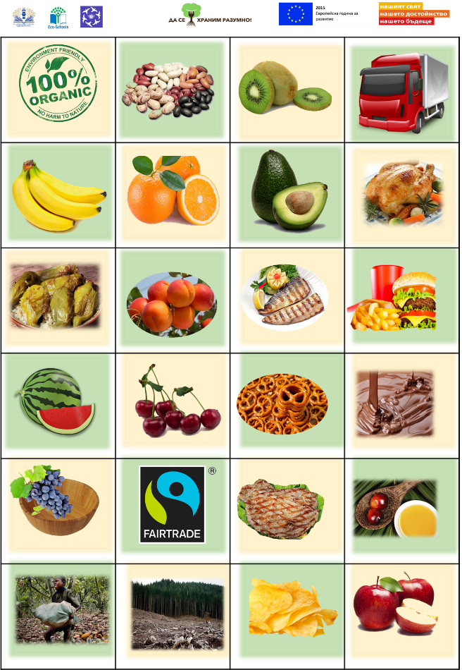
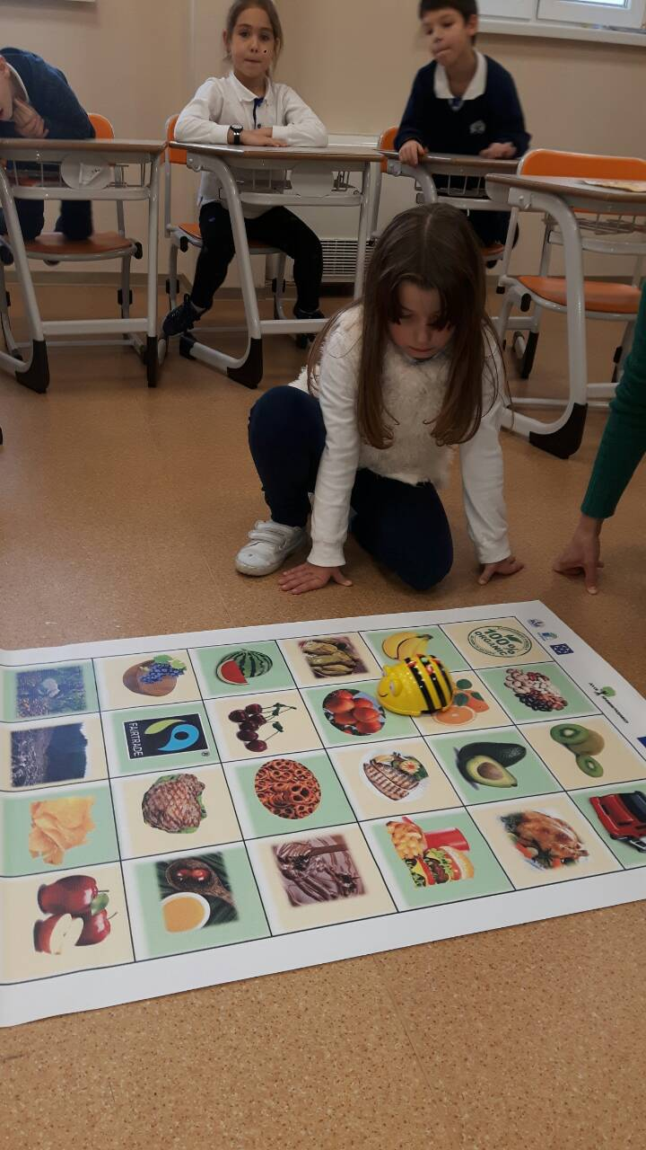
“Alexander Georgiev-Kodzhakafaliyata”
Secondary School
Bee Bot Board Game

Slide 18
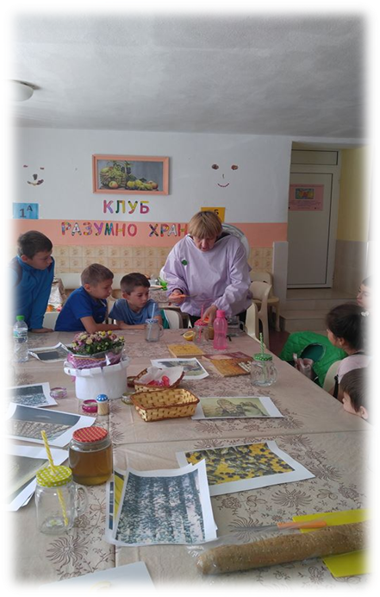
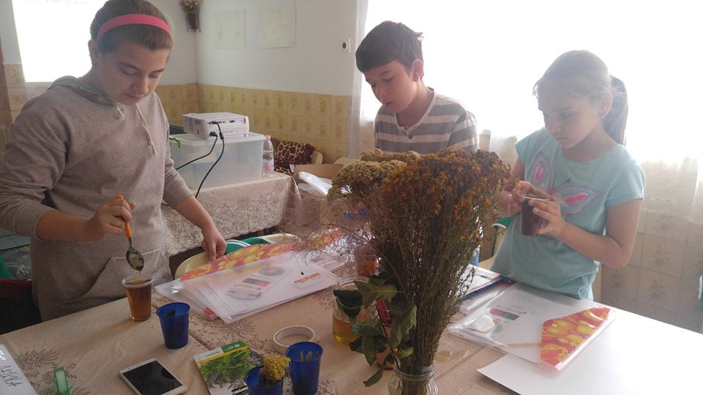
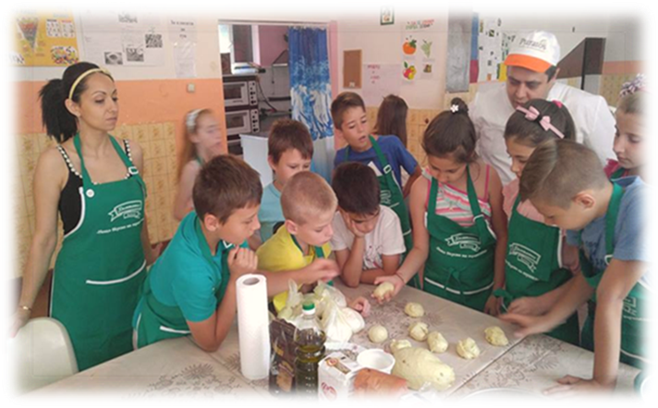
Primary School
“Petko Rachov Slaveikov”
And we learned a lot about biodiversity and plants which bees collect pollen from.
We met the valuable qualities of honey.
We distinguish healthy from reasonable eating.

Slide 19
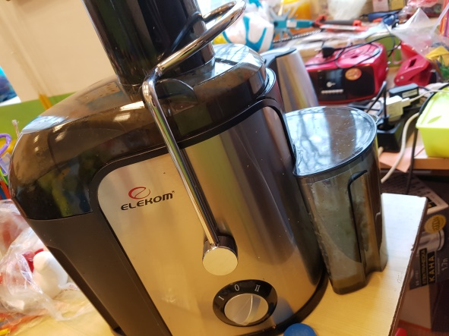
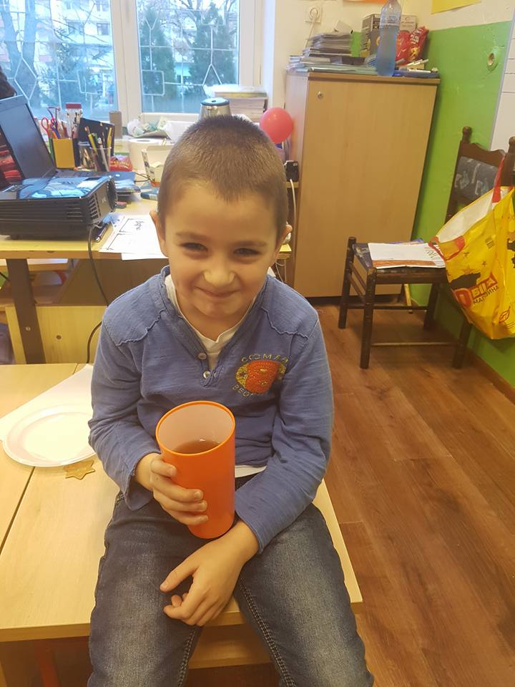
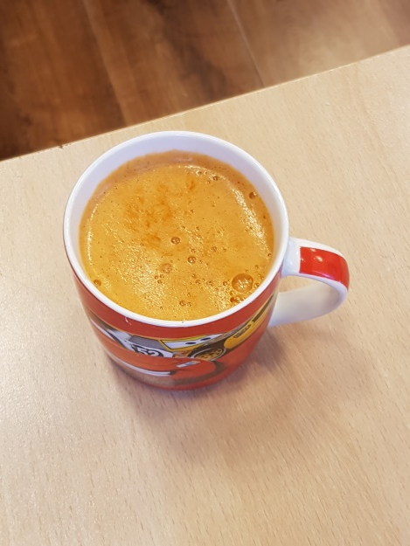
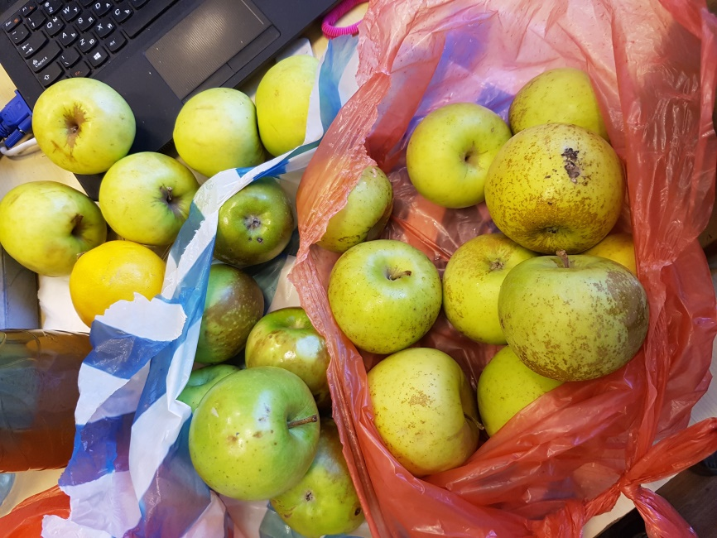
Primary School
“Hristo Botev”- Varna
Tea at school. Herbal teas are made from 100% organic herbs with bio honey from beekeeper.
The other activity at classroom – fresh multivitamin. The fresh is made from seasonal and local fruits and vegetables.

Slide 20

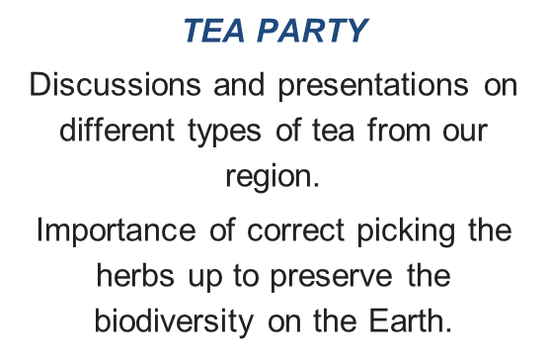
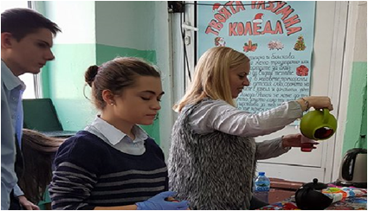
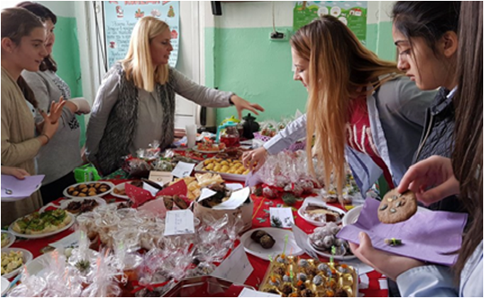
Secondary School of Economics “Georgi S. Rakovski”, Varna
EXHIBITION WITH SEASONAL AND LOCALLY SOURCED FOOD
There were creative ideas of food presentations in which there is a balance of color, texture and shapes.

Slide 21
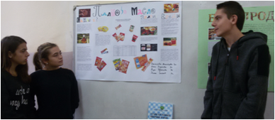


Secondary School of Economics “Georgi S. Rakovski”, Varna
PALM OIL DISCUSSION
Students studied and presented to their classmates palm oil and its effects on health, the environment and sustainability.

Slide 22



The Little Prince
International culinary exhibition
“National cuisine with local produts”
Venue: “The Little Prince”
Private School
Participants:
110 students
5 teachers
2 guest chefs
50 parents /guests/

Slide 23



The Little Prince
What is real food and what makes it such?
Reading the labels - what do all the E-s stand for?
A lecture by a food specialist /dietologist/ followed by a discussion
REMEMBER! AVOID E951/952/954/955

Slide 24



The Little Prince
My menu for change - culinary competition
With the help of their parents and specialists, the students developed their own menu with healthy dishes, prepared with local and seasonal food.
https://m.facebook.com/thelittleprinceschool; www.thelittleprinceschool.com/school/news/762-kulinarno-predizvikatelstvo

Slide 25














EAT RESPONSIBLY, PRESERVE BULGARIAN,
SAVE THE PLANET
https://learningapps.org/display?v=pw5n9g6ia18

