Slide 1
Story of one Czech
Eco-School
Tereza, educational centre

Slide 2
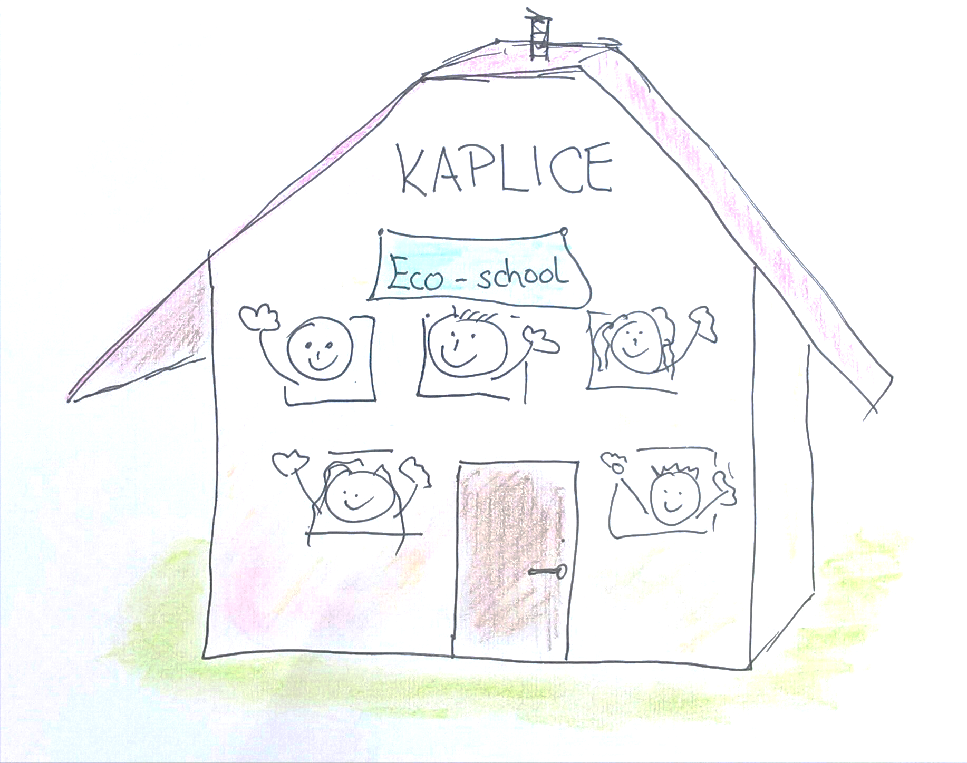

Slide 3
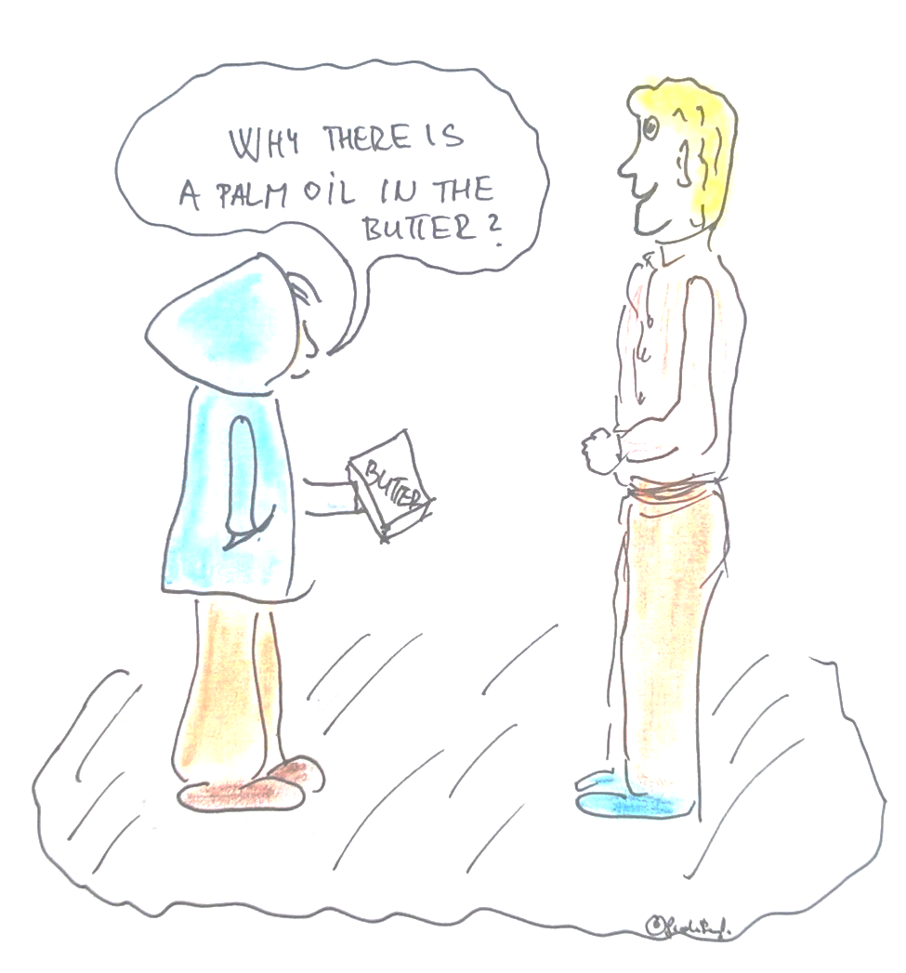

Slide 4
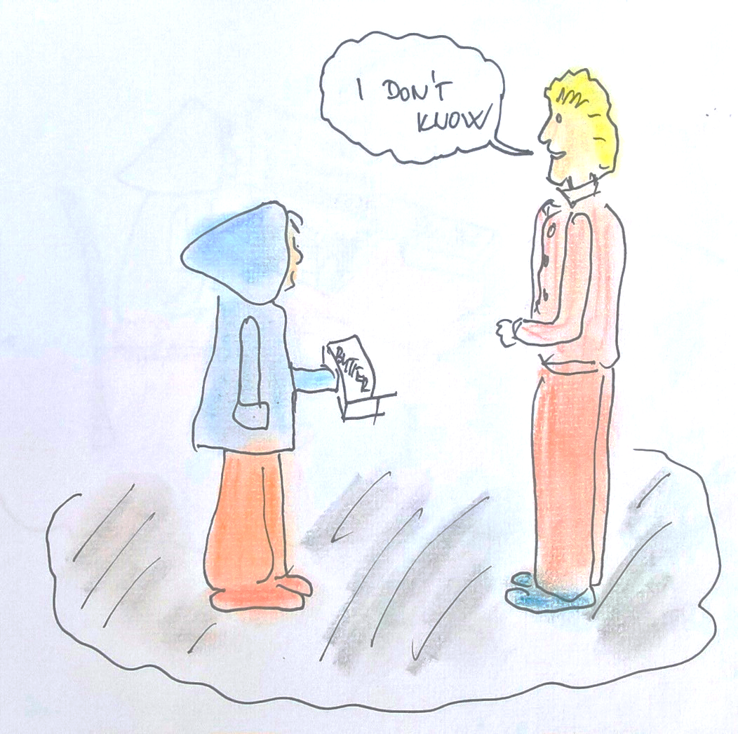

Slide 5
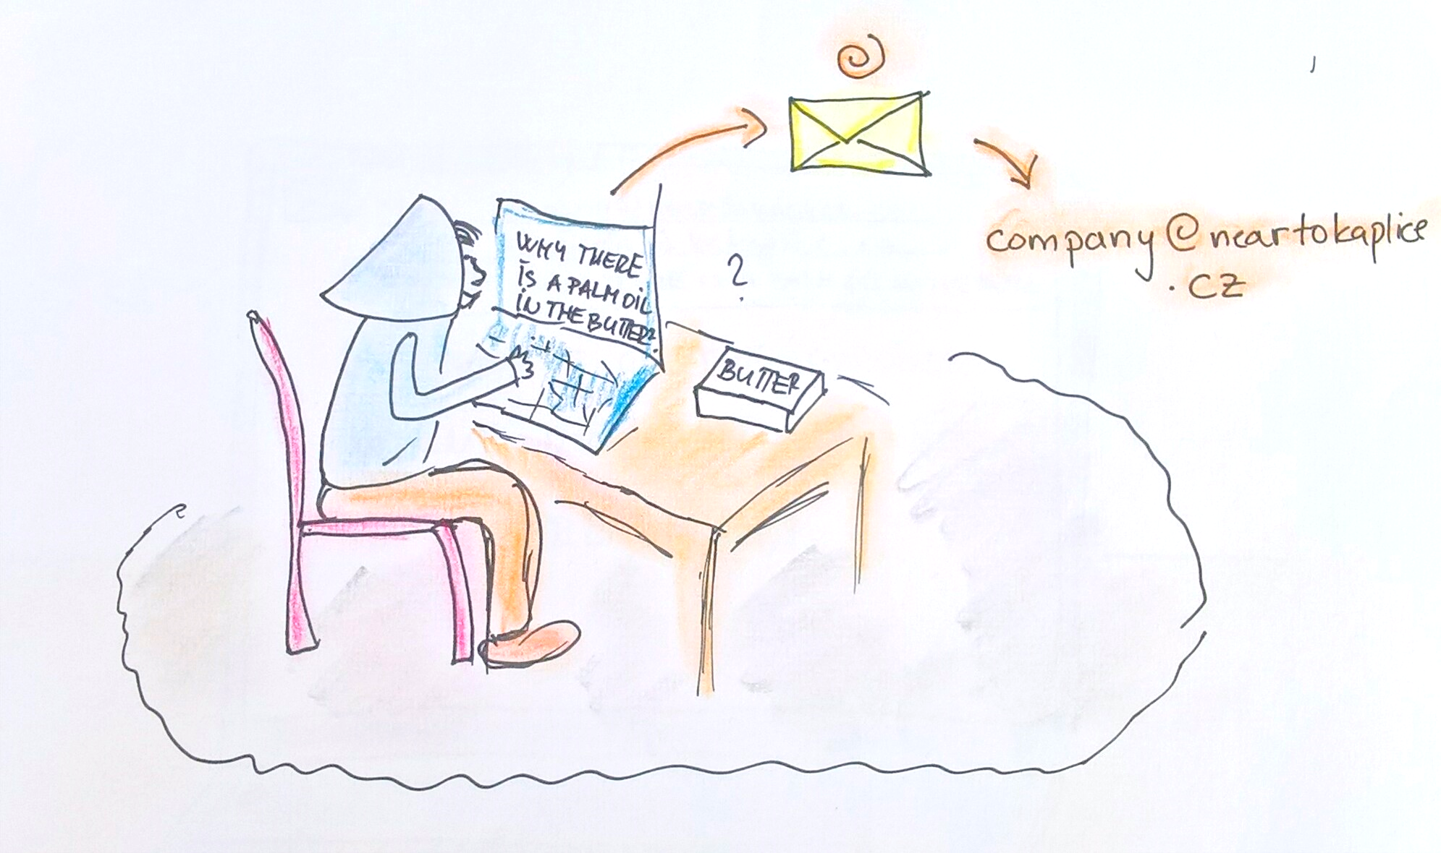

Slide 6
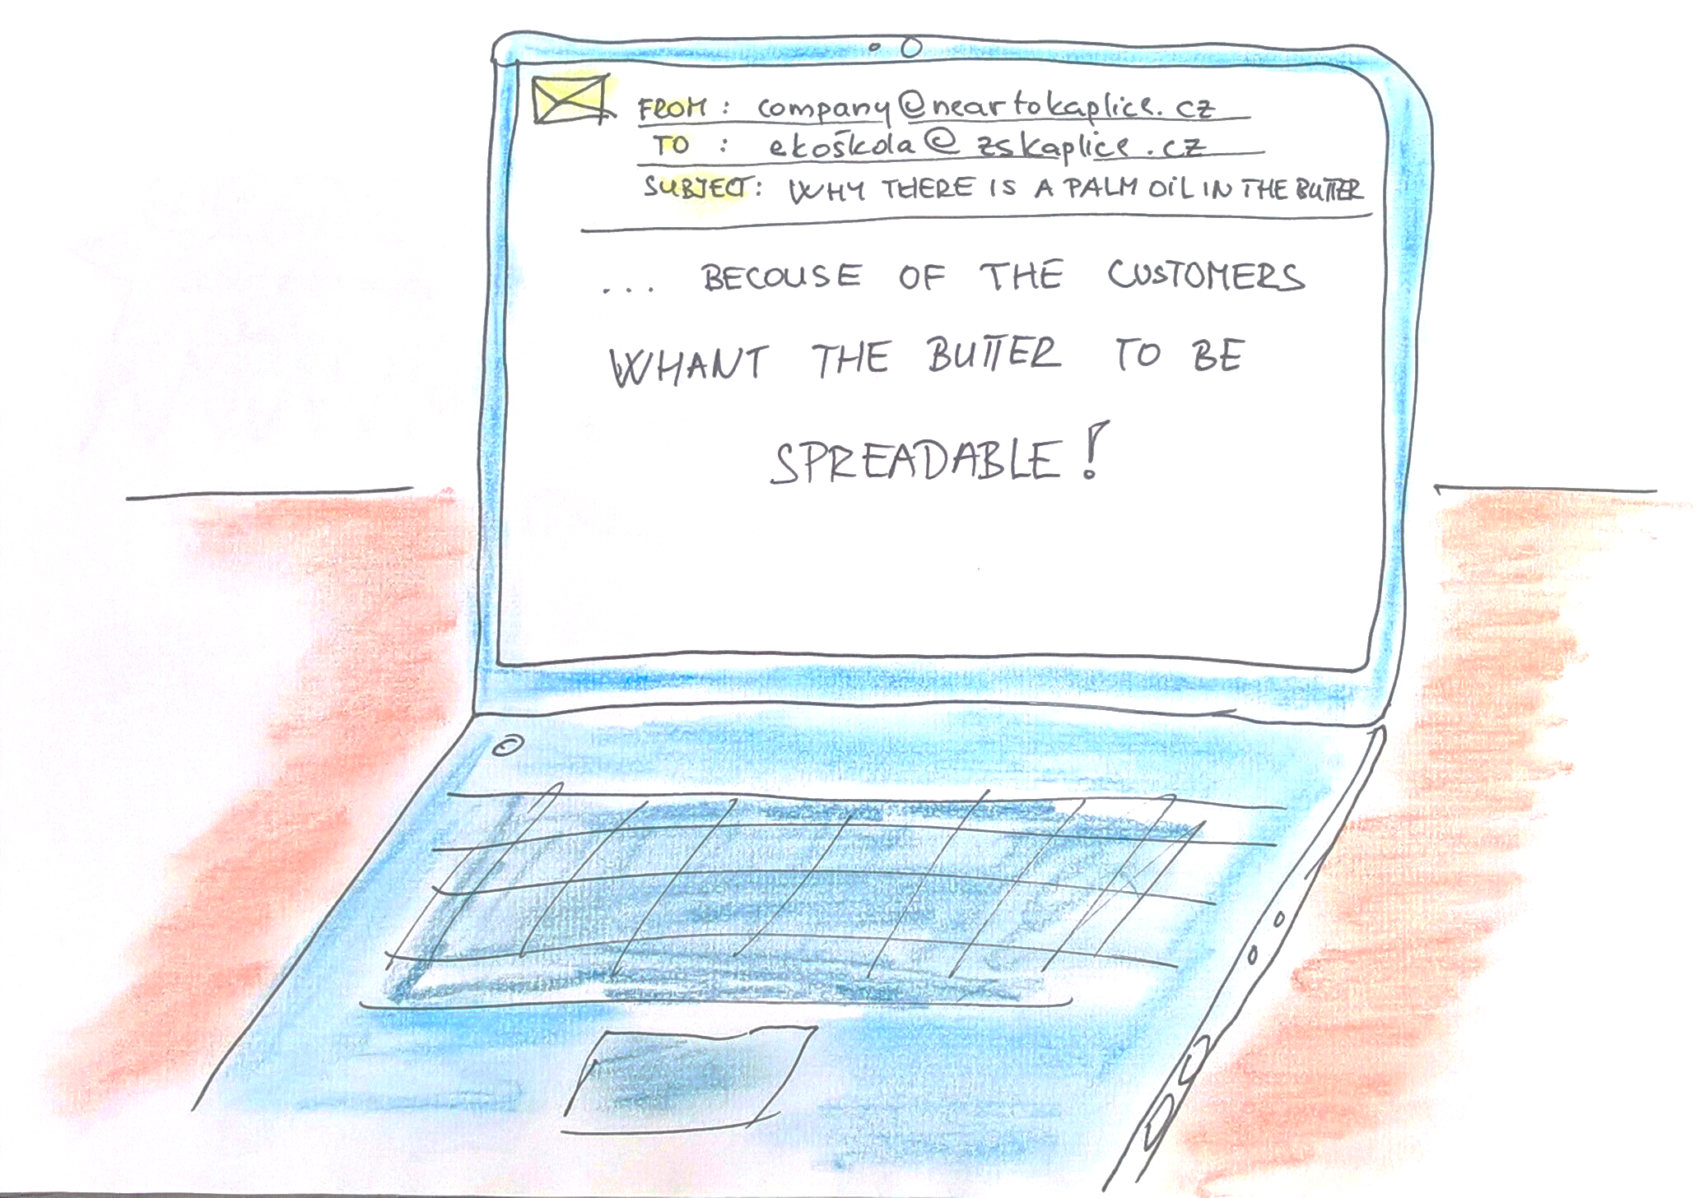

Slide 7
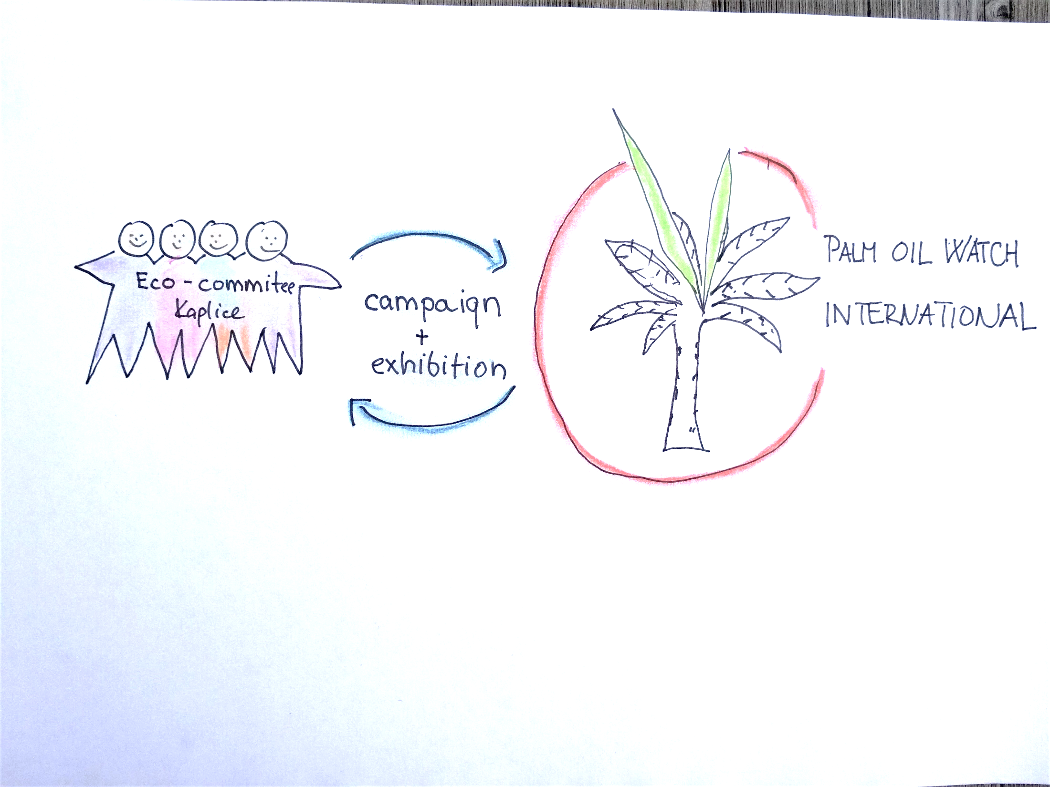
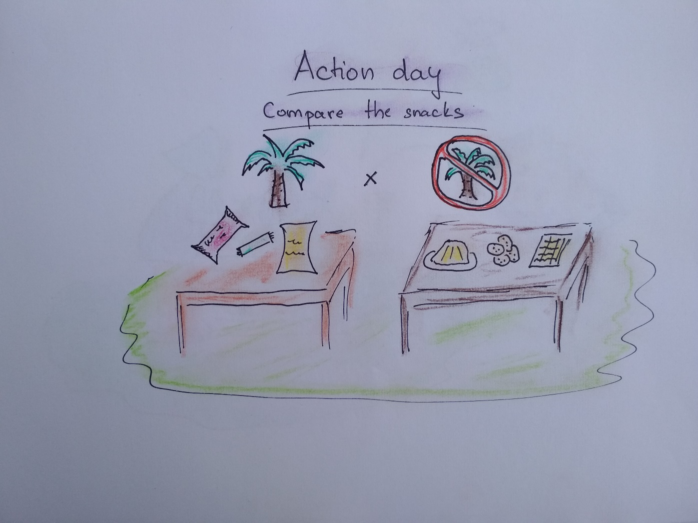

Slide 8
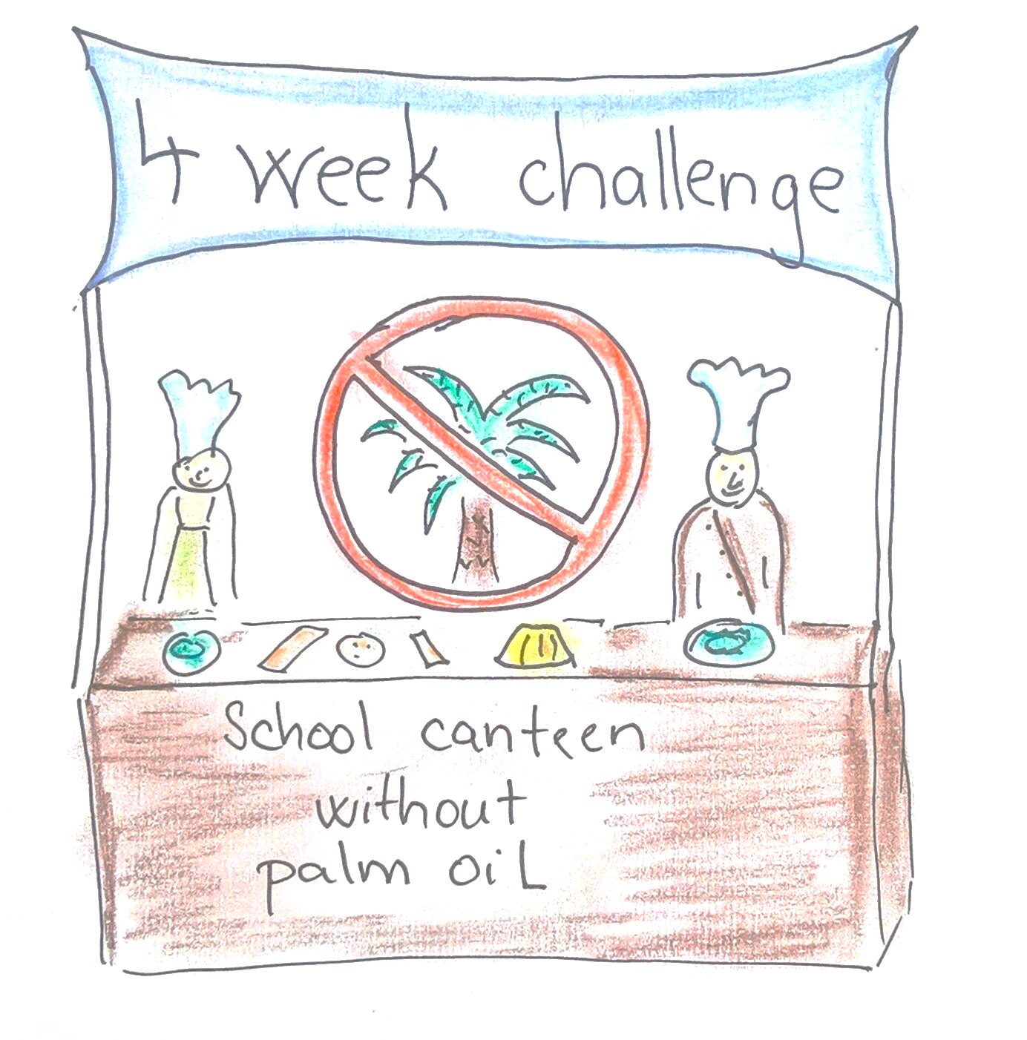

Slide 9
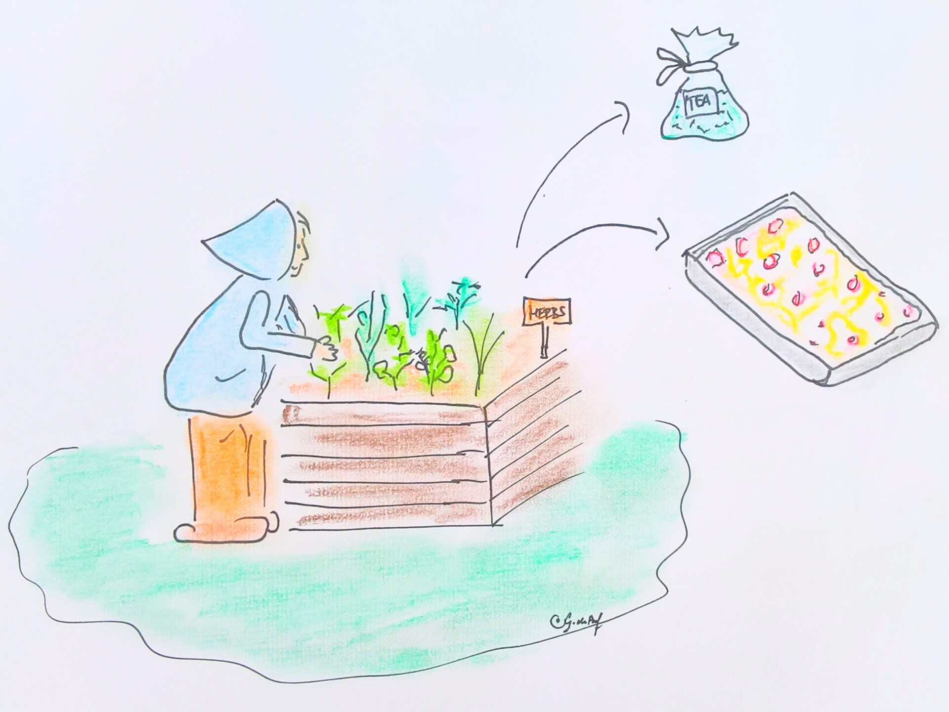

Slide 10
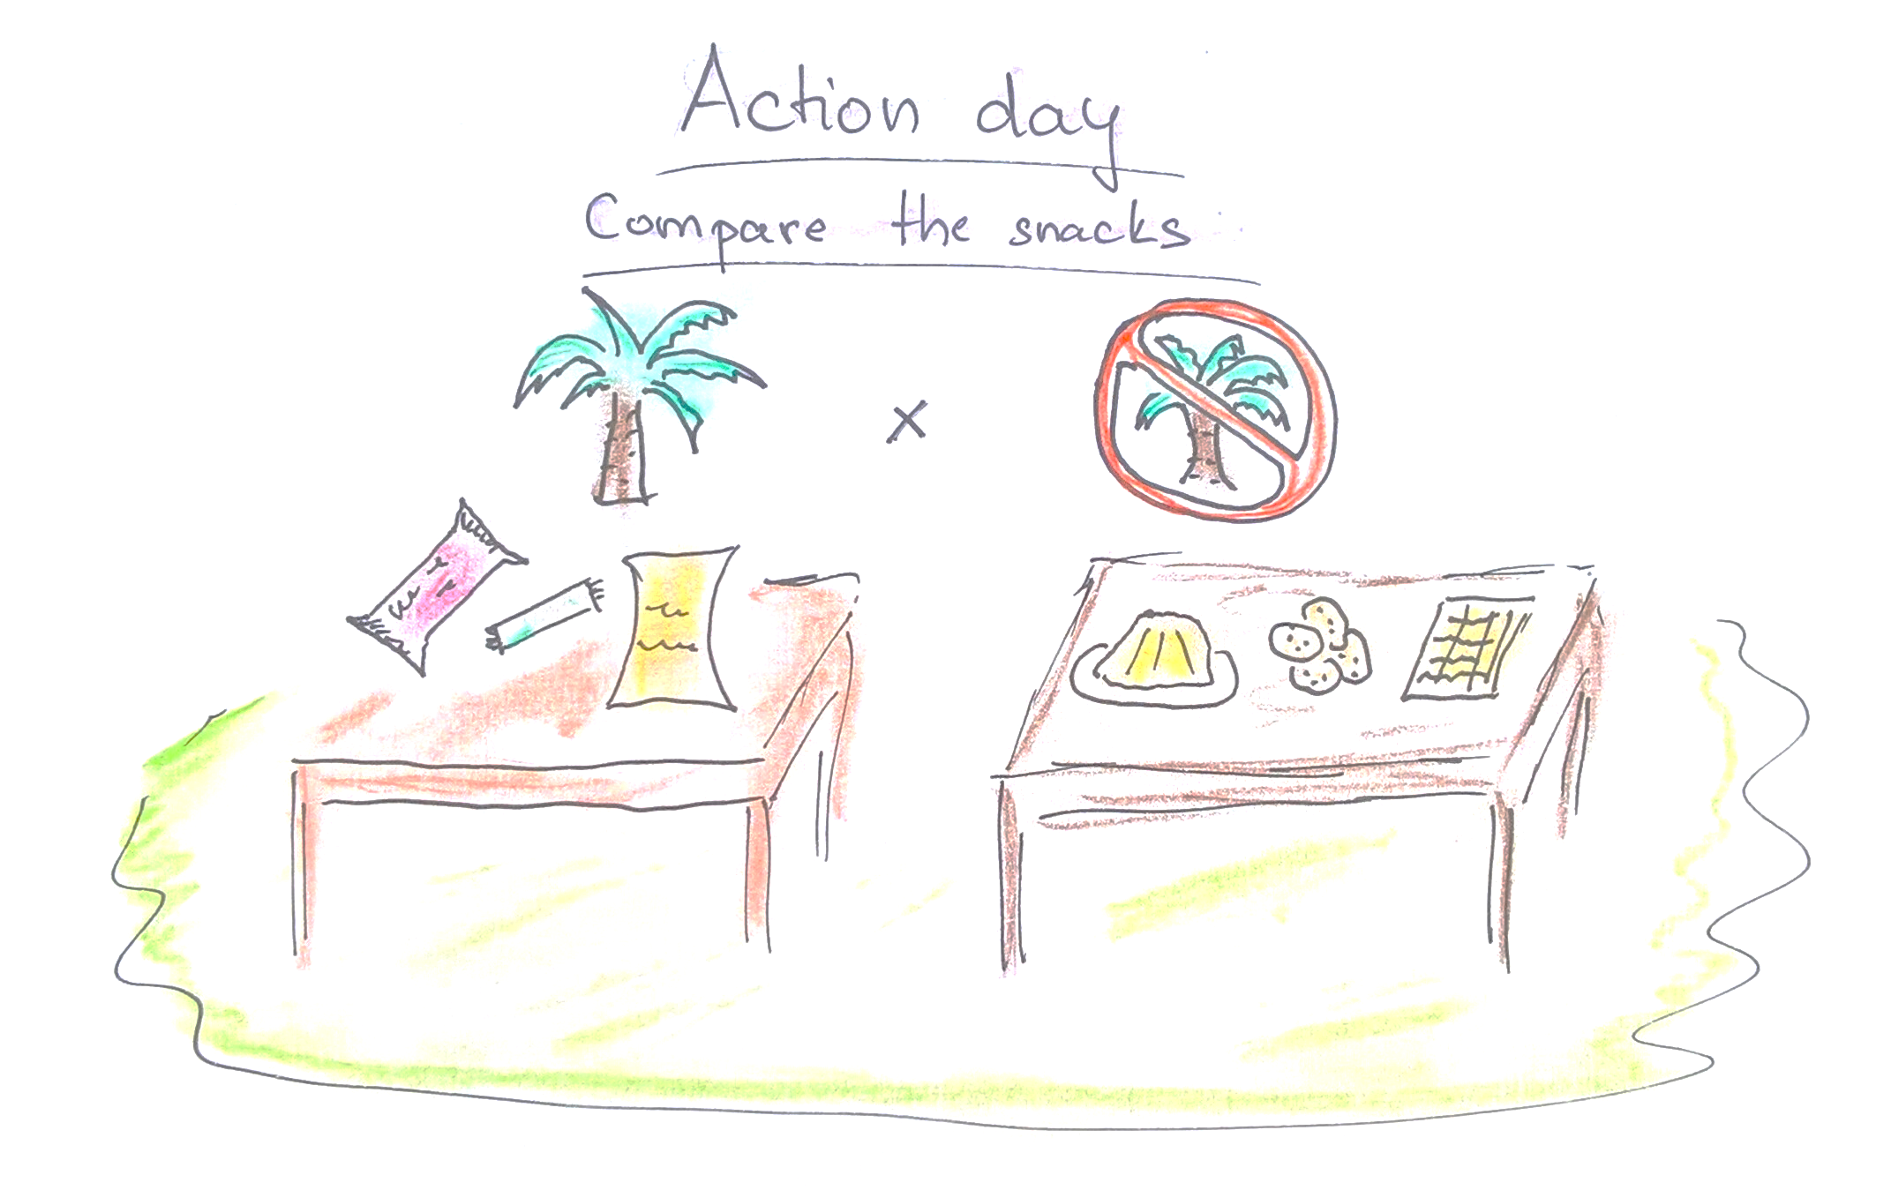

Slide 11
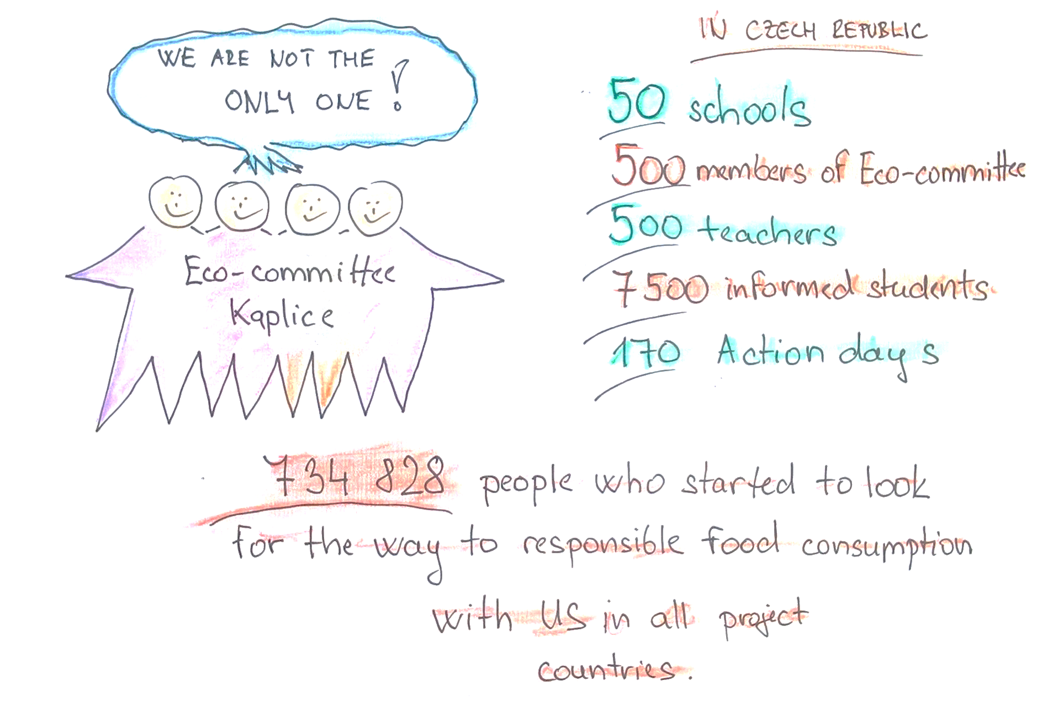

Slide 12

Story of one Czech Eco-school
Story: Secondary school in Kaplice, Czechia
Illustrations: Zuzana Jakobová
Original idea of the story: Jitka Krbcová
Execution: Ivana Moravcová

