Slide 1

Making the finances work

Slide 2
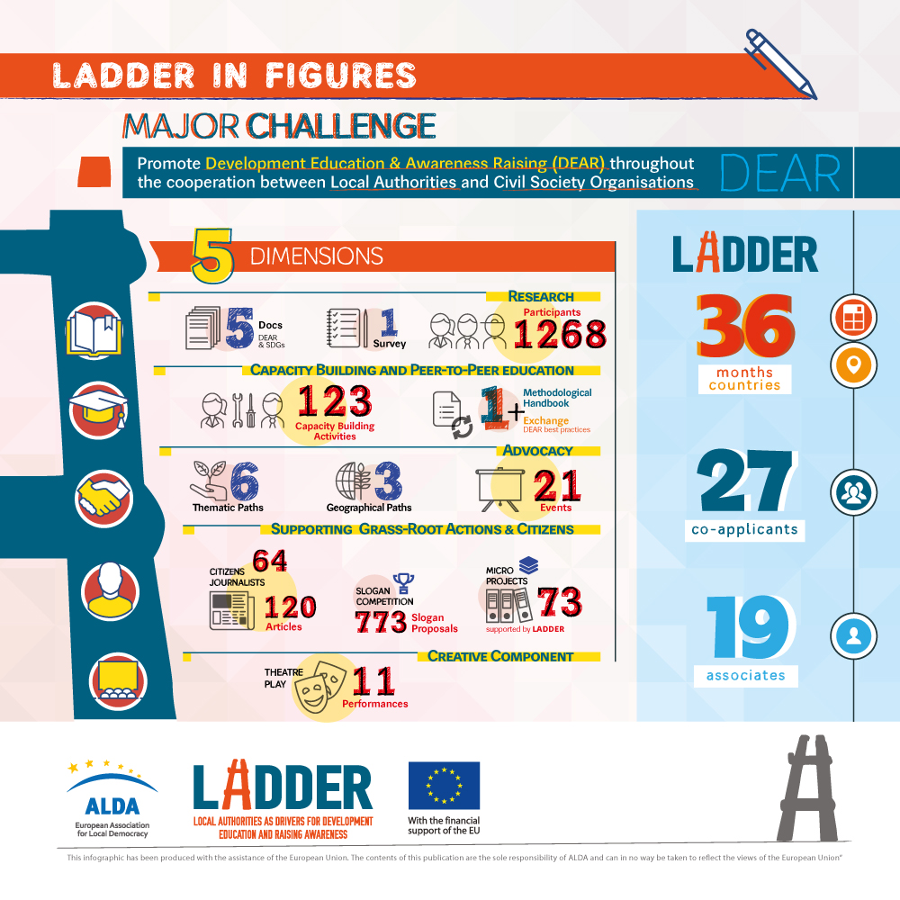
THE LADDER Project
3.8 Million
27 partners
ALDA lead partner

Slide 3
1. Provide guidelines
The Lead partner should provide clear instructions to all the partners.
During the LADDER Project some guidelines were created by ALDA and shared with the co-applicants. These were inserted within the Individual Convention of each partner.

Slide 4
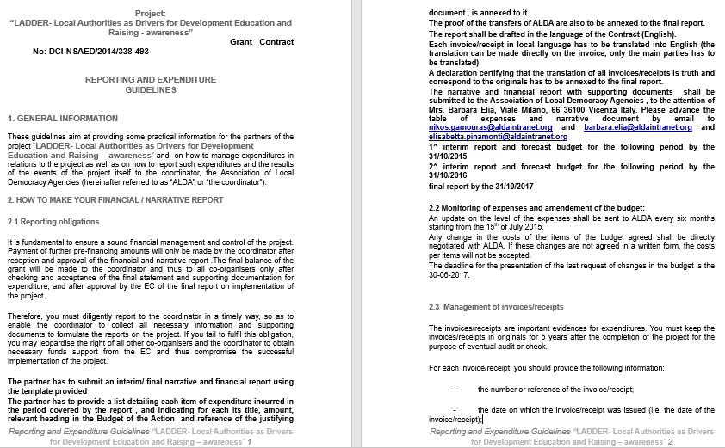

Slide 5
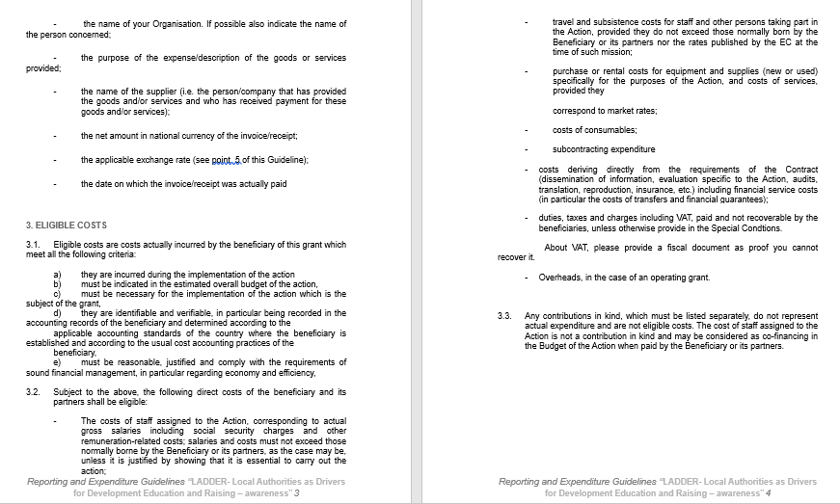

Slide 6
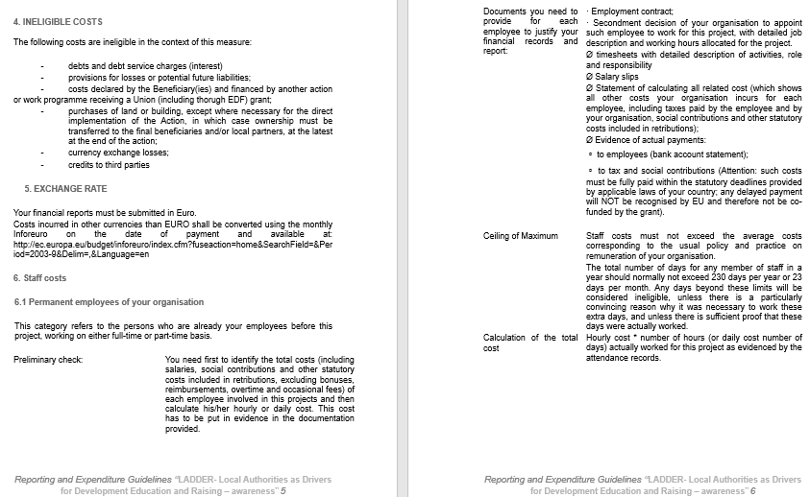

Slide 7
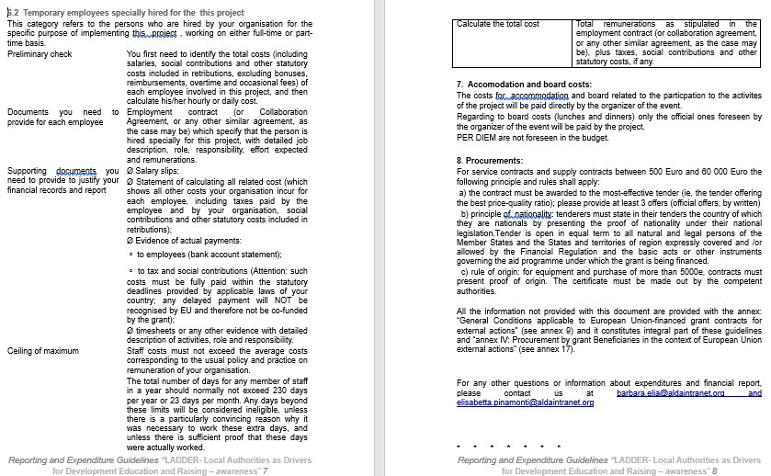

Slide 8
2. UNIFORM The NECESSARY INFOS
The Lead partner should provide clear instructions on how to report the costs implemented by each co-applicant.
During the LADDER Project some templates were created by ALDA and shared with the co-applicants. These were inserted within the Individual Convention of each partner.
SEE Excel Table Financial Report – Declaration of honour / co-funding – Template of Timesheets

Slide 9
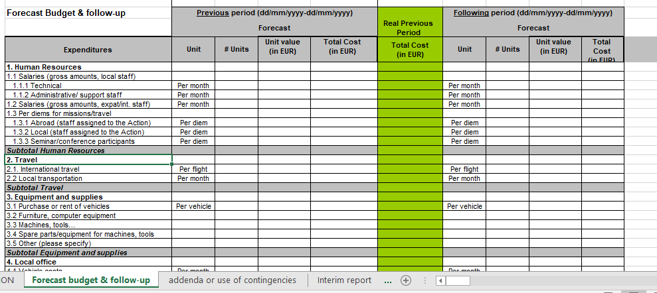
ANNEX 6: Template of financial report
General Information
Forecast budget & Follow up
Addenda
Interim report
Final report
Final sources of funding

Slide 10
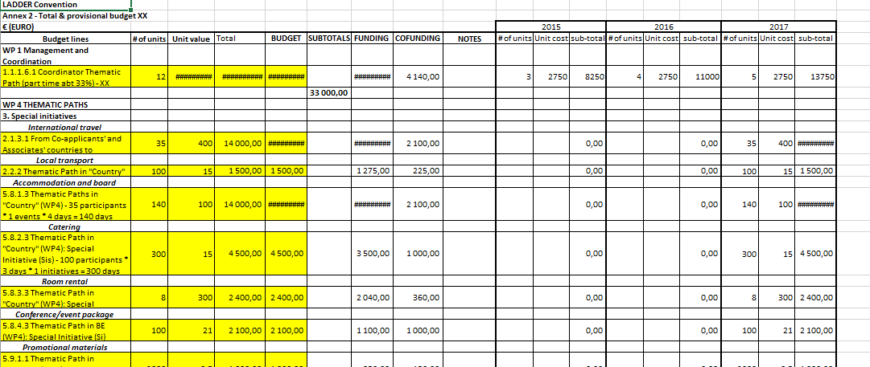
ANNEX 2: LADDER Budget of the partner

Slide 11
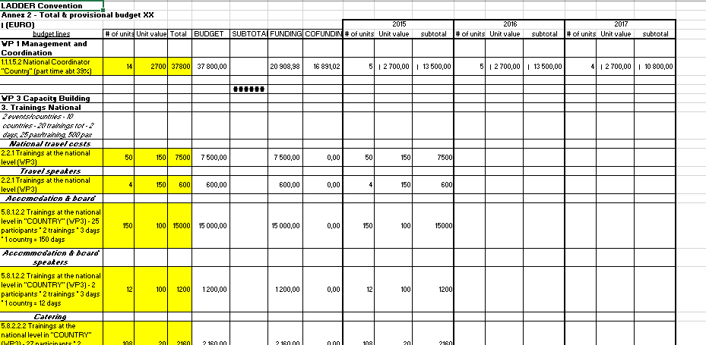
ANNEX 2: LADDER Budget of the partner

Slide 12
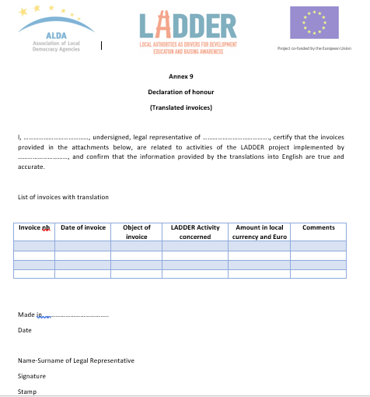
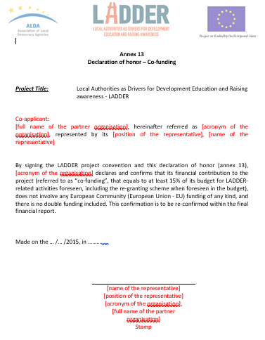

Annex 9 - Template of declaration of honor - invoices
Annex 13 - Declaration of honor - co-funding

Slide 13
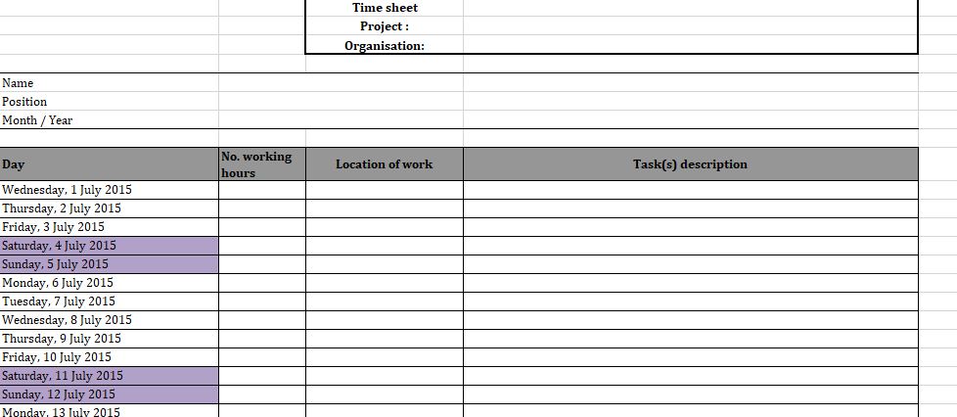
ANNEX 19: Template of timesheet

Slide 14
3. Monitor the actions & the costs
The Lead partner should closely monitor all the co-applicants in the implementation of their activities.
During the LADDER Project the PM was constanstly monitoring the partners’ activities in order to ensure the fulfilment of the actions and costs.
Additionally, a request for the «Financial point» of each partner was requested each 6 months and – in the last year – each 3 months.

Slide 15
4. Reallocate
In case of leftover or extra costs within some of the activities, an amendment of the budget should be submitted to the EC.
This is aimed to bring an added value to the project thus relevant actions should be produced.
LADDER Project example: SDGs Workshop + Example from the Staff

Slide 16
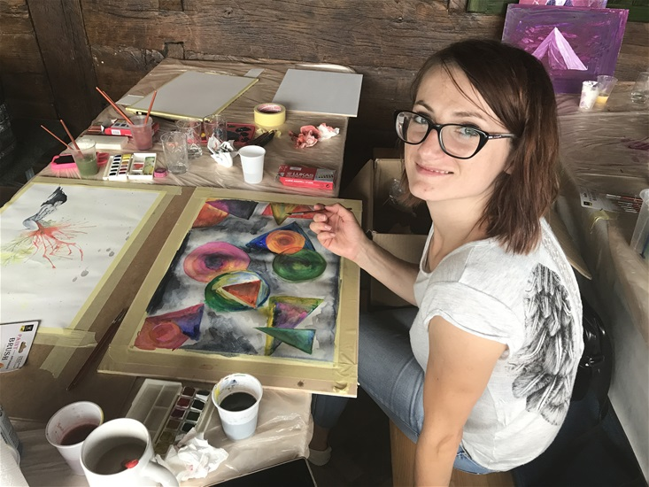
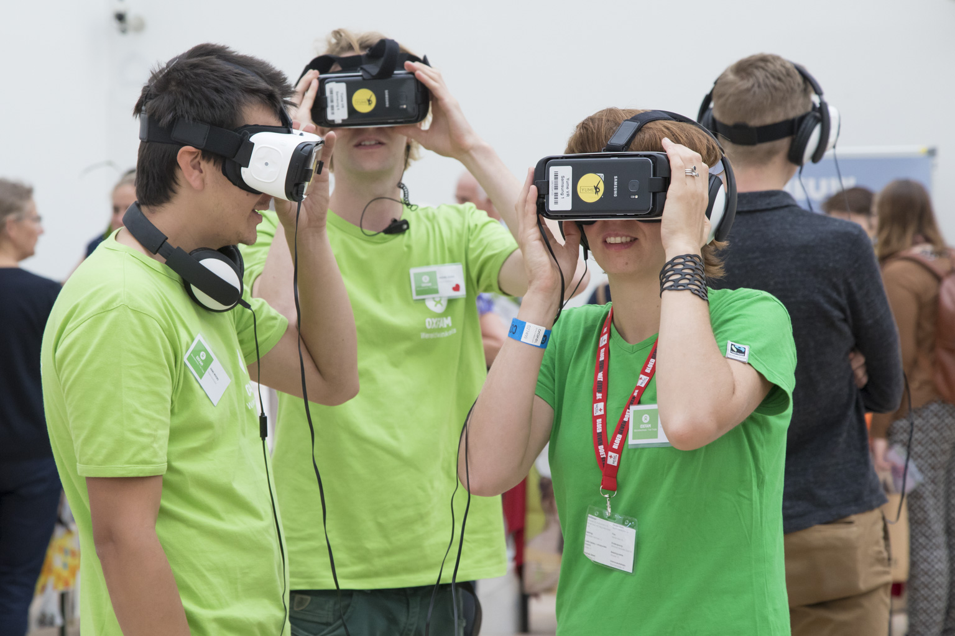
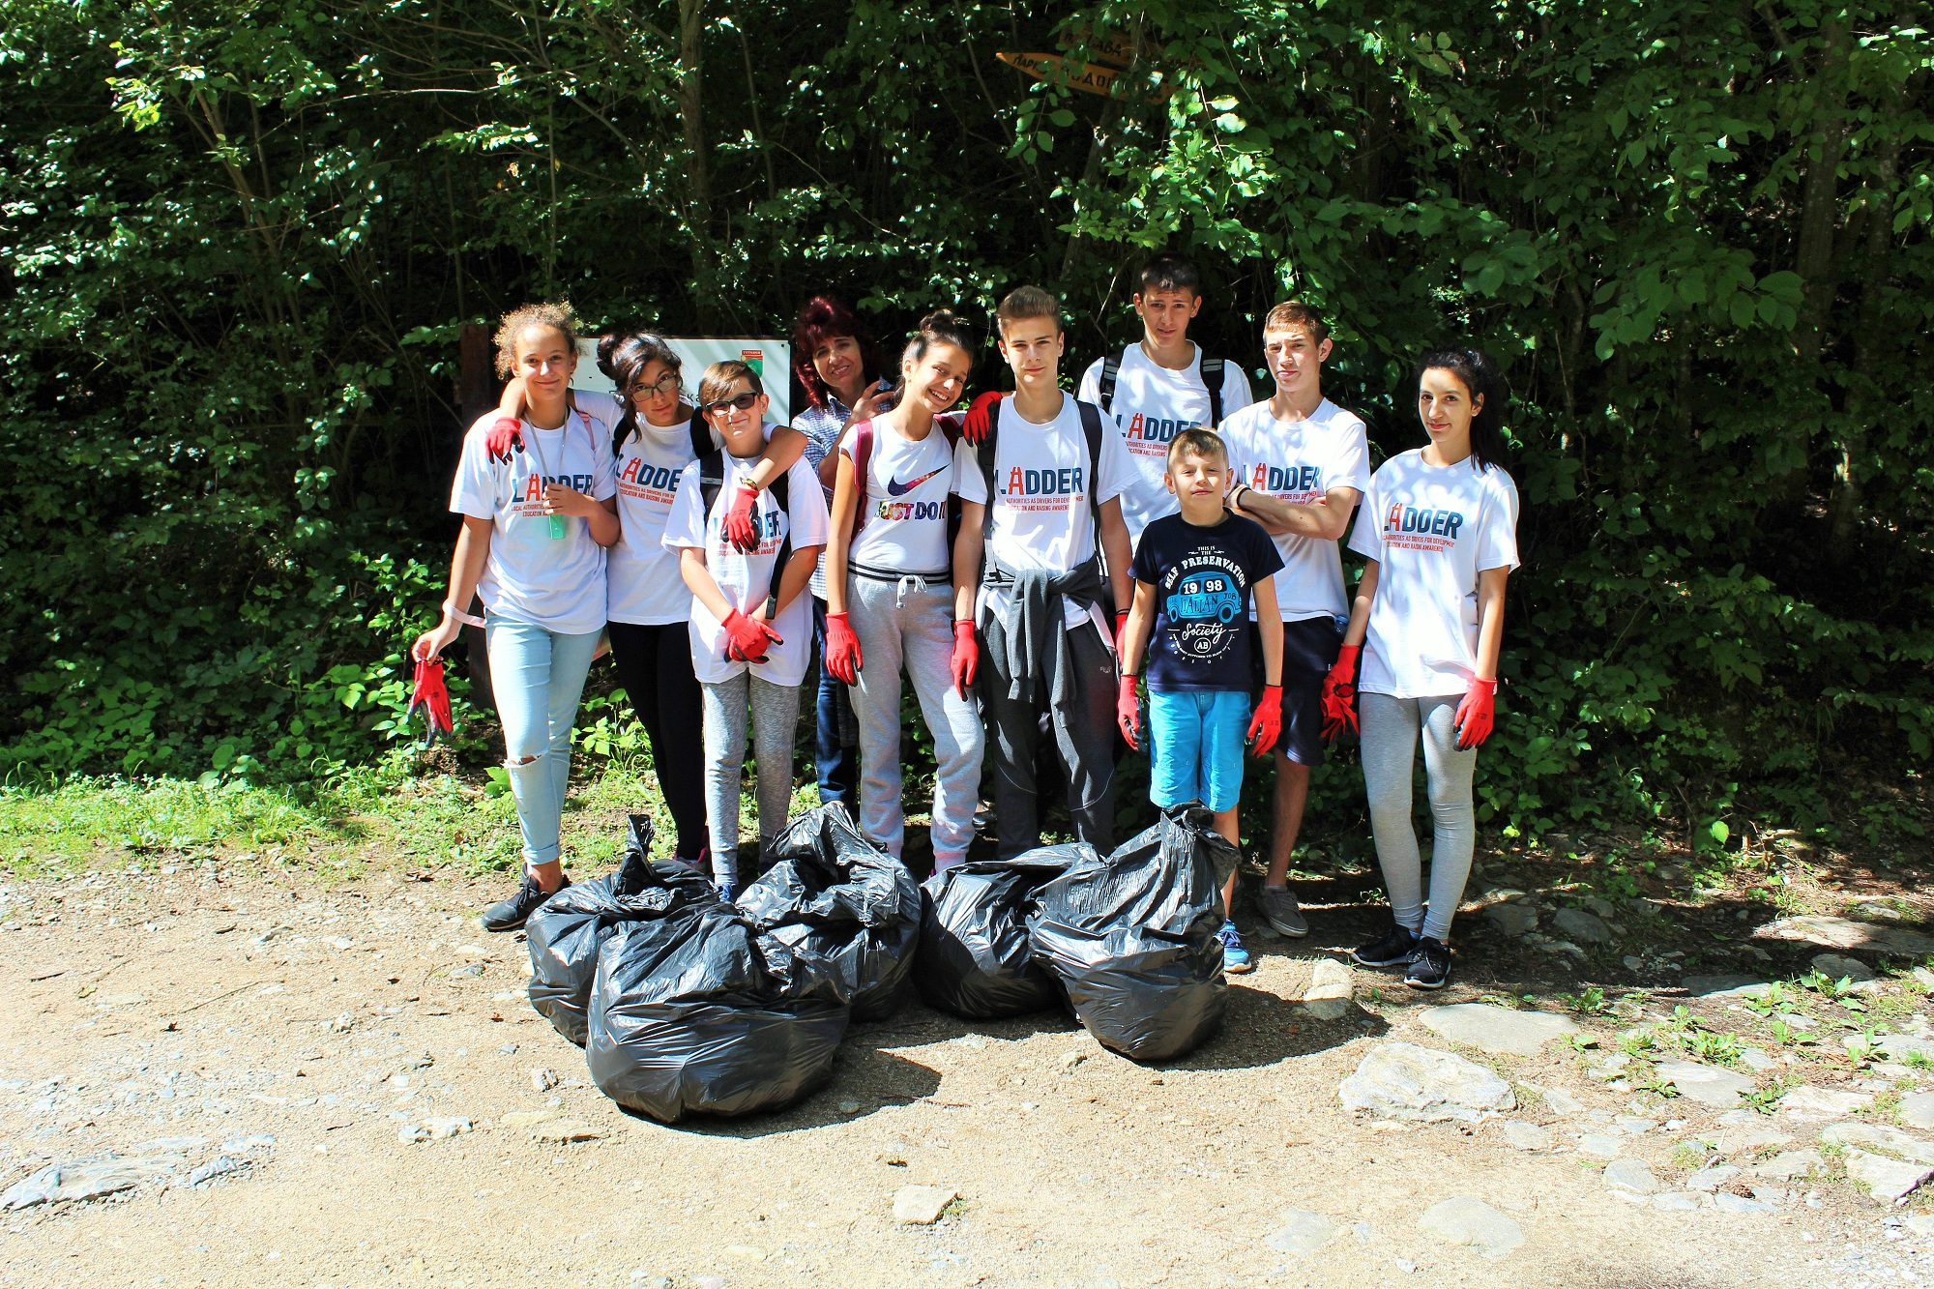
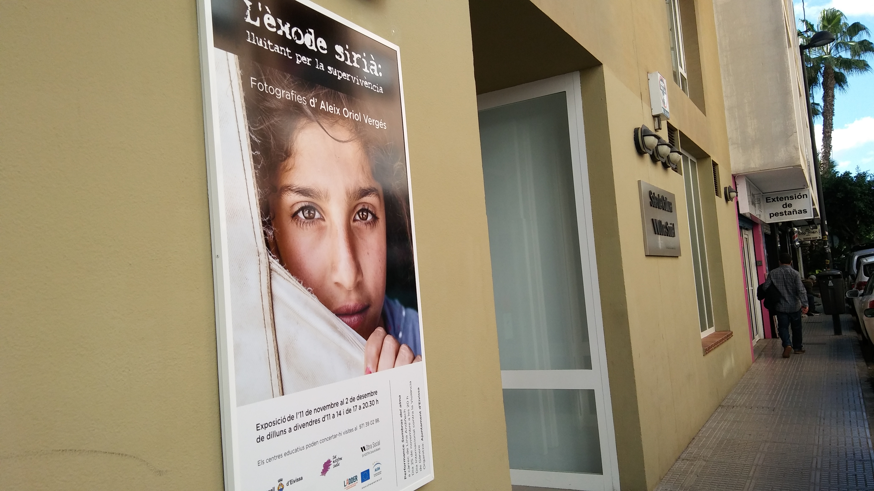
GOOD LUCK & THANKS FOR YOUR ATTENTION!
Sofia Caiolo (ALDA) – LADDER Project
sofia.caiolo@aldaintranet.org
http://www.alda-europe.eu
http://www.ladder-project.eu/

