Slide 1
Why ?

Slide 2
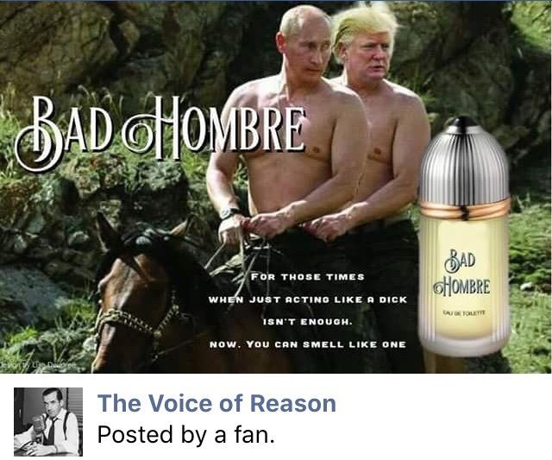

Slide 3
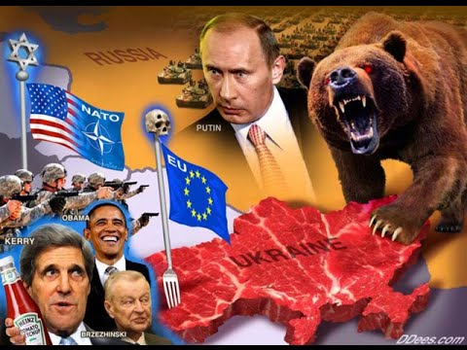



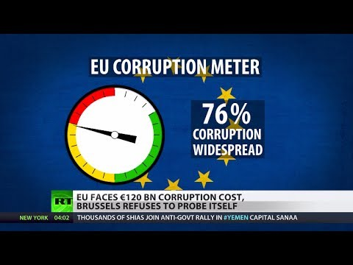


Slide 4
As the man said…
"We are seeing with increasing frequency how rapidly and effectively messages
misrepresenting and undermining the aims, benefits and achievements of the European
Union can gain traction in public opinion"
"Good communication is not an optional extra, but a core task and a mandatory component of everything we do"
August 2017

Slide 5



Slide 6








You are going to love
Chill
The Requirements

Slide 7

The 2010 Manual
Not least because they are not
which:
Makes no mention of storytelling, or people
Makes no mention of social media
Makes no distinction between 'must' and 'can'

Slide 8


Slide 9

Five things you need to know about
The Requirements
Why are they called 'Requirements'?
The emblem, logos and other animals
Planning C&V
Creativity and impact
Dos and donts

Slide 10
Why 'Requirements'?
NOT a "how-to" guide
NOT a manual of best practice
But it is pretty short, because it's focused on….

Slide 11

The Law

Slide 12

The emblem, logos and other animals
You must advertise the EU's support for your programme, and to do that…
You must use this, and only this :

Slide 13




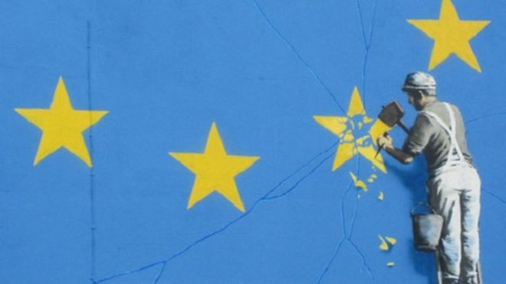



Slide 14





But…can partners still use programme logos?

Slide 15

Just as long as you do not mess with :

Slide 16
Planning C&V
C&V planned from the start of the project, like any other activity
Essential ingredients of a C&V plan:

Slide 17

Creativity and impact
People-focused (storytelling)
Use of local language(s)
Focus on internet, social media, audiovisual material

Slide 18


Dos and donts spelled out
Disclaimers
Standard texts for explaining the EU's support
Exceptions
Intellectual property rights
(communications products belong to
you, but we can use them)

Slide 19
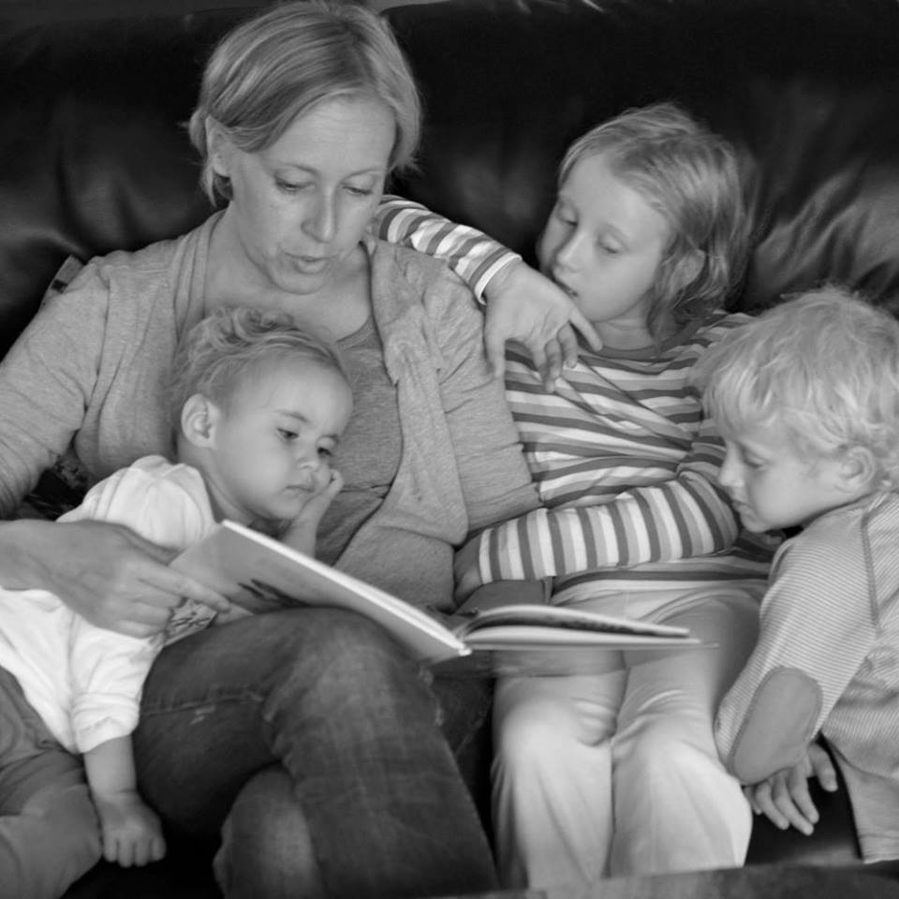


Slide 20
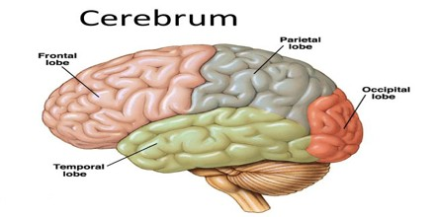

Slide 22
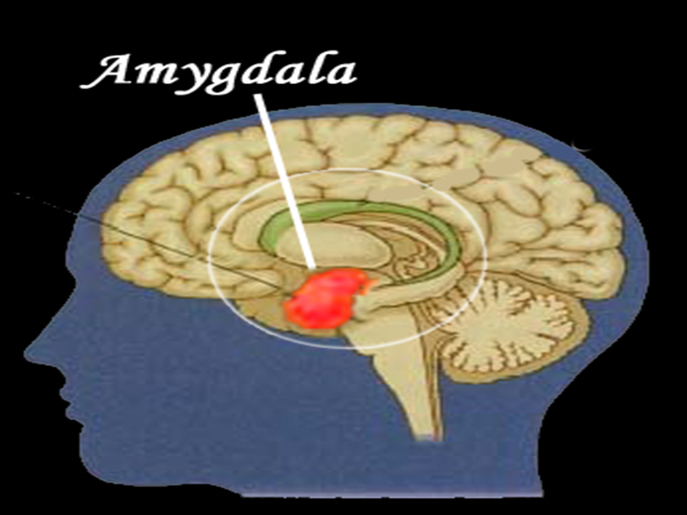

Slide 23

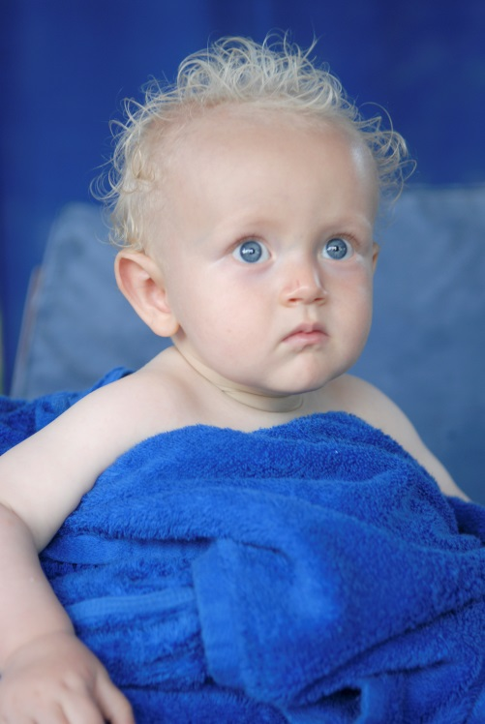
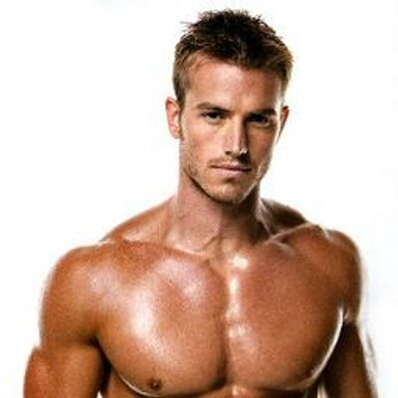
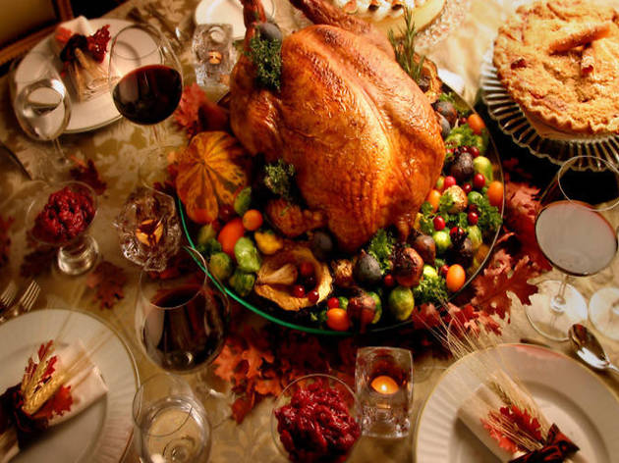
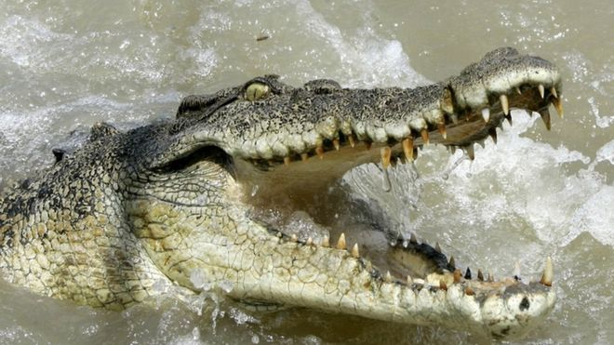
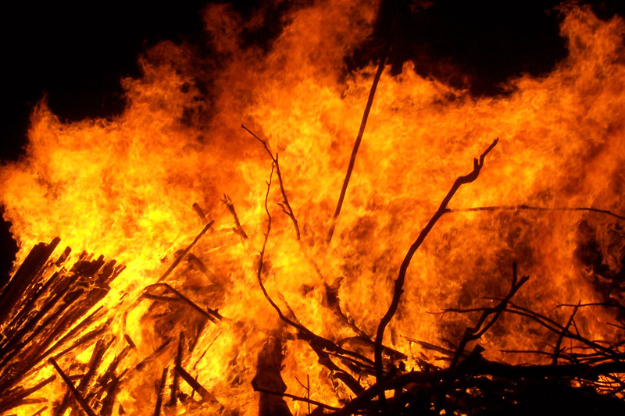
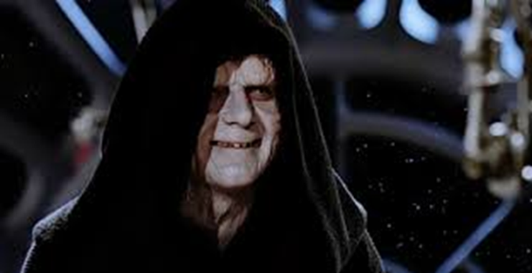

Slide 24


Slide 25
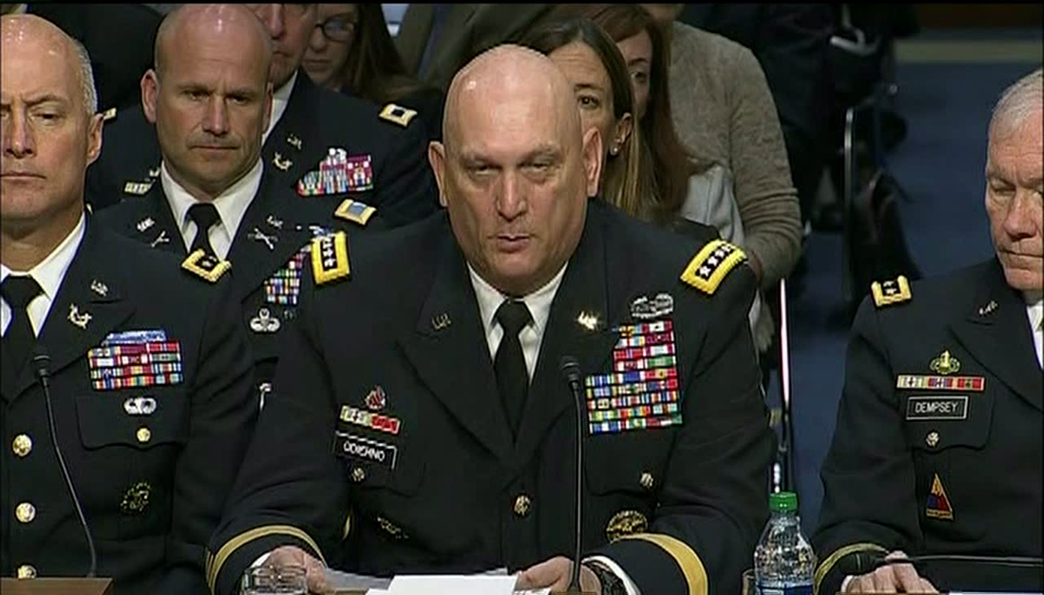

Slide 26
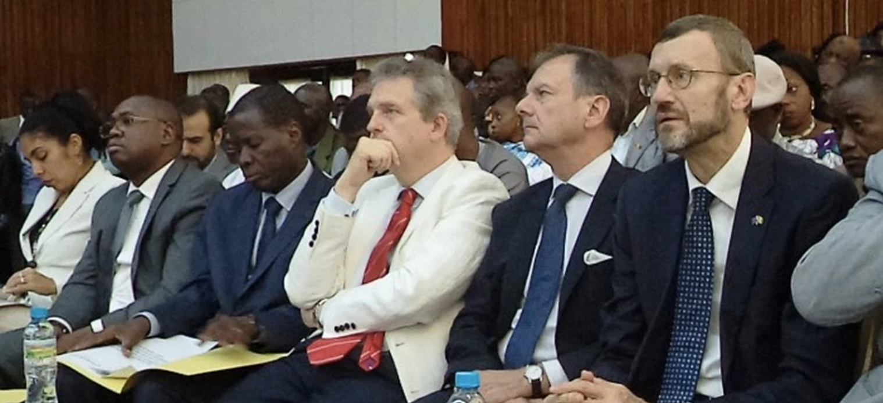

Slide 27


Slide 28


Slide 30


Slide 31


Slide 32


Slide 33


Slide 34


Slide 35

Thank you!
richard.hands@ec.europa.eu
https://ec.europa.eu/europeaid/communication-and-visibility-manual-eu-external-actions_en

