Slide 1


Communications

Slide 2

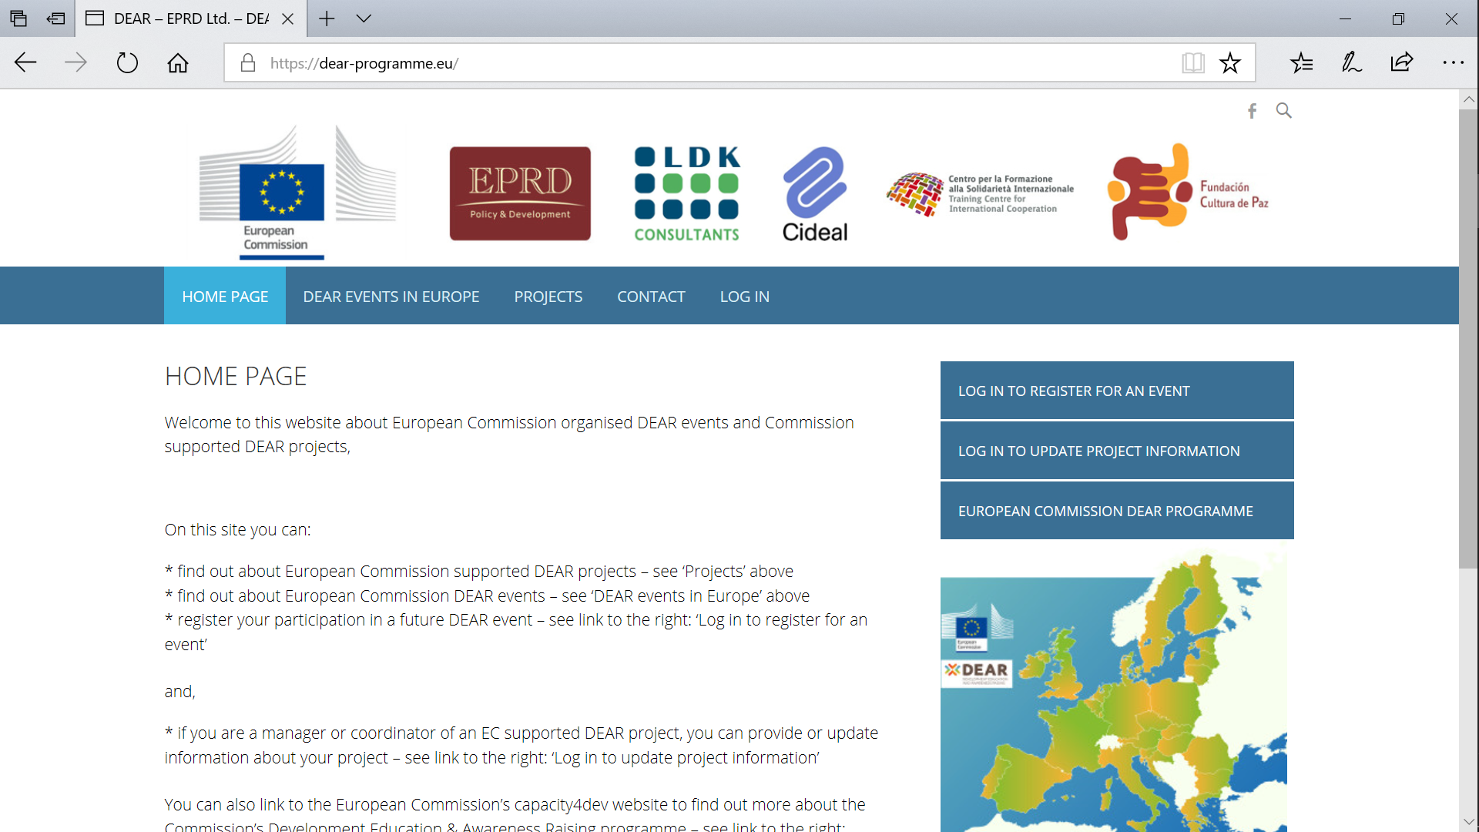
Two websites:
www.capacity4dev.eu/dear www.dear-programme.eu

Slide 3


Slide 4
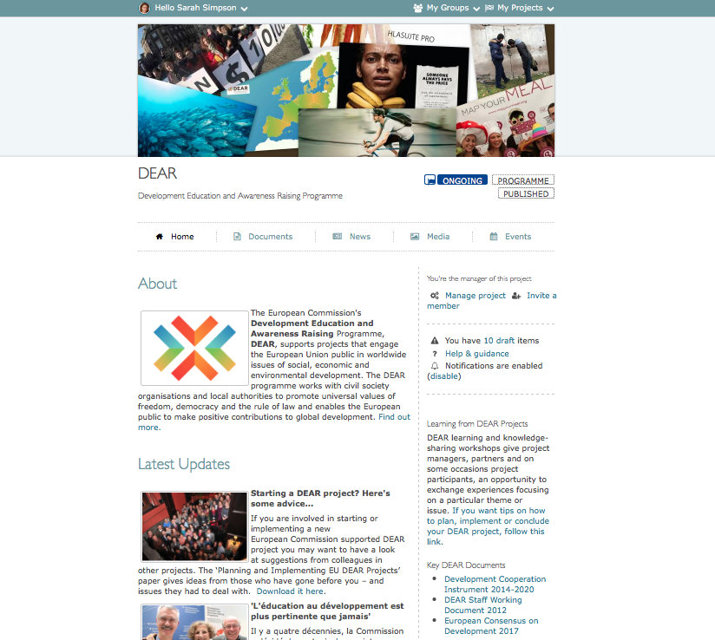

Slide 5
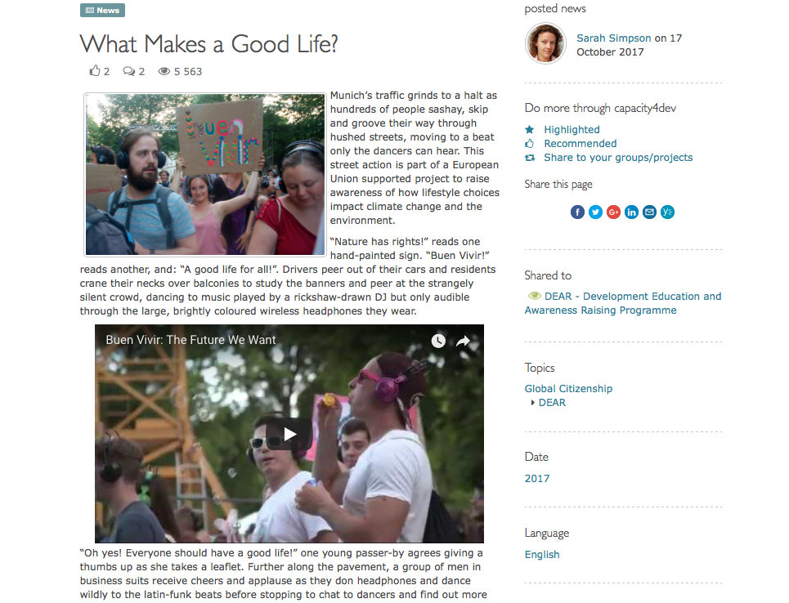

Slide 6
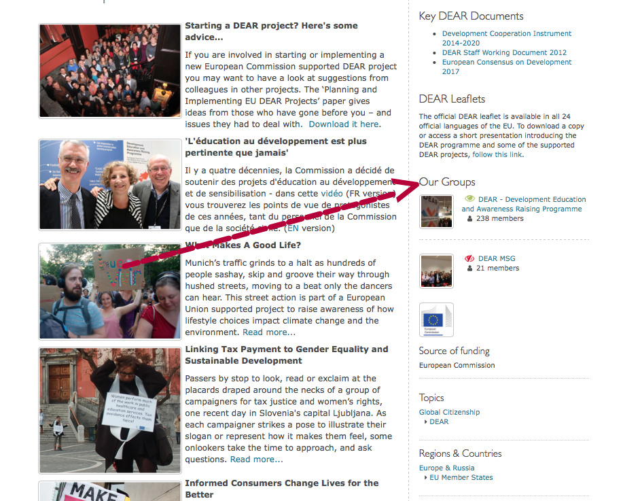

Slide 8
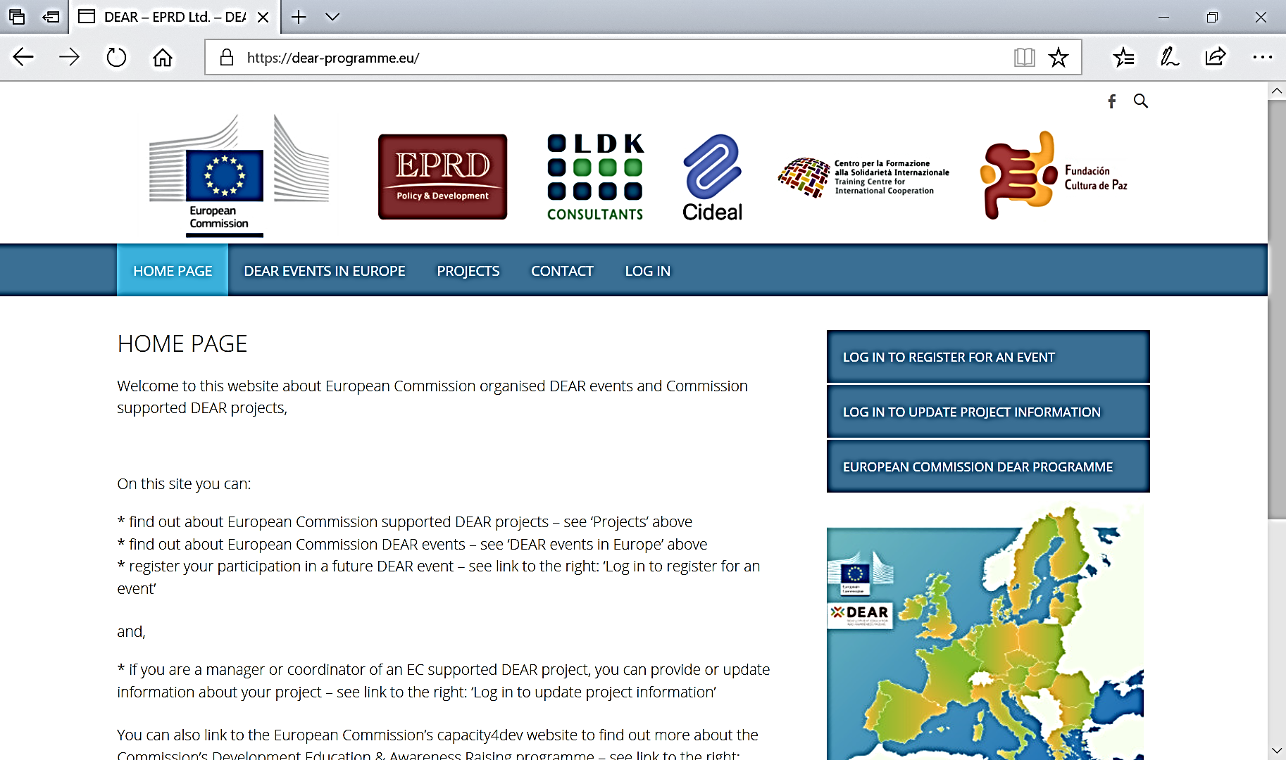
The <dear-programme.eu> website

Slide 9
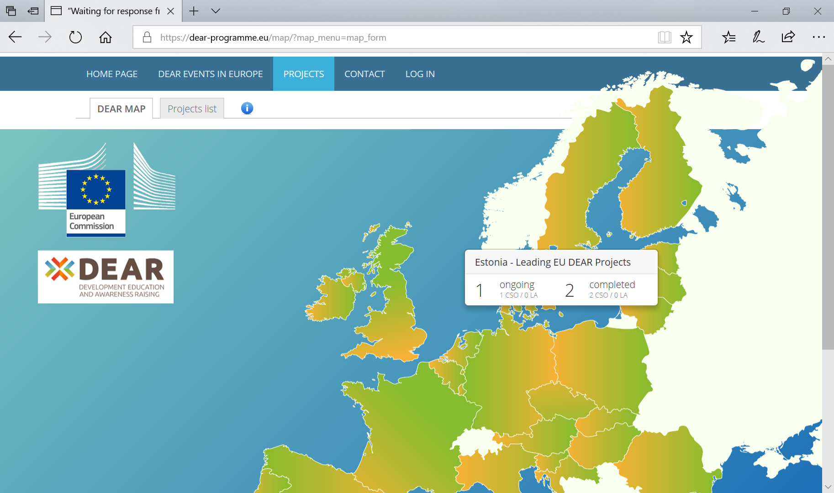
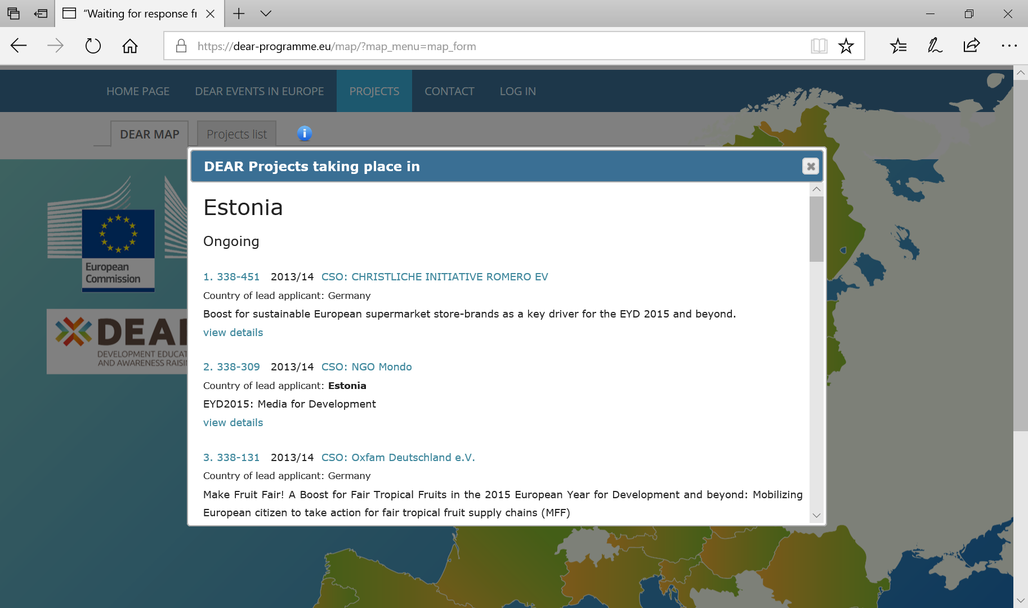
Selecting the ‘projects’ button: finding all those in a particular country via the map

Slide 10
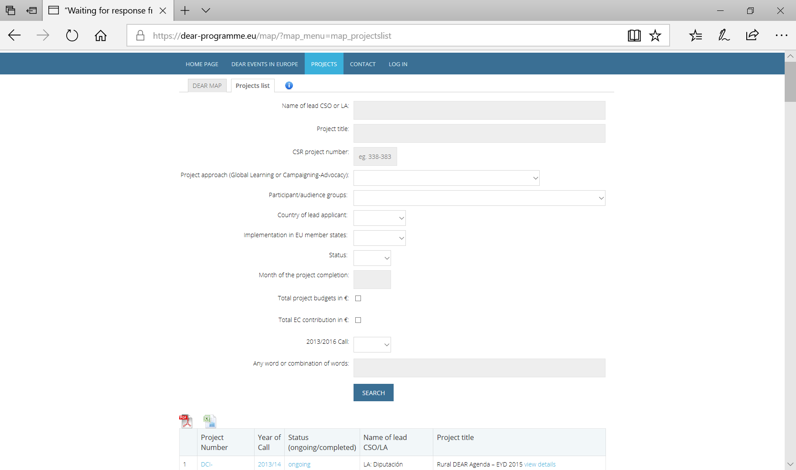
Selecting the ‘projects list’ sub-button: enables searches against various criteria

Slide 11
www.capacity4dev.eu/dear www.dear-programme.eu

