Slide 1

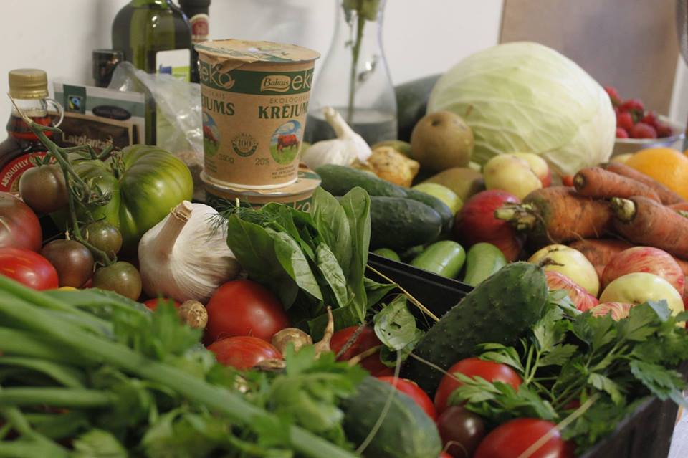





Slide 2
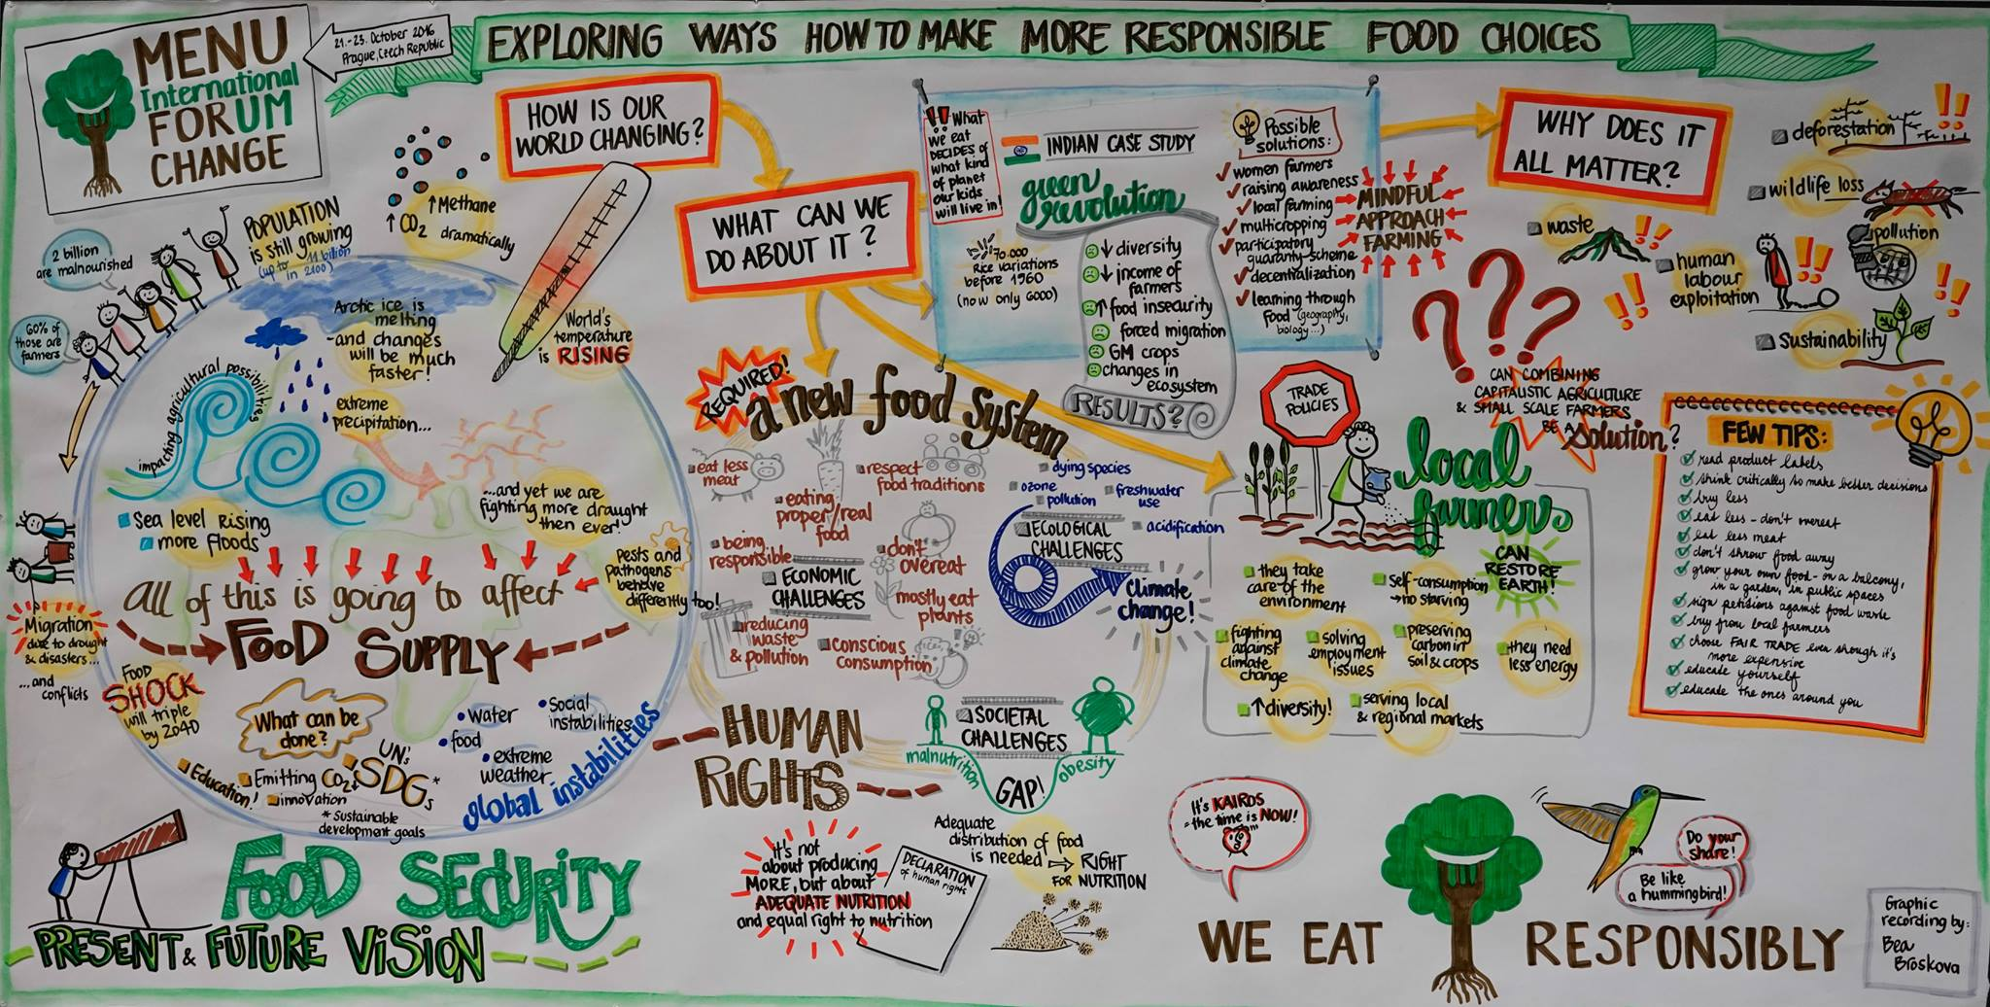

Slide 3

Monitoring & Evaluation experience

Slide 4
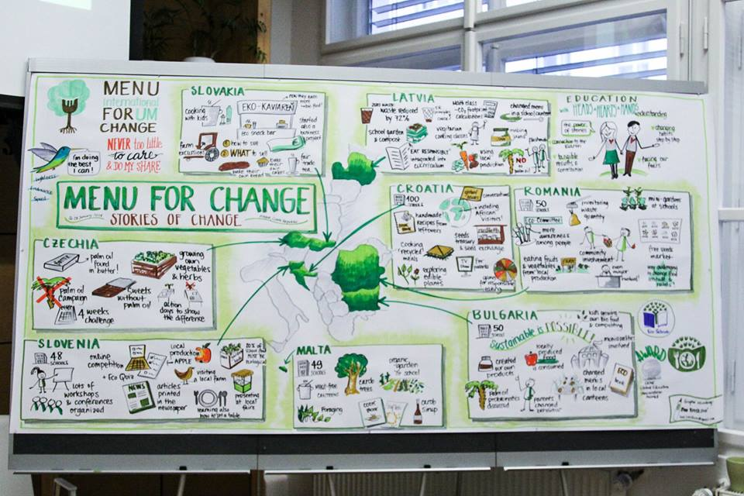

Slide 5
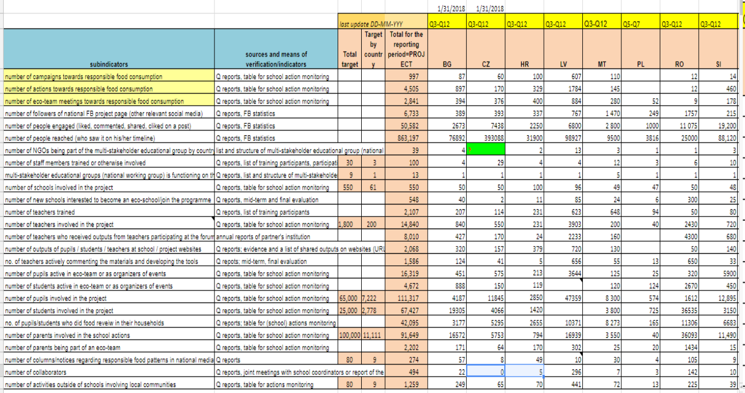
Partner’s Quaterly Monitoring

Slide 6
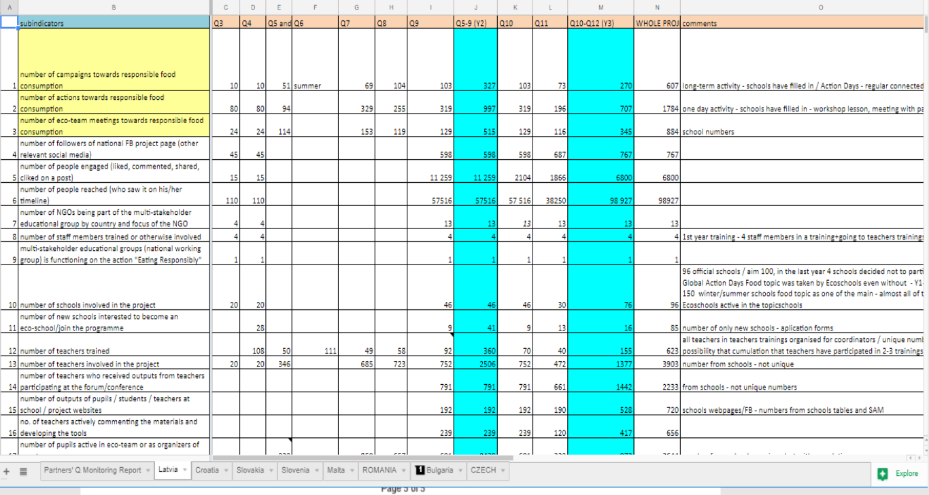
Partners quaterly monitoring: Example from Latvia

Slide 7
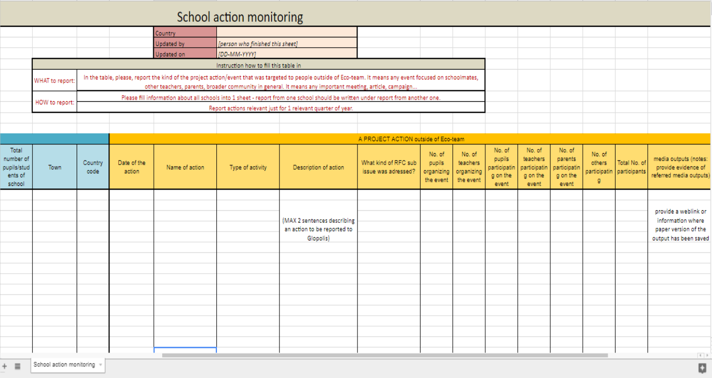

Slide 8
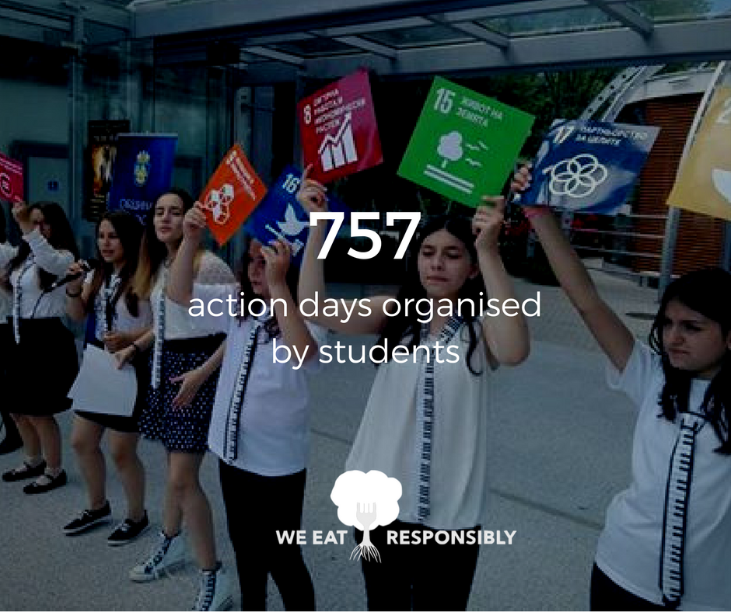

Slide 9

Outcomes gathering: coordination calls, monthly reports, learning circles
Why to make learning circles?
To learn together! ;-) The purpose is to build and extend our knowledge about development and environmental perspective of food systems and global education methods, exchange ideas and opinions in order to build our capacity to guide teachers during the project.
How does it work?
We come together in a group of max 7 people to exchange about inspiring project related content or methodology during a skype call of an hour. Everytime one different person facilitates the discussion. We discuss what surprised us, what were the key interesting facts about the issue, how it relates to what we are working on, etc.
For whom is it?
This targets in particular the people who will be the reference people for the project content in each countries (and who play a role in the trainings for teachers). It can be the country coordinators, or colleagues, or members of working groups. At least one person per country should take part, but more are welcome.
How often does it happen?
Once in two month. Two dates are proposed for the skype call. People just sign up for one of them.

Slide 10

Result Orienting Monitoring experience (ROM)

Slide 11
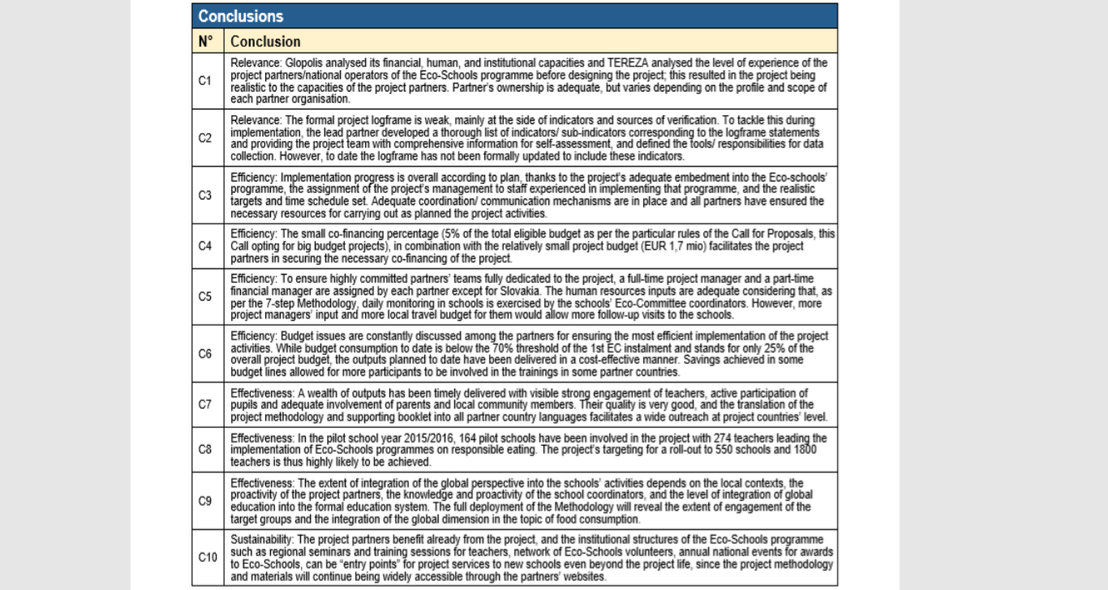

Slide 12
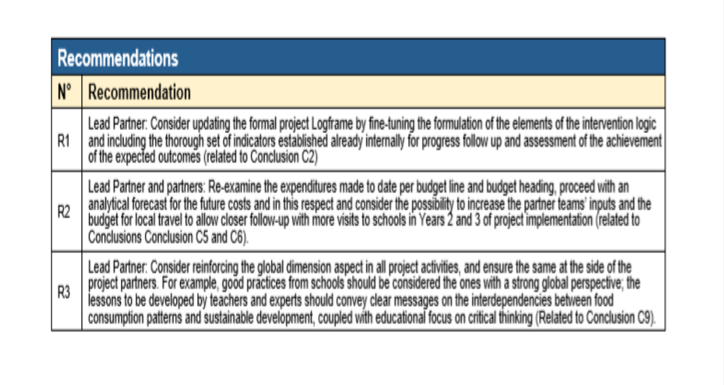

Slide 13
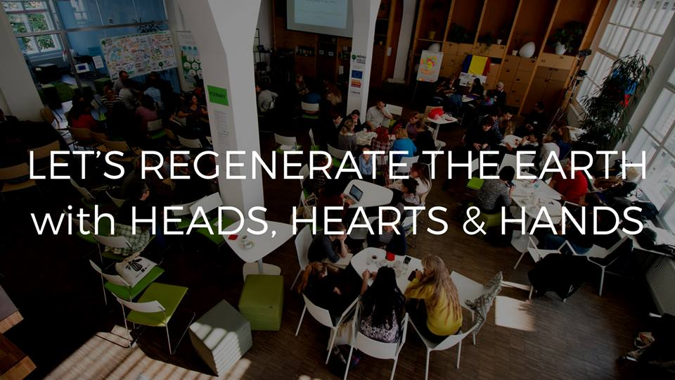
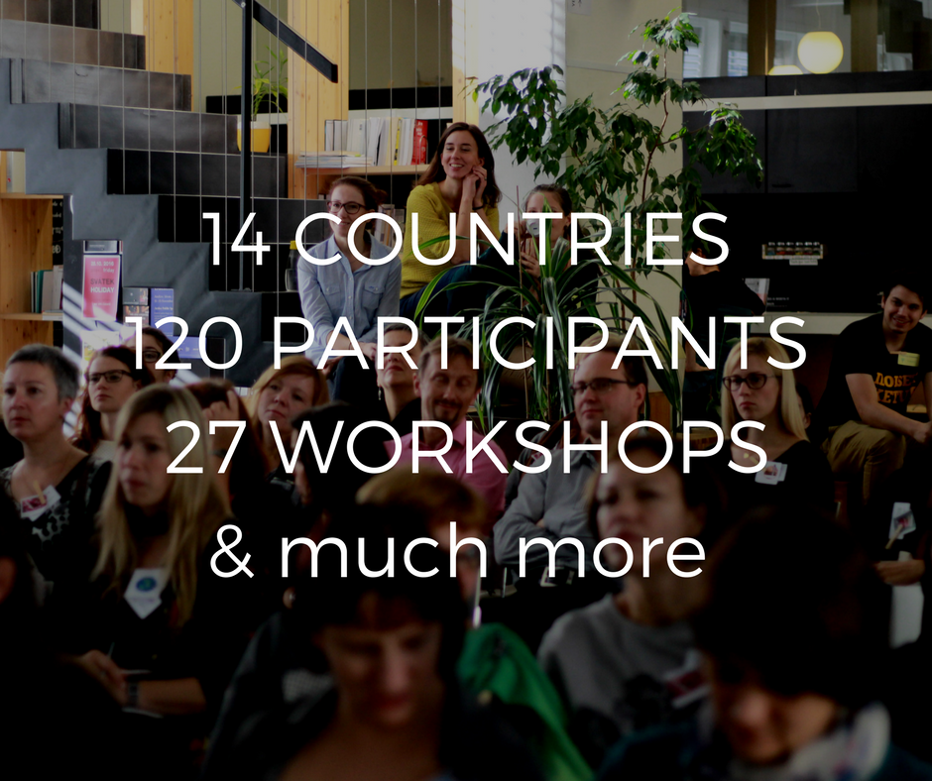

Slide 14
Mid-term & Final evaluation

Slide 15
Objectives of the mid-term evaluation:
Identification of project components that play role of factors enabling and supporting sustainability of impact and meaning of the project programme even after the end of the Eat Responsibly project, and qualitative analysis of contexts in which the factors can be efficient
Identification of factors (good practices) that have supported project successes in the project countries, with special focus on entering of global dimension into network of environmentally oriented schools –
Focus on stories of change: identification and evaluation of changes that the project has brought to the project countries in terms of
  Mind-set of the target groups representatives
  Skills and everyday behaviour of the target groups representatives
  Concrete structural change relevant to responsible food consumption
Case studies in 2 selected countries evaluating in depth changes that the project has brought with special focus on drives of these changes and on their impact on public engagement of project target groups

Slide 16
Final evaluation - objectives:
Summarise experience of individual actors (coordinators & teachers)
Identify factors enabling and supporting sustainability
Identification of factors (good practices) that have supported project successes
Implementation of global dimension into network of environmentally oriented schools
Identification and evaluation of changes that project has brought into everyday life of its participants
Methods:
Menu for Change International Forum: quantitative evaluation
Coordinators: on-line in-depth interviews
All teachers: brief quantitative questionnaire
Involved teachers in-depth: on-line in-depth interviews with selected teachers

Slide 17
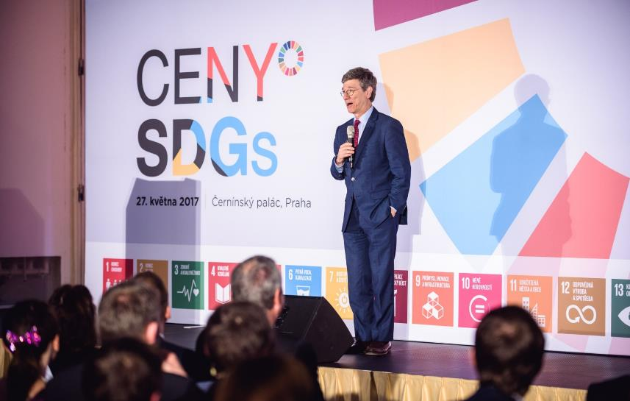
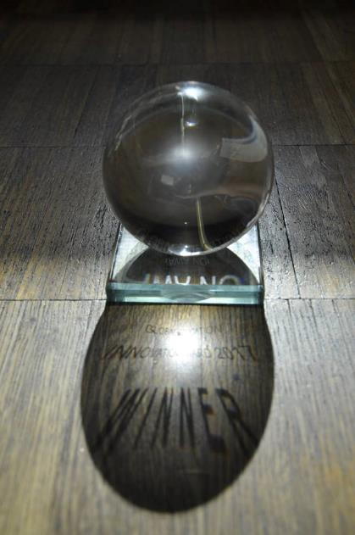


Slide 18
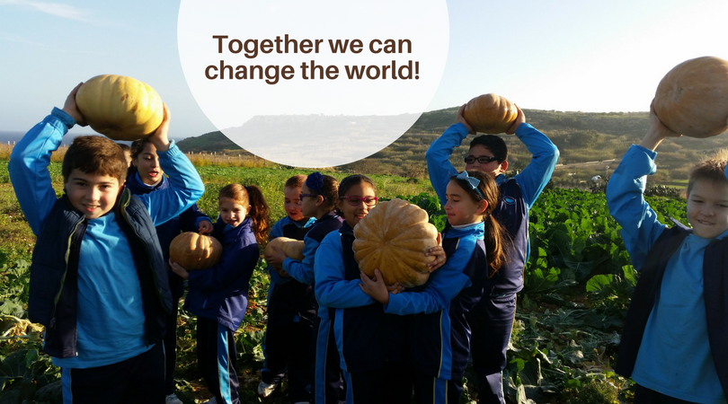
You cannot get through a single day without having an impact on the world around you. What you do makes a difference, and you have to decide what kind of difference you want to make.
Jane Goodall

Slide 19

Thank you for your attention!
Tereza Cajkova (cajkova@glopolis.org)

Slide 20
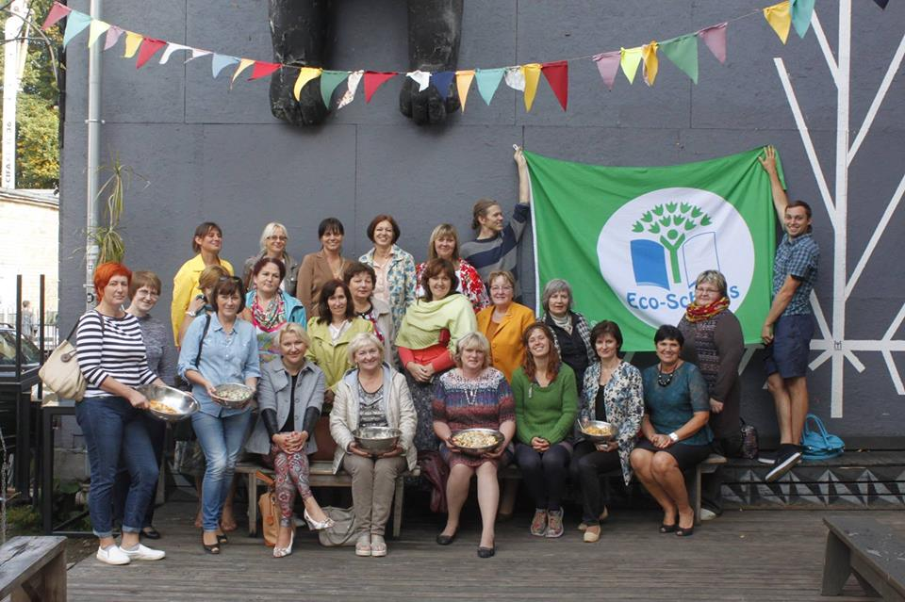
550 schools
2107 teachers trained
14840 teachers involved

Slide 21
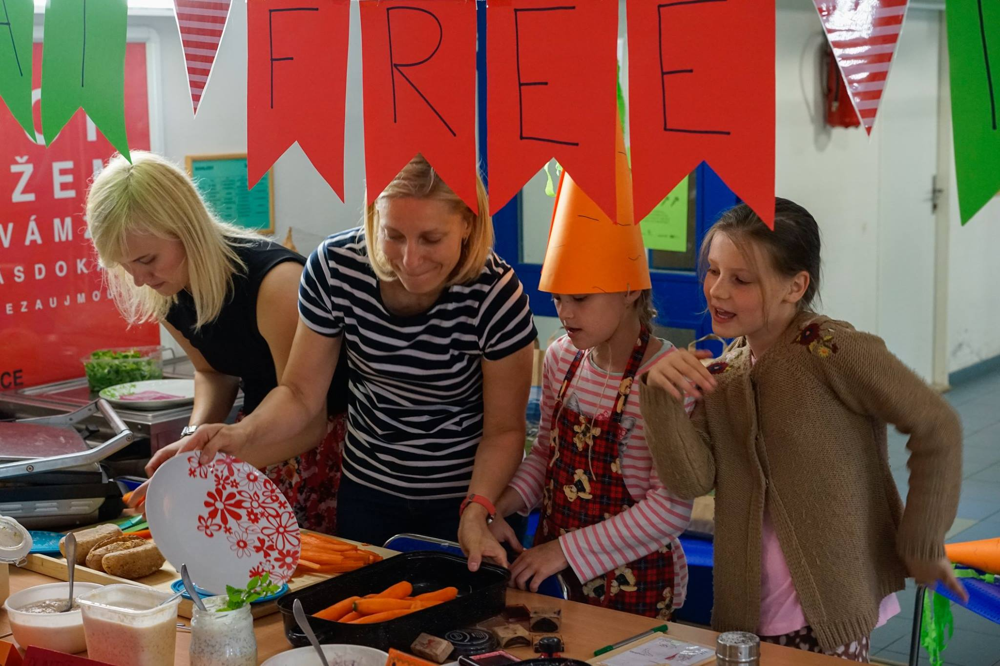
757 (out of) school actions

Slide 22
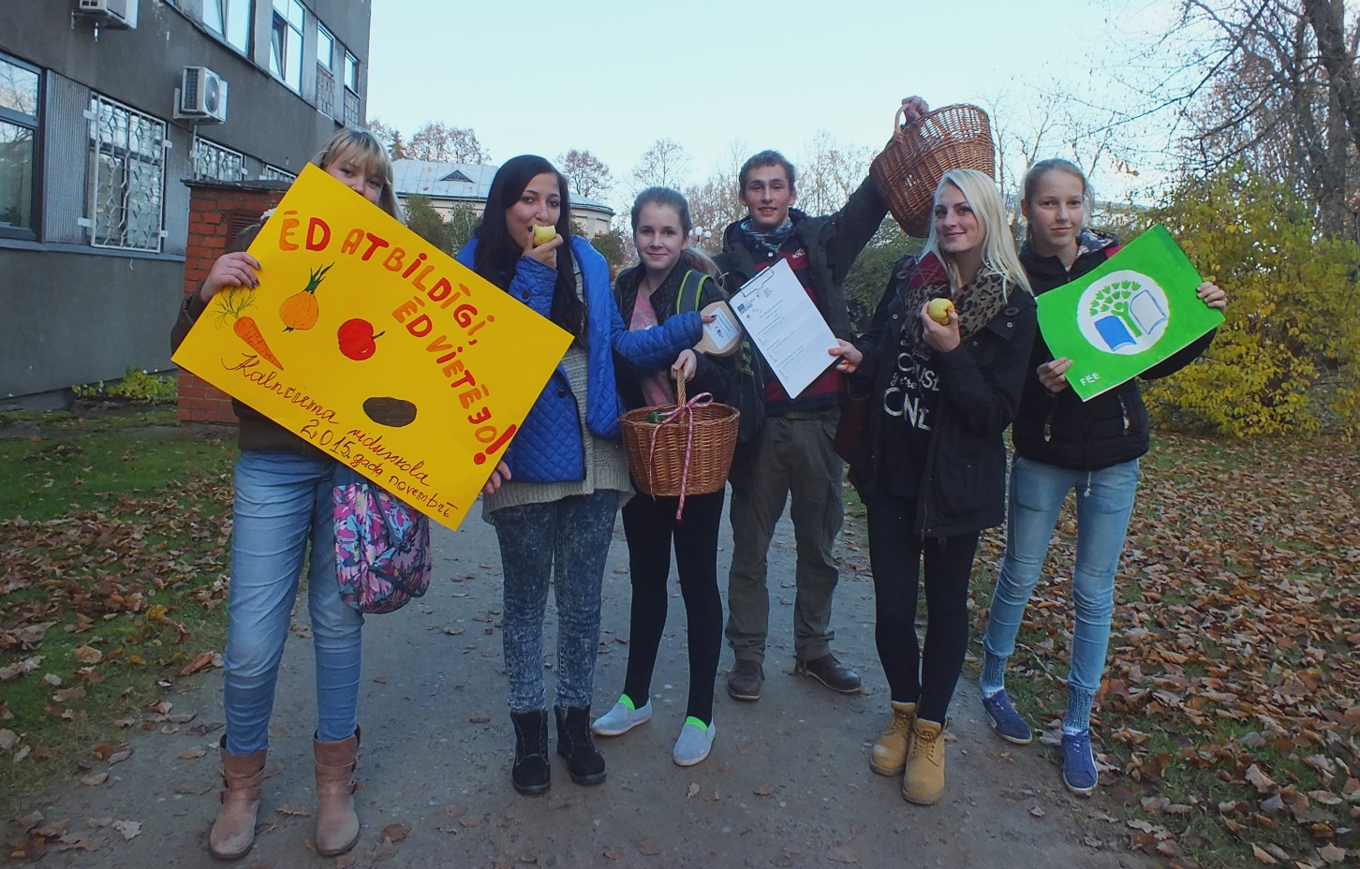
111 317 pupils and
67 427 students were active organisers of project events

Slide 23
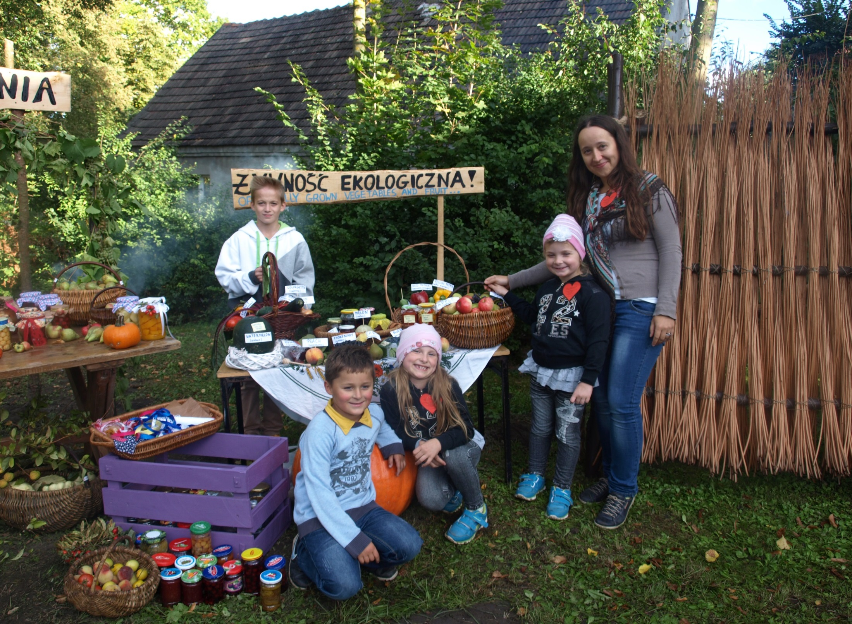
91 649 parents involved
2202 parents active part of eco-teams

Slide 24
42 095 households
= participating in the food review
91 649 parents
= participating on the events

