Slide 1

Campaign for fair and sustainable
fruit supply chains
Mirjam Hägele

Slide 2

Monitoring & Evaluation

Slide 3



























MFF Consortium
27 partners (incl. sub-grantees) in: Austria, Belgium, Bulgaria, Croatia, Cyprus, Czech Republic, Estonia, France, Germany, Hungary, Italy, Latvia, Lithuania, Malta, Poland, Portugal, Romania, Slovenia, Slowakia, Spain, United Kingdom; Cameroon, Colombia, Ecuador, Saint Vincent and the Grenadines

Slide 4
MFF Consortium as an example
27 partners (incl. sub-grantees) plus additional counterparts in Global South: Austria, Belgium, Bulgaria, Croatia, Cyprus, Czech Republic, Estonia, France, Germany, Hungary, Italy, Latvia, Lithuania, Malta, Poland, Portugal, Romania, Slovenia, Slowakia, Spain, United Kingdom; Cameroon, Colombia, Costa Rica, Ecuador, Ghana, Saint Vincent and the Grenadines

Slide 5
MFF!s M&E system
support from external evaluator dp evaluation from the very start
attendance of evaluator at (kick off) meetings and events
development of monitoring system based on EC reporting needs after the kick off
regular contact between Project Manager, internal evaluation specialist and external evaluator > Trust
Mid-term Review
learning report with findings and recommendations
(internal use only)
discussion of findings & recommendations at planning meeting
Final evaluation
Final Evaluation Report (for MFF and EC) to cover outputs
and outcomes/impact

Slide 6
How we collected knowledge and evidence + main methods used
Suite of online tools (aligned to EC reporting)
BOX: data, info & evidence storage system
living logframe: Excel spreadsheet based closely on project logical framework, with tabs for all partners to enter all quantitative data against all output/outcome indicators
anecdotal evidence box (physically) and online folder
campaign, media, policy & advocacy trackers: Excel spreadsheets to enter quantitative and qualitative information in each major area of work

Slide 7
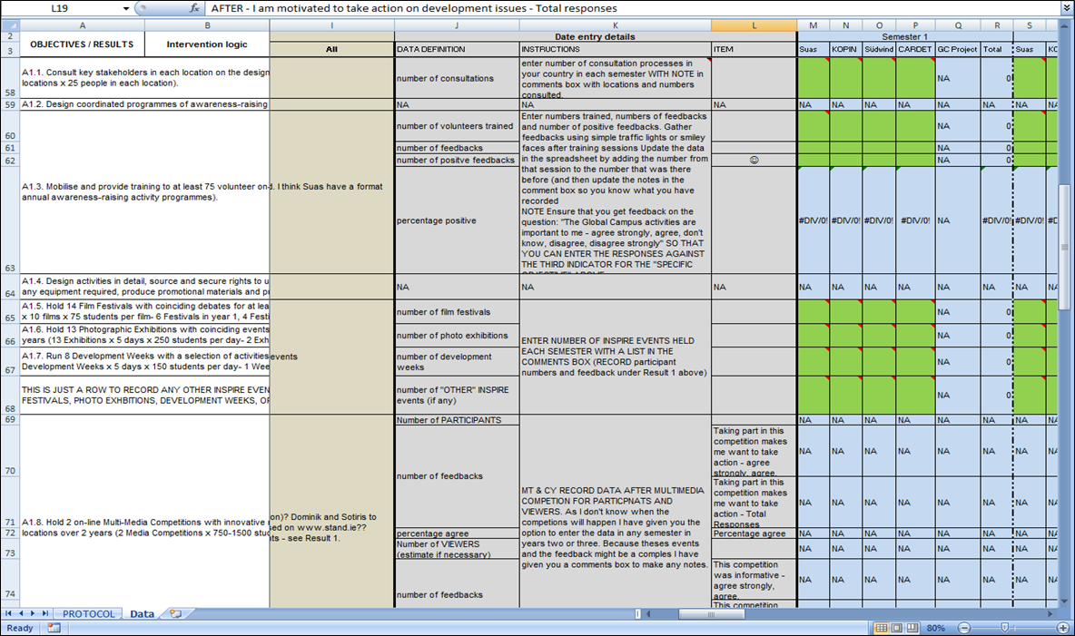
Examples of M&E tools:
Living Logframe

Slide 8
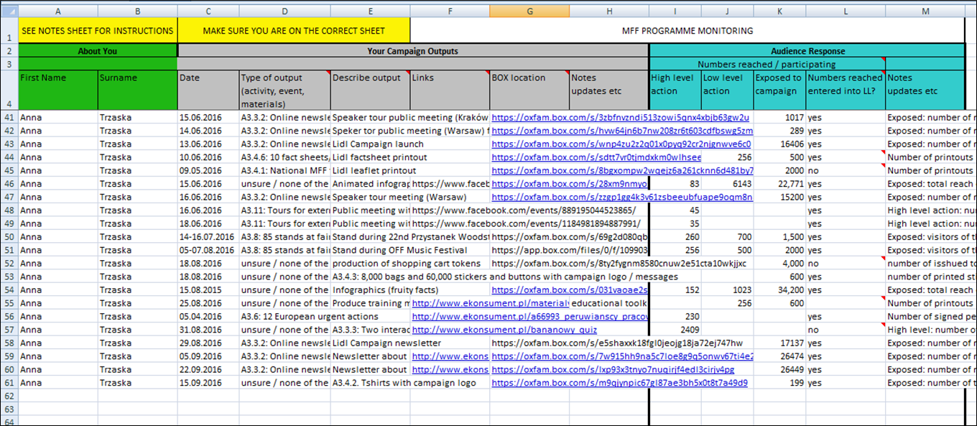
Examples of M&E tools : trackers

Slide 9
How we collected knowledge and evidence + main methods used
Ongoing support for data gathering and use of data in reporting from Oxfam as lead organization
Evaluator observation of key events and meetings
Mid-term Review and final evaluation through external evaluator: outcome harvesting at partner meetings, in depth interviews incl. externals, review of LL, trackers, materials in BOX
Outcome is when someone does something differently – this change can be observed and “harvested”.

Slide 10
What have we learned about M&E
The management and monitoring needs of a project of this scale is far more challenging than in smaller projects.
Thus we needed support from an external evaluation consultancy from the very start on to develop a monitoring system and secure all relevant documentation for the final evaluation as well as for the EC interim and final reporting.
M&E has been integral part of all partner meetings and TelCons.
Nevertheless, keeping the monitoring of such a big project on track has proved to be very time consuming and work intensive especially for the lead applicant but also for partners.
Training on the M&E system and continuous support for partners was essential.
The budget and staff resources you put in your application for such a big project should reflect the size of your project and amount of work on M&E that will be necessary!

Slide 11
What have we learned about M&E
It is crucial to adopt the Logframe in the beginning of the project when partners plan the project together as during the application process there is normally not enough time and no physical meetings to discuss all details.
A sophisticated monitoring system is very helpful and effective to meet EU reporting needs because it had been aligned with EC reporting.
It is hard but essential to focus on outcomes (not just outputs) & evidence
The Mid-term review was confidential and only for internal purposes. It was every helpful to get a feedback how the project and the consortium were actually running. The findings and recommendations improved the further working together.

Slide 12
ROM
Having the M&E system in place made the ROM visit quite easy.
But it is still essential to be well prepared and have presentations, materials and interview dates with externals well prepared.
The best moment for a ROM from our point of view is not too early (so there is nothing to report on yet) and also not too late (otherwise, the ROM recommendations cannot be absorbed). The best moment in terms of timing and also for preparing the needed information that for is probably around the first or second interim report.

Slide 13
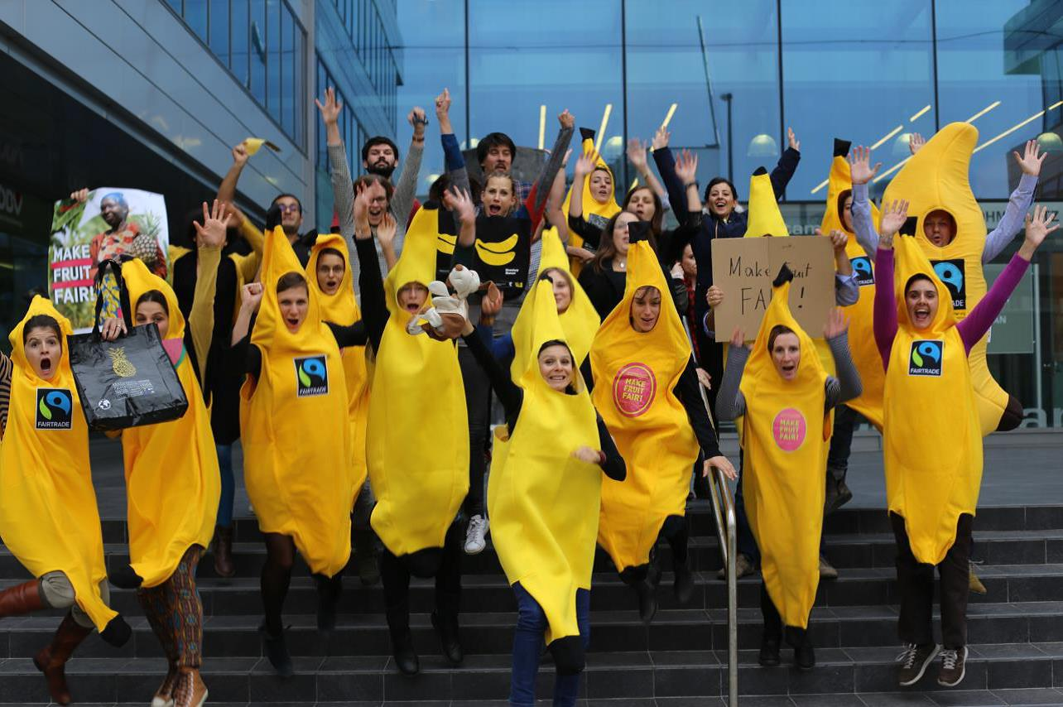

Thank You!

